Slide 1
Abundance projections
SSA 200

Slide 2
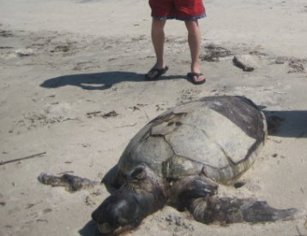
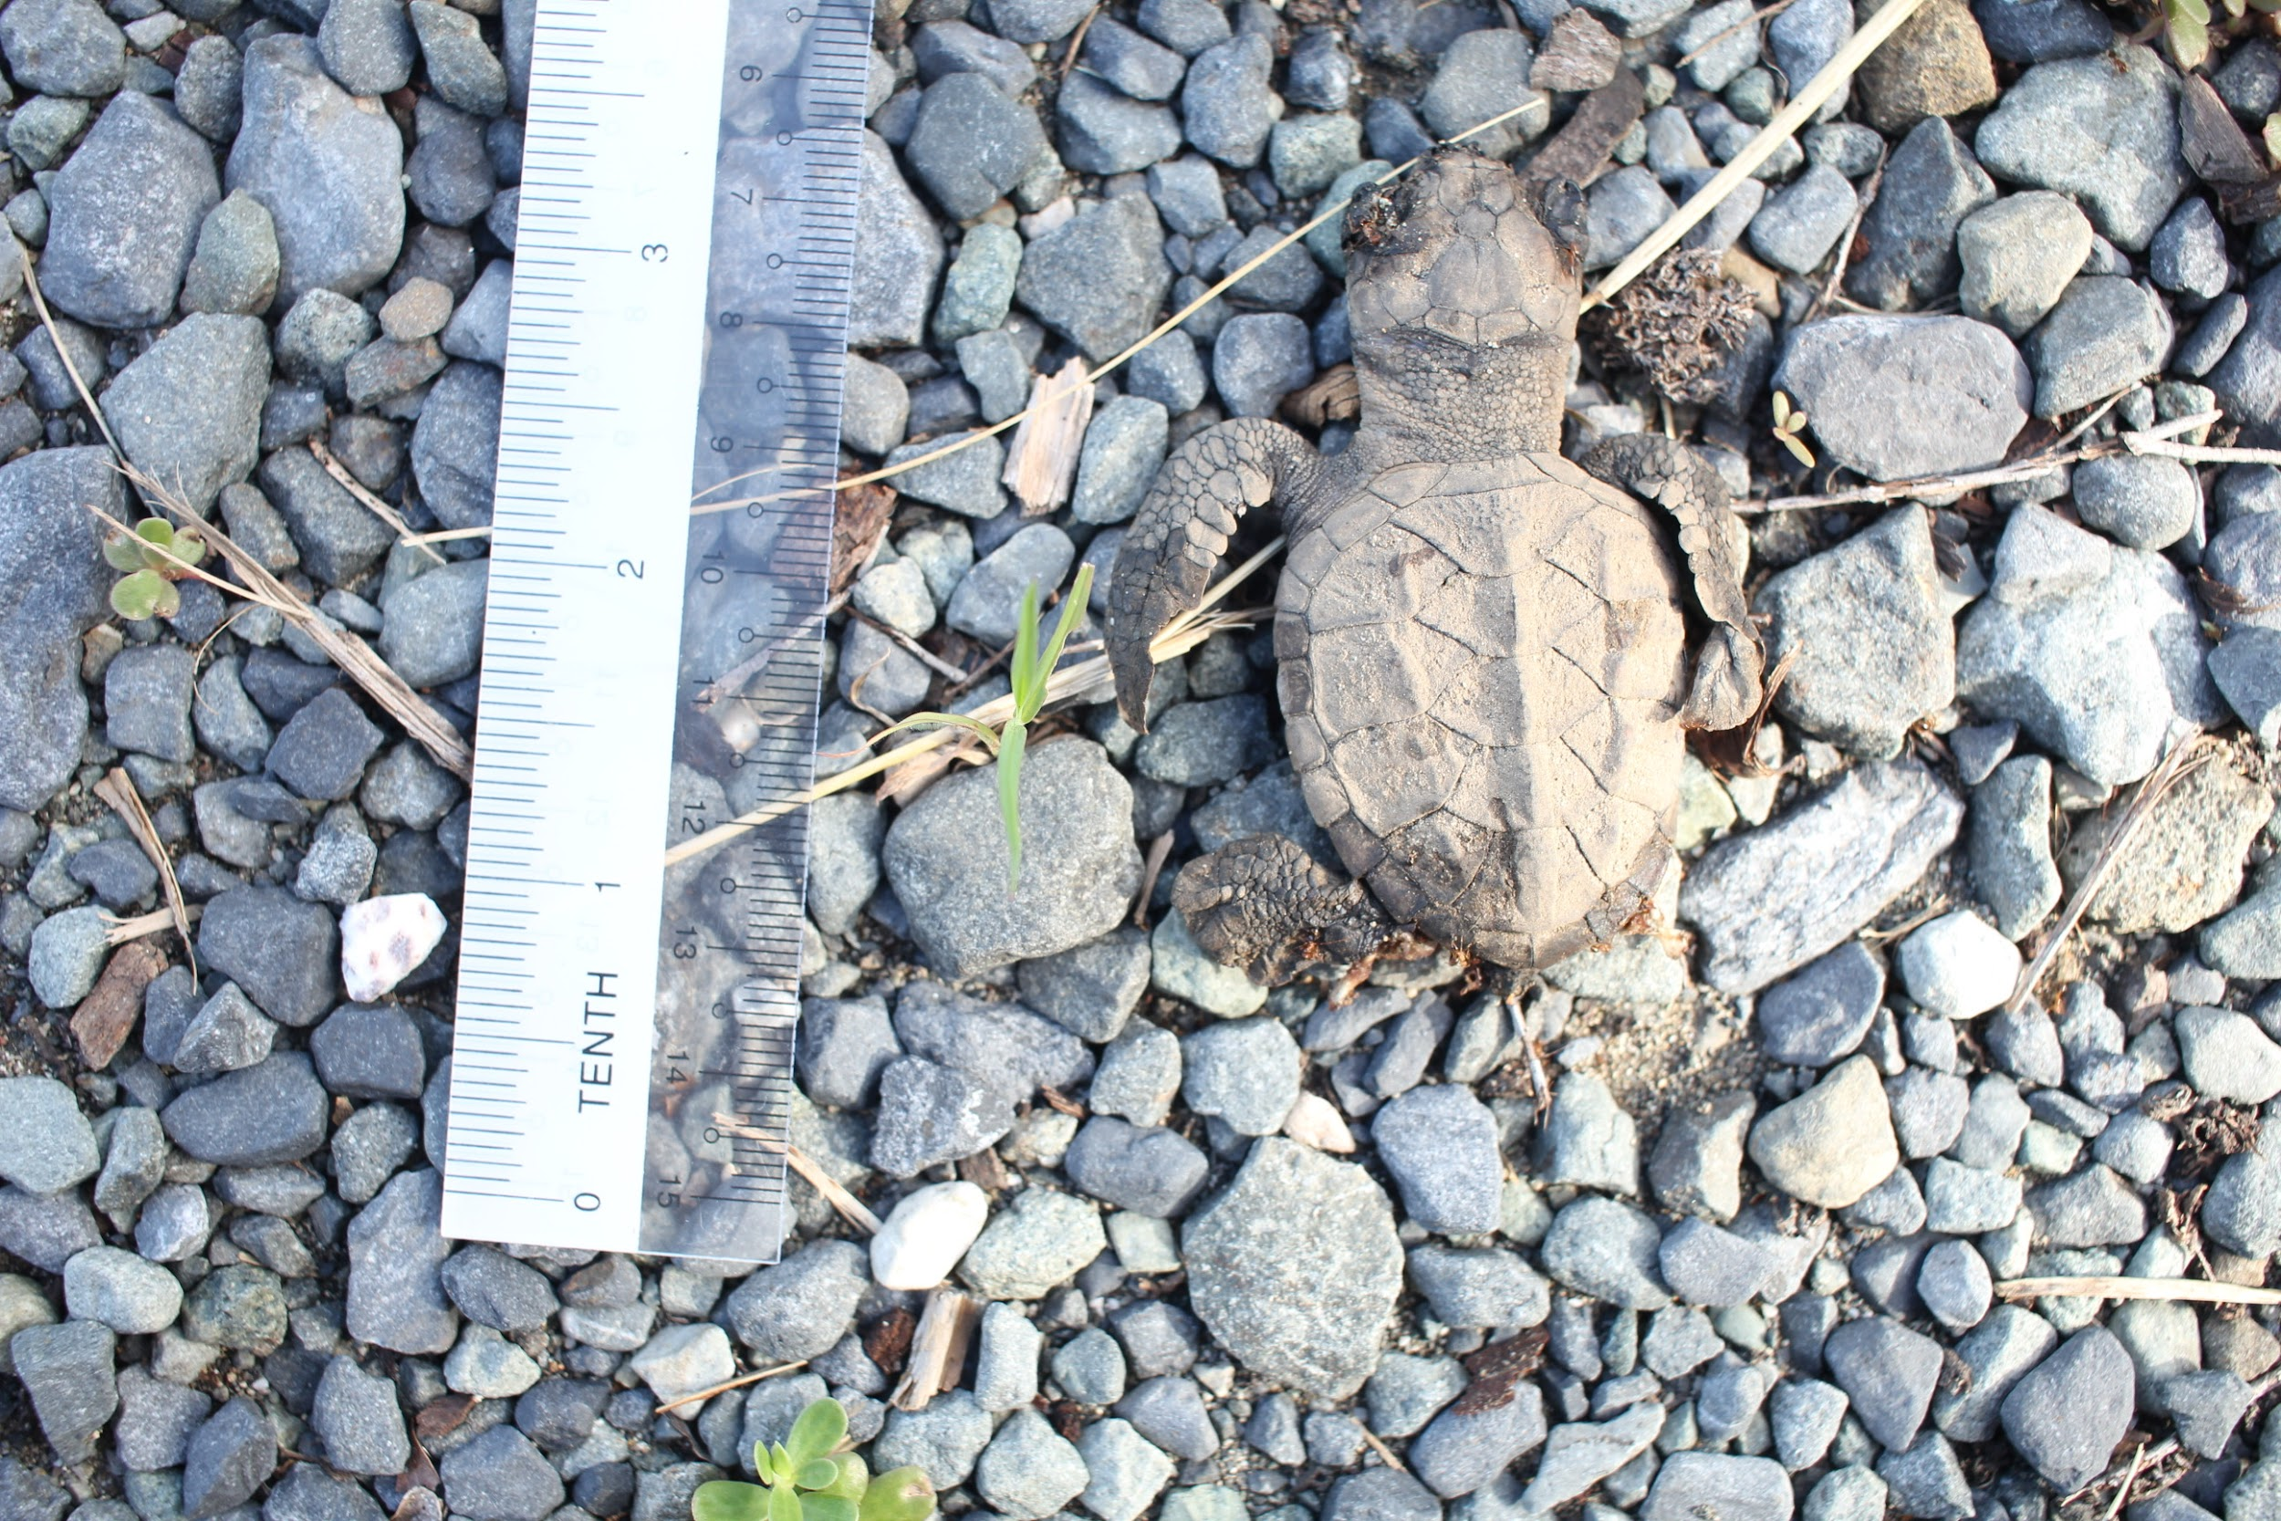
How do you suggest we make abundance projections into the future for species that we know very little about?
Notes:
Don’t have detailed data for survival or recruitment estimates

Slide 3
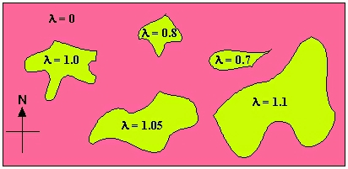
Population growth models - classic
Exponential growth curves are some of the
foundations of metapopulation theory; minimum viable population

Slide 4
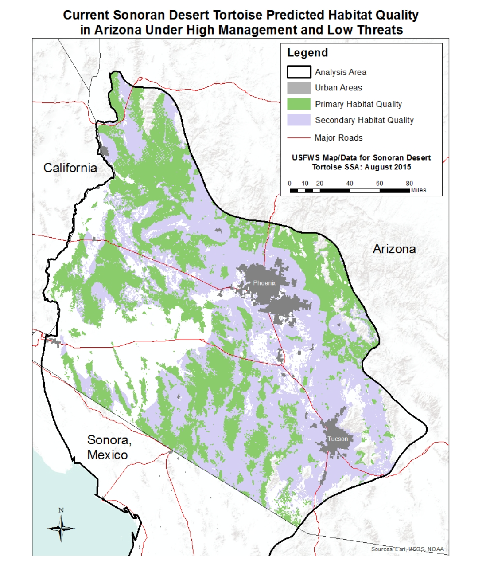
Population growth models - classic
Exponential growth curves are some of the
foundations of metapopulation theory; minimum viable population
Exponential model assumption: unlimited resources in each patch.

Slide 5
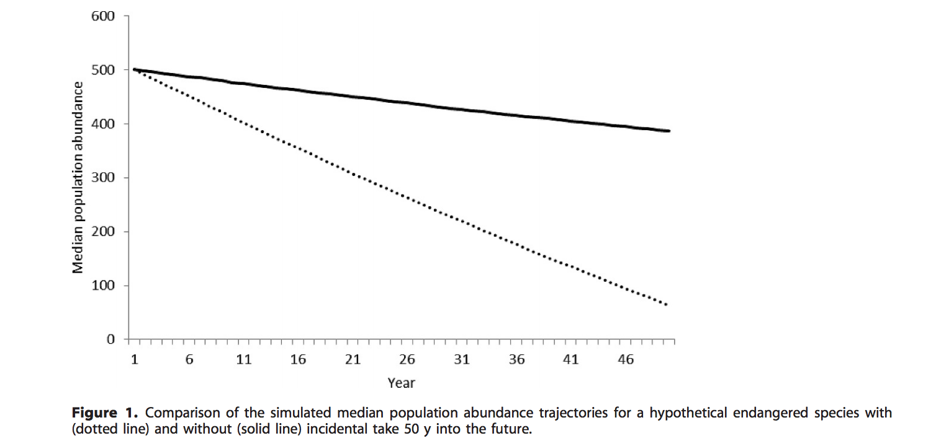
When could you use a ‘simple’ growth curve?
-SSA Current condition
-SSA Future condition
-SSA Scenario building
-Sec 7 consultation
-Biological opinions
McGowan and Ryan 2010. Journal of Fish and Wildlife Management.

Slide 6
Instantaneous growth models
Exponential growth, when growth in continuous across time
dN/dt= rN - rate of change
N_{t}= N_{o}e^{rt} - calculating population size by integration
r is the growth rate of the population over time interval t
Natural log base
Initial number
Notes:
Conceptually continuous growth models are the easiest to conceive once you get past the calculus
Abundance in a population is constantly changing

Slide 7
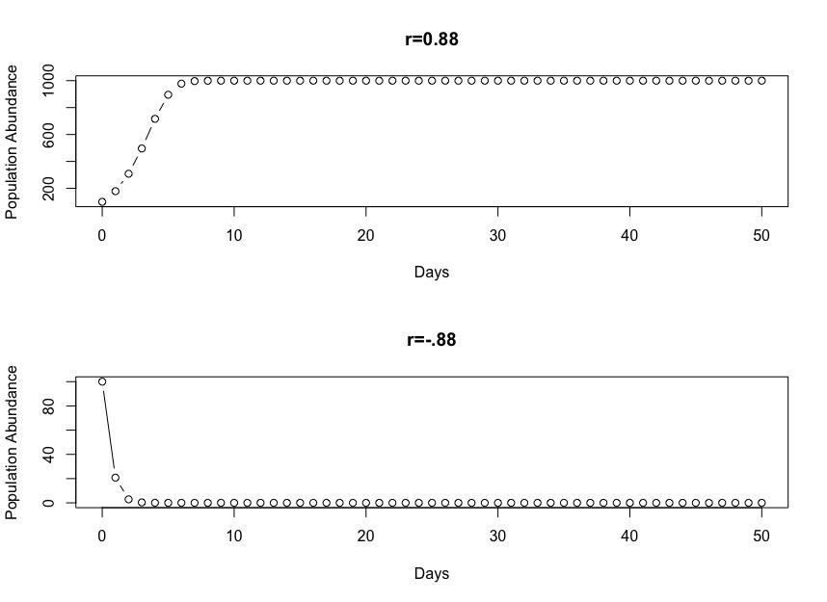
The future condition: understanding how populations increase and decrease is imperative for decision-making
The future condition: understanding how populations increase and decrease is imperative for decision-making
Define terms
N - abundance
G - gains (births + immigration)
S - survivors
y - observed counts
K - carrying capacity (resource limitation)
r - intrinsic growth rate (births - deaths)
λ - geometric growth rate
Notes:
Define these terms

Slide 8
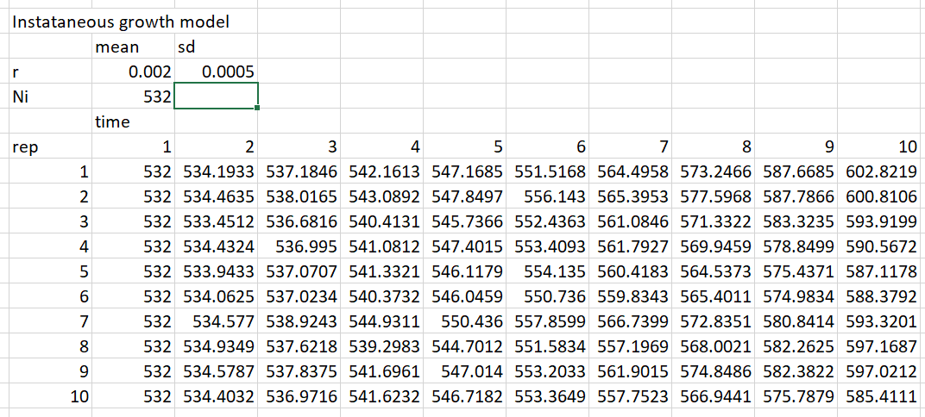

Slide 9
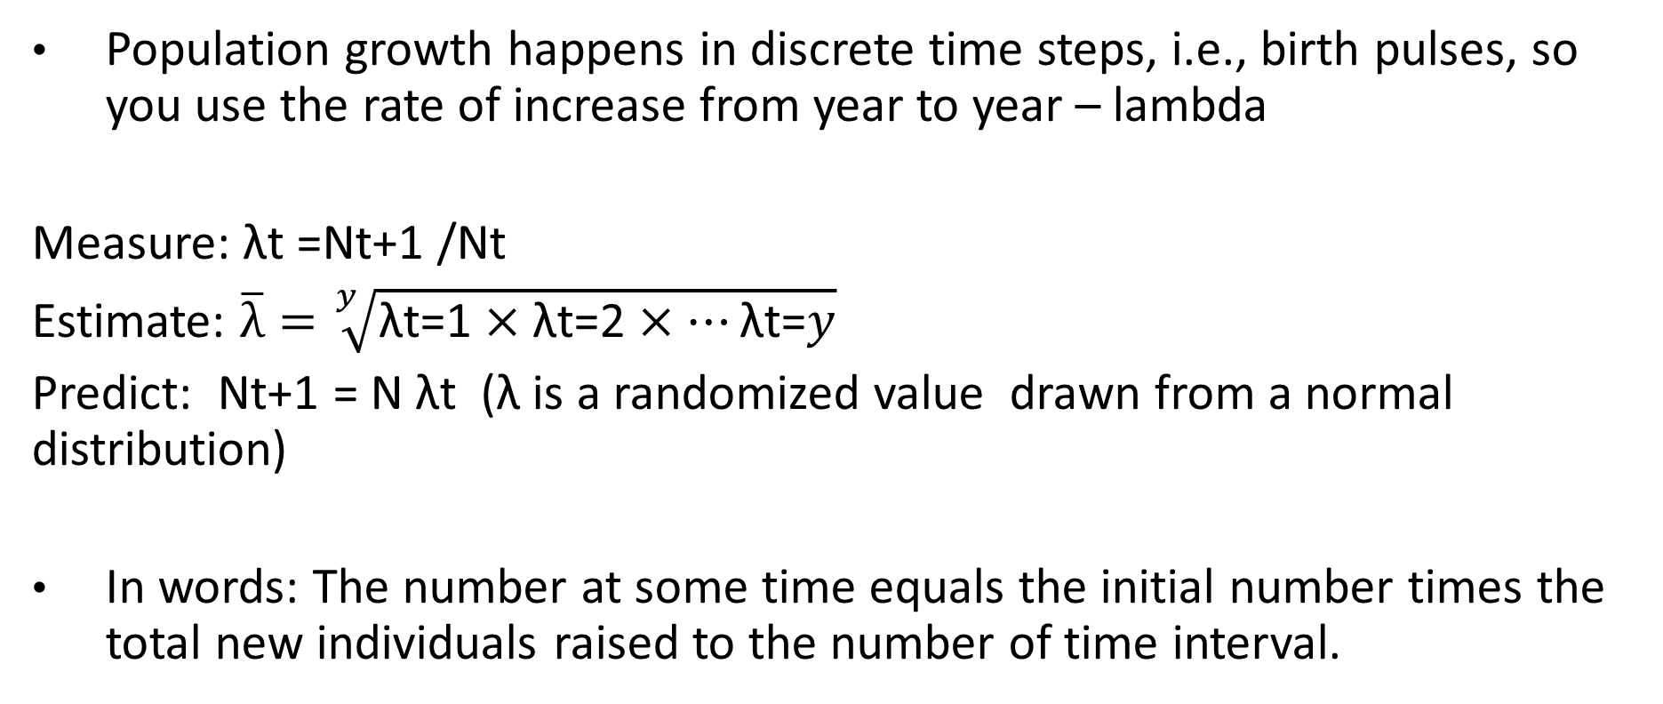
Discrete population growth models
Population growth happens in discrete time steps, i.e., birth pulses, so you use the rate of increase from year to year – lambda
Measure: λt =Nt+1 /Nt
Estimate: $\overline{λ}=\sqrt[y]{\text{λ}\text{t}\text{=}\text{1}×\text{λ}\text{t}\text{=}\text{2}×…\text{λ}\text{t}\text{=}y}$
Predict: Nt+1 = N λt (λ is a randomized value drawn from a normal distribution)
In words: The number at some time equals the initial number times the total new individuals raised to the number of time interval.
Notes:
Lambda growth models are more typical for wildlife, fish and plants etc in temperate zones
Populations with a breeding season, because r is highly variable over time
Eg it is very big during the breeding season as births are added much faster than mortalities, but then it becomes negative when the breeding season ends and mortalities in any moment exceed new births.
So, we simplify to a birth pulse, lambda model that basically averages the cnage in the population of the course of a year

Slide 10
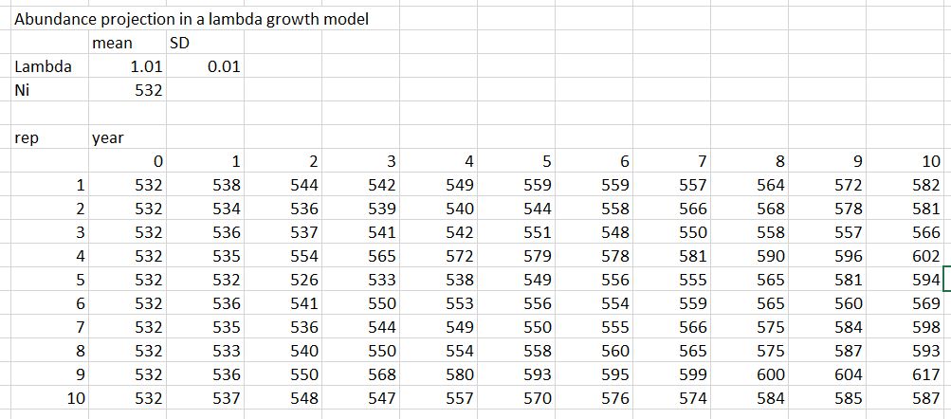

Slide 11
Logistic population growth
At times, populations increase rapidly, but they also slow down because resources become limited; the environment has a carrying capacity for a species population.
K - Carrying capacity
Logistic dN/dt= rN(1 - N/K) - instantaneous rate of change
Nt=K/1+(K-No)/No)e^rt -calculate population size
In words: The individuals at some time equals the intrinsic rate of increase times the total new individuals constrained by the capacity that is available at a site.
Notes:
K can limit population growth and lower future abundance predictions.
K is extremely difficult to measure from empirical data

Slide 12
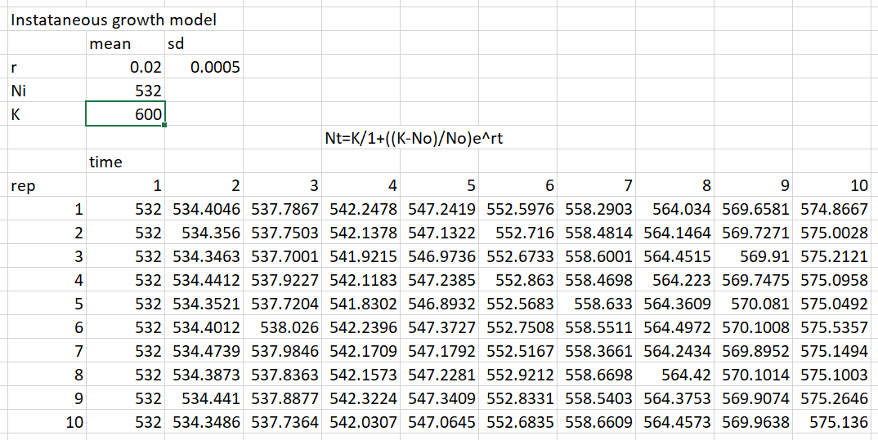

Slide 13
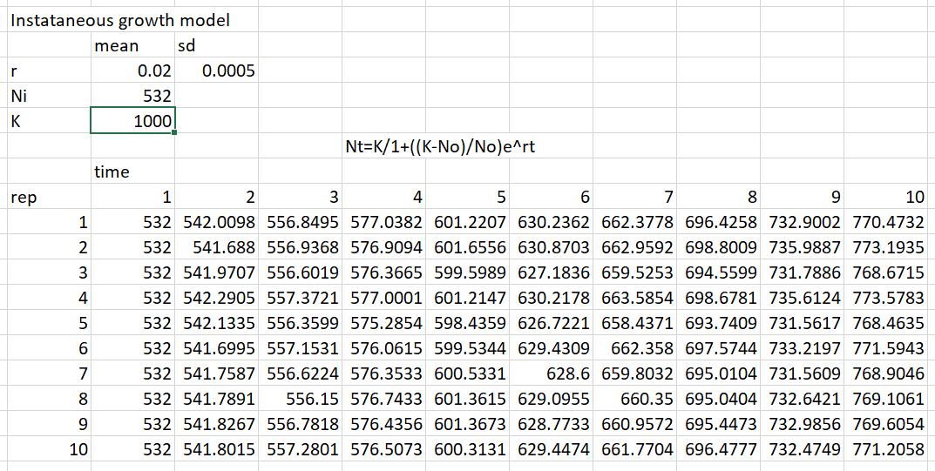

Slide 14
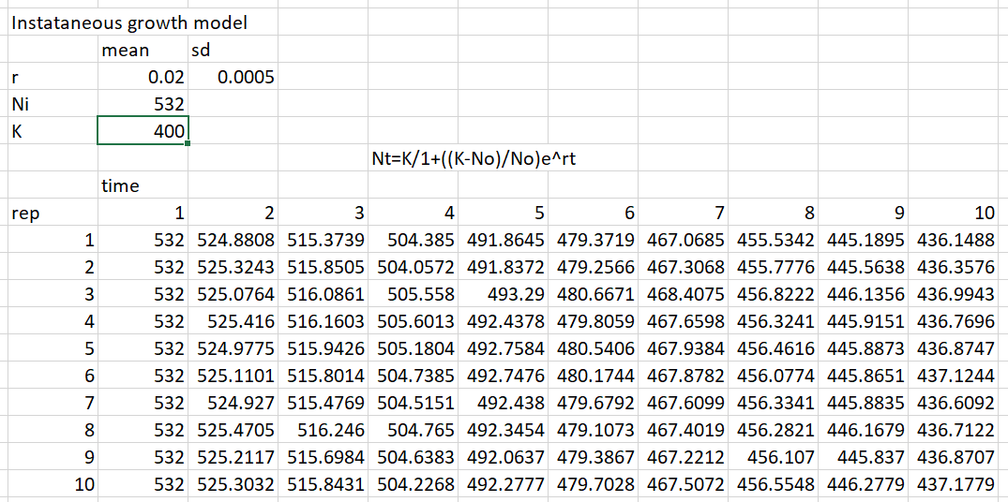

Slide 15
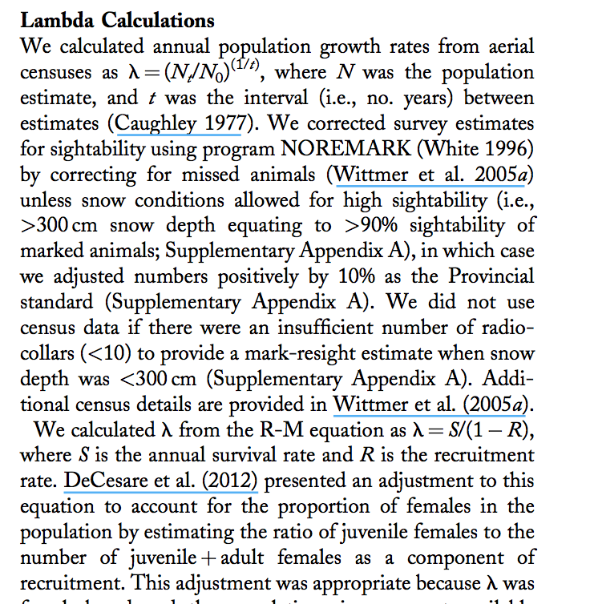
REAL example. How do you interpret this analysis for your SSA?
Exponential model!
Nt= Noe^^{rt}
What type of model is this?
What assumptions are the authors making with this type of model?
Serrouya et al. JWM. 2016.
Notes:
This is a standard recent paper using a simple growth model to calculate the future condition. This is a real world situation where you might need to ID the type of model used so that you can understand its assumptions.

Slide 16
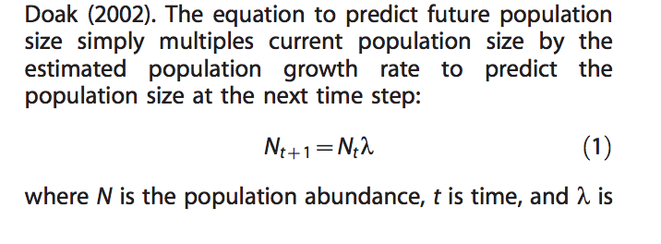
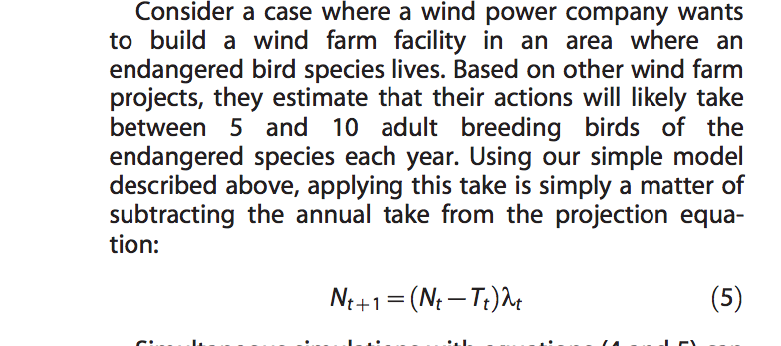
Application of lambda growth models
McGowan and Ryan. JFWM. 2010.
Notes:
Exponential: Nt = No λ^{t} ---> re-arranged to calculate population size

Slide 17
Alternative incidental take scenarios
Alternative “Take” scenarios
Solid line: “no take”
Nt+1 = Nt λt
Dotted line: “5-10 animals killed by wind farm annually”
Nt+1 = (Nt – Tt) λt
Change in resilience?

Slide 18
Application - St. Croix ground lizard growth
Sec. 7 consultation - if rats are introduced and mortality increases, what will happen to the population?
Trait | Scenario 1 | Scenario 2 | Scenario 3
Founder Population | 57 | 57 | 57
Carrying capacity | 3520000 | 3520000 | 3520000
Survivorship | Type III | Type III | Type III
Intrinsic growth rate | 1.13 | 0.5 | 0.35
Clutch size | 1 where 1/3 females produce 1 egg | 1 where 1/3 females produce 1 egg | 1 where 1/3 females produce 1 egg
Clutch frequency | 2 | 2 | 2
Mortality | 12% | Random 20 - 50 | Random 50 - 66%
Notes:
St. Croix ground lizard translocated in 2008 to a small island. Here, we model its population trajectories.

Slide 19
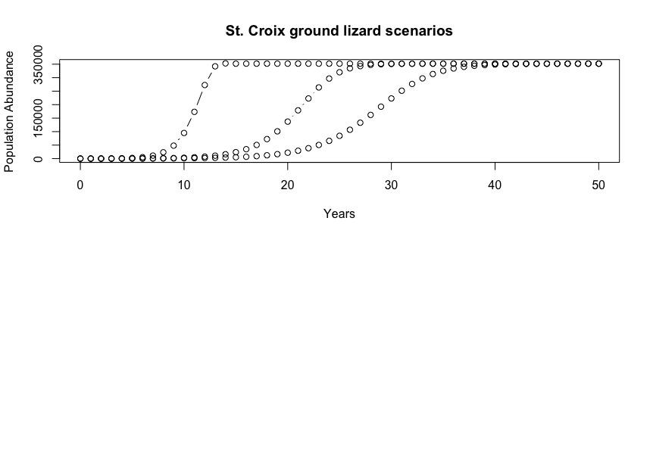

Application - St. Croix ground lizard growth
dN/dt= rN(1 - N/K)
Foreseeable future 25 yrs
Intrinsic growth rate (r) | 1.13 | 0.5 | 0.35
Mortality | 12% | Varies by poisson(20 - 50) | Varies by poisson(50 - 66%)
Notes:
Resiliency varies among scenarios

Slide 20
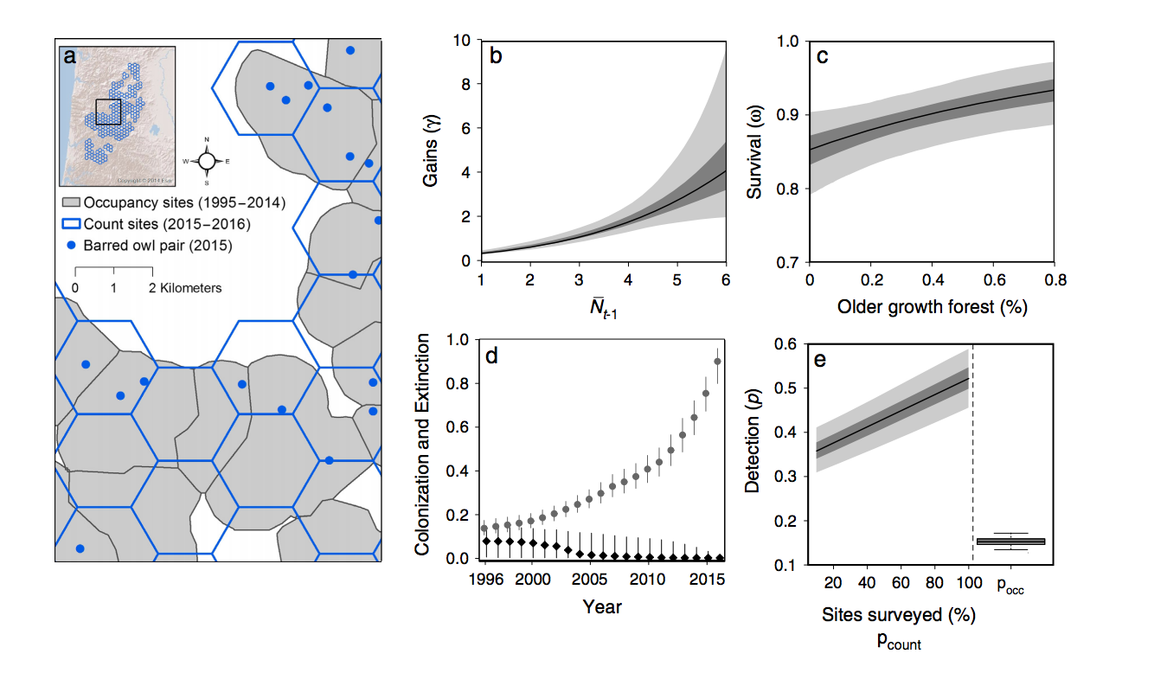
Population growth models – complicated demographic projections can be useful for your SSA
Historic and Current!
You could also use the trends to estimate the future condition!
(Zipkin et al. 2017. Ecology.)

Slide 21
Conclusions
Extrapolating into the future is tricky when you make things complicated. So simplify!
Things to remember: trends are valid until scenario changes
Environments….change
Genetics, morphology, distribution of species….change
Conservation actions…change
Notes:
Maybe helpful: http://fwspubs.org/doi/full/10.3996/062010-JFWM-014

