Slide 1


SSA 200 Strategic Use of Data
Oct 23-24, 2018
Houston, TX
Lecture slides, activities, and additional supplementary materials are available online at: ssa200.github.io
What is a model?
The purpose of modeling
Statistical analysis of data
Use statistical analysis to predict the future
Explaining variation
Using data analysis to understand ecological processes
Predict patterns in the future
Evaluate competing hypothesis about how the system works
Conor P. McGowan
Anna M. Tucker
Nicole F. Angeli
Kylee Dunham

Slide 2
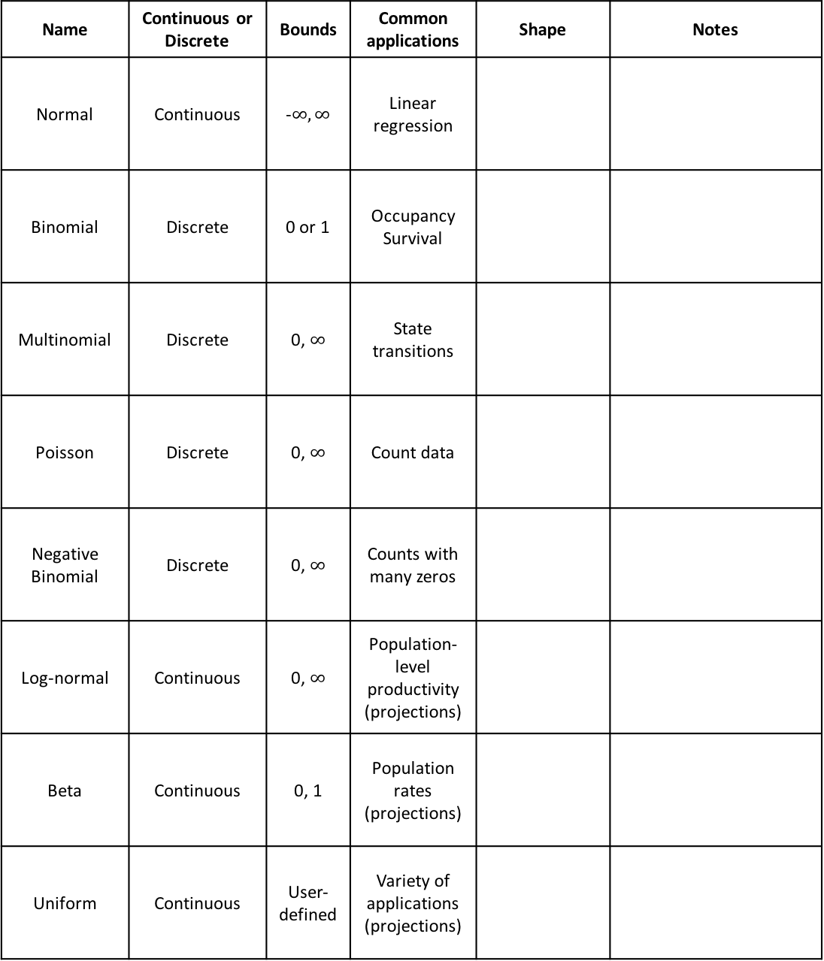
Statistical distributions
Name | Continuous or Discrete | Bounds | Common applications | Shape | Notes
Normal | Continuous | -$∞, ∞$ | Linear regression
Binomial | Discrete | 0 or 1 | Occupancy Survival
Multinomial | Discrete | 0, $∞$ | State transitions
Poisson | Discrete | 0, $∞$ | Count data
Negative Binomial | Discrete | 0, $∞$ | Counts with many zeros
Log-normal | Continuous | 0, $∞$ | Population-level productivity (projections)
Beta | Continuous | 0, 1 | Population rates (projections)
Uniform | Continuous | User-defined | Variety of applications (projections)

Slide 3

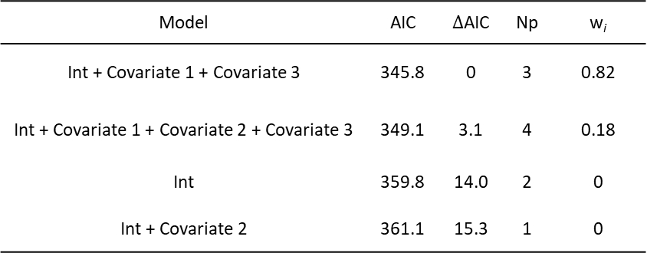
Linear regression and AIC
General linear model – response variable (y) has a Normal distribution
Generalized linear model – response variable (y) has some other distribution
Logistic regression – Binomial distribution
Poisson regression – Poisson distribution
$$y=a+bx$$
Parameter | Estimate | SE | t | p-value
Intercept | -0.22 | 1.29 | -0.169 | 0.866
b | 2.07 | 0.0978 | 21.16 | < 0.0001
Model | AIC | $∆$AIC | Np | w_{i}
Int + Covariate 1 + Covariate 3 | 345.8 | 0 | 3 | 0.82
Int + Covariate 1 + Covariate 2 + Covariate 3 | 349.1 | 3.1 | 4 | 0.18
Int | 359.8 | 14.0 | 2 | 0
Int + Covariate 2 | 361.1 | 15.3 | 1 | 0

Slide 4
Types of uncertainty
Partial controllability – We are unable to control the exact management actions taken in a system.
Examples:
Setting management goals – we may intend to fully restore a habitat, but may not be able to implement the exact management goals due to other logistical constraints
Observational uncertainty – We are unable to perfectly observe the state of natural systems.
Examples:
Count data – in almost all cases, we cannot count every individual present at a specific location, but instead assume there is some probability of detecting individuals
Environmental variation – Stochastic environmental fluctuations mean that conditions typically vary randomly from year to year.
Examples:
Predicting effects of temperature – we may estimate a relationship between temperature and survival probability that we can use to predict survival under future temperature conditions, but temperature will likely vary in a stochastic way from year to year.
Ecological uncertainty – We have an imperfect understanding of how ecological systems work.
Examples:
Metapopulation dynamics – we think a set of populations function as a metapopulation, but have not conducted studies to explicitly estimate immigration among sites, and therefore we are unsure to what extent immigration plays a role in measured population growth rate at each site.

Slide 5
Some key terms
Response/dependent variable – in a statistical model, the variable that you are interested in better understanding or predicting (the “y” variable)
Predictor/independent variable – in a statistical model, the variable(s) that explain some of the observed variation in the response variable (the “x” variables)
Covariate – an environmental or ecological quantity that usually represents a stressor or species need and is included in a model as a predictor variable
Parameter – statistical quantities that are estimated to explain the relationship between predictor and response variables. Can also be used to refer to demographic vital rates of interest
Collinearity – occurs when two predictor variables in the same model are correlated with each other
Overfitting – occurs when too many predictor variables are included in the model, resulting in a model that is not very useful for prediction
AIC – stands for Aikaike’s Information Criterion – a metric used to rank models based on how well they fit the data with a penalty for the number of covariates in the model (to avoid overfitting)
Intercept – the theoretical value of the response variable if all predictors were equal to zero
Null model – the “intercept-only” model that does not include any covariates
Global model – the most complex model in the model set that includes all covariates
Population closure – an important concept for occupancy and abundance estimation, a population is considered “closed” when there are no births, deaths, immigration, or emigration

Slide 6
Data analysis roadmap
What kind of data do you have?
Descriptive or categorical
Presence-type data
Counts
Demographic data
Follow the color of your data type!
How was it collected?
Opportunistic
(e.g. citizen science, historical records, museum specimens)
Designed survey
(e.g. transects, repeated counts, mark-recapture)
State transition model
State transition model
Are there repeated measurements within a closed period?
Species distribution model OR paired points analysis
No
Logistic regression
Yes
Poisson regression (counts)
Multinomial regression
Occupancy model
Abundance estimation (mark-recapture)
N-mixture model
Poisson regression (fecundity)
Survival analysis (mark-recapture)
This roadmap is to serve as a general guide and is not an exhaustive list of all analysis options. Also, always check the specific assumptions of your planned modeling approach!

