Slide 1
Demographic models
SSA 200

Slide 2
Applications to SSAs
Models are designed to output useful metrics on future resiliency and redundancy.
Metrics like future abundance, future extinction probability, future population growth rate
Output metrics are determined by available input data and what metrics will be most useful to decision makers
Models allow us to predict future condition of the populations and characterize uncertainties in future condition.
We will focus on environmental variation and observation/parametric uncertainties

Slide 3
Lecture outline
We will look at simple model construction
From conceptual to quantitative
We will look at incorporating environmental covariates and density dependence
We will look at parametric uncertainty

Slide 4
Conceptual model
Two life stages
Adults
Young of the year
Young of the year
Adults

Slide 5
Conceptual model
Adults reproduce
Young of the year
Adults

Slide 6
Conceptual model
Young of the year survive and transition to adults
Young of the year
Adults

Slide 7
Conceptual model
Adults survive and remain adults
Young of the year
Adults

Slide 8




Quantitative model
$$N_{t+1}^{a}=N_{t}^{a}S_{t}^{a}+N_{t}^{a}F_{t}^{a}S_{t}^{Y}$$
$$F_{t}^{a}$$
Young of the year
Adults
$S_{t}^{Y}$
$$S_{t}^{a}$$
Notes:
KDD – include the conceptual diagram?

Slide 9
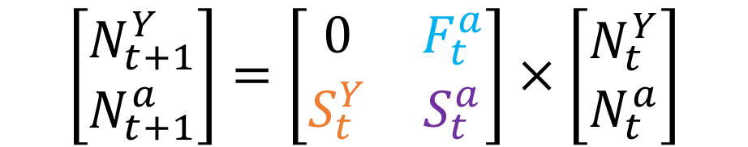



Matrix formulation
$$\left[\begin{matrix}N_{t+1}^{Y} \\ N_{t+1}^{a}\end{matrix}\right]=\left[\begin{matrix}0 & F_{t}^{a} \\ S_{t}^{Y} & S_{t}^{a}\end{matrix}\right]×\left[\begin{matrix}N_{t}^{Y} \\ N_{t}^{a}\end{matrix}\right]$$
$$F_{t}^{a}$$
Young of the year
Adults
$S_{t}^{Y}$
$$S_{t}^{a}$$
Notes:
Can get this information on demographic rates in a number of ways (refer to Annas demo data Day 1)

Slide 10
Integrated population models
Data input
Analysis
Output
IPM
Combine demographic data with counts
Use the model to make projections
Counts
IPM
Abundance estimate
Mark-recapture
Survival probability
Number of offspring/female
Average fecundity
Notes:
Can be used to estimate the demographic rates with and/or without data by combining multiple data sources. Typically gets plugged into a matrix model and the “output” is used to project forward

Slide 11


Matrix projections
$$\left[\begin{matrix}N_{t+1}^{Y} \\ N_{t+1}^{a}\end{matrix}\right]=\left[\begin{matrix}0 & F_{t}^{a} \\ S_{t}^{Y} & S_{t}^{a}\end{matrix}\right]×\left[\begin{matrix}N_{t}^{Y} \\ N_{t}^{a}\end{matrix}\right]$$
$N_{t+1}= A∗N_{t}$
$$N_{t+1}= λ∗N_{t}$$

Slide 12
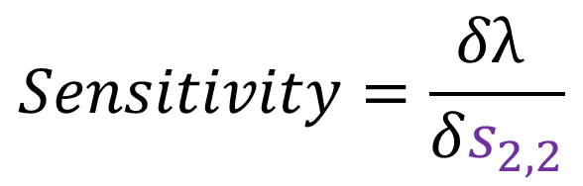
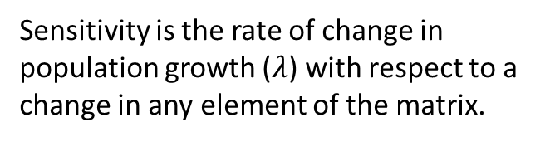
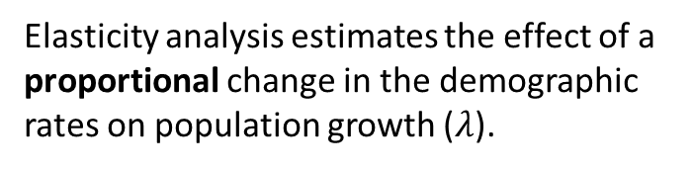
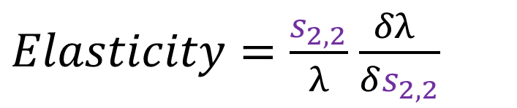
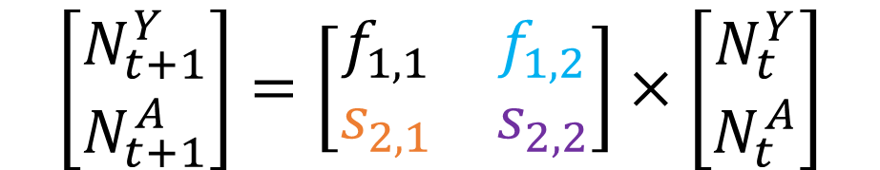
Sensitivity and elasticity
$$\left[\begin{matrix}N_{t+1}^{Y} \\ N_{t+1}^{A}\end{matrix}\right]=\left[\begin{matrix}f_{1,1} & f_{1,2} \\ s_{2,1} & s_{2,2}\end{matrix}\right]×\left[\begin{matrix}N_{t}^{Y} \\ N_{t}^{A}\end{matrix}\right]$$
$$Sensitivity=\frac{δλ }{δs_{2,2}}$$
$Elasticity=\frac{s_{2,2}}{λ}$ $\frac{δλ }{δs_{2,2}}$
Sensitivity is the rate of change in population growth ($λ$) with respect to a change in any element of the matrix.
Elasticity analysis estimates the effect of a proportional change in the demographic rates on population growth ($λ$).

Slide 13
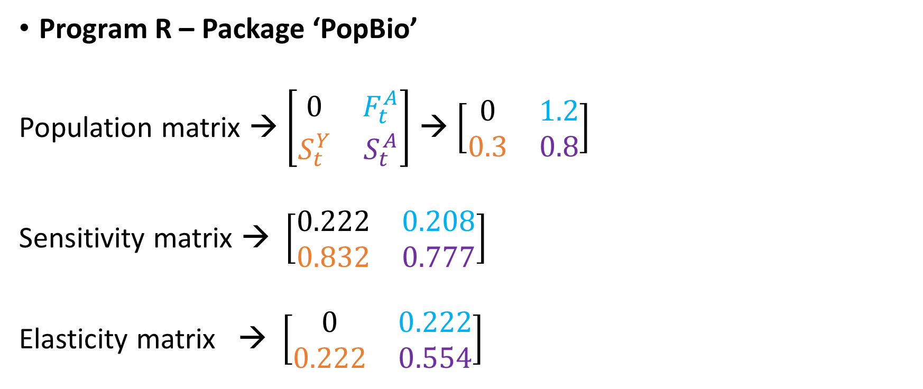
How to estimate sensitivity and elasticity
Program R – Package ‘PopBio’
Population matrix → $\left[\begin{matrix}0 & F_{t}^{A} \\ S_{t}^{Y} & S_{t}^{A}\end{matrix}\right]$ → $\left[\begin{matrix}0 & 1.2 \\ 0.3 & 0.8\end{matrix}\right]$
Sensitivity matrix → $\left[\begin{matrix}0.222 & 0.208 \\ 0.832 & 0.777\end{matrix}\right]$
Elasticity matrix → $\left[\begin{matrix}0 & 0.222 \\ 0.222 & 0.554\end{matrix}\right]$
Notes:
Add slide to include methods for doing this (R, Excel)

Slide 14
Simple future condition assessments
Using sensitivity and/or elasticity output
Results indicate population growth is most sensitive to adult survival
Conceptual modeling and literature review suggest that adult survival is negatively affected by drought frequency
Climate change predictions suggest that drought frequency will increase over the next 50 years
We therefore expect adult survival to decrease and in turn population growth will decrease
We conclude that if climate predictions are accurate, future resiliency will decrease

Slide 15
Forms of uncertainty
Partial controllability
Observational uncertainty
Environmental variation
Ecological uncertainty
Demographic stochasticity
Notes:
Move back to beginning before environmental uncertainty

Slide 16
Incorporating uncertainty
Environmental stochasticity
Survival parameters typically drawn from a beta distribution
Convert estimated mean and variance to beta shape parameters
Continuous but restricted between 0 and 1
Really useful to species with high or low survival
Productivity parameters have two typical methods
Log-normal, bounded by 0 and infinity
Convert estimated mean and variance to log-normal distribution
Poisson distribution summed over all the individuals in the population
Notes:
Environmental Stochasticity – unpredictable spatiotemporal fluctuations in environmental conditions

Slide 17
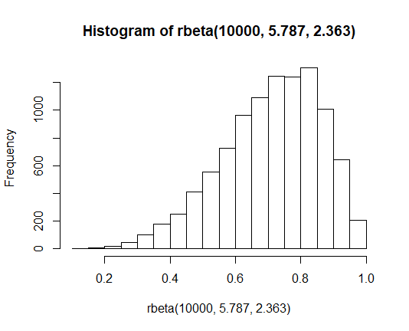
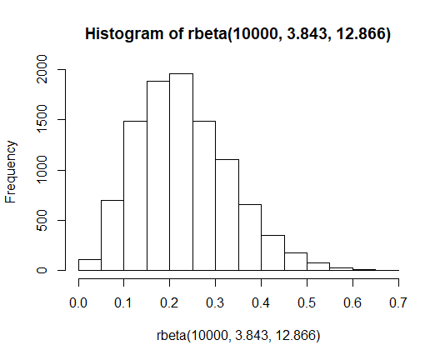
Survival rates
S = 0.71, S.D. = 0.15 → Beta1 =5.787 Beta2 =2.363 →
S = 0.23, S.D. = 0.1 → Beta1 =3.843 Beta2 =12.866 →

Slide 18
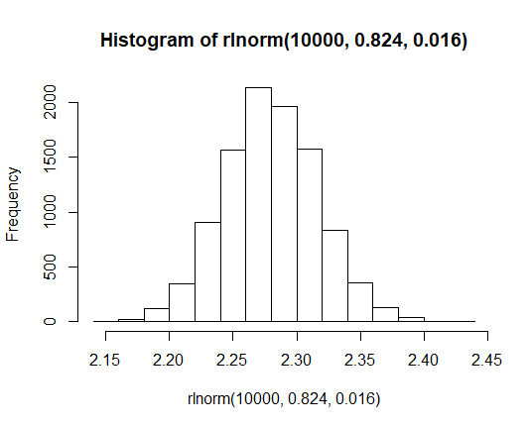
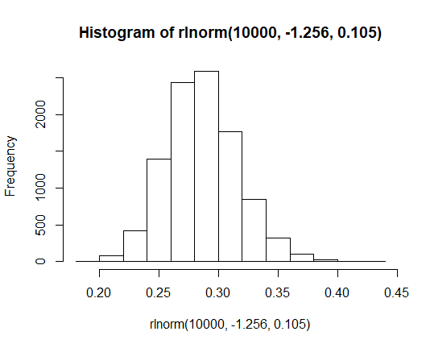
Productivity rates
F = 2.3, S.d. = 0.3 → S1= 0.824, S2 = 0.016 →
F = 0.3, S.d. = 0.1 → S1= -1.256, S2 = 0.105 →

Slide 19
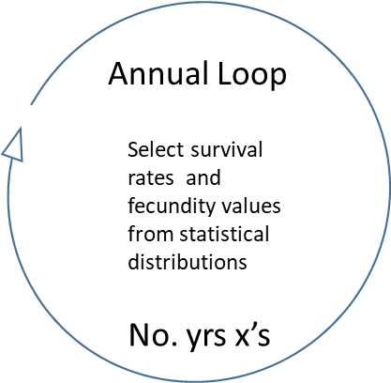
For loops in simulation models
Programmers utilize loop functions that tell a program to execute the following set of functions over and over again a specified number of times:
for(i in 1:1000){
#Tells the computer to repeat a function
#1000 times
}
With in those loops we can choose randomized parameter values and project populations
Typically use 2 loops to project time and replicate the simulations

Slide 20
Density dependence
Model parameters are a function of population density

Slide 21

Applying density dependence
Incorporated a density dependent function on juvenile survival
$N_{t+1}=N_{t}{F_{A,t }S}_{j,t}+N_{t}S_{a,t}$
$$S_{j,t}=\frac{exp \left(α−β\left(N_{t}+ N_{t}F_{A,t}\right)\right)}{1+\left(exp\left(α−β\left(N_{t}+N_{t}F_{A,t}\right)\right)\right)}$$

Slide 22
Ceiling type density dependence
Threshold Density dependence
“If the population exceeds a ceiling threshold, fecundity is equal to zero”
if (n[i,j] > ncrit) F[i,j] = 0
Or
“As the population approaches some ceiling threshold, fecundity gets smaller and smaller”
F[i,j]= F[i,j]*(1-n[i,j]/ncrit)

Slide 23
Conceptual models environmental effects
Drought year
Stream length
Young of the year
Adults

Slide 24


Quantitative model
Drought year
Stream length
$$F_{t}^{A}$$
Young of the year
Adults
$S_{t}^{Y}$
$$S_{t}^{A}$$

Slide 25
Environmental covariates
Conditionally linked events:
Use “If→then” statements to link a demographic parameter to some other randomized event
E.g., if a Bernoulli trial for drought returns a 1, then mean fecundity is 1.1 offspring per female, but if it returns a 0 then mean fecundity is 2.3 offspring per female

Slide 26
Logit link for population parameters
Based on logit link functions
Correlation parameter estimates from survival estimates or occupancy analyses are on the logit scale
You can use the logit function to predict the survival rate for any give value of the measured covariates

Slide 27
Environmental covariates
Adult survival (Sa) can be a function of some other environmental parameter/variable
(“op” for other parameter, e.g., stream length)

Slide 28
Environmental covariates
Adult survival (Sa) can be a function of “op” but it has variability
Sa=matrix(plogis(-rnorm(1,1.4,.1)+(rbeta(1,18,1)*op)),r,t)

Slide 29
Parametric uncertainty
Parameters values are not precisely known
Variance or standard deviation estimates for parameters estimated over years conflate environmental variation with sampling variance
Sampling variance is the result of only using a specific number of individuals or locations to study a phenomenon
Happens with every wildlife study because we can’t study every individual in every location

Slide 30
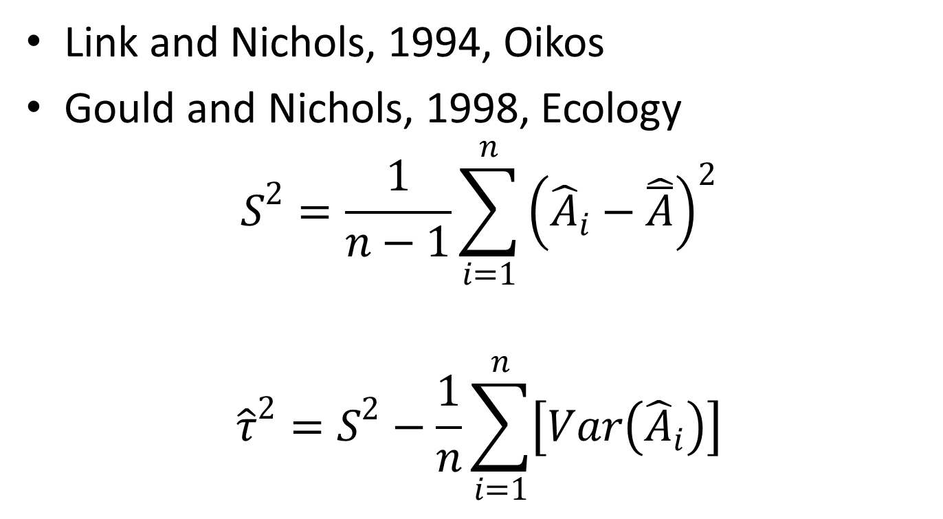
Methods to partition variance
Link and Nichols, 1994, Oikos
Gould and Nichols, 1998, Ecology
$S^{2}=\frac{1}{n−1}\sum_{i=1}^{n}{{\left({\hat{A}}_{i}−\hat{\overline{A}}\right)}^{2}}$
${\hat{τ}}^{2}=S^{2}−\frac{1}{n}\sum_{i=1}^{n}{\left[Var\left({\hat{A}}_{i}\right)\right]}$
Notes:
Just explain that methods exist and these smart people figured out how to do it – not going to worry about it

Slide 31
Great, so what do we do about it?
Most models will discard sampling variance
Not always a good idea!
Pretending that we know system parameters with precision
Less variation in the model predictions
Could affect assessment of management choices

Slide 32
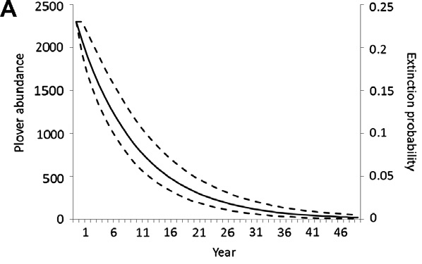
Projection without sampling variance
Notes:
Extinction probability axis is wrong?

Slide 33
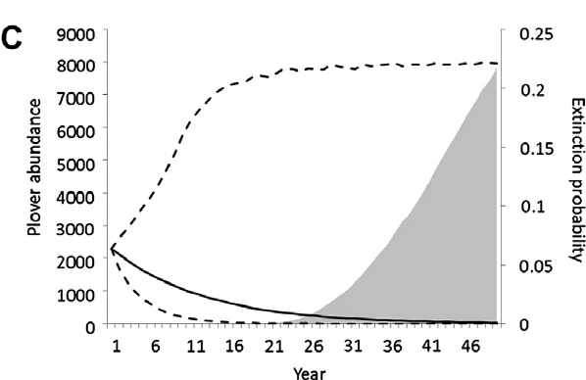
Projection with sampling variance

Slide 34
How do we model these uncertainties?
Replication Loop
Hierarchical loop structure:
parametric and environmental uncertainty
Select survival rates and fecundity values from statistical distributions
Annual Loop
Select survival rates and fecundity values from statistical distributions
1000 x’s
No. yrs x’s
Model Output

Slide 35
Modeling uncertainty in adult survival
Mean = 0.656
replicate 1
Mean = 0.731
replicate 2
Mean = 0.793

Slide 36
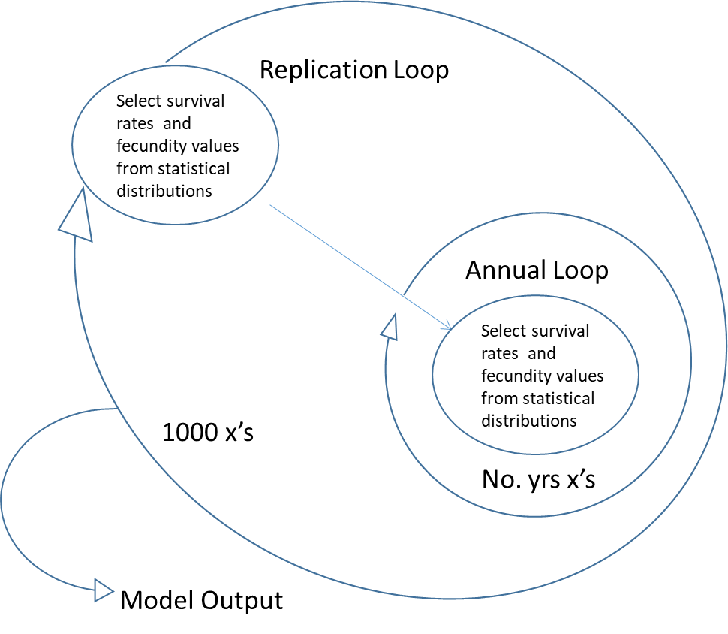
Double for loops
for(i in 1:1000){
#Select mean parameter values a replicate
for(j in 1:50){
#Select values for each year until you reach 50 years then move on to
#the next replicate
}
#save and summarize output from a replicate until you reach 1000 #replicates
}

Slide 37



Inputting scenarios
Use the conceptual model and sensitivity analysis to guide scenarios
i.e., what ecological facts affect the most sensitive parameters?
Design scenarios to explore the expected range of future variation in important covariates
Drought year
Stream length
$$F_{t}^{A}$$
Young of the year
adults
$S_{t}^{Y}$
$$S_{t}^{A}$$

Slide 38
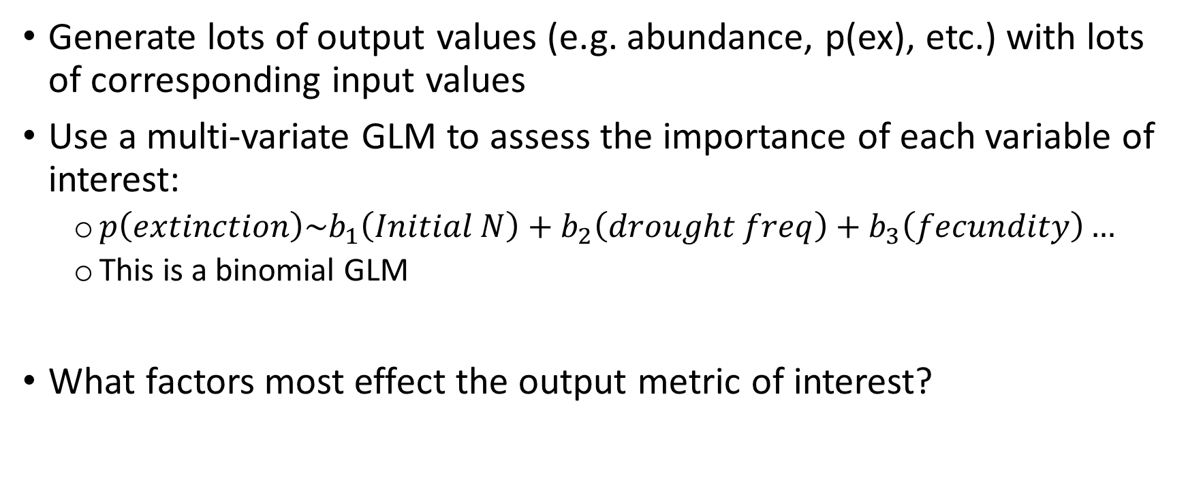
Using this structure to build GLMs
Generate lots of output values (e.g. abundance, p(ex), etc.) with lots of corresponding input values
Use a multi-variate GLM to assess the importance of each variable of interest:
$p\left(extinction\right)\sim b_{1}\left(Initial N\right)+b_{2}\left(drought freq\right)+b_{3}\left(fecundity\right)…$
This is a binomial GLM
What factors most effect the output metric of interest?

Slide 39
Sonora desert tortoise example
𝑃(𝑄𝑒100) =‒ 5.602 + (18.42 𝑥 𝑀𝐷𝑅) ‒ (5.363𝑒 ‒ 6𝑥 𝑁𝐴𝐼) ‒ (1.797𝑒 ‒ 6𝑥 𝑀𝑎𝑥𝑃𝑜𝑝)
MDR = mean drought rate
NAI = Initial Number of adults
MaxPop = habitat based maximum population size
You could input different values of MDR, NAI or MaxPop to predict the corresponding P(Qe100), i.e., input alternative future scenarios.

Slide 40
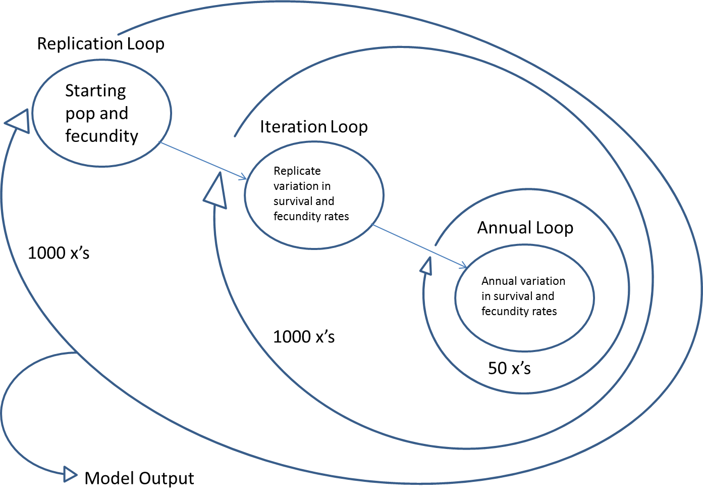
Hierarchical loop structure
Initial population size, habitat quantity and quality, drought
Notes:
You’ve already seen temporal and replicates in the prior lectures using excel, this is how its formatted for coding in R

Slide 41
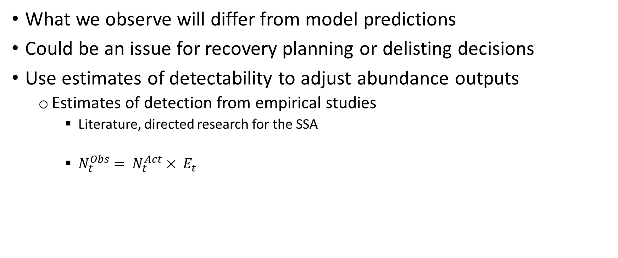
Incorporating posterior observation uncertainty
What we observe will differ from model predictions
Could be an issue for recovery planning or delisting decisions
Use estimates of detectability to adjust abundance outputs
Estimates of detection from empirical studies
Literature, directed research for the SSA
$N_{t}^{Obs}= N_{t}^{Act}× E_{t}$
Where E is the counting error
Notes:
Figure for actual pop and observed population under differing detection probabilities

Slide 42
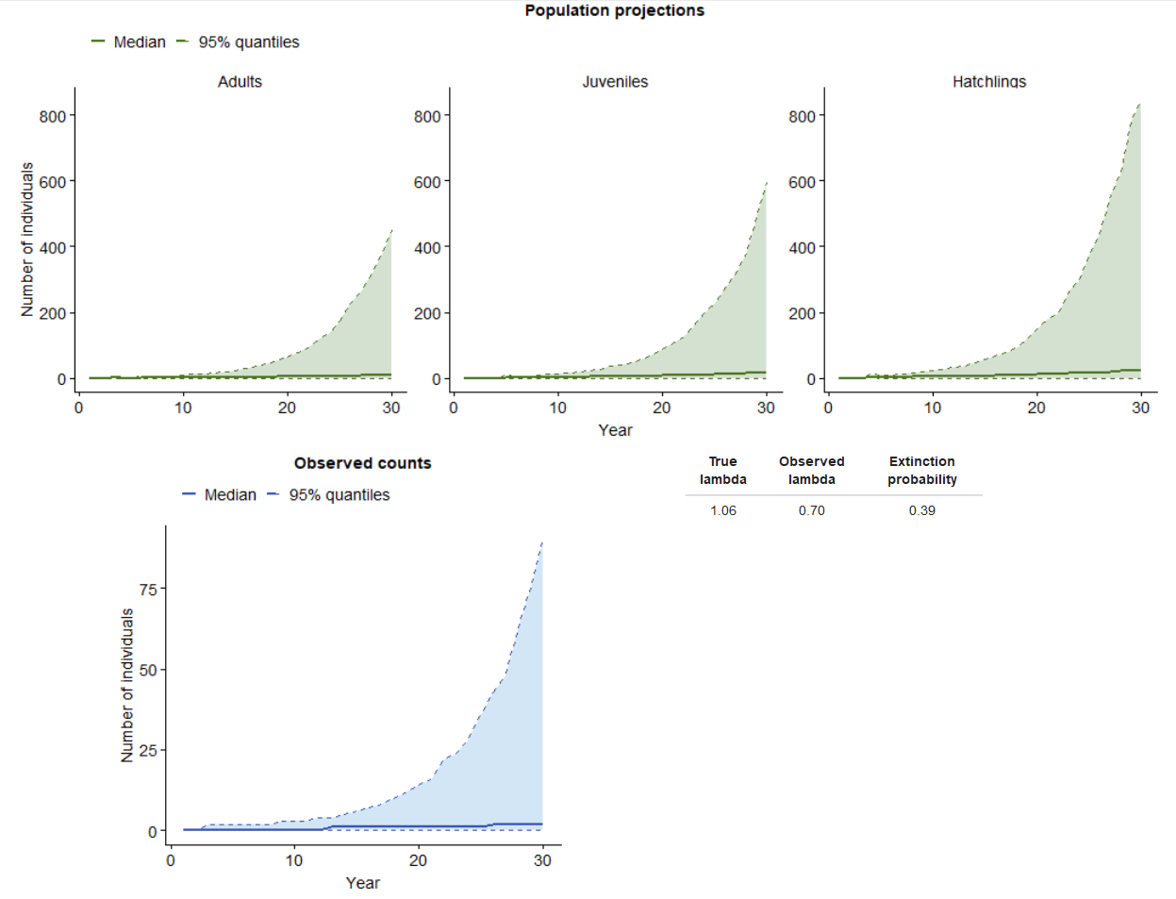
Abundance projections
Expected counts

Slide 43
Questions?

