Slide 1
Species Status Assessments
SSA 200
Quantitative training for SSAs

Slide 2

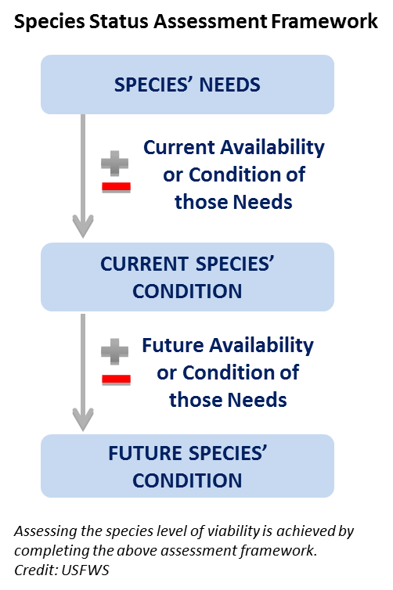

Species Status Assessment
Notes:
IMAGE ON LEFT IS HYPERLINK TO NATHAN’S VIDEO.
Just to get you back in the SSA frame of mind, let’s look at the overview video together. CLICK THE LINK (Load the video onto the laptop you are using.)
During the video, write down ONE burning question that you have…we will collect those at the end of the video and MAKE SURE that we answer them during the week.
After video:
This week, we will spend one whole day on each of the three main parts of the SSA . On Tuesday, we will go in-depth on SPECIES NEEDS. Wednesday is CURRENT CONDITION, and THURSDAY is FUTURE CONDITION. On Friday, we will wrap it up by explaining how it all goes into the document, and we will be introducing you to your group and species that you will work with over the summer to develop a low-analytic draft SSA. DON’T PANIC YET! Lots more to come on this…

Slide 3
Objectives of this class
Become familiar with common terminology and approaches used in
population modeling including constraints, weaknesses, and underlying assumptions.
Identify an appropriate analytical approach for assessing the status of a species given the available data.
Communicate/understand relevant analytics and interpret population modeling results pertinent to an SSA.
Communicate population modeling results to decision makers as part of SSA results.
“Models can do cool things for biologists and decision makers, and we want the biologists to think they’re cool–not voodoo.”
Notes:
AMT- Updated objectives to match course announcement

Slide 4
What this class is not:
A class intended to teach technical skills in analysis or modeling
A computer coding class to learn how to use R or some statistical program
Etc…

Slide 5
Day 1
Types of data typically available and used in SSAs and associated analyses
Descriptive data
Presence and presence/absence data
Count data over time and space
Demographic data (mark recapture, nest monitoring)
Notes:
AMT- removed “qualitative”

Slide 6
Day 1
Analysis of existing data can give insight into:
Species ecological needs
Relating data on the species to environmental variables
Species current status
Current redundancy
Current resiliency
Notes:
AMT- be sure to emphasize why we are not covering representation—that is usually determined in some other way, and we will assume for this class that representation units have been determined/assigned a priori

Slide 7
Day 2
Projection models for each data type
Randomized categorical projections
Single-state and multistate occupancy modeling
Linear projection models, Poisson process projection models
Matrix population models, matrix state transition models

Slide 8
Day 2
Projection models give insight into:
Future redundancy
Future resiliency
Using the results of the current status and needs analysis to predict future redundancy and resiliency

Slide 9
Questions?

Slide 10
The purpose of modeling
Statistical analysis of data
Assess and describe patterns
Estimate system or population parameters
Relate population parameters to ecological or environmental variables
Estimate and characterize variability in data
Use statistical analysis to predict the future
Organize and structure your uncertainty/variability

Slide 11
Explaining variation
Using data analysis to understand ecological processes
Predict patterns in the future
Evaluate competing hypothesis about how the system works
AIC model selection evaluates competing models
Advancements beyond traditional inference methods (R² value for a regression, p-values)

Slide 12

George Box’s Pipe
Notes:
“All models are wrong, but some models are useful” The goal here is build useful statistical models and projection models
Focus on the decision context: i.e. “What uncertainties are important to the decision making?” & “What metrics are useful for addressing the decision at hand?”

Slide 13
Forms of uncertainty
Partial controllability
Observational uncertainty
Environmental variation
Ecological uncertainty
Demographic stochasticity

Slide 14
Statistical distributions characterize uncertainties
We use statistical distributions to generate parameter values with some variation
The distributions have some predefined properties that reflect our knowledge or data of how a parameter behaves
e.g., Mean and SD or variance

Slide 15
The normal distribution
Notes:
Between negative and positive infinity, mean and standard deviation describe the shape

Slide 16
The Poisson distribution
Notes:
Poisson distribution: zero to positive infinity, mean and SD are the same, integers only, so its good for count data

Slide 17
The binomial distribution

Slide 18
The beta distribution
Notes:
The Beta Distribution: between zero and one, alpha and beta shape parameters can be canculated from the the mean and distribution. Very good for representing rates, like survival rate

Slide 19
The log-normal distribution

Slide 20
The uniform distribution

Slide 21
Application and use in the class and beyond
The analysis tools and projection tools will refer to these statistical distributions
E.g., count data → Poisson distribution
Simulation models will use these distributions to mimic variability in a virtual setting

Slide 22
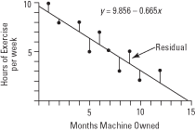
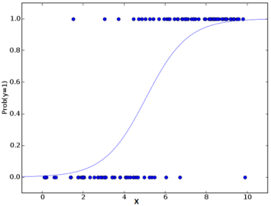
Generalized Linear Models (GLM)
Regression modeling is the central premise for relating parameters to environmental variables
Least squares regression – normal distribution
GLMs use other underlying distributions
Poisson (Count data)
Binomial (Logistic regression)
Negative binomial (count data with lots of zero counts)

Slide 23
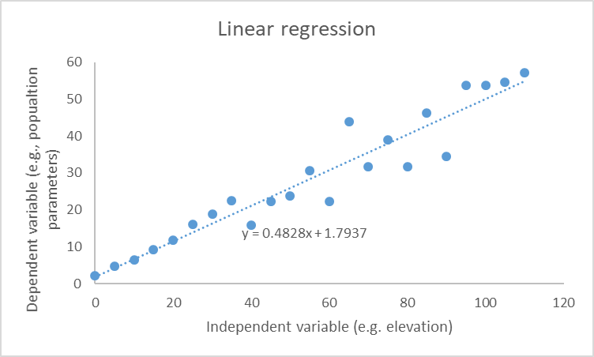

Slide 24


Multiple regression: relating parameters to multiple variables
The parameter y is a function of X.
$$y=b_{1}X+a$$
The parameter y is a function of X, Z, and K.
$$y=b_{1}X+b_{2}Z+b_{3}K+a$$
Notes:
AMT- updated formatting. Emphasize that blue = things we have data for and orange = model parameters to be estimated

Slide 25






Slide 26


What variables best predict bear occurrence?
$$y=b_{1}W+a$$
$$y=b_{1}W+b_{2}T+b_{3}R+b_{4}S+a$$
$$y=b_{2}T+b_{4}S+a$$
None of the above
$$y=a$$
How do we know which one is better??
Notes:
y= b₁X + a one independent variable
y= b₁X + b₂Z + a two independent variables
y= b₁X + b₂Z + b₃K + a three independent variables
y= a no independent variables (“null model”)
HOW DO WE KNOW WHICH IS BETTER???
AIC model selection evaluates competing models of the data
Advancements beyond tradidtion inference methods
E.g., R² value for a regression, p-values

Slide 27
Comparing models using AIC
AIC is a metric used to rank competing models that are fit with the same data
Find the model that fits the best with the fewest number of parameters (parsimony)
Model | Model fit | Number of parameters | AIC rank
water | Not great | 2 | 3
water + trees + rocks + salmon | Better | 5 | 2
trees + salmon | Best | 3 | 1
none of the above | Worst | 1 | 4
Notes:
AMT- Not sure about this new slide– but I think illustrating in a general way how AIC works might make explaining it in more detail later easier.

Slide 28
Questions?

