Slide 1

Species Status Assessments
SSA 200
Quantitative training for SSAs
Quantitative Tools for SSA

Slide 2

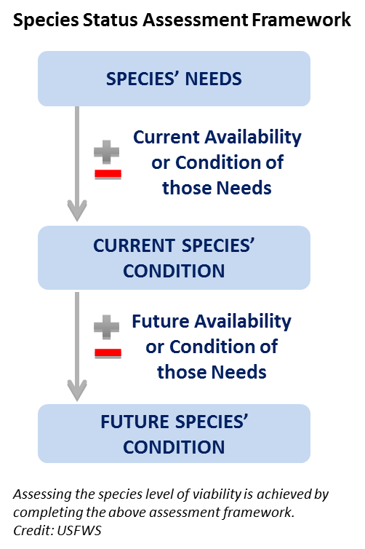

Species Status Assessment
Quantitative Tools for SSA
Notes:
IMAGE ON LEFT IS HYPERLINK TO NATHAN’S VIDEO.
Just to get you back in the SSA frame of mind, let’s look at the overview video together. CLICK THE LINK (Load the video onto the laptop you are using.)
During the video, write down ONE burning question that you have…we will collect those at the end of the video and MAKE SURE that we answer them during the week.
After video:
This week, we will spend one whole day on each of the three main parts of the SSA . On Tuesday, we will go in-depth on SPECIES NEEDS. Wednesday is CURRENT CONDITION, and THURSDAY is FUTURE CONDITION. On Friday, we will wrap it up by explaining how it all goes into the document, and we will be introducing you to your group and species that you will work with over the summer to develop a low-analytic draft SSA. DON’T PANIC YET! Lots more to come on this…

Slide 3
This Class
2 overview of data types, analytical approaches and associated projection models
Objectives:
Introduce field office biologists, species leads, and listing biologists to data types and quality
Familiarize the same audience analytical approaches for common data types
Familiarize the same audience with tools and techniques for making predictions (i.e., projection modeling) with those data types
Help field office biologists, species leads, and listing biologists, understand and interpret the results and outputs of analyses and projection models
“Models can do cool things for biologists and decision makers, and we want the biologists to think they’re cool – not voodoo.”
Quantitative Tools for SSA

Slide 4
What this class is not:
A class intended to teach technical skills in analysis or modeling
A computer coding class to learn how to use R or some statistical program
Etc…
Quantitative Tools for SSA

Slide 5
Day 1
Types of data typically available and used in SSAs and associated analyses
Qualitative and descriptive “data”
Presence and presence absence data
Count data over time and space
Demographic data (mark recapture, nest monitoring)
Quantitative Tools for SSA

Slide 6
Day 1
Analysis of existing data can give insight into:
Species ecological needs
Relating data on the species to environmental variables
Species current status
Current redundancy
Current resiliency
Quantitative Tools for SSA

Slide 7
Day 2
Projection models for each data type
Randomized categorical projections
Occupancy and multistate occupancy modeling
Linear projection models, Poisson process projection models
Matrix populations model, matrix state transition models
Quantitative Tools for SSA

Slide 8
Day 2
Projection models give insight into:
Future redundancy
Future resiliency
Using the results of the current status and needs analysis to predict future redundancy and resiliency
Quantitative Tools for SSA

Slide 9
Questions?
Quantitative Tools for SSA

Slide 10
The purpose of modeling
Statistical analysis of data
Assess and describe patterns
Estimate system or population parameters
Relate population parameters to ecological or environmental variables
Estimate and characterize variability in data
Use statistical analysis to predict the future
Organize and structure your uncertainty/variability
Quantitative Tools for SSA

Slide 11
Explaining variation
A second goal of Statistical analysis of data is to explain patterns of variation
E.g., relationship between animal abundance and habitat feature
Using data analysis to understand ecological processes
Also helps with predicting patterns in the future
AIC model selection evaluates competing models of the data
Advancements beyond tradidtion inference methods
E.g., R² value for a regression, p-values
Quantitative Tools for SSA

Slide 12

George Box’s Pipe
Quantitative Tools for SSA
Notes:
“All models are wrong, but some models are useful” The goal here is build useful statistical models and projection models
Focus on the decision context: i.e. “What uncertainties are important to the decision making?” & “What metrics are useful for addressing the decision at hand?”

Slide 13
Forms of uncertainty
Partial controllability
Observational uncertainty
Environmental variation
Ecological uncertainty
Demographic stochasticity
Quantitative Tools for SSA

Slide 14
Statistical distributions for characterizing uncertainties
We use statistical distributions to generate parameter values with some variation
The distributions have some predefined properties that reflect our knowledge or data of how a parameter behaves
e.g., Mean and SD or variance
Quantitative Tools for SSA

Slide 15
The normal distribution
Quantitative Tools for SSA
Notes:
Between negative and positive infinity, mean and standard deviation describe the shape

Slide 16
The Poisson distribution
Quantitative Tools for
Notes:
Poisson distribution: zero to positive infinity, mean and SD are the same, integers only, so its good for count data

Slide 17
Quantitative Tools for SSA Pilot Course
2018 FIT Summit, Tucson AZ

Slide 18
The beta distribution
Quantitative Tools for SSA
Notes:
The Beta Distribution: between zero and one, alpha and beta shape parameters can be canculated from the the mean and distribution. Very good for representing rates, like survival rate

Slide 19
Quantitative Tools for SSA Pilot Course
2018 FIT Summit, Tucson AZ

Slide 20
Quantitative Tools for SSA Pilot Course
2018 FIT Summit, Tucson AZ

Slide 21
Application and use in the class and beyond
The analysis tools and projection tools will refer to these statistical distributions
E.g., analyzing count/abundance data will like use a Poisson distribution as the underlying statistical distribution
Simulation models will use these distributions to mimic variability in a virtual setting
Quantitative Tools for SSA

Slide 22
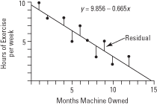
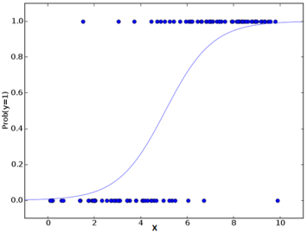
Generalized Linear Models
Regression modeling is the central premise for relating parameters to environmental variables
Least squares regression – normal distribution
GLM’s use other underlying distributions
Poisson (Count data)
Binomial (Logistic regression)
Negative binomial (count data with lots of zero counts)
Quantitative Tools for SSA

Slide 23
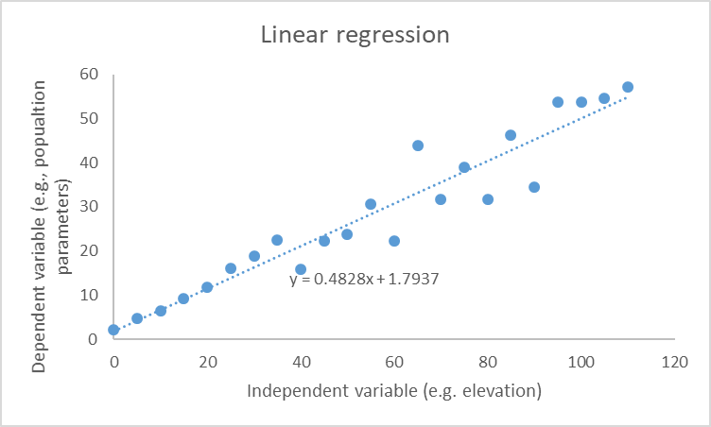
Linear regression!
Quantitative Tools for SSA

Slide 24
Multiple regression: relating parameters to multiple variables
y=b₁X + a
This is mathematical notation for say the parameter Y is equal to a function of X
y= b₁X + b₂Z + b₃K + a
This is mathematical notation for saying that y is a function of many variables (X, Z, and K)
AIC model selection evaluates competing models of the data
Advancements beyond tradidtion inference methods
E.g., R² value for a regression, p-values
Quantitative Tools for SSA

Slide 25
Multiple Models
y= b₁X + a one independent variable
y= b₁X + b₂Z + a two independent variables
y= b₁X + b₂Z + b₃K + a three independent variables
y= a no independent variables (“null model”)
HOW DO WE KNOW WHICH IS BETTER???
AIC model selection evaluates competing models of the data
Advancements beyond tradidtion inference methods
E.g., R² value for a regression, p-values
Quantitative Tools for SSA

Slide 26
Questions?
Quantitative Tools for SSA

