Slide 1
Analysis of presence-type data
SSA 200 – Day 1 – Lecture 3

Slide 2
Presence only vs. Presence-absence data
Example 1: A National Park office often gets reports from people who have seen wolverines in the park. They keep track of the locations and dates of these sightings.
Example 2: A researcher conducts point counts for birds in the same forest plot every month from May – July each year. During point counts they make an effort to detect and record every species within the survey window.
Example 3: A natural history museum has plant specimens that contain information about the location and date of collection.
Example 4: iNaturalist has over 29,000 recorded observations of Monarch butterflies from across their range dating back to 2009.
Presence only
Presence-absence
Presence only
Presence only

Slide 3
Presence only data

Slide 4
Example data sources
Presence-only data
Information about where/when a species was detected but NOT where/when it was looked for but not found
Opportunistic reporting by the public
Some eBird checklists (*complete checklists = presence-absence data)
Historical records (e.g. museum specimens, field notes)

Slide 5
Example questions
Presence-only data
Where is this species found? (Representation)
What ecological factors best predict it’s occurrence? (stressors/ecological needs)
Where will this species likely occur in the future? (Resiliency)
Predicted occurrence in areas without data
Climate change scenarios
Change in land use

Slide 6
Common analysis approaches
Presence-only data
Species Distribution Modeling
MaxEnt
BIOCLIM
Notes:
Aka ecological niche modeling

Slide 7
Species distribution models
Presence-only data
Species distribution modeling
Current conditions
Potential future conditions
Known species occurrences
Insert map here
Insert map here
Modeling algorithm (e.g. Maxent, BIOCLIM, boosted regression)
Environmental variables (GIS)

Slide 8
Example
Presence-only data
Species distribution modeling
Notes:
Example from the literature

Slide 9
Model outputs and considerations
Presence-only data
Species distribution modeling
Debate in the literature about the validity of inferences from SDMs
Concern about using publically-collected data
Notes:
Interpreting outputs using literature example

Slide 10
Common analysis approaches
Presence-only data
Species Distribution Modeling/Ecological Niche Modeling
MaxEnt
BIOCLIM
Paired points
Notes:
Difficult to parse apart observation/detection probability from true occurrence probability

Slide 11
Paired points
Presence-only data
Paired points analysis
Notes:
Difficult to parse apart observation/detection probability from true occurrence probability

Slide 12
Logistic regression
Presence-only data
Paired points analysis
A type of generalized linear model where the y variable is drawn from the Binomial distribution
Response variable consists of 1s and 0s (“successes” and “failures”)
Forms the basis for many more complex models
Occupancy analysis
Survival analysis
Resource selection

Slide 13
Example
Presence-only data
Paired points analysis
Paired points example from literature
Notes:
Difficult to parse apart observation/detection probability from true occurrence probability

Slide 14
Model outputs and considerations
Presence-only data
Paired points analysis
Notes:
Difficult to parse apart observation/detection probability from true occurrence probability

Slide 15
Common analysis approaches
Presence-only data
Broader spatial scale of data
Species Distribution Modeling/Ecological Niche Modeling
Paired points
Many others!
Local spatial scale
Notes:
Difficult to parse apart observation/detection probability from true occurrence probability

Slide 16
Presence-absence data

Slide 17
Example data sources
Presence-absence data
Information about where/when a species was detected AND where/when it was looked for but not found
Transect surveys
Point counts
Any other systematic survey effort
Complete eBird checklists

Slide 18
Example research questions
Presence-absence data
What habitat characteristics are associated with species presence? (ecological needs)
What is the distribution of a species in a given area? (Representation, Redundancy)
How has that distribution shifted over time? (e.g. due to habitat loss, invasive species, etc.)
What is the extent of the species range?
To what extent does this species co-occur with other species?
Species interactions, exclusion, etc.
How many species are found in this area?
Notes:
Difficult to parse apart observation/detection probability from true occurrence probability

Slide 19
Common analysis approaches
Presence-absence data
Logistic regression

Slide 20
Example
Presence-absence data
Logistic regression
Notes:
SSA/literature example

Slide 21
Model outputs and assumptions
Presence-absence data
Logistic regression

Slide 22
Common analysis approaches
Presence-absence data
Logistic regression
Site-occupancy models

Slide 23
When is occupancy analysis appropriate?
Presence-absence data
Site-occupancy models
Presence/absence data
Multiple sites
Repeated visits in a closed period
Assume that true occupancy of a given site does not change between visits
Need to be collected within a short enough time-frame for this to be reasonable—depends on species of interest
Notes:
Multiple sites not necessary for the analysis, but needed to estimate effect of ecological covariates.

Slide 24
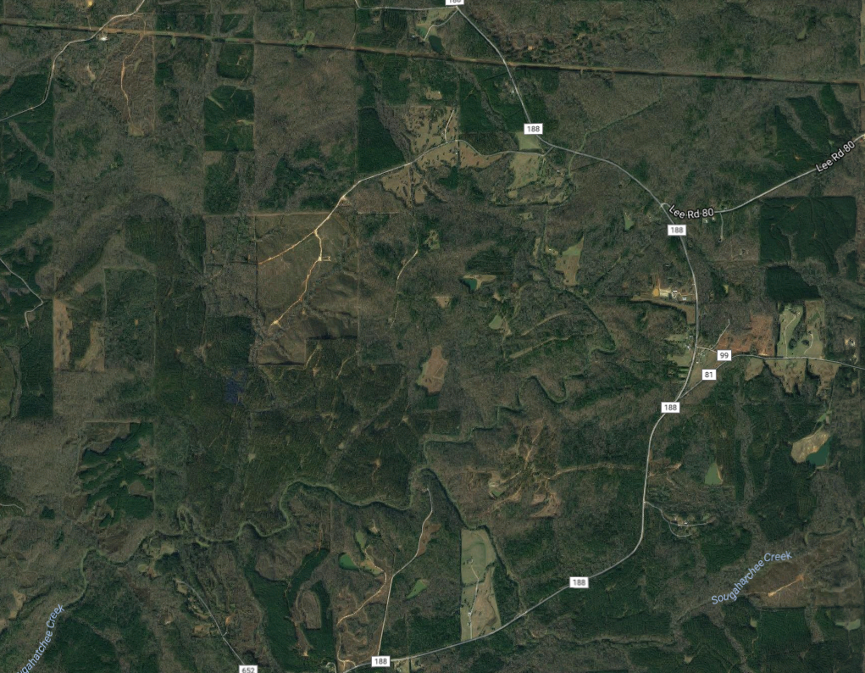
Sampling design
Presence-absence data
Site-occupancy models
Replication is key
Spatial – multiple, randomly selected sites or sampling units within the area of interest
Temporal – repeated visits to each site
Visit 1
Visit 2
Visit 3
Notes:
Difficult to parse apart observation/detection probability from true occurrence probability

Slide 25
Data wrangling
Presence-absence data
Site-occupancy models
Site | Date | Species detected?
A | 6/27/2006 | Yes
B | 6/28/2006 | Yes
C | 6/25/2006 | No
A | 7/3/2006 | No
B | 7/5/2006 | Yes
C | 7/2/2006 | No
A | 7/12/2006 | Yes
B | 7/11/2006 | Yes
C | 7/13/2006 | Yes
Site | Visit 1 | Visit 2 | Visit 3
A | 1 | 0 | 1
B
C
Site | Visit 1 | Visit 2 | Visit 3
A | 1 | 0 | 1
B | 1 | 1 | 1
C
Site | Visit 1 | Visit 2 | Visit 3
A | 1 | 0 | 1
B | 1 | 1 | 1
C | 0 | 0 | 1
Site | Visit 1 | Visit 2 | Visit 3
A
B
C
Notes:
Difficult to parse apart observation/detection probability from true occurrence probability

Slide 26
Presence-absence data
Site-occupancy models
Species is present
Species is not present
Detected
Not detected
Detected
Not detected
Notes:
Potential of underestimating occupancy is this is not taken into account

Slide 27
Assumptions
Presence-absence data
Site-occupancy models
Sites are closed to changes in occupancy between sampling occasions
Appropriate duration between surveys
Detection process is independent at each site
Appropriate distance between sites
Both detection probability and occupancy probability are constant across all sites OR explained by covariates
For example, if we think rainfall influences our ability to detect the species, then rainfall should be included in the model

Slide 28
Model parameters
Presence-absence data
Site-occupancy models
ψ_{i} = probability that site i is occupied
p_{i,t} = probability of detecting the species in site i at time t, given that the species is present
* Check text and captions for notation definitions within each paper – not always consistent!

Slide 29



Presence-absence data
Site-occupancy models
Is the species present?
Was it detected?
1
1
Occupancy probability (ψ)
Detection probability (p)
0
0

Slide 30
Model outputs
Presence-absence data
Site-occupancy models
Occupancy probability
Odds
Notes:
Difficult to parse apart observation/detection probability from true occurrence probability

Slide 31
What influences occupancy probability?
Presence-absence data
Site-occupancy models
Potential stressors and threats included as covariates
Site characteristics (e.g. land cover)
Weather (rainfall, temperature)
Distance to other occupied sites
… etc. …
Effect of covariates often expressed as odds

Slide 32
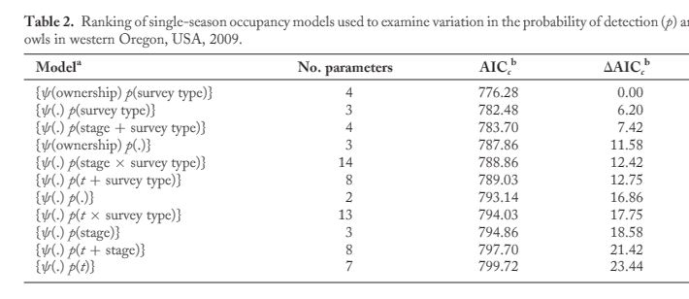
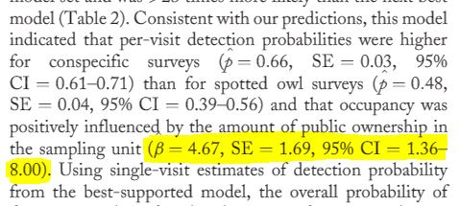
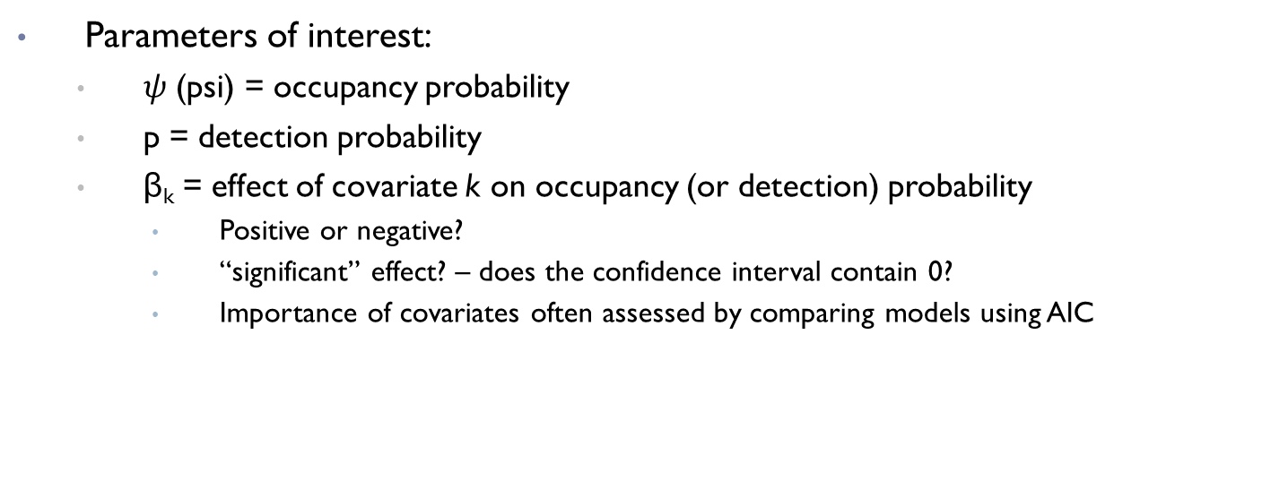
Interpreting model outputs
Presence-absence data
Site-occupancy models
Parameters of interest:
$ψ$ (psi) = occupancy probability
p = detection probability
β_{k} = effect of covariate k on occupancy (or detection) probability
Positive or negative?
“significant” effect? – does the confidence interval contain 0?
Importance of covariates often assessed by comparing models using AIC
Wiens et al 2011

Slide 33
Example
Presence-absence data
Site-occupancy models
Occupancy example
Notes:
Difficult to parse apart observation/detection probability from true occurrence probability

Slide 34
Why estimate occupancy?
Presence-absence data
Site-occupancy models
Abundance can tell you more about species status, site use, and ecology
More difficult to collect abundance data (time, money) and therefore often limited in spatial and/or temporal scope
Presence/absence data is typically:
Less intensive to collect
Cheaper
Covers larger area/time scale
Can be more practical depending on objectives

Slide 35
Common analysis approaches
Presence-absence data
Dynamic occupancy models
Logistic regression
Site-occupancy models
Dynamic occupancy models
Notes:
Difficult to parse apart observation/detection probability from true occurrence probability

Slide 36
Dynamic occupancy models
Presence-absence data
Dynamic occupancy models
Estimate change in occupancy over time (colonization and extinction)
1
P
1
0
P
E
1
E
0
C
1
1 - C
0
Time 1
Time 2
Time 3

Slide 37
Common analysis approaches
Presence-absence data
Logistic regression – lacking spatial and/or temporal replication
Site-occupancy models – single year, several sites
Dynamic occupancy models – several years, several sites
Account for imperfect detection
Assume detection is perfect
Notes:
Difficult to parse apart observation/detection probability from true occurrence probability

Slide 38
Do I have true absences in my data?
Presence only
Presence-absence
Spatial coverage?
Replicated surveys?
Yes
Number of years?
Rangewide
Local
No
few
lots
Species distribution model
Paired points or similar
Logistic regression
Site occupancy model
Dynamic occupancy model
Always check specific model assumptions!

