Slide 1
Demographic Matrix Population Models
SSA 200

Slide 2
Applications to SSAs
Models are designed to output useful metrics on future resiliency and redundancy
Future abundance, extinction probability, population growth rate
Models allow us to predict future condition of the populations and characterize uncertainties
Notes:
Uses for matrix population models
Assessing extinction risk of single population
Comparing relative risk of two or more populations
Analyzing and synthesizing monitoring data
Identifying key life stages or demographic processes for management
Determining reserve size required to gain desired level of protection
Determine how many individuals to release to establish a new population
Setting limits on harvest or take
Deciding how many populations are needed to protect a species from regional or global extinction

Slide 3
Lecture outline
Simple model construction
Review of data types/analysis
From conceptual to quantitative
Incorporate environmental covariates and density dependence
Model environmental stochasticity, demographic stochasticity, and parametric uncertainty

Slide 4
Constructing the model
1. Choose state variables (age, stage)
Dependent on data and species
2. Use demographic data to estimate vital rates for each state
Fecundity, survival probability, recruitment probability
3. Use state-specific vital rate estimates to create matrix model

Slide 5
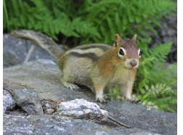
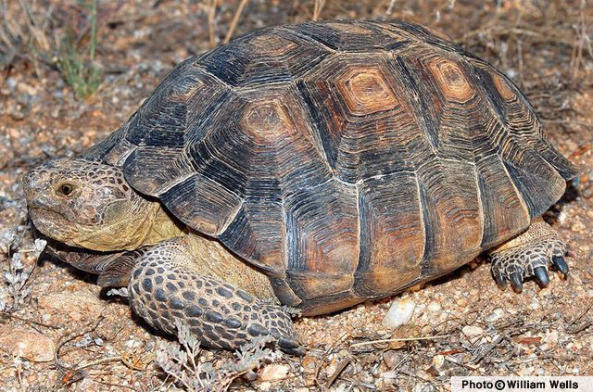
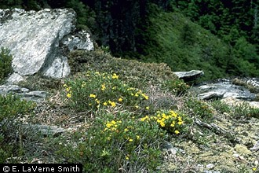
State variables
Age classes (Leslie Matrix)
Equal time intervals & all individuals advance at next time
Short lived species with age-specific data
Stage classes (Lefkovitch Matrix)
Unequal time intervals
Population divided by developmental stage or size
Difficult to age individuals but can get length, height, etc.
Juvenile, subadult
Seeds, dormancy, small plants, large plants
Notes:
Leslie Matrices (P.H. Leslie 1945)
Age class specific matrix model → Golden-mantled ground squirrel (Callospermophilus lateralis)
Hostetler et al. 2012. Stochastic Population dynamics of a montane dwelling squirrel. Plos One 7(3) e34379.
Lefkovitch Matrix (L.P. Lefkovitch 1965)
Stage class matrix models
Sonoran Desert Tortoise (Gopherus morafkai)
McGowan et al. 2017. Incorporating population viability models into species status assessment and listing decisions under the U.S. Endangered Species Act. Global Ecology and Conservation 12:119-130.
Mountain Golden Heather (Hudsonia montana)
Morris and Doak 2002. Quantitative Conservation Biology: Theory and practice of population viability analysis.
SEE ALSO – Program R, ‘popbio’ package for details on model and code with tutorials on MGH

Slide 6
Constructing the model
1. Choose state variables (age, size, stage)
Dependent on data and species
2. Use demographic data to estimate vital rates for each state
Fecundity, survival probability, recruitment probability
3. Use state-specific vital rate estimates to create matrix model
Notes:
Refer back to Anna’s presentation from Day 1 “Demographic Data”
* May conduct your own analyses or take values from literature or expert opinion

Slide 7
Demographic data
Depends on ecology/life history of species
Data types
Number of offspring per female
Nest/den success or failure
Number of young returning next year
Radio telemetry
Individual mark-recapture/resight
Annual plot census (plants)
Growth rate
Demographic vital rate
Fecundity
Breeding success probability
Recruitment probability
Survival probability (seasonal or annual)
Transition probability (annual)
Notes:
Note that receiving demographic data may be unlikely, but published scientific literature can be a good source of estimated survival, fecundity, etc.

Slide 8
Estimate vital rates
Fecundity
Number of offspring/female -> Poisson GLM
Successful breeding (yes/no) -> Binomial GLM
Annual survival/mortality
Radio telemetry -> known-fate models
Individual CMR -> Cormack-Jolly-Seber (CJS) models
Proportion of marked plants alive next year
OR – use values reported in literature/expert opinion

Slide 9
Constructing the model
1. Choose state variables (age, size, stage)
Dependent on data and species
2. Use demographic data to estimate vital rates for each state
Fecundity, survival probability, recruitment probability
3. Use state variables and state-specific vital rate estimates to create a conceptual model and matrix model

Slide 10
Conceptual model
Species with two stage classes
Survival
Adults – CMR data
Young of year – estimate in literature
Fecundity
Number of offspring/ adult female
Young of the year
Adults
Notes:
Frequently build a conceptual model or diagram of state variables to help keep organized and figure out the dimensions and placement of elements within a matrix.

Slide 11



Conceptual model
$$F_{t}^{a}$$
Species with two stage classes
Survival
Adults – CMR data
Young of year – estimate in literature
Fecundity
Number of offspring/ adult female
Young of the year
Adults
$S_{t}^{Y}$
$$S_{t}^{a}$$
Notes:
Best to visualize the vital rates associated with the arrows to keep track of everything!

Slide 12
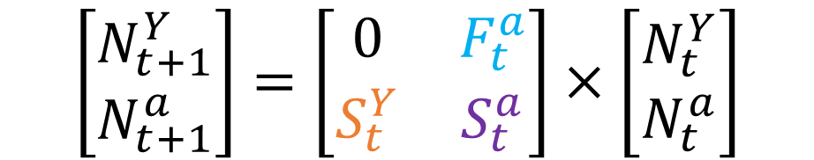



Create matrix model
Matrix models are used to present, analyze, and project population dynamics
$$F_{t}^{a}$$
$$\left[\begin{matrix}N_{t+1}^{Y} \\ N_{t+1}^{a}\end{matrix}\right]=\left[\begin{matrix}0 & F_{t}^{a} \\ S_{t}^{Y} & S_{t}^{a}\end{matrix}\right]×\left[\begin{matrix}N_{t}^{Y} \\ N_{t}^{a}\end{matrix}\right]$$
Young of the year
Adults
$S_{t}^{Y}$
$$S_{t}^{a}$$
Notes:
To create the matrix model, we build off of the conceptual model/diagram
Your matrix dimensions (number of rows and columns) will be equal to one another and will correspond to the number of nodes in your conceptual model (the black circles!).
The number of vital rates in the matrix (non-zero elements) will correspond to the number of arrows in your conceptual diagram.
Here, we have two nodes (YoY and adult stages) and three arrows (fecundity of adults (Fat), survival of YoY and transition to adults (Syt), survival of Adults (Sat))
The number of rows in the population vector (Nt) corresponds to the number of nodes in the conceptual diagram. It is the list of the number of individuals in each state. The sum of these elements equals the total population size.

Slide 13

Integrated population models
$$\left[\begin{matrix}N_{t+1}^{Y} \\ N_{t+1}^{a}\end{matrix}\right]=\left[\begin{matrix}0 & F_{t}^{a} \\ S_{t}^{Y} & S_{t}^{a}\end{matrix}\right]×\left[\begin{matrix}N_{t}^{Y} \\ N_{t}^{a}\end{matrix}\right]$$
Data input
Analysis
Output
Combine demographic data with counts
Use the model to make projections
Counts
IPM
Matrix Model
Abundance estimate
Mark-recapture
Survival probability
Number of offspring/female
Average fecundity
Notes:
Can be used to estimate the demographic rates with and/or without data by combining multiple data sources.
Typically gets plugged into a matrix model and the “output” is used to project forward
Analyze all data sources in one analysis – OUTPUT is functionally boiled down to a population matrix model
May produce more precise estimates than analyzing each of the data sets separately
May be able to estimate vital rate values for states without any data
This model gets projected forward in the same way as a typical matrix population model

Slide 14



Matrix projections
$$\left[\begin{matrix}N_{t+1}^{Y} \\ N_{t+1}^{a}\end{matrix}\right]=\left[\begin{matrix}0 & F_{t}^{a} \\ S_{t}^{Y} & S_{t}^{a}\end{matrix}\right]×\left[\begin{matrix}N_{t}^{Y} \\ N_{t}^{a}\end{matrix}\right]$$
$N_{t+1}= A∗N_{t}$
$$N_{t+1}= λ∗N_{t}$$
Notes:
Population matrix containing the state specific vital rates can also be called “A” in the literature for simplicity.
The population matrix A can be devolved into the metric of population growth rate (lambda) through matrix algebra, it is called an eigenvalue.
This should be familiar from Conors presentation on count based projections
To make predictions about population resiliency just requires some multiplication!

Slide 15
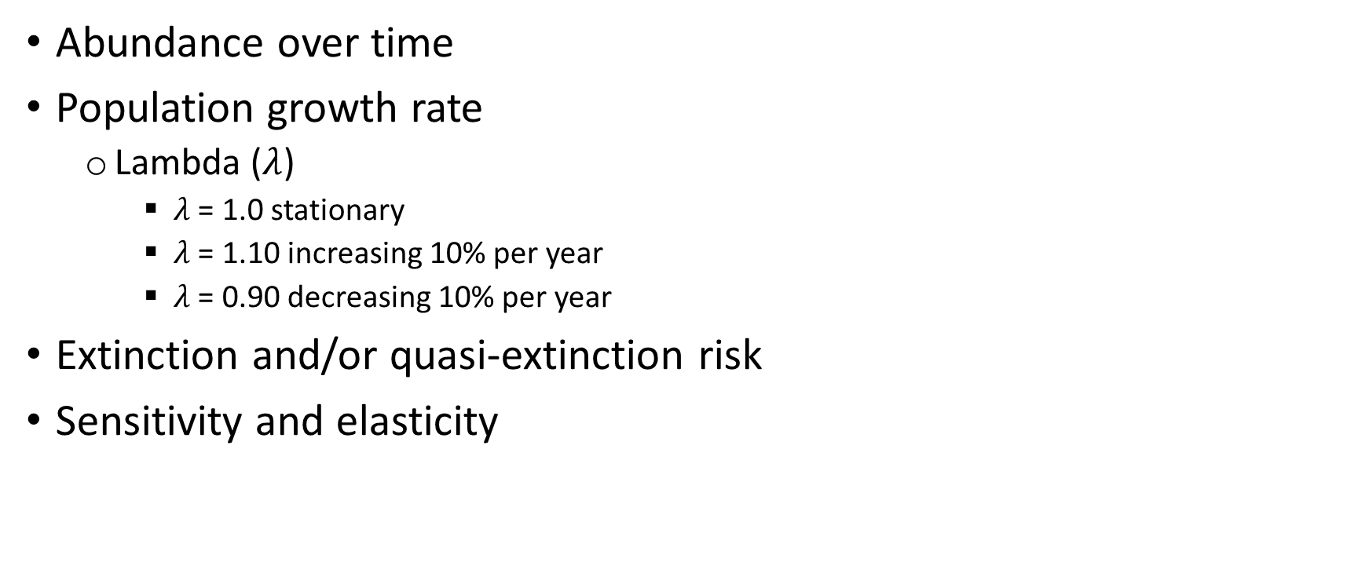
Matrix projection outputs
Abundance over time
Population growth rate
Lambda ($λ$)
$λ$ = 1.0 stationary
$λ$ = 1.10 increasing 10% per year
$λ$ = 0.90 decreasing 10% per year
Extinction and/or quasi-extinction risk
Sensitivity and elasticity
Population Resiliency
Notes:
All of these outputs represent metrics useful for evaluating population resiliency
You can choose to use any combination (or all) of these metrics for presenting population resiliency

Slide 16
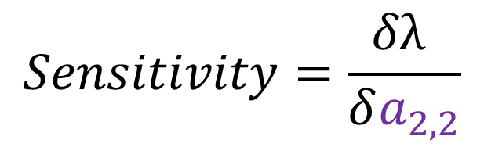
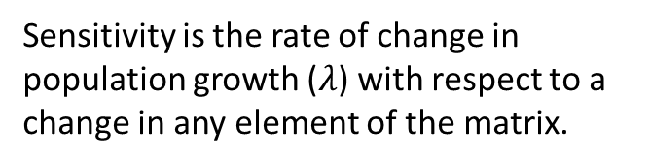
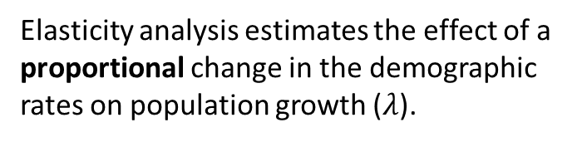
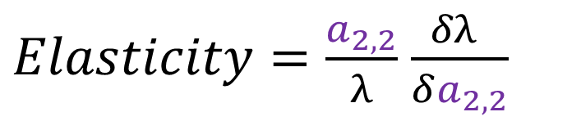
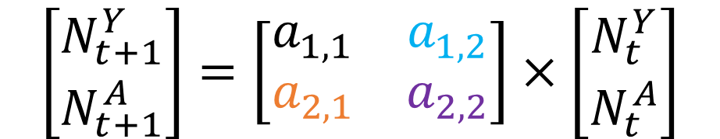
Sensitivity and elasticity
$$\left[\begin{matrix}N_{t+1}^{Y} \\ N_{t+1}^{A}\end{matrix}\right]=\left[\begin{matrix}a_{1,1} & a_{1,2} \\ a_{2,1} & a_{2,2}\end{matrix}\right]×\left[\begin{matrix}N_{t}^{Y} \\ N_{t}^{A}\end{matrix}\right]$$
$$Sensitivity=\frac{δλ }{δa_{2,2}}$$
$Elasticity=\frac{a_{2,2}}{λ}$ $\frac{δλ }{δa_{2,2}}$
Sensitivity is the rate of change in population growth ($λ$) with respect to a change in any element of the matrix.
Elasticity analysis estimates the effect of a proportional change in the demographic rates on population growth ($λ$).
Notes:
Note the changes in the matrix elements from F and S to little a’s
This is common practice in matrix models and generalizes the vital rates that go into a matrix
Remember, another way to represent a matrix is with a capital A, so the elements within A can be represented by little a’s
You can ignore the specifics of the equations for sensitivity and elasticity, but I want you to recognize that they are different
That is because sensitivity is the rate of change in population growth with respect to a change in any element of the matrix
Whereas, elasticity estimates the effect of a proportional change in demographic rates on population growth
* Elasticity is more useful because you can directly compare the effect of a 10% change in survival and a 10% change in fecundity even though they are traditionally on different scales (i.e. survival is between 0 and 1, and fecundity is between 0 and infinity).

Slide 17
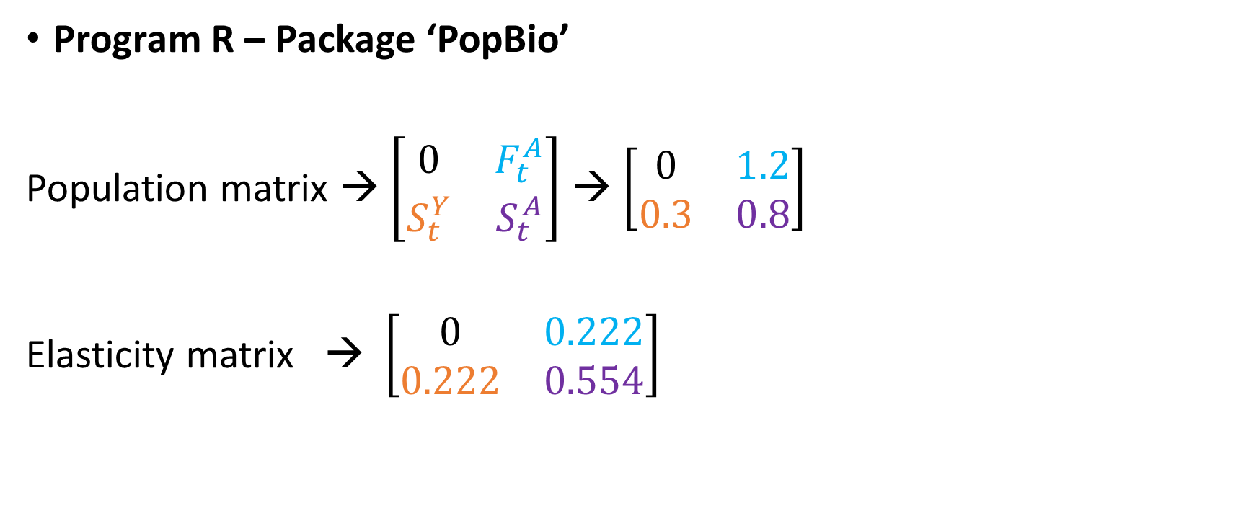
How to estimate sensitivity and elasticity
Program R – Package ‘PopBio’
Population matrix → $\left[\begin{matrix}0 & F_{t}^{A} \\ S_{t}^{Y} & S_{t}^{A}\end{matrix}\right]$ → $\left[\begin{matrix}0 & 1.2 \\ 0.3 & 0.8\end{matrix}\right]$
Elasticity matrix → $\left[\begin{matrix}0 & 0.222 \\ 0.222 & 0.554\end{matrix}\right]$
Notes:
Interpreting for management and conservation
It is very simple to calculate sens and elast using a package in R called ‘popbio’
This is the same package I mentioned in regard to the Mountain Golden Heather in the count presentation
It includes a number of tutorials and easy commands to calculate desired metrics from a matrix model
The results of the elasticity analysis on our population matrix indicates that adult survival has the most influence on population growth rate

Slide 18
Simple future condition assessments
Using sensitivity and/or elasticity output
Results indicate population growth is most sensitive to adult survival
Conceptual modeling and lit review suggest that adult survival is negatively affected by drought frequency
Drought frequency will increase over next 50 years
What can we expect given this information?
Adult survival will likely decrease
Population growth will likely decrease
If climate predictions are accurate, future resiliency will decrease
Notes:
Emphasize simplicity of this “projection”
This is more of a qualitative assessment using quantitative information
BUT, we can model these scenarios and quantitatively determine the population resiliency to increased drought frequency!

Slide 19
Forms of uncertainty
Partial controllability
Observational uncertainty
Environmental variation
Ecological uncertainty
Demographic stochasticity

Slide 20
Incorporating uncertainty
Use statistical distributions and functional relationships
Environmental variation/stochasticity
Demographic stochasticity
Ecological/structural uncertainty
Density dependence
Parametric uncertainty
Notes:
To incorporate uncertainty in population projection modeling (PVA’s) we typically use different statistical distributions and run models for a larger number of iterations over time.
To model something like density dependence we may model a vital rate as a function of the number of individuals in the population

Slide 21
Environmental stochasticity
Survival parameters typically drawn from a beta distribution
Continuous but restricted between 0 and 1
Very flexible
Fecundity parameters have two typical methods
Log-normal, bounded by 0 and infinity
Poisson distribution summed over all the individuals in the population
Notes:
Environmental Stochasticity – unpredictable spatiotemporal fluctuations in environmental conditions and their influence on vital rates. Acts on all individuals in a population in the same or similar way causing population growth rate to fluctuate randomly in populations of all sizes.
To incorporate environmental stochasticity in population projections we can draw vital rates from statistical distributions
Survival parameters are often drawn from a beta distribution
We can convert the mean and variance of the vital rate to the beta shape parameters
This distribution is restricted between 0 and 1
Shape of distribution is very flexible and can be really useful for species with high or low survival
Fecundity parameters can be modeled using two different methods
Log normal bounded between 0 and infinity
Poisson distribution – always good for counts!

Slide 22
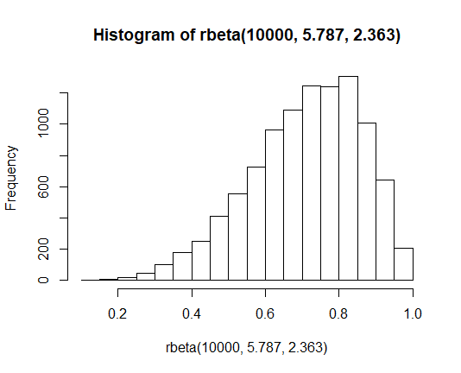
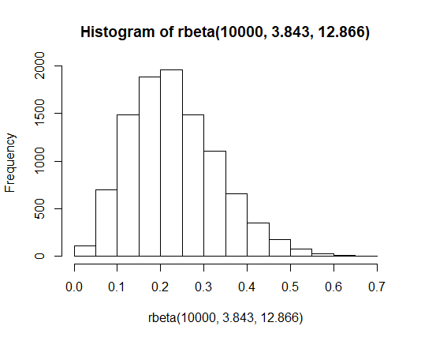
Survival rate distribution
S = 0.71, S.D. = 0.15 →
Beta1 =5.787 Beta2 =2.363 →
S = 0.23, S.D. = 0.1 →
Beta1 =3.843 Beta2 =12.866 →

Slide 23
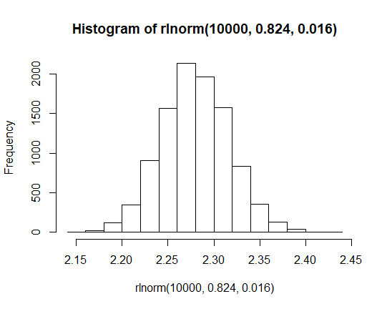
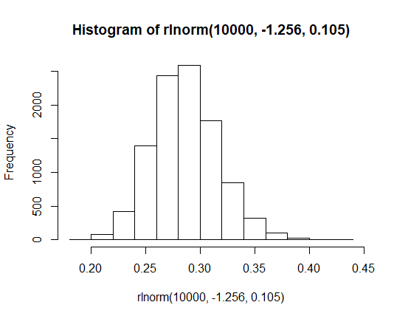
Fecundity distribution
F = 2.3, S.D. = 0.3 →
s1= 0.824, s2 = 0.016 →
F = 0.3, S.D. = 0.1 →
s1= -1.256, s2 = 0.105 →

Slide 24
Demographic stochasticity
Animals live or die as whole animals - not as fractions
Without demographic stochasticity mean survival probability = 0.8
6 individuals * 0.8 = 4.8 individuals at the next time step
With demographic stochasticity
Model survival using a Binomial distribution
Computer picks 6 random numbers: 0.32, 0.89, 0.81, 0.11, 0.94, 0.70
3 out of the 6 individuals die because their random picks were less than the mean of 0.8
Notes:
Demographic stochasticity – chance independent events of individual survival and reproduction causing random fluctuations in population growth rate because birth and death of each individual is a discrete and probabilistic event.
Particularly important in small populations!
Typically get ignored in larger populations
Without accounting for demographic stochasticity (i.e. using a beta distribution or something else) the mean survival probability of 0.8 multiplied by a number of individuals will likely give you a fraction of individuals at the next time step.
In larger populations this tends to balance out
Modeling demographic stochasticity
Binomial distribution for survival
Poisson for fecundity
The number of individuals at the following time step will be a whole number
This sampling variation can result in numbers lower than expected from the mean (3 w/ ds, 4.8 without)
In small populations population growth rate will be lower than if it were not accounted for and extinction risk will increase

Slide 25
Ecological or structural uncertainty
Density dependence
Model parameters are a function of population density
Notes:
Ecological or structural uncertainty arises from competing hypotheses about system dynamics
Including density dependence in demographic PVAs can be difficult due to the number of parameters and generally lacking data on the function form of density dependence.
We generally need to consider which vital rates are density-dependent.
How do those rates change with density?
And, if density of one stage class affects only individuals in that stage or if it affects other stages.
We may expect that juvenile survival decreases as winter abundance increases. However, to address the ecological/structural uncertainty we should consider multiple functional forms of density dependence.

Slide 26
Modeling density dependence
Threshold Density dependence
If the population exceeds a ceiling threshold, fecundity is equal to zero
if (n[i,j] > ncrit) F[i,j] = 0
As the population approaches some ceiling threshold, fecundity gets smaller and smaller
F[i,j]= F[i,j]*(1-n[i,j]/ncrit)
Notes:
Modeling density dependence can be difficult because there is generally a large amount of uncertainty in its effects.
We can model it using two relatively simple approaches
Place a limit or threshold on the size of one or more classes, at which point the density dependent parameters is set equal to zero
Incorporate density dependent functions (similar to that in the previous figure) where as population size increases towards a threshold the density dependent parameter decreases

Slide 27
Parametric uncertainty
Parameters values are not precisely known
Variance or standard deviation estimates for parameters estimated over years conflate environmental variation with sampling variance
Sampling variance is the result of only using a specific number of individuals or locations to study a phenomenon
Happens with every wildlife study because we can’t study every individual in every location
Notes:
Parametric uncertainty can arise from a number of sources including limitations in data dur to sampling variation, observation error, and sampling error. Alternatively, if parameters were elicited from experts uncertainty can arise from errors in expert judgement.

Slide 28
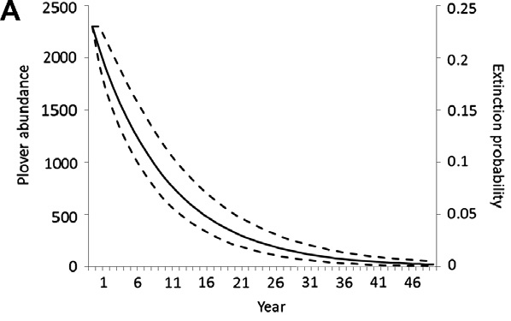
Projection without sampling variance
Notes:
In this figure, we have projected abundance of Plovers for 50 years and assumed that there was no sampling variance in the population size. This means we assume we know the population growth rate (or underlying demographic rates) perfectly. Therefore, when we project forward extinction probability is zero because at 50 years we are certain there is 1 or 2 individuals left in the population.
But that should sound terrifying to most of us…therefore,

Slide 29
Great, so what do we do about it?
Modeled by selecting a random value for the mean and variance from a distribution that represents potential parameter values
The sampled mean and variance are used to generate a new distribution for the parameter
The vital rate or population growth rate is then randomly selected from the new distribution

Slide 30
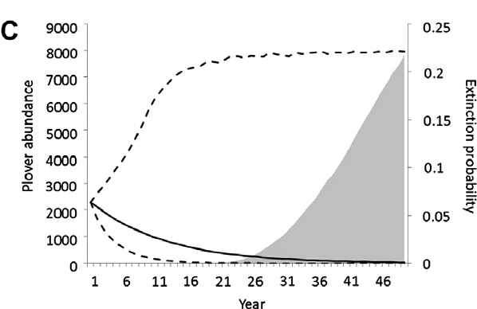
Projection with sampling variance
Notes:
We project the population including sampling variance and thus parametric uncertainty. Here we see that the probability of extinction (shaded gray) increases over time and confidence intervals increase representing more variability in predicted abundance. We want to represent this uncertainty!

Slide 31



Modeling environmental effects
Drought year
Back to conceptual models!
Stream length
$$F_{t}^{A}$$
Young of the year
Adults
$S_{t}^{Y}$
$$S_{t}^{A}$$

Slide 32



Incorporating environmental covariates
Conditionally linked events
Use IF→THEN statements to link a demographic parameter to some other randomized event
E.g., if a Bernoulli trial for drought returns a 1, then mean fecundity is 1.1 offspring per female, but if it returns a 0 then mean fecundity is 2.3 offspring per female
Drought year
Stream length
$$F_{t}^{A}$$
Young of the year
$S_{t}^{Y}$
adults
$$S_{t}^{A}$$

Slide 33
Environmental covariates
Adult survival (Sa) can be a function of some other environmental parameter/variable
(“op” for other parameter, e.g., stream length)

Slide 34
Environmental covariates
Adult survival (Sa) can be a function of “op” but it has variability
Sa=matrix(plogis(-rnorm(1,1.4,.1)+(rbeta(1,18,1)*op)),r,t)

Slide 35

Inputting scenarios
Use the conceptual model and sensitivity analysis to guide scenarios
i.e., what ecological factors affect the most sensitive parameters?
Design scenarios to explore the expected range of future variation in important covariates
Drought year
Stream length
$$F_{t}^{A}$$
Young of the year
$S_{t}^{Y}$
adults
$$S_{t}^{A}$$

Slide 36
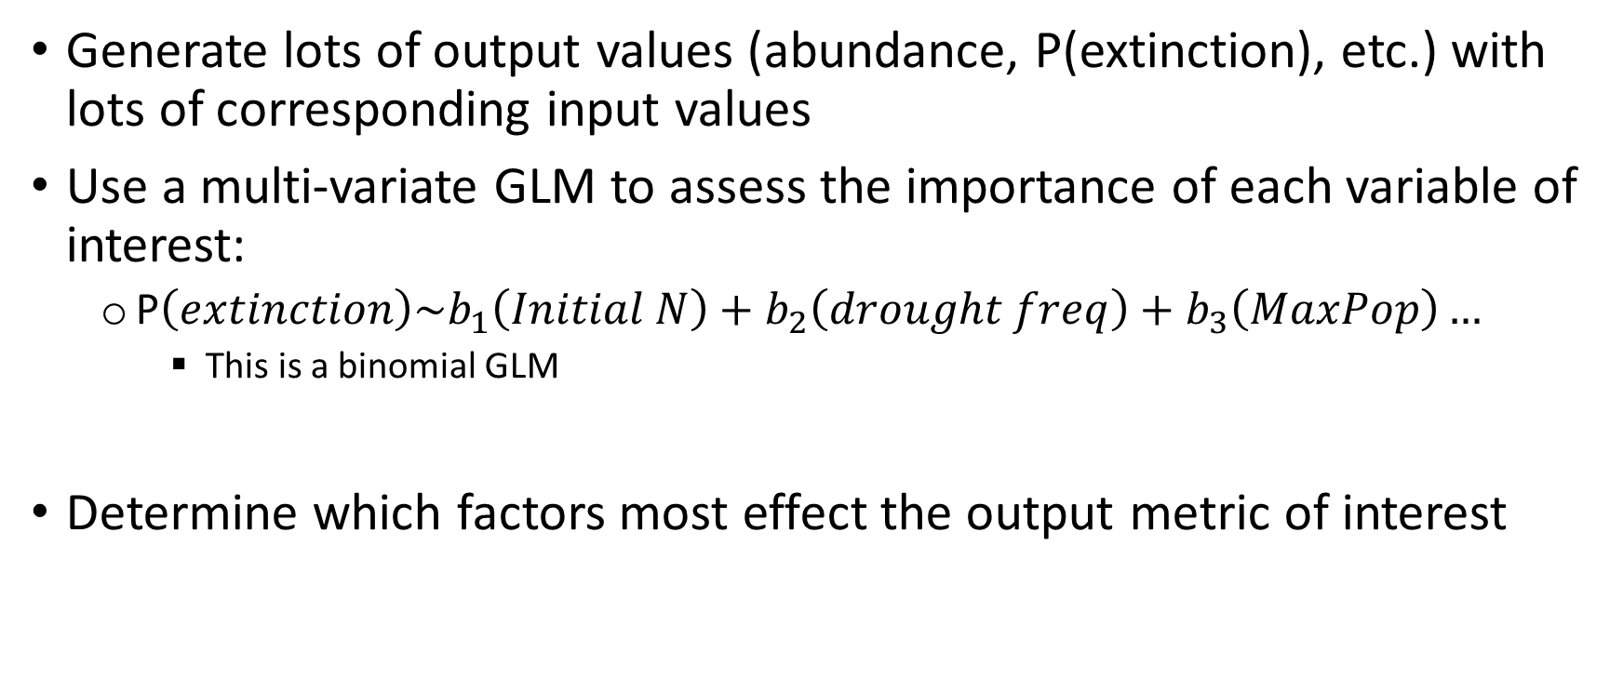
Using this structure to build GLMs
Generate lots of output values (abundance, P(extinction), etc.) with lots of corresponding input values
Use a multi-variate GLM to assess the importance of each variable of interest:
P$\left(extinction\right)\sim b_{1}\left(Initial N\right)+b_{2}\left(drought freq\right)+b_{3}\left(MaxPop\right)…$
This is a binomial GLM
Determine which factors most effect the output metric of interest

Slide 37
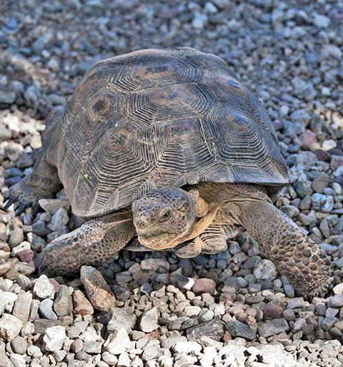
Sonoran desert tortoise example
MDR = mean drought rate
NAI = Initial Number of adults
MaxPop = habitat based maximum population size
You could input different values of MDR, NAI or MaxPop to predict the corresponding P(Qe100), i.e., input alternative future scenarios
𝑃(𝑄𝑒100) =‒ 5.602 + (18.42 𝑥 𝑀𝐷𝑅) ‒ (5.363𝑒 ‒ 6𝑥 𝑁𝐴𝐼) ‒ (1.797𝑒 ‒ 6𝑥 𝑀𝑎𝑥𝑃𝑜𝑝)
Notes:
McGowan et al. 2017. Global Ecology and Conservation.

Slide 38
Review
What metrics are available for assessing population resiliency using a demographic matrix model?
What sources of uncertainty may make it difficult to predict population dynamics?
How can we incorporate uncertainty in our population projections?
Notes:
Population metrics
Sensitivity/elasticity (importance) of vital rates to population growth
Population growth rate
Extinction or quasi-extinction probability
Future population size
Sources of uncertainty
Demographic stochasticity
Parametric uncertainty
Environmental stochasticity
How to incorporate uncertainty (model parameters with statistical distributions)
Demographic stochasticity → model survival with binomial distribution
Parametric uncertainty →
Environmental stochasticity →

Slide 39
Questions?

