Slide 1

Occupancy and multi-state occupancy projection models
SSA 200 – Day 2 – Lecture 7

Slide 2
Site occupancy projection
Year t
Year t +1
Site Occupied
?

Slide 3

Essentially a weighted coin flip

Slide 4


Probability of heads (1) = occupancy probability (P)
Estimated from analysis of presence/absence data
Borrowed from the literature
Expert elicitation
1
0

Slide 5
P can be a function of environmental factors
Year t
Year t +1
Recolonize?
Site Occupied
?
Invasive fish community affects P
These effects and relationships are estimated from data (i.e., the needs analysis) or elicited from experts
Natural persistence probability (P, near 1)
Stream Length affects P
Round tail and Headwater Chub site occupancy model
Hydrology/flood frequency affects P

Slide 6
Multiple replicates
Year t
Year t +1
Year t
Year t +1
Year t
Year t +1
Site Occupied
?
Site Occupied
?
Site Occupied
?
Invasive fish community affects P
Invasive fish community affects P
Invasive fish community affects P
Natural persistence probability (P, near 1.0)
Natural persistence probability (P, near 1.0)
Natural persistence probability (P, near 1.0)
Stream Length affects P
Stream Length affects P
Stream Length affects P
Site 1, rep 1
Site 1, rep 2
Site 1, rep 3
Hydrology/flood frequency affects P
Hydrology/flood frequency affects P
Hydrology/flood frequency affects P
Year t
Year t +1
Year t
Year t +1
Year t
Year t +1
Site Occupied
?
Site Occupied
?
Site Occupied
?
Invasive fish community affects P
Invasive fish community affects P
Invasive fish community affects P
Natural persistence probability (P, near 1.0)
Natural persistence probability (P, near 1.0)
Natural persistence probability (P, near 1.0)
Stream Length affects P
Stream Length affects P
Stream Length affects P
Site 1, rep 4
Site 1, rep 5
Site 1, rep 6
Hydrology/flood frequency affects P
Hydrology/flood frequency affects P
Hydrology/flood frequency affects P

Slide 7
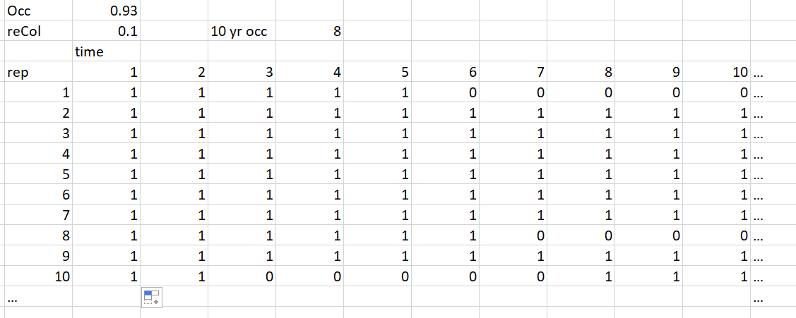
Spread sheet example
Persistence, near 1.0 – stream conditions (e.g., predators, length, etc.
Sum of replicates that are occupied at year 10

Slide 8

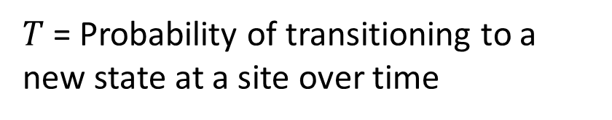
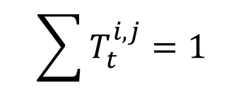


Multistate projection models
Year t +1
State 1?
Year t
$$T_{t}^{1,1}$$
Site in state 1
State 2?
$$\sum{T_{t}^{i,j}=1}$$
$$T_{t}^{1,2}$$
$$T_{t}^{1,E}$$
Extinct?
$T$= Probability of transitioning to a new state at a site over time

Slide 9
Multiple population states
Low abundance
Extirpated
High abundance

Slide 10






Multiple population states
Low abundance
$$T_{t}^{EL}$$
Extirpated
$$T_{t}^{LE}$$
$$T_{t}^{HL}$$
$$T_{t}^{LH}$$
$$T_{t}^{HE}$$
High abundance
$$T_{t}^{EH}$$

Slide 11
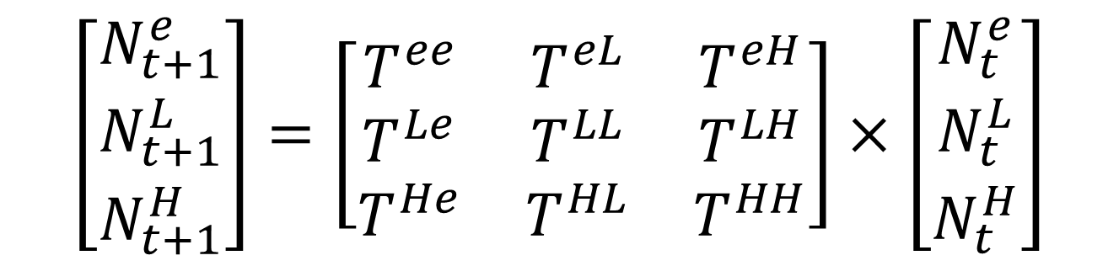
Matrix formulation
$$\left[\begin{matrix}N_{t+1}^{e} \\ N_{t+1}^{L} \\ N_{t+1}^{H}\end{matrix}\right]=\left[\begin{matrix}T^{ee} & T^{eL} & T^{eH} \\ T^{Le} & T^{LL} & T^{LH} \\ T^{He} & T^{HL} & T^{HH}\end{matrix}\right]×\left[\begin{matrix}N_{t}^{e} \\ N_{t}^{L} \\ N_{t}^{H}\end{matrix}\right]$$

Slide 12
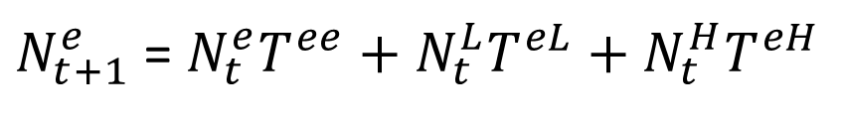
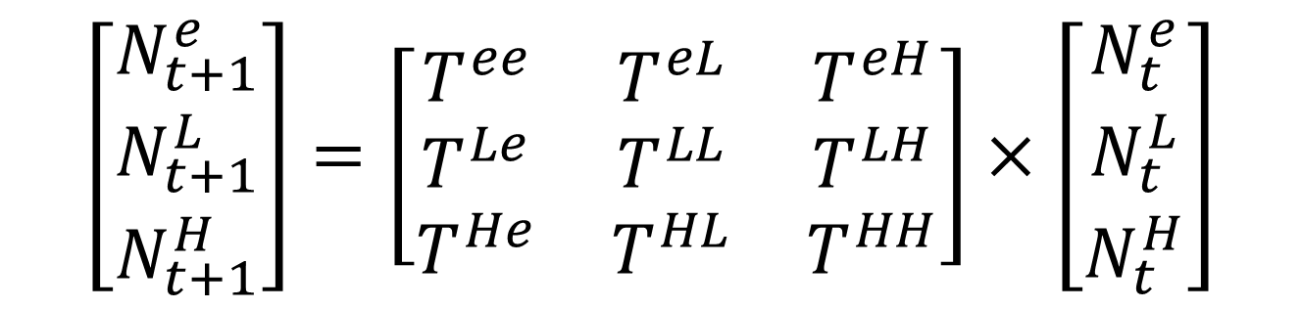
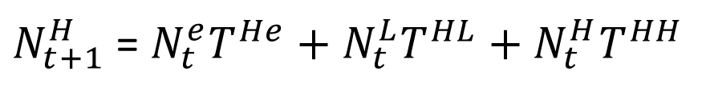
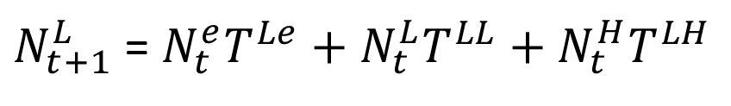
Matrix formulation
$$\left[\begin{matrix}N_{t+1}^{e} \\ N_{t+1}^{L} \\ N_{t+1}^{H}\end{matrix}\right]=\left[\begin{matrix}T^{ee} & T^{eL} & T^{eH} \\ T^{Le} & T^{LL} & T^{LH} \\ T^{He} & T^{HL} & T^{HH}\end{matrix}\right]×\left[\begin{matrix}N_{t}^{e} \\ N_{t}^{L} \\ N_{t}^{H}\end{matrix}\right]$$
$N_{t+1}^{e}$ = $N_{t}^{e}T^{ee}+N_{t}^{L}T^{eL}+N_{t}^{H}T^{eH}$
$N_{t+1}^{L}$ = $N_{t}^{e}T^{Le}+N_{t}^{L}T^{LL}+N_{t}^{H}T^{LH}$
$N_{t+1}^{H}$ = $N_{t}^{e}T^{He}+N_{t}^{L}T^{HL}+N_{t}^{H}T^{HH}$

Slide 13
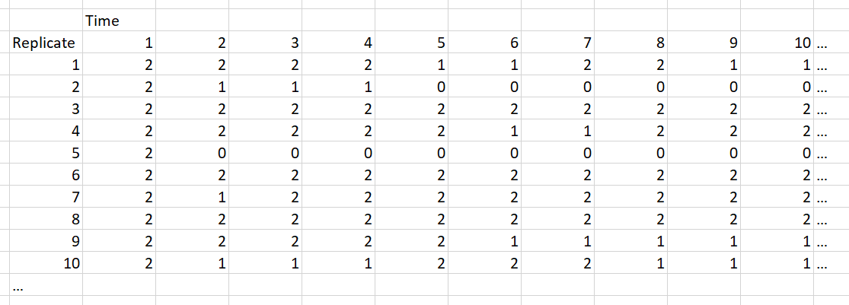
Example output

Slide 14
Environmental effects on probabilities
Year t
Year t +1
Site Occupied
?
Invasive fish community affects P
Natural persistence probability (P, near 1.0)
Stream Length affects P
Hydrology/flood frequency affects P

Slide 15
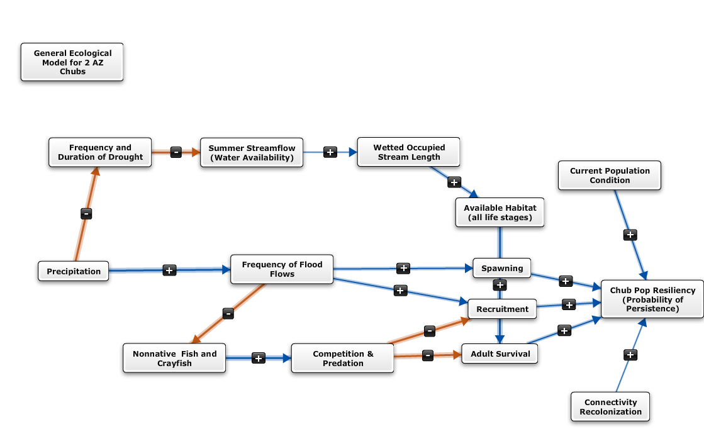
Chub Model Parameters
Model inputs

Slide 16
Conditional Logical functions
Link population parameters to environmental conditions by discrete logic function
“If average rainfall is less than x, then occupancy probability is y”
Notes:
AMT – edit to give more specific example

Slide 17
Continuous functions

Slide 18
Measurement error
Simulation data assume perfect knowledge of the system
i.e., no partial observability/observation error in monitoring data
May be important to add observation error to output from the models
Recovery planning
Section 7 planning
Delisting decisions
Observed system response will not match predictions
This is the case no matter, but account for all uncertainties might be important

Slide 19
Modify model outputs
Randomized adjustments to model output data
Spread sheet example

Slide 20
Questions?

