Slide 1

Occupancy and multi-state occupancy projection models
SSA 200 – Day 2 – Lecture 7
Quantitative Tools for SSA

Slide 2
Site occupancy projection
Year t
Year t +1
Site Occupied
?
Quantitative Tools for SSA

Slide 3

Essentially a weighted coin flip
Quantitative Tools for SSA

Slide 4



1
0
$$O=Binomial (1, p)$$
Quantitative Tools for SSA

Slide 5
P can be a function of environmental factors
Year t
Year t +1
Recolonize?
Site Occupied
?
Invasive fish community affects P
Natural persistence probability (P, near 1.0)
These effects and relationships are estimated from data (i.e., the needs analysis) or elicited from experts
Stream Length affects P
Round tail and Headwater Chub site occupancy model
Hydrology/flood frequency affects P
Quantitative Tools for SSA

Slide 6
Multiple replicates
Year t
Year t +1
Year t
Year t +1
Year t
Year t +1
Site Occupied
?
Site Occupied
?
Site Occupied
?
Invasive fish community affects P
Invasive fish community affects P
Invasive fish community affects P
Natural persistence probability (P, near 1.0)
Natural persistence probability (P, near 1.0)
Natural persistence probability (P, near 1.0)
Stream Length affects P
Stream Length affects P
Stream Length affects P
Site 1, rep 1
Site 1, rep 2
Site 1, rep 3
Hydrology/flood frequency affects P
Hydrology/flood frequency affects P
Hydrology/flood frequency affects P
Year t
Year t +1
Year t
Year t +1
Year t
Year t +1
Site Occupied
?
Site Occupied
?
Site Occupied
?
Invasive fish community affects P
Invasive fish community affects P
Invasive fish community affects P
Natural persistence probability (P, near 1.0)
Natural persistence probability (P, near 1.0)
Natural persistence probability (P, near 1.0)
Stream Length affects P
Stream Length affects P
Stream Length affects P
Site 1, rep 4
Site 1, rep 5
Site 1, rep 6
Hydrology/flood frequency affects P
Hydrology/flood frequency affects P
Hydrology/flood frequency affects P
Quantitative Tools for SSA

Slide 7
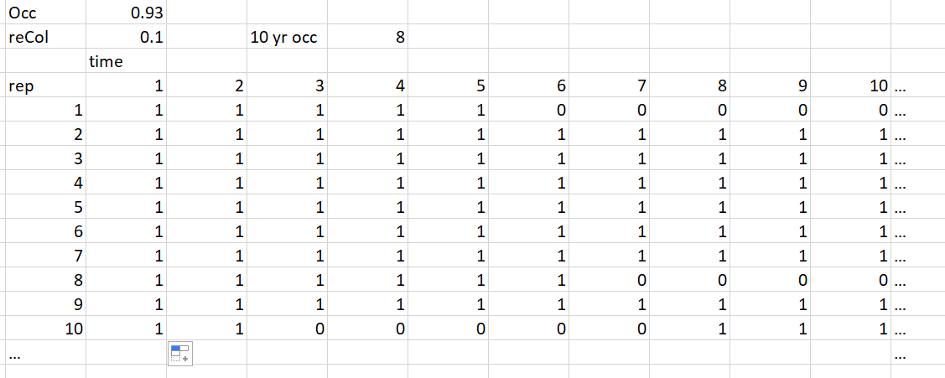
Spread sheet example
Persistence, near 1.0 – stream conditions (e.g., predators, length, etc.
Sum of replicates that are occupied at year 10
Quantitative Tools for SSA

Slide 8

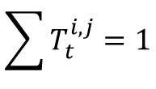


Occupancy projection models
Year t +1
State 1?
$$\sum{T_{t}^{i,j}=1}$$
Year t
$$T_{t}^{1,1}$$
Site in state 1
State 2?
$$T_{t}^{1,2}$$
$$T_{t}^{1,E}$$
Probability of transitioning to a new state at a site over time
Extinct?
Quantitative Tools for SSA

Slide 9
Multiple population states
Low abundance
Extinct
High abundance
Quantitative Tools for SSA

Slide 10
Multiple population states
Low abundance
Extinct
High abundance
Quantitative Tools for SSA

Slide 11
Multiple population states
Low abundance
Extinct
High abundance
Quantitative Tools for SSA

Slide 12






Multiple population states
Low abundance
$$T_{t}^{EL}$$
Extinct
$$T_{t}^{LE}$$
$$T_{t}^{HL}$$
$$T_{t}^{LH}$$
$$T_{t}^{HE}$$
High abundance
$$T_{t}^{EH}$$
Quantitative Tools for SSA

Slide 13
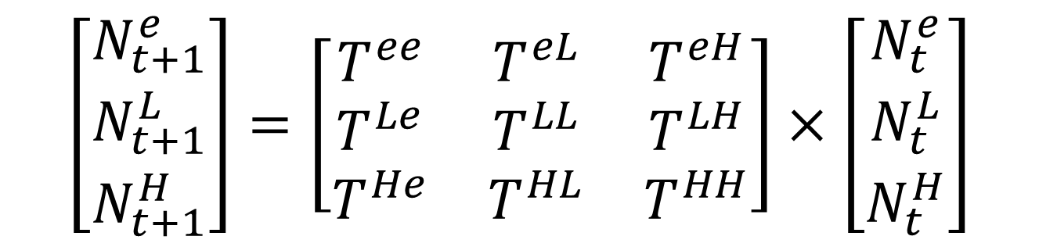
Matrix formulation
$$\left[\begin{matrix}N_{t+1}^{e} \\ N_{t+1}^{L} \\ N_{t+1}^{H}\end{matrix}\right]=\left[\begin{matrix}T^{ee} & T^{eL} & T^{eH} \\ T^{Le} & T^{LL} & T^{LH} \\ T^{He} & T^{HL} & T^{HH}\end{matrix}\right]×\left[\begin{matrix}N_{t}^{e} \\ N_{t}^{L} \\ N_{t}^{H}\end{matrix}\right]$$
Quantitative Tools for SSA

Slide 14
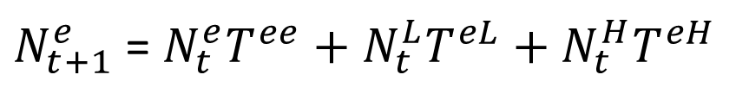
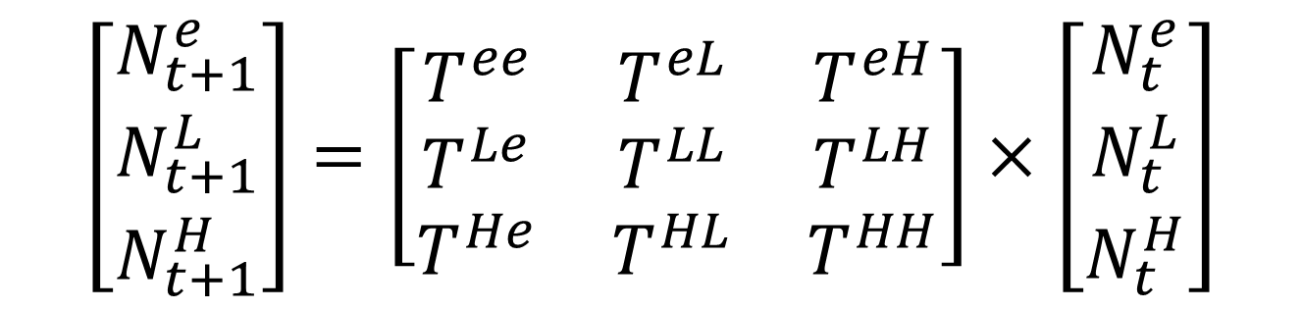
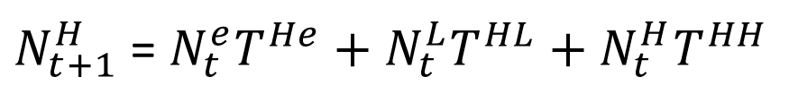
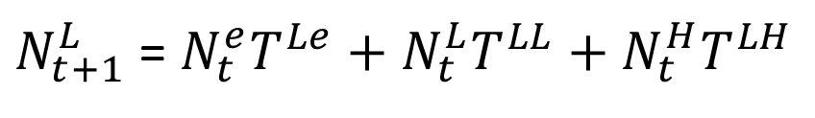
Matrix formulation
$$\left[\begin{matrix}N_{t+1}^{e} \\ N_{t+1}^{L} \\ N_{t+1}^{H}\end{matrix}\right]=\left[\begin{matrix}T^{ee} & T^{eL} & T^{eH} \\ T^{Le} & T^{LL} & T^{LH} \\ T^{He} & T^{HL} & T^{HH}\end{matrix}\right]×\left[\begin{matrix}N_{t}^{e} \\ N_{t}^{L} \\ N_{t}^{H}\end{matrix}\right]$$
$N_{t+1}^{e}$ = $N_{t}^{e}T^{ee}+N_{t}^{L}T^{eL}+N_{t}^{H}T^{eH}$
$N_{t+1}^{L}$ = $N_{t}^{e}T^{Le}+N_{t}^{L}T^{LL}+N_{t}^{H}T^{LH}$
$N_{t+1}^{H}$ = $N_{t}^{e}T^{He}+N_{t}^{L}T^{HL}+N_{t}^{H}T^{HH}$
Quantitative Tools for SSA

Slide 15
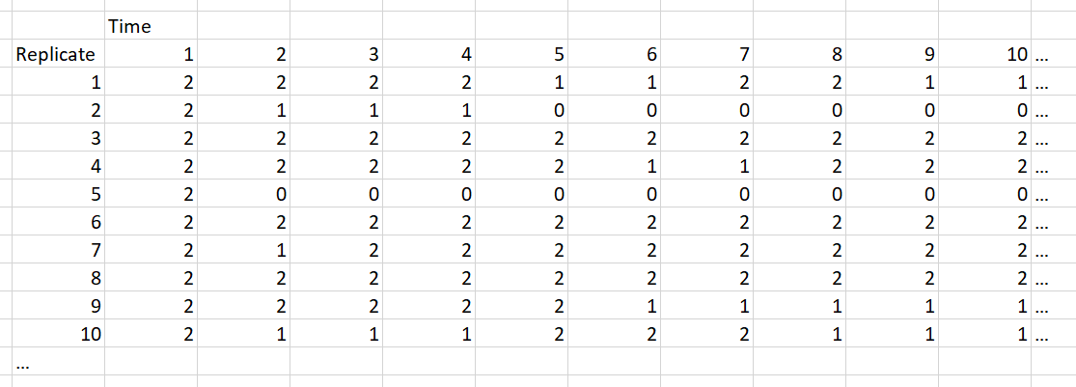
Example output
Quantitative Tools for SSA

Slide 16
Environmental effects on probabilities
Year t
Year t +1
Site Occupied
?
Invasive fish community affects P
Natural persistence probability (P, near 1.0)
Stream Length affects P
Hydrology/flood frequency affects P
Quantitative Tools for SSA

Slide 17
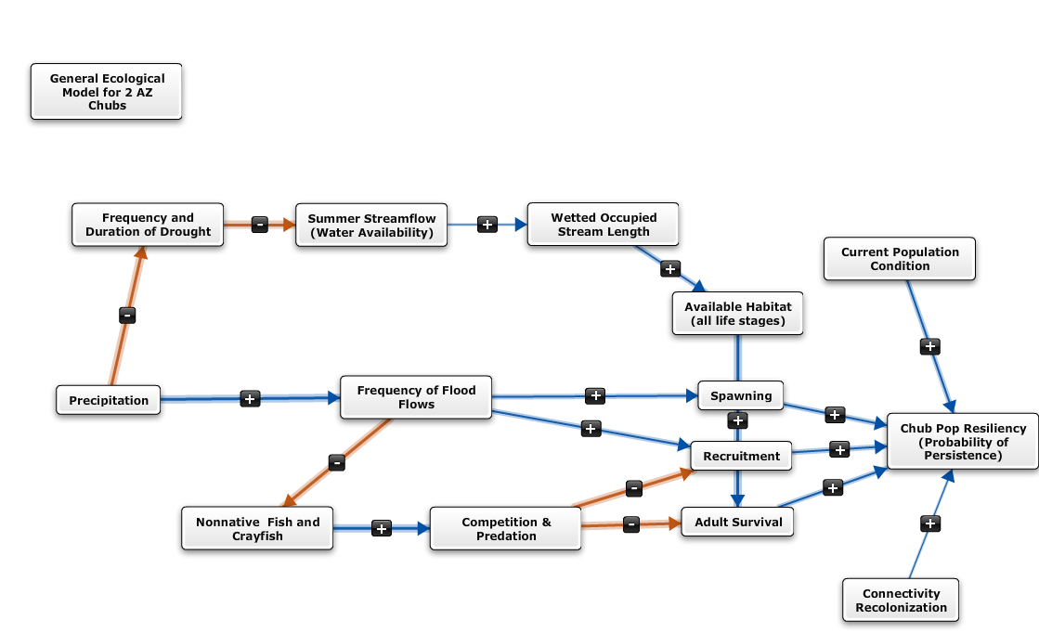
Chub Model Parameters
Occupancy Model
Inputs
Quantitative Tools for SSA

Slide 18

Conditional Logical functions
Link population parameters to environmental conditions by discrete logic function
“If environmental variable i ≥ x1 and i < x2, then $\overline{φ}$ = 0.79, else $\overline{φ}$ = 0.92”
Mean $φ$ decreases when the value of I falls between x1 and x2.
Quantitative Tools for SSA

Slide 19
Continuous functions
Quantitative Tools for SSA

Slide 20
Measurement error
Simulation data assume perfect knowledge of the system
I.e., no partial observability/observation error in monitoring data
May be important to add observation error to output from the models
Recovery planning
Section 7 planning
Delisting decisions
Observed system response will not match predictions
This is the case no matter, but account for all uncertainties might be important
Quantitative Tools for SSA

Slide 21
Modify model outputs
Randomized adjustments to model output data
Spread sheet example
Quantitative Tools for SSA

Slide 22
Questions?
Quantitative Tools for SSA

