Slide 1
Survey Builder
Anna Nardelli

Slide 2
Introduction
This web application is a survey system
Users can create surveys, answer others’ surveys, and view responses to their own surveys
Each user must have an account to interact with the system

Slide 3
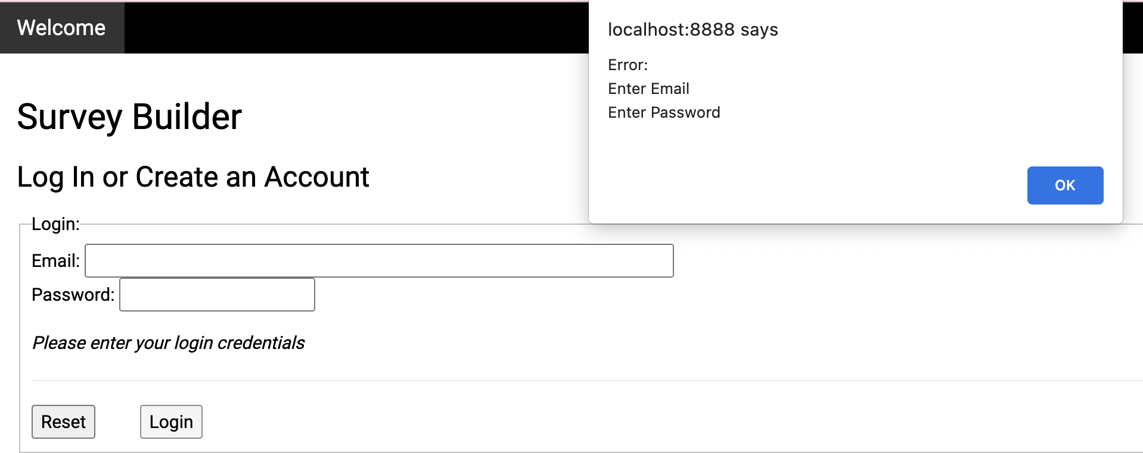
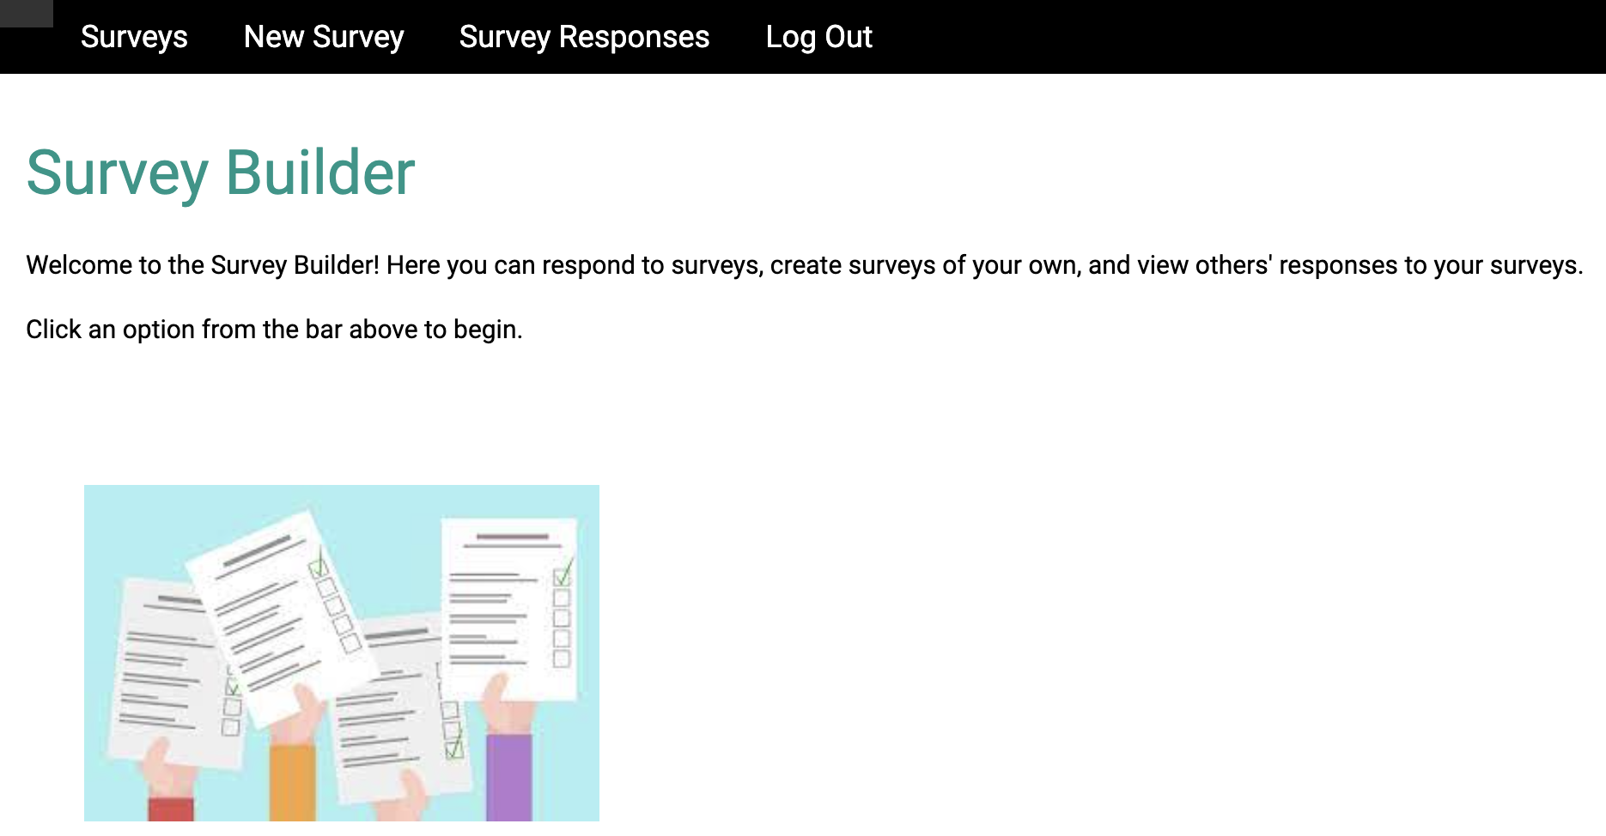
Implementation
Front-End
JavaScript to validate inputs
CSS to style HTML files
Using a template from W3

Slide 4
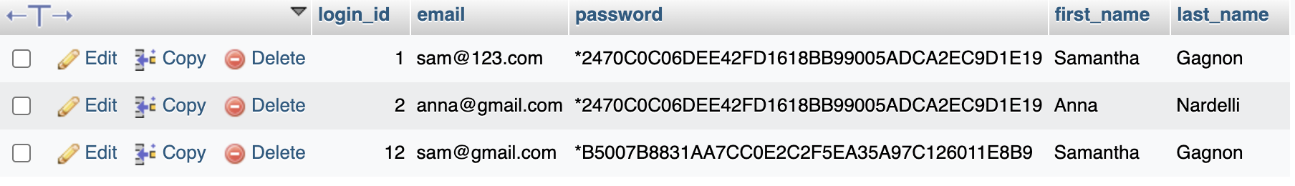
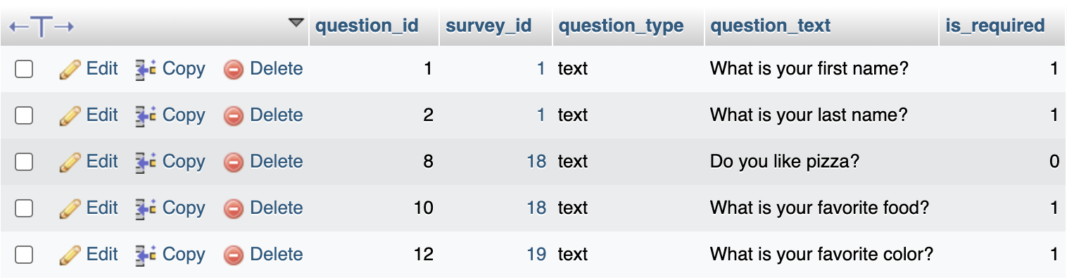
Implementation
Back-End
phpMyAdmin to host database
MVC structure
5 models, 8 Controllers/Views
php
PDO library to handle database communication

Slide 5
Demo

