Slide 1
Clustering Countries
on Integrated
Socio-Economic Data
Project presentation
Anna Fabbri
Data Mining and Machine Learning

Slide 2
Problem description:
The aim of this project is to compare different unsupervised learning techniques on their capability of clustering world countries. This is done on the basis of real world socio economic data consisting in an integration of two datasets which required heavy data preprocessing.
The question(s) it tries to answer are:
  Is there a way at all to categorize world countries in different clusters considering multiple aspects of their social, geographical and economic aspects, and to show evolution in time?
  Which algorithm is able to give more significant results?

Slide 3
Dataset description:
The project integrates two datasets:
  World Development Indicators (WDI) database, published by the World Bank; a comprehensive collection of global development data, it includes over 1,500 indicators (link here)
  World Happiness Report, a survey of the state of global happiness that ranks countries by how ‘happy’ their citizens perceive themselves to be (link here)
The rationale was combining material development indicators of different origins with “holistic” wellbeing measures.

Slide 4
References:
The project takes inspiration from Saraiva, C., & Caiado, J. (2025). Global development patterns: A clustering analysis of economic, social and environmental indicators.
This original study, though, emphasizes the aspect of sustainability and employs a single algorithm. The project adopts a more exploratory approach by integrating datasets with different perspectives and testing multiple algorithms in order to try to identify when meaningful clusters can be obtained.

Slide 5
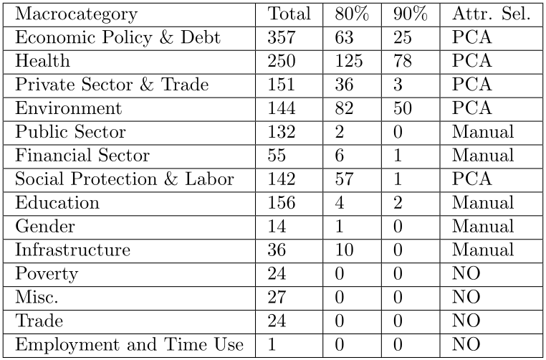
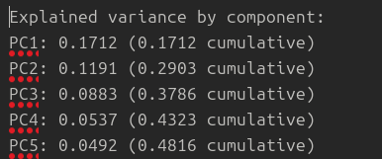
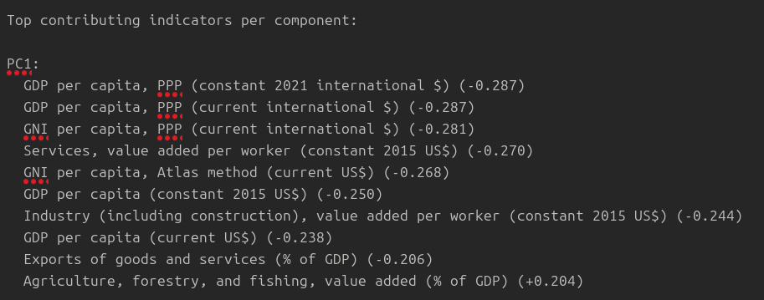
Preprocessing steps:
  WDI attribute selection

Slide 6
Preprocessing steps:
  WDI attribute selection
  WHR attribute selection
  Dataset integration
  Final dimension reduction
  Missing values cleaning and final normalization
End result: 24 attributes, 1 dataset per year (2005/2022)
Reference year for clustering exploration: 2017

Slide 7
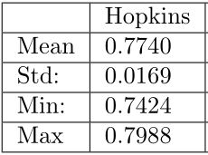
Algorithms chosen:
  K-means
  CLARA (K-medoids)
  DBSCAN
  Agglomerative Hierarchical
Multiple algorithms to compare different clustering techniques.
Clustering tendency measured
with Hopkins Statistic (30 iterations)

Slide 8
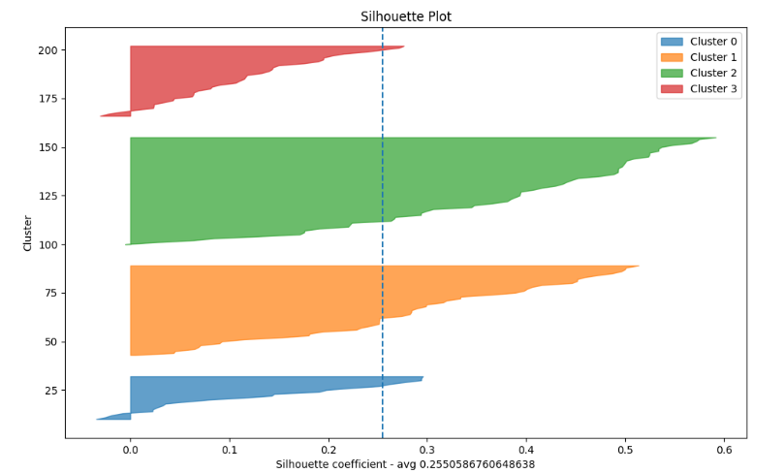
K-Means:
  Cluster 0: Good energy infrastructure, institutional weaknesses, high
  perceived corruption, unstable economy
  Cluster 1: Economically developed, urbanized countries.
  Cluster 2: Low income, limited digitalization and urbanization, high vulnerable employment.
  Cluster 3: Energy infrastructure in place but unsustainable, with significant social fragility.

Slide 9
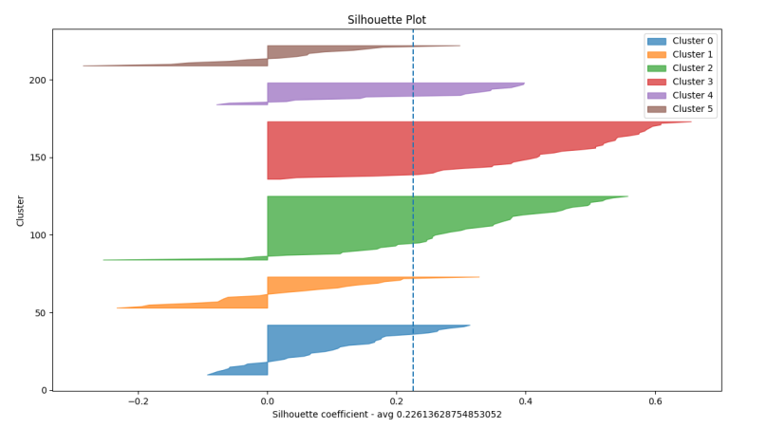
CLARA:
  Cluster 0: Strong energy access, low job participation, limited generosity, high corruption concerns.
  Cluster 1: Low income and industrial output, rural, high social support and generosity, widespread corruption concerns.
  Cluster 2: Economically strong and connected, low vulnerable jobs, high life satisfaction.
  Cluster 3: Economically weak and less connected, low urbanization, high renewables, mixed well-being.
  Cluster 4: High energy access and urbanization, limited renewables and fragile social cohesion.
  Cluster 5: Economically weak, low exports and digital access, fragile social mood.

Slide 10
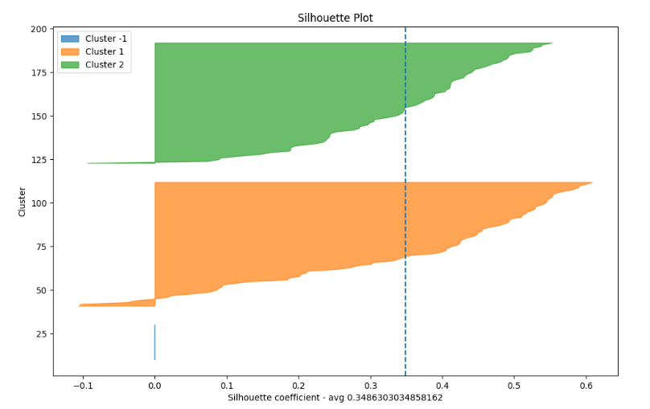
DBSCAN:
  This clustering configuration returned 2 clusters and 15 outlier countries.
  Cluster 1: Low gdp per capita, low % of individuals using the internet, low industry value added per worker, low % of population ages 15-64, high vulnerable employment.
  Cluster 2: high access to electricity, high % of individuals using the internet, high % of population 15-64, low vulnerable employment.

Slide 11
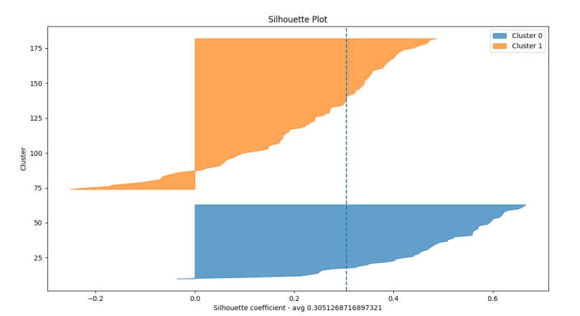
HIERARCHICAL:
  Cluster 0: Economically weak, low digital and industrial activity, high employment vulnerability, limited social support.
  Cluster 1: High electricity access, more digitally connected, generally low vulnerable employment.

Slide 12
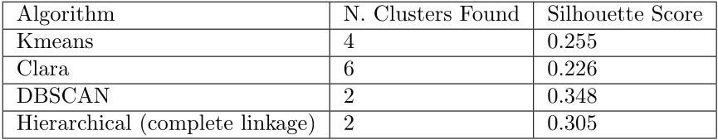
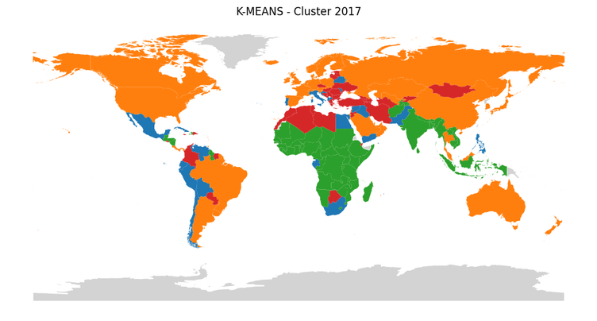
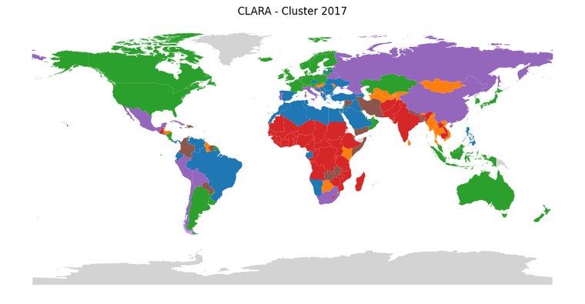
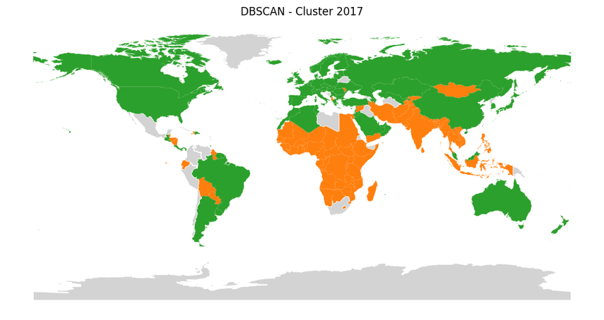
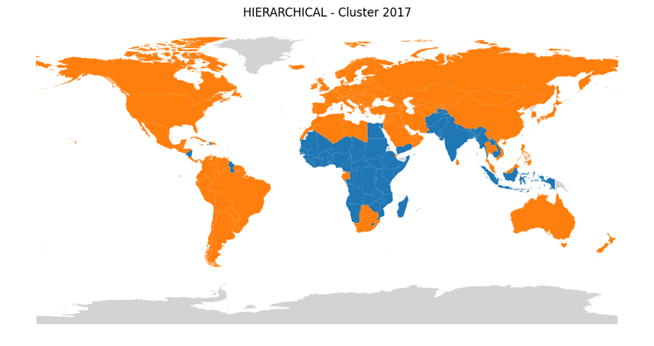
Results:

Slide 13
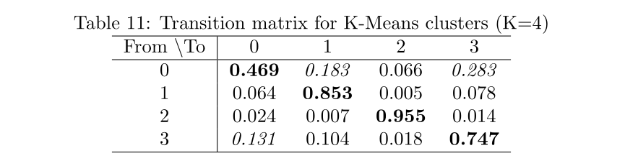
Temporal stability: K-MEANS
Clusters not perfectly stable and interpretable over time. Some degree of mobility, particularly around Cluster 0, intrinsic to the structure of the data.

Slide 14
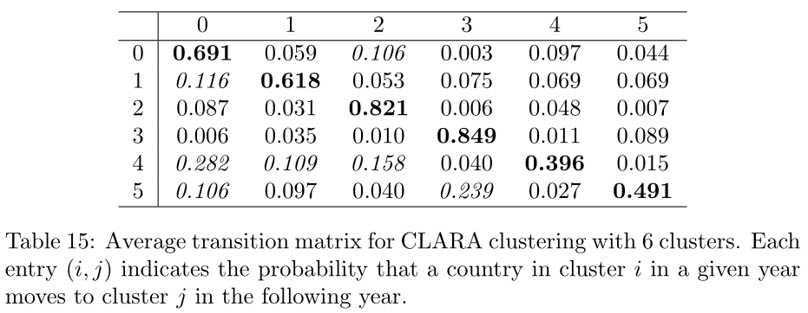
Temporal stability: CLARA
structurally sufficiently coherent but more nuanced and more dynamic than the K-Means alternative.

Slide 15
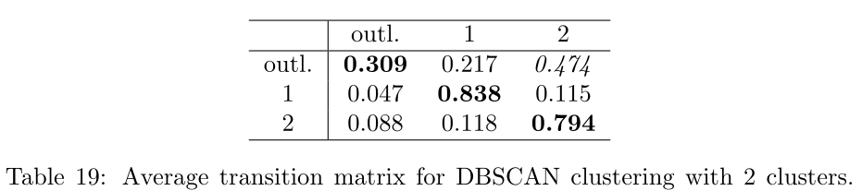

Temporal stability: DBSCAN and HIERARCHICAL

Slide 16
Final results:
  K-Means: best balance between interpretability and temporal stability.
  CLARA: finer distinctions, with volatility.
  DBSCAN: robust two-cluster structure, successfully detected anomalies (e.g., post-2008 crisis).
  Hierarchical clustering: highlight rich–poor divide, showed sensitivity to yearly normalization.
  No definitive “perfect” clustering emerged: the curse of dimensionality persists.

