Slide 1

UX RESEARCH
Persona Report and Presentation
A deep dive into the everyday friction of cable chaos — and the professional whose productivity depends on solving it.
Group: Everyday Friction | Members: Shannon Cullen, Ryan Jankowski, Rohan Pratap Reddy Ravula, Annanahmed Shaikh

Slide 2

THE PROBLEM
Never Having the Right Cable When You Need It
You're always one cable short — the right one is in your other bag, at home, or simply doesn't exist for the specific device combination you're trying to connect right now.
Immediate Impact
Bigger Consequences
Wasted time hunting, borrowing, or buying cables on the spot
Dead devices during travel, meetings, or critical work moments
Frustration from carrying multiple "just in case" cables that still aren't enough
Repeated purchases of the same cable for different locations — car, office, home, travel bag
Cable clutter and e-waste from obsolete or duplicate connectors
Damaged ports from forcing wrong cables or worn-out adapters
Lost productivity and professional credibility when you can't charge or present
The Gap: Universal standards like USB-C promised to solve this, but the reality is a messy mix of Lightning, USB-A, HDMI, micro-USB, and proprietary connectors that change device-to-device. Even worse — you might own the right cable, but it's simply not with you when the moment strikes.

Slide 3


OUR PERSONA
Meet Jeffrey Carbonella
Jeffrey lives and works at the intersection of high-stakes decisions and constant mobility. He commutes to job sites, flies weekly to meet employers across the country, and manages complex timelines — all while staying connected across multiple devices. His greatest constraint isn't time or budget. It's the mental capacity required to perform at peak level in a consistently demanding environment.
Jeffrey Carbonella
High-Accountability Professional
Time-Optimizer & Systems Thinker
Project Manager, National Construction Management Firm
Dead laptops in meetings damage reputation. He won't let the same mistake happen twice.
He eliminates recurring friction permanently rather than tolerating it repeatedly.
📍 Houston, Texas
Devices: Laptop, personal phone, company phone, calculator, wireless earbuds
Mentally Loaded, Performance-Driven
Charging anxiety is cognitive clutter. He values tools that free focus for meaningful work.
🏗️ Mobile Operator
⚡ Momentum-Driven
Lean setups are operational necessities, not aesthetics.
Reliability preserves execution, performance, and reputation.

Slide 4
DAY IN THE LIFE
A Day With Jeffrey
Before Sunrise
1
Scanning overnight emails, preparing for the day ahead before heading to the job site.
2
8:00 AM — Site Meeting
Laptop open, phones buzzing. A subcontractor requests to review drawings on screen. Jeffrey reaches for his charger — wrong cable. The room waits. Five minutes lost. Small lapse, big embarrassment.
Noon — Airport
3
Company phone dips below 10%. He packed a charger — just not the right cable for this device. Two hours offline isn't downtime; it's lost momentum.
4
Evening — Hotel
Preparing for a client presentation. Earbuds die mid-call. Different cable. Same frustration. Again.
For a man who optimizes everything, the wrong cable isn't mere inconvenience — it's friction, distraction, and a direct threat to the reliability his reputation depends on.
Jeffrey represents a wide variety of consumers who share this pain point — America's executive and corporate professionals on the go, devices needed at the ready, with constant pressure to be prepared.

Slide 5
MARKET CONTEXT
Market Snapshot
The scale of this problem is vast. Virtually every American carries a device — and the majority carry several. The charging cable problem isn't a niche inconvenience; it's a universal daily friction point affecting hundreds of millions of people.
98%
81%
62%
Own a Cellphone
Have a Computer
Own a Tablet
As of 2023, nearly all Americans own a cell phone, with 91% owning a smartphone — up from just 35% in 2011. (Pew Research)
81% of U.S. households owned a desktop or laptop as of 2021, meaning most people manage multiple devices simultaneously. (US Census Bureau)
62% of U.S. households also owned a tablet, further multiplying the number of connectors and cables required per person.
Strategic Investors & Partners
The Real Cost of the Problem
Companies like Google, Apple, Amazon, HP, Samsung, and Dell have enormous incentive to support a solution — fixing a problem their own users experience daily directly boosts loyalty, reputation, and revenue.
Not having the right charger means emergency purchases, wasted time, and cognitive burden. Multiply that across millions of professionals and the aggregate cost — in dollars, hours, and frustration — is staggering. The market opportunity is equally large.

Slide 6
VALUE PROPOSITION
What a Solution Means for Jeffrey
The right solution doesn't just solve a technical problem — it gives Jeffrey back his confidence, his time, and his mental clarity. Here's what's genuinely at stake:
Restored Professional Confidence
Reclaimed "Lost" Time
Never starting a meeting with an apology for a dead laptop or missing dongle. Maintaining a rock-solid "prepared for anything" reputation.
Saving an estimated 2–3 hours per month previously spent hunting for cables, untangling drawers, or making emergency trips to buy overpriced replacements.
Mental Decoupling
Optimized Mobility
Eliminating the "charging anxiety" checklist before leaving the house — freeing cognitive space for work and family instead of inventory management.
Reducing daily carry weight and bag clutter by 60% or more, enabling a truly lean, one-bag commute without fear of being stranded.
Financial & Environmental Stewardship
Uninterrupted Productivity
Stopping the cycle of panic-buying duplicate $30 cables and reducing personal e-waste from broken or obsolete proprietary connectors.
Ensuring critical workflows — 11th-hour project edits, long-distance travel — are never throttled by a 0% battery warning at the worst possible moment.

Slide 7
SOURCES
Resources & References
The following sources informed our research into device ownership, market sizing, and the push toward universal charging standards:
European Commission — Common Charger Mandate
U.S. Census Bureau — Computer & Internet Use
Pew Research Center — Mobile Fact Sheet
Questions and Answers: Common charger solution for electronic devices. Press Release, Brussels, Belgium, Oct. 4, 2022.
Computer and Internet Use in the United States: 2021. Press Release, 2024. Covers household ownership of desktops, laptops, and tablets nationwide.
Mobile device ownership trends from 2011 to 2023, including the dramatic rise in smartphone adoption across American adults.
ec.europa.eu — Common Charger Q&A
census.gov — Computer Internet Use 2021
pewresearch.org — Mobile Fact Sheet

Slide 8
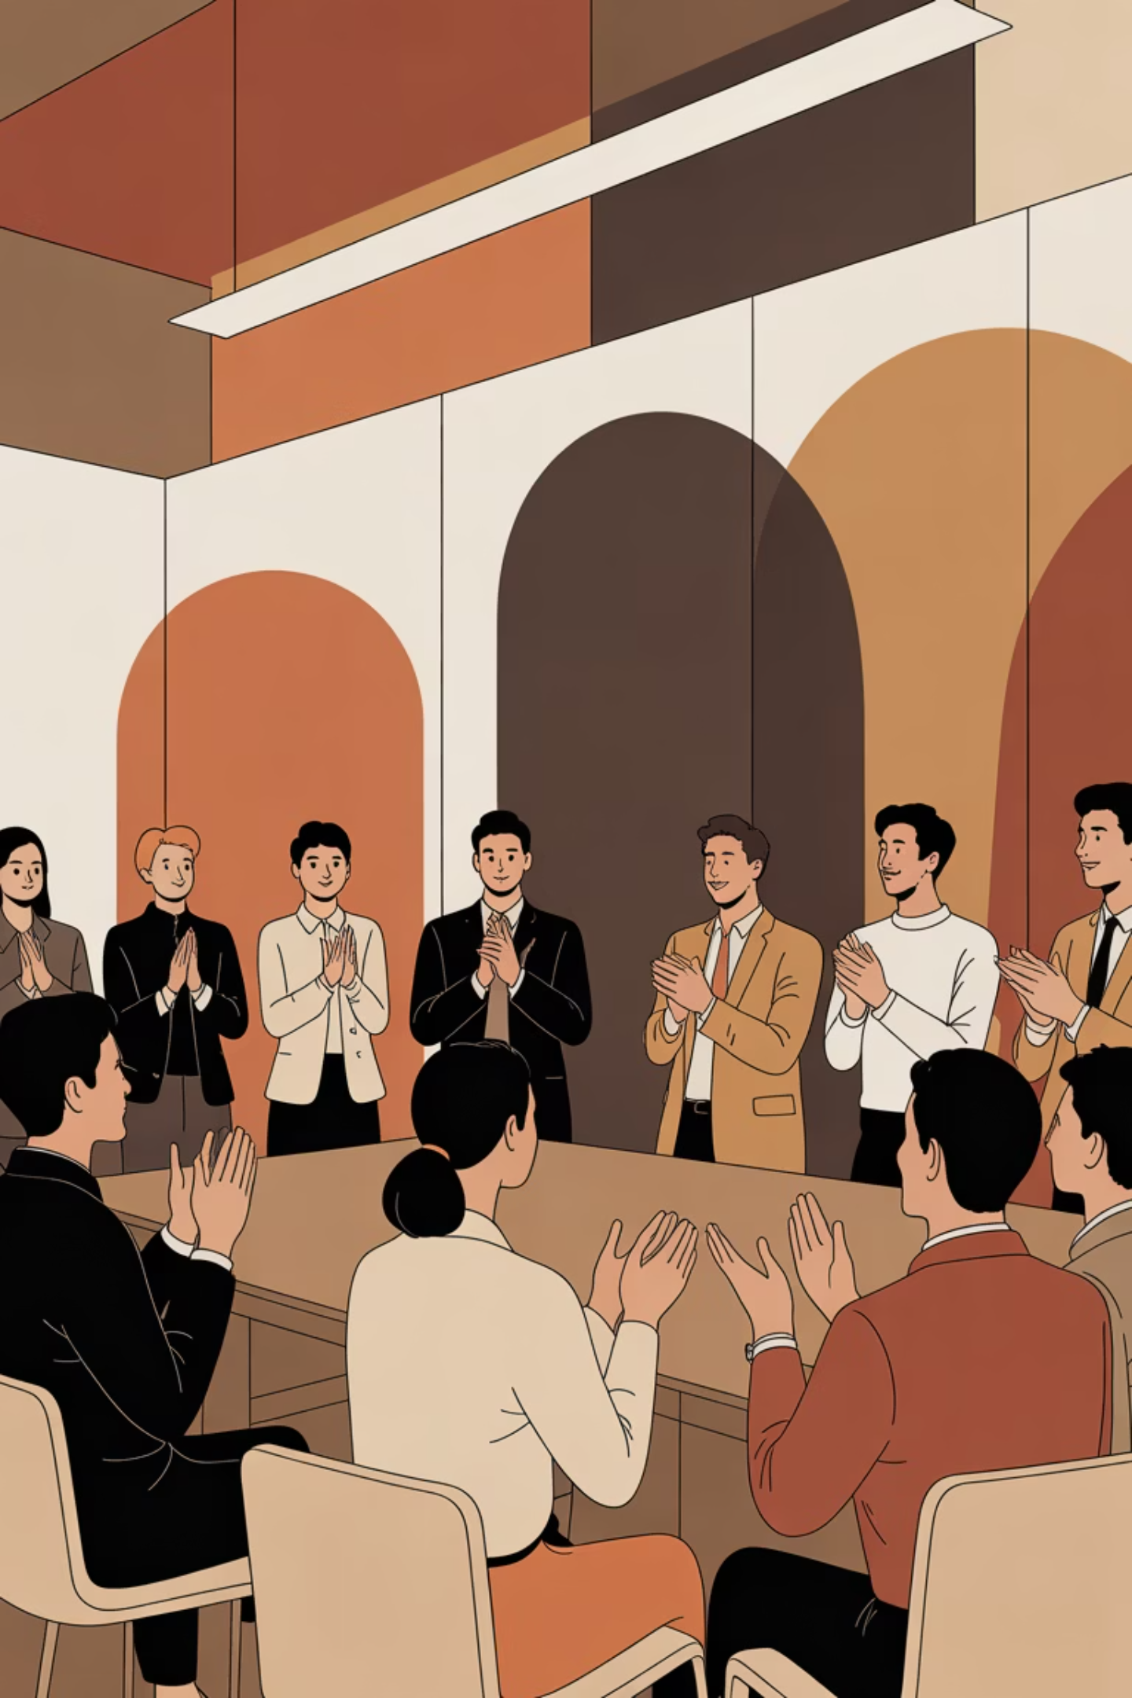
Thank You
We appreciate your time and attention. The everyday friction of cable chaos may seem minor in isolation — but for professionals like Jeffrey, it represents a meaningful opportunity to design solutions that restore confidence, reclaim time, and reduce cognitive load.
Group: Everyday Friction | Shannon Cullen · Ryan Jankowski · Rohan Pratap Reddy Ravula · Annanahmed Shaikh

