Slide 1










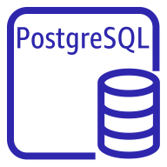

AWS Cloud
Availability Zone 1
Availability Zone 2
VPC
Public subnet
Public subnet
NAT gateway
NAT gateway
Amazon CloudWatch
Auto Scaling group
Optional Linux bastion instance
Optional Linux bastion instance
Amazon SNS
Private subnet
Private subnet
PostgreSQL cluster
AWS KMS
Write replica
Amazon RDS
Read replica

