Slide 1
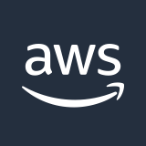

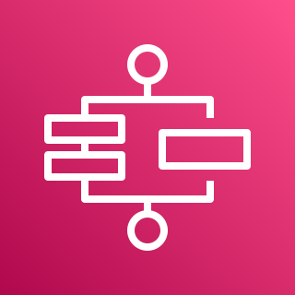
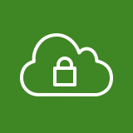
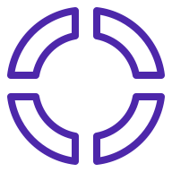
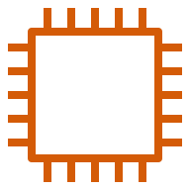
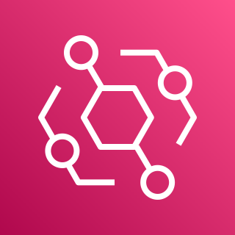
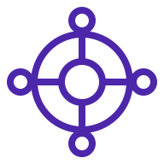
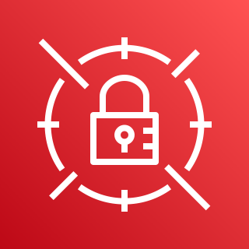
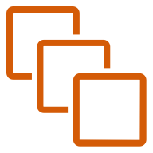
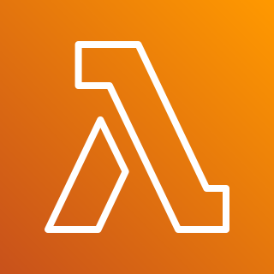
AWS Cloud
us-west-1 Region
us-east-1 Region
Transit VPC
Transit VPC
AWS Step Functions
Availability Zone
Availability Zone
SDWAN segment
SD-WAN segment
Meraki vMX
Meraki vMX
Workload segment
Availability Zone
Availability Zone
Amazon EventBridge
Core network edge
Meraki vMX
Meraki vMX
Workload VPC
AWS Secrets Manager
Workload VPC
Workload segment
AWS Lambda
Notes:
The Quick Start sets up the following:
Two highly available Transit VPCs in two separate regions.
Each VPC is configured with two AZs, each with a Meraki vMX appliance with internet access via an Internet Gateway (not shown).
An AWS Cloud WAN Global Network and Core Network along with a Core Network Policy (CNP) that includes the routing policy.
Core Network includes single SDWAN Segment but can be integrated into any Workload Segment provided by customer (not part of Quick Start).
Routes from each Meraki branch connected via the Transit VPCs will be propagated throughout the SDWAN Segment with the future option to share these routes with additional Workload Segments.
Each region deployed will include a Cloud WAN Core Network Edge (CNE) that will attach to the associated regional Transit VPC.
Amazon Step Function State Machine to orchestrate the API calls to update the Cloud Wan CNP with any additional branch routes as they are discovered in the Meraki Dashboard.
AWS Lambda works with Step Functions to update the CNP
AWS Secrets Manager to store a Meraki API key. AWS Lambda uses the API key to access the Meraki dashboard when updating route tables.
Amazon EventBridge to send events from each region to the Step Function State Machine when an update is needed

Slide 2


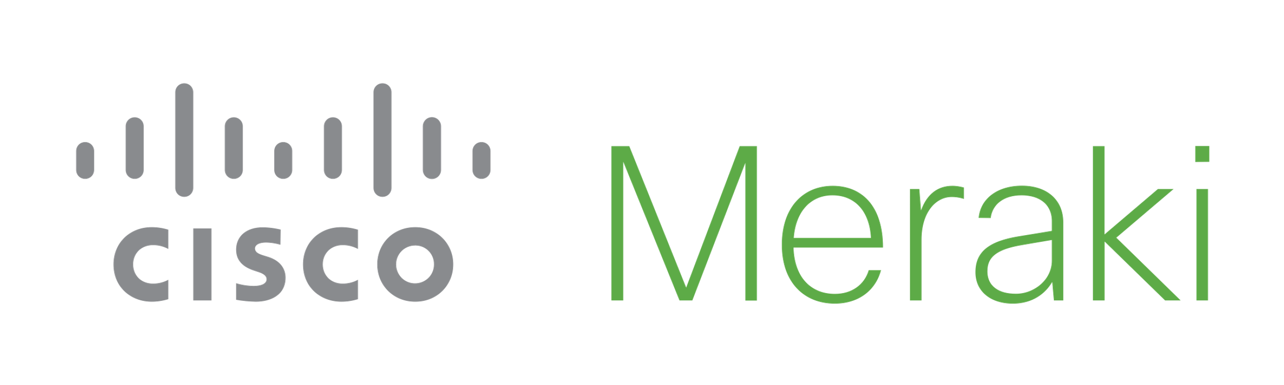

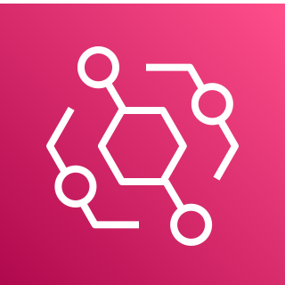
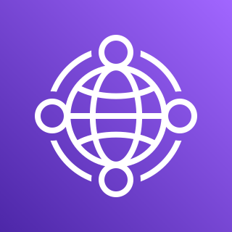
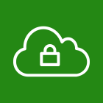
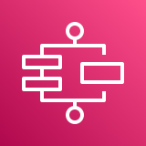

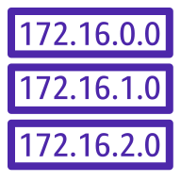
LA
Branch
New York
Branch
Meraki Dashboard
AWS Cloud
us-west-1
us-east-1
AWS Cloud WAN Core Network
Transit VPC
Transit VPC
Amazon EventBridge
Global Network
AZ1
AZ2
AZ1
AZ2
us-west-1
us-east-1
Meraki vMX
Meraki vMX
Meraki vMX
Meraki vMX
AWS Step Functions
SDWAN Segment
Workload Segment
AWS Lambda
Existing Workload VPC
Existing Workload VPC
AWS Secrets Manager
CNE
CNE
Notes:
The Quick Start sets up the following:
Two highly available Transit VPCs in two separate regions.
Each VPC is configured with two AZs, each with a Meraki vMX appliance with internet access via an Internet Gateway (not shown).
An AWS Cloud WAN Global Network and Core Network along with a Core Network Policy (CNP) that includes the routing policy.
Core Network includes single SDWAN Segment but can be integrated into any Workload Segment provided by customer (not part of Quick Start).
Routes from each Meraki branch connected via the Transit VPCs will be propagated throughout the SDWAN Segment with the future option to share these routes with additional Workload Segments.
Each region deployed will include a Cloud WAN Core Network Edge (CNE) that will attach to the associated regional Transit VPC.
Amazon Step Function State Machine to orchestrate the API calls to update the Cloud Wan CNP with any additional branch routes as they are discovered in the Meraki Dashboard.
AWS Lambda works with Step Functions to update the CNP
AWS Secrets Manager to store a Meraki API key. AWS Lambda uses the API key to access the Meraki dashboard when updating route tables.
Amazon EventBridge to send events from each region to the Step Function State Machine when an update is needed

Slide 3
LA
Branch
New York
Branch
Meraki Dashboard
AWS Cloud
us-west-1
us-east-1
AWS Cloud WAN Core Network
Transit VPC
Amazon EventBridge
Transit VPC
Global Network
AZ1
AZ2
AZ1
AZ2
us-west-1
us-east-1
Meraki vMX
Meraki vMX
Meraki vMX
Meraki vMX
AWS Step Functions
SDWAN Segment
AWS Lambda
Workload VPCs
Workload VPCs
AWS Secrets Manager
CNE
CNE
Notes:
The Quick Start sets up the following:
Two highly available Transit VPCs in two separate regions.
Each VPC is configured with two AZs, each with a Meraki vMX appliance with internet access via an Internet Gateway (not shown).
An AWS Cloud WAN Global Network and Core Network along with a Core Network Policy (CNP) that includes the routing policy.
Core Network includes single SDWAN Segment but can be integrated into any Workload Segment provided by customer (not part of Quick Start).
Routes from each Meraki branch connected via the Transit VPCs will be propagated throughout the SDWAN Segment with the future option to share these routes with additional Workload Segments.
Each region deployed will include a Cloud WAN Core Network Edge (CNE) that will attach to the associated regional Transit VPC.
Amazon Step Function State Machine to orchestrate the API calls to update the Cloud Wan CNP with any additional branch routes as they are discovered in the Meraki Dashboard.
AWS Lambda works with Step Functions to update the CNP
AWS Secrets Manager to store a Meraki API key. AWS Lambda uses the API key to access the Meraki dashboard when updating route tables.
Amazon EventBridge to send events from each region to the Step Function State Machine when an update is needed

Slide 4

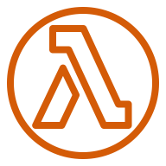
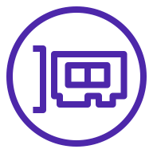

LA
Branch
New York
Branch
Meraki Dashboard
AWS Cloud
Base Region
AWS Cloud WAN Core Network
Base Region
AZ1
AZ2
Global Network
AZ1
AZ2
Transit VPC
us-west-1
us-east-1
Transit VPC
Public subnet
Public subnet
Public subnet
Public subnet
Polling
Lambda
Polling
Lambda
CNE
CNE
Meraki vMX
Meraki vMX
Meraki vMX
Meraki vMX
SDWAN Segment
Elastic network interface
Elastic network interface
Elastic network interface
Elastic network interface
Update State Machine
Route Update
Update CNP routes based on branch updates
Notes:
The Quick Start sets up the following:
Two highly available Transit VPCs in two separate regions.
Each VPC is configured with two AZs, each with a Meraki vMX appliance with internet access via an Internet Gateway (not shown).
An AWS Cloud WAN Global Network and Core Network along with a Core Network Policy (CNP) that includes the routing policy.
Core Network includes single SDWAN Segment but can be integrated into any Workload Segment provided by customer (not part of Quick Start).
Routes from each Meraki branch connected via the Transit VPCs will be propagated throughout the SDWAN Segment with the future option to share these routes with additional Workload Segments.
Each region deployed will include a Cloud WAN Core Network Edge (CNE) that will attach to the associated regional Transit VPC.
Amazon Step Function State Machine to orchestrate the API calls to update the Cloud Wan CNP with any additional branch routes as they are discovered in the Meraki Dashboard.
AWS Lambda works with Step Functions to update the CNP
AWS Secrets Manager to store a Meraki API key. AWS Lambda uses the API key to access the Meraki dashboard when updating route tables.
Amazon EventBridge to send events from each region to the Step Function State Machine when an update is needed

Slide 5
LA
Branch
New York
Branch
Meraki Dashboard
AWS Cloud
Base Region
AWS Cloud WAN Core Network
Base Region
AZ1
AZ2
Global Network
AZ1
AZ2
Transit VPC
us-west-1
us-east-1
Transit VPC
Public subnet
Public subnet
Public subnet
Public subnet
Polling
Lambda
Polling
Lambda
CNE
CNE
Meraki vMX
Meraki vMX
Meraki vMX
Meraki vMX
SDWAN Segment
Elastic network interface
Elastic network interface
Elastic network interface
Elastic network interface
Update State Machine
Route Update
Workload VPCs
Update CNP routes based on branch updates
Notes:
The Quick Start sets up the following:
Two highly available Transit VPCs in two separate regions.
Each VPC is configured with two AZs, each with a Meraki vMX appliance with internet access via an Internet Gateway (not shown).
An AWS Cloud WAN Global Network and Core Network along with a Core Network Policy (CNP) that includes the routing policy.
Core Network includes single SDWAN Segment but can be integrated into any Workload Segment provided by customer (not part of Quick Start).
Routes from each Meraki branch connected via the Transit VPCs will be propagated throughout the SDWAN Segment with the future option to share these routes with additional Workload Segments.
Each region deployed will include a Cloud WAN Core Network Edge (CNE) that will attach to the associated regional Transit VPC.
Amazon Step Function State Machine to orchestrate the API calls to update the Cloud Wan CNP with any additional branch routes as they are discovered in the Meraki Dashboard.
AWS Lambda works with Step Functions to update the CNP
AWS Secrets Manager to store a Meraki API key. AWS Lambda uses the API key to access the Meraki dashboard when updating route tables.
Amazon EventBridge to send events from each region to the Step Function State Machine when an update is needed

Slide 6
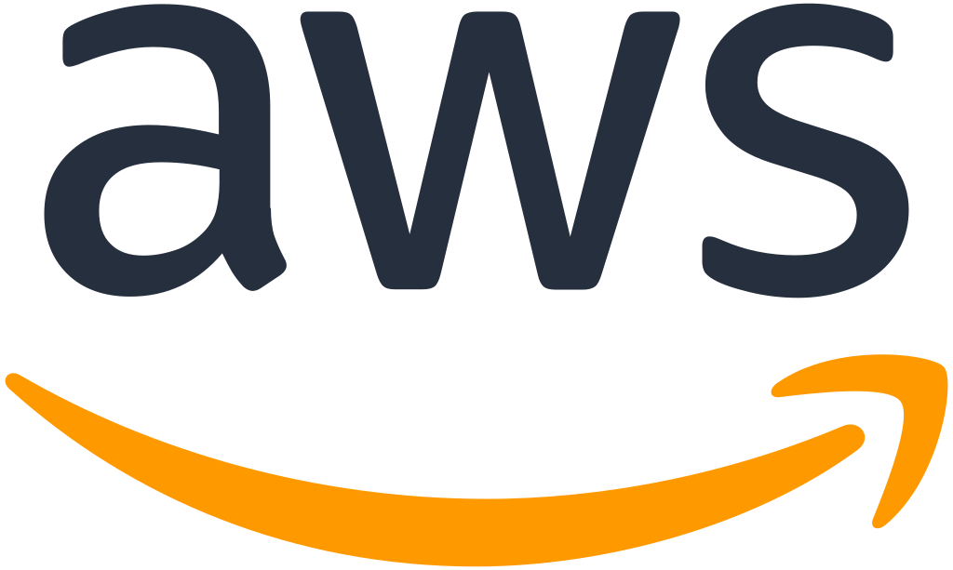
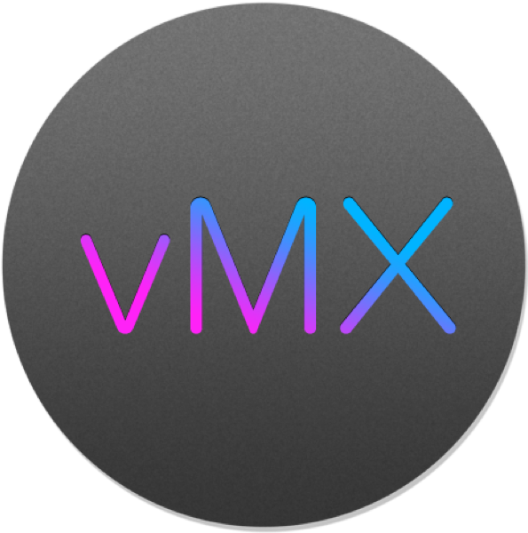


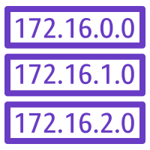
LA
Branch
New York
Branch
Meraki Dashboard
vMX
Cloud WAN
AWS Cloud
us-west-1
us-east-1
Amazon EventBridge
AWS Cloud WAN
Transit VPC
Transit VPC
AWS Step Functions workflow
AZ1
AZ2
AZ1
AZ2
create/update global network
Meraki vMX
Meraki vMX
Meraki vMX
Meraki vMX
SD-WAN
create/update core network
Workload
Workload VPC
Workload VPC
create/update attachment
E
E
create/update network policy

