Slide 1


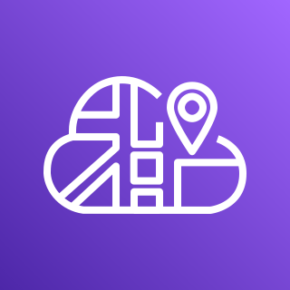






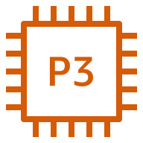





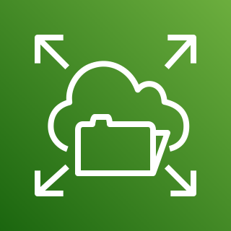
Region
Availability Zone
Availability Zone
VPC
Internet gateway
Public subnet
Public subnet
AWS Cloud Map
NAT gateway
Application Load Balancer
NAT gateway
Private subnet
Private subnet
Amazon ECS
P3 instance
Auto Scaling group
P3 instance
Amazon CloudWatch
Container
Task
CuChem service
Task
Container
Container
Task
Megamolbart service
Task
Container
Amazon EFS

