Slide 1



POWER BI PROJECT
Sales Performance Dashboard
An interactive Power BI report analyzing sales, customers, and
product performance across four regions, 2011–2014
Anna Pauseiro · Data & Audit Analyst
Notes:
1

Slide 2
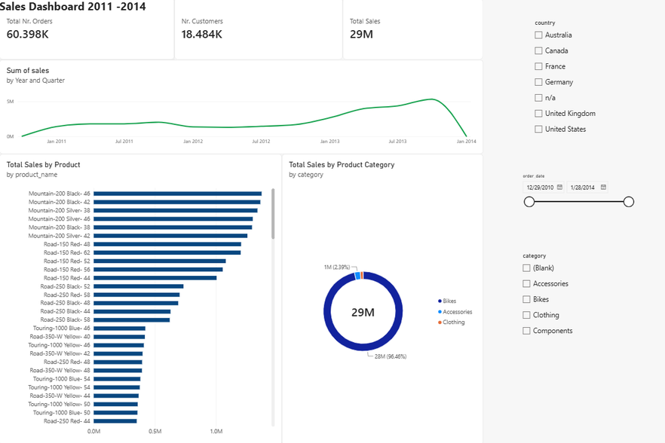
The Dashboard
One page, four filters, and every number a click away — country, order date, and category slicers drive the whole report.
60.4K Orders 18.5K Customers $29M Total Sales
Notes:
2

Slide 3
What the Dashboard Demonstrates
Interactive Filtering
Slicers for country, order date, and category drive every visual on the page in real time.
Trend Analysis
A quarterly sales line from 2011–2014 surfaces the seasonal peaks and shifts in momentum.
Category & Product Breakdown
A donut chart and a ranked product list show exactly where the $29M in revenue concentrates.
KPI Summary Cards
Order count, customer count, and total sales stay visible at a glance, whatever filters are applied.
Notes:
3

Slide 4
Skills Demonstrated
Data Modeling
DAX Measures
Structured sales, customer, and product tables into a clean relational model for fast, accurate queries.
Built calculated measures for totals, distinct counts, and category-level breakdowns.
Interactive Visuals
Dashboard Design
Cross-filtering slicers, KPI cards, and charts that respond instantly to every selection.
A single-page layout that balances density and readability across summary and detail views.
PART OF AN ONGOING POWER BI + COPILOT PORTFOLIO PROJECT
Anna Pauseiro · Data & Audit Analyst
Notes:
4

