Slide 1
Electronic Informed Consent Management System
Anna Poluektova
Natallia Isayenka

Slide 2
Main Objective
is to build a web application that would implement all consent management workflows including:
Patient management module;
Consent form template management module;
Informed Consent tracking module;
Search and reporting capabilities

Slide 3
Corporate Goals
Patient demographic information management
Consent form management
Fast and secure access to patient and consent information through search and reporting capabilities

Slide 4
Business Opportunity
Electronic Consent management is vital part of the patient enrolment process
Most of modern Clinical Trial Management System have Electronic Consent Management feature as the part of the system
Systems like that are intended to be used in regulated clinical trials and it significantly increase the license cost and total cost of the ownership

Slide 5
Business Opportunity
Non-commercial institutions such as university research teams who are conducting non-regulated trials and have limited budgets may not be able to afford those systems
This system is intended to fill that gap and provide robust cost effective solution to manage patients/subjects consents

Slide 6
Problem Statement
Electronic Informed Consent Management System aims to improve and organize the process of:
capturing
reasoning
sharing consent permissions provided by patients for reusing clinical data and samples for research

Slide 7
TASKS

Slide 8
Tasks
Activity | Date
Development environment setup (WebStorm, Firebug) | January 6, 2015 – January 19, 2015
Database setup and configuration (MongoDB)
Node JS setup and configuration (Express, bower, protractor, karma, Mongoose modules deployment and configuration)
Static resources request/response controller implementation
Server side default controller implementation
Server side /patients controller implementation. Temporary loopback returns hardcoded JSON object collection for data grid until interface to database is implemented.
Bower client side dependency management integration implemented

Slide 9
Tasks
Activity | Date
Full bootstrap support has been added to main page | January 19, 2015 – February 02, 2015
Main tabs(patients, templates, consent) and main controller have been added to main page
Patients data UI grid has been added to patients tab
Patient grid search has been implemented
Redundant code and dependencies has been removed
Patients data grid editor UI has been implemented

Slide 10
Tasks
Activity | Date
Implement patients server side loopback which returns sent of hardcoded JSON objects for testing purposes | February 03, 2015 – March 02, 2015
Migrate tabs from angular to JQuery Implement syntax highlighter integration
Organize dependencies and remove angular
Implement Consent Templates Editor
Implement Consent Templates search

Slide 11
Tasks
Activity | Date
Implement Consent Editor | March 03, 2015 – March 15, 2015
Implement Consent search
Implements Consent Grid
Use JSON to send data from a server to a web page
Testing System

Slide 12
SYSTEM FEATURES

Slide 13
System Features
ID | Feature | Stakeholder Requirement ID
1_FR_01 | System must have online form for password-based authentication. It shall have at least following UI components: User name; User password Log in button | System Administrator, Clinical Research Coordinator, Study Director, Project Sponsor
1_FR_02 | User password text field control shall mask entered symbols on the fly. | System Administrator, Study Director, Project Sponsor
2_FR_01 | System shall have role based security feature and maintain at least two roles: Clinical Research Coordinator System Administrator | System Administrator, Study Director, Project Sponsor
3_FR_01 | System shall have audit log feature | Study Director, Project Sponsor
3_FR_02 | Audit log shall reflects all changes in the database | Study Director, Project Sponsor
3_FR_03 | Audit log must be maintained in the database | Study Director, Project Sponsor
3_FR_04 | Audit log entity record shall retain at least following information: Entity or table name User name who made this change Old value if available New value Time stamp(date and time) | Study Director, Project Sponsor

Slide 14
System Features
ID | Feature | Stakeholder Requirement ID
4_FR_01 | System shall have encryption feature. All interactions between users and application server shall go trough secure HTTP over SSL connection. | System Administrator, Study Director, Project Sponsor
5_FR_01 | System shall have patient registry feature | Clinical Research Coordinator, Study Director, Project Sponsor
5_FR_02 | System shall have at least two forms: Patient/subject grid; Patient Add/Edit patient details form | Clinical Research Coordinator, Study Director, Project Sponsor
5_FR_03 | Patient/subject grid feature shall allow users to filter patients by: First Name Middle Name Last Name Date of Birth Registration Date Address | Clinical Research Coordinator, Study Director, Project Sponsor
5_FR_04 | System shall have patient delete feature. There must be possible to check more than one patient and perform delete operation on all checked patients at once. There must be confirmation pop-up before actual patient removal. This removal must not delete physically patient record from the system to preserve integrity. This must be “soft-delete”, user must not be visible for search and modification once deleted but all historical information including audit log must be retained in the database. | Clinical Research Coordinator, Study Director, Project Sponsor

Slide 15
System Features
ID | Feature | Stakeholder Requirement ID
5_FR_05 | Patient grid must have check all button or checkbox to allow user to check all patients | Clinical Research Coordinator, Study Director, Project Sponsor
5_FR_06 | System must allow Clinical Research Coordinator to perform following actions for specific subject/patient from patient/subject grid from: Add subject/patient Update subject/patient Add consent Revoke consent | Clinical Research Coordinator, Study Director, Project Sponsor
5_FR_07 | Patient Add/Edit patient details form shall capture and store following patient information: First Name Middle Name Last Name Date of Birth Registration Date Address | Clinical Research Coordinator, Study Director, Project Sponsor

Slide 16
System Features
ID | Feature | Stakeholder Requirement ID
5_FR_08 | Patient Add/Edit patient details form shall have two buttons: Save Cancel “Save” button shall store all information updated by user. “Cancel” button action must dismiss all changes made. If “Cancel” button pressed during new patient entry, then new patient shall not be added to the database. In any case, regardless which button has been pressed, system must bring user back to patient/subject grid form. | Clinical Research Coordinator, Study Director, Project Sponsor
5_FR_09 | Patient/subject grid shall have button to update (grant or revoke) patient consent | Clinical Research Coordinator, Study Director, Project Sponsor

Slide 17
System Features
6_FR_01 | System must provide consent form templates registry feature | Clinical Research Coordinator, Study Director, Project Sponsor, System Administrator
6_FR_02 | System must have feature that maintain have unique name and version ID for each consent form template | Clinical Research Coordinator, Study Director, Project Sponsor, System Administrator
6_FR_03 | System shall have adding new consent form template feature. | Clinical Research Coordinator, Study Director, Project Sponsor, System Administrator
6_FR_04 | System shall have updating consent form template feature. This feature must mark each consent form modification as the new version of specific consent form template. | Clinical Research Coordinator, Study Director, Project Sponsor, System Administrator
6_FR_05 | System shall have automatic incremental consent form template versioning feature. Nobody shall modify consent form template version ID. This is accessible in read-only mode for all type of users. | Clinical Research Coordinator, Study Director, Project Sponsor, System Administrator
6_FR_06 | System shall have consent form deletion feature. This feature shall allow deleting consent form template version only in case if there are no even single patient/subject who signed off this specific version of the consent template. Otherwise consent template cannot be removed to preserve data integrity and audit trial. | Clinical Research Coordinator, Study Director, Project Sponsor, System Administrator

Slide 18
System Features
7_FR_01 | System shall have Consent tracking feature | Clinical Research Coordinator, Study Director, Project Sponsor
7_FR_02 | System shall have full electronic signature capture feature. This feature must use mouse, touch screen or other type of cursor manipulator supported by browser or client device host operation system to obtain picture of the full electronic signature. | Clinical Research Coordinator, Study Director, Project Sponsor
7_FR_03 | Full electronic signature shall be stored in the database. | Clinical Research Coordinator, Study Director, Project Sponsor
7_FR_04 | This full electronic signature capture feature shall not allow modifying the picture once signature is taken. | Clinical Research Coordinator, Study Director, Project Sponsor
7_FR_05 | The full electronic signature capture feature shall allow rendering the picture of signature in read-only mode. | Clinical Research Coordinator, Study Director, Project Sponsor
7_FR_06 | Consent tracking feature shall be able to capture full electronic signatures of both Clinical Research Coordinator and patient/subject. | Clinical Research Coordinator, Study Director, Project Sponsor

Slide 19
System Features
7_FR_03 | Full electronic signature shall be stored in the database. | Clinical Research Coordinator, Study Director, Project Sponsor
7_FR_04 | This full electronic signature capture feature shall not allow modifying the picture once signature is taken. | Clinical Research Coordinator, Study Director, Project Sponsor
7_FR_05 | The full electronic signature capture feature shall allow rendering the picture of signature in read-only mode. | Clinical Research Coordinator, Study Director, Project Sponsor
7_FR_06 | Consent tracking feature shall be able to capture full electronic signatures of both Clinical Research Coordinator and patient/subject. | Clinical Research Coordinator, Study Director, Project Sponsor
7_FR_07 | Consent tracking feature shall be able to capture date and time (timestamp) of the moment of time when patients/subject-full electronic signature obtained. This timestamp shall not be modified in any mean and must be available in read-only mode. | Clinical Research Coordinator, Study Director, Project Sponsor
7_FR_08 | Consent tracking module shall have consent revoke feature. Using this feature by patient request, Clinical Research coordinator shall be able to document consent revoke of any previously signed specific consent or all consents at one time. Consent revoke form must be available as a part of consent form registry and must be versioned as other consent form templates | Clinical Research Coordinator, Study Director, Project Sponsor

Slide 20
System Features
8_FR_01 | System shall provide patient/subject search feature | Clinical Research Coordinator, Study Director, Project Sponsor
8_FR_02 | Patients/subject feature shall allow user to search by: First Name Middle Name Last Name Date of Birth Registration Date Address | Clinical Research Coordinator, Study Director, Project Sponsor
8_FR_03 | System shall provide Consent form template search feature | Clinical Research Coordinator, Study Director, Project Sponsor
8_FR_04 | Consent form template search feature shall allow user to search by: Consent form template name Consent form template version Full text search by consent form content is optional. | Clinical Research Coordinator, Study Director, Project Sponsor
8_FR_05 | System shall provide option to search patients who signed specific consent form templates feature i.e. “Search patient by consent” | Clinical Research Coordinator, Study Director, Project Sponsor

Slide 21
DEVELOPMENT ENVIRONMENT

Slide 22
Development environment setup
JetBrains WebStorm is a commercial IDE for JavaScript, CSS & HTML built on JetBrains' IntelliJ IDEA platform
It is a specialized version of PhpStorm, offering a subset of its features
It ships with pre-installed JavaScript plugins (such as for Node.js)

Slide 23
Development environment setup
Firebug is a free and open-source web browser extension for Mozilla Firefox that facilitates the live debugging, editing, and monitoring of any website's CSS, HTML, DOM, and JavaScript
It is a useful tool for web security testing and web page performance analysis

Slide 24
Database setup and configuration
MongoDB is a cross-platform document-oriented database
It is classified as a NoSQL database
It eschews the traditional table-based relational database structure in favor of JSON-like documents with dynamic schemas
It makes the integration of data in certain types of applications easier and faster

Slide 25
NodeJS setup and configuration
Node.js is an open source, cross-platform runtime environment for server-side and networking applications
Node.js applications are written in JavaScript, and can be run within the Node.js runtime on OS X, Microsoft Windows and Linux
It uses the Google V8 JavaScript engine to execute code, and a large percentage of the basic modules are written in JavaScript.

Slide 26
NodeJS setup and configuration
Express is a minimal and flexible Node.js web application framework that provides a robust set of features for web and mobile applications
Bower is a package manager for the web. Web sites are made of lots of things - frameworks, libraries, assets, utilities, and rainbows. IT manages all these things for you

Slide 27
Security
Use passport framework which provides seamless authentication to number of back-end
Like twitter, Facebook, LDAP, local database. Additionally used passport-local, which is passport implementation for local database as a back
and passport-local-mongoose which is the plugin which use MongoDb as the local MongoDb database as credentials and roles storage
Notes:
Jquery JqueryUI
Use passport framework which provides seamless authentication to number of back-ends like twitter, facebook, LDAP, local database. Additionally to passport, I used passport-local, which is passport implementation for local database as a back and and passport-local-mongoose which is the plugin which use mongodb as the local mongodb database as credentials and roles storage.

Slide 28
DEMO

Slide 29
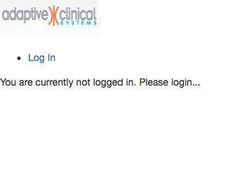
Nobody Logged In

Slide 30
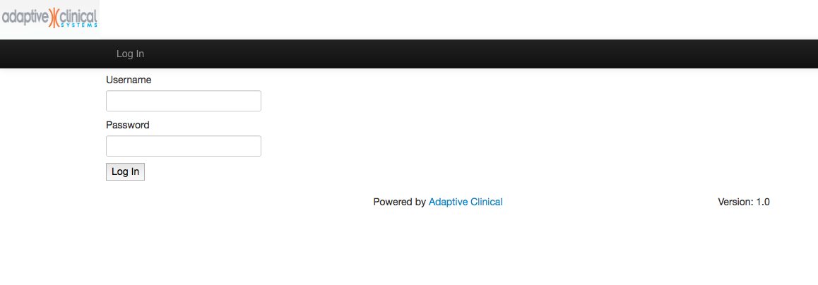
Log In Page

Slide 31
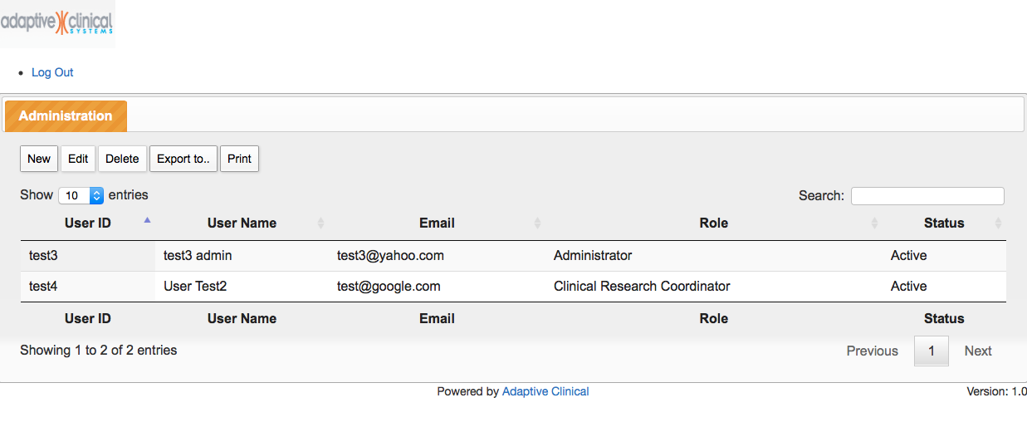
Admin Page

Slide 32
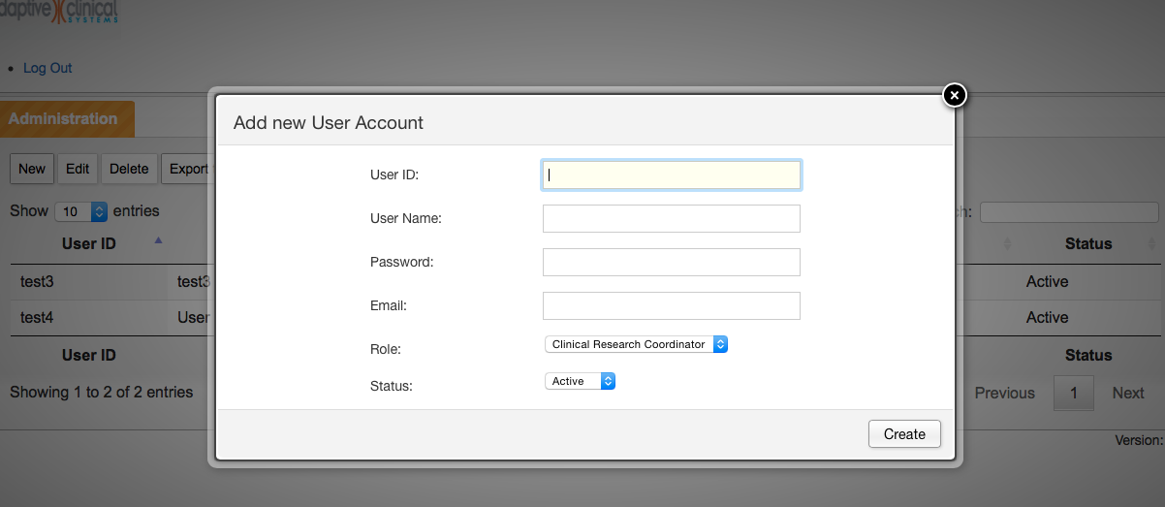
Add User Account

Slide 33
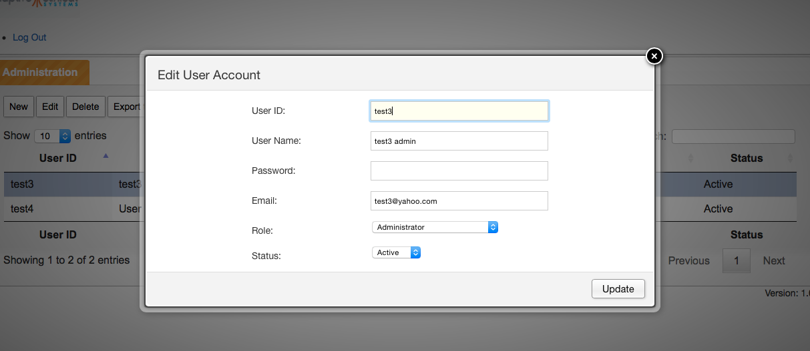
Edit User Account

Slide 34
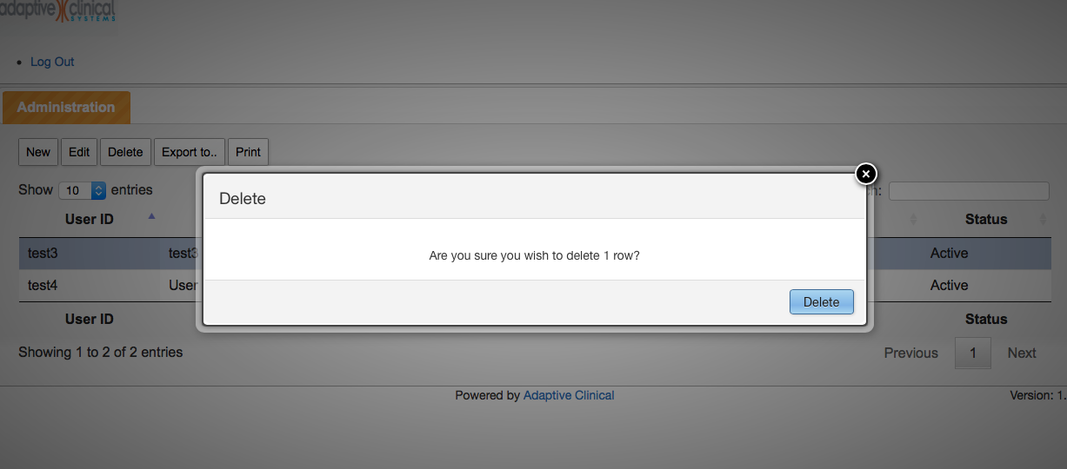
Delete User Account

Slide 35
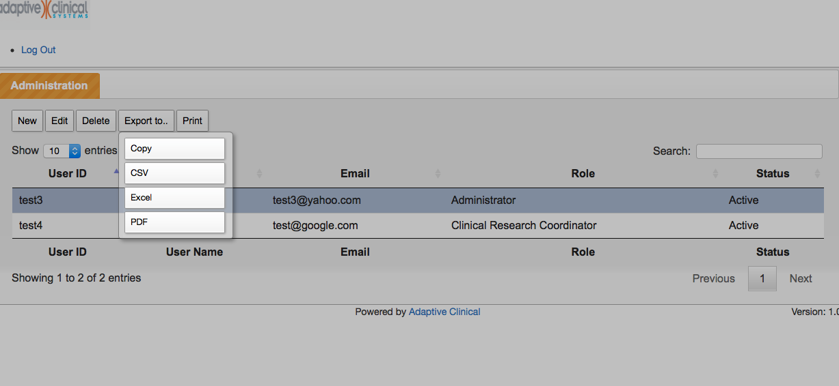
Export To

Slide 36
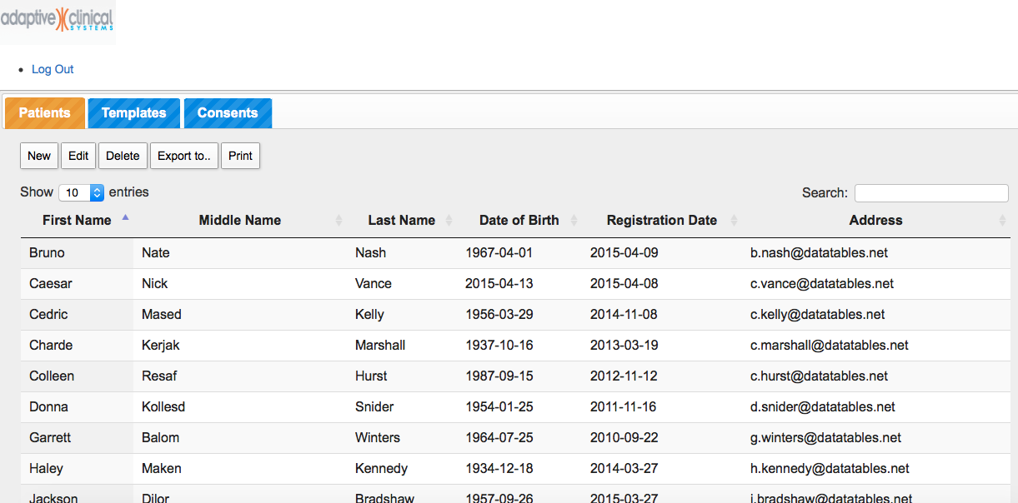
Patient Page

Slide 37
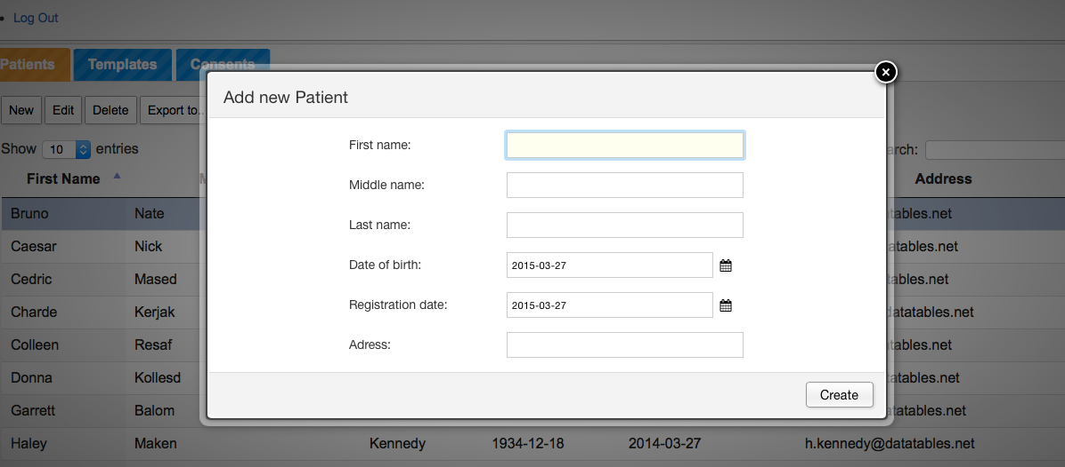
Add New Patient

Slide 38
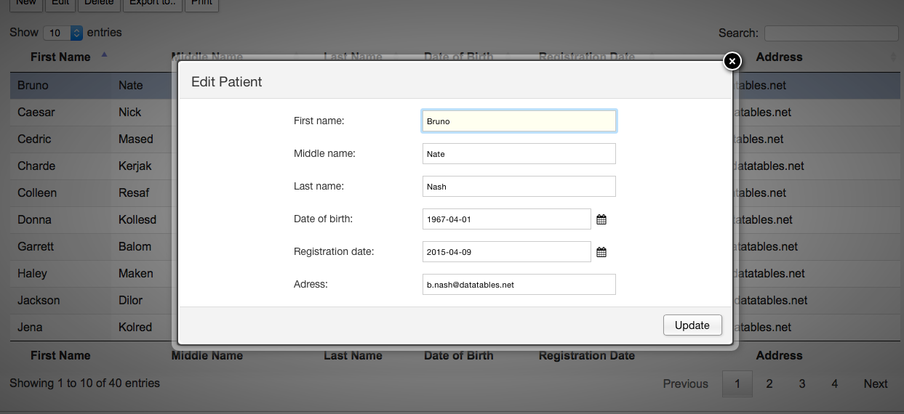
Edit Patient

Slide 39
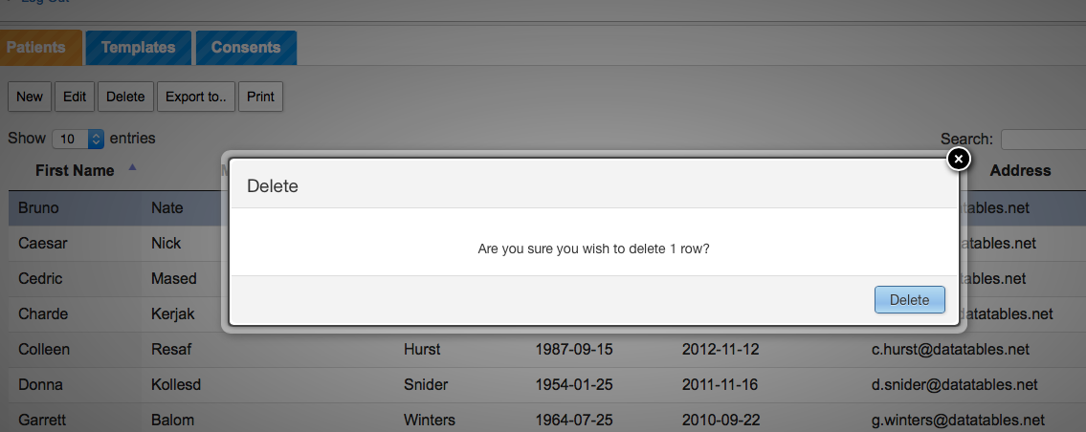
Delete Patient

Slide 40
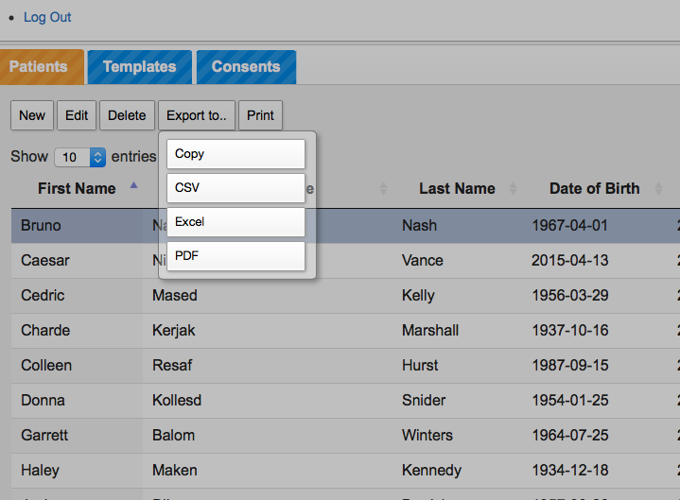
Export To

Slide 41
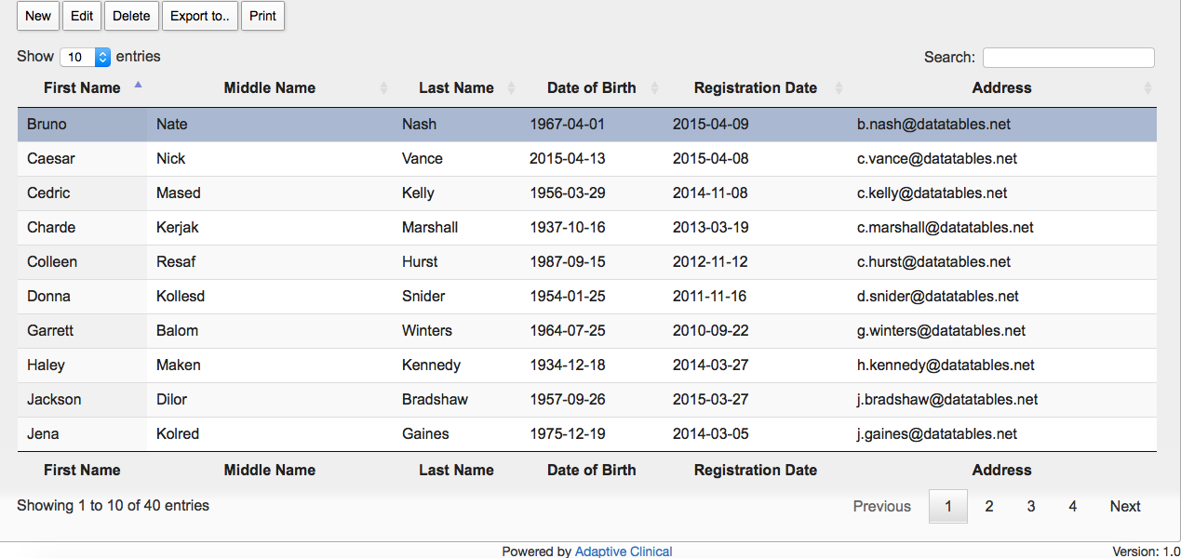
List of Patients

Slide 42
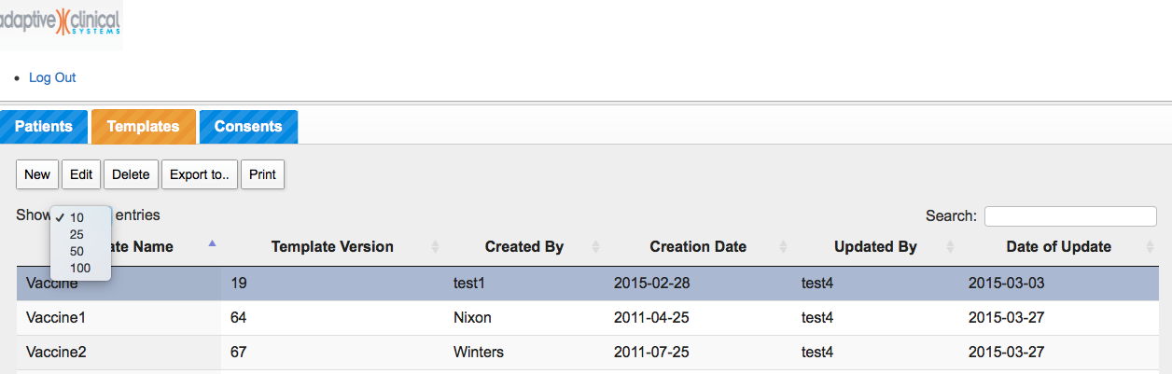
Main Template

Slide 43
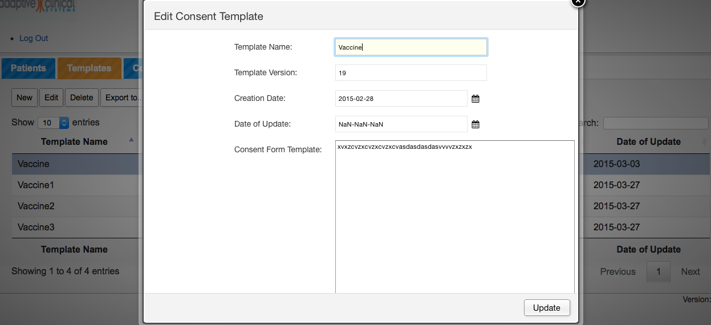
Edit Consent Template

Slide 44
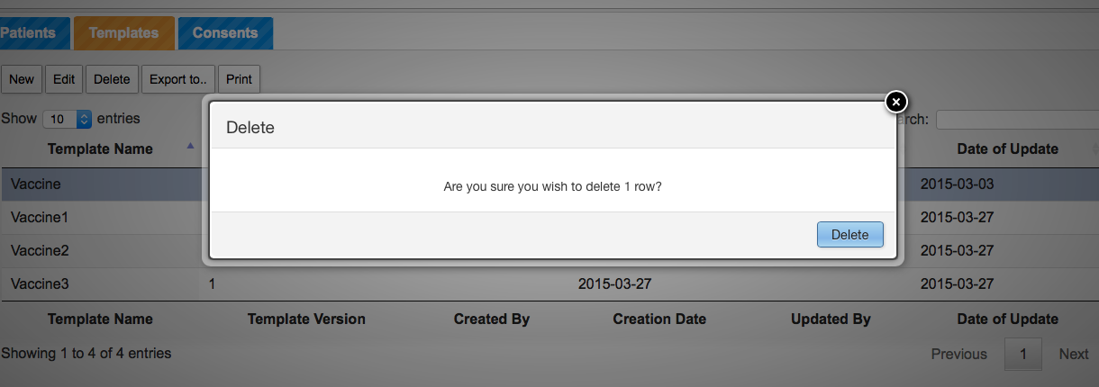
Delete Consent Template

Slide 45
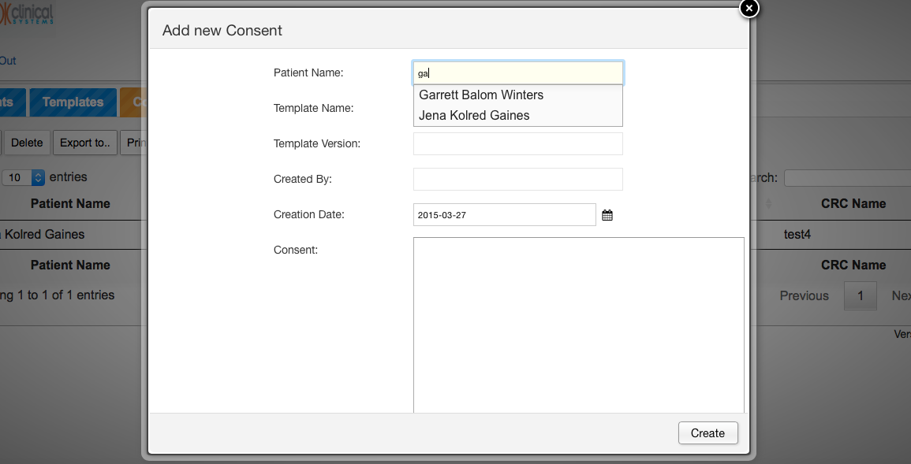
Add New Consent

Slide 46
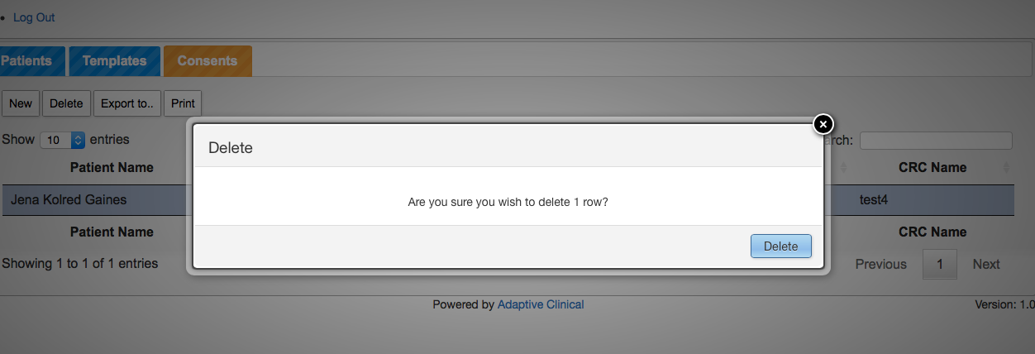
Delete Consent

