Slide 1
PathMapper
Anna Ptasznik
An Android app for recording and visualizing user-defined routes

Slide 2
What is PathMapper?

Slide 3
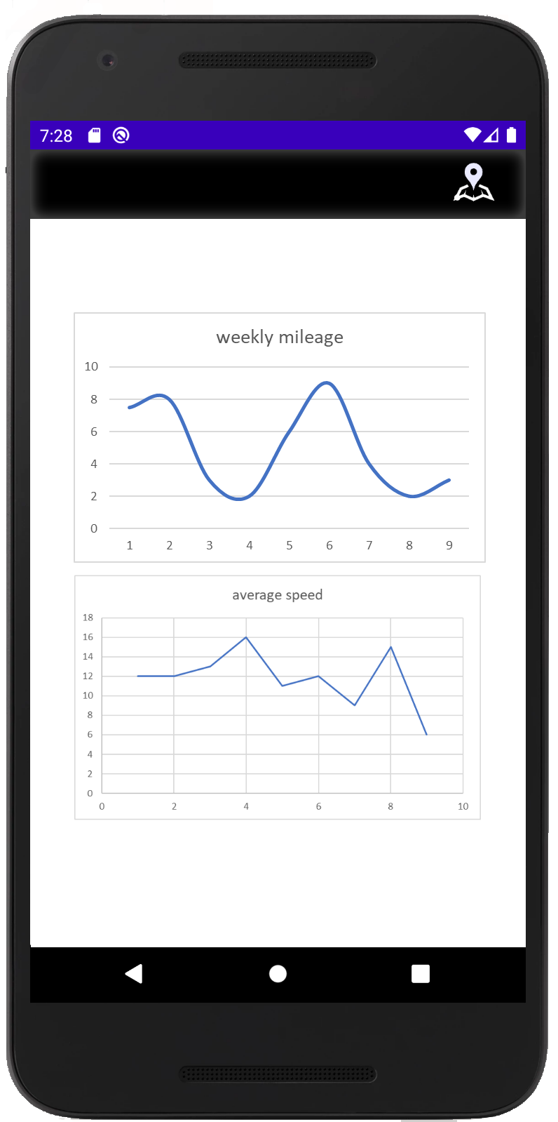
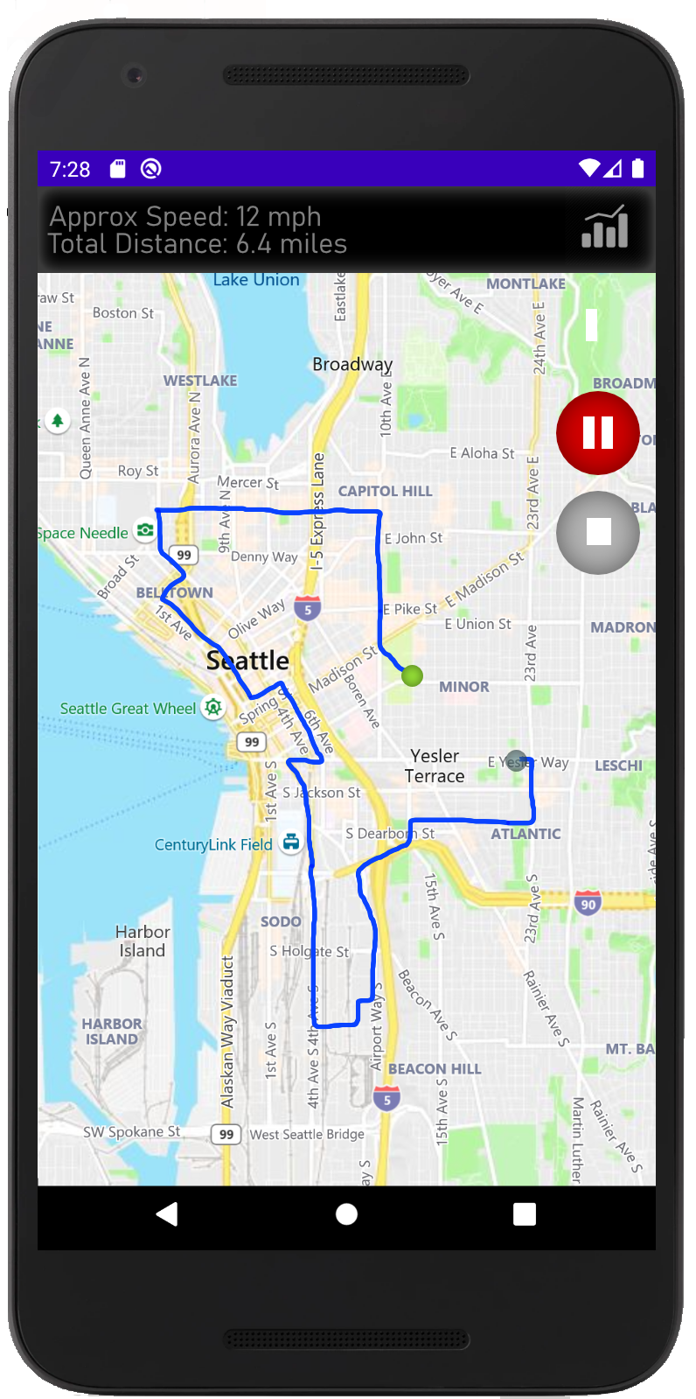
The Original Mock-Up

Slide 4
Project Evolution

Slide 5
How it Works: An Overview

Slide 6
How it Works: App Organization

Slide 7
Next Steps

