Slide 1


Combining Word Embeddings and Deep Neural Networks to Predict Structural Features in Proteins
Anna Reithmeir
Introduction to Bachelor‘s thesis
Advisor: Michael Heinzinger
5th December 2018

Slide 2
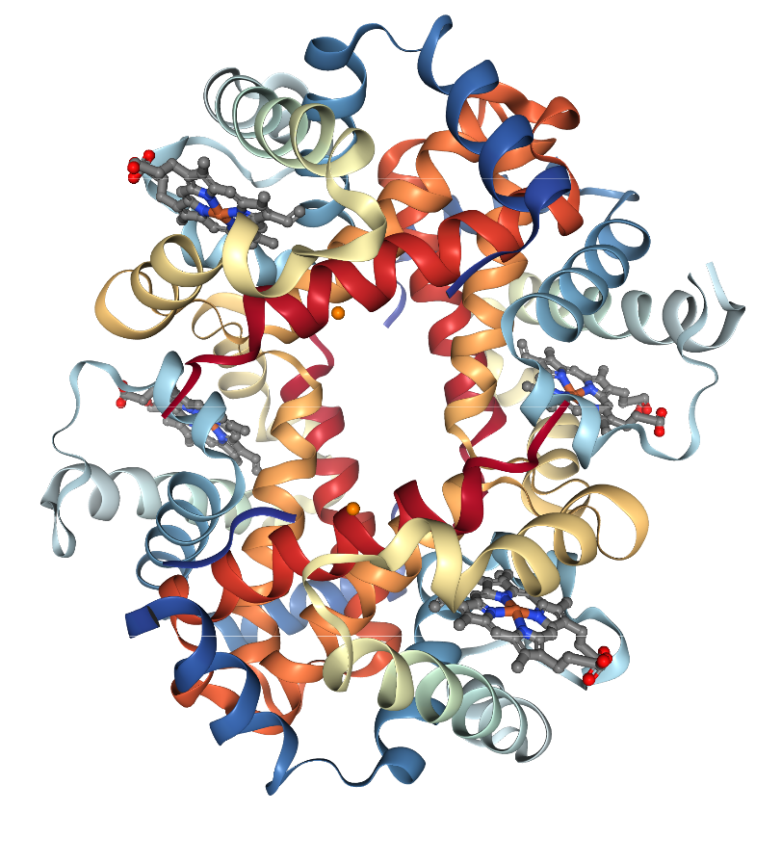
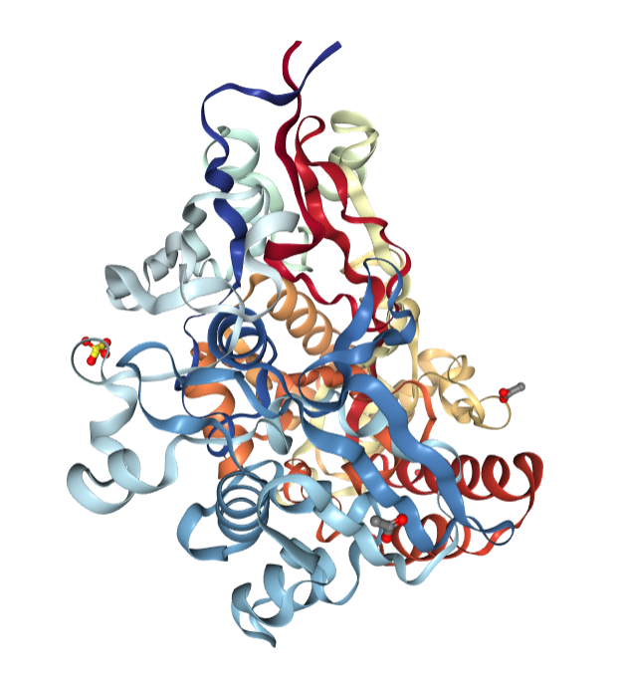
Overview
Project introduction
Dataset
Data preprocessing
Convolutional neural networks
Results so far
Outlook

Slide 3
Project Introduction
Secondary structure prediction with neural networks
Multi target prediction
  Secondary structure
  Solvent accessibility
  Flexibility
Integrate evolutionary information in ProtVec input
ProtVec representation on residue basis

Slide 4
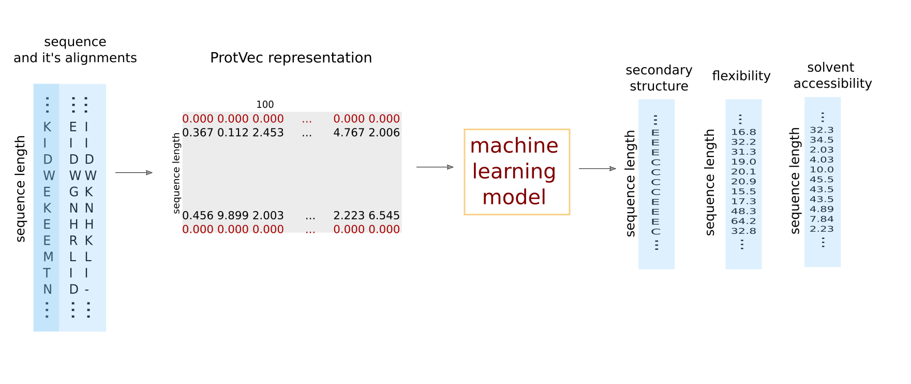
Project Introduction

Slide 5
Dataset
3313 protein sequences from PDB
According structure information,
solvent accessibility and flexibility
from DSSP algorithm
Aligned sequences for each protein
sequence

Slide 6
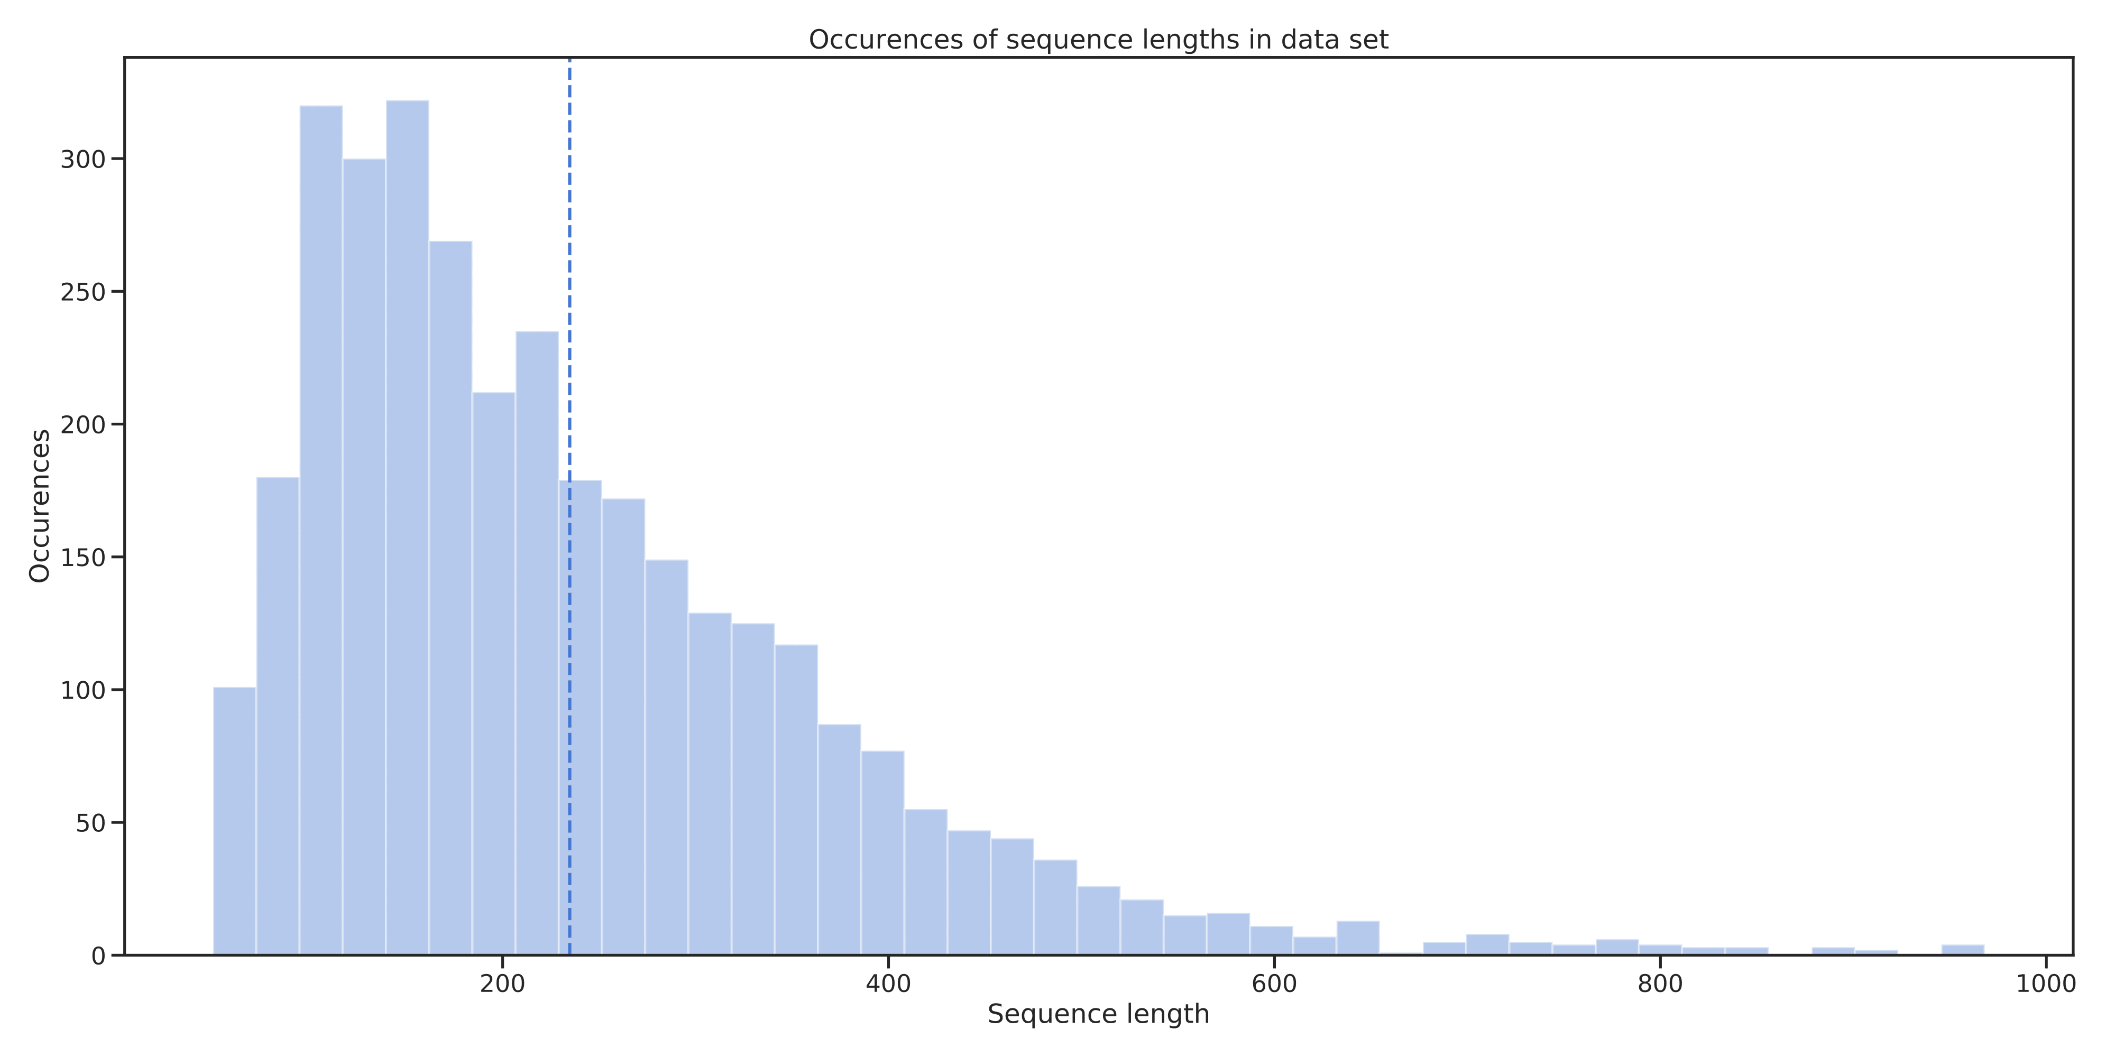
Dataset – Sequence Lengths
Avg: 235 residues

Slide 7
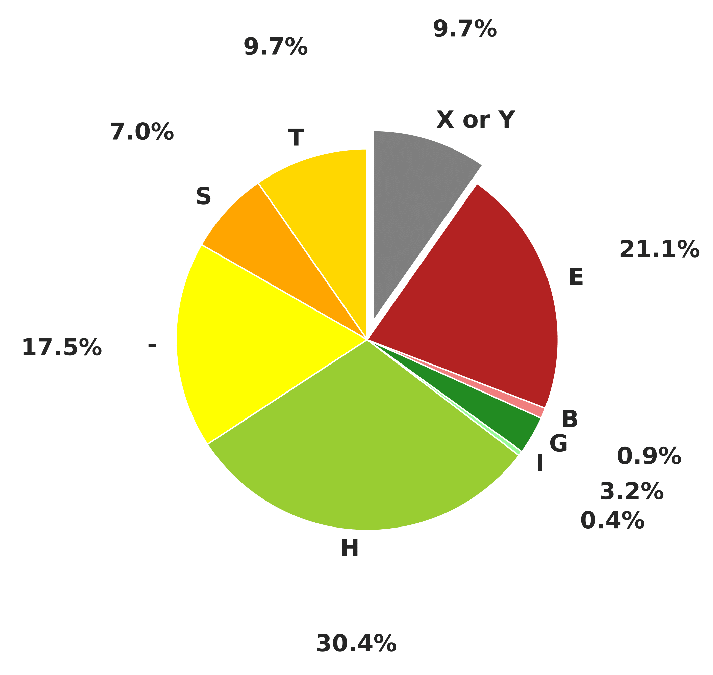
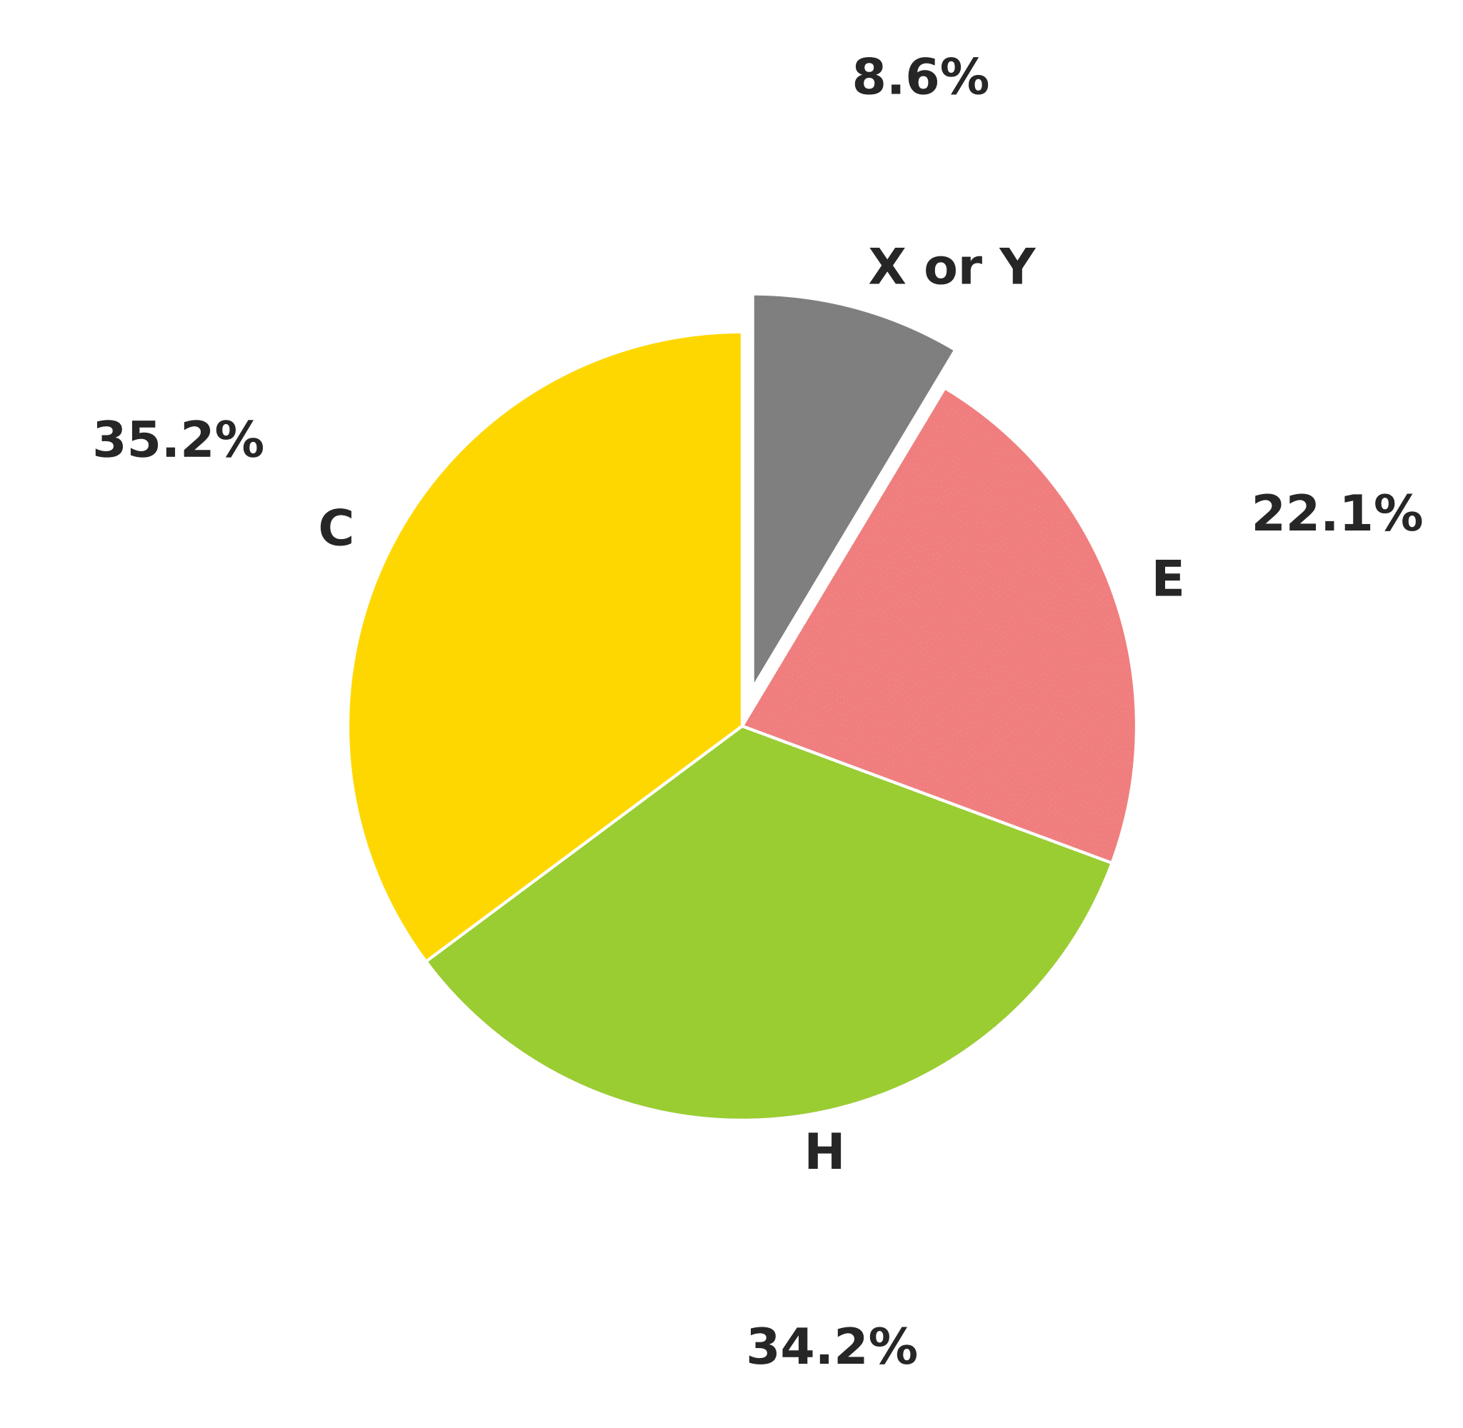
Dataset – DSSP States

Slide 8
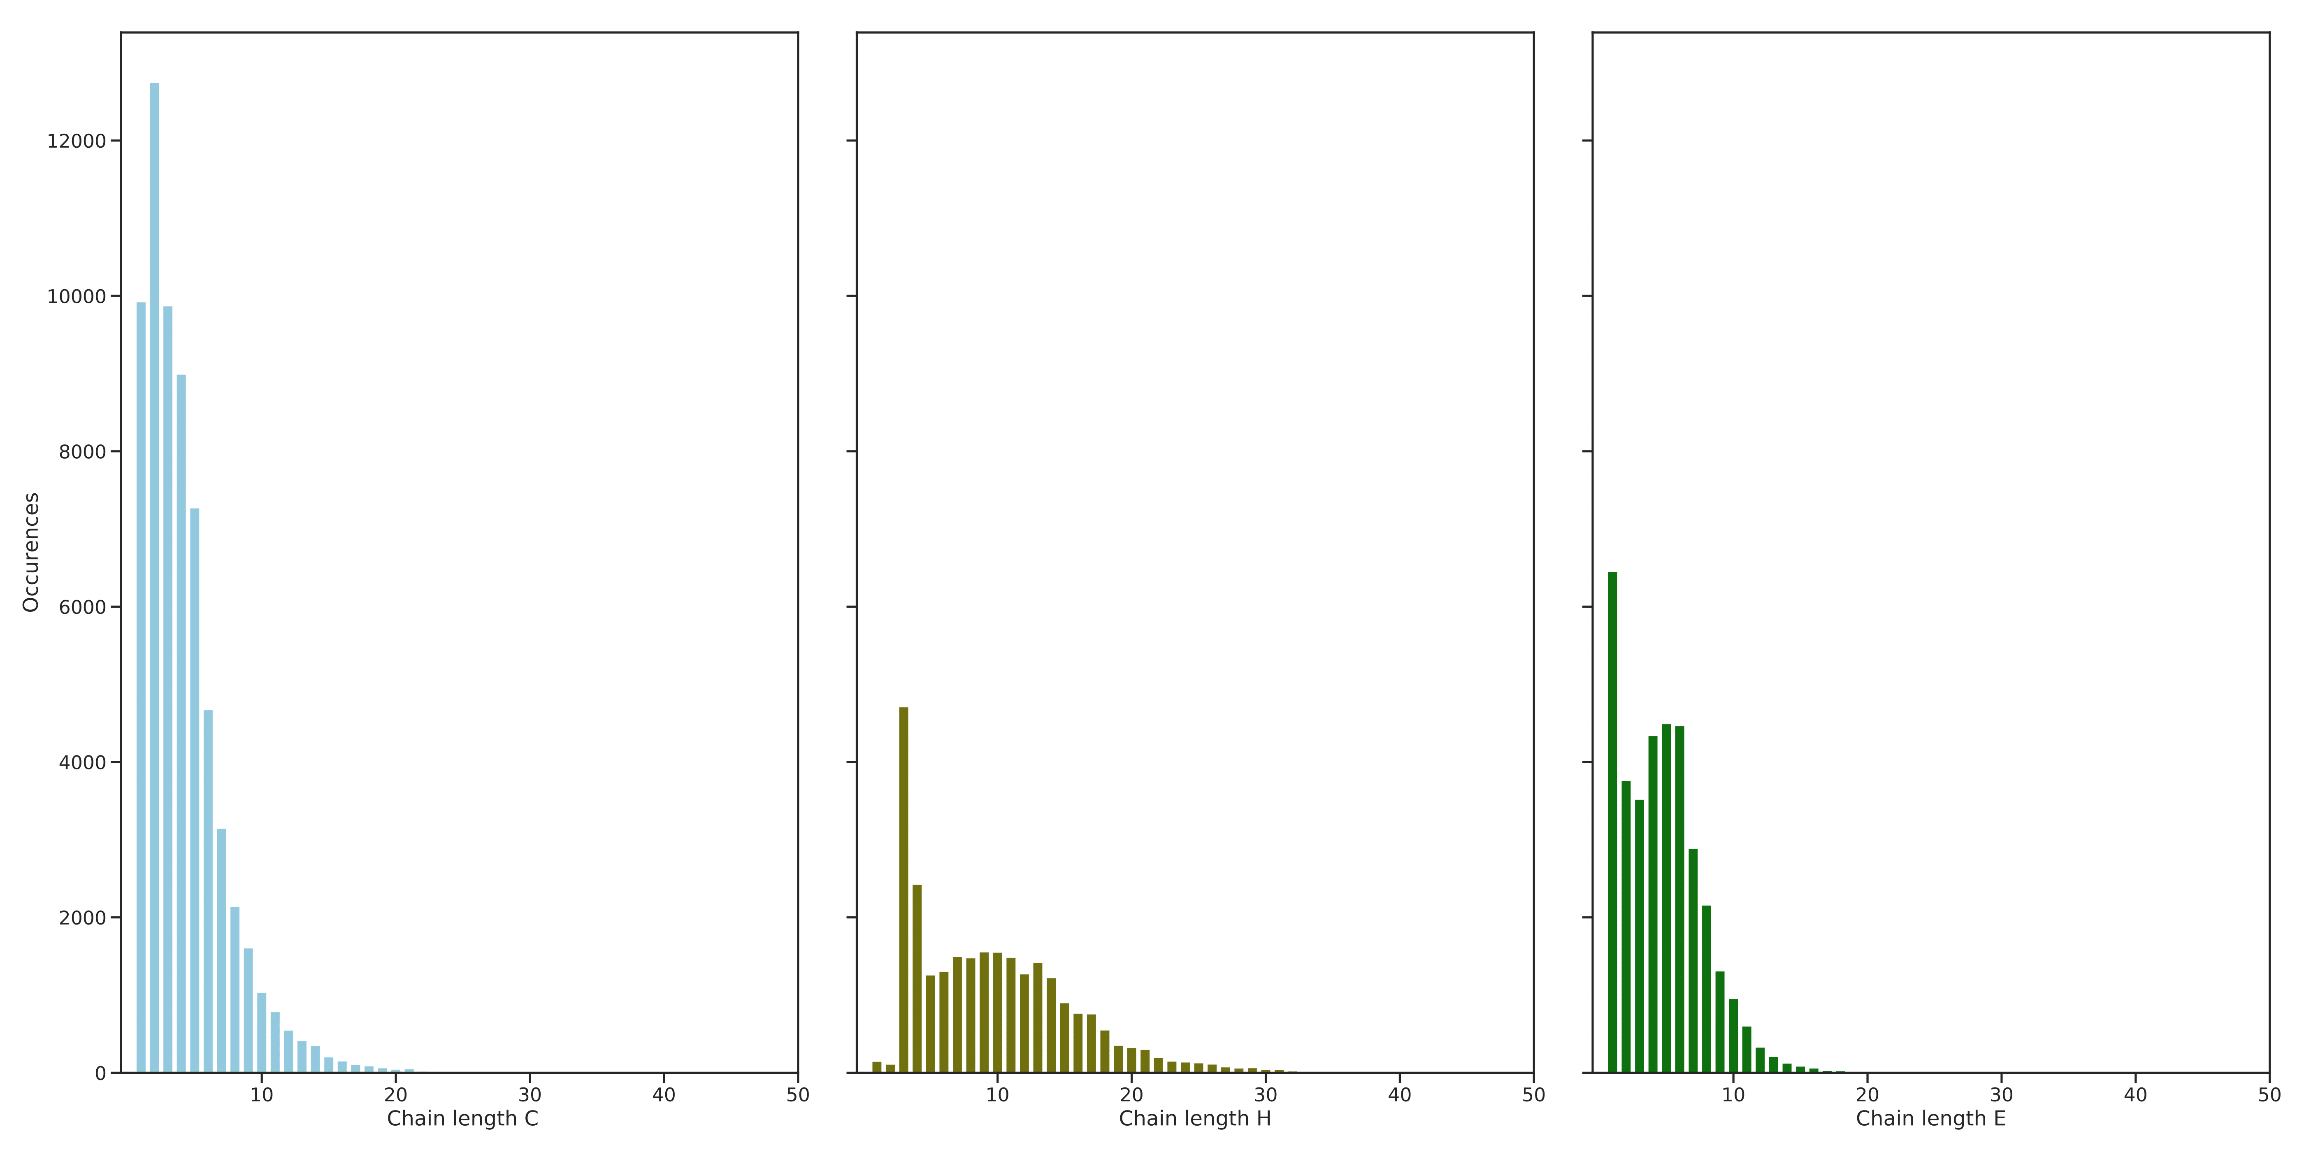
Dataset – DSSP-3 States Chains
Avg: 4,2 Avg: 9,8 Avg: 4,7

Slide 9
Dataset – Training, Validation, Test Set
20% of the samples → test set (649 samples)
Remaining 80% → train and validation set (2092 and 529 samples)
Random selection, assured equal distribution

Slide 10
Implementation So Far
Training and testing pipeline implemented
Simple CNN used
  3 layers
  Kernels: 1, 7, 15
  NLL loss + log_softmax
Secondary structure prediction without evolutionary information

Slide 11
Data Preprocessing
Protein sequences represented through word embeddings
ProtVec
  Vector embeddings learned through Word2Vec
  Vector for each possible n-gram, fixed length
3-grams, length 100

Slide 12
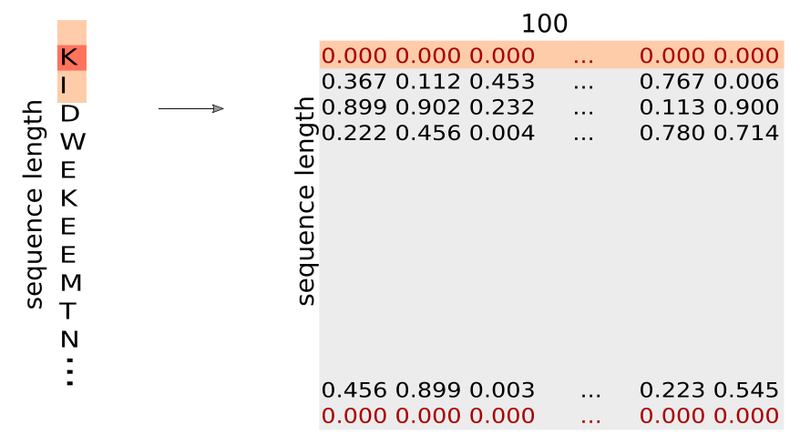
Data Preprocessing

Slide 13
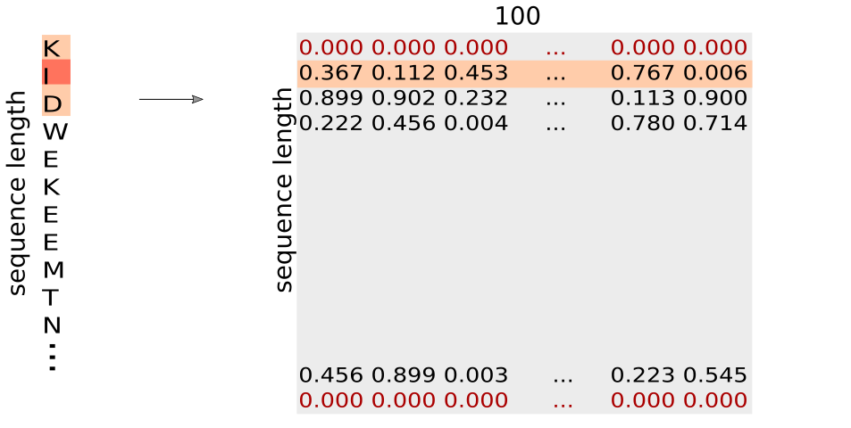
Data Preprocessing

Slide 14
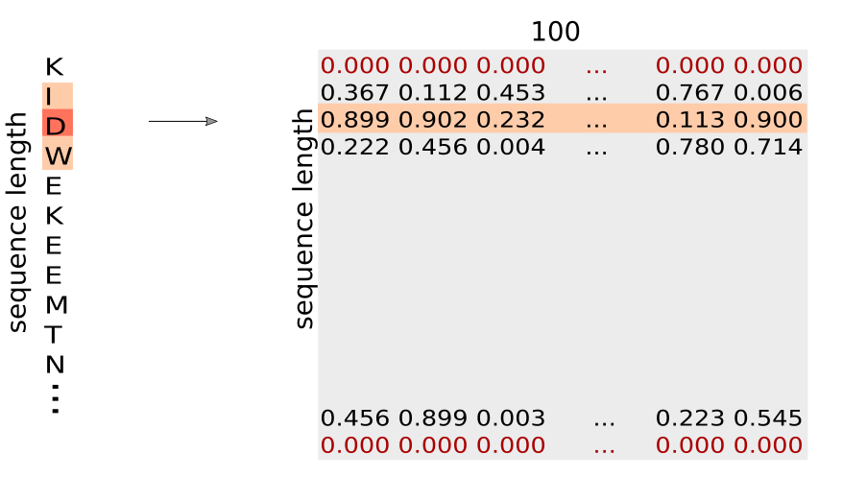
Data Preprocessing

Slide 15
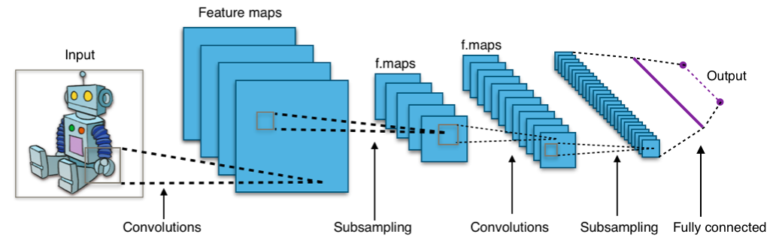
Convolutional Neural Networks
https://de.wikipedia.org/wiki/Convolutional_Neural_Network

Slide 16
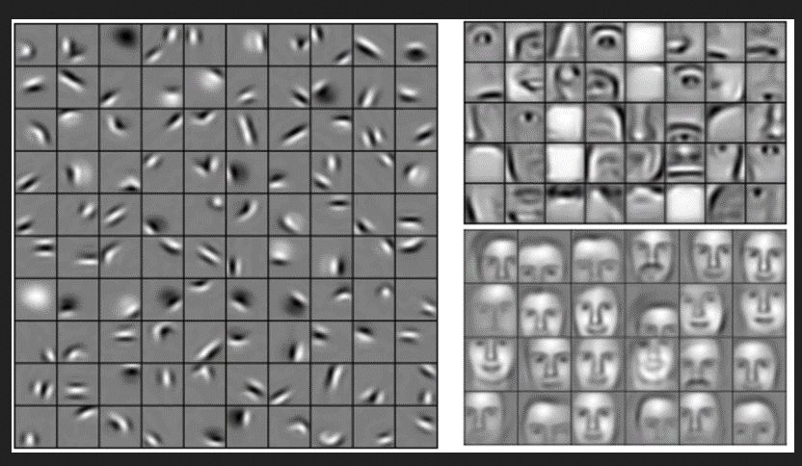
Convolutional Neural Networks
https://brohrer.github.io/images/cnn18.png

Slide 17
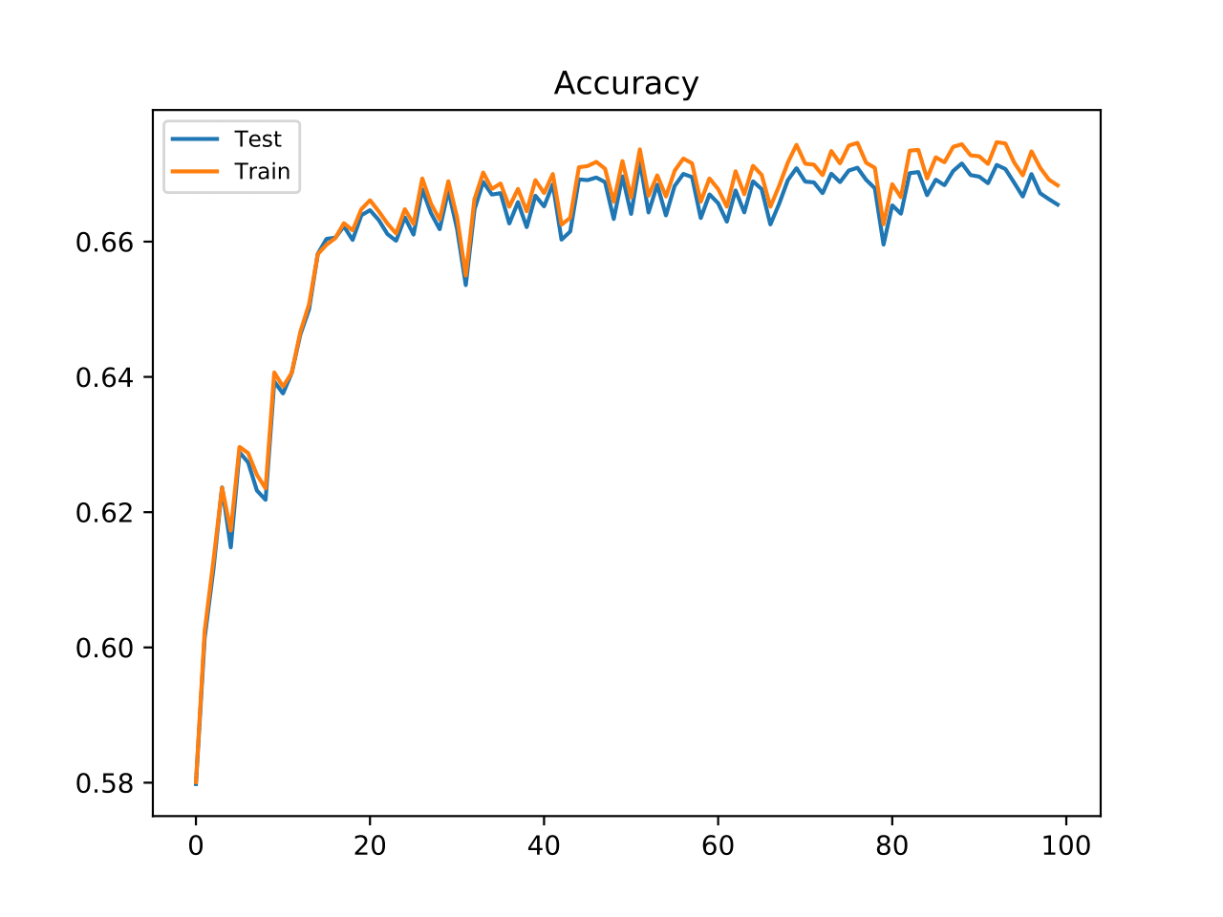
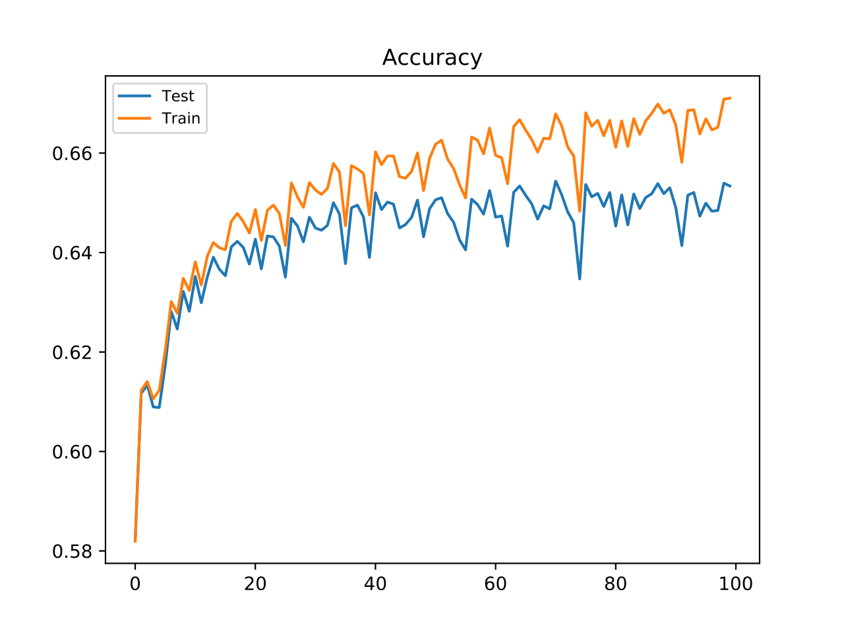
Results So Far – 1hot & ProtVec Accuracy
1hot
ProtVec

Slide 18
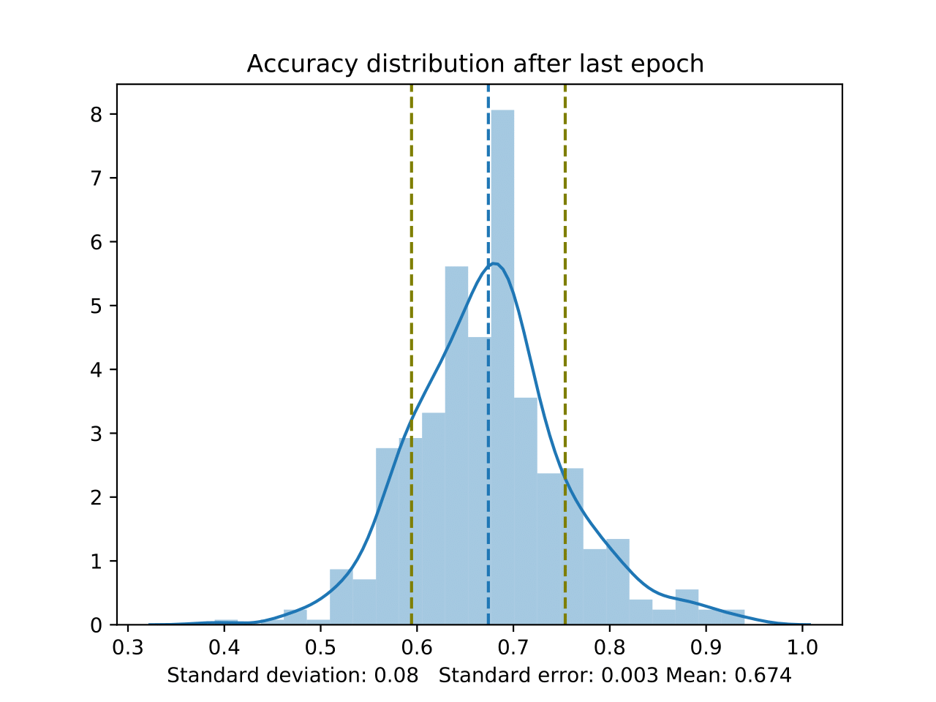
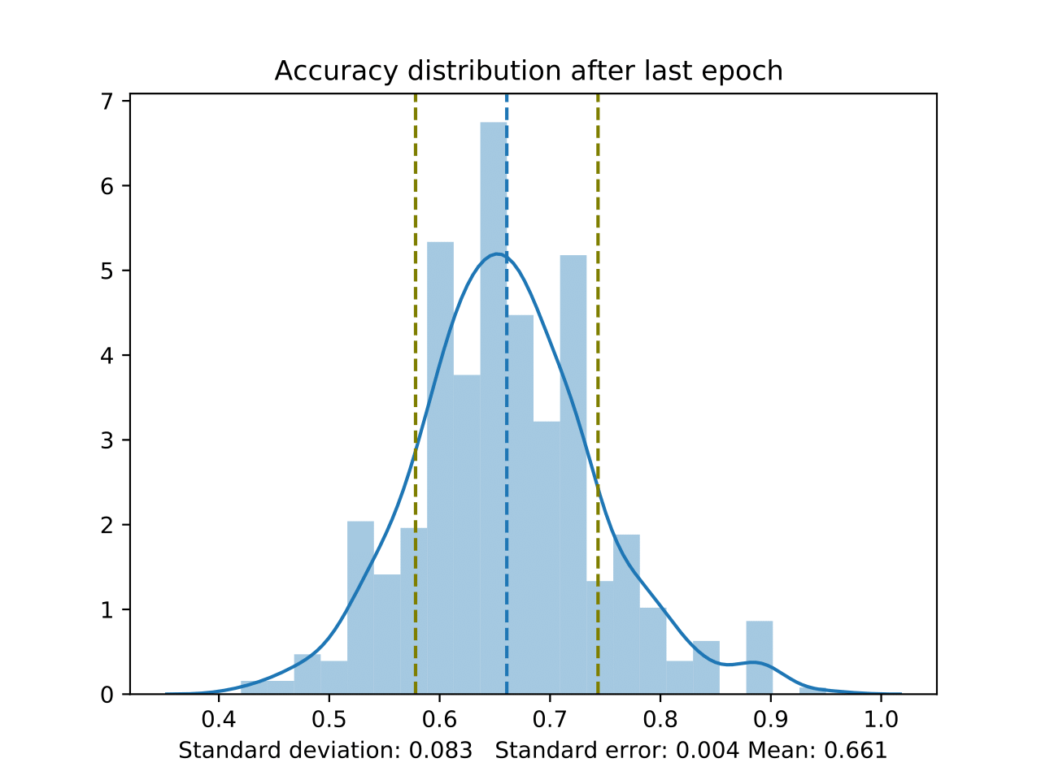
Results So Far – 1hot & ProtVec Accuracy
1hot
ProtVec
67.4% ± 0.003
66.1% ± 0.004

Slide 19
Outlook
Incorporate evolutionary information
Flexibility and solvent accessibility prediction
Tune hyperparameters
  Kernel sizes
  Regularization
  Non-linear activation functions e.g. SeLU
LSTM networks
  Capable of learning long-term dependencies

Slide 20
Thank You For Your Attention!

