Slide 1
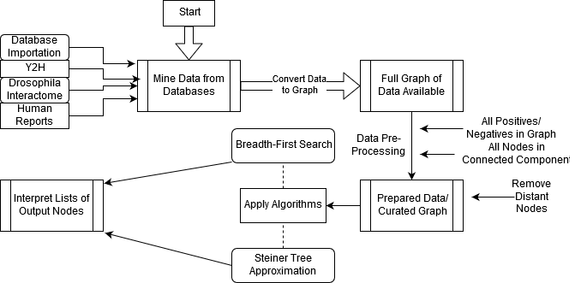
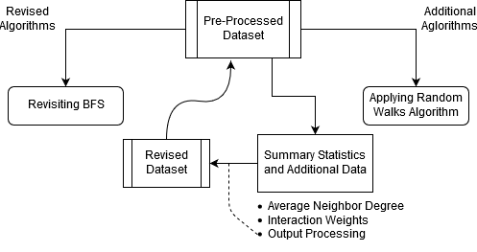
Exploration and Identification of Novel Fog Signaling Pathway Members via Application of [Placeholder] Algorithms
Miriam Bern, Wyatt Gormley, Elaine Kushkowski, Kathy Thompson, Logan Tibbetts[, Anna Ritz?]
Bio 331: Computational Systems Biology
Fog Signaling Pathway and Computational Investigation of Candidate Proteins
Methods and Approach
Results
Phase 1:
Pre-processing of initial dataset
Application of BFS algorithm
Application of ST algorithm
Fig 1. Chart describing approach to question during Stage 1 of our project.
Phase 2:
Revision of BFS algorithm.
Application of Random Walks algorithm.
Additional scrutiny of our data inputs and outputs (Summary Stats, Edge/Interaction Weights, Output Processing)
Fig 2. Chart describing our approach to the question during Stage 2 of our project.
Phase 1:
Cells respond to both internal events and external stimuli by producing a variety of signaling molecules.
These signaling molecules cause changes within the target cell(s) by activating a sequence of chemical messengers and effectors.
These sequences of molecules and the other proteins they interact with constitute Signaling Pathways.
Identifying the relevant contributors to a signaling pathway are necessary to understand it.
The Fog signaling pathway is responsible for the process of cellular Apical Constriction.
Apical Constriction is instrumental for correct morphogenesis during development; disruption of the Fog pathway is pathogenic.
Using a traditional experimental approach to find new members of a pathway may cost an enormous amount of time and money.
Many graph algorithms have been applied as a way of finding new genes and proteins of interest to investigate.
Fig 3. List of proteins resulting from application of BFS.
Fig 4. List of proteins resulting from application of ST approximation.
Driving Question: Can we find previously unassociated members of the Fog pathway by using a computational approach?
Phase 2:
Fig 5. Results of BFS from Positives -> NMII Fig 6. Results of Random Walk w/ Restarts from NMII
Findings and Implications
Future Directions
Due to time constraints, we were unable to apply [x]. We think [x] may be valuable to this project due to reason [y].
Candidate genes/proteins identified by this project will be tested experimentally by students under the supervision of Dr. Applewhite. This data will then be used to revise our models and improve the accuracy of future iterations of this project.
References
Acknowledgments
Manning, A.J., and Rogers, S.L. (2014). The Fog signaling pathway: Insights into signaling in morphogenesis.Developmental Biology394, 6–14.
[Maybe more.]
Thanks Anna!

