Slide 1
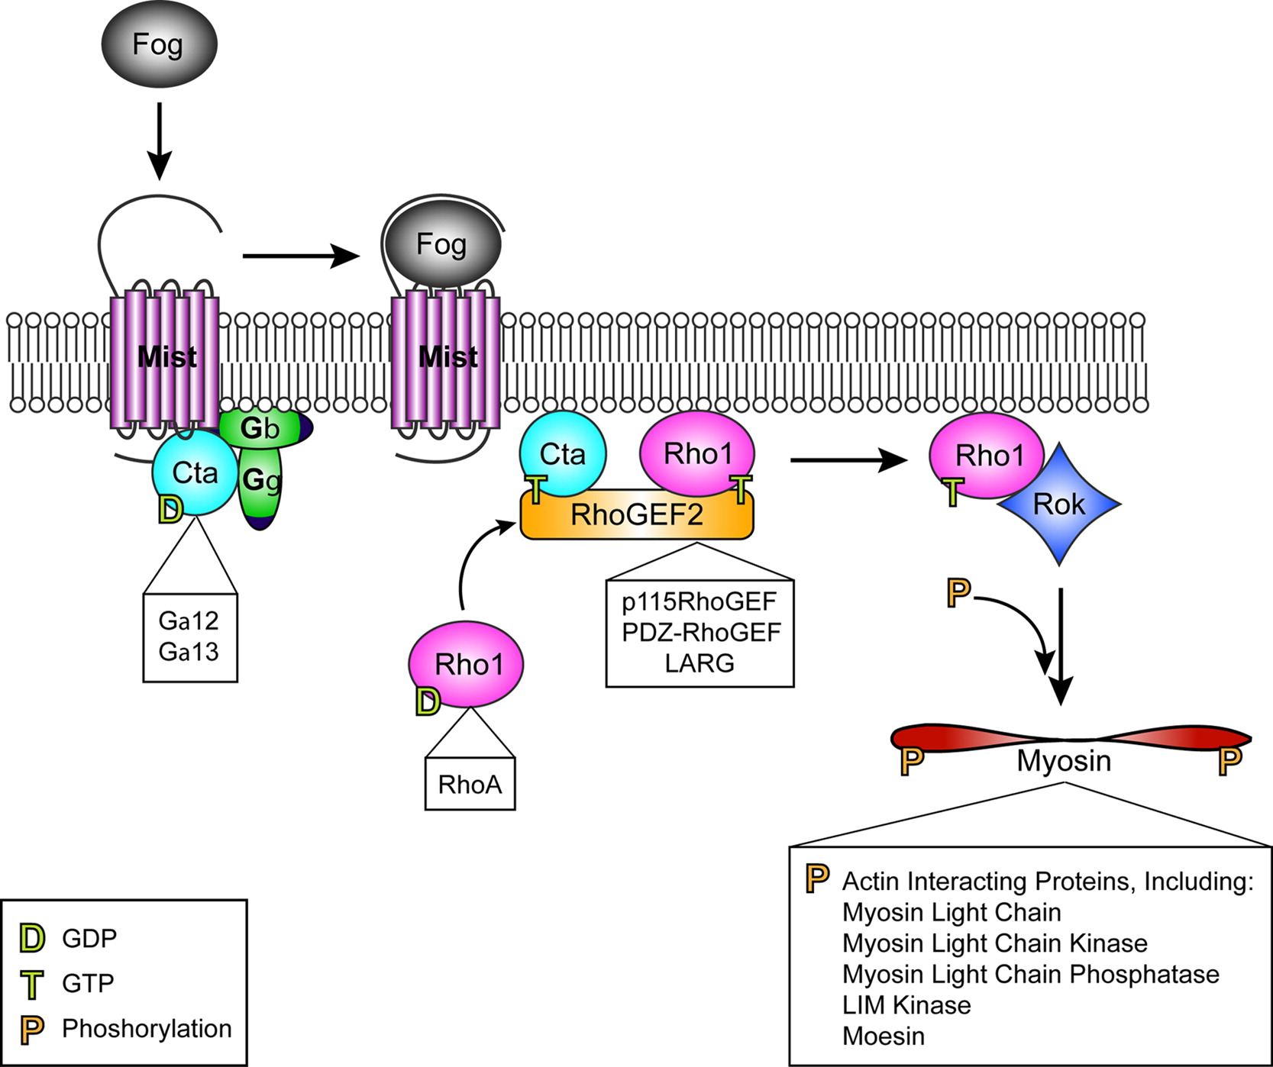
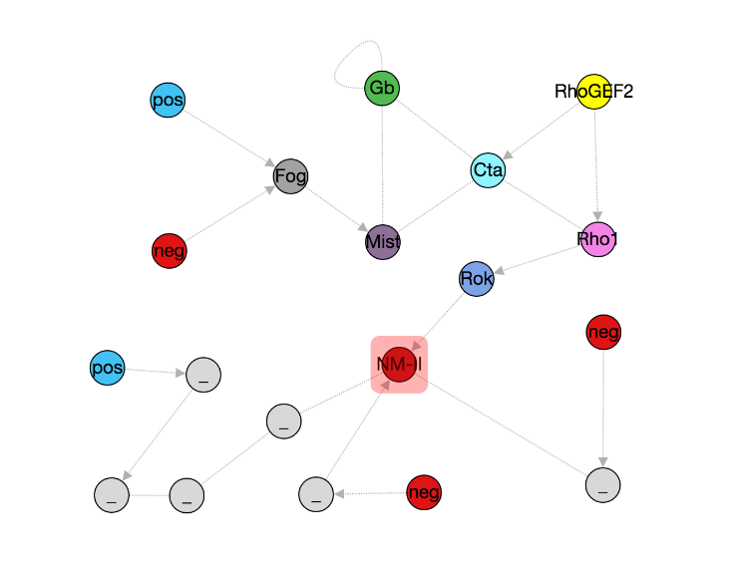
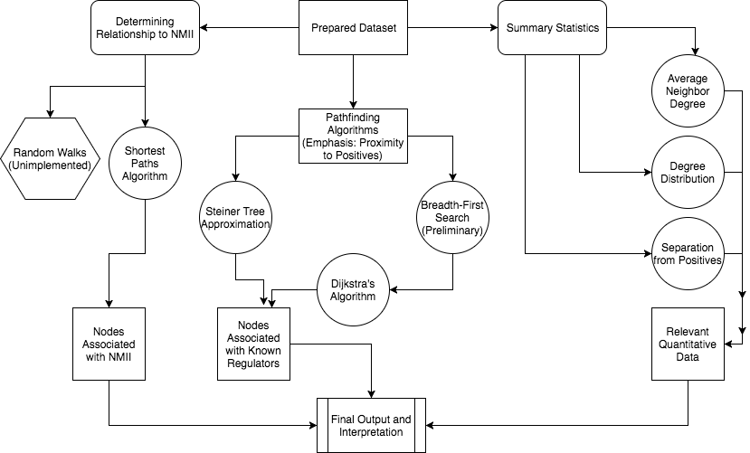
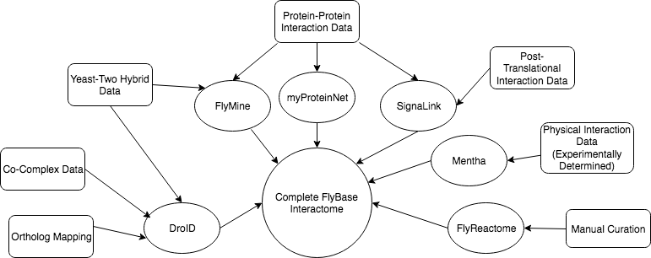
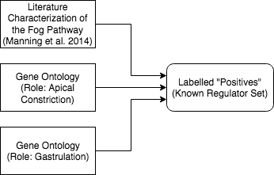
Exploration and Identification of Novel Fog Signaling Pathway Members via Application of Pathfinding Algorithms
Miriam Bern, Wyatt Gormley, Elaine Kushkowski, Kathy Thompson, Logan Tibbetts, Anna Ritz
Bio 331: Computational Systems Biology
Computational Investigation of the Fog Signaling Pathway
Methods and Approach
Results
14-3-3epsilon | Hsc70-4 | Pkc53E | Ubi-p63E | nonA-l
14-3-3zeta | Hsp83 | Rbp9 | drk | sbr
Act42A | Myc | Smox | dsh | sgg
Act5C | N | Smurf | fne | spi
Akt1 | Nab2 | Spn | gro | -
Appl | Nedd4 | Stat92E | gskt | .
Cdc5 | NetB | Su(dx) | mts | .
CkIIalpha | Pi3K21B | Ubi-p5E | nej | .
Table 1. List of proteins resulting from application of Dijkstra’s algorithm.
CG10347 | CG7164 | His3:CG33839 | Nup54 | Spn
CG11581 | Chi | Khc | Pkn | Ten-m
CG17666 | CtBP | Lcp4 | Rac1 | Ubi-p63E
CG34168 | DCTN3-p24 | Lsd-2 | Sgt | eIF4G2
CG34227 | Drep2 | NetB | Sin3A | gro
In order to respond to an internal or external stimulus, cells produce and utilize a variety of proteins. More proteins are then recruited in turn to coordinate and effect the necessary changes in the cell. The sequence of proteins running from stimulus to effector are known collectively as a Signaling Pathway.
The Fog Signaling Pathway (above, left) is essential for the process of Apical Constriction. Apical Constriction is a critically important part of Gastrulation, and disruptions to this pathway during development are pathogenic.
Experimental investigation of these pathways can be time consuming and expensive. Graphs may be used to represent protein-protein interactions. Applying pathfinding algorithms to these networks is a way to find new proteins for investigation and improve the efficiency and quality of research.
The example graph (above, right) describes a hypothetical graph representing the relationships of the proteins in the Fog pathway. By evaluating the attributes and relationships of known members in the pathway we are better able to determine which uninvestigated proteins are the best candidates for further investigation.
Our primary approach focused on the identification of candidate genes based on their relationship with known regulators. In this approach, we implemented multiple pathfinding algorithms. Our implementation of a Steiner Tree approximation allowed us to determine which nodes are most relevant as intermediary connections between identified positives. In our preliminary work, a Breadth-First Search (BFS) algorithm was used to determine which nodes were proximal to the most positives - this was supplanted with an implementation of Dijkstra’s algorithm for final output.
Non-Muscle Myosin II (NMII) is an integral effector during Apical Constriction – because of this, we determined it was important to produce a set of outputs with specific relevance to NMII. We did this by implementing a BFS algorithm to find nodes which were relevant to the shortest path between NMII and other positives.
Table 2. List of proteins resulting from application of ST approximation.
14-3-3 epsilon | Acam | Act57B | Alk | CG10347 | CG17666 | CG7164 | Cam | CanB2 | Chi | CkIIalpha | CycB
Cyp4g1 | Df31 | Diap2 | Drep2 | Hsp83 | Khc | Lsd-2 | Moe | N | Patj | RPA2 | Rad51D
RfC3 | RpA-70 | Sema-1a | Sin3A | Snapin | Spn | Spps | Ten-m | Tl | Ubi-p63E | alc | cep290
cher | csw | dally | eIF4G2 | ems | esc | eya | flw | p53 | qkr58E-1 | sgg | wbl
Driving Question: Can we find previously unassociated members of the Fog pathway by using a computational approach?
Table 3. List of proteins resulting from a BFS from Positives to Non-Muscle Myosin II
Inputs and Preprocessing
Discussion and Future Directions
Application of our each algorithms (Dijkstra’s, ST approx., Shortest Paths) has produced a separate list for proteins of interest. Of these, we received a total list of 107 distinct genes. We would like to emphasize the 24 genes in Table 4 because they appeared in the output of multiple algorithms. Due to time constraints, we were unable to apply a Random Walk with Restarts from NMII. We think this algorithm may be valuable as an additional method of determining a protein’s level of association with NMII. Results of output from our Steiner Tree algorithm are approximate and therefore variable. Running and evaluating additional iterations may help us determine the relative frequency with which proteins appear in this output.
Candidate genes/proteins identified by this project will be tested experimentally by students under the supervision of Dr. Applewhite. This data will then be used to revise our models and improve the accuracy of future iterations of this project.
14-3-3zeta | CG7164 | CG10347 | CG17666 | CkIIalpha | Chi
Drep2 | Hsp83 | Khc | Pi3K21B | 'Pkc53E | Spn
Ubi-p63E | Lsd-2 | Ten-m | Sin3A | Ubi-p63E | eIF4G2
drk | sgg | mts | Spn | dsh | -
This project utilized a composite produced from six prior interactome for its analysis to increase its scope and accuracy. The above figure identifies the component interactomes and which types of data were used to produce them. A list of known regulators or “Positives” was generated from known regulators of the Fog pathway in the literature (reviewed by Manning et al. 2014), as well as genes essential to relevant processes (Apical Constriction and Gastrulation) from Gene Ontology databases. After assembly, some nodes were removed to decrease runtime. Nodes were removed if they were not present in the largest connected component or if they were greater than four edges away from the nearest known regulator.
Table 4. List of proteins found in more than one output.
References
Acknowledgments
Manning, A.J., and Rogers, S.L. (2014). The Fog signaling pathway: Insights into signaling in morphogenesis. Developmental Biology 394, 6–14.
Thanks Anna!

