Slide 1
Reassembly stats workshop
Anna & Nico
01.09.2026

Slide 2

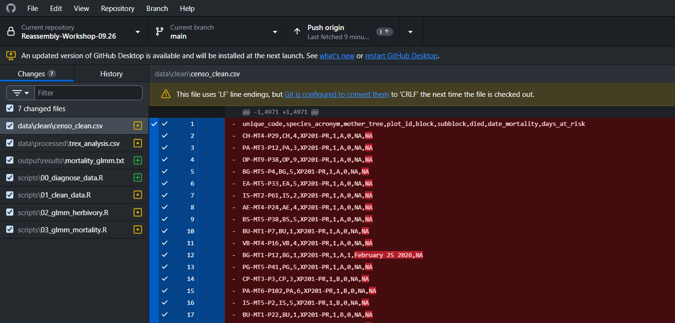
How to organize your project
Several ways to connect R to GitHub
You can keep track of changes
Shared projects
Project in the cloud
https://github.com/annarlandim/Reassembly-Workshop-09.26

Slide 3
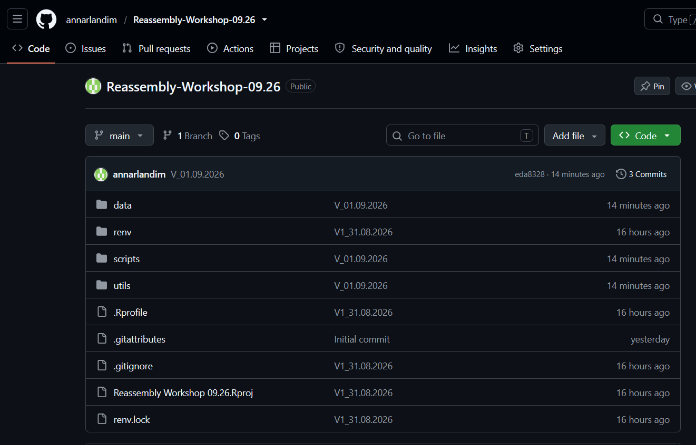
Organizing your project
Rproject
Data:
Raw
Clean (corrected)
Processed (changed)
Renv
Libraries
.gitignore
(everything you dont want
to go to github)
Readme
Scripts
Utils
functions (script with all built-in function)
workflow (script that calls all other scripts)
Output
Figures
.csv and RDS with results

