Slide 1
AI - Health Symptom Checker
IBM AICTE PROJECT
Presented By: Annasha
Student name : Annasha Saha
College Name & Department : University of Engineering & Management, Kolkata and Computer Science Engineering (Artificial Intelligence & Machine Learning)

Slide 2
OUTLINE
Problem Statement
Technology used
Wow factor
End users
Result
Conclusion
Git-hub Link
Future scope
IBM Certifications

Slide 3
Problem Statement
People often face symptoms like fever or fatigue but lack quick access to reliable health information. Searching online can be confusing or misleading, highlighting the need for a trusted, easy-to-use tool that educates without diagnosing.
Proposed Solution:
Health Symptom Checker is an AI chatbot built on IBM Watsonx.ai (Lite) that analyzes symptoms described in natural language and provides possible causes, urgency levels, self-care tips, and guidance—using trusted sources like CDC and WHO.

Slide 4
Technology used
IBM cloud lite services
Natural Language Processing (NLP)
Retrieval Augmented Generation (RAG)
Prompt-based AI technology for conversational flows
IBM Granite model

Slide 5
IBM cloud services used
IBM Cloud Watsonx AI Studio
IBM Cloud Watsonx AI runtime
IBM Cloud Agent Lab
IBM Granite foundation model

Slide 6
Wow factors
Fully built and deployed using IBM Cloud Lite with no paid upgrades.
Simple setup with no complex data pipelines or training required.
Provides friendly, educational health guidance based on trusted medical sources.
Prompt-based conversational flow for easy customization and updates.
Can be integrated as a web chat widget or previewed instantly for user interaction.

Slide 7
End users
Individuals experiencing mild symptoms seeking quick health insights
Students and working professionals looking for trusted, on-demand symptom guidance
Health educators or wellness coaches needing a supportive AI assistant
Anyone wanting reliable, non-diagnostic information for informed health decisions

Slide 8
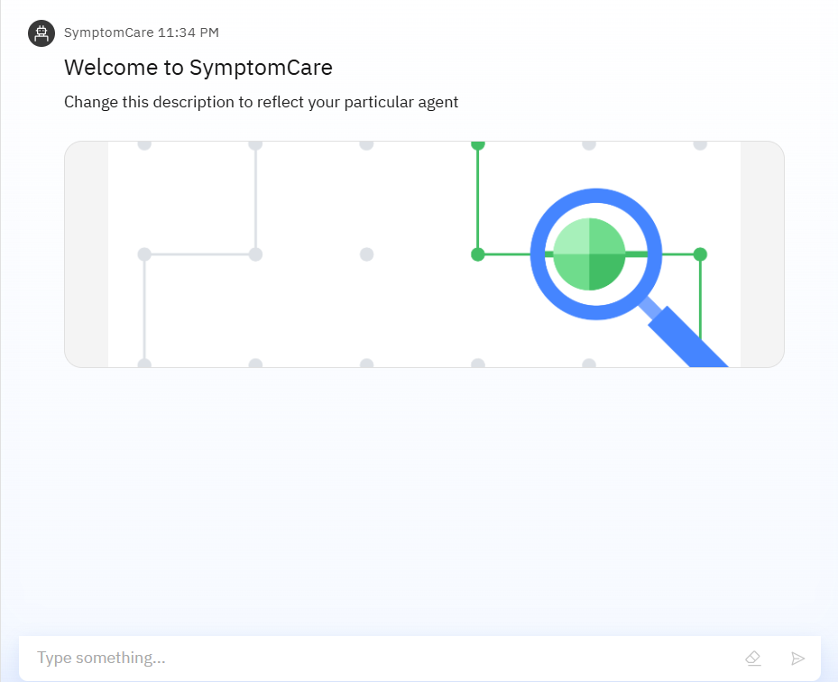
Results

Slide 9
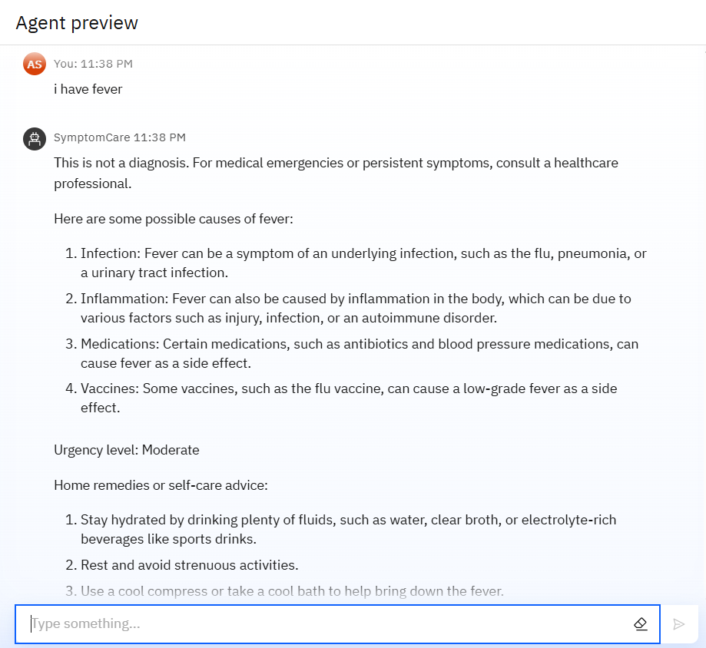
Results

Slide 10
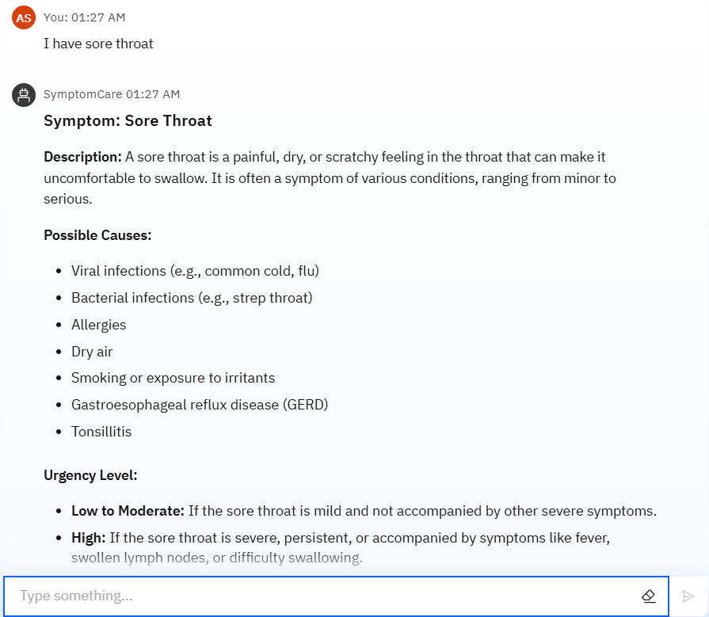
Results

Slide 11
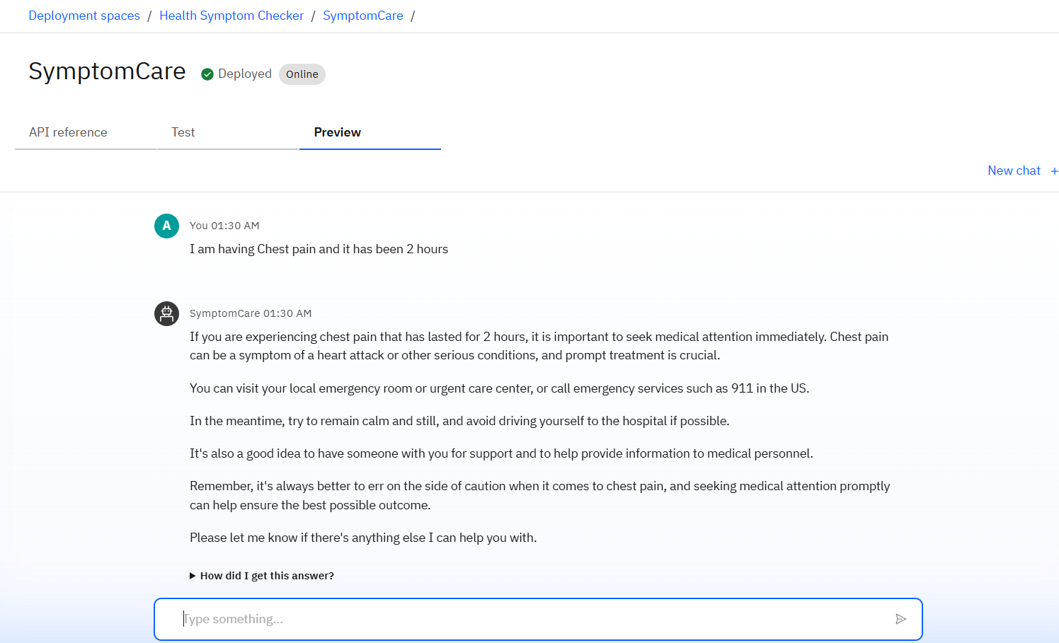
Results
Deployed AI Agent

Slide 12
Conclusion
The Health Symptom Checker AI agent leverages IBM Cloud Lite’s free services to deliver accessible, educational health guidance based on user-described symptoms. This project demonstrates how prompt engineering and IBM Watsonx.ai can be used to build effective, no-cost conversational AI assistants that support informed health decisions—without requiring complex infrastructure or training.

Slide 13
GitHub Link
https://github.com/annasha234/Health-Symptom-Checker

Slide 14
Future scope
Add user profile tracking for personalized health insights
Enable voice-based interaction using IBM Watson Speech-to-Text and Text-to-Speech
Integrate with wearable health devices for real-time symptom monitoring
Expand to multi-language support for broader accessibility
Enhance responses using advanced RAG-based knowledge retrieval for deeper context and accuracy

Slide 15
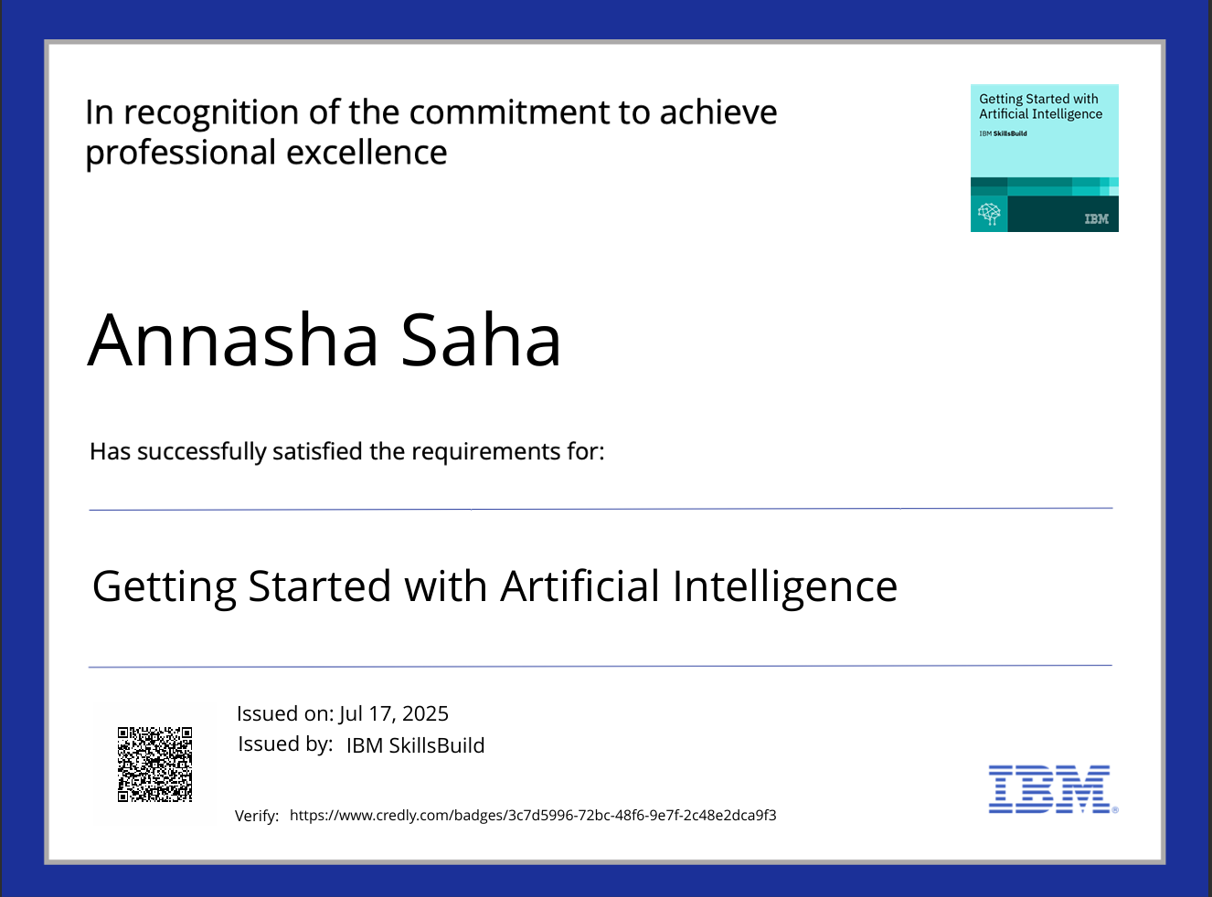

IBM Certifications

Slide 16
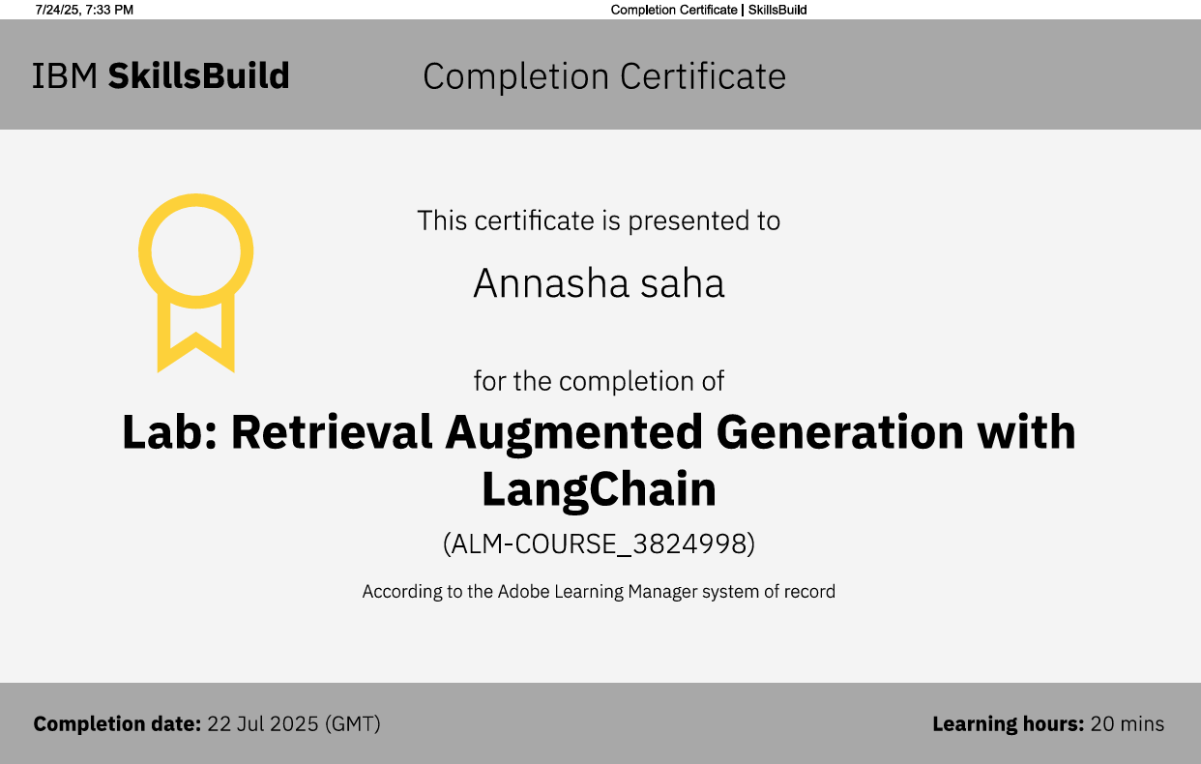
IBM Certifications

Slide 17
THANK YOU

