Slide 1
SPA Conference 2014
Keeping Passwords Private with OAuth
Nick Rozanski
nick@rozanski.org.uk
http://www.nick.rozanski.org.uk
Eoin Woods
eoin.woods@artechra.com
http://www.eoinwoods.info
Chris Cooper-Bland
Chris.Cooper-Bland@endava.com
http://www.endava.com/

Slide 2
Agenda
09:15 - 09:20 Presenter Introduction
09:20 - 09:30 Problem Statement
09:30 – 10:00 OAuth Overview
10:00 – 10:15 Environment Setup and Break
10:15 –11:00 Exercise 1: Granting Access to Dropbox Programmatically
11:00 – 11:15 Break
11:15 – 11:45 Exercise 2: Using the Dropbox API to Read and Write Files
11:45 – 12:00 Discussion: What Do We Think of OAuth?

Slide 3

Presenters
Nick Rozanski
Architect for Rates IT and Control at Barclays Investment Bank
30 years in IT, been working as an architect for about 12 years
Last wrote code for a living about 15 years ago…
Eoin Woods
Software architect for securities processing systems at UBS, and head of software engineering for the Operations IT group
Worked in software engineering since 1990 for companies including Ford, Group Bull, Sybase, InterTrust and BGI
Chris Cooper-Bland
Head of Architecture and Analysis (UK) at Endava

Slide 4
Problem Statement
There are many third-party programs which access cloud-based services like Dropbox, Amazon or Facebook
These cloud-based services are almost always secured using usernames and passwords
However trusting such a program with your user credentials is risky
You have no way of knowing how the program will keep them secure
You have no way of preventing the program from using them maliciously
This problem is known as cross-domain authentication
resource server
resource credentials
request
resource credentials
request
client program
resource (services and data)
response
response

Slide 5

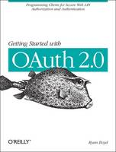
A More Interesting Problem Statement
“In the movie Ferris Bueller’s Day Off, a valet attendant takes a fully restored 1961 Ferrari out for a joyride.
How do you prevent the same thing from happening to your brand-new Mustang?
Some cars now come with special keys that allow the owner to provide limited authorization to valet attendants (or kids!) and prevent activities such as opening the trunk and driving at excessive speeds.
OAuth was created to solve the same
core issue online.”
Getting Started with OAuth 2.0, Ryan Boyd, O’Reilly Books 2012

Slide 6
A Solution: OAuth
One way of solving the cross-domain authentication problem is to use an open standard called OAuth
A client which implements the OAuth protocol uses a specially-negotiated key and secret to gain access to secured services or data
The client program never sees the user’s credentials, which are submitted only to the service as part of the one-off authorisation process
resource server
(client credentials)
request
key and secret
request
client program
resource (services and data)
response
response
key and secret
authorisation server
resource credentials

Slide 7

A Brief History of OAuth
OAUTH
OAuth 1.0: 2007-2010
development co-ordinated by Eran Hammer
Twitter was an early adopter (mandated for all Twitter clients since 2010)
OAuth 2.0 2012:
new authorisation model, not backwards-compatible with OAuth 1.0
Adoption
Wikipedia now lists about 70-80 service providers who support OAuth 1 or 2
from Amazon to Zendesk via Google, Facebook, Microsoft, Yahoo, Dropbox…
Controversy and Criticism
Eran Hammer eventually resigned his role of lead author, withdrew from the IETF working group, and removed his name from the specification
He describes Oauth 2 as “a designed-by-committee patchwork of compromises”

Slide 8
OAuth Benefits (and Criticisms)
Lessens the need to trust the client
the resource server can constrain access to data and services
Decouples resource access from password changes
the key and secret do not need to change if the user changes their password
Allows the user to revoke access without having to change their password
can revoke access by one client without affecting others
Helps avoid users becoming “desensitised” to phishing and password-harvesting
Authorisation is done in the context of the service (eg on the Dropbox website) rather than of the client
OAuth is about authorisation, not identity
possession = authorisation
anyone can use the valet keys
User can use OpenId to authenticate themselves with the resource server
OAuth 2 does not require signatures to identify endpoints
easy for developer to accidentally send credentials to a malicious endpoint
partly mitigated by the use of SSL (client must validate endpoint)
this aspect of the standard is still being developed
OAuth 2 is “complicated!”
easy for developers to get something wrong

Slide 9
Some OAuth Terminology
Term | Description | Example
Resource owner | Person who has authority to grant access to data and services | You
Protected resource | Data and / or services which the resource owner wants to keep secure | Dropbox files / Dropbox actions (eg upload file)
Resource server | The server which hosts the resources that are protected by OAuth | data server in the Dropbox data centre
Authorisation server | Server which performs resource authorisation actions, including: receive access consent from user issue access token to client validate access tokens provided by clients | authorisation server in the Dropbox data centre
Client | A program which makes Oauth calls to perform actions on protected resources on behalf of the resource owner | Desktop program, mobile app or web server which stores its data in Dropbox
Registration | The process whereby a developer sets up key attributes of their application and is given an access token in return | See following slides
Authorisation workflow | A sequence of steps in which the resource owner authorises a client to access a protected resource | See following slides

Slide 10
Application Registration
OAuth 2 requires that clients register with the authorisation server so that client requests can be properly identified
Service providers normally provide some sort of web console to do this, eg:
Google API Console
Windows Live Application Management site
Facebook Developer site
Dropbox App Console
Once registered, the client is issued with a client id and client secret
During registration you have to specify one or more allowable redirect URLs or URIs (Uniform Resource Identifiers)
The client can only redirect to one of these URIs
Registration helps ensure workflow requests are authentic, and enables the service provider to tailor its response according to the privileges granted to that client

Slide 11
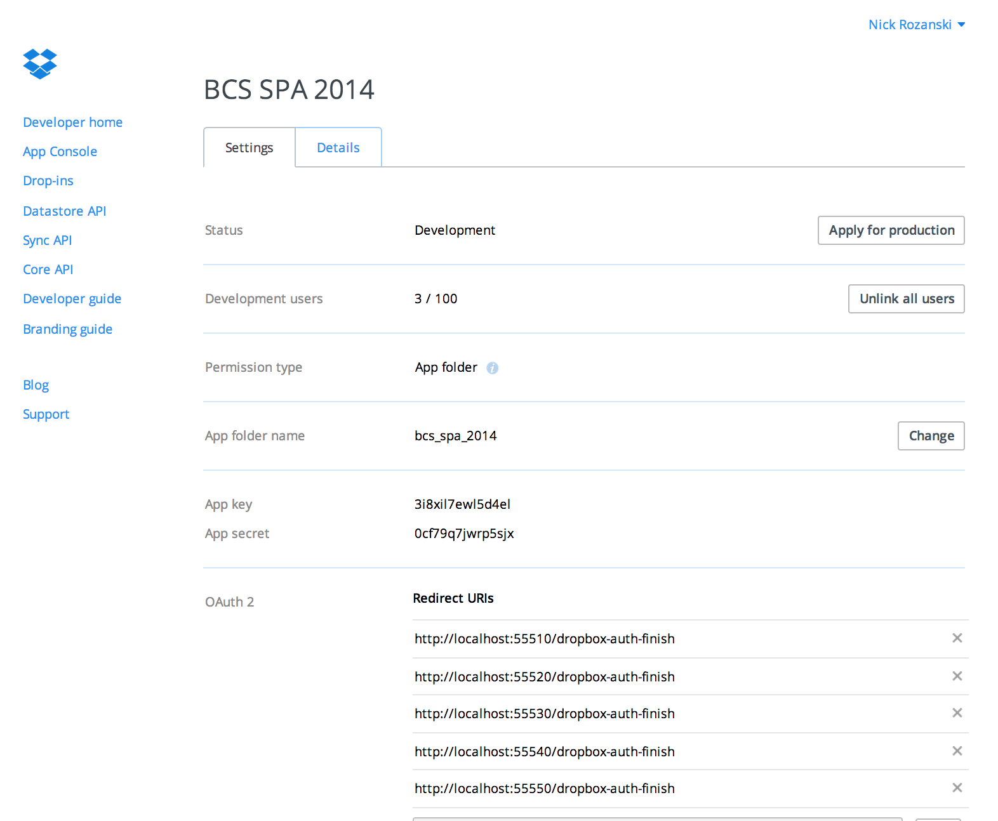
Example: Dropbox Application Registration
The Dropbox app is called BCS SPA 2014
Application files are stored in the Dropbox folder apps/bcs_spa_2014
The client key and secret are allocated by Dropbox at registration time
The app owner enters one or more redirect URIs the client can only redirect to one of these in the “finish” step of authorisation

Slide 12
OAuth Workflow
The steps to authorise a client are referred to as authorisation workflow
The OAuth standard defines four types of authorisation workflow
We will be looking at one of these today (“authorization code” workflow)
The demo illustrates two flavours of this workflow, with or without a final redirect step
Workflow | Description | Used For
Authorization Code | After authorisation, the client is redirected back to a web URL (can be a local URL or URI scheme) | Server-side web applications Clients who can run a web server or use URI schemes
Implicit Grant | Access token passed back in a #fragment in the URL | Client-side web applications running in a browser
Password-Based Grant | Client is given and forwards username and password | Highly-trusted client (eg provider’s own mobile app)
Client Credentials | Authorisation is previously arranged | Where the client is accessing an API (such as a storage service or database) on behalf of itself rather than the user

Slide 13
Authorization Code Workflow (No-Redirect)
client program
authorisation server
resource server
START AUTHORISATION
START
redirect
(display authentication page)
(authenticate)
display authorisation page
authorise this client
display authorisation code
enter authorisation code
FINISH
request access token
return access token
FINISH AUTHORISATION
submit request
submit request + access token
validate access token
return response

Slide 14
Authorization Code Workflow (Redirect)
client program
authorisation server
resource server
START
START AUTHORISATION
redirect
(display authentication page)
(authenticate)
display authorisation page
authorise this client
this part of the workflow is different
redirect with authorisation code
FINISH
request access token
return access token
FINISH AUTHORISATION
submit request
submit request + access token
validate access token
return response

Slide 15
Exercise
The exercise has two parts:
Authorise with Dropbox using OAuth
Run various commands to display or manipulate Dropbox files (to demonstrate that authorisation was successful)
Once you have authorised with Dropbox, the access token is saved to a file on disk and used in subsequent calls to Dropbox functions
You can authorise / deauthorise as many times as you want
The exercise supports both Dropbox authorisation modes
In no-redirect mode, the Dropbox authorisation webpage displays an authorisation code which the user copies and pastes into the demo client when prompted
In redirect mode, the Dropbox authorisation webpage automatically redirects the client back to a “finish” webpage served by the demo HTTP server

Slide 16
Setting up the Exercise
Sign up to Dropbox if you don't already have an account
Download all the files in my git repository (https://github.com/rozanski/bcs_spa14)
You can download the files directly from the website (click Download Zip) or retrieve or clone them using a git tool
The repository includes the the Dropbox Core API software (Python and Java)
Follow the other instructions in the project README and the README for your chosen language
Run the unit tests to make sure everything is working
You are ready to start coding!

Slide 17
What’s in the Repository (see Appendix)
The demo directory contains two complete implementations of the code needed for the session, one in Python and one in Java
They are functionally equivalent, so you can use whichever language you prefer
The demo code runs on Windows, Mac and Linux
Each of these directories has its own README with instructions on running the demo and unit tests
The exercise directory contains code skeletons created from the demo directory
This is the code you will be editing
The exercise code contains comments which guide you to the various API calls you need to make
If you ever get stuck, you can refer to the corresponding code in the demo directory

Slide 18
Example
DropboxWorkflowNoRedirect.java
public static DropboxStatus noRedirectClientStart() {
ConsoleLogger.debug("starting Dropbox authorisation (no-redirect mode)");
ConsoleLogger.debug("creating DbxWebAuthNoRedirect client for app %s with key %s and secret %s",
AppData.APP_NAME, AppData.APP_KEY, AppData.APP_SECRET);
// EXERCISE:
// - create a Dropbox no-redirect client object with which to execute the Dropbox no-redirect workflow
// hint: class is DbxWebAuthNoRedirect()
// - this needs to be supplied with the app information
// hint: get this from AppData()
// - it also needs to be supplied with a Dropbox DbxRequestConfig() object
// hint: use the app name/version from AppData and the default Locale
// - call start() to start the no-redirect workflow
// @see http://dropbox.github.io/dropbox-sdk-java/api-docs/ v1.7.x/com/dropbox/core/DbxWebAuthNoRedirect.html
// - store the authorise URL returned by start() in authoriseUrl
// TODO ==> INSERT CODE HERE <==
ConsoleLogger.info("Dropbox authorisation start successful, got authorisation URL %s", authoriseUrl);
return new DropboxStatus(301, DropboxStatus.makeUrl(authoriseUrl));
}

Slide 19
Keeping Passwords Private with OAuth
Exercise 1: Granting Access to Dropbox Programmatically

Slide 20
Exercise 1: Granting Access to Dropbox Programmatically
Complete the code in the following files in the exercise directory
Each source file identifies the code blocks you need to write using TODO tags
The tag is preceded by comments which explain what you have to do
If you get stuck, look at the same file in the demo directory
Tasks | Python | Java
optional: define OAuth access data load / save data from token and session files | common_oauth.py
start the no-redirect and redirect workflows | oauth_client.py | OauthClient.java
implementation of the no-redirect and redirect workflows | dropbox_workflow.py | DropboxWorkflowNoRedirect.java DropboxWorkflowRedirect.java

Slide 21
Keeping Passwords Private with OAuth
Exercise 2: Using the Dropbox API to Read and Write Files

Slide 22
Exercise 2: Using the Dropbox API to Read and Write Files
Complete the code in the following files in the exercise directory
The source file identifies the code blocks you need to write using TODO tags
The tag is preceded by comments which explain what you have to do
If you get stuck, look at the same file in the demo directory
You can also make Dropbox calls in the Python interpreter using the module variable dropbox_client (a DropboxClient())
see https://www.dropbox.com/developers/core/docs/python
Tasks | Python | Java
display, create, delete files | dropbox_tools.py | DropboxTools.java

Slide 23
Keeping Passwords Private with OAuth
Conclusion

Slide 24

Conclusion
What do we think of OAuth?
How easy is it to understand?
How easy is it to use?
How well does it work?
Was Eran Hammer right to resign as lead author, withdrew from the IETF working group, and remove his name from the specification?
Or is OAuth good enough to solve the Fuerris Bueller problem?
Eran Hammer

Slide 25
Keeping Passwords Private with OAuth
Appendix

Slide 26
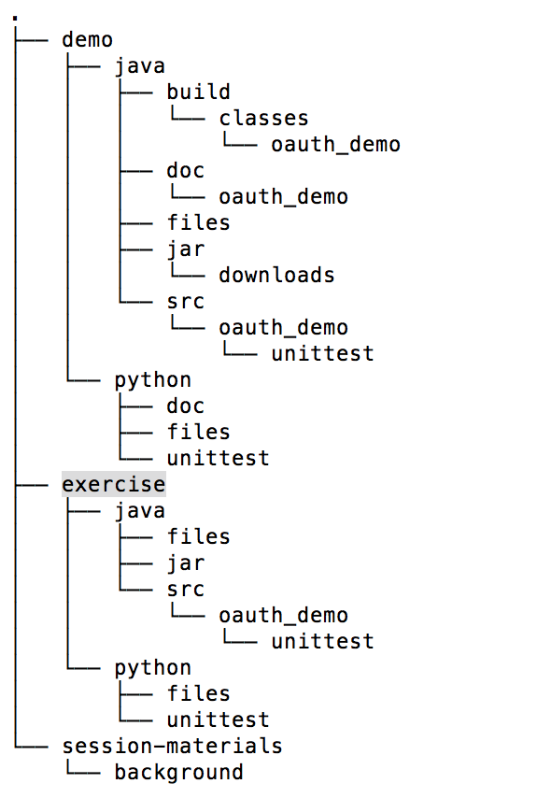
Appendix: Directory Structure
demonstration files (do not change these)
help files for demo code
help files for demo code
exercise files (work in here)
where token and session files go
where token and session files go
where token and session files go
source files (edit these)

Slide 27
Further Information
OAuth Website
http://oauth.net
OAuth 2 Specification
http://www.rfc-editor.org/info/rfc6749
OAuth 2 Workflow Diagrams
https://github.com/mitreid-connect/OpenID-Connect-Java-Spring-Server/raw/master/docs/OAuth2.0_Diagrams.pdf
APIs
Dropbox Core API
https://www.dropbox.com/developers/core (Python, Java, Ruby, Android, iOS etc)
Dropbox REST API
https://www.dropbox.com/developers/core/docs
Dropbox Tutorials
https://www.dropbox.com/developers/core/start/python (also Java, Ruby, …)
Eran Hammer
http://hueniverse.com/2012/07/26/oauth-2-0-and-the-road-to-hell/

