Slide 1
SPA Conference 2014
Keeping Passwords Private with OAuth
Nick Rozanski
nick@rozanski.org.uk
http://www.nick.rozanski.org.uk
Eoin Woods
eoin@copse.org.uk
http://www.eoinwoods.info
Chris Cooper-Bland
Chris.Cooper-Bland@endava.com
http://www.endava.com/

Slide 2
Agenda
00:00 - 00:05 Presenter Introduction
00:05 - 00:15 Problem Statement
00:15 – 00:45 OAuth Overview
00:45 – 01:00 Environment Setup and Break
01:00 – 01:30 Exercise 1: Granting Access to Dropbox Programmatically
01:30 – 01:45 Break
01:45 – 02:15 Exercise 2: Using the Dropbox API to Read and Write Files
02:15 – 02:30 Discussion: What Do We Think of OAuth?

Slide 3

Presenters
Nick Rozanski
Architect for Rates IT and Control at Barclays Investment Bank
30 years in IT, been working as an architect for about 12 years
Last wrote code for a living about 15 years ago…
Eoin Woods
Software architect for securities processing systems at UBS, and head of software engineering for the Operations IT group
Worked in software engineering since 1990 for companies including Ford, Group Bull, Sybase, InterTrust and BGI
Chris Cooper-Bland
need bio from Chris

Slide 4
Problem Statement
There are many third-party programs which access cloud-based services, such as Dropbox, Amazon or Facebook, which are secured using usernames and passwords
However trusting such a program with your user credentials is risky
You have no way of knowing how the program will keep them secure
You have no way of preventing the program from using them maliciously
This problem is known as cross-domain authentication
resource server
resource credentials
request
resource credentials
request
client program
resource (services and data)
response
response

Slide 5

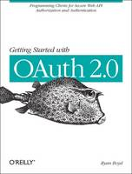
A More Interesting Problem Statement
“
In the movie Ferris Bueller’s Day Off, a valet attendant takes a fully restored 1961 Ferrari out for a joyride.
How do you prevent the same thing from happening to your brand-new Mustang?
Some cars now come with special keys that allow the owner to provide limited authorization to valet attendants (or kids!) and prevent activities such as opening the trunk and driving at excessive speeds.
OAuth was created to solve the same core issue online.
“
Getting Started with OAuth 2.0, Ryan Boyd, O’Reilly Books 2012

Slide 6
A Solution: OAuth
One way of solving the cross-domain authentication problem is to use an open standard called OAuth
A client which implements the OAuth protocol uses a specially-negotiated key and secret to gain access to secured services or data
The client program never sees the user’s credentials, which are submitted only to the service as part of the one-off authorisation process
resource server
(client credentials)
request
key and secret
request
client program
resource (services and data)
response
response
key and secret
resource credentials
authorisation server

Slide 7

A Brief History of OAuth
OAUTH
OAuth 1.0: 2007-2010
development co-ordinated by Eran Hammer
Twitter was an early adopter (mandated for all Twitter clients since 2010)
OAuth 2.0 2012:
new authorisation model, not backwards-compatible with OAuth 1.0
Adoption
Wikipedia now lists about 70-80 service providers who support OAuth 1 or 2
Controversy and Criticism
Eran Hammer resigned his role of lead author, withdrew from the IETF working group, and removed his name from the specification

Slide 8
OAuth Benefits and Criticisms
Lessens the need to trust the client
the resource server can constrain access to data and services
Decouples resource access from password changes
the key and secret do not need to change if the user changes their password
Allows the user to revoke access without having to change their password
can revoke access by one client without affecting others
Helps avoid users becoming “desensitised” to phishing and password-harvesting
Authorisation is done in the context of the service (eg on the Dropbox website) rather than of the client
OAuth is about authorisation, not identity
possession = authorisation
anyone can use the valet keys
User can use OpenId to authenticate themselves with the resource server
Unlike OAuth 1, OAuth 2 does not require the use of signatures to identify endpoints
easy for developer to accidentally send credentials to a malicious endpoint
partly mitigated by the use of SSL (client must validate endpoint)
this aspect of the standard is still being developed

Slide 9
Some OAuth Terminology
Term | Description | Example
Resource owner | User of the client application, who has authority to grant access to their own data and services | You
Protected resource | Data and / or services which the resource owner wants to keep secure | Dropbox files
Resource server | The server which hosts the user-owned resources that are protected by OAuth | Dropbox web server
Authorisation server | Server performs resource authorisation actions, including: receives access consent from user issues access token to client validates access tokens provided by clients | Dropbox authorisation server
Client | A program which makes API calls to perform actions on protected resources on behalf of the resource owner | Desktop program, mobile app or web server which stores its data in Dropbox
Authorisation workflow | A sequence of steps in which the resource owner authorises a client to access a protected resource | See next slide

Slide 10
Types of OAuth Workflow
The OAuth standard defines four types of authorisation workflow
Workflow | Description | Used For
Authorization Code | After authorisation, the client is redirected back to a web URL (can be a local URL or URI scheme) | Server-side web applications Clients who can run a web server or use URI schemes
Implicit Grant | Access token passed back in a #fragment in the URL | Client-side web applications running in a browser
Password-Based Grant | Client is given and forwards username and password | Highly-trusted client (eg provider’s own mobile app)
Client Credentials | Authorisation is previously arranged | Where the client is accessing an API (such as a storage service or database) on behalf of itself rather than the user

Slide 11
Application Registration
OAuth requires that clients register with the authorisation server so that client requests can be properly identified
Service providers normally provide some sort of web console to do this
Google API Console
Windows Line Application Management site
Facebook Developer site
Dropbox App Console
During registration you have to specify one or more allowable redirect URLs or URIs (Uniform Resource Identifiers)
The client is only allowed to redirect to one of these URIs
Once registered, the client will be issued a client id and client secret
Registration helps ensure workflow requests are authentic, and enables the service provider to tailor its response according to the privileges granted to that client

Slide 12
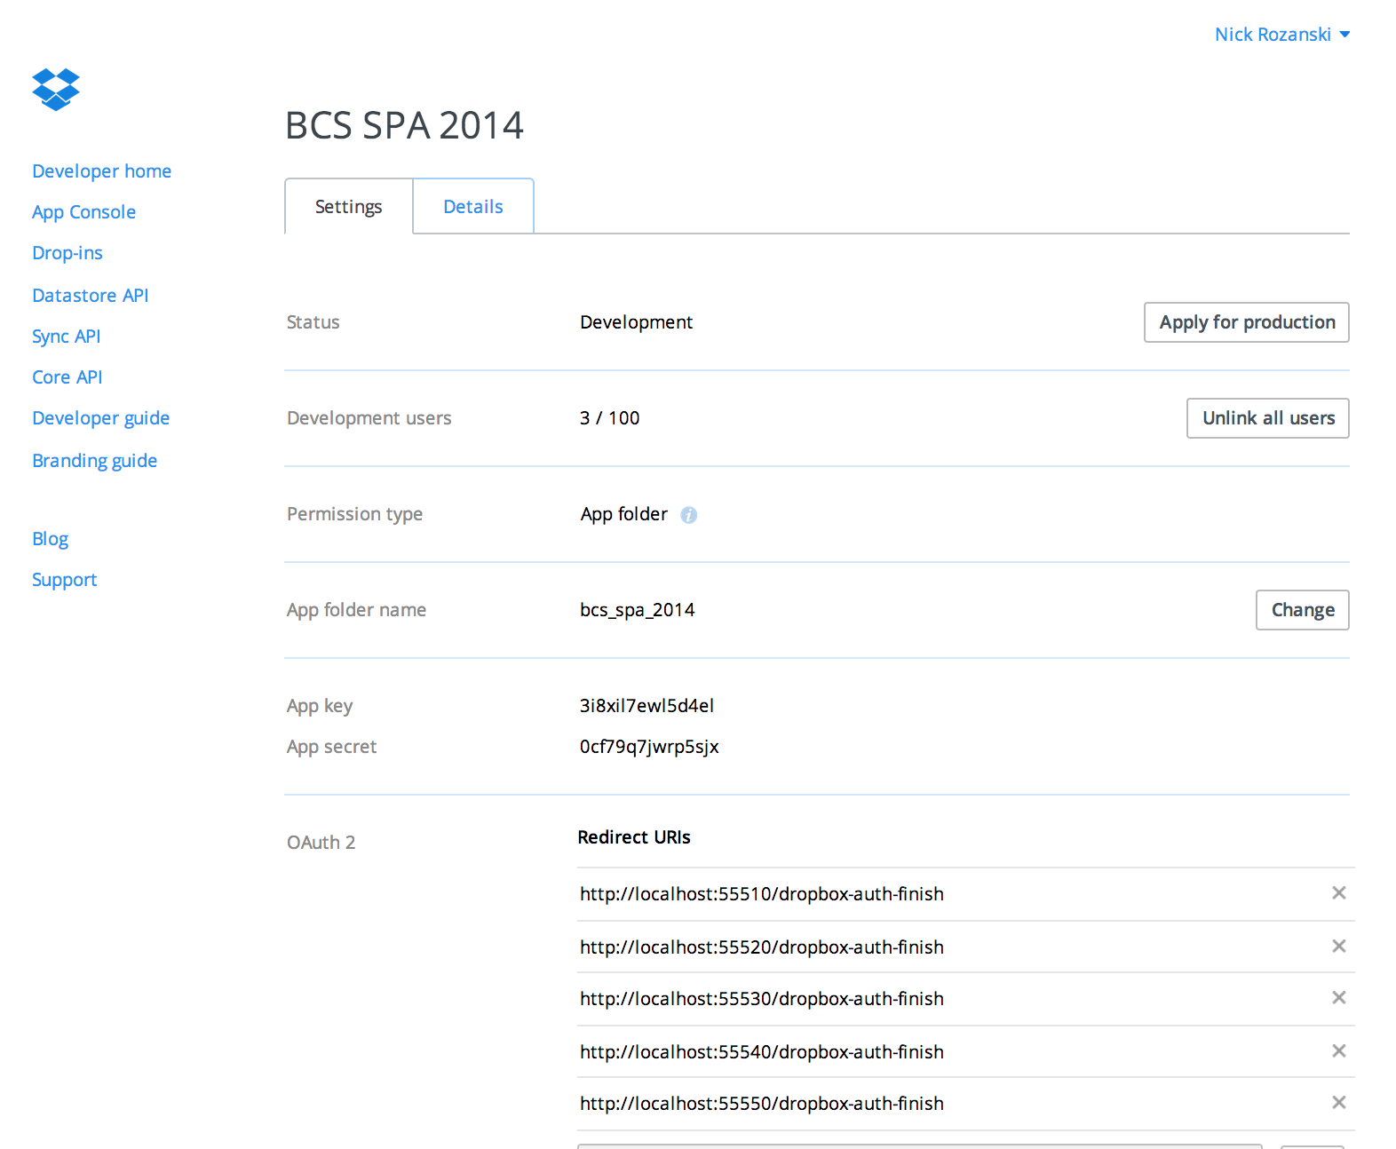
Dropbox Application Registration
The Dropbox app is called BCS SPA 2014
Application files are stored in the Dropbox folder apps/bcs_spa_2014
The client key and secret are allocated by Dropbox at registration time
The app owner enters the allowed redirect URIs (the client can only redirect to one of these in the finish step of authorisation)

Slide 13
Authorization Code Workflow (No Redirect)
client program
authorisation server
resource server
START AUTHORISATION
START
redirect
(display authentication page)
(authenticate)
display authorisation page
authorise this client
display authorisation code
enter authorisation code
FINISH
request access token
return access token
FINISH AUTHORISATION
submit request
submit request + access token
validate access token
return response

Slide 14
Authorization Code Workflow (Redirect)
client program
authorisation server
resource server
START
START AUTHORISATION
redirect
(display authentication page)
(authenticate)
display authorisation page
authorise this client
this part of the workflow is different
redirect with authorisation code
FINISH
request access token
return access token
FINISH AUTHORISATION
submit request
submit request + access token
validate access token
return response

Slide 15
Environment Setup
There are two implementations of the code needed for the session, one in Python and one one Java
They are functionally equivalent, so you can use whichever language you prefer
You will need to sign up to Dropbox if you don't already have an account
You will need to download the files in my git repository at https://github.com/rozanski/bcs_spa14
You can download the files directly from the website (click Download Zip) or retrieve them using a git tool
You will need to download the Dropbox Core API software (Python or Java)
There are a number of other setup steps, which are described in the project README and the READMEs for Python and for Java

Slide 16
Exercise
The demo has two parts:
Authorise with Dropbox using OAuth
Run various commands to display or manipulate Dropbox files (to demonstrate that authorisation was successful)
The demo client authorises with Dropbox in one of two modes:
In no-redirect mode, the Dropbox authorisation webpage displays an authorisation code which the user copies and pastes into the client when prompted. It does not redirect the client to a URL after authorisation
In redirect mode, the Dropbox authorisation webpage automatically redirects the client back to another webpage after authorisation. No authorisation code is displayed (it is returned as part of the redirect URL)
Once you have authorised with Dropbox, the access token is saved to a file on disk and used in subsequent calls to Dropbox functions

Slide 17
Conclusion
What do we think of OAuth?
How easy is it to understand?
How easy is it to use?
How well does it work?
Was Eran Hammer right to resign as lead author, withdrew from the IETF working group, and remove his name from the specification?
Or is OAuth good enough to solve the Fuerris Bueller problem?

Slide 18
Keeping Passwords Private with OAuth
Appendix: Further Information

Slide 19
Further Information
OAuth Website
http://oauth.net
OAuth 2 Specification
http://www.rfc-editor.org/info/rfc6749
OAuth 2 Workflow Diagrams
https://github.com/mitreid-connect/OpenID-Connect-Java-Spring-Server/raw/master/docs/OAuth2.0_Diagrams.pdf
APIs
Dropbox Core API
https://www.dropbox.com/developers/core (Python, Java, Ruby, Android, iOS etc)
Dropbox REST API
https://www.dropbox.com/developers/core/docs
Dropbox Tutorials
https://www.dropbox.com/developers/core/start/python (also Java, Ruby, …)

