Slide 1
Big RUP
Dave Cleal & John Daniels

Slide 2
Think Tank Goal
Decide on the top five tips we can give to anyone running a large RUP project
Why is it hard?

Slide 3
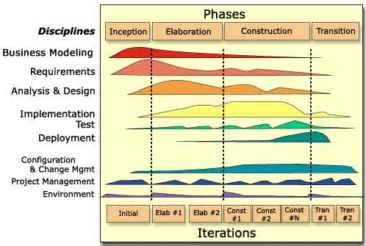
RUP Review

Slide 4
Constraints
Large = 25+ people
Assume division into sub-teams
Assume a geographically dispersed team
Assume RUP as a starting point

Slide 5
Process
0-10 Welcome and introduction
10-25 Generate issues in groups
25-40 Generate solutions resulting in a top five issues/solutions
40-55 Join small groups into three larger groups, present lists to each other. Merge identical tips and then vote to create three combined top fives
55-70 Repeat the previous round as a plenary to generate one top five.
70-75 Address in plenary any issues without solutions that emerge from the first two rounds.

