Slide 1
Requirements & Architecture
Traps & Pitfalls
Rob Machin, Chief Technical Architect @ Concise
Chris Cooper-Bland, Solution Architect (Independent)
SPA 2006
Notes:
Intros
RM
CCB
History of where this has come: few sessions last year, experience on £100M + programmes!!!
Is this your first time at SPA?? If so – open forum, participative, etc

Slide 2
Agenda
Time (mins) | Topic
0 – 15 | General Introductions Typical problems in Requirements and Architecture
15 – 35 | Group Work: Come up with top 3 problems in groups; cross-floor discussion
35 – 55 | Best Practices & anti-patterns
55 – 80 | Group work: Define your own requirements anti-pattern(s) + Coffee
80 – 110 | Present back on your group’s patterns & our requirements anti-patterns
110 – 135 | Group work: Define your own architecture anti-pattern(s) + Coffee
135 – 165 | Present back on your group’s patterns & our architecture anti-patterns
165 – 180 | Summary & Close Prize for most creative Anti-Pattern from the team!
Notes:
RM

Slide 3



As an industry we seem to get this wrong a lot!
“Some 75 percent of most large-scale IT projects fail by missing both time and budget projections …”
  Mark Driver, Gartner
Even in successfully delivered projects: “64% of features actually delivered are either rarely or never used”
  Jim Johnson, Standish Group
Of the work executed: “Many (possibly most) organisations lose as much as 45% of their total revenues due to costs associated with low quality”
  Six Sigma Report
Notes:
RM

Slide 4
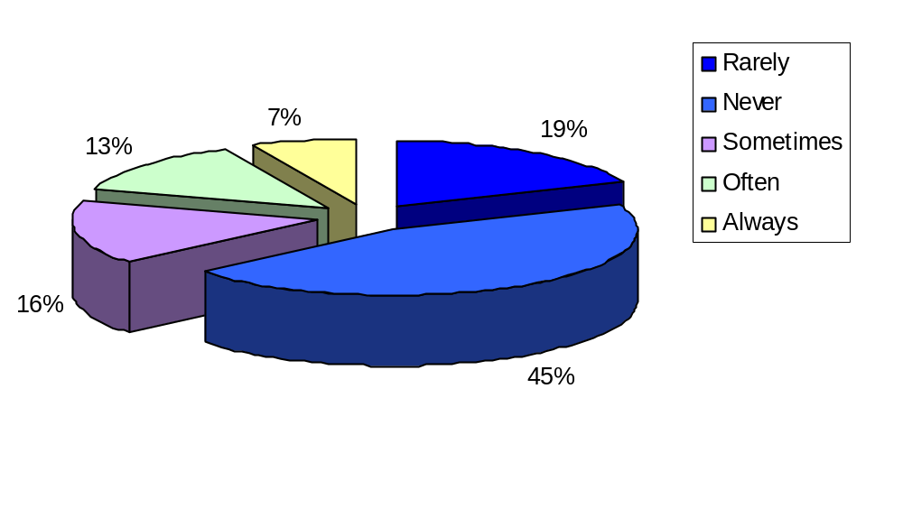

Requirements Capture and Management is TOUGH:
Even in successfully delivered projects…
The biggest drain on resources and most wasted effort is spent on incorrect requirements: this is a major industry issue
Often or Always
Used Features: 20%
Rarely or Never
Used Features: 64%
Standish Group Study Reported at XP2002 by Jim Johnson, Chairman
Source © Mary Poppendieck 2004
Notes:
RM

Slide 5


Traps and Pitfalls
Traps and Pitfalls are common and frequently occurring in large organisations
In this session we:
  Will be identifying common pitfalls particularly relating to requirements and architecture
  Hope to make some progress with you in clarifying how we can apply best practice to avoid them
We all know projects that have fallen foul of them:
  Bad smells from the design that “can’t be fixed”
  Long hours in endless meetings
  Slipping and sliding deadlines
  Endless defect reports
Notes:
RM
Walk through how the tips/techniques can help us avoid these pitfalls

Slide 6
Example Traps and Pitfalls
Pitfalls: Requirements Traps & Pitfalls
Failure to define scope
Inability to manage change
Analysis paralysis
…
Pitfalls: Architecture Traps & Pitfalls
Architecture is ‘performed’ in an Ivory Tower™
There is no usable definition of the architecture
Architecture team in silos
…
Notes:
Walk through how the tips/techniques can help us avoid these pitfalls
Prepare them to create there own “top” list
15mins in

Slide 7
Work in groups to come up with your top three (requirements & architecture) pitfalls
10 mins
Volunteer from each group to give us the team’s list and why!
Notes:
RM
10mins to work in groups
10mins to present back and discuss
And run feedback session

Slide 8
What is an “anti-pattern”?
An ‘anti-pattern’ is*
  Negative solution… A form that “describes a commonly occurring solution to a problem that generates decidedly negative consequences”
  Malice? Mainly ignorance, apathy and sloth!
Finding anti-patterns:
  Find a problem
  Establish a pattern of failure
  Look for a way to turn-around & prevent
Pitfall + Evidence + Solution = Anti-pattern
*William J. Brown, AntiPatterns: Refactoring Software, Architectures, and Projects in Crisis
Notes:
CCB
You now have 20mins

Slide 9
Best Practices which can help
Collaborative Working
Risk Based Prioritisation
Clear Traceability
Best Practices
Visual Modelling
Tools and Best Practices
Iterative working
Change Control
Notes:
CCB

Slide 10
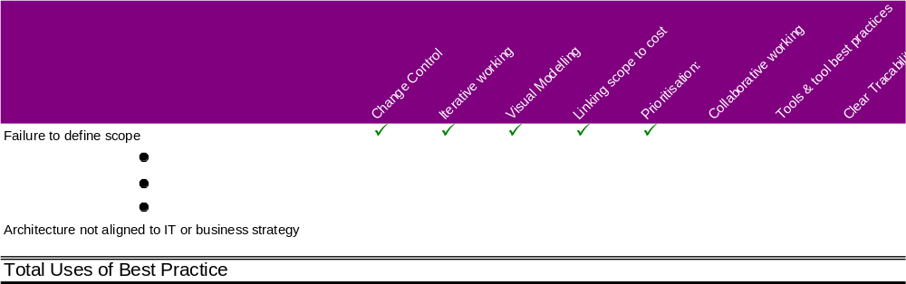
How Useful are the Best Practices?
Map Anti-patterns against their solutions
Will re-visit completed grid at the end
Notes:
CCB

Slide 11
Anti-Pattern: <<TEMPLATE>>
Synopsis: Basic deal
Symptoms:
  How to recognise the symptoms
Solutions:
  How to apply best practice to correct and/or avoid
In the exercises (coming up next) use a template like this to define the basic anti-pattern(s)
Notes:
CCB

Slide 12
Anti-Pattern: Failure to define scope
Synopsis: Scope is never clear to the team, constant scope flux, different opinions on what is in/out of scope leading to FUD
Symptoms:
  Inability to break solution down
  Rolls Royce Syndrome
  Lack of clear modelling – not understanding boundaries
  Fuzzy application of ‘features’ to real business needs
  Everything “must have”
  No visible delivery cycles – everything must have now
  Driven in lack confidence from Business in IT – don’t trust prioritization
  Cost of requirements not visible
Solutions:
  Change Control: Baseline, and control the baseline
  Iterative working: Use iterations to clarify and force scope discussions
  Linking scope to cost: Be clear on the cost and scope of features
  Prioritisation: Define priorities – require clarity to enable this
Notes:
example

Slide 13
Work in groups to come up with your own requirements anti-pattern(s)
25 mins including coffee
Volunteer from each group to present
Notes:
CCB
They have 25 mins for this + coffee

Slide 14
Walk-through: Requirements Anti-patterns
Inability to manage change
Analysis Paralysis
Failure to define scope
Failure to see the big picture
Anti-patterns
Key stakeholder groups ignored
Difficult problems are ignored
Solution becomes a requirement
Inconsistent level of detail
Tacit knowledge not made explicit
Notes:
RM
Pick which ones to go through (have our own list) but ask class which (if any!) they are most interested in!

Slide 15
Work in groups to come up with your own architecture anti-pattern(s)
25 mins including coffee
Volunteer from each group to present
Notes:
RM

Slide 16
Walk-through: Architecture Anti-patterns
Architecture in Ivory Tower™
No useable definition of the architecture
Architecture not aligned to business strategy
Ineffective governance
Anti-patterns
Architecture team in silo(s)
No traceability to/from architecture
Amount of architecture/ control wrong
Notes:
CCB
Pick which ones to go through (have our own list) but ask class which (if any!) they are most interested in!

Slide 17
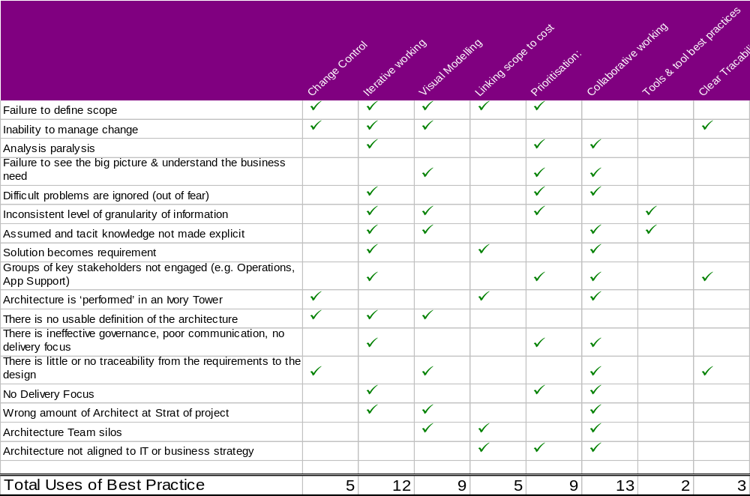
Best practices – Our View of Usefulness
Notes:
CCB
PUT ON WALL WHEN COMPLETE

Slide 18

Prizes for most creative Anti-pattern!

Slide 19
Appendix 1: Best Practices

Slide 20

Best Practice: Requirements Management
Collaborative working
Prioritisation
Visual modelling
Iterative working
Change control
Tools and tool best practices
Link scope & features to cost & value
Highly Effective Analysis Teams
  Proximity
  Collaborating on goals
  Building trust
  Developing expert Knowledge
  Clear goals and objectives
  Celebration success
Work Closely with the business
  Extract Tacit knowledge
  Identify real need
  Under project planning pressure
  Address the real need
Best Practices
In Requirements Management
Notes:
RM – covers this slide and hands over to Chris

Slide 21
Best Practice: Architecture
Collaborative working
Prioritisation
Visual modelling
Iterative working
Change control
Tools and tool best practices
Link scope & features to cost & value
Architects embedded in project teams with X project Enterprise Architecture function
  Collaborating on technology
  Building trust
  Developing expert Knowledge
  Clear goals and objectives
  Allows re-use
Work Closely with the business
  Extract Tacit knowledge
  Communicate the capability of technology
  Align business and IT Strategy
Best Practices
In Architecture
Notes:
RM – covers this slide and hands over to Chris

Slide 22
Best Practice: Requirements Management
Collaborative working
Prioritisation
Visual modelling
Iterative working
Change control
Tools and tool best practices
Link scope & features to cost & value
Establish Priorities with the business for effective scheduling using value and accounting metric for requirements
Scope iterations using MoSCow rules
Continuous delivery/integration
Allay business nervousness by
  Involving them in the planning process
  Frequent releases of code to the business
  Visible progress monitoring
Best Practices
In Requirements Management
Notes:
RM – covers this slide and hands over to Chris

Slide 23
Best Practice: Architecture
Collaborative working
Prioritisation
Visual modelling
Iterative working
Change control
Tools and tool best practices
Link scope & features to cost & value
Establish Priorities with the business to produce IT Strategy and Technology roadmaps
Address significant architectural risk early
Continuous delivery/integration
Allay business nervousness by
  Involving them in the planning process
  Frequent releases of code to the business
  Visible progress monitoring
Best Practices
In Architecture
Notes:
RM – covers this slide and hands over to Chris

Slide 24
Best Practice: Requirements Management
Collaborative working
Prioritisation
Visual modelling
Iterative working
Change control
Tools and tool best practices
Link scope & features to cost & value
Don’t’ produce long SRS/SORs
Use UML to capture and document
  Business process
  Operations processes
  Technical requirements
Exploit User Stories or Use-Cases/Activity diagrams and standard architectural description techniques
To give a requirements model that enables the on-going enhancement & development of the business
Best Practices
In Requirements Management
Notes:
RM – covers this slide and hands over to Chris

Slide 25
Best Practice: Architecture
Collaborative working
Prioritisation
Visual modelling
Iterative working
Change control
Tools and tool best practices
Link scope & features to cost & value
Have a single set of enterprise architecture diagrams
Don’t produce long architecture documents
Use UML to capture and document
  Analysis & Design Model
  Implementation Model
Identify proof of concept work to address risks
Best Practices
In Architecture
Notes:
RM – covers this slide and hands over to Chris

Slide 26
Best Practice: Requirements Management
Collaborative working
Prioritisation
Visual modelling
Iterative working
Change control
Tools and tool best practices
Link scope & features to cost & value
Plan and scope iterations
  Project 4-6 weeks
  Team level every 24 Hrs
Flex the scope not the date
Deliver visible functionality
Have daily Scrum meeting
  Progress since last meeting?
  Are there any obstacles?
  What am I doing to do before the next meeting?
Use prioritized requirements and features lists
Best Practices
In Requirements Management
Notes:
RM – covers this slide and hands over to Chris

Slide 27
Best Practice: Architecture
Collaborative working
Prioritisation
Visual modelling
Iterative working
Change control
Tools and tool best practices
Link scope & features to cost & value
Do just enough architecture in Elaboration
Plan and scope iterations
  Project 4-6 weeks
  Team level every 24 Hrs
Flex the scope not the date
Deliver visible functionality
Have daily Scrum meeting
  Progress since last meeting?
  Are there any obstacles?
  What am I doing to do before the next meeting?
Best Practices
In Architecture
Notes:
RM – covers this slide and hands over to Chris

Slide 28
Best Practice: Requirements Management
Collaborative working
Prioritisation
Visual modelling
Iterative working
Change control
Tools and tool best practices
Link scope & features to cost & value
Ensure change is monitored and controlled against a baseline
  even in “Agile” projects
  even if change is zero-sum cost
Asses the risk of the change using scope, time and financial impact
Change must be communicated when agreed
Use appropriate tools to track change and reflect in project plans/costs
Configuration Management is the cornerstone of change control
Best Practices
In Requirements Management
Notes:
RM – covers this slide and hands over to Chris

Slide 29
Best Practice: Architecture
Collaborative working
Prioritisation
Visual modelling
Iterative working
Change control
Tools and tool best practices
Link scope & features to cost & value
Need to be able to understand the impact/cost of change quickly
Ensure change is monitored and controlled against a baseline
  even in “Agile” projects
  even if change is zero-sum cost
Change must be communicated to developers when agreed
Must reflect architectural changes up to enterprise architecture
Configuration Management is the cornerstone of change control
Best Practices
In Architecture
Notes:
RM – covers this slide and hands over to Chris

Slide 30
Best Practice: Requirements Management
Collaborative working
Prioritisation
Visual modelling
Iterative working
Change control
Tools and tool best practices
Link scope & features to cost & value
Use the right toolset for the job
Toolset review should include:
  Environment
  Products
  Techniques
Baseline toolset - focus on delivery
  But aim to improve process
Toolset should include:
  Visual Modelling Tool
  Requirements Management
  Configuration Management
  Requirements/Analysis Standard
In Requirements Management
Best Practices
Notes:
RM – covers this slide and hands over to Chris

Slide 31
Best Practice: Architecture
Collaborative working
Prioritisation
Visual modelling
Iterative working
Change control
Tools and tool best practices
Link scope & features to cost & value
Use the right toolset for the job
Toolset review should include:
  Environment
  Products
  Techniques
Baseline toolset - focus on delivery
  But aim to improve process
Toolset should include:
  Visual Modelling Tool
  Enterprise architecture
  Configuration Management
  Architecture standards (?)
In Architecture
Best Practices
Notes:
RM – covers this slide and hands over to Chris

Slide 32
Best Practice: Requirements Management
Collaborative working
Prioritisation
Visual modelling
Iterative working
Change control
Tools and tool best practices
Link scope & features to cost & value
Use traceability to link cost to effort
  Top Down Matrix from features to requirements
  Bottom up from artifacts, code, etc to requirements
Team must determine:
  What to estimate against
  Assign complexities and volatilities
  Calculate against metrics suitable for project profile
  Collaborative estimation process
Use a tool for estimating, as automated as possible
Best Practices
In Requirements Management
Notes:
RM – covers this slide and hands over to Chris

Slide 33
Best Practice: Architecture
Collaborative working
Prioritisation
Visual modelling
Iterative working
Change control
Tools and tool best practices
Link scope & features to cost & value
Need to understand impact of function on factors like performance and COTS
Understand when features will be re-used and invest accordingly
Team must determine:
  What to estimate against
  Assign complexities and volatilities
  Calculate against metrics suitable for project profile
  Collaborative estimation process
Use a tool for estimating, as automated as possible
Best Practices
In Architecture
Notes:
RM – covers this slide and hands over to Chris

Slide 34
Appendix 2: Requirements Pitfalls

Slide 35
Anti-Pattern: Failure to define scope
Synopsis: Scope is never clear to the team, constant scope flux, different opinions on what is in/out of scope leading to FUD
Symptoms:
  Lack of clear modelling – not understanding boundaries
  Inability to break solution down
  Rolls Royce Syndrome
  Fuzzy application of ‘features’ to real business needs
  Everything “must have”
  No visible delivery cycles – everything must have now
  Driven in lack confidence from Business in IT – don’t trust prioritization
  Cost of requirements not visible
Solutions:
  Change Control: Baseline, and control the baseline
  Iterative working: Use iterations to clarify and force scope discussions
  Linking scope to cost: Be clear on the cost and scope of features
  Prioritisation: Define priorities – require clarity to enable this
Notes:
RM

Slide 36
Anti-Pattern: Inability to manage change
Synopsis: Change is un-controlled new requirements just seems to slip in
Symptoms:
  Not understanding what is a change
  Insufficient visibility of scope or not agreement
  Not joined up – information on scope hidden in peoples heads
  Lack of communication
  No change process
  No traceability – impact of change
  No clear architecture – impact of change – how to implement it
Solutions:
  Iterative working practices: Embrace change, but be clear on scope and reconfirm at the start of each iteration
  Change control: guard the baseline
  Clear traceability of scope to cost: show the effect of change
  Visual Modelling: Clarity on baseline, change is clear
Notes:
CCB

Slide 37
Anti-Pattern: Analysis paralysis
Synopsis: Team never seems to deliver, constant refinement or dragging out of requirements and architectural concepts
Symptoms:
  Requirements gathering in a comfort zone
  Point at wrong problems – easy problems, interesting not risk driven
  Constant refinement/elaboration
  Meeting culture – meetings with no clear purpose, agenda or outputs
  Indecision from business; insufficient pressure for a decision from IT
  Not close enough to customer to get/make a decision
  No delivery – people not pulling in the same direction or together
  Churn of: people, ideas, scope
Solutions:
  Prioritization: Schedule is clear on scope and dates
  Iterative working: Regular small deliveries of business value
  Collaborative working: Working with the business means needing to demonstrate regular progress
Notes:
RM

Slide 38
Anti-Pattern: Failure to see the big-picture
Synopsis: Team focus on technical or stylistic issues, don’t understand large purpose or usage of system by business
Symptoms:
  No clear requirement / business model
  No clear vision
  No architecture
  Business requirements are given as “what they think the technology should do” requirements not business directed
  No thought leadership
  Lack of contact with business; lack of domain experience in team
  Failure to consult all stakeholders
  Project Managers too focussed on schedule not on coherence/quality/solving problem
Solutions:
  Collaborative working practices: work with business to understand need and architects to see technology picture
  Visual modelling: clear business object and requirement models
  Prioritisation: Let the business direct the prioritisation of feature delivery

Slide 39
Anti-Pattern: Difficult problems are ignored
Synopsis: Team focuses on cool or interesting problems, early work to demonstrate feasibility is based on the “art of the possible” not by uncovering and addressing key implementation risks
Symptoms:
  Fear: too hard
  Quick wins / low hanging fruit!
  Believe it will get easier – build up capability etc
  Wrong difficult problems identified!
  Feeling in the team that it’s been too easy
Solutions:
  Prioritisation: understand what is important to the business
  Iterative working: address areas of significant architectural and business risk
  Collaboration with business: to understand the complex business process

Slide 40
Anti-Pattern: Inconsistent level of detail
Synopsis: Requirements range from coarse to finely grained based on level of interest/knowledge/experience of analysts, no separation or consistency of expression for business and system requirements
Symptoms:
  Assumptions of tacit knowledge
  Confusing systems and business processes
  Avoidance of difficult problems
  Over generalisation
  Over specification
  Requirements gathered for trivial or impossible to change technical details (e.g. Use-Case for “Establish SSL session” in a business system!)
  Not using business and system use-cases appropriately
  People learning document too much, or the wrong thing. Temptation to demonstrate what you know not what will quickly communicate requirement
Solutions:
  Visual modelling: Force discussions on detail, separate model into specific views
  Tools & tool best practices: Use a good modelling metaphor (e.g. 4+1)
  Iterative working: Resolve questions on scope and detail by iterative working
  Prioritisation: Assess the cost for features in a delivery and ensure information modelled allows accurate planning
Notes:
CCB

Slide 41
Anti-Pattern: Assumed/Tacit knowledge not made explicit
Synopsis: Information necessary for the solution is never documented but is carried in the minds of various individuals spread throughout the project team and business
Symptoms:
  Requirements not articulate – project relies on team “knowing” – personal or schedule pressure becomes hard to manage
  Hard to “on-board” people
  Change cannot be controlled, scope never clear
  Hard to write a contract to deliver it!
  Brain-drain – knowledge leaves company via SI or via natural wastage
Solutions:
  Collaborative working: Proximity and communication uncover information, effective questioning techniques extract right sort of information from the business
  Visual modelling: Get knowledge into the open
  Tools & best practices: Gap analysis, effective questioning technique
  Iterative working: Short iterations regular delivery of understanding/solution back to business
Notes:
RM

Slide 42
Anti-Pattern: Solution becomes requirement
Synopsis: Assigned “business experts” can’t see past the legacy solution and specify requirements based on what the previous system did (even reproducing technical limitations). Or previously technical “business analysts” specify requirements based on a mistake idea of what the technology does (specifying batch processing etc)
Symptoms:
  Requirements specify a specific solution
  Requirements start with “exactly what system X does, plus a, b, c)
  Business experts for the new system are the technical team within IS that built the old system 10 years ago (no access to the “real” business)
  (can be a benefit in lessons learnt if used properly)…
Solutions:
  Collaboration with business: to understand business process/need
  Linking scope & features: to cost/value
  Iterative working: carry out all aspects of analysis at appropriate point

Slide 43
Anti-Pattern: Groups of key stakeholders ignored
Synopsis: Certain stakeholders are not included at appropriate points. This often applies to IT Operations teams whose requirements are not sufficiently understood in initial scope and subsequently in the impact of change
Symptoms:
  Lack of focus on internal stakeholders
  No stakeholder analysis
  Or representative goes native and cease to effectively represent stakeholder group
  System comes back from UAT/OAT with critical new requirements (e.g. control)
  Lack of buy-in
  Trade-offs not understood
  Inability to quantify impact of deployment – e.g. ops costs ignored
  No clear stakeholder sign-off of scope
  Testing process tests for success against design not failure against business requirements
Solutions:
  Clear traceability: Stakeholder analysis
  Collaborative working: Clarity in roles and ensures the team works with the stakeholders
  Prioritisation: Clear priority on what will be in each delivery and what the quality gate will be
  Iterative working practices: ensures feedback quicker, forces engagement
Notes:
CCB

Slide 44
Appendix 3: Architecture Pitfalls

Slide 45
Anti-Pattern: Architecture is ‘performed’ in an Ivory Tower™
Synopsis: Architects lose touch with reality of the team pressures & schedule and produce “ideal” designs that will never be implemented
Symptoms:
  Design does not match the architecture
  Projects carry out architecture and design work without consulting central design office
  Architects don’t know what is going on
Solutions:
  Collaborative working: architects are embedded in the projects and stay with the teams through development
  Linking of scope to cost: Show projects the architects add value by putting requirements in context
  Change control; involve architecture office in change process
Notes:
RM

Slide 46
Anti-Pattern: There is no usable definition of the architecture
Synopsis: There is no clear model/document/explanation of the architecture available to the team
Symptoms:
  The holistic ‘5-year plan’ is directed towards a single, clear architectural end state – and this cannot be clearly and simply articulated
  Architects produce complex Visio and PowerPoint slides that only they understand and use
  Projects cannot explain how their design fit with the architecture
Solutions:
  Visual Modelling: makes the architecture accessible to all
  Iterative development: the architecture moves steadily towards the end state
  Change control: applied to the architecture definition to ensure it is maintained
Notes:
RM

Slide 47
Anti-Pattern: There is ineffective governance, poor communication, no delivery focus
Synopsis: There is no governance, standards or review of architectural ideas, no communication and no sense of urgency or focus on delivery. No-one seems to be driving the definition of how to deliver the system technically
Symptoms:
  No clear achievement of milestones, always nearly there
  There is no architectural governance or there is an “over” focus on governance (no… or endless… meetings and con-calls)
  The architects never talk to the business or end users
  The architects do not communicate with the project management or developers
  The process for “sign-off” is painful, linear, a bottle-neck and usually results in “reviewed but no comments” from reviewers, or ‘documents’ are simply never finished
Solutions:
  Collaborative working: architects talk to the business users and project
  Prioritisation: the important activities are tackled first
  Iterative working: there are clear deliverables to the business which provide business value
Notes:
RM

Slide 48
Anti-Pattern: There is little or no traceability from the requirements to the design
Synopsis: No demonstrable way of showing or explaining how the architecture (usually boxes in a Visio figure) relates to what the business asked for in the costs.
Symptoms:
  Delays cause the project to be overtaken by advances in technology; licence costs spiral, or a single vendor controls the project
  No clear statements can be found related to non-functional requirements
  Change requests cannot be impacted, or they are wildly inaccurate
Solutions:
  Visual Modelling: tools provide mechanisms to support traceability
  Collaborative working: the analysts, architects and designers must talk to each other
  Change control: change in design/requirements must be reflected in the corresponding area
Notes:
RM

Slide 49
Anti-Pattern: Amount of Architecture wrong at start of Project
Synopsis: Either too little or too much Architecture at start of projects
Symptoms:
  Very long architecture and deign activity before code development starts
  Architecture documents are very long and focus on the detail
        OR
  Code is cut before anybody understands the shape of the target system, resulting in continual re-work
  Significant risks are left until late in the project because they are hard
Solutions:
  Iterative working: Ensures that Architects know that some issues can be addressed later
  Collaborative working: between architects, designers and developers to ensure that each understands the scope of what the other is doing
  Visual Modelling: helps present the big picture without the detail which can be left until the appropriate time
Notes:
RM

Slide 50
Anti-Pattern: Architecture Team in silos
Synopsis: Each project has Its own architects who do not talk to each other or believe that any other project in the enterprise may have already solved this problem
Symptoms:
  No Enterprise architecture
  Many hardware and software platforms throughout the enterprise
  Functionality implemented in different whys in different systems
  Spaghetti architecture with many proprietary interfaces
Solutions:
  Collaborative working between architects across projects
  Visual modelling of the Enterprise architecture
  Linking of scope and features: across the enterprise
Notes:
RM

Slide 51
Anti-Pattern: Architecture not aligned to the IT or business strategy or no account taken of strategy in implementation
Synopsis: Systems are wonderful from technical perspective, but do not do what the business want when they want it
Symptoms:
  Window of opportunity missed for new products or upgrades
  IT specify a Ferrari when the business want a tractor (or vica versa)
  Release 2 of the product cost more than Release 1 to develop, when it was not planned that way
Solutions:
  Link of scope and function: to the product roadmap
  Collaborative working: between IT Strategy and Business Strategy
  Prioritisation: of requirements in order of their value to the business
Notes:
RM

