Slide 1

What motivates software practitioners?
Helen Sharp Tracy Hall
Open University University of Hertfordshire
SPA2007

Slide 2
Why is motivation important?
Motivation important for:
  Individuals
  Peers
  Organisations
Motivation is different for different people at different times
The literature presents a confused picture of motivation in software engineering
We’ll come back to these issues later….

Slide 3
What’s going to happen…
Introduction
Discussion of experiences in role groups & Plenary discussion
Repertory grid technique (RGT) exercise in role groups
  Identify elements in pairs & plenary discussion
  Identify constructs (triad 1) in pairs & plenary discussion
  Score grids individually (triad 2) & plenary discussion
Report and discussion of findings from ours and others' research into motivation in software engineering
Wrap Up

Slide 4
In your role groups:
Question 1:
  What aspects of your job do you get most satisfaction from?
Question 2:
  What are the features of a project that make you stay in your job?
Question 3:
  What factors keep you in software engineering?
Question 4:
  What makes developing software worthwhile to you?

Slide 5
In your role groups:
Identify three things that are important to you in the context of motivation
Write on your form under Triad 3
Be prepared to share them

Slide 6
How Repertory Grids work
Forms record your thoughts which we can then analyze. Please leave them here!
RGT a psychology technique that identifies how people interpret the world
Using Repertory Grid Technique (RGT) to explore motivation in software engineering
Enables us to understand how:
  similarly or differently people view the world
  generic some views are
RGT has 2 core parts: Elements & Constructs

Slide 7
Elements
Elements in the world are:
  events, objects, people, activities
Elements could include:
  This university, your home, your workplace
  Software testing, requirements capture, coding
  Kent Beck, Barry Boehm, Richard Stallman
Elements considered in 3’s (called triads)

Slide 8
Constructs
Constructs draw out how people interpret these elements
Constructs are bi-polar (opposite) perceptions about elements
Constructs are formed by thinking about similarities and differences between elements in a triad

Slide 9
An example…
Element triad:
  (1) Playing golf, (2) Horse riding, (3) Sailing
Construct elicitation = similarities and differences:
  Golf & riding v sailing (1,2 v 3)
    On land v on sea
  Golf & sailing v riding (1,3 v 2)
    With other people v with an animal

Slide 10
Construct Elicitation
For Triad, work in pairs to suggest constructs
Write them on form
Plenary discussion

Slide 11
Rate each construct on a scale 1-7 according to the following:
A. Where does agile rate?
B. Where does plan-driven rate?
C. Where do you rate?
A
C
B
1 2 3 4 5 6 7

Slide 12
Our research findings (1)
Report from our systematic review of literature
Most commonly found motivators:
  having clear goals
  a personal interest
  understanding the purpose of a task
  how it fits in with the whole
  having job satisfaction
  working on an identifiable piece of quality work

Slide 13
Motivators
Intrinsic
Extrinsic
Identify with task
Career paths
Variety of work
Recognition for
work done
Development needs
addressed
Technically challenging
work
Autonomy
Making a contribution
Empowerment/
responsibility
Trust/respect/equity
Employee participation
Good management
Sense of belonging
Rewards and
incentives
Feedback
Job security
Good work life
balance
Appropriate working
conditions
Successful
company
Sufficient resources
Inherent
in SE
Challenging
Changing
Problem-solving
Beneficial
Lifecycle models
Scientific
Experimental
Team working
Development
practices

Slide 14
Our research findings (2)
Motivating aspects of software engineering:
  Learning
  exploring new techniques
  problem solving
Career stage of software engineers important
Turnover and absenteeism most frequently cited outcomes of de-motivation
No comprehensive model of motivation in software engineering currently exists

Slide 15
Motivators
Intrinsic
Extrinsic
Inherent in
software
engineering
Specific
organisational/job
factors
Results in
Outcomes
Specific
organisational/job
factors
Orientate
towards
Influence
strength of
Influences effectiveness of
Software Engineer
Characteristics
Contextual factors
Mediates
Individual personality

Slide 16
Software Engineer Characteristics | % in studies
Ch.4 Growth oriented (e.g. challenge, learn new skills) | 9%
Ch.6 Introverted (low need for social interaction) | 8%
Ch.11 Autonomous (need for independence) | 8%
Ch.1 Need for stability (organisational stability) | 5%
Ch.3 Achievement orientated (e.g. seeks promotion) | 4%
Ch.12 Need for variety | 4%
Ch.14 Need for challenge | 4%
Ch.16 Need to be sociable/identify with group/organisation | 4%
Ch.2 Technically competent | 3%
Ch.5 Need for competent supervising | 3%
Ch.8 Need for feedback (needs recognition) | 2%
Ch.10 Need to make a contribution (job is worthwhile) | 2%
Ch.13 Marketable | 2%
Ch.15 Creative | 2%
Ch.7 Need for involvement in personal goal setting | 1%
Ch.9 Need for Geographic stability | 1%
Table 1: Software Engineer Characteristics [Beecham et al 2007]

Slide 17
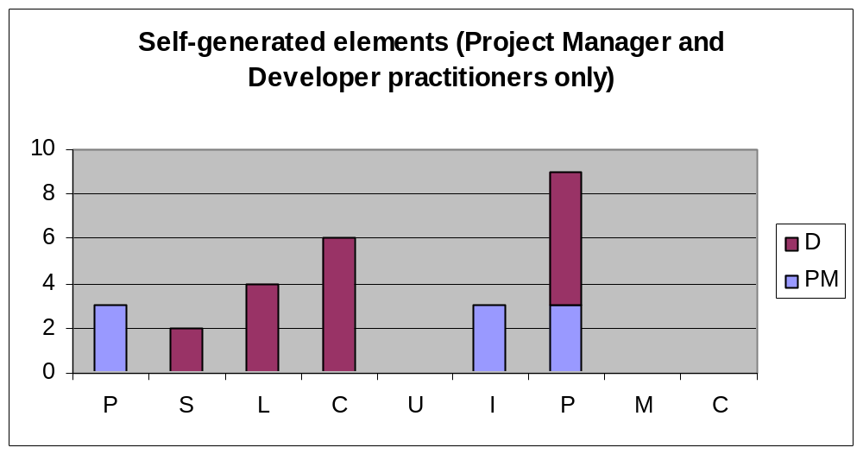
RGT at XP2006 - results
P: problem-solving; S: success; L: learning; C: creativity; U: users; I: influence; P: people; M: making a difference; C: clear presentation

Slide 18
Wrap up
What surprises?
Reflections on the workshop approach?
Further comments on motivation in software?

Slide 19
Please leave your forms behind

