Slide 1
SPA2012
01st – 04th July 2012
Business Process Management and Agile
Andy Longshaw (Blue Skyline)
Chris Cooper-Bland (Endava)

Slide 2

00:00 – 00:10 | Introductions, session objectives and Presentation: Business Processes in organizations
00:10 – 00:20 | Exercise: Processes in your organization
00:20 – 00:35 | Presentation: Inside a BPM tool
00:35 – 00:55 | Presentation: BPM and agile
00:55 – 01:10 | Exercise: Would it work for you?
01:10 – 01:15 | Summary and Wrap-up

Slide 3

Andy Longshaw
  Blue Skyline (guru)
Chris Cooper-Bland
  head of architecture and analysis at Endava

Slide 4

This session is about business processes, it describes what they are and how they are used to drive an application development where the agile methodology is used
Exploring issues and conflicts between agile and BPM

Slide 5

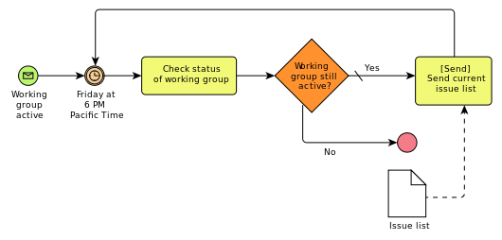
What is a “Business Process”?
  A business process is a collection of related, structured activities or tasks that produce a specific service or product (serve a particular goal) for a particular customer or customers. It often can be visualized with a flowchart as a sequence of activities with interleaving decision points or with a Process Matrix as a sequence of activities with relevance rules based on the data in the process.
http://en.wikipedia.org/wiki/Business_process

Slide 6

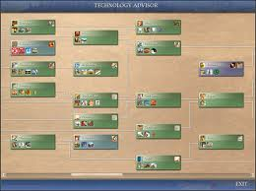
Development of BPM has been dependant on both the organisation thinking about how work is done and the charting concepts
Analysis of work types – Adam Smith -Wealth of Nations 1759
Scientific management of work – Taylorism 1890s
Business Process Re-Engineering – 1990
  Hammer: “Don’t automate, obliterate”
Business Process Change – mid 1990s – Continuous improvement
Business Process Management – 2003 – support innovation and flexibility
Gantt Charts – Project dependencies - 1899
Flow process charts – engineering -1921
Programming flow charts - Goldstine and von Neumann at IBM - 1941
Flow Charts with swim lanes 1970s
Activity diagrams – UML -1990s

Slide 7
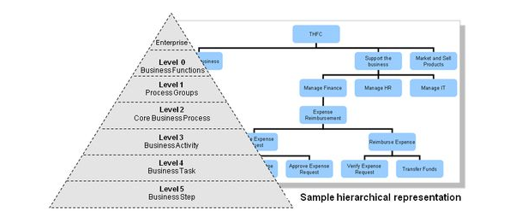
BP in Organisations
Business process work at different levels
Need to understand how this works for you

Slide 8

Processes in an organisation
  Core vs Supporting
  Case, cyclic, event driven, state management
Roles – who is doing these things
Process descriptions including:
  Tasks – human and machine
  Flow lane
  Critical Success Factors
  KPIs – how to measure improvements
BPMN – Business Process Modelling Notation
BPM Tool to run your process

Slide 9

Individually start thinking about what the key processes are in your organisation or department.
Come up with at least 3 or 4, think about the CSFs, the roles involved
You only have about 10 minutes

Slide 10







Standard for BPM provided by OMG
  http://www.omg.org/spec/BPMN/2.0/PDF/
  538 pages ☹
Most Important Notation concepts are
  Events
  Activities
  Gateways
  Sequence flow
  Message flow
  Associations

Slide 11

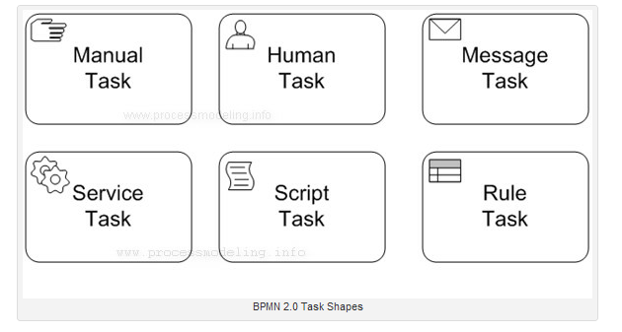

Slide 12

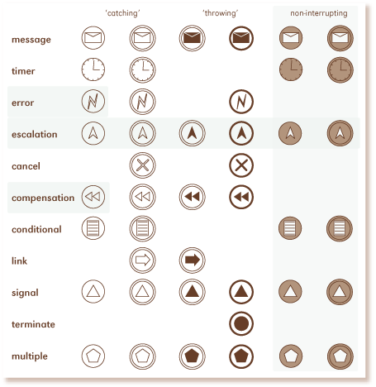

Slide 13

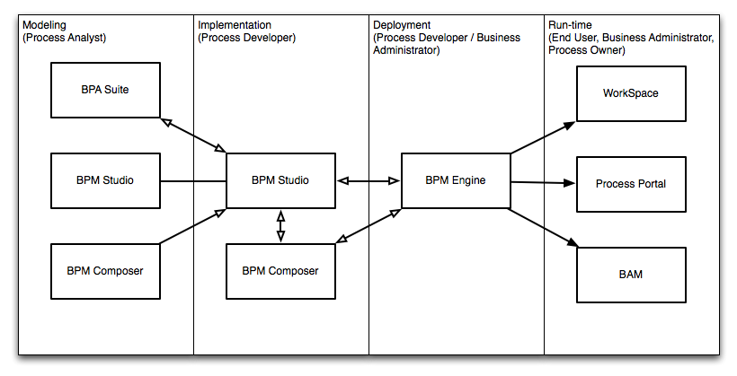
Create a deployable Process
Focus on user changeable content and rules

Slide 14

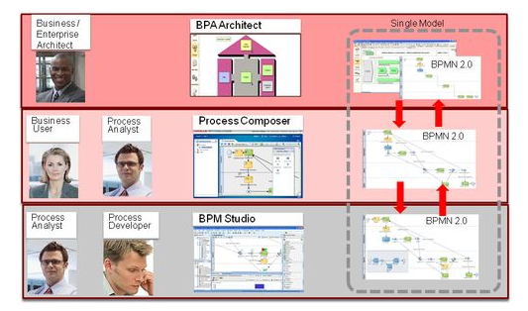
Different tools for different people

Slide 15

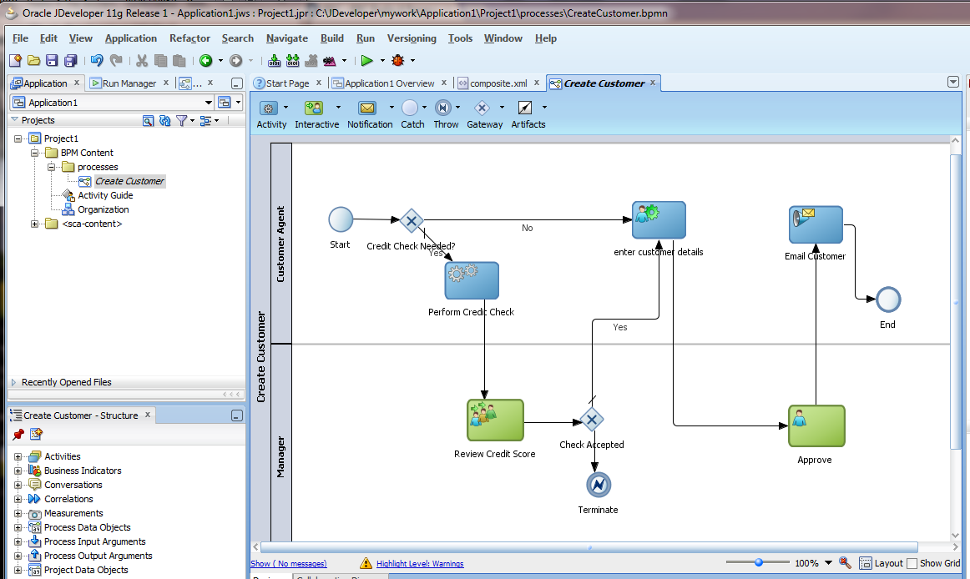

Slide 16

Scope
  BPM projects usually have a very wide scope, IT and human activities.
  Agile much more focused – one product owner
Timeframe
  BPM projects look at improvement over a long time
  In many agile developments the development team will have moved on
Who
  BPM: Consultants come in to “do” BPM to the organization
  Agile: often from the ground up
So it looks like multiple agile delivery projects
may come out of a BPM project

Slide 17

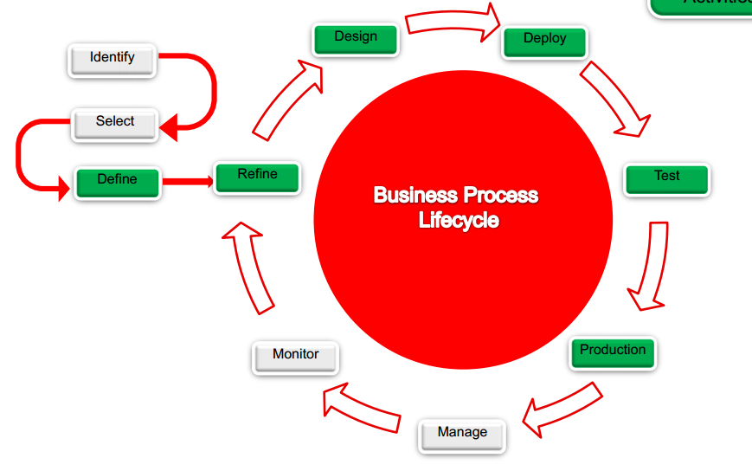
It all sounds very agile but …

Slide 18

Agile
  relies strongly on automated testing to deliver speed of change while maintaining quality
BPM
  environments do not lend themselves to unit tests (large dependencies on platform and lots of configuration instead of code)
Our solution:
  Concentrate on outside-in testing with tools like selenium/cucumber

Slide 19

Agile
  dev team rapidly delivers changes supported by automated regression tests
BPM
  sells vision of business changing process and rules themselves
Our solution:
  fight it as long as you can …
  …then run to beyond the blast zone

Slide 20
Agile
  deliver minimal viable system in terms of features and deliver this to learn more
BPM
  often used in this way:
    work out the end-to-end process in an analysis phase
    Appeals to BAs and waterfall PMs
Our solution:
  avoid like the plague

Slide 21

Agile
  deliver minimal viable system in terms of features and deliver this to learn more
BPM
  can be used in this way:
    work out process in rapid prototype and deploy to gather metrics
    shallow implementation of whole system, little bit of all stories
    add depth to stories in iterations/increments
    - dirt track, wooden road and tarmac

Slide 22
Issues
  Dirt track or wooden road implementation (rough UI and swivel chair integration) deeply in attractive to users, especially if you are replacing an existing system
  difficult to deliver working software at end of each iteration
  Users and stakeholders are used to having “complete” features delivered

Slide 23

Users and stakeholders mostly didn’t want the BPM stuff (not in their CSFs)
  Metric gathering
  SLA management
  Process enforcement
  Long-term process improvement based on data
What they really wanted was
  Quick delivery of a polished application
  Data capture
  Reporting
  The ability to circumvent the process!!

Slide 24

Can use it in an agile process if you're
willing to
  deliver a thin layer and then grow it
  live with minimal implementations in some places
  swivel chair integration
  build up empirical process metrics
  upgrade integration points and minimal implementations
  improve the process – including the organizational changes

Slide 25

Agile/lean software development is a backlash against attempts to industrialise software development
BPM is about industrialising other processes
In the private sector it is not unusual for one customer request to be turned into as many as nine sub-tasks to be completed by different people in back-office functions. As in other mass-production systems, managers believe that by breaking down and standardising tasks they will gain economies of scale. They take as given that the work will arrive in the right places, be done in the standard times and returned within the service levels. Careful study of the work shows that this rarely happens. The fragmentation of work creates waste in the back office and failure demand in the front office.
John Seddon

Slide 26

Does your organization have automatable processes?
Would the stakeholders embrace this?
Would the organization change?
Would this work with your existing tools and processes?
Discuss in groups and come up with a conclusion

Slide 27

BPMN is a useful perspective across your application
BPM is more about organizational change than techie tools automating existing processes

