Slide 1
To tackle inequality, (re)Build worker power
Anna Stansbury Stone PhD Scholar & Economics PhD Candidate
Nov 2 2020

Slide 2
1. Declining worker power can explain a large share of the rise in U.S. income inequality
2. Worker power differentials are important determinants of other inequalities in health, autonomy, safety
3. Worker power matters for sustainable political and social change

Slide 3





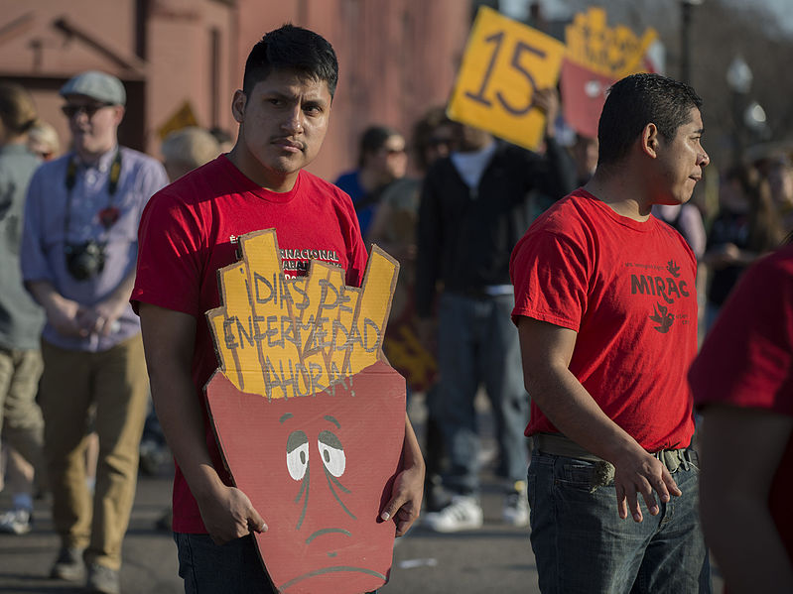
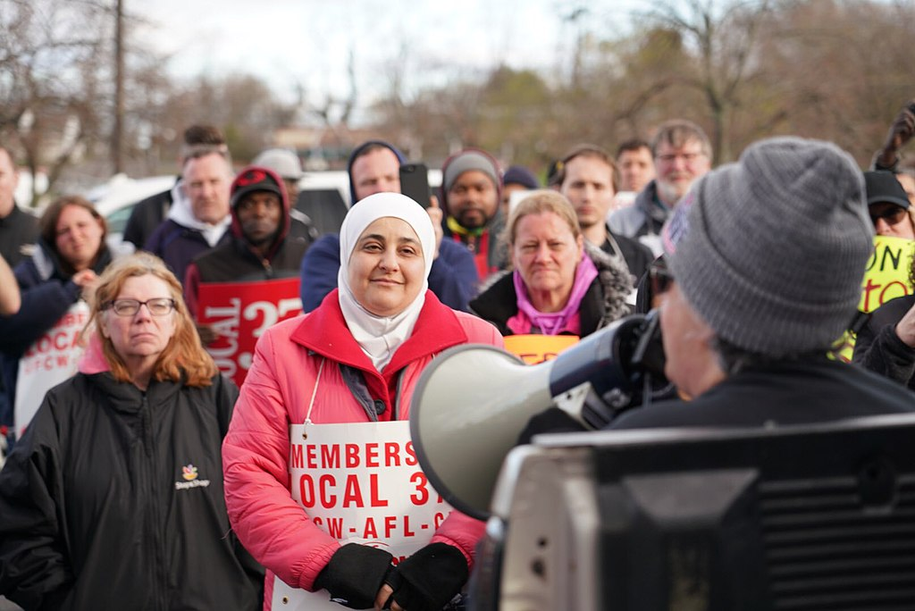


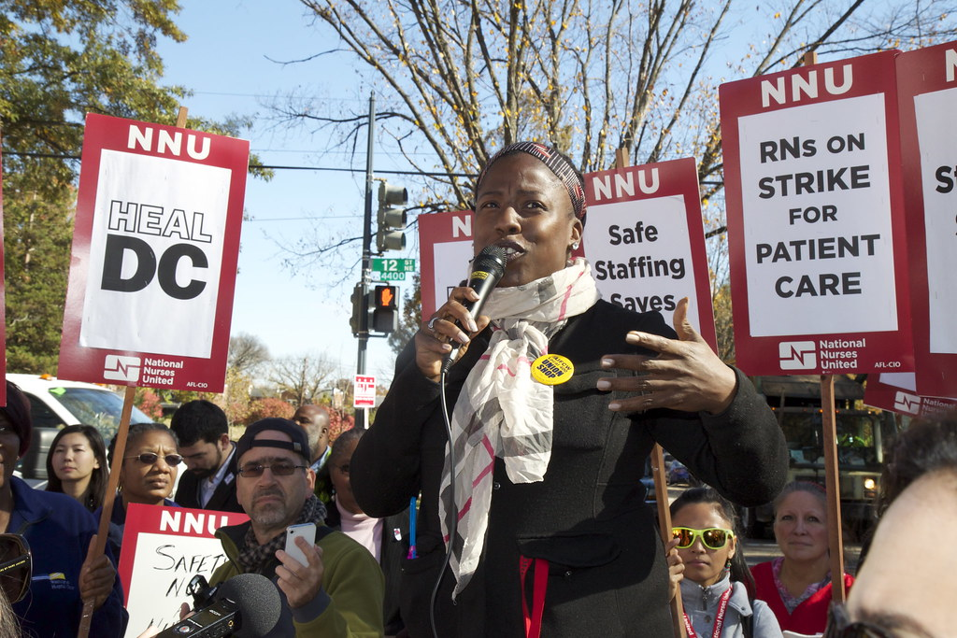
What is worker power?
FORMAL INSTITUTIONS:
Unions
Workers on boards
Employee ownership
Works councils
Wage boards
INFORMAL INSTITUTIONS:
Fairness norms
Public pressure
Images: fast food workers’ strike; nursing strike; Stop and Shop strike
Fast food workers’ strike

Slide 4
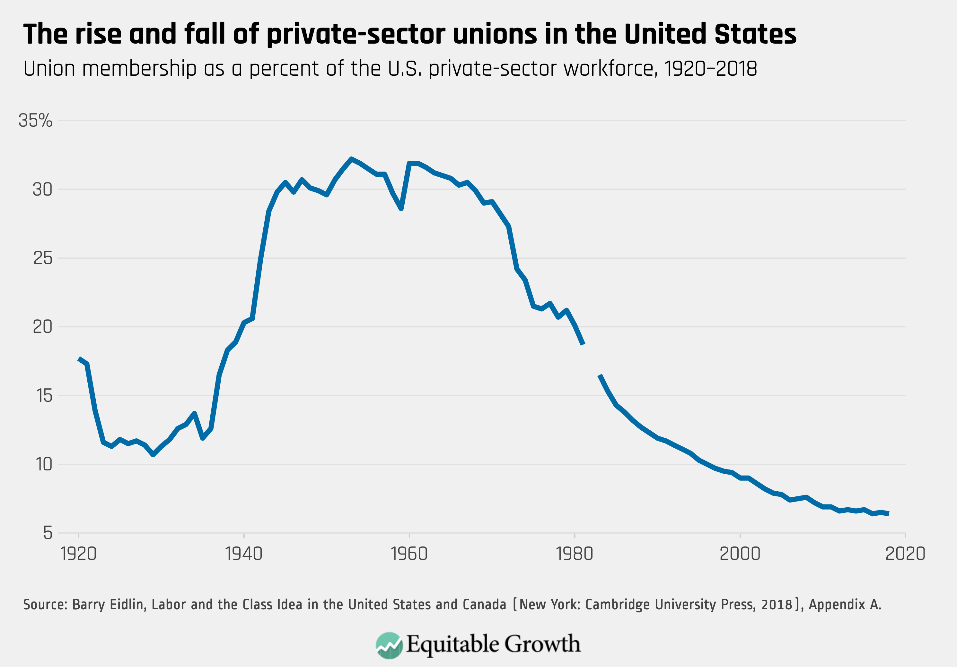
Worker power has declined steeply in the U.S. in recent decades

Slide 5
1. Declining worker power can explain a large share of the rise in U.S. income inequality

Slide 6
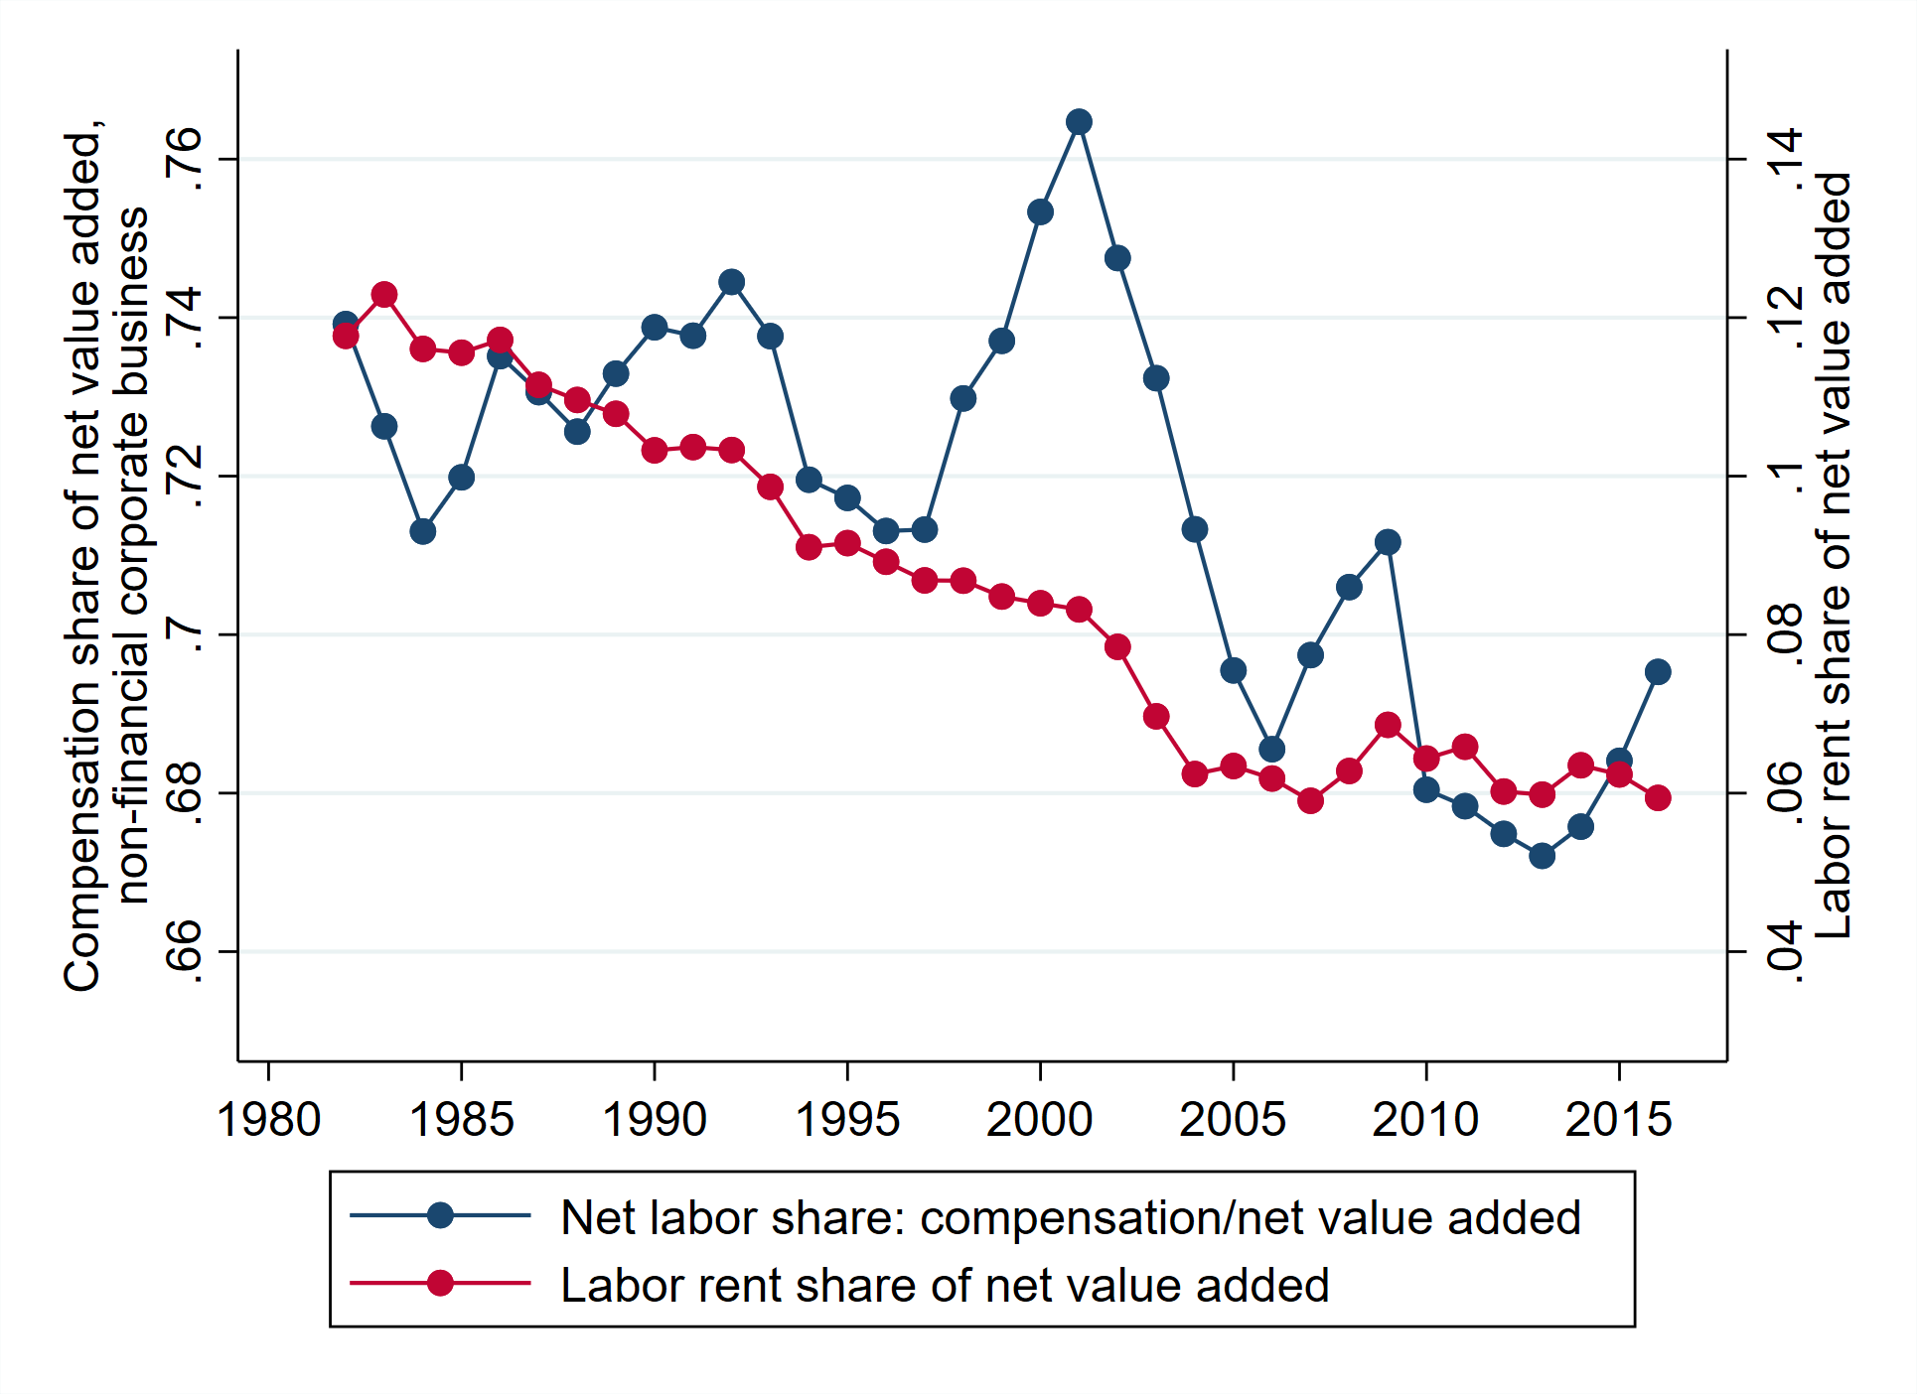
Declining worker power can explain (a large share of) major inequality trends
US labor share and “labor rent” share, 1982-2016
Source: Stansbury and Summers (2020)

Slide 7
Declining worker power can explain (a large share of) major inequality trends
Falling labor share
Rising labor income inequality
Rising top 1% share
Slowing decline of racial wage gap
Cross-country dynamics
A growing collage of evidence, including: DiNardo, Fortin, and Lemieux (1996), Levy and Temin (2007), Kristal (2010), Western and Rosenfeld (2011), Kleykamp and Rosenfeld (2012), Bivens and Mishel (2013), Jaumotte and Osorio-Buitron (2015), Farber, Herbst, Kuziemko, and Naidu (2018), Fortin, Lemieux, and Lloyd (2018), Denice and Rosenfeld (2018), Stansbury and Summers (2020)

Slide 8
Declining worker power can explain (a large share of) major inequality trends
Falling labor share
Rising labor income inequality
Rising top 1% share
Slowing decline of racial wage gap
Cross-country dynamics
A growing collage of evidence, including: DiNardo, Fortin, and Lemieux (1996), Levy and Temin (2007), Kristal (2010), Western and Rosenfeld (2011), Kleykamp and Rosenfeld (2012), Bivens and Mishel (2013), Jaumotte and Osorio-Buitron (2015), Farber, Herbst, Kuziemko, and Naidu (2018), Fortin, Lemieux, and Lloyd (2018), Denice and Rosenfeld (2018), Stansbury and Summers (2020)

Slide 9
Declining worker power can explain (a large share of) major inequality trends
Falling labor share
Rising labor income inequality
Rising top 1% share
Slowing decline of racial wage gap
Cross-country dynamics
A growing collage of evidence, including: DiNardo, Fortin, and Lemieux (1996), Levy and Temin (2007), Kristal (2010), Western and Rosenfeld (2011), Kleykamp and Rosenfeld (2012), Bivens and Mishel (2013), Jaumotte and Osorio-Buitron (2015), Farber, Herbst, Kuziemko, and Naidu (2018), Fortin, Lemieux, and Lloyd (2018), Denice and Rosenfeld (2018), Stansbury and Summers (2020)

Slide 10
Declining worker power can explain (a large share of) major inequality trends
Falling labor share
Rising labor income inequality
Rising top 1% share
Slowing decline of racial wage gap
Cross-country dynamics
A growing collage of evidence, including: DiNardo, Fortin, and Lemieux (1996), Levy and Temin (2007), Kristal (2010), Western and Rosenfeld (2011), Kleykamp and Rosenfeld (2012), Bivens and Mishel (2013), Jaumotte and Osorio-Buitron (2015), Farber, Herbst, Kuziemko, and Naidu (2018), Fortin, Lemieux, and Lloyd (2018), Denice and Rosenfeld (2018), Stansbury and Summers (2020)

Slide 11
Declining worker power can explain (a large share of) major inequality trends
Falling labor share
Rising labor income inequality
Rising top 1% share
Slowing decline of racial wage gap
Cross-country dynamics
A growing collage of evidence, including: DiNardo, Fortin, and Lemieux (1996), Levy and Temin (2007), Kristal (2010), Western and Rosenfeld (2011), Kleykamp and Rosenfeld (2012), Bivens and Mishel (2013), Jaumotte and Osorio-Buitron (2015), Farber, Herbst, Kuziemko, and Naidu (2018), Fortin, Lemieux, and Lloyd (2018), Denice and Rosenfeld (2018), Stansbury and Summers (2020)

Slide 12
2. Worker power differentials are important determinants of other inequalities in health, autonomy, safety

Slide 13
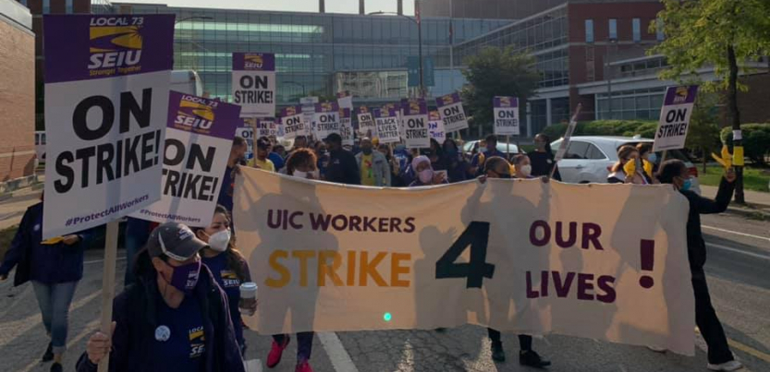
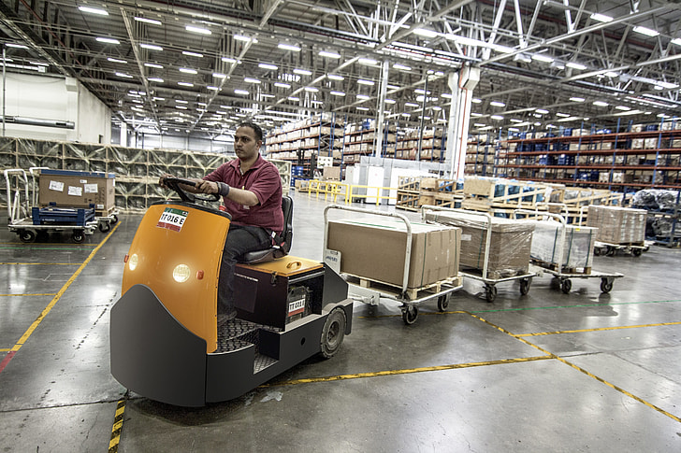
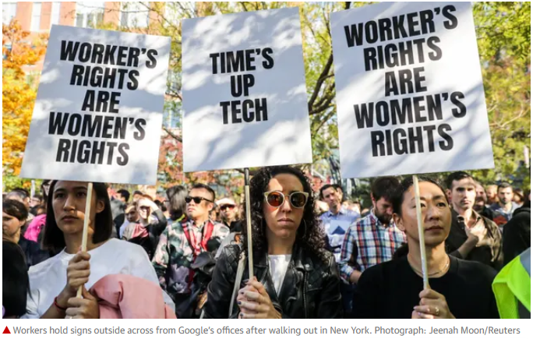
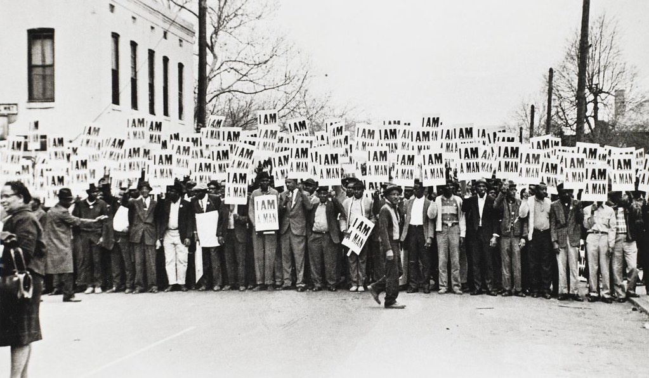
Worker power matters for other inequalities
Workplace health and safety
Autonomy on the job
Image: UIC Healthcare Strike; Matt Hoffman, Labornotes.org
Image: Wikimedia Commons
Harassment or abusive working conditions
Economic justice as racial justice
Image: Memphis Sanitation Workers’ Strike; Ernest Withers (Creative Commons)

Slide 14
3. Worker power matters for sustainable political and social change

Slide 15

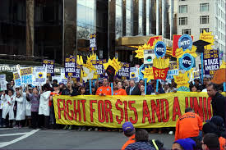
Worker power matters for sustainable political and social change
Image: Nebraska State Historical Society
Image: Wikimedia Commons

Slide 16
(re)Building worker power in 21st century America?
LOTS of ideas. My favorites:
Sectoral collective bargaining
Codetermination (significant worker representation on boards)
Firm-level councils with power over health & safety, technology adoption, other issues
Key obstacles/considerations:
Legal environment
Fissuring of the workplace
Minimize unemployment consequences
(Prioritization!)

Slide 17
Appendix

Slide 18
How does worker power work?
In a perfectly competitive world:
raises pay, but
lowers employment
But with monopsony power (in labor markets):
raises pay by providing “countervailing” power, and
may raise employment
And with monopoly power (in product markets):
raises pay by enabling workers to share in the excess profits / “rents” their firms produce, and
may not affect employment
Labor supply
Minimum wage / union wage
Market wage
Labor demand

Slide 19
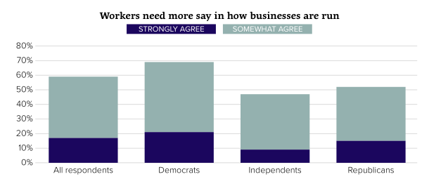
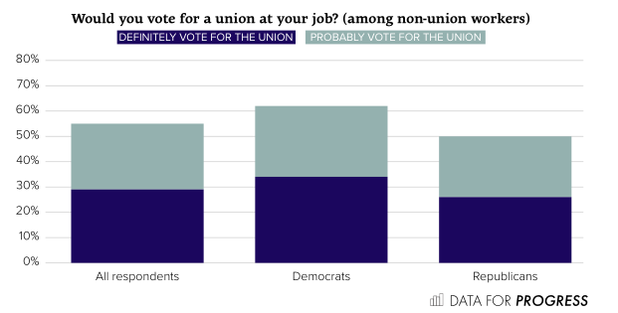
Workers want more voice in their workplace
see e.g. : Freeman and Rogers (2006), Kochan, Yang, Kimball, and Kelly (2019), Hertel-Fernandez, Naidu, Reich, & Youngblood (2020), Hertel-Fernandez, Kimball, and Kochan (2020), Hertel-Fernandez (2020), Mazumder and Yan (2020)

