Slide 1
a brief introduction to Performant Python
analysis, testing, tools and techniques

Slide 2
a brief introduction
I work in the Azure SDK for Python, so my background is in writing customer facing client-side code.
We’re going to talk about:
Why and where performance matters.
How to profile your Python code.
How to process and interpret the results.
Some strategies to optimize code performance.
This talk is only going to cover CPython.
This talk will reference Adam Ling and my work on Python AMQP library.
Notes:
Throughout this talk you’ll often here me refer to the ‘customer experience’ – and this is because I work in customer facing code, SDKs and utilities that customers interact with. These SDK’s are also how Python developers will experience the Azure platform as a whole, so the quality of that experience is actually part of how they will view Microsoft’s cloud platform. And an aspect of that quality is performance.
This talk is a consolidation of a couple of talks my colleague Adam Ling and I did for our team and has largely grown out of the work we have been doing on the uAMQP Python library.
This is an implementation of the AMQP messaging protocol, that needs to be able to receive, deserialize and process upwards of 10k messages per seconds. Currently this is done by a Cython bindings over a C library. We are currently rewriting this in Pure Python, where we found ourselves needing to spend significant amounts of time fine-tuning performance.

Slide 3
The What, Why, And when.

Slide 4
what is performance in python?
‘Performance’ means different things to different projects.
For this talk we’re going to focus on the efficient execution of CPU-bound Python code.
Not going to cover efficient IO, asynchronous, multi-threaded or multi-process code.
Notes:
Performance can mean different things: - Disk or CPU usage
- Networking bandwidth usage
- Memory usage
- Latency
- Throughput

Slide 5
why should we care about perf?
Python does not have a reputation for great performance anyway…
Shouldn’t customers write performance-focused code in a different language?
Can’t I just use C extensions?

Slide 6
why we should care about perf
When written carefully Python code can actually have pretty great performance.
Customers may have existing projects/systems/trained devs in Python. Rewriting in a different language may not be an option.
Just because perf might not be the primary focus of project, doesn’t mean it should be slow.
Using C extensions for expensive operations is an option, but can have some customer unfriendly drawbacks.
Notes:
Just because performance may not be the primary reason a customer selects to work in Python, does not mean that it's inconsequential. Depending on how it's used, Python can actually be performant - and not tapping into this can be a frustration for customers.
For the uamqp Python project, we had to publish 32 compiled wheels per release. And this only covered the major operating systems – Windows, MacOS and ManyLinux.
We had no support for ARM architectures – anyone needing this had to compile on their own.
I’m not saying there aren’t vastly simpler ways to achieve C extensions – just that there can be complications for both the dev team and customers. They also may run slower on Pypy.
As an open-source project, having a C extension can also be a bigger barrier to entry for open-source engagement and contribution. It’s also harder to maintain for a team that is primarily Python developers.

Slide 7
so then when should we care?
What services is your code interacting with?
How will customers expect to interact with your project?
Is the code critical path, or highly reused?
Notes:
Do all projects need to be “performant”? Here are some questions to gage the level of attention that should be applied to the performance of the project.
If you are writing a project that communicates with other services – like a client-side SDK or utility – are these services highly performant? Or maybe they will throttle excessive traffic? For example, most ARM services will only allow 1200 writes per subscription per hour, so fine tuning an SDK for high volume of requests might be wasted effort. Are these services, by their nature, dealing with high throughput workloads, for example messaging services or storage?
And in these scenarios, we want to make sure that the code we write is maximizing the throughput these services can handle.
Will customers be running your project irregularly? For example, administrative, or resource-management style tasks.
Or will it be running on an ongoing basis, like a webservice or app?
Doing performance analysis doesn’t just apply to projects as a whole – perhaps we only need to scrutinize the critical path, or particular functions or modules.
Depending on the perf needs of the project, maybe we can focus on areas of the code that will be used frequently during the running of an application - e.g. serializing and deserializing requests and responses. Due to the volume of usage, making these areas performant will have more impact on customers than fining tuning an expensive utility that is only run once during the construction of a Client.

Slide 8
The how.

Slide 9
step 1. analyze
Identify our metrics. What does performance mean for this project?
Decide what success looks like:
Is there a specific benchmark that must be met?
Are we targeting a specific throughput?
Are we targeting a maximum end-to-end time?
Simply minimize major bottlenecks?
Make as much improvement as possible in a single sprint?
Notes:
Identify our metrics:
Throughput: How much amount of work could be done in a certain period of time (e.g. 10 ops/seconds)
Response time/latency: How long it takes from performing a request until receiving the response (e.g. 40 ms)
Resource allocation: CPU/Memory/Disk/Network Bandwidth Usage (e.g. 10K memory)
How to select a benchmark:
Maybe we want to maximize the capabilities of a service endpoint we’re communicating with.
Maybe we want to achieve comparable results to the same project in a different language.
Maybe we want to achieve parity with a competing product.
Maybe we need to assess a certain amount of data within a particular time frame before it becomes stale or expired.
In AMQP we needed to achieve parity with the C-based implementation – which meant a throughput of 15k messages per second.
Perhaps we don’t have an exact target in mind, maybe we just need to invest a sprint or less to do some investigation to see what the major bottlenecks are and whether there’s some low-hanging fruit that can be tackled to improve performance.
That’s still a very valid approach and really important (and awesome) that you are investing in it.

Slide 10
step 2. profile
Tools:
cProfile/profile
PyCharm
SnakeViz
Austin
Profiling can help us see:
Which areas are computationally expensive (how much time).
Which areas are excessively repetitive (how many times).
Time wasted unproductively (methods that shouldn’t be there).
Notes:
We’re going to be looking at cProfile today, which is the profiler that ships in the stdlib. There are other options – I’ve linked to Austin on the slide. I haven’t used it yet, but it looks really interesting.
There are several approaches to using cProfile – if you are wanting to profile a single function, or targeted section of a project, it can be imported as a module and run from within your code. Today we’re going to be looking at running it from the command line, which is a simple utility for measuring end-to-end performance of a script. I’ve linked to the cProfile docs there, so you can take a closer look at the in-code solution if that’s what you need.
The other two links there are tools for interacting with the profile results.
How long does this piece of code take to run? An expensive function might be fine if it's only run once per request
How many times is it run? An inexpensive function might seem fine, but cumulatively causes a problem if it's run 1000 times per request.
Time spent in methods that aren’t achieving our objectives. This might be in builtin Python functions, or object constructors. Or it could point to poor design choices.
The first two might be addressable with syntax substitutions or simple refactoring, the third one may indicate a more substantial design change is needed.

Slide 11
example: amqp frame decode
from decode_v1 import decode_frame
frame_bytes = b'\x00S\x11\xc0\x15\x08@Cp\x00\x01\x00\x00p\x00\x01\x00\x00p\xff\xff\xff\xff@@@'
def decode_lots_of_frames1():
for _ in range(150000):
decode_frame(frame_bytes)

Slide 12
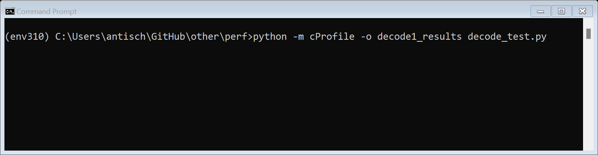
example: running the profiler
> python -m cProfile -o [OUTPUT] [INPUT]

Slide 13
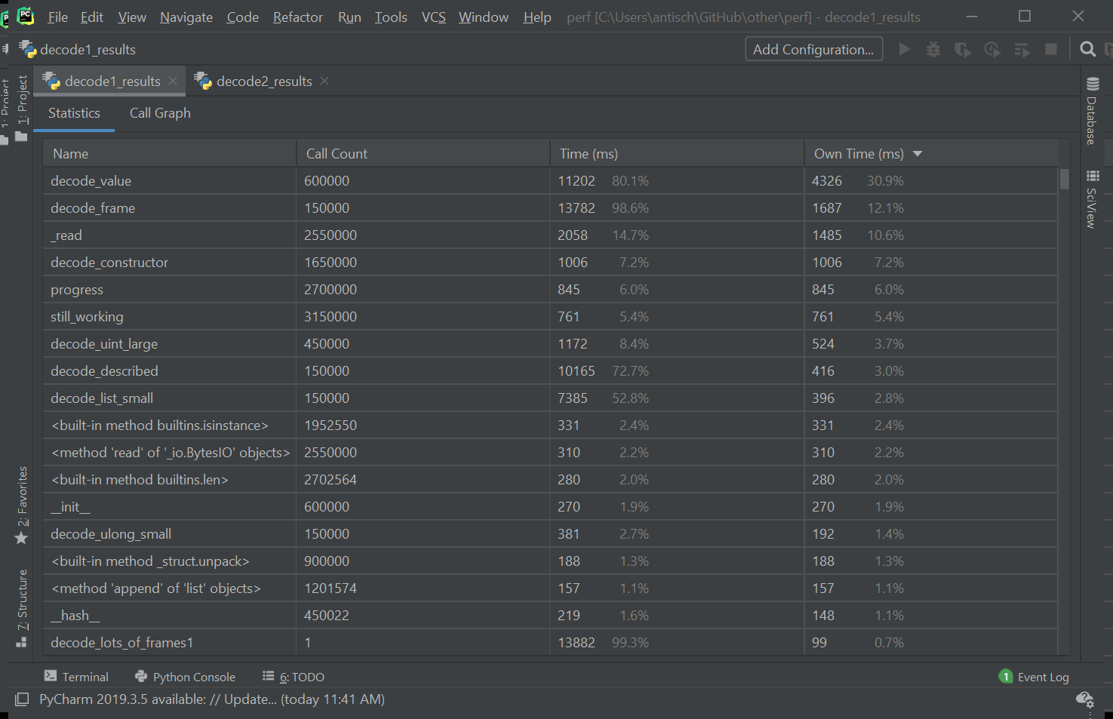
Pycharm screenshot: profile results table

Slide 14
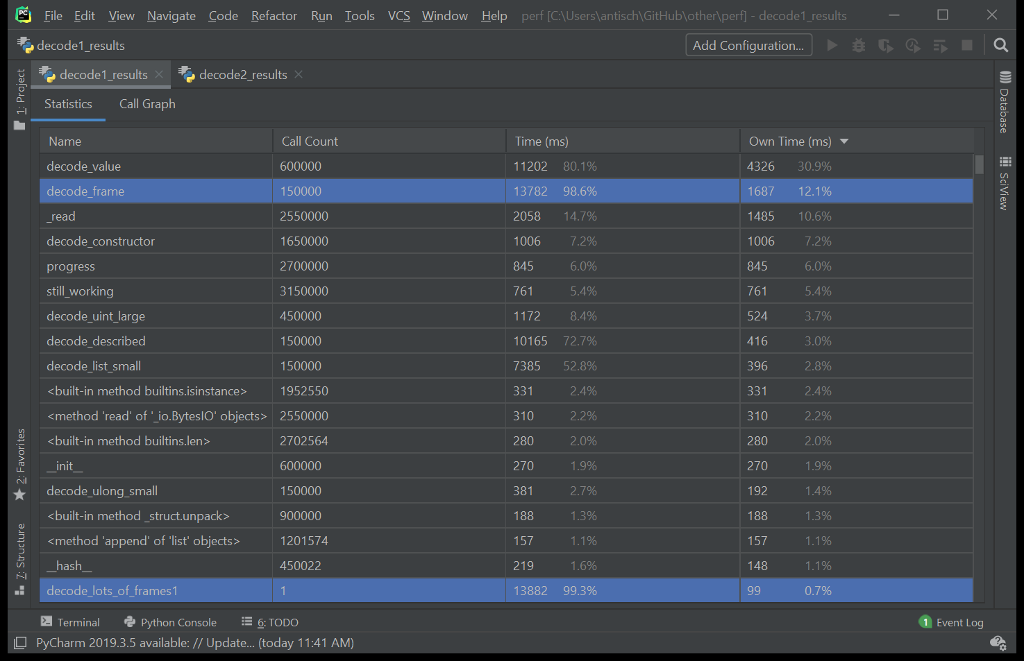
Pycharm screenshot: profile results table with primary functions

Slide 15
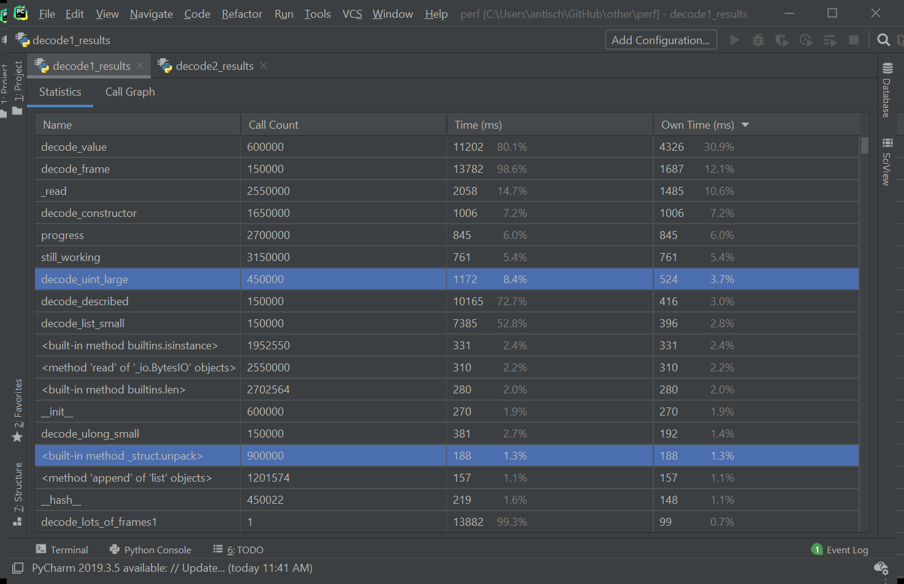
Pycharm screenshot: profile results table with calculation functions

Slide 16
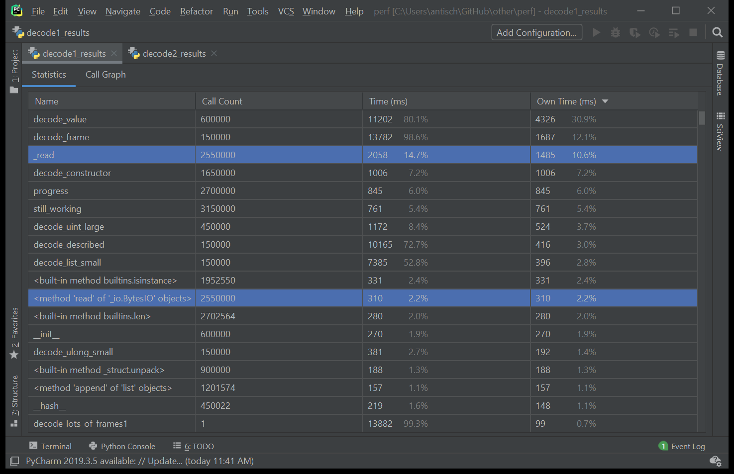
Pycharm screenshot: profile results table with read functions

Slide 17
example: reading bytes
def decode_frame(data, offset=0): byte_buffer = BytesIO(data[offset:]) ...
def _read(buffer, size): data = buffer.read(size) if data == b'' or len(data) != size: raise ValueError(...) return data

Slide 18
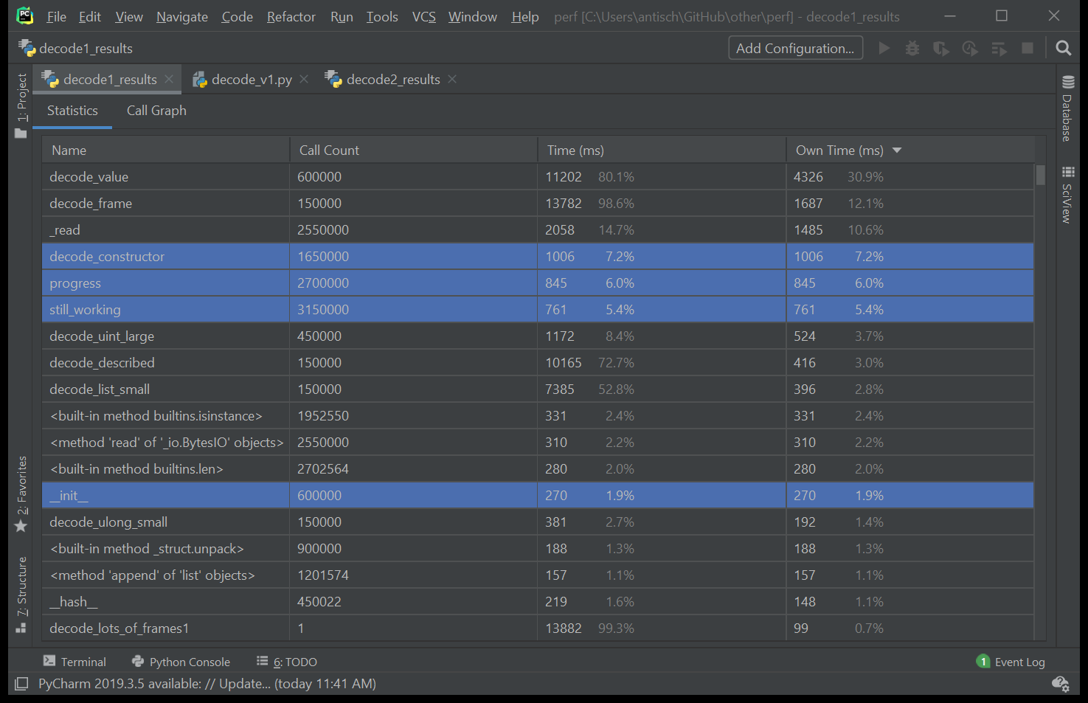
Pycharm screenshot: profile results table with decode status functions

Slide 19
example: decoder status
class Decoder(object):
def __init__(self, length): self.state = DecoderState.constructor self.bytes_remaining = length self.decoded_value = {} self.constructor_byte = None
def still_working(self): if self.bytes_remaining is None: return self.state != DecoderState.done return self.bytes_remaining > 0
def progress(self, num_bytes): if self.bytes_remaining is None: return if self.bytes_remaining - num_bytes < 0: raise ValueError("Buffer bytes exhausted.") self.bytes_remaining -= num_bytes

Slide 20
example: more decoder state
class DecoderState(object): constructor = 'CONSTRUCTOR’ type_data = 'TYPE_DATA’ done = 'DONE'
def decode_constructor(decoder): if decoder.constructor_byte == ConstructorBytes.null: decoder.decoded_value = None decoder.state = DecoderState.done elif decoder.constructor_byte == ConstructorBytes.bool_true: decoder.decoded_value = True decoder.state = DecoderState.done elif decoder.constructor_byte == ConstructorBytes.bool_false: decoder.decoded_value = False decoder.state = DecoderState.done elif decoder.constructor_byte in [ConstructorBytes.uint_0, ConstructorBytes.ulong_0]: decoder.decoded_value = 0 decoder.state = DecoderState.done else: decoder.state = DecoderState.type_data

Slide 21
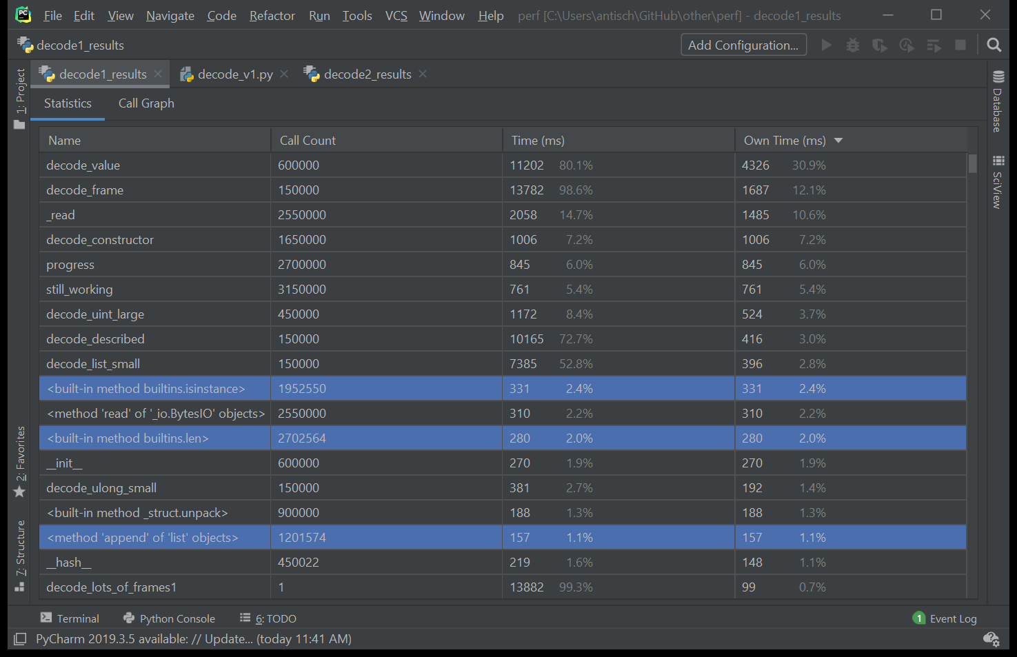
Pycharm screenshot: profile results table with built-in functions

Slide 22
step 3. optimize
Question every line of code:
Is this method/object/line/operation/utility even necessary?
Can it be replaced with a faster version?
Can it be refactored to run fewer times?
Can it be optimized for the majority case(s), possibly at the expense of the minority case?
If we understand when and how C is being used under the surface, we can write our Python code to best utilize it.
Notes:
We’re going to start diving into the weeds a little bit here and actually look at how to optimize Python syntax.
And let’s be very clear – we’re talking about saving microseconds at this point.
How relevant this will be to you comes back to our larger questions about the needs of your customers and the goals of your project.
I mentioned at the start that this endeavor was driving by the need for us to replace a C extension for processing 15k+ incoming messages per second.
For us if we could save microseconds in the deserialization of a single message, then that has a measurable cumulative effect.
So if you have very rigorous perf requirements for your project, these might be helpful.
If you don’t have those requirements, I hope it will at least help you think a little bit more about how you write Python code, and the potential trade offs you might be unconsciously making.

Slide 23
pythonic == performant
Use built-in functions where possible.
A local variable look-up is faster than a global one. A hard-coded value is even faster.
Index access and iteration is faster in a List, but loop-up is faster in a dictionary.
A dictionary look-up is faster than accessing an object attribute.
Instantiating a dictionary or a tuple is faster than an object.
If you are concatenating data, bytearray is faster than bytes.
If you are slicing data, use memoryview rather than reading from an IO.
Loop and dictionary comprehensions are highly optimized.
For 'if-statements' - always use the first path to represent your highest traffic case.
Notes:
If we are using Pythonic syntax in our code, we are often unknowingly already using the most performant option.
As we’ve seen, this can be especially important when translating projects between different languages.
Often these things will only make a _tiny_ difference – but if you’re doing any tight loops, for example iterating over large data sets, or processing 15k frames per second, these things can _really_ add up.
Built-ins
These are often implemented in C, and therefore will be the fastest version. Always check the docs for stdlib modules like itertools before embarking on unique loop traversal - you may find an existing utility that will be faster.

Slide 24
pythonic != performant?
If you have many conditional options, with no obvious preference, using a list or dictionary lookup might be faster.
Calling methods is expensive. For critical path - avoid moving code out into many 'utilities’.
In Python we prefer EAFP instead of LBYL. This is largely because raising errors is considered inexpensive in Python. This may not always be the case, and should be validated for a given scenario.

Slide 25
example: amqp frame decode v2
from decode_vlatest import decode_frame
frame_bytes = memoryview(
b'\x00S\x11\xc0\x15\x08@Cp\x00\x01\x00\x00p\x00\x01\x00\x00p\xff\xff\xff\xff@@@'
)
def decode_lots_of_frames2():
for _ in range(150000):
decode_frame(frame_bytes)

Slide 26
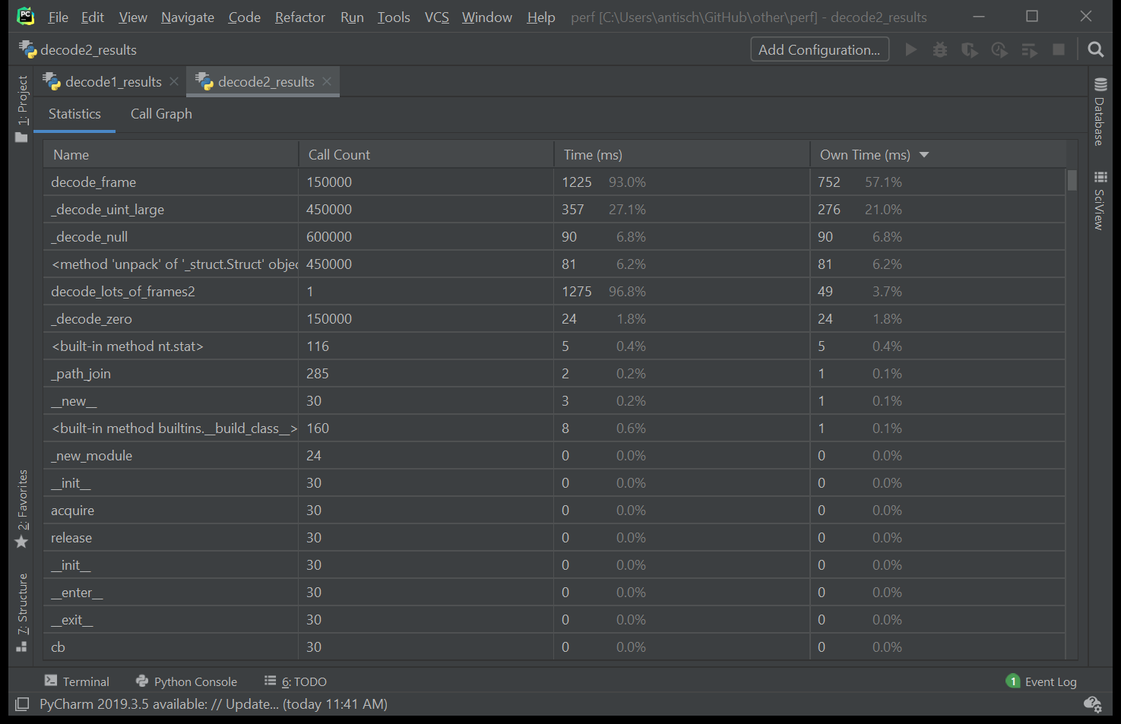
Pycharm screenshot: profile results table v2

Slide 27
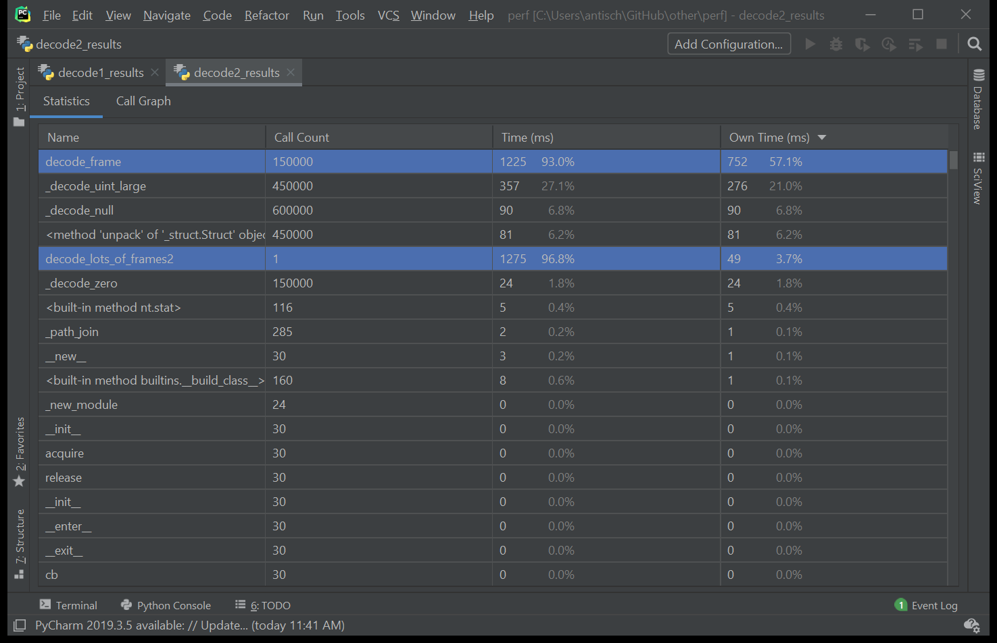
Pycharm screenshot: profile results table v2 with primary functions

Slide 28
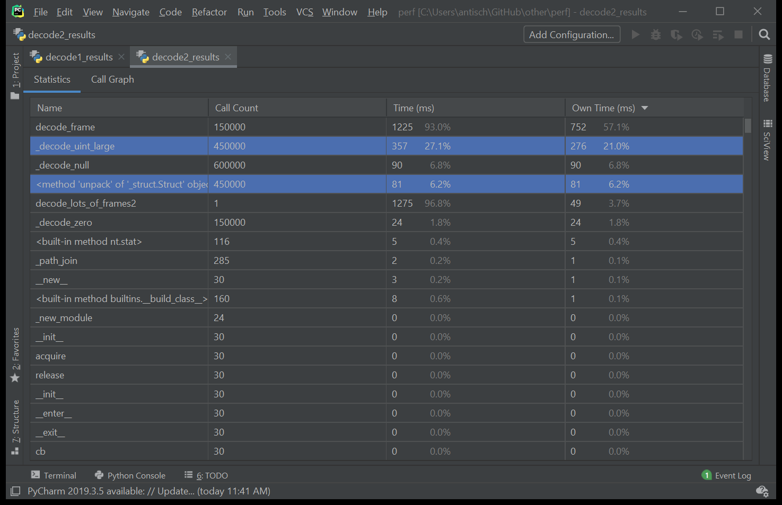
Pycharm screenshot: profile results table v2 with calculation functions

Slide 29
going deeper with dis
The dis module in Python will disassemble the bytecode to show you the underlying instructions.
Great way to fine-tune the performance of tight loops or functions.
For even deeper analysis, you can find use gdb to debug specific instructions in Cpython.

Slide 30
example: perf analysis with dis
import dis
def test_func(a):
multiplier = 2
return [ i*multiplier for i in range(a) ]
if __name__ == '__main__':
dis.dis(test_func)
5 0 LOAD_CONST 1 (2) 2 STORE_DEREF 0 (multiplier) 6 4 LOAD_CLOSURE 0 (multiplier) 6 BUILD_TUPLE 1 8 LOAD_CONST 2 (<code object <listcomp> at …, file "dis_test.py", line 6>) 10 LOAD_CONST 3 ('test_func.<locals>.<listcomp>’) 12 MAKE_FUNCTION 8 (closure) 7 14 LOAD_GLOBAL 0 (range) 16 LOAD_FAST 0 (a) 18 CALL_FUNCTION 1 6 20 GET_ITER 22 CALL_FUNCTION 1 24 RETURN_VALUE Disassembly of <code object <listcomp> at …, file "dis_test.py", line 6>: 6 0 BUILD_LIST 0 2 LOAD_FAST 0 (.0) >> 4 FOR_ITER 6 (to 18) 7 6 STORE_FAST 1 (i) 8 LOAD_FAST 1 (i) 10 LOAD_DEREF 0 (multiplier) 12 BINARY_MULTIPLY 6 14 LIST_APPEND 2 16 JUMP_ABSOLUTE 2 (to 4) >> 18 RETURN_VALUE

Slide 31
step 4. verify
Use the timeit module to compare different approaches.
Make sure you have the tests in place to validate your success criteria.
Make sure you have the tests in place to prevent perf regression going forward.
Notes:
For the Azure SDK we built a custom perf testing framework from scratch. The reasons for this were because we wanted easy test portability between all the major Azure SDK languages by non-language experts, and a consistent experience for running and collecting the results across all languages.
We are currently in the process of incorporating this perf test framework into our nightly test runs so that we can see performance over time, and changes to perf with any given feature or release.

Slide 32
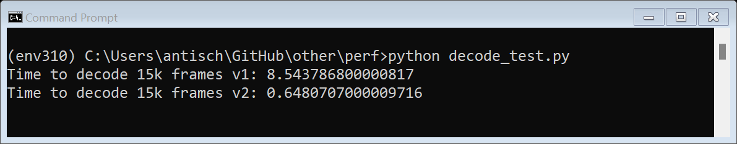
example: using timeit
from decode_v1 import decode_frame as decode1
from decode_vlatest import decode_frame as decode2
import timeit
frame_bytes = b'\x00S\x11\xc0\x15\x08@Cp\x00\x01\x00\x00p\x00\x01\x00\x00p\xff\xff\xff\xff@@@'
t = timeit.timeit(lambda: decode1(frame_bytes), number=15000)
print(f"Time to decode 15k frames v1: {t}")
t = timeit.timeit(lambda: decode2(memoryview(frame_bytes)), number=15000)
print(f"Time to decode 15k frames v2: {t}")

Slide 33
step 5. repeat
Performance refinement can be a slow process.
Fixing a few “low-hanging fruit” can make a big difference to performance.
With each iteration, you will likely get smaller returns on investment.
But you can always make it faster.
Notes:
Improving Python perf is not a quick process and involves many iterations.
Often after a first profiling, low hanging fruit will become obvious, and improving these can result in some immediate gains, which may be 'sufficient'.
Each iteration after than may only shave a tiny fraction off the run time. Some iterations will probably go backwards. What helped speed up one SDK, may not work for the next - so profile and iterate will always be a unique experience for each application and its parameters.
There's not really an endpoint. It can probably always get better, but knowing your metrics, and what baseline perf you need to achieve, should help you reach a state that is 'good enough'.
The more you do it, the more you will instinctively use the most efficient tools.
It's very easy for perf to regress over time as features are added. Making sure that perf is a feature of CI should help prevent this happening - or at least keep it transparent so that we aware of the tradeoffs we are making for new features.

Slide 34
my code is now fast and ugly
def decode_payload(buffer, length): decoder = Decoder(length) decoded_values = {} while decoder.still_working(): if decoder.state == DecoderState.constructor: try: decoder.constructor_byte = _read(buffer, 1) except ValueError: break decoder.progress(1) decode_constructor(decoder) elif decoder.state == DecoderState.type_data: decode_described(decoder, buffer) decode_message_section( Message.SECTIONS[decoder.decoded_value[0]], decoded_values, decoder.decoded_value[1]) else: raise ValueError("Invalid state") if decoder.state == DecoderState.done: decoder.state = DecoderState.constructor decoder.decoded_value = {} decoder.constructor_byte = None return Message(**decoded_values)
def decode_payload(buffer): message = [None] * 9 while buffer: descriptor = buffer[2] buffer, value = _DECODE_BY_CONSTRUCTOR[buffer[3]](buffer[4:]) if descriptor == 112: message[0] = Header(*value) elif descriptor == 113: message[1] = value elif descriptor == 114: message[2] = value elif descriptor == 115: message[3] = Properties(*value) elif descriptor == 116: message[4] = value elif descriptor == 117: try: message[5].append(value) except KeyError: message[5] = [value] elif descriptor == 118: try: message[6].append(value) except KeyError: message[6] = [value] elif descriptor == 119: message[7] = value elif descriptor == 120: message[8] = value return message
Notes:
In order to achieve the most performant code, you may need to go against some of your instincts to write developer-friendly readable code.
This is a function we pulled from the first iteration of our decoder, and the same function in the most recent version.
It went from a short, human-readable paragraph to a giant switch statement full of integer indexes.

Slide 35
managing trade offs
Sometimes the most performant code may go against some of our instincts as programmers.
Often less readable, less modular – and therefore more difficult maintain or add to (especially if ownership changes).
Compensate with plenty of inline commenting and documentation.
Will need to decide for a given project how much should be compromised in pursuit of performance.
Notes:
For our project, performance was paramount, and we were happy to accept difficult-to-parse code to achieve a few more messages per second.
Not all projects will have those requirements – so keep these trade-offs in mind.

Slide 36
That just leaves: who and where.

Slide 37
who: you
Please take the time to understand the perf needs of your customers.
It doesn’t take much to run a quick profile of your code to understand any major bottlenecks.
Sometimes a couple of lines of code can make a huge difference.
If you have major performance requirements and are feeling a bit daunted…

Slide 38
where to go
Please reach out if you have questions about how to approach your performance requirements.
pytalk@microsoft.com
Teams channels:
Python
Azure SDK
Python AMQP project.
Python performance presentation notes.

Slide 39
a brief conclusion
Analyze
Profile
Optimize
Verify
Repeat
Repeat
Rep…

Slide 40
thanks
Questions, thoughts, comments

