Slide 1
GLOBOX
A
B
A/B TESTING

Slide 2
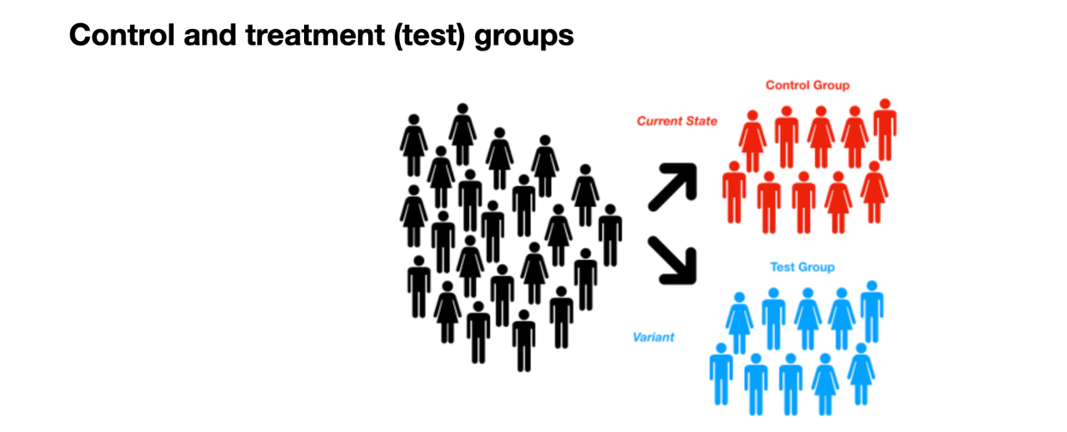
A/B Testing overview
The Growth team decides to run an A/B test that highlights key products in the food and drink category as a banner at the top of the website. The control group does not see the banner, and the test group sees it.
Step 1
Step 2
Test setup
Confirming our test results
Step 3
Step 4
Statistical significance (based on conversion rate)
Hypothesis testing – p-value
Step 5
Confidence interval for the difference in the conversion rate

Slide 3
The setup of the A/B test
Define goal
Test unit and period
Primary goal: increase revenue
Our target randomization unit of the test – individual users. Testing period – 12 days
01
Generate idea
05
02
We believe that shopping should be an adventure.
KPI and Hypothesis
04
03
Implement changes
Better metric: conversion rate.
H0:p=p0
Ha:p≠p0
p and p0 - conversion rate of the new and old design
The page loads the banner if the user is assigned to the test group, and does not load the banner if the user is assigned to the control group.

Slide 4
Groups have significant size and roughly comparable
49.78%
Grand Total
Grand Total
50.22%
50.02%
Female
A
B
Female
49.98%
49.54%
Male
Male
50.46%

Slide 5


VS
Variation A
Variation B
4.17% conversion
4.96% conversion
Average conversion rate 4.59%

Slide 6
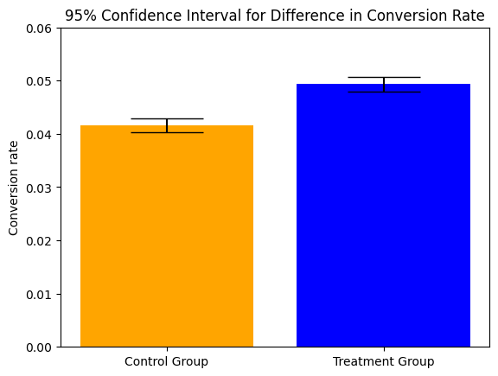
Statistical significance
Variation | Users | Conversions | CR | St deviation | Change
A Control | 24343 | 1014 | 4.17% | 0.0013 | —
B Treatment | 24600 | 1219 | 4.96% | 0.0014 | 19%
Chance of B outperforming A

Slide 7
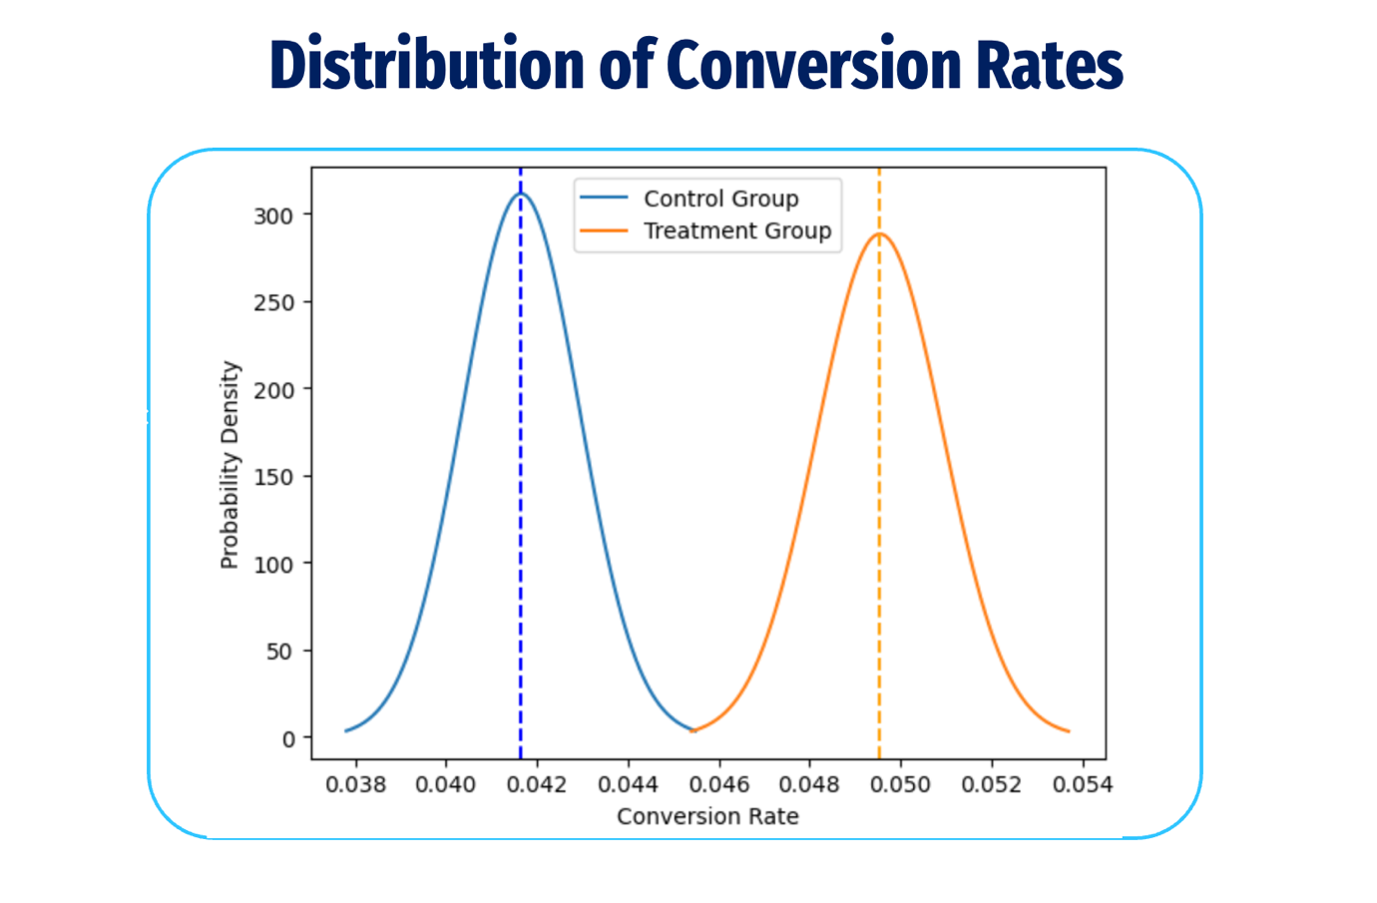

Slide 8
Since p-value=0.0003 is way below our α=0.05, we reject the null hypothesis
0.00003
vs
0.05
p-value
α

Slide 9
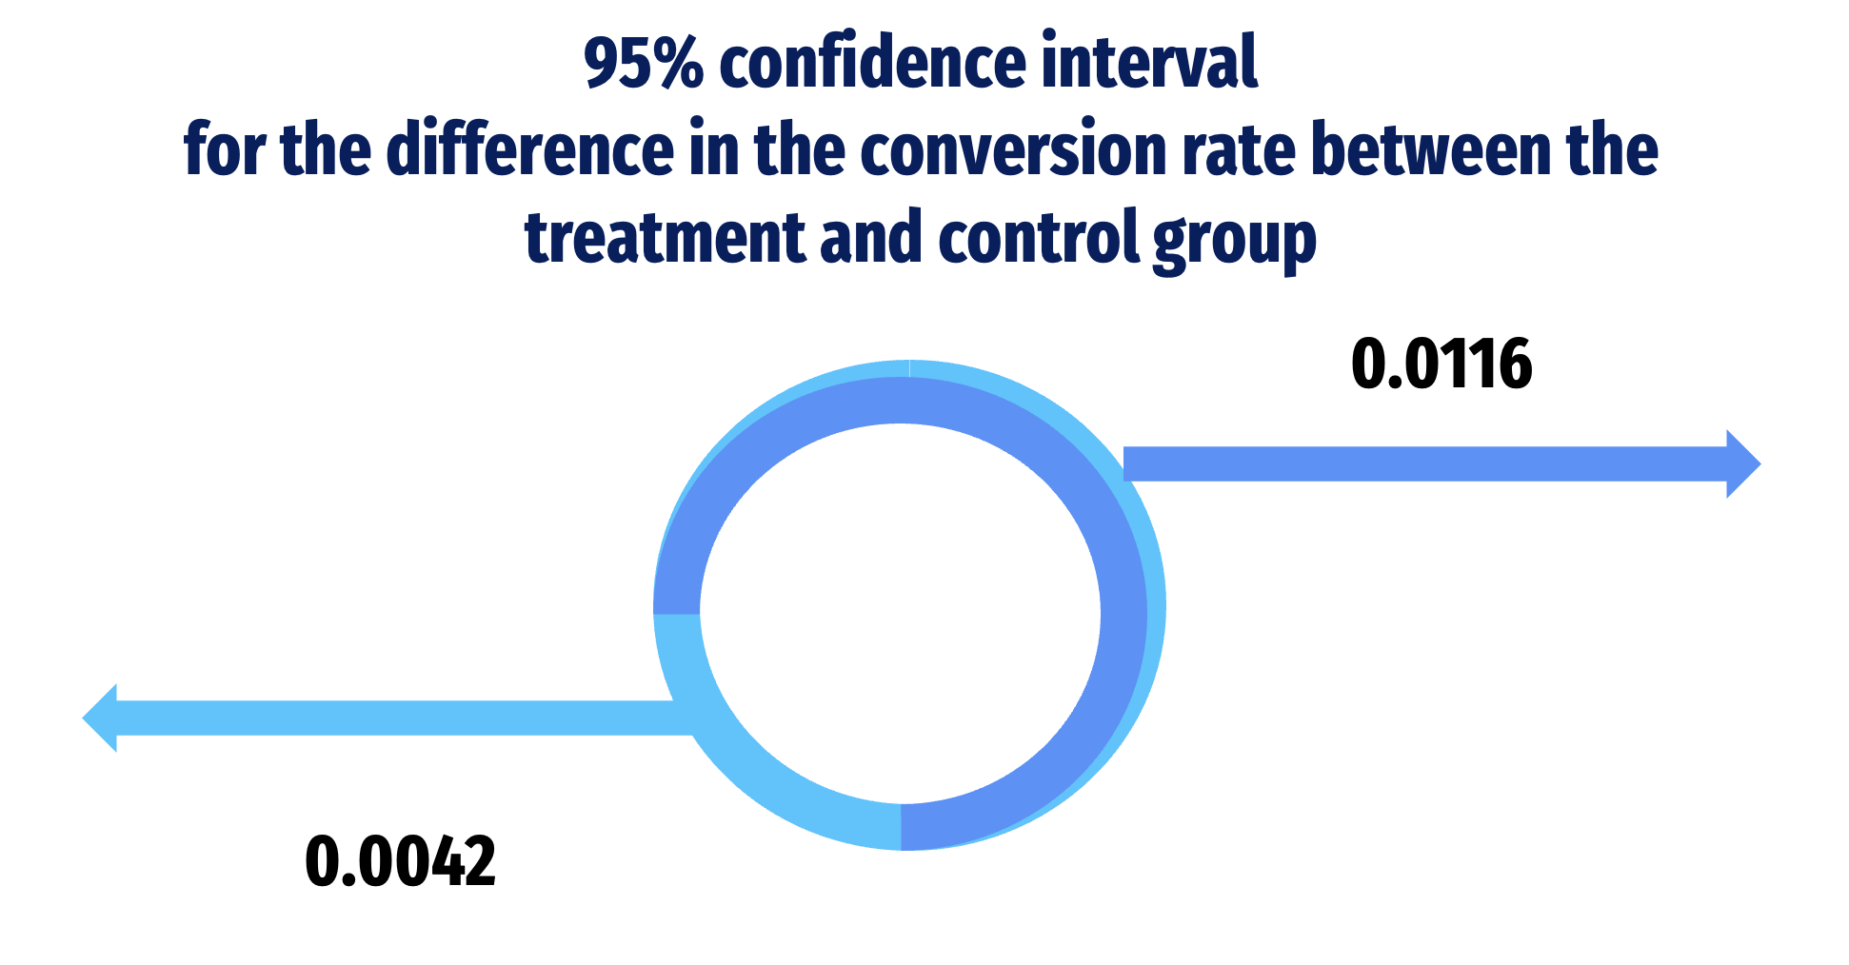

Slide 10
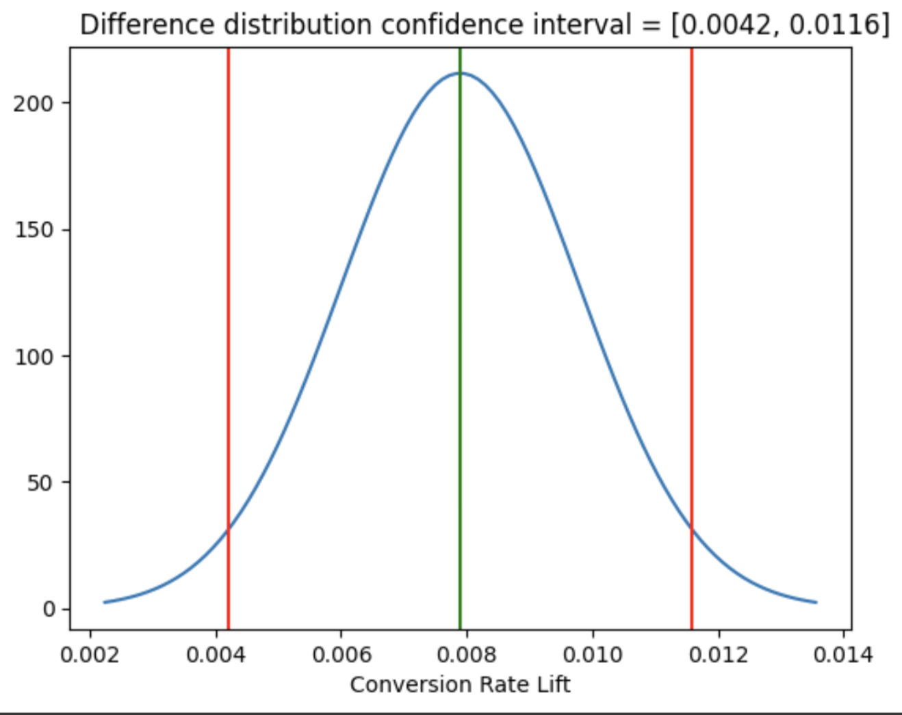
Difference distribution confidence interval
A
B

