Slide 1
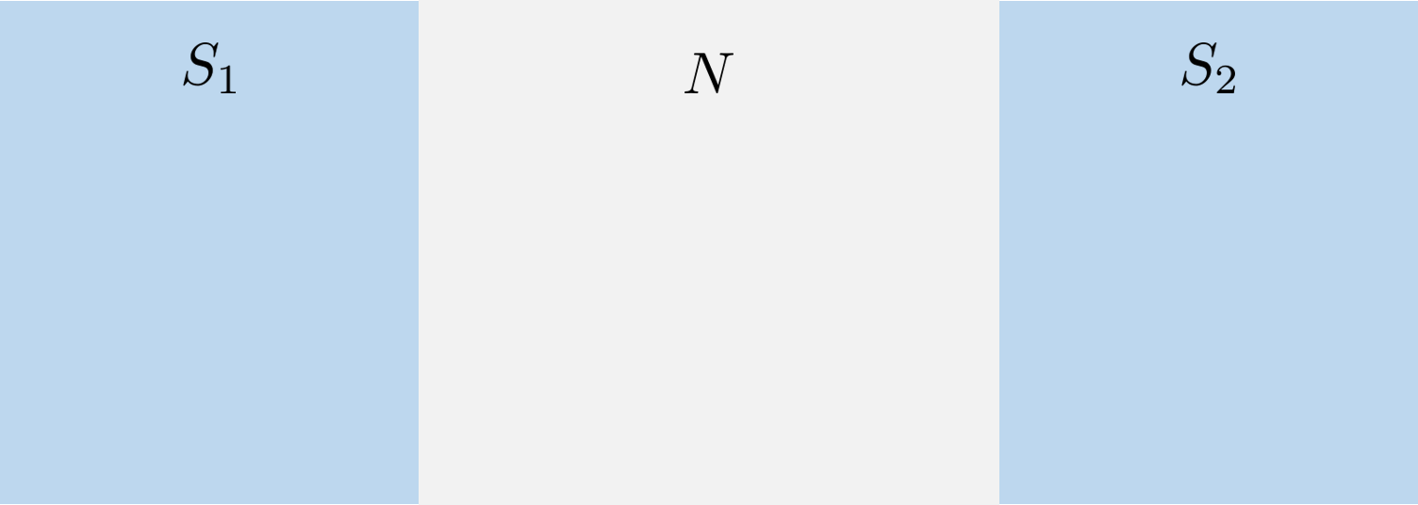
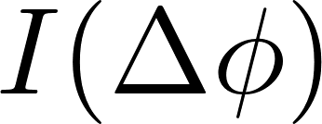

Slide 2
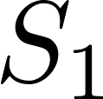

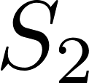

Slide 4


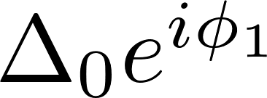



Slide 5


Slide 7

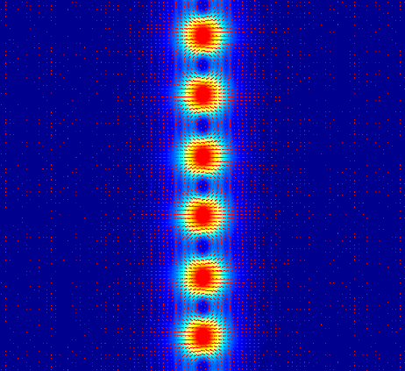

Slide 8
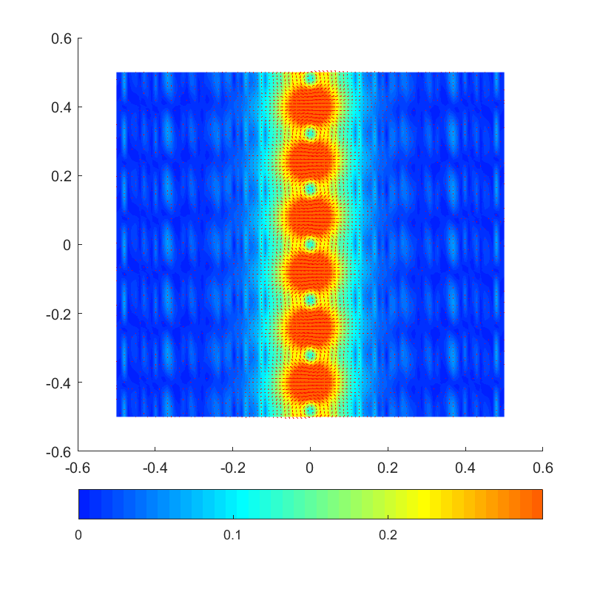

Slide 9
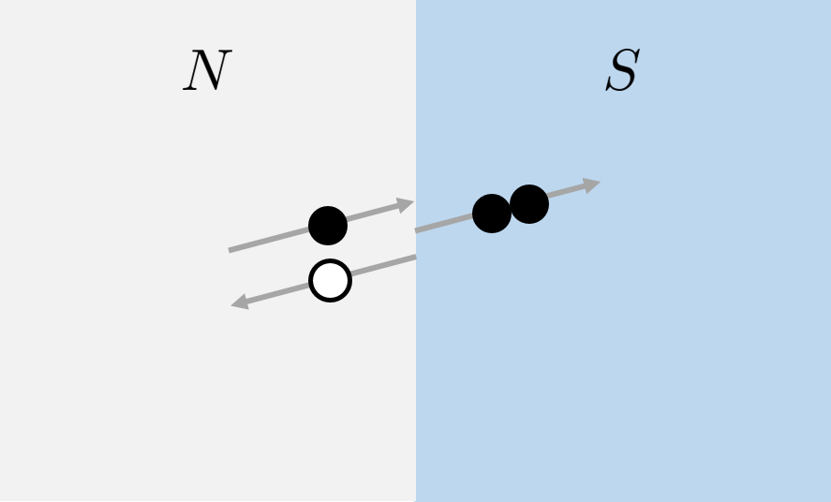
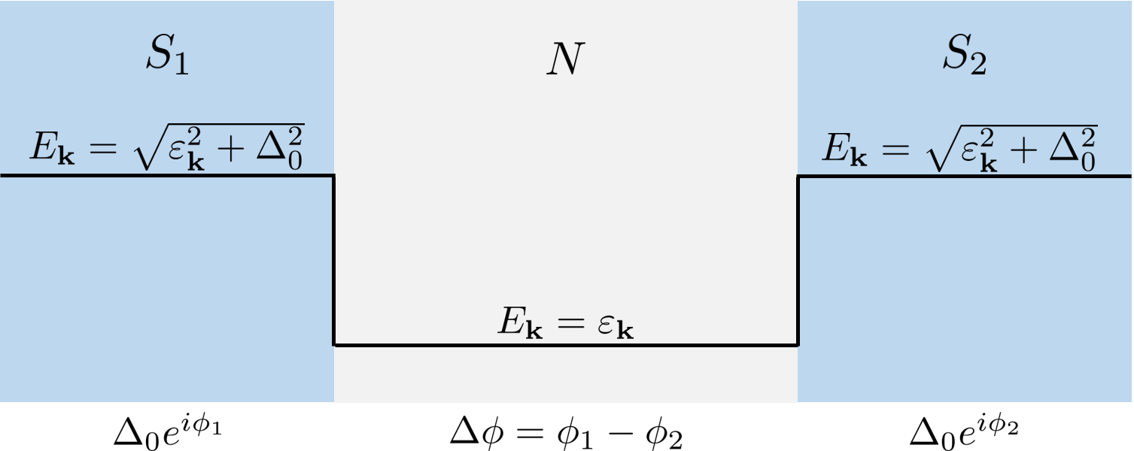

Mechanism of Josephson Current
Supercurrent transported by Cooper-pairs
Energy gap for quasiparticles in superconductor
Supercurrent transported through normal metal via Andreev Bound States
Phase driven Josephson current
External magnetic field

Slide 10

