Slide 1
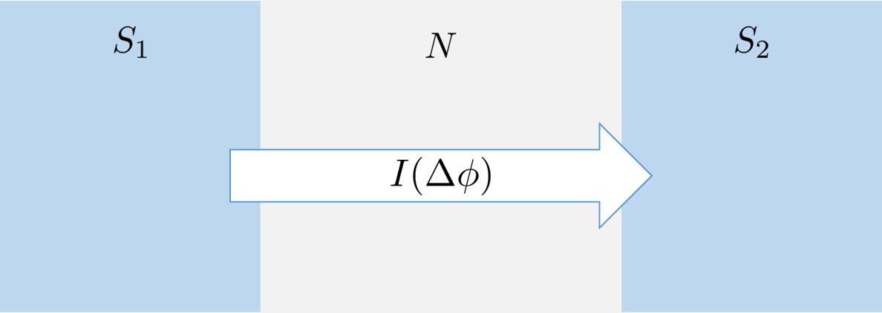
Supercurrent transport via Andreev bound states in an external magnetic field
Anna Brøyn
Supervisor: Jacob Linder

Slide 2
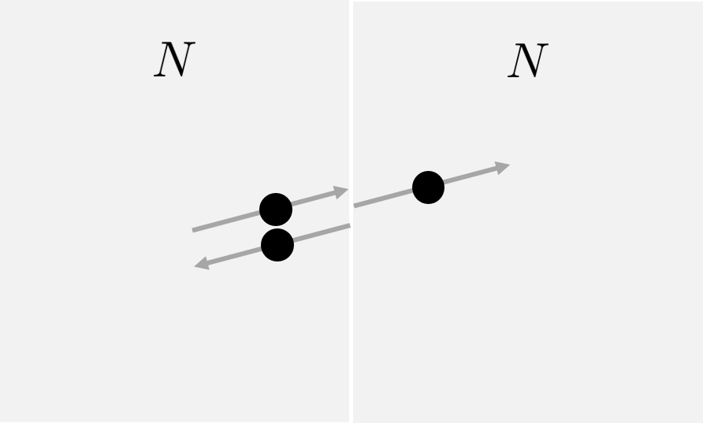
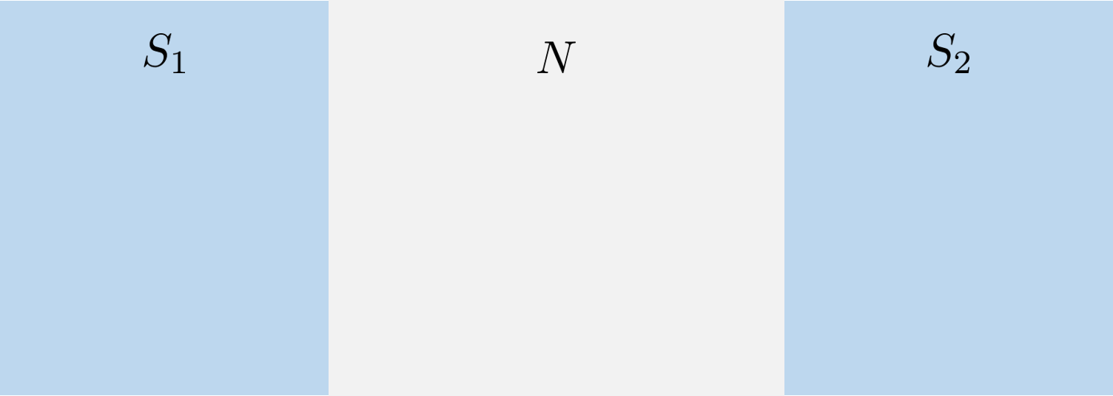
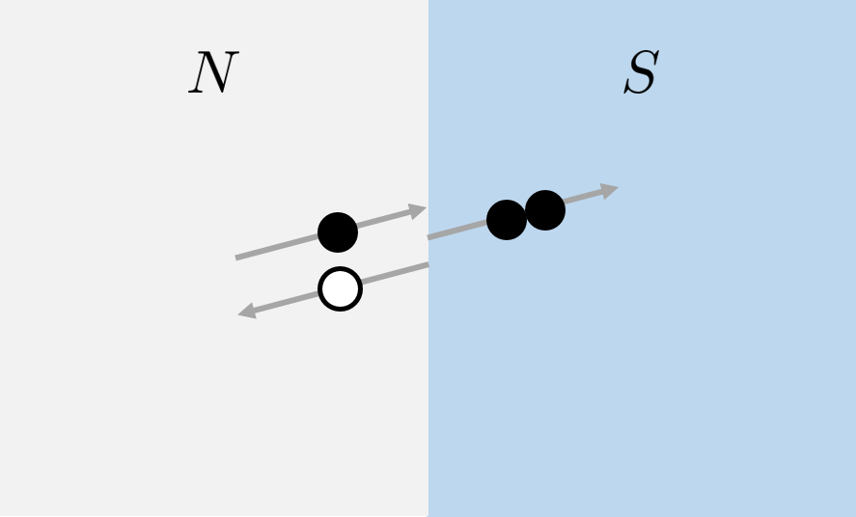

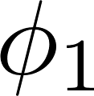
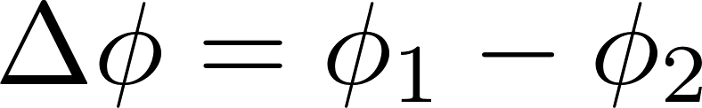
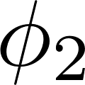
Mechanism of supercurrent transport
Cooper-pairs transport supercurrent in superconductor
Andreev Bound States transport supercurrent in normal metal
The supercurrent is phase driven

Slide 3
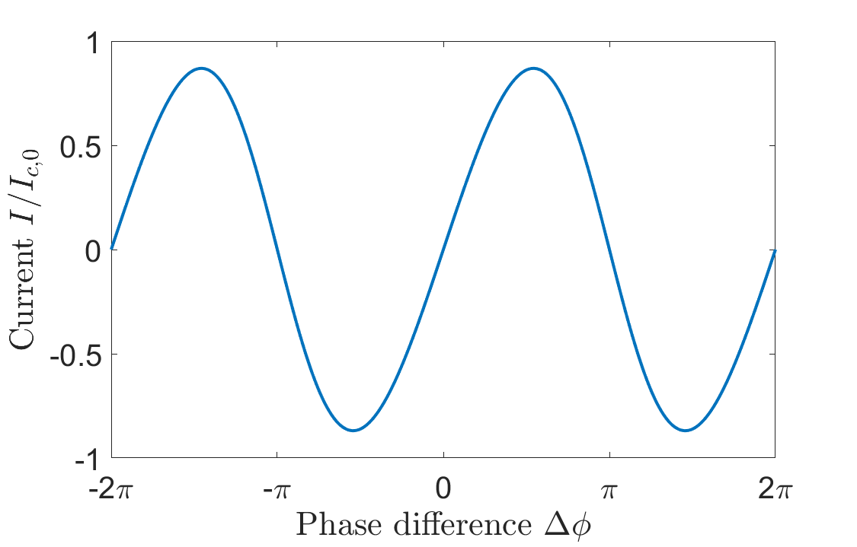
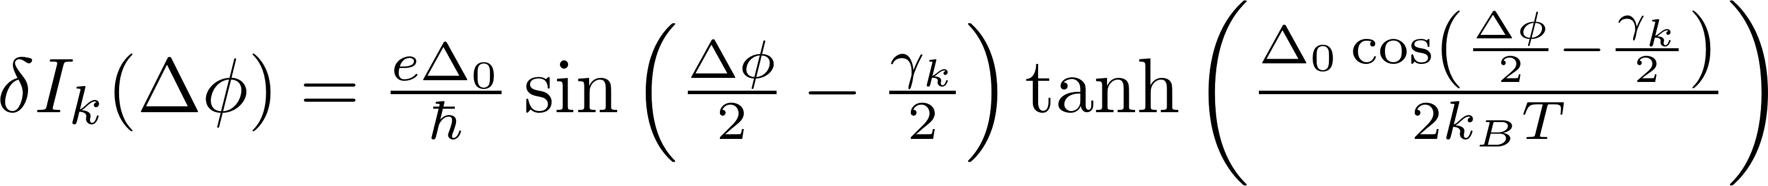
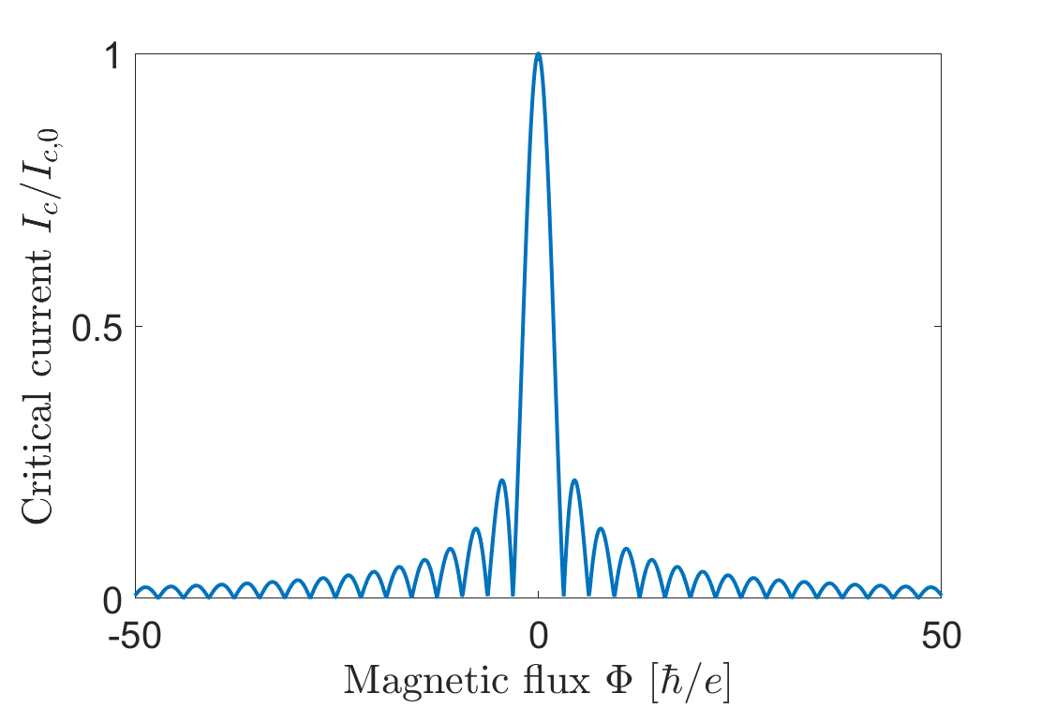
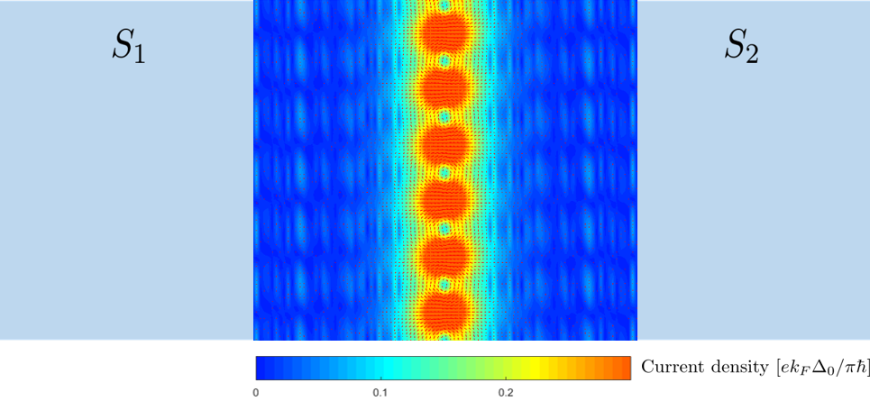
Some Results

Slide 4
Conclusion and outlook
Supercurrent vortices
Apply non-constant magnetic field
Use magnetic field to control the supercurrent

