Slide 1
SMART CHAIR Group 7
Rudy Ramjas - EE
Mackenson Jean - EE
Annavay Kean - CpE
Thien Nguyen - CpE

Slide 2
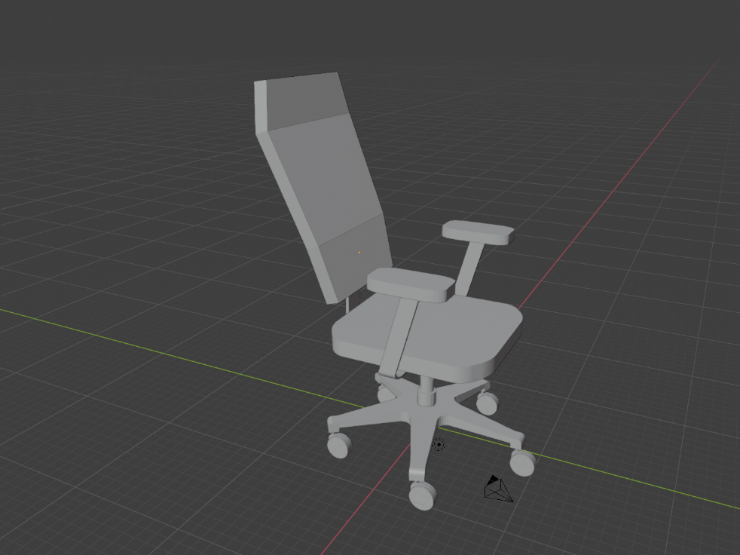
Goals & Objectives
Help user to become more mindful of posture habits.
Provide feedback based on measured data.
Target audience: middle-class office workers.

Slide 3
Specifications
The device should update the sensor input readings every 30 seconds.
The device should pair with a phone app.
The application will display posture data.
The application will provide feedback.
The software will store user data.
2-day standby battery life, minimum.
PCB not to exceed 200 cm squared.
Enclosure not to exceed 1500 cm cubed.
Sensor array should be able to load a minimum of 100lbs (45.4kg).
Vibrate module should operate between 200-400 Hz or rpm equivalent.

Slide 4
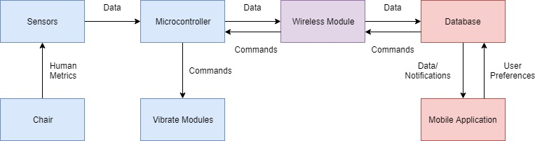
Overview Diagram

Slide 5
Standards
Power Standards
IEC-60601-1
Electrical Shock & Fire Safety
UL 1310
Devices using multiple power supplies
Wireless Standards
IEEE 802.11
Application
Flutter Development Standards
User Privacy Standards

Slide 6
Microcontroller Selection
MCU | F280049PMSR | ATMEGA 2560-16AU | PIC24FJ1024GA606-I/PT | MSP430FR2311IPW16R | ATSAMA5D21C-CUR
Manufacturer | Texas Instruments | Atmel | Microchip Technology | Texas Instruments | Microchip Technology
Program Memory (kB) | 256 | 256 | 1024 | 3.75 | 160
Data Memory (kB) | 100 | 8 | 32 | 8 | 128
Clock Frequency (MHz) | 100 | 16 | 32 | 16 | 500
GPIO | 26 | 86 | 53 | 11 | 128
Supply Voltage Range | 1.2 - 1.3V | 1.8V – 5.5V | 2 - 3.6V | 1.8V -3.6V | 1.2V
Size L x W (cm) | .072 x .072 | 1.6 x 1.6 | .07 x .07 | .05 x .04 | 1.4 x 1.4
Price (USD) | $10.81 | $12.20** | $4.41 | $1.62 | $6.71
ADC Channels
PWM Channels
Timers
Communication Protocols

Slide 7
Power Supply
The system will be powered by an AC to DC adapter.
Back up power will provide to the chair by a 9V battery to allows the circuit running after it is disconnected to the wall.
2 DC to DC converters to power the MCU and the electronics components.
It will be operated by a voltage range from 12V to 3.3V.
The battery will take over when the main power source is unplugged.

Slide 8
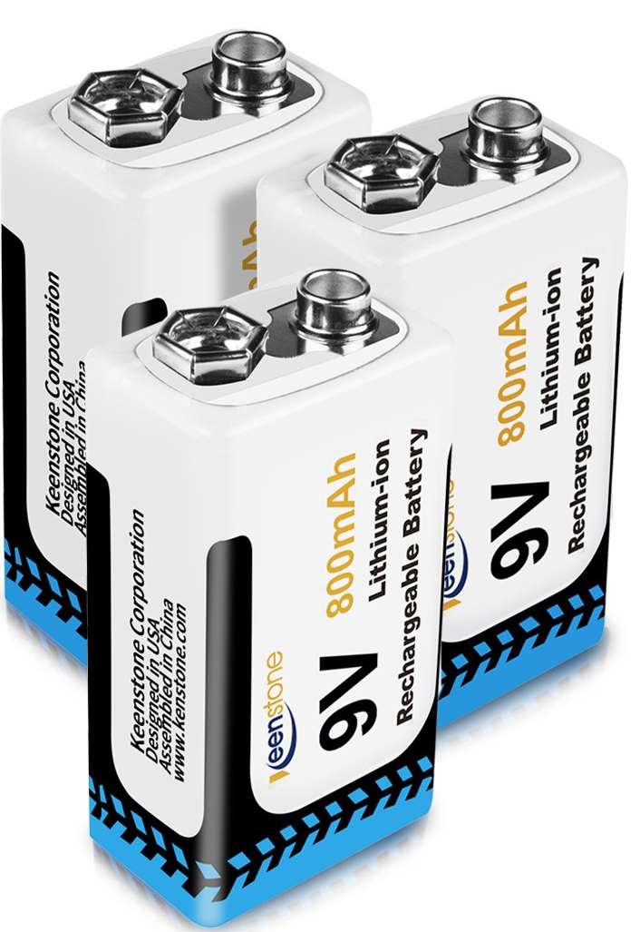
Battery Supply
9V Rating
Lithium ion composition
Rechargeable
Less Expensive
Easily substitutable
$9.52 for 2

Slide 9
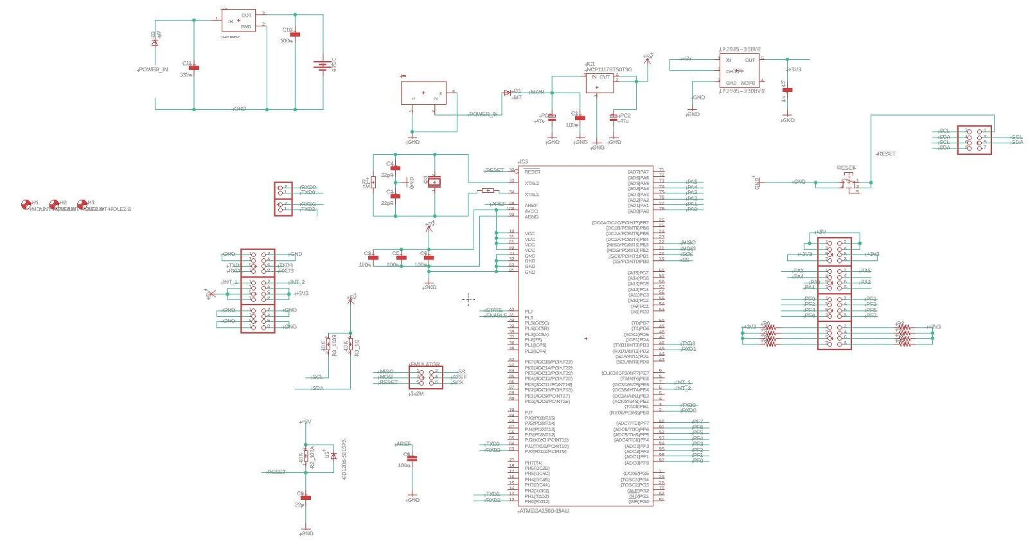
Schematic Overview

Slide 10
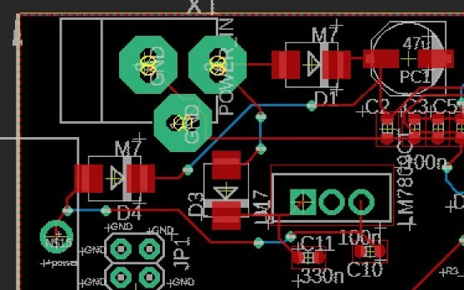
PCB Power Supply

Slide 11
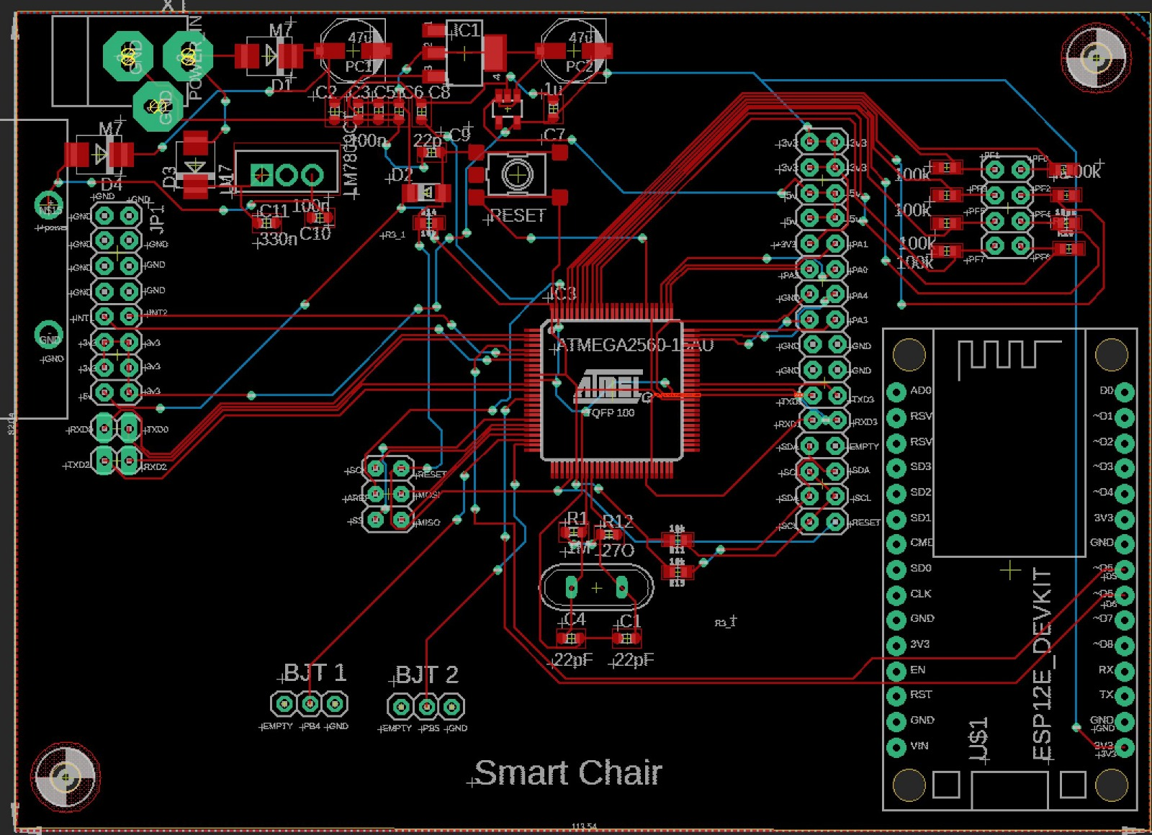
Overall PCB
113.54 x 82.04 mm (LW)
Designed in Eagle Software
2 screw-holes

Slide 12
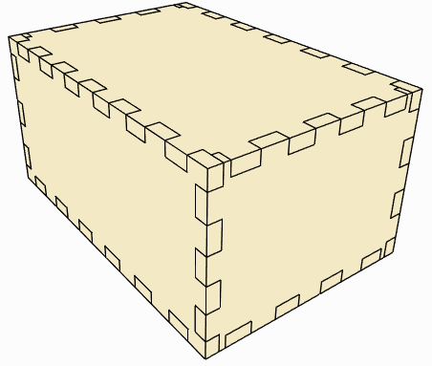
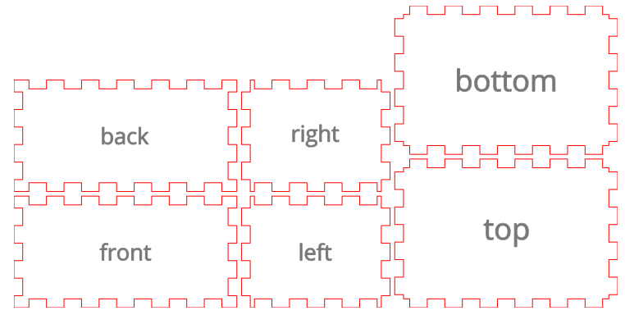
PCB Enclosure
Wood
Laser cut in TI lab
5.75” x 3.5” x 2.75” (LWH)
Using wood glue to assembly

Slide 13
FSR Selection
 | Tekscan A502 | Tekscan A301 | SEN-09376 | FSR-406
Price per unit | $23.24 | $12.18 | $11.25 | $12.99
Surface Area(in²) | 4 | 0.375(diam) | 3.0625 | 2.25
Response time(µs) | ≤ 3 | ≤ 3 | ≤ 5 | ≤ 5
Load range(N) | 44kN max | 444N max | * | 100N max
Drive voltage(V) | Variable | Variable | * | *
Amplifier circuit | Multiple | Multiple | Volt. Div. | Multiple

Slide 14
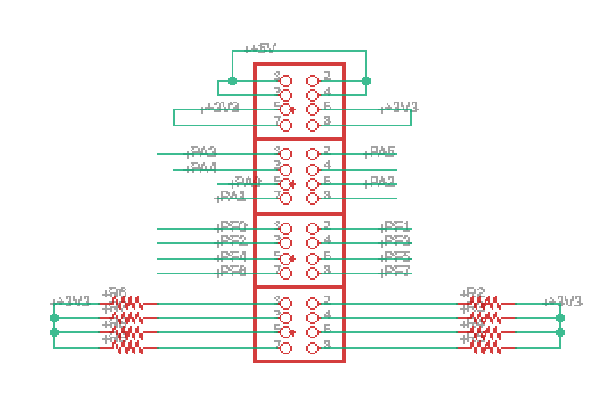
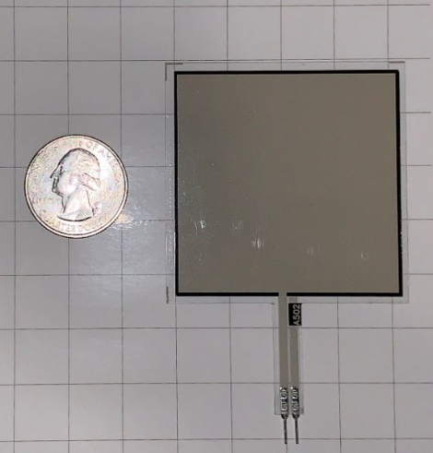
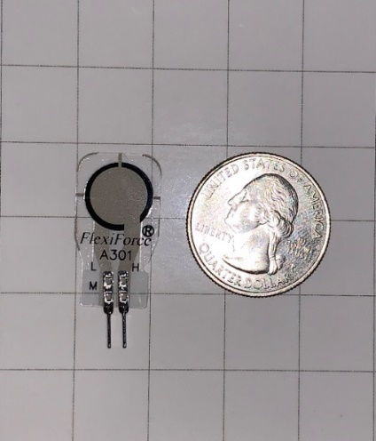
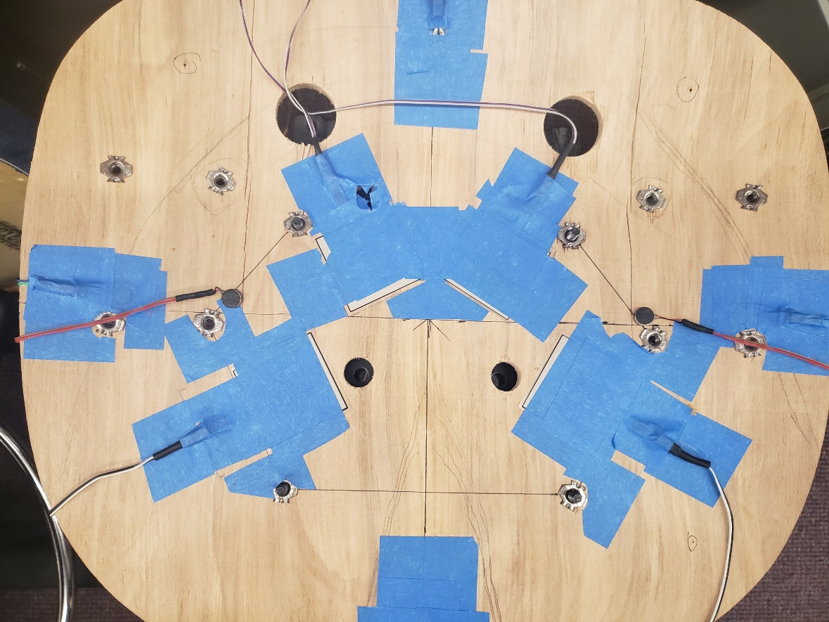
FSR Selection
Tighter tolerance: < 3%
Multiple integration methods
Voltage Divider
Engineering support (Manufacturer)
Utilize MCU ADC channels to process signal

Slide 15
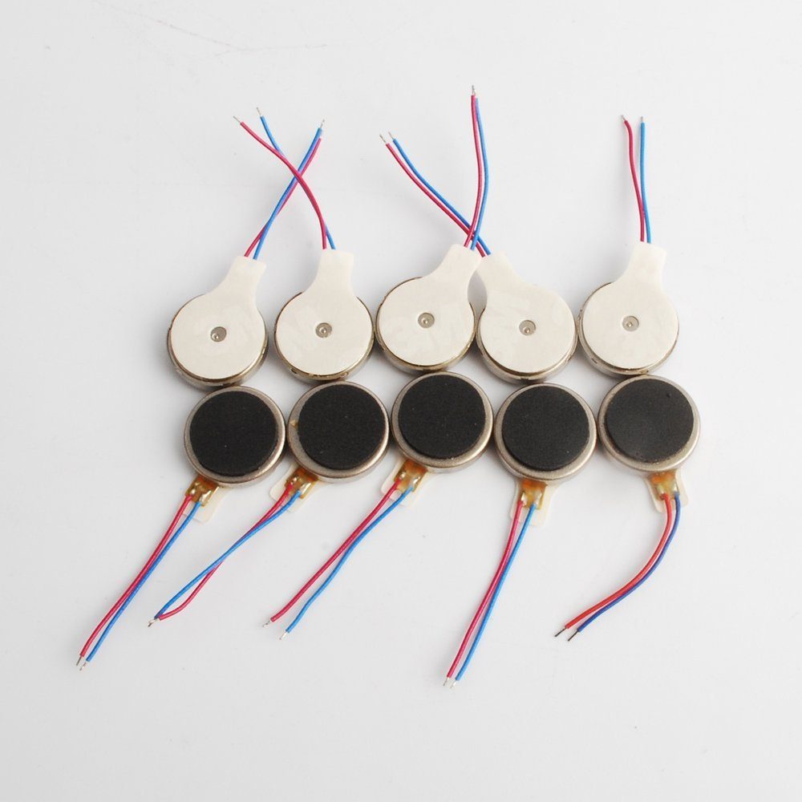
Vibrate Module
Dowonsol DC coin module
Low cost: $0.90 per unit
Simple integration
DAC to supply pulse signal
2.8v - 5v

Slide 16

Software Design
Wireless Communication
NoSQL Database
Application Framework

Slide 17
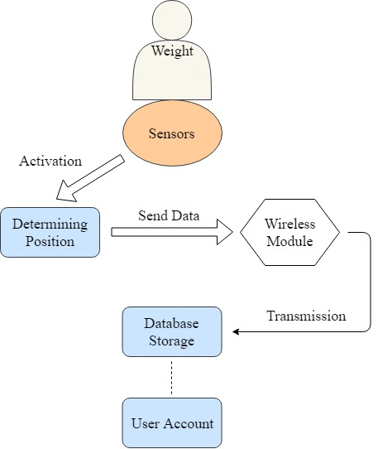
Flowchart Diagram

Slide 18
Wireless Modules
Bluetooth | Wi-Fi
Shorter Range | Longer Range
Close proximity | Remote Location
Direct Connections | Online Connection
Lower Power | Higher Power

Slide 19
Bluetooth Specification
Hardware Features | Software Features
-80 dBm sensitivity | PIO: low-disconnect & high-connect
+4 dBm RF transmit power | Rising Pulse will disconnect
Low Power 1.8 V Operation | Auto-connect on last device
PIO Control | Pair Last Device as Default
UART Interface | PINCODE: 0000 / 1234

Slide 20
Wi-Fi Specification
Hardware Features | Software Features
CPU: Tensilla L 106 32-bit | Security: WPA / WPA2
Integrated Memory (SRAM) | Encryption: WEP/TKIP/AES
SPI External Flash | Firmware: OTA Network
RF 2.4 GHz Receive/Transmit | SDK: Supports Cloud Server
Adjustable Power Mode | Network Protocol: TCP/UDP/HTTP

Slide 21
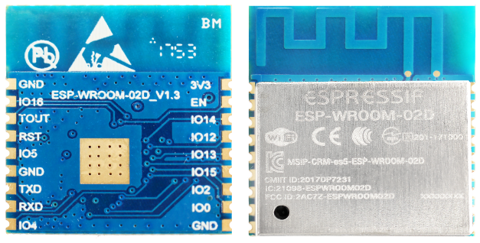
Wireless Module
Wi-Fi vs Bluetooth
Wi-fi can send value to database
Bluetooth relies on user device connection to database
Chose Wi-Fi for library compatibility and data integrity
ESP8266
Breadboard testing
Antenna RF optimization

Slide 22
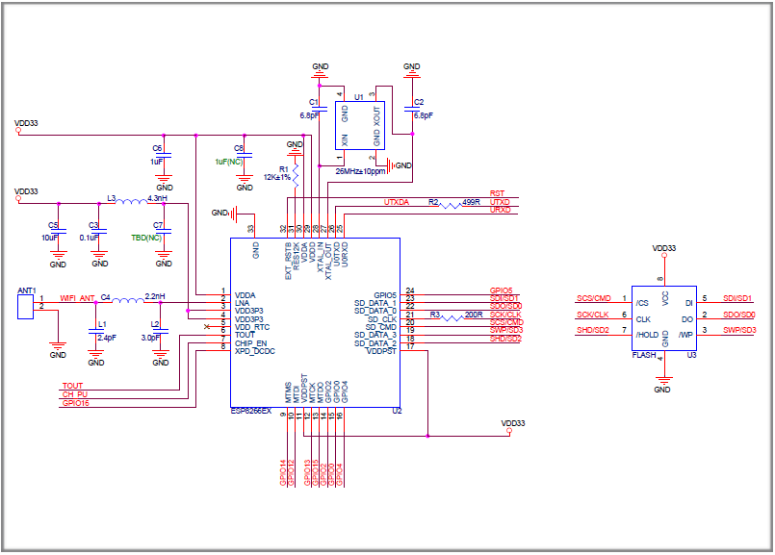
ESP8266 Schematic
Main Aspects
Power Supply
Power-on sequence and reset
Flash
Crystal oscillator
RF
External resistor
UART

Slide 23
ESP8266 Pros and Cons
Pros
Compatibility with IDE
Multiple GPIO pins
Powerful capabilities
Cons
Difficult to start working
Requires multiple libraries

Slide 24
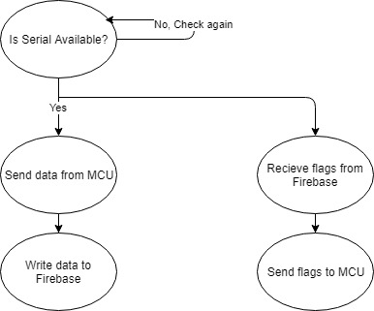
Serial Communication
Transmission of data between MCU and Wi-Fi module
UART supports full duplex communication

Slide 25
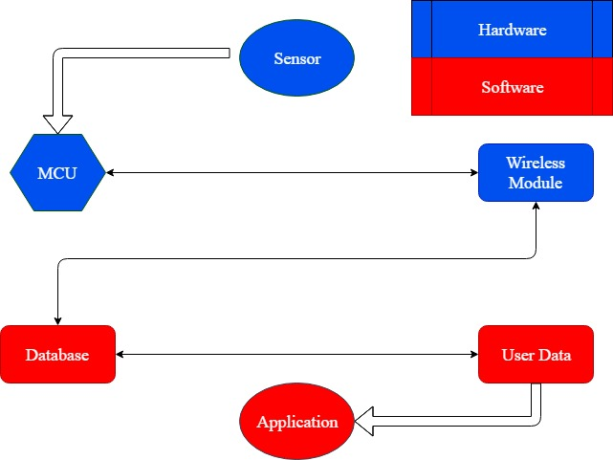
Wireless Communication
Sensor data
Wi-Fi Transmission
Send data through cloud
Database Receive data
Firebase

Slide 26
Purpose of Application
To allow the user to view posture data.
To provide feedback to the user.
To allow the user to alter vibrate and notification settings.

Slide 27
Application Design
Technologies Used:
Firebase serves as the back-end.
User Accounts
NoSQL Database
Flutter serves as the front-end framework.
Developed by Google
Dart Language
Hot reload

Slide 28
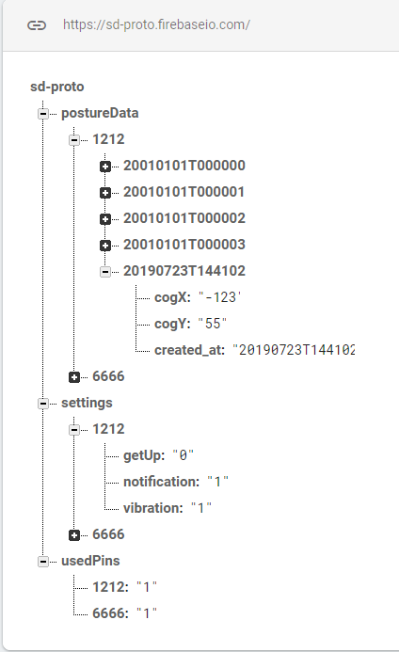
NoSQL Database Design
Each data entry contains the posture measurement on the left-to-right axis and the front-to-back axis and the timestamp.
Each user has settings saved by pin. Settings allow user to enable/disable notifications and vibration.
getUp serves as flag to trigger notifications.
Used Pins field prevents user from registering a pin that is already in use.

Slide 29
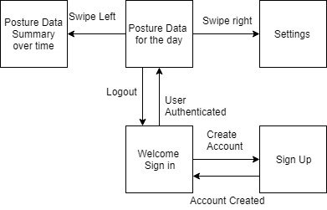
User Interface Design

Slide 30
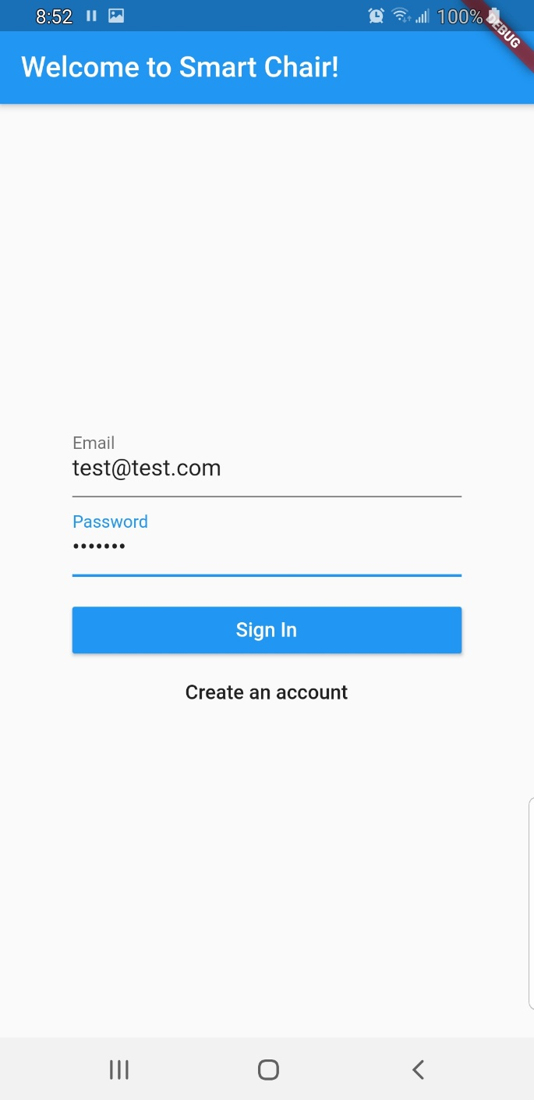
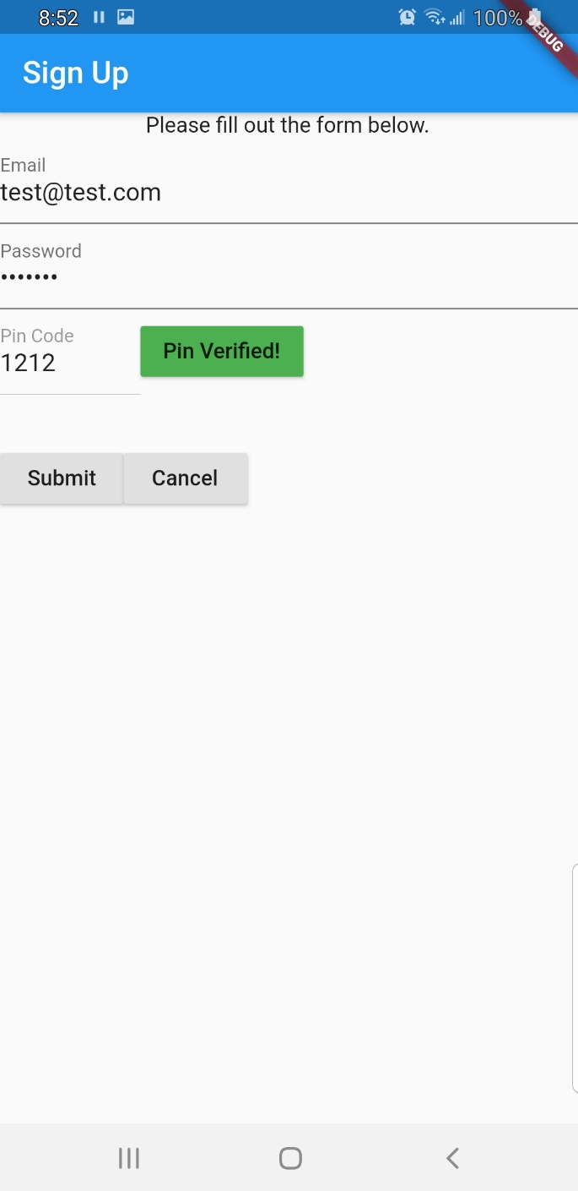
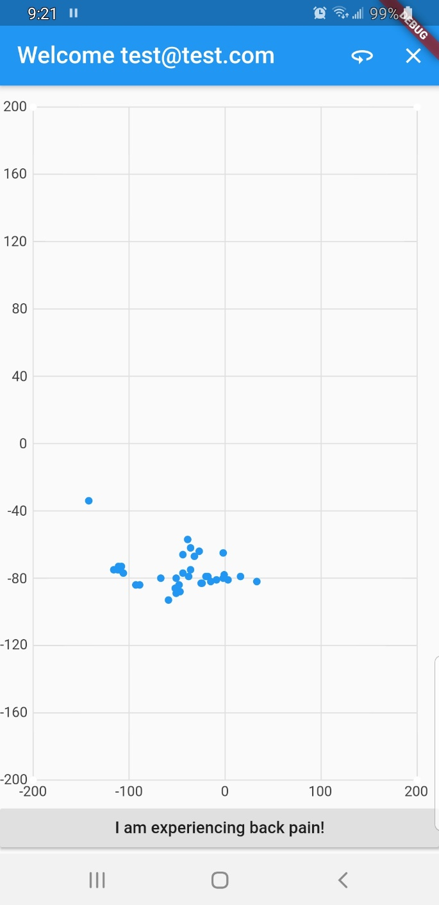
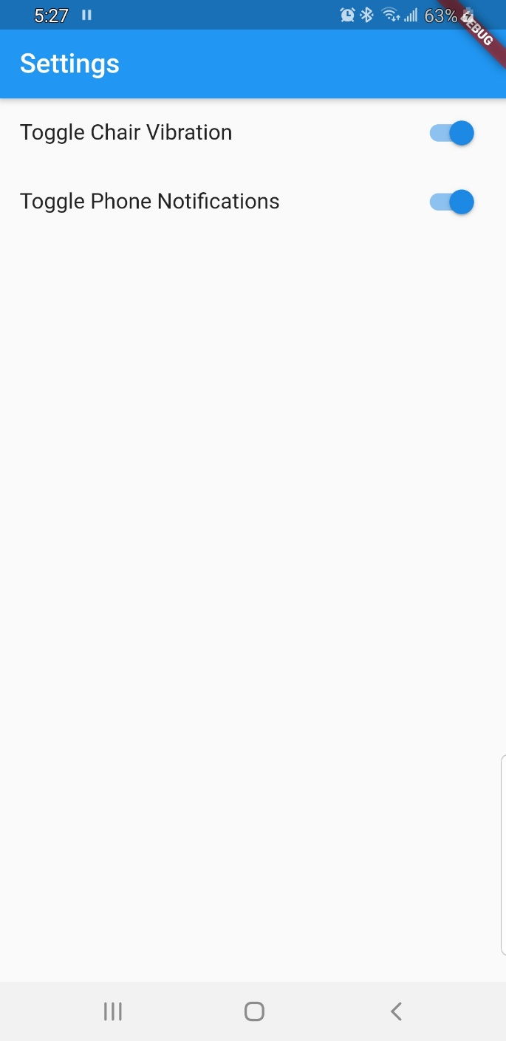
User Interface Design

Slide 31
Roles
Task | Primary | Secondary | Status
Wireless Communication | Thien | Annavay | completed
Database Developmnt | Annavay | Thien | completed
Mobile Application | Annavay | Thien | completed
Microcontroller | Rudy | Mackenson | incorporated
Power Supply | Mackenson | Rudy | completed
Rechargeable Battery | Mackenson | Rudy | incorporated
Force Sensor Integration | Rudy | Thien | completed
Vibration Module | Rudy | Thien | incorporated
PCB Design | Mackenson | Rudy | completed

Slide 32
BUDGET SHEET
Item | Description | Quantity | Cost | Total | Estimated Cost
Tekscan A301 | round force sensors - 4 pk | 1 | $ 53.60 | $ 53.60 | $150.00
Tekscan A502 | Larg square force sensors - 4 pk | 1 | $108.25 | $ 108.25
556-ATMEGA2560-16AU | Microcontroller | 3 | $ 12.20 | $ 36.60 | $ 40.00
Chair | Office chair, cloth, rolling | 2 | - | - | $ 75.00
Eleego Mega 2560 R3 | ATmega Dev board | 1 | $ 13.99 | $ 13.99 | $ 16.00
Mircrochip ATMega2560 | microcontroller samples from OEM | 5 | - | - | -
ESP8266 | Wifi Module | 4 | $ 5.00 | $ 19.99 | $ 40.00
ESP32 | Wifi Module | 3 | $ 10.99 | $ 32.97 | $ 50.00
HC-05 | Bluetooth Module | 2 | $ 6.50 | $ 12.99 | $ 50.00
Various Components | SMT components, etc. | Multiple | $156.86 | $ 156.86 | $200.00
Dowonsol Vibrate Module | DC coin vibrate Modules | 10 | $ 0.90 | $ 8.99 | $ 50.00
PCB Enclosure | Housing for PCB | 1 | - | - | $ 50.00
PCB | PCB manufacturing | Multiple | - | $ 52.00 | $100.00
Firebase | Backend manager | 1 | - | - | -
Margin | Unexpected Cost | - |  | - | $150.00
Total |  |  |  | $496.24 | $971.00

Slide 33
If we had more time…
Reduce end-to-end latency.
Add sensors to the spine of the chair to enhance data.
Custom phone notifications for leaning.
Custom chart for mobile application as opposed to chart from open-source library for improved visualization.
Add chair overlay to chart for increased readability.
Improve process of analyzing data.
Support multiple users.
Pick a better project name.

Slide 34
Q&A

