Slide 1
SMART CHAIR Group 7
Rudy Ramjas - EE
Mackenson Jean - EE
Annavay Kean - CpE
Thien Nguyen - CpE

Slide 2
Goals & Objectives
Help user to become more mindful of posture habits.
Provide feedback based on measured data.
Target audience: middle-class office workers.
Methodology: Center of Gravity

Slide 3
Specifications
The device should update the sensor input readings every 30 seconds.
The device should pair with a phone app.
The application will display posture data.
The application will provide feedback on data.
The software will store user data.
5-day standby battery life, minimum.
PCB not to exceed 230 cm squared.
Sensor array should be able to load a minimum of 100lbs (45.4kg).
Vibrate module should operate between 200-400 Hz or rpm equivalent.

Slide 4
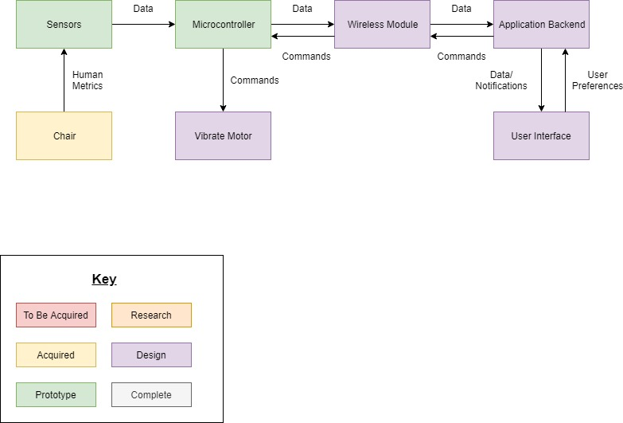
Overview Diagram

Slide 5
Standards
Power Standards
IEC-60601-1
Electrical Shock & Fire Safety
UL 1310
Devices using multiple power supplies
Wireless Standards
IEEE 802.11
Application
Flutter Development Standards
Distribution Standards
User Privacy Standards

Slide 6
Microcontroller Selection
MCU | F280049PMSR | ATMEGA 2560-16AU | PIC24FJ1024GA606-I/PT | MSP430FR2311IPW16R | ATSAMA5D21C-CUR
Manufacturer | Texas Instruments | Atmel | Microchip Technology | Texas Instruments | Microchip Technology
Program Memory (kB) | 256 | 256 | 1024 | 3.75 | 160
Data Memory (kB) | 100 | 8 | 32 | 8 | 128
Clock Frequency (MHz) | 100 | 16 | 32 | 16 | 500
GPIO | 26 | 86 | 53 | 11 | 128
Supply Voltage Range | 1.2 - 1.3V | 1.8V – 5.5V | 2 - 3.6V | 1.8V -3.6V | 1.2V
Size L x W (cm) | .072 x .072 | 1.6 x 1.6 | .07 x .07 | .05 x .04 | 1.4 x 1.4
Price (USD) | $10.81 | $12.20** | $4.41 | $1.62 | $6.71
Communication Protocols

Slide 7
Power Supply
The system will be powered by an AC to DC adapter.
It will be operated by a voltage range from 12V to 3.3V.
The PCB will be using power 24 hours and keep it running under all conditions.
Back up power will provide to the chair by a 9V battery to allows the circuit running after it is disconnected to the wall.
The battery will take over when the main power source is unplugged.

Slide 8
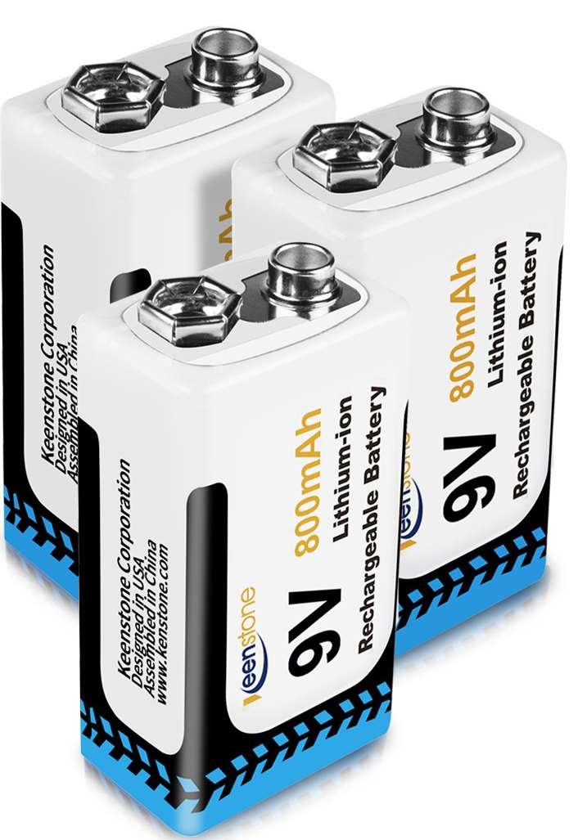
Battery Supply
9V Rating
Lithium ion composition
Rechargeable
Less Expensive
Easily substitutable

Slide 9
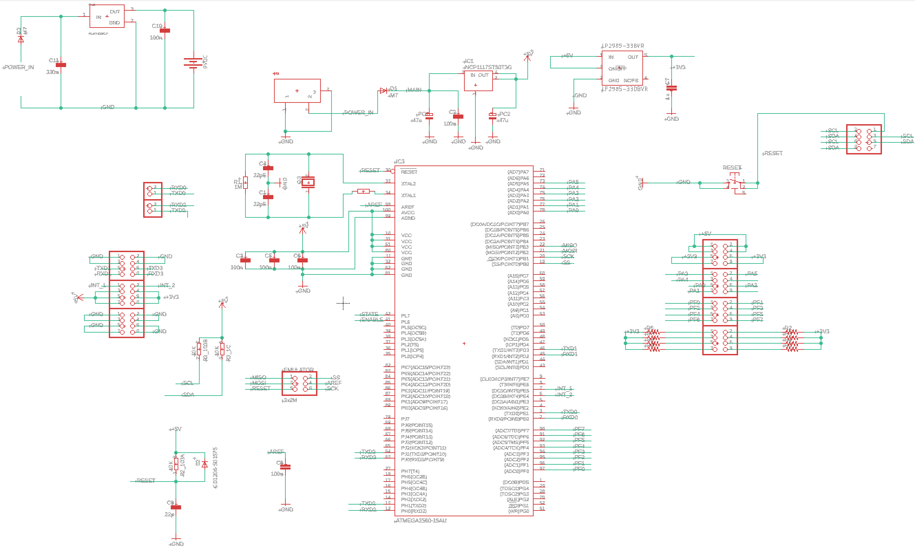
Schematic Overview

Slide 10
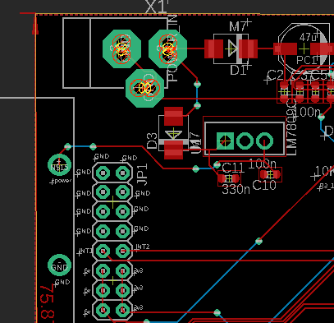
PCB Power Supply

Slide 11
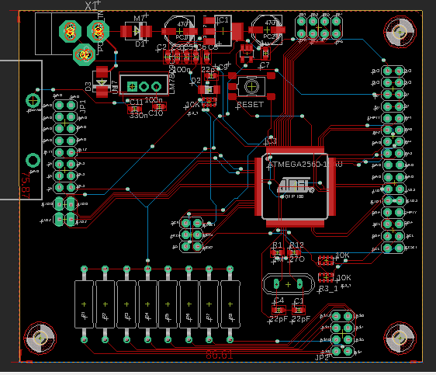
Overall PCB
76 x 87mm (LW)
Designed in Eagle
3 screw-holes

Slide 12
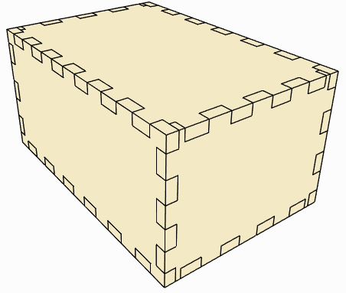
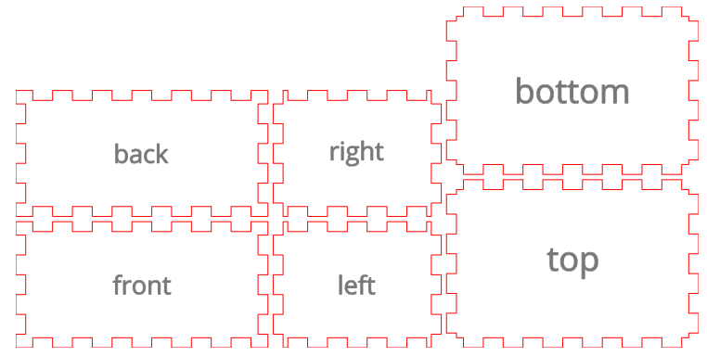
PCB Enclosure
Wood
Laser cut in TI lab
6” x 4” x 4” (LWH)

Slide 13
FSR Selection
 | Tekscan A502 | Tekscan A301 | SEN-09376 | FSR-406
Price per unit | $23.24 | $12.18 | $11.25 | $12.99
Surface Area(in²) | 4 | 0.375(diam) | 3.0625 | 2.25
Response time(µs) | ≤ 3 | ≤ 3 | ≤ 5 | ≤ 5
Load range(N) | 44kN max | 444N max | * | 100N max
Drive voltage(V) | Variable | Variable | * | *
Amplifier circuit | Multiple | Multiple | Volt. Div. | Multiple

Slide 14
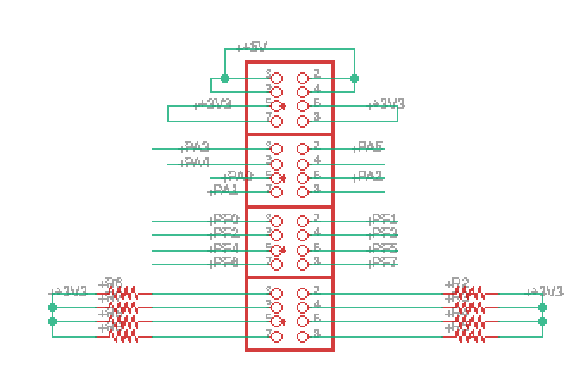
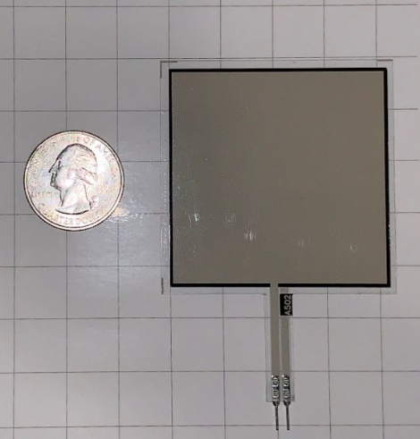
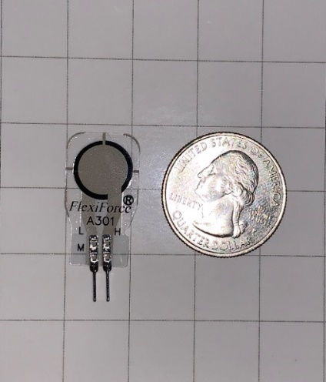
FSR Selection
Tighter tolerance: < 3%
Multiple integration methods
Voltage Divider
Engineering support (Manufacturer)
Utilize MCU ADC channels to process signal

Slide 15
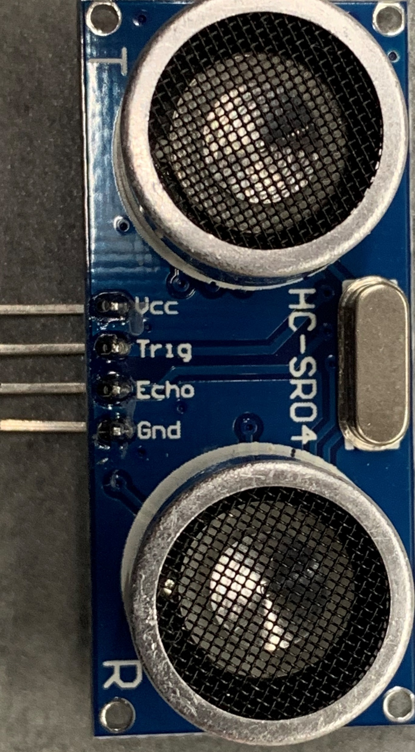
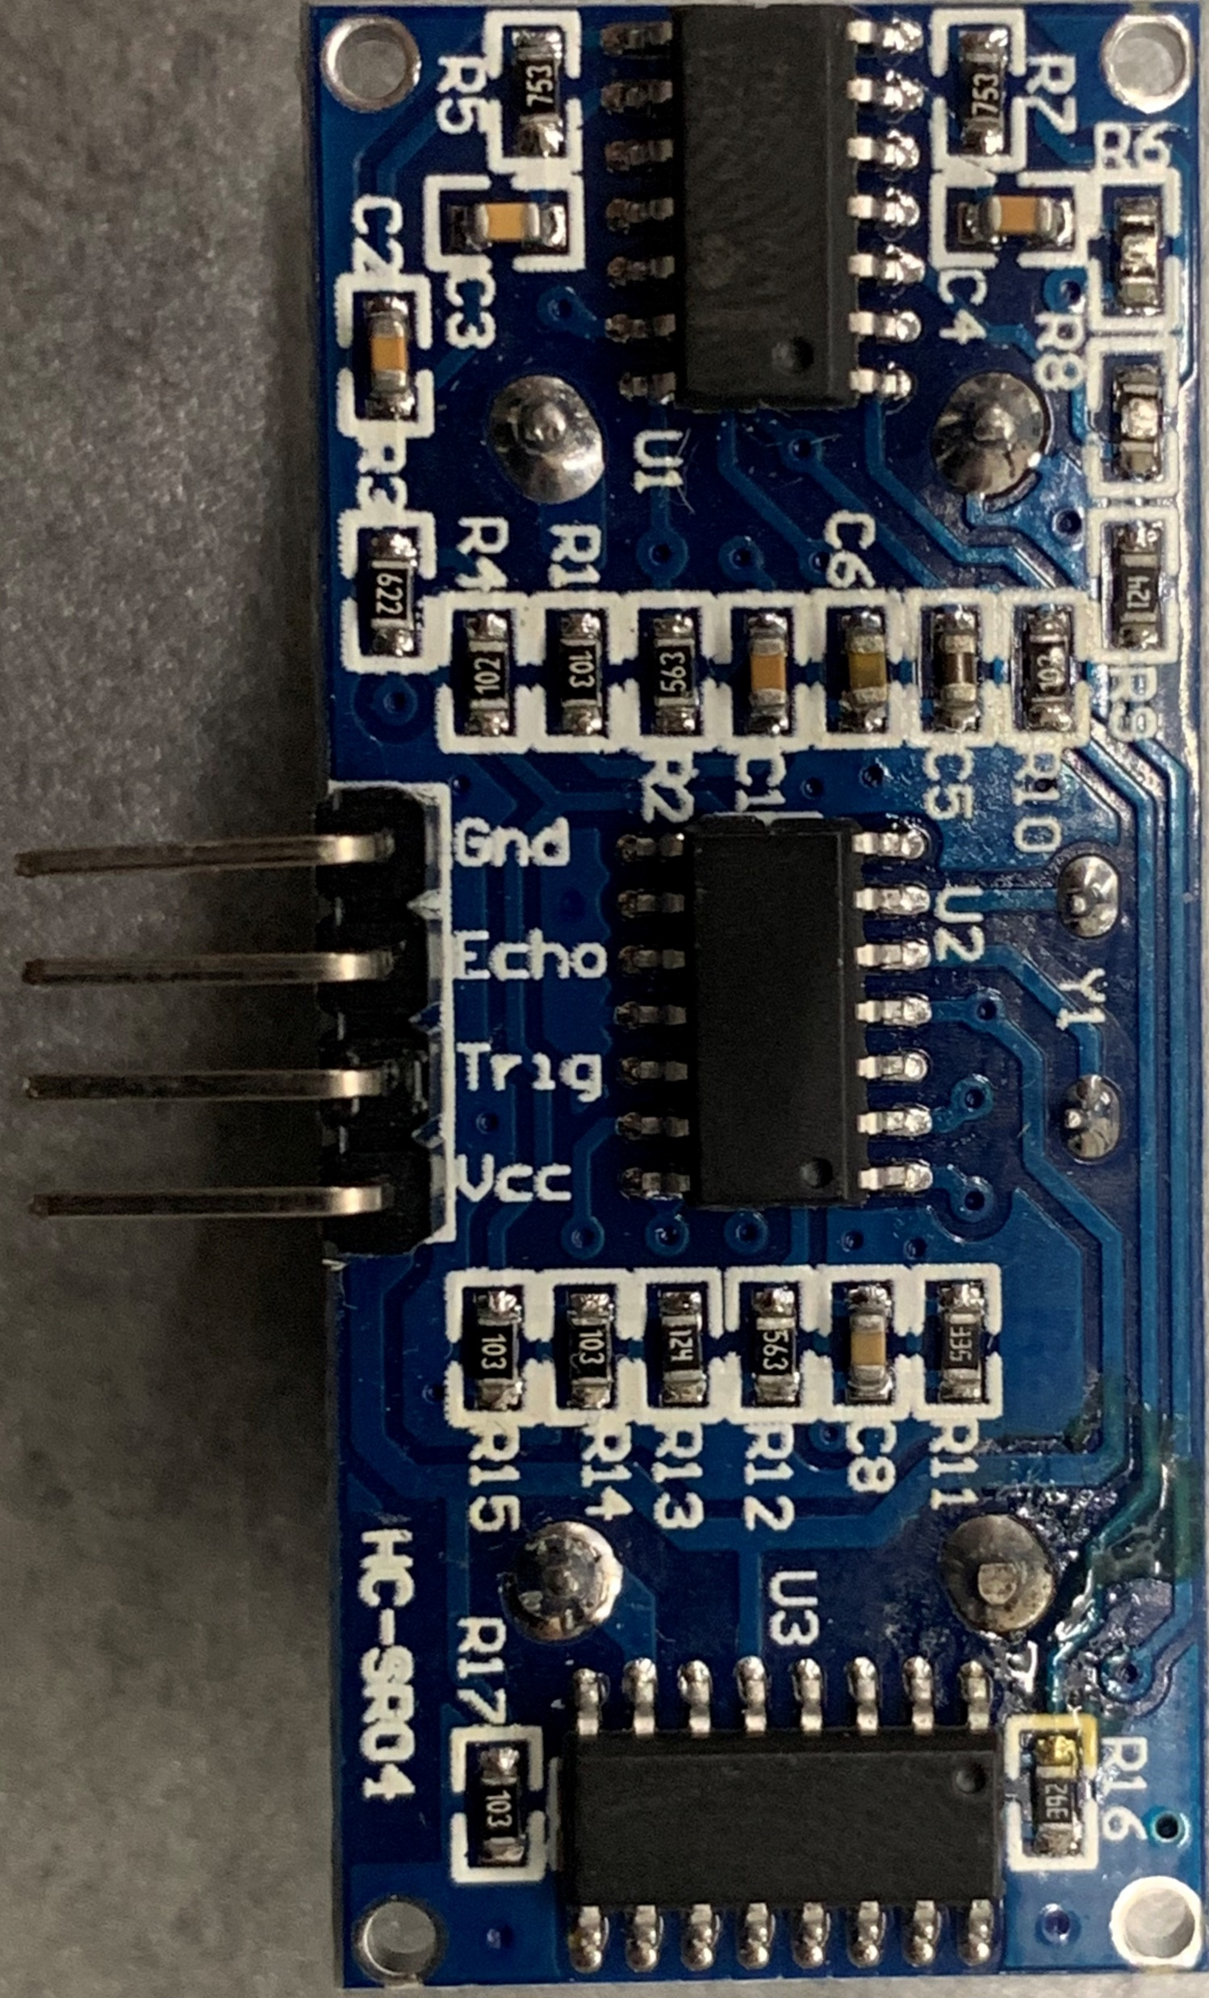
Proximity Sensor
Operates within 3cm range
Located on mid-back of chair

Slide 16
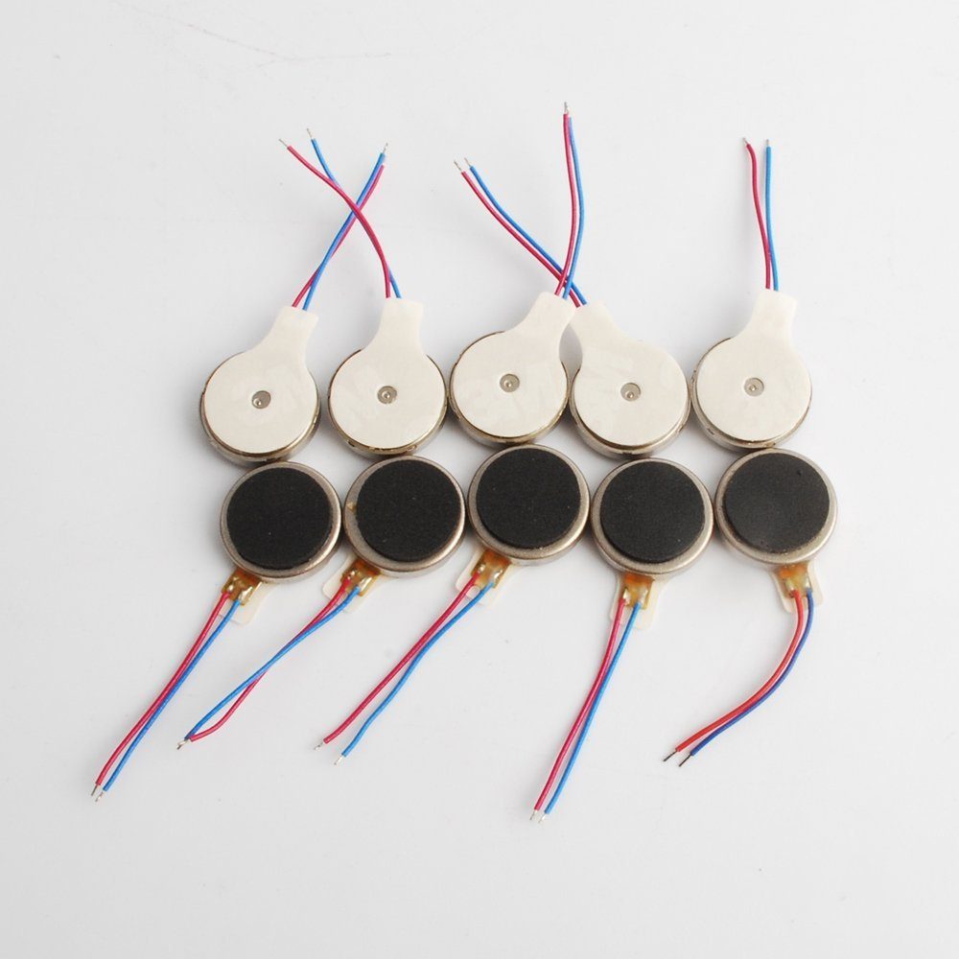
Vibrate Module
Low cost: <$1.00 per unit
Simple integration
DAC to supply pulse signal
2.8v - 5v

Slide 17

Software Design
Wireless Communication
NoSQL Database
Application Framework

Slide 18
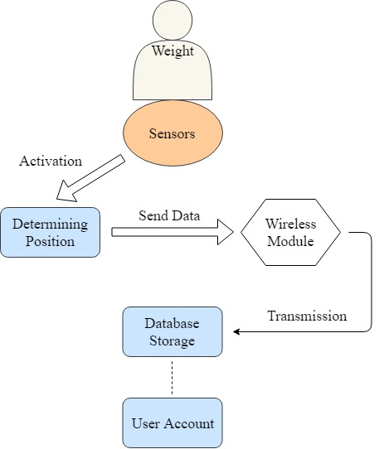
Flowchart Diagram

Slide 19
Wireless Modules
Bluetooth | Wi-Fi
Shorter Range | Longer Range
Close proximity | Remote Location
Direct Connections | Online Connection
Lower Power | Higher Power

Slide 20
Bluetooth Specification
Hardware Features | Software Features
-80 dBm sensitivity | PIO: low-disconnect & high-connect
+4 dBm RF transmit power | Rising Pulse will disconnect
Low Power 1.8 V Operation | Auto-connect on last device
PIO Control | Pair Last Device as Default
UART Interface | PINCODE: 0000 / 1234

Slide 21
Wi-Fi Specification
Hardware Features | Software Features
CPU: Tensilla L 106 32-bit | Security: WPA / WPA2
Integrated Memory (SRAM) | Encryption: WEP/TKIP/AES
SPI External Flash | Firmware: OTA Network
RF 2.4 GHz Receive/Transmit | SDK: Supports Cloud Server
Adjustable Power Mode | Network Protocol: TCP/UDP/HTTP

Slide 22
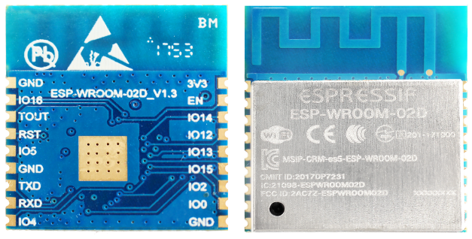
Wireless Module
Wi-Fi vs Bluetooth
Wi-fi can store value into database
Bluetooth has no storage
Bluetooth lack of Full Duplex support
ESP8266
Breadboard testing
Surface mount
Antenna RF optimization

Slide 23
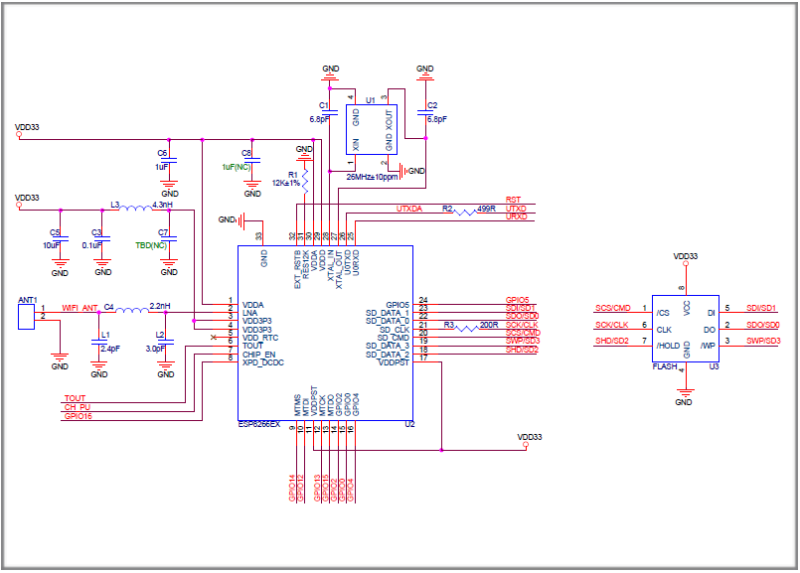
ESP8266 Schematic
Main Aspects
Power Supply
Power-on sequence and reset
Flash
Crystal oscillator
RF
External resistor
UART

Slide 24
ESP8266 Pros and Cons
Pros
Compatibility with IDE
Multiple GPIO pins
Powerful capabilities
Cons
Difficult to start working
Requires multiple libraries

Slide 25
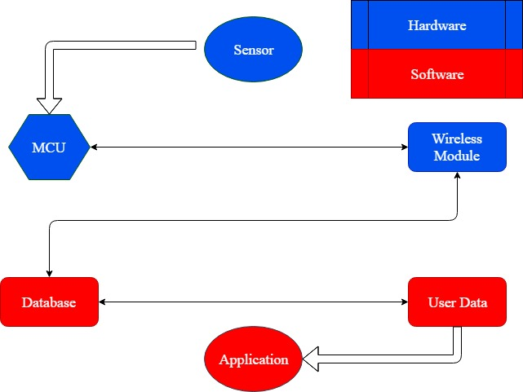
Wireless Communication
Sensor data
Wi-Fi Transmission
Send data through cloud
Database Receive data
Firebase

Slide 26
Purpose of Application
To allow the user to view posture data.
To provide feedback on posture data to the user.
To allow the user to alter settings.

Slide 27
Application Design
Technologies Used:
Firebase serves as the back-end.
User Accounts
NoSQL Database
Flutter serves as the front-end framework.
Developed by Google
Dart Language
Hot reload

Slide 28
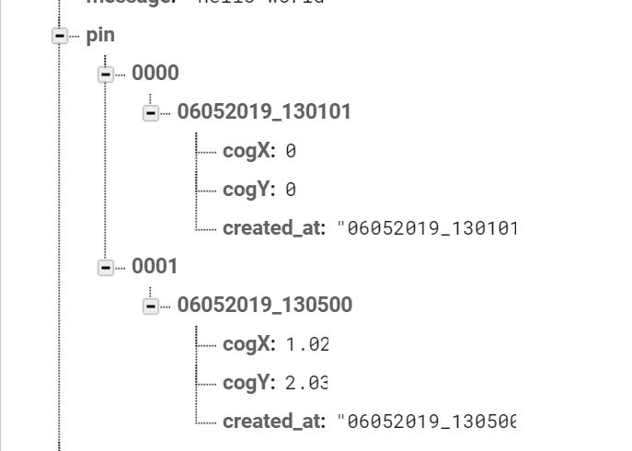
NoSQL Database Design
Provides support for offline data persistence.
Each data entry contains the center of gravity on the left-to-right axis and the front-to-back axis and the timestamp.
This is subject to change during the process of integrating the legitimate sensor data into the software.

Slide 29
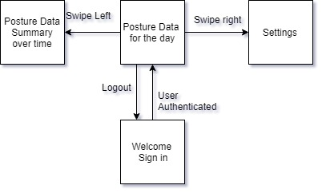
User Interface Design

Slide 30
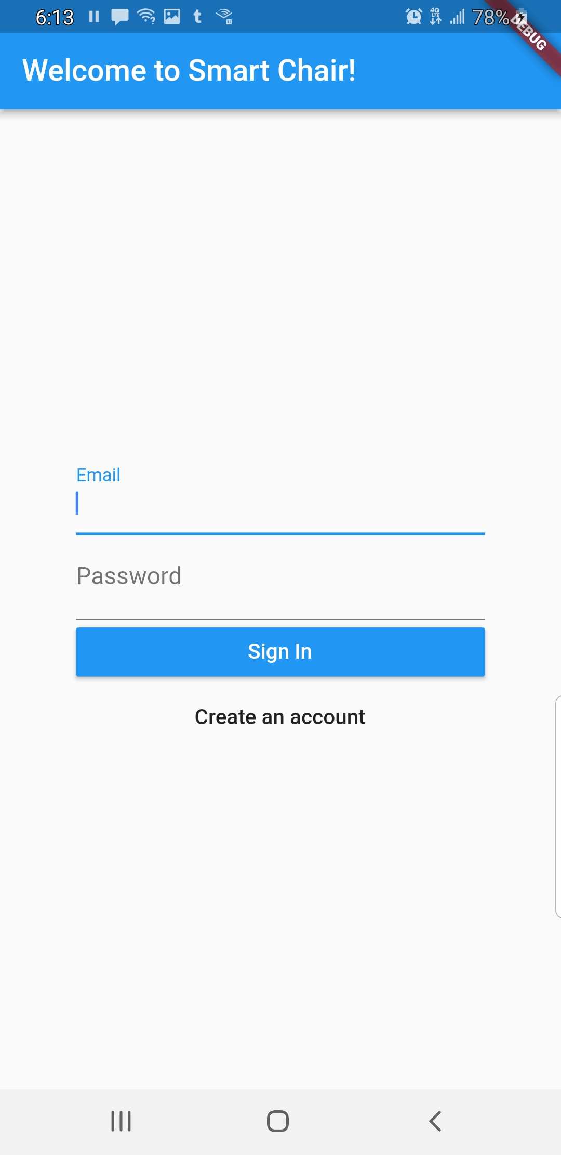
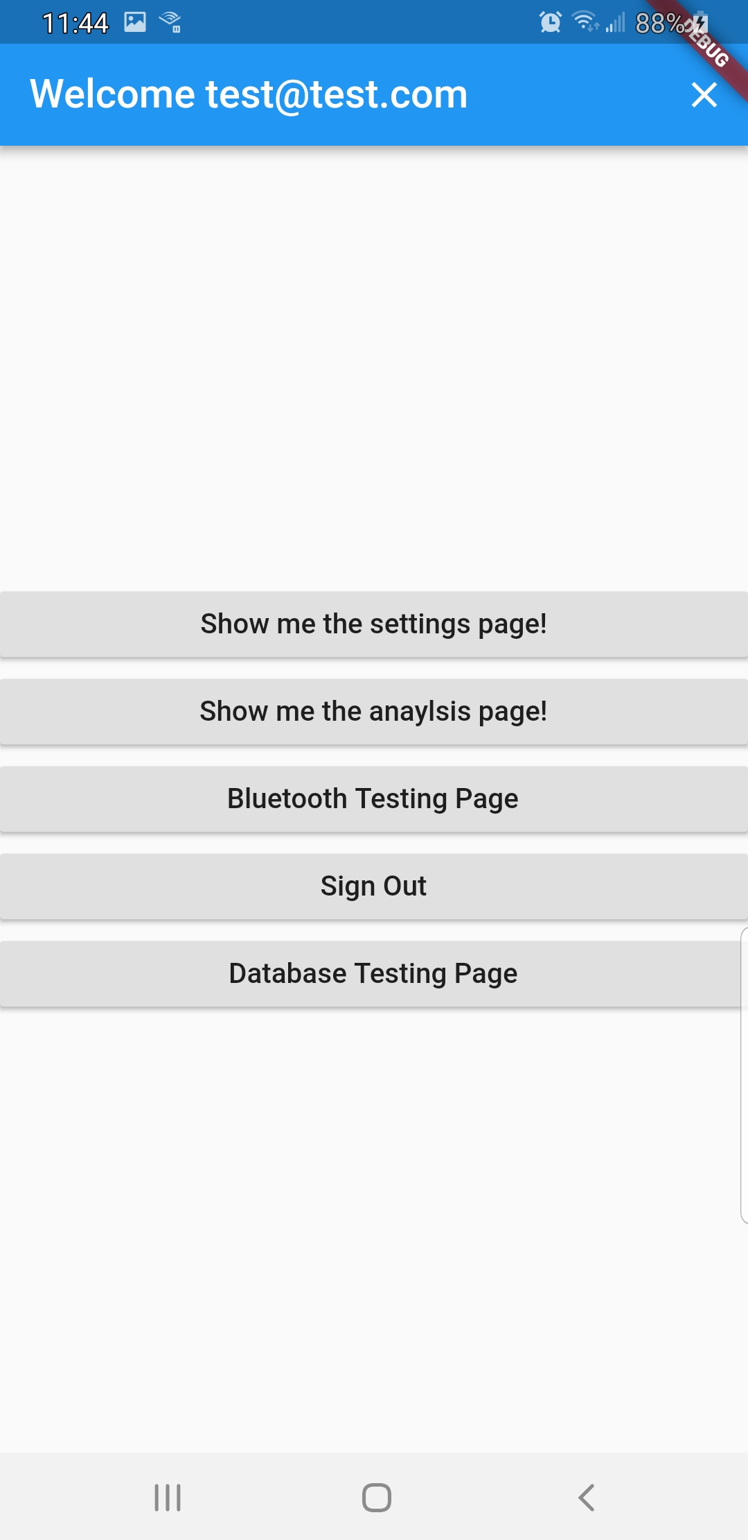
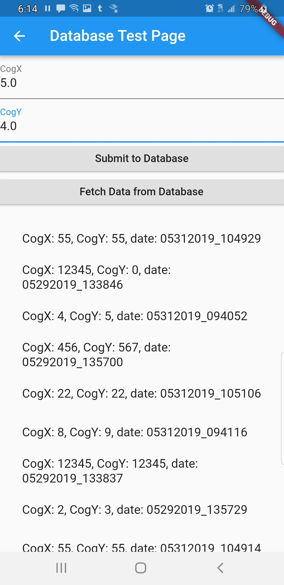
User Interface Design

Slide 31
Application Completion Status
Complete:
Firebase authentication
Firebase database (including read/write)
Basic Layout
Basic navigation
Pending:
Settings / User Preferences
Posture data represented in graphical format
Recommend Stretches/Yoga poses
Swipe navigation
Color Theming

Slide 32
PROGRESS GRAPH

Slide 33
Roles
Task | Primary | Secondary | Status
Wireless Communication | Thien | Annavay | proto
Database Development | Annavay | Thien | proto
Mobile Application | Annavay | Thien | Proto
Microcontroller | Rudy | Mackenson | Ordered
Power Supply | Mackenson | Rudy | proto
Rechargeable Battery | Mackenson | Rudy | Received
Force Sensor Integration | Rudy | Thien | proto
Vibration Module | Rudy | Thien | Received
User Interface | Annavay | Thien | In development
PCB Design | Mackenson | Rudy | 2nd iteration

Slide 34
BUDGET SHEET
Item | Description | Quantity | Cost | Total | Estimated Cost
Tekscan A301 | round force sensors - 4 pk | 1 | $53.60 | $53.60 | $150.00
Tekscan A502 | Larg square force sensors - 4 pk | 1 | $108.25 | $108.25
556-ATMEGA2560-16AU | Microcontroller | 3 | $12.20 | $36.60 | $40.00
Chair | Office chair, cloth, rolling | 2 | 0 | 0 | $75.00
Eleego Mega 2560 R3 | ATmega Dev board | 1 | $13.99 | $13.99 | $16.00
HC-SR04 | ultrasonic proximity sensor | 1 | 0 | 0 | $10.00
Mircrochip ATMega2560 | microcontroller samples from OEM | 5 | 0 | 0 | -
Final Paper | printing and binding | 1 | $27.98 | $27.98 | $30.00
System Enclosure | Housing for PCB
PCB surface components | PCB resistors, caps, etc. | Multiple |  | 34.17 | $50.00
Firebase | Backend manager | 1 | - | - | -
ESP8266 | Wi-Fi Module | 4 | $19.99 | $19.99 | $40.00
Total |  |  |  | $291.33 | $840.00

Slide 35
Implementation Challenges
Software-Hardware Integration
Proper data transmission
Formatting data
Foam of chair (Sensors)
Reduce thickness of foam
Partition foam
Add barrier between sensors and foam

Slide 36
Q&A

