Slide 1


What can we learn about our health using machine learning?
Anna Sophie Welter
Proteome Dynamics
MDC, Berlin
annasophie.welter@mdc-berlin.de

Slide 2
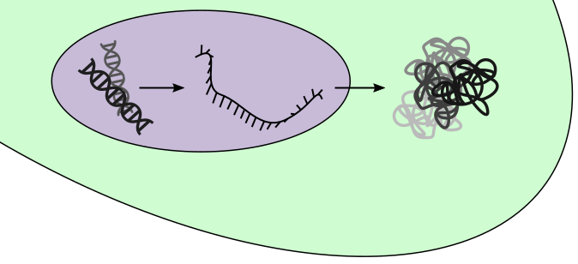
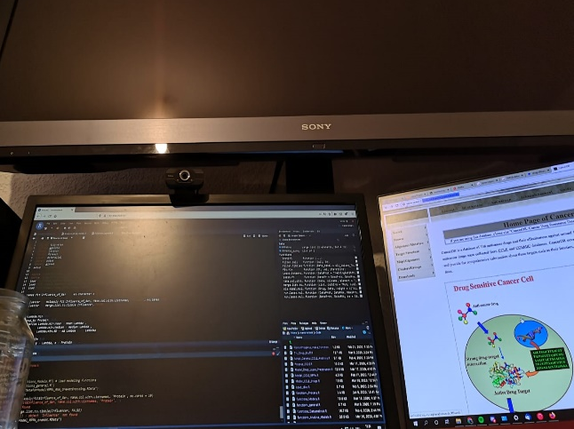
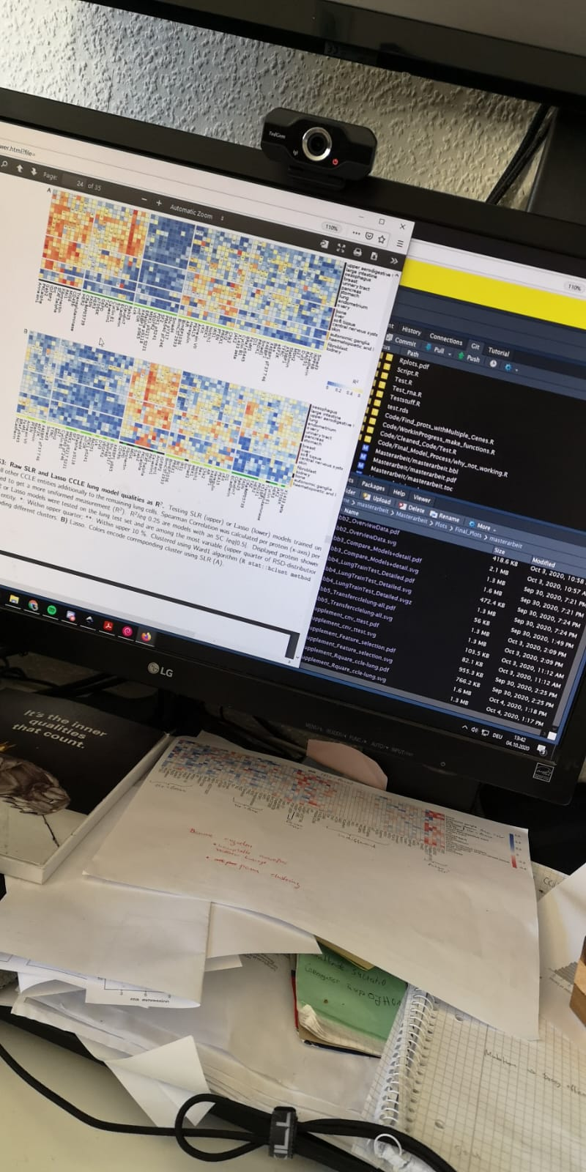
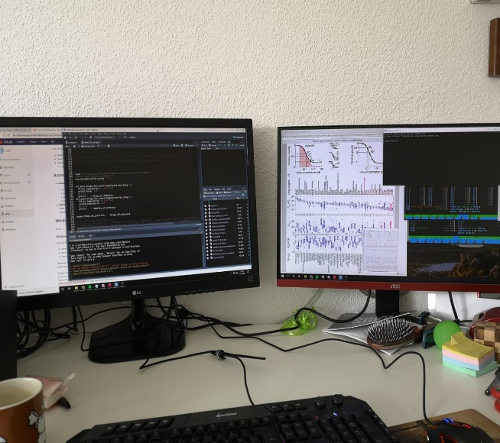



Master project – Predicting protein levels in cancer
Drugs act on (phospho)protein levels which are not measured
Poor correlation between expression of (phospho)protein and encoding mRNA¹
¹Gygi et al. (1999): Correlation between Protein and mRNA Abundance in Yeast. Molecular and Cellular Biology;

Slide 3


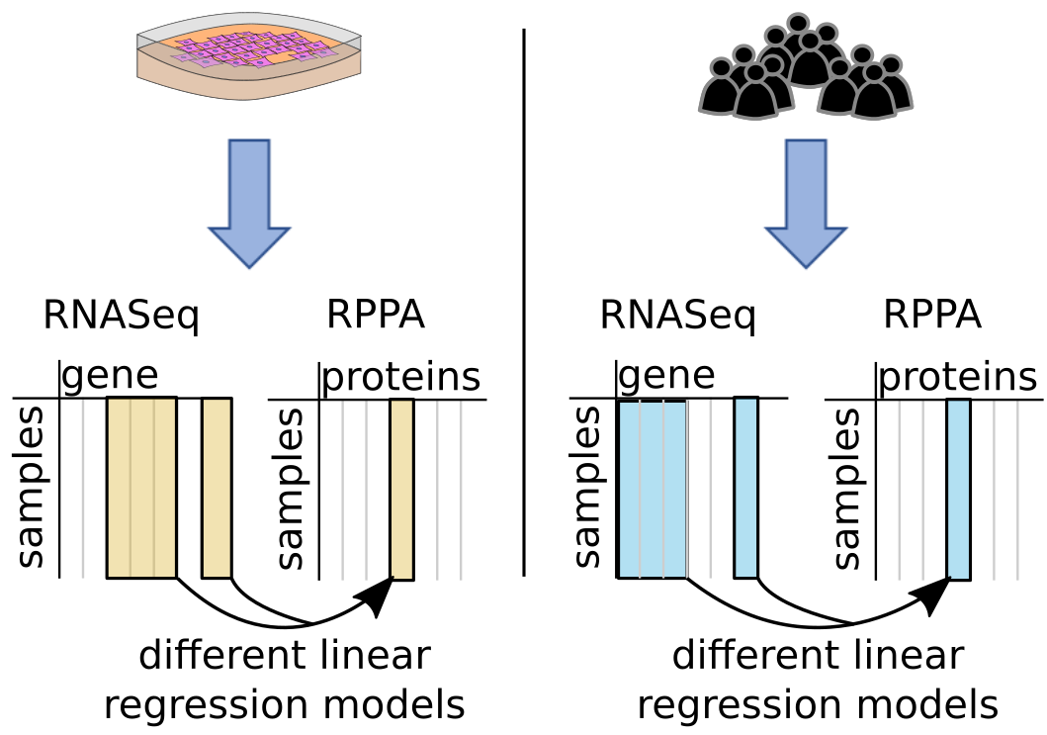



Master project – Predicting protein levels in cancer
Different ML algorithms
Different ML algorithms

Slide 4
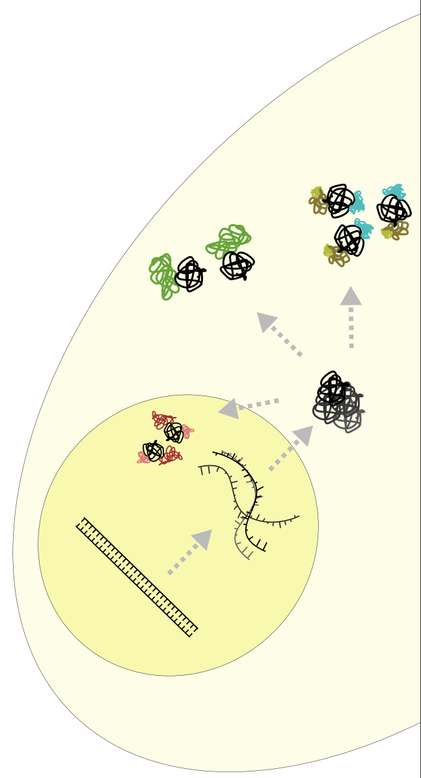





PhD project – Towards high-throughput analysis of protein-protein-interactions
Protein-Protein-Interactions regulate cellular signaling and are abberant in many cancers
Understanding change in PPI might lead to discovery of new drug targets^{1,2}
Implementing a screening in clinical settings might allow better treatments
Understanding disease needs high amounts of data of different levels so we aim to implement mass spectrometry (MS)
German consortium aiming to implement MS in clinics:
MSCoreSys - Massenspektrometrie in der Systemmedizin
https://www.mscoresys.de/
¹Lu et al. (2020): Recent advances in the development of protein–protein interactions modulators: mechanisms and clinical trials.
²Socinski et al. (2018): Atezolizumab for First-Line Treatment of Metastatic Nonsquamous NSCLC.

Slide 5









Using Mass Spectrometry to analyse proteins

Slide 6
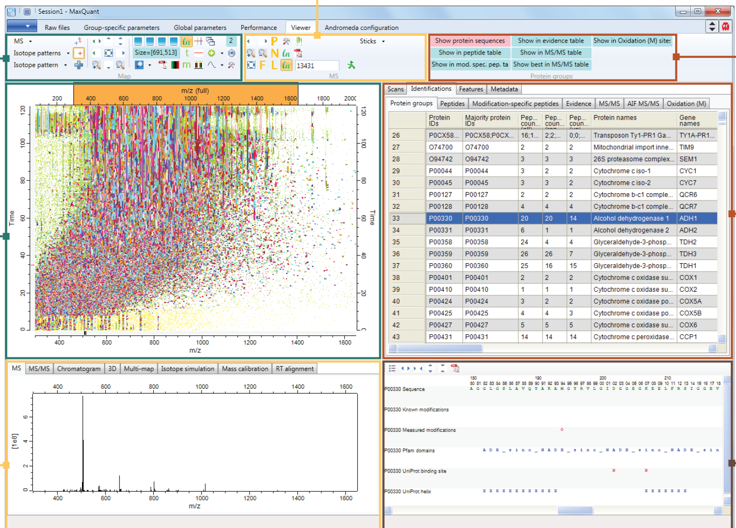
Using Bioinformatics to deal with large amounts of data
Powerful tools to identify the ~ 20.000 peptides and deduct the proteins they build
Even more effort to quantify the proteins (peak intensity isn’t directly correlated to amount of protein)
Use statistics and ML to analyze and integrate the data
Picture from MaxQuant Website: https://www.maxquant.org/

Slide 7

Take Home Messages
You don’t need to know what you want to do after finishing school.
Use every opportunity you have to check out different fields!
It’s never too late to learn programming.

