Slide 1
global holiday travel Data engineerinG
By: Rania Al-Samarai,
Oanh Nguyen,
Axel Keller,
Anna Whitaker
Notes:
AXEL

Slide 2
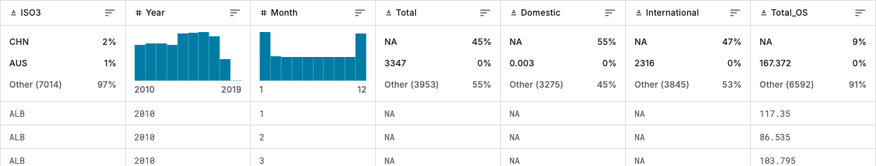
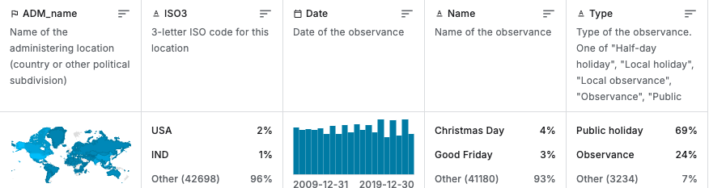
Overview of Data Sets
Data sets – https://www.kaggle.com/datasets/umerhaddii/global-holidays-and-travel-data?select=global_holidays.csv
Monthly passengers csv
Global Holidays csv
Potential data set shortfalls = Inconsistent / missing data
Notes:
AXEL
We extracted our data from two different CSV files from Kaggle.com. One was the monthly passengers CSV file.
This file had data regarding total passengers traveling during the month associated with a country code.
The other CSV file was the global holidays CSV file. This file had the country code, month, and holiday data.
There were a couple of potential data set shortfalls, but the main one was the inconsistent and missing data that we cleaned.

Slide 3
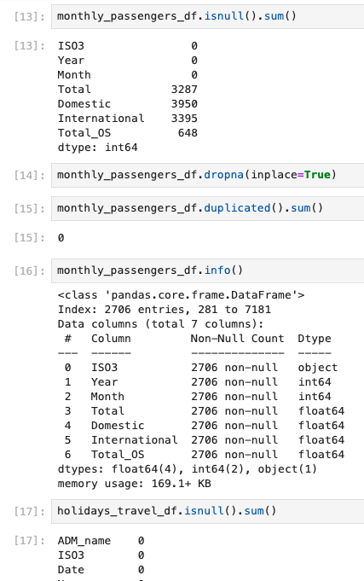
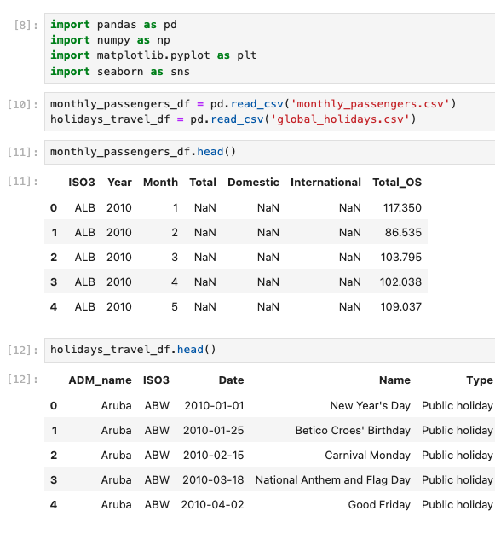
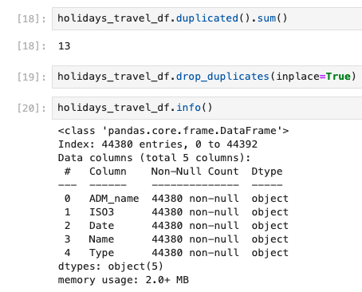
Extract, Transform, Load
Data extraction
Data transformation
Notes:
OANH
We started by extracting the data from the CSV into a pandas dataframe.
Then, checked for null and duplicate values and removed all.

Slide 4
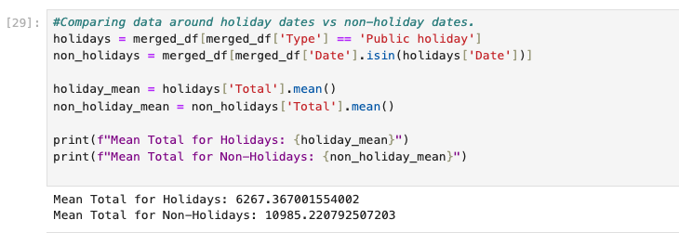
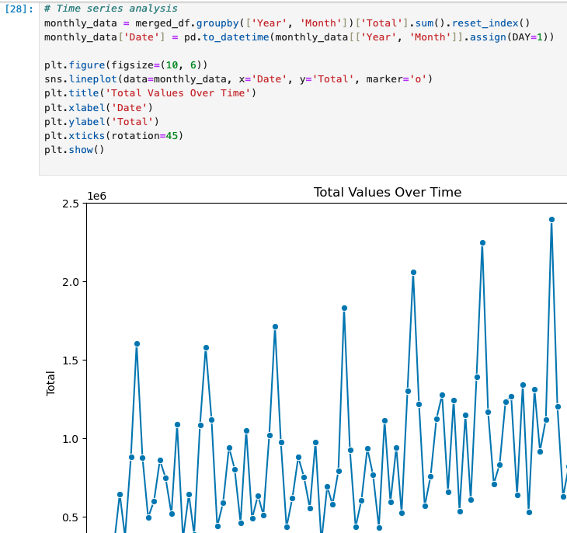
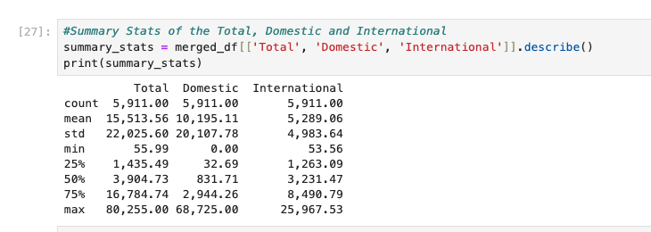
Exploratory analysis
Exploratory analysis to familiarize ourselves with the data sets
Notes:
OANH
After cleaning the data, we did some exploratory analysis. Looking at the summary statistics and did a quick time series analysis to get more familiar with the data set.

Slide 5
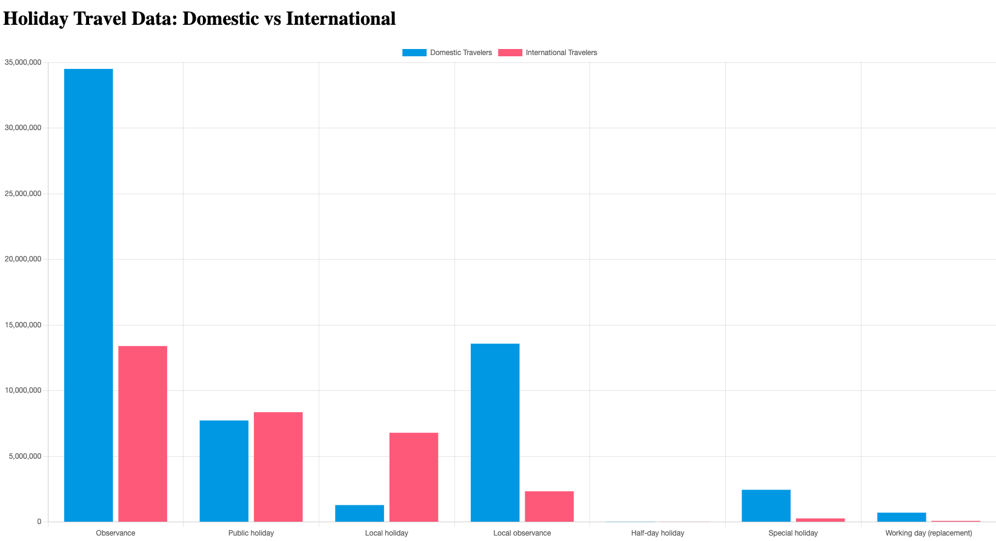
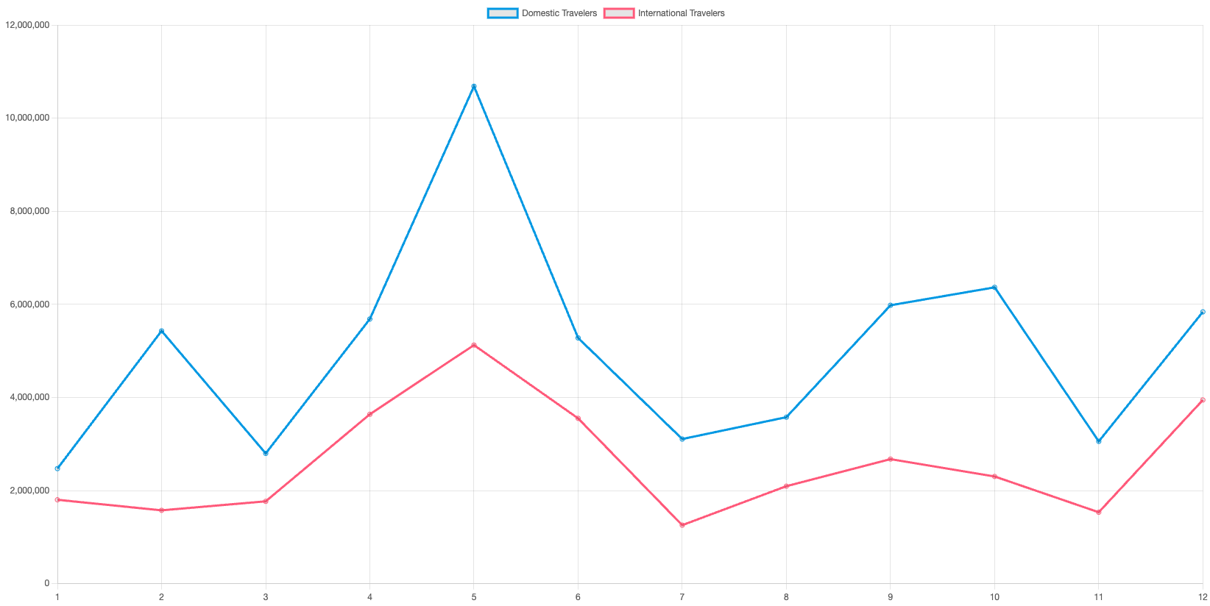
visualizations
Comparison of domestic and international travelers by holiday.
Comparison of Domestic and International Travelers by month.
Notes:
ANNA

Slide 6
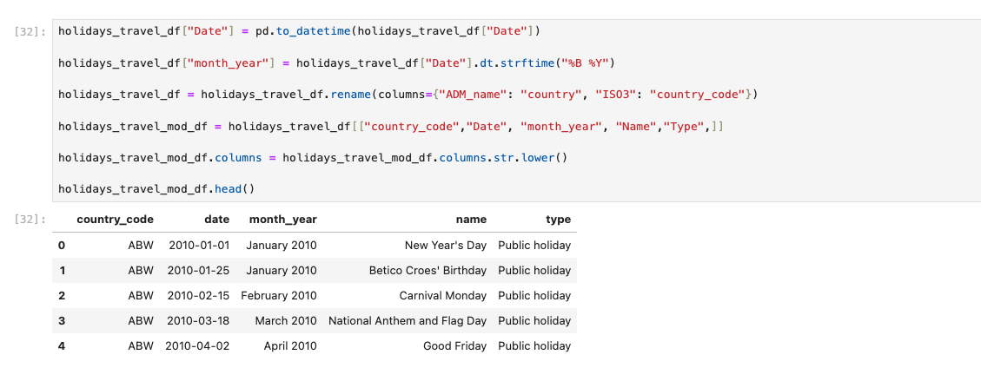
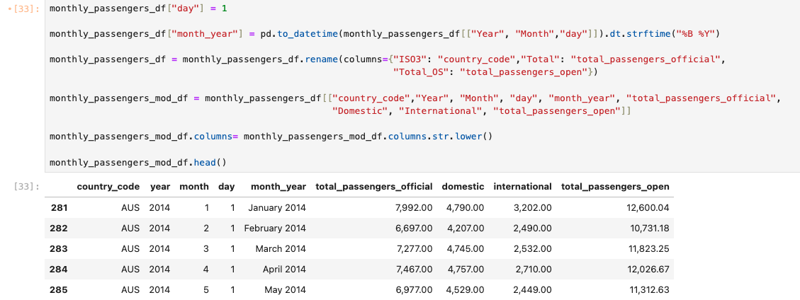
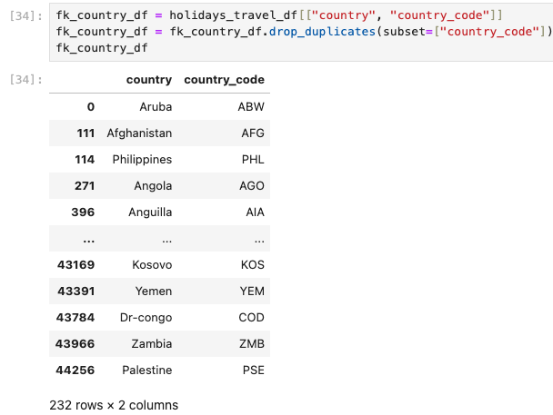
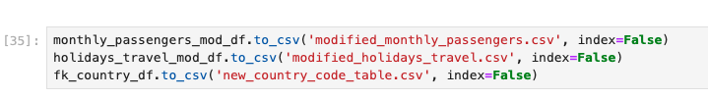
Extract, Transform, Load
There Transformed dataframes to csv
Notes:
ANNA
After exploratory analysis we cleaned up the tables by updating the column names to better describe the data and updating the date format to stay consistent across dataframes.
We also created a new dataframe with the country code and country name.
Then, we exported the transformed dataframes to CSV files to use in our DQL database.

Slide 7
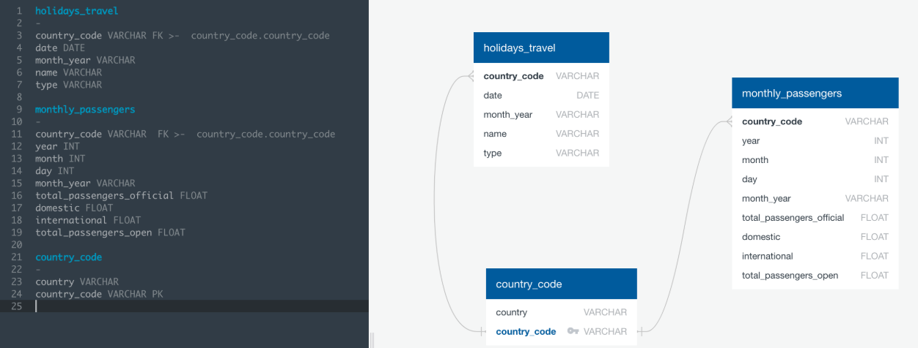
ERD
ERD to visually represent the structure of our database showing the Relationships between tables
Notes:
RANIA

Slide 8
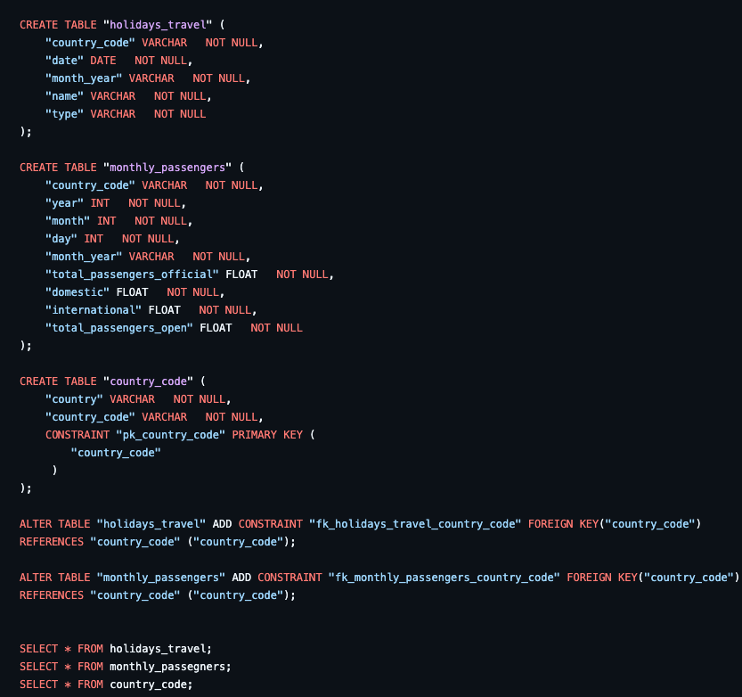
Extract, transform, load
SQL database created. Tables created.
CSV files loaded.
Notes:
RANIA
We created the tables with relationships in a SQL database and the loaded the csv files against those tables for future use!

Slide 9
THANK YOU!
Notes:
RANIA

