Slide 1
Project 4 Loan approval prediction model
By: Rania Al-Samaria, Oanh Nguyen, Axel Keller, and Anna Whitaker
Notes:
Axel

Slide 2
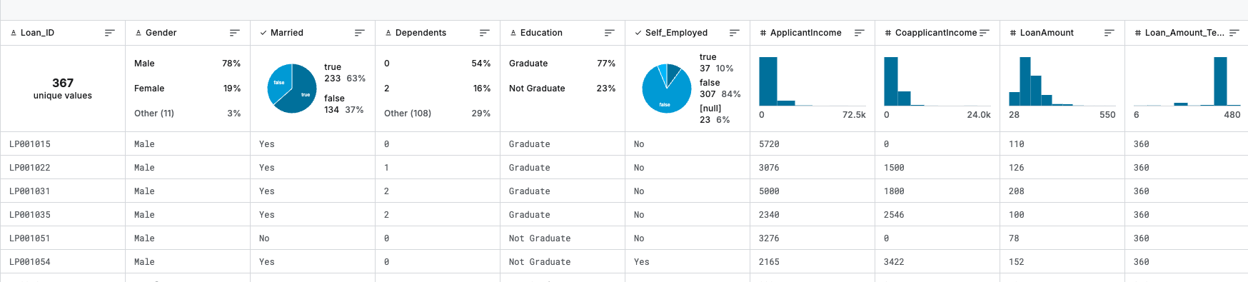
Overview of data set
Loan Data Set Link – from Kaggle
Potential data set shortfalls = missing values, imbalanced target variable, and categorical data (need encoding prior to training)
Notes:
Axel

Slide 3
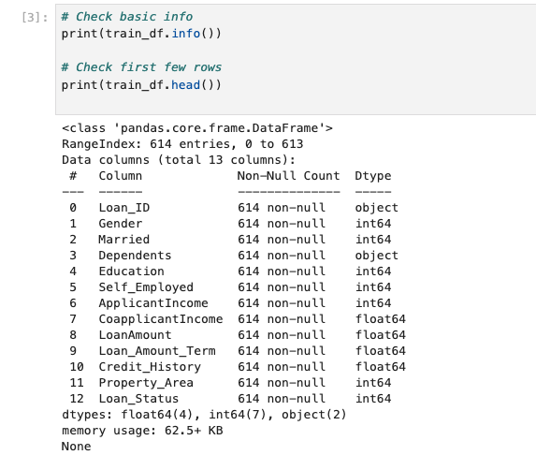
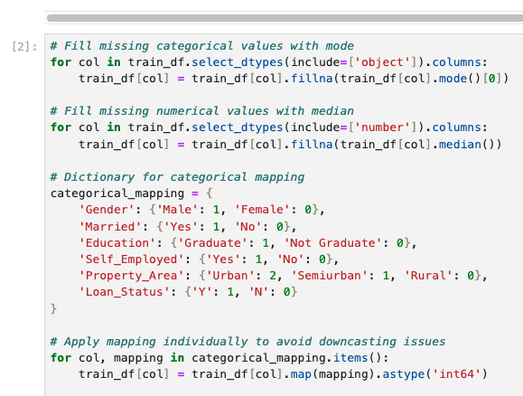

Data Clean
Fill missing values, map categorical variables, update data types, as needed.
Check data types.
Notes:
Rania

Slide 4
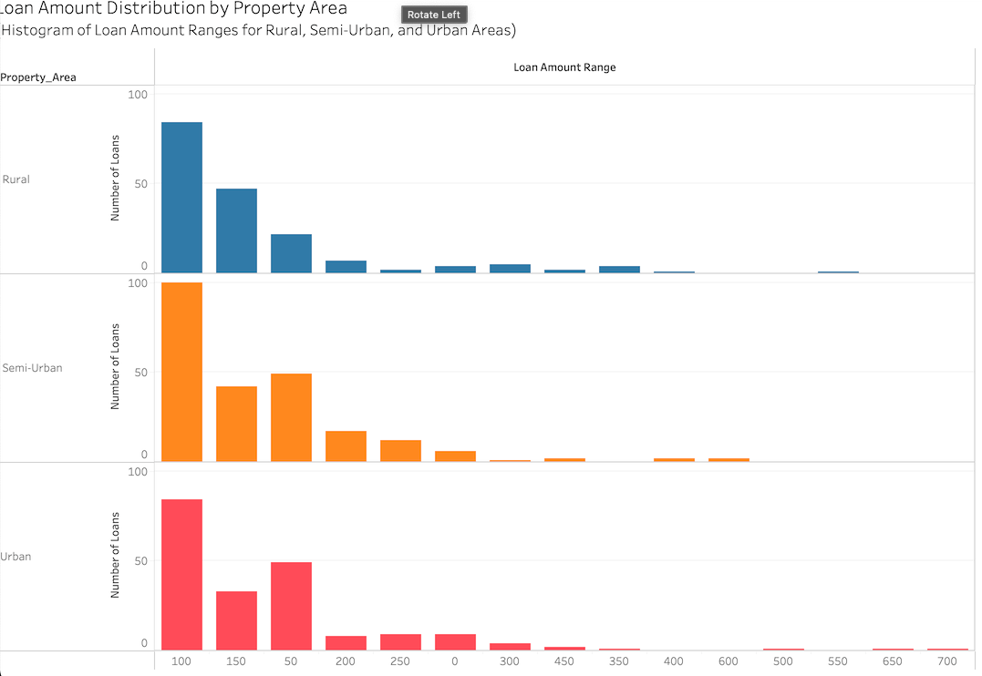
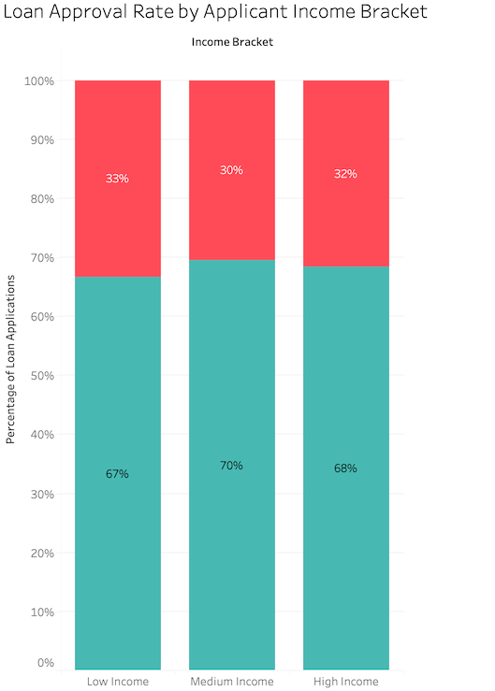
Exploratory Analysis
Comparison of Loan Amount per Property Area
Comparison of Loan Amount per Martial Status
Notes:
Rania -Tableau

Slide 5
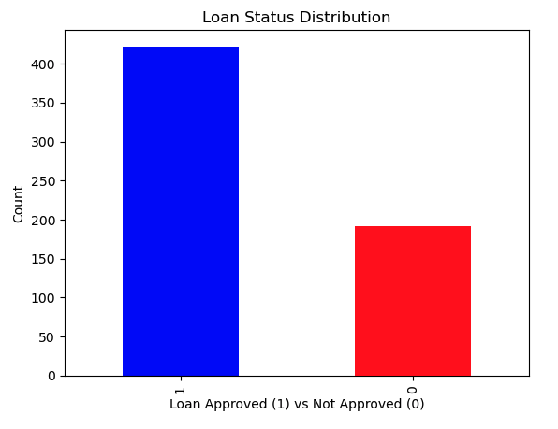
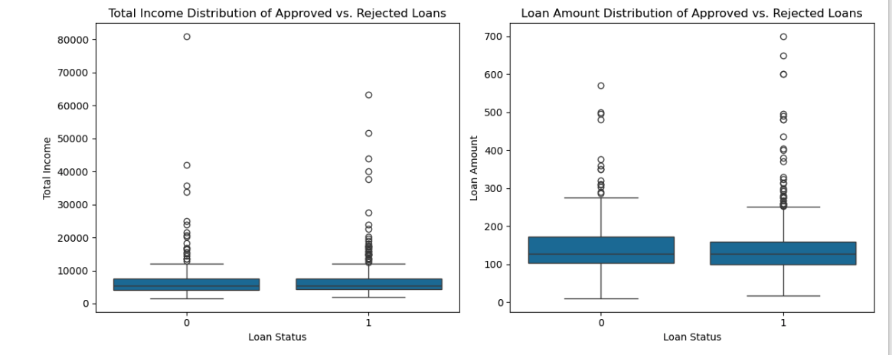
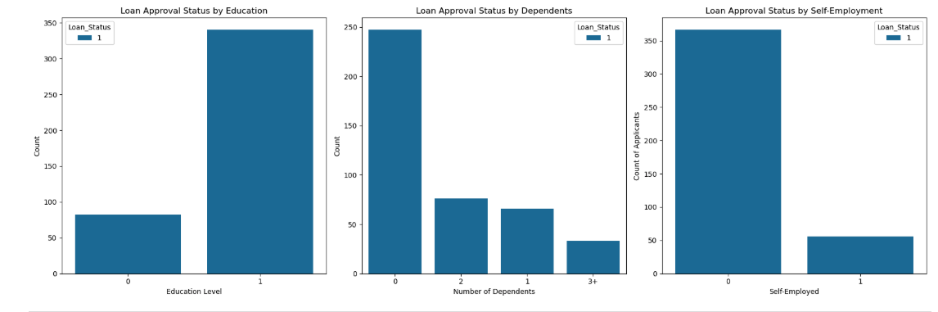
Exploratory Analysis
Outlier check.
Balance of target variable.
Interaction of features with target variable
Notes:
Oanh - Python

Slide 6
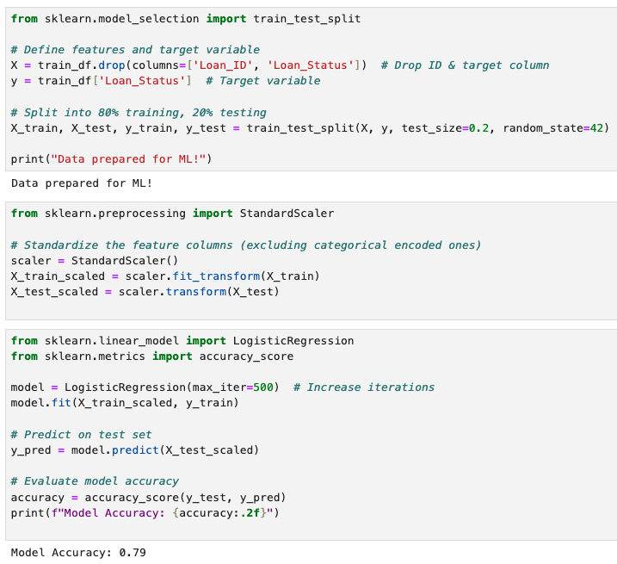
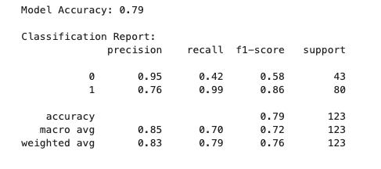
MODEl
Defined features and target variable.
Created train and test variables.
Standardized the features.
Ran the model.
Model Accuracy = .79
Notes:
Oanh

Slide 7


MODEL ADJUSTMENTS Impact on accuracy
ADJUSTMENT ONE
Removed a few additional features, including Self_Employed (imbalanced), CoapplicantIncome and ApplicantIncome (total income feature remained).
Slightly decreased model accuracy.
ADJUSTMENT TWO
Removed a few additional features, including Self_Employed (imbalanced), CoapplicantIncome and ApplicantIncome (total income feature remained), Education (imbalanced).
Model accuracy stayed the same as the original model.
Notes:
Anna

Slide 8
THANK YOU!
Notes:
Anna

