Slide 1

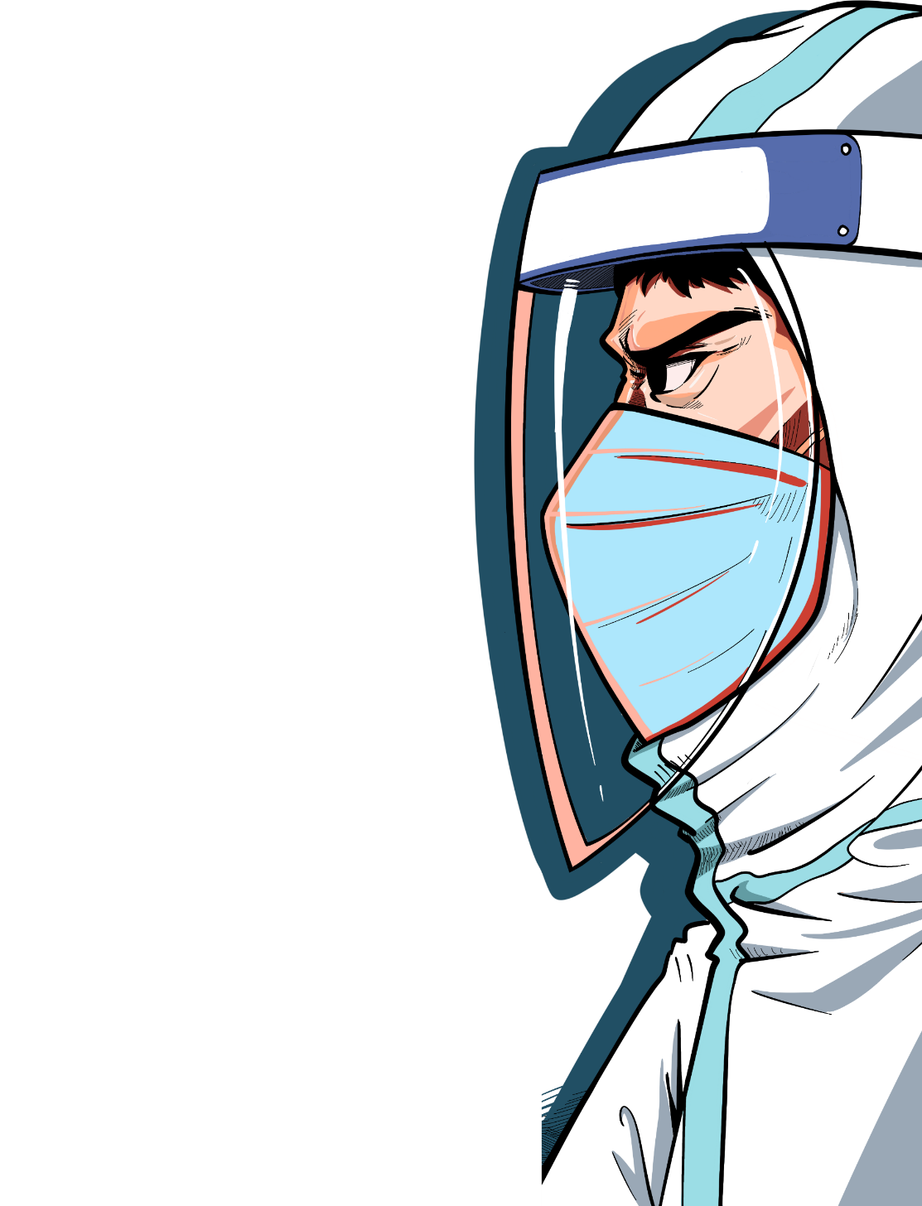
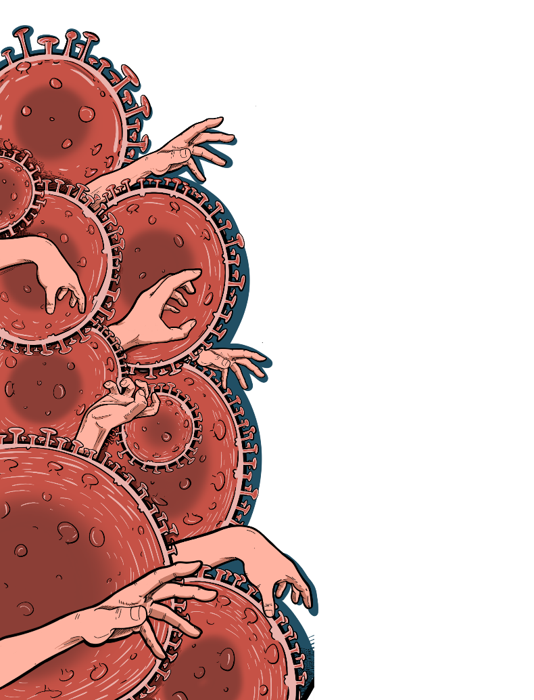
DignoseMe
Hack for Wuhan
黑客松初赛作品

Slide 2
6项目名称：DiagnoseMe
队长：Email/Slack ID: inedit.bf@gmail.com
组员：WeChat: Boris BAGBILA, maxoOthentic, wxid_s4zhj3ziuivp22
导师：
项目简介：
In order to reduce the risk of transmission on the way to the hospital and promote rapid management, our idea is about to implement a mobile application for remote self-diagnosis of symptoms (helped by connected objects, watchs masks, etc...) and suspects case mapping so that a specialized ambulance can travel to remove suspect patient
Github

Slide 3


PROJECT NAME
DiagnoseMe
Realtime remote diagnose system of COVID-19 suspected cases and prevention tips
Email: inedit.bf@gmail.com sy.traore@outlook.com
WeChat ID: ineditbf
Project Link: https://urlz.fr/c08I

Slide 4
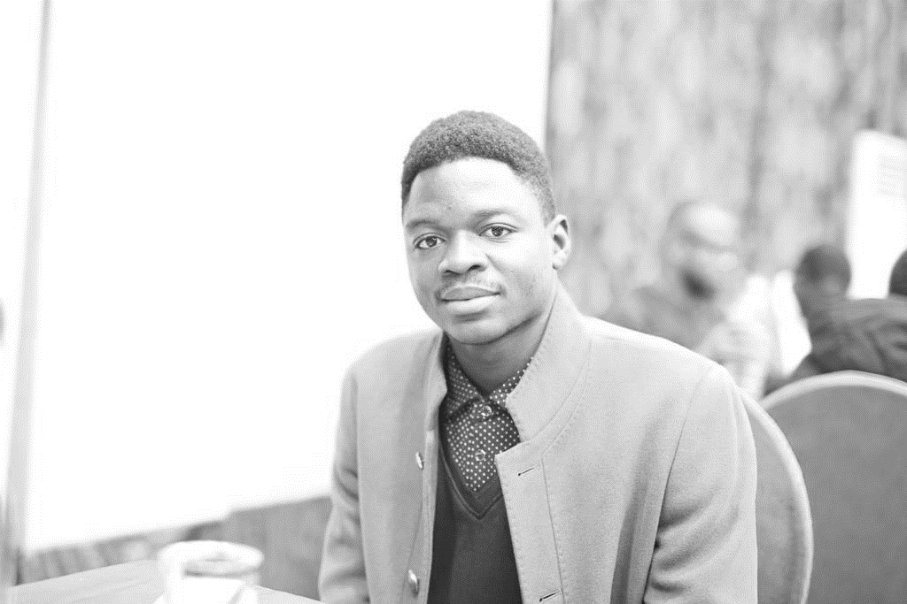
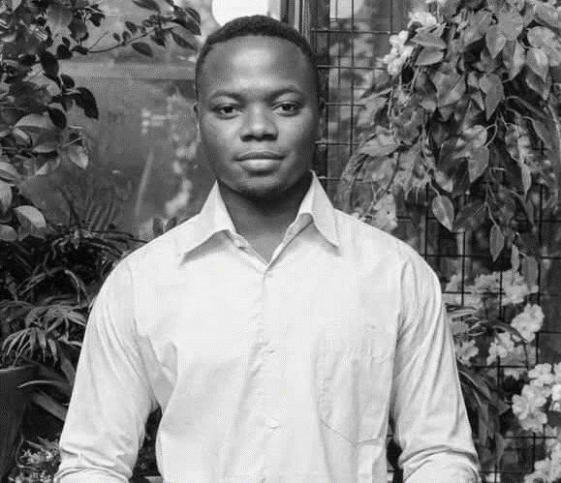

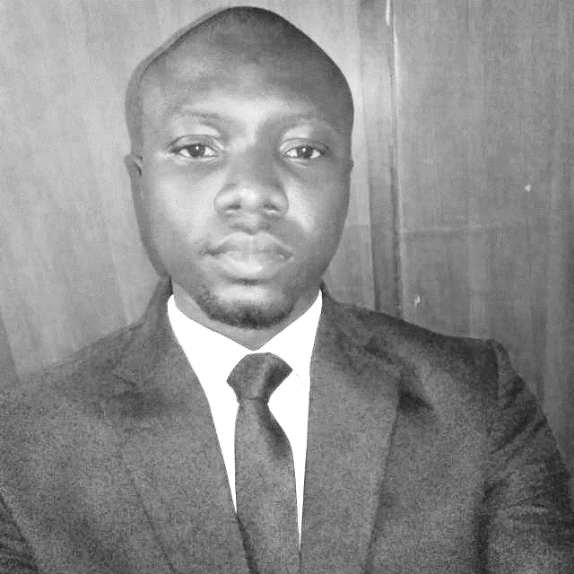
TEAM MEMBERS
“We are not professional developer by we think our idea can be perform by software and hardware Industrial designers
So only simulation is available”
Pakindessama Maxime KONKOBO
Boris Flavy
BAGBILA
Sy Adama
TRAORE
Faissal
NIKIEMA
24 years
Student
Wuhan University of Technology
25 years
Civil engineer from
Hubei University of Technology
30 years
Consultant/ Trainer
Electronics and automation ingineer
31 years
General doctor
Medical center in BURKINA FASO

Slide 5
REASON FOR PROJECT
To fight an epidemic, limit the spread. This requires isolation of suspected cases and rapid management.
However for COVID-19, in the absence of isolation measure, each sick person can affect two.
And people can be contagious very early on when symptoms start, or even before they appear. Our Project responds to this problem. The objective is to bring this figure below one, in order to stem proliferation.

Slide 6
PROJECT ROLE
Permit remote Symptomes detection of Virus
Facilitate the detection of suspect cases and their rapid management
Quickly and securely sort people based on their risk of COVID-19 infection and provide adequate care (those who must be confined to the home, referred to a care facility or isolated in an emergency)

Slide 7
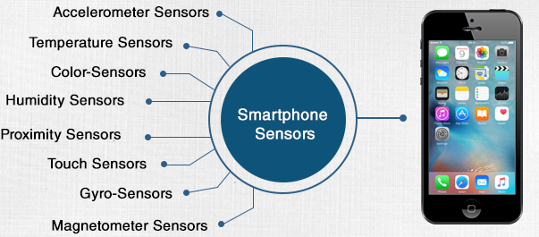
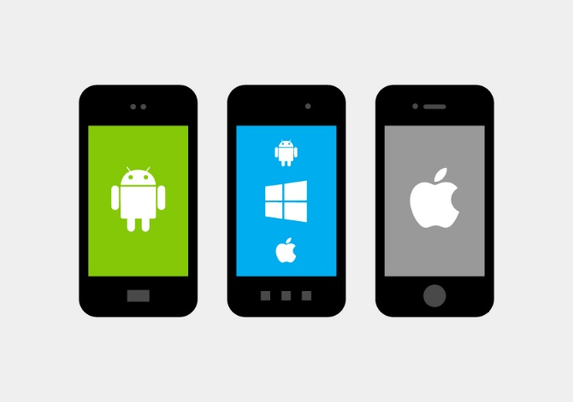
TECHONOLOGY TO USE
MOBILE APP
NATIVE SENSORS
OR
ALL IN ONE INDUSTRIAL DESIGN

Slide 8
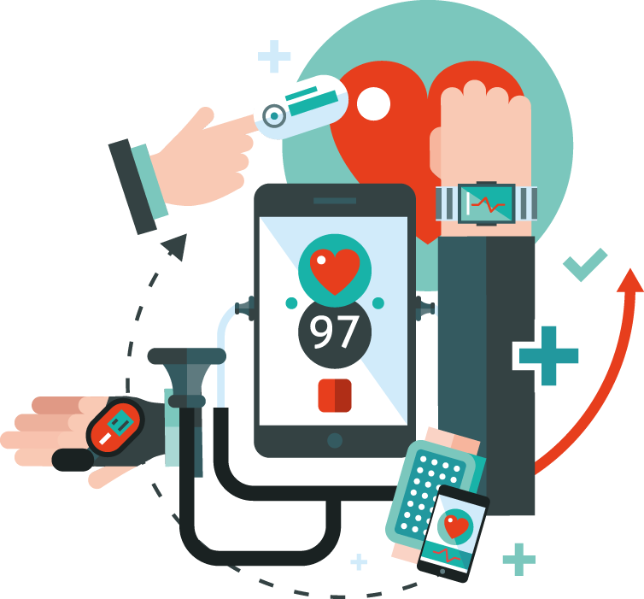
TECHONOLOGY TO USE
The project can be 02 Types:
A connected object (watch, smart mask) for personal use with the phone
A Industrial design (set of Hardware and Software as a Tablet) which will be at the entry points of the countries (airports, train station, border ...) at the entrance to gathering places (schools, places of worship, public transport ...) and hospital entrances

Slide 9
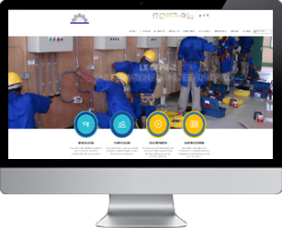

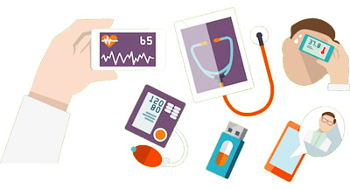

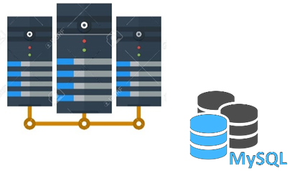



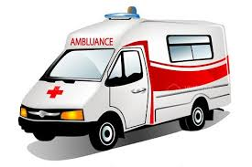
HOW IT WORK ?
2
COVID-19 SYMPTOMS DETECTION
1
IOT
DIAGNOSE ME PROJECT
DiagnoseMe
Realtime remote diagnose system of COVID-19 suspected cases
In order to reduce the risk of transmission on the way to the hospital and promote rapid management, our project will implement a mobile application for remote self-diagnosis of symptoms (thanks to connected objects) and suspected cases mapping so that a specialized ambulance can travel to the scene to remove the suspect patient.
3

Slide 10
HOW IT WORK ?
2
COVID-19 SYMPTOMS DETECTION
1
IOT
DIAGNOSE ME PROJECT
DiagnoseMe
Realtime remote diagnose system of COVID-19 suspected cases
In order to reduce the risk of transmission on the way to the hospital and promote rapid management, our project will implement a mobile application for remote self-diagnosis of symptoms (thanks to connected objects) and suspected cases mapping so that a specialized ambulance can travel to the scene to remove the suspect patient.
3

Slide 11
MAIN FUNCTIONALITIES
FAQ on COVID-19 (HELP)
Prevention (TIPS)
Get the constants of the user using captors and make the diagnosis
Geolocation and Management of the suspected cases by Hospital
Chat with suspect patient

Slide 12
USERS
The users of the project are mainly for people living in a region affected by COVID-19 and people from areas at risk. Health staff will use the back office to detect suspected cases and decide to remove them. But everybody must use it. They can download free of use if their phone is compatible

Slide 13
STRONG POINTS
Transmission of user constants through sensors
Allow rapid treatment and this will give a better chance of recovery.
Bring suspected cases to the health services. This will allow them to
be more efficient since they will no longer have to worry about detecting suspicious cases.
Limits the spread of the virus during trips to hospitals by restricting trips to only those in real need.
Limits the spread of the virus in the hospital in the waiting room by patient sorting
Limits the risk of infection of health personnel thanks to sorting

Slide 14
BUSINESS MODELE
The DiagnoseMe solution in its final version will be an All in One product which in a personal and general public version. It may be made available to users free of charge in stores in iOS and Android versions, which will be made aware by social marketing. Social networks; the media will promote it.
The main users will be individuals, health centers; the Ministry of Health.
It can be adapted to other epidemics

Slide 15
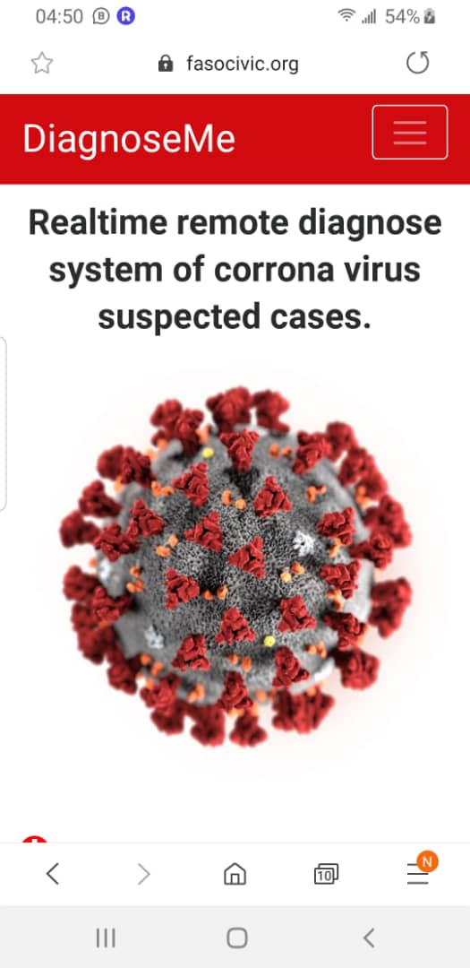
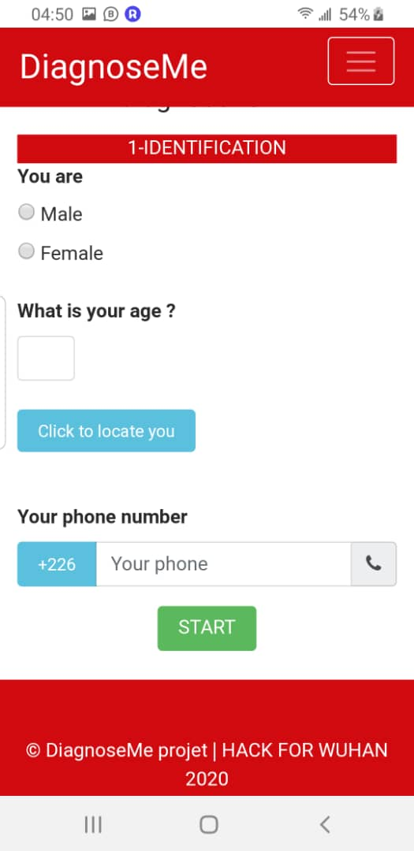
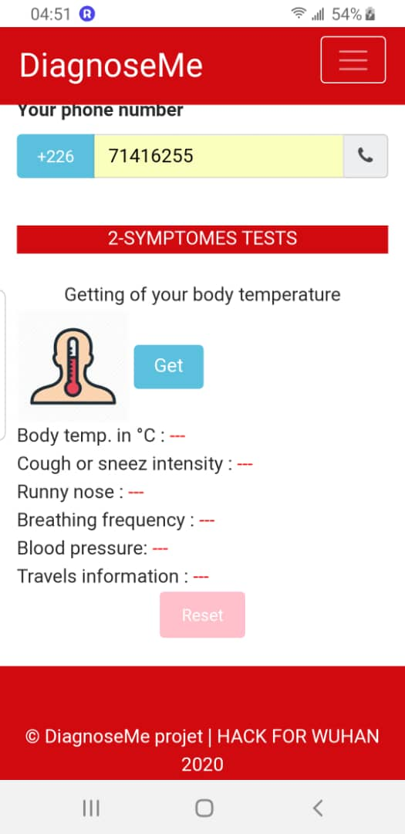
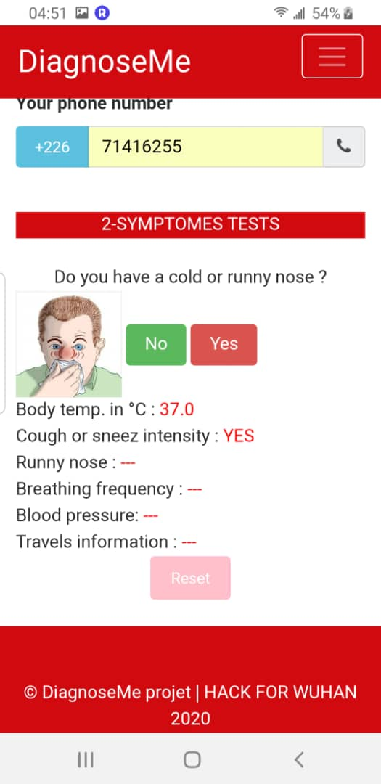
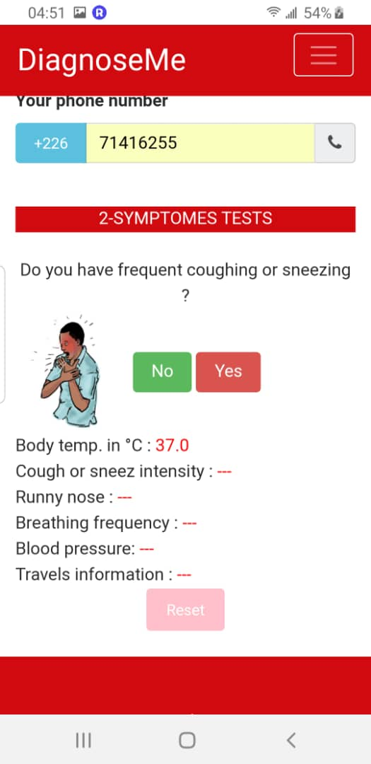
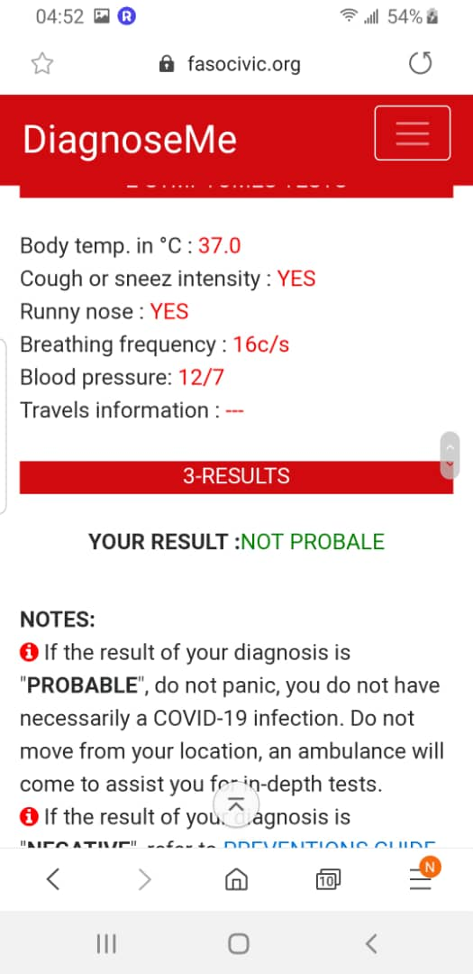
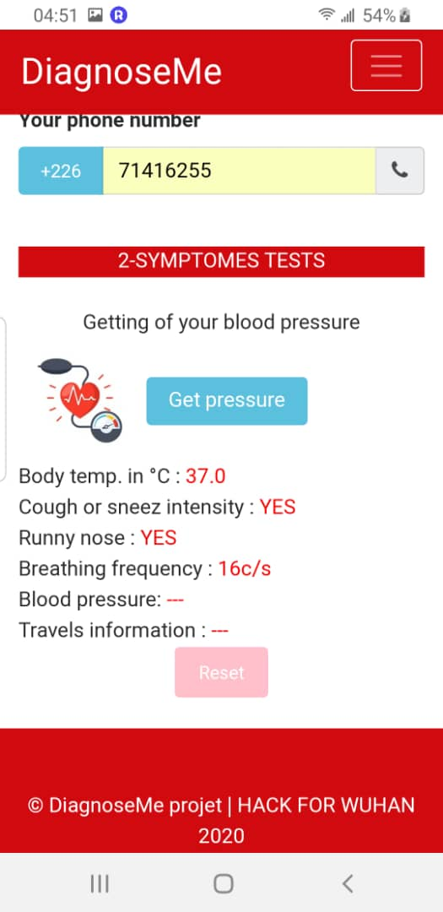
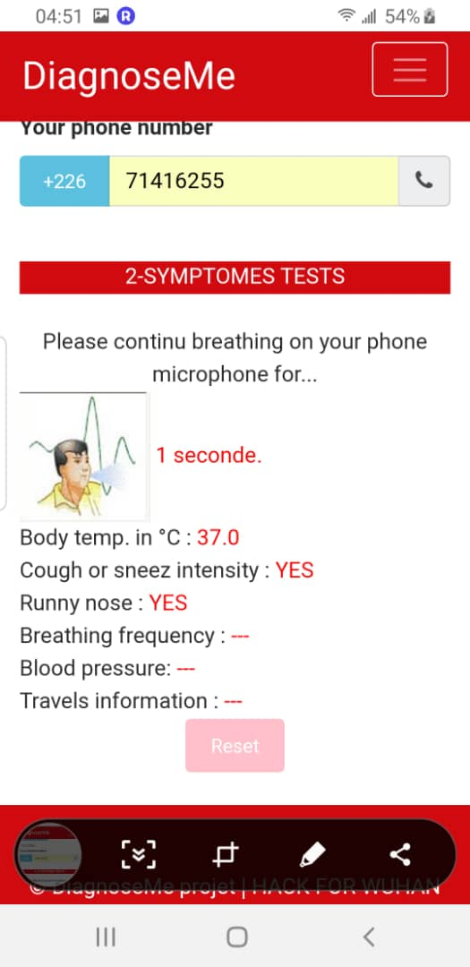
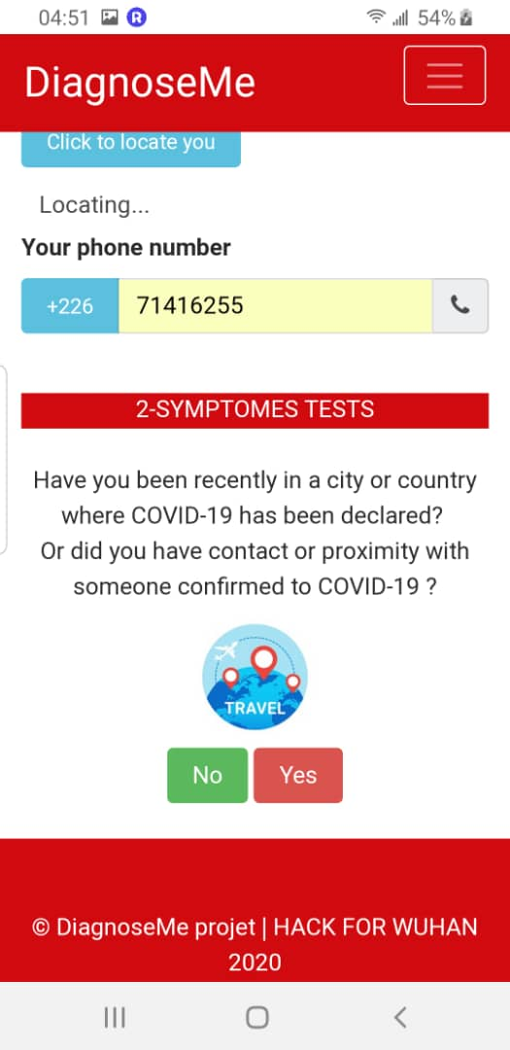
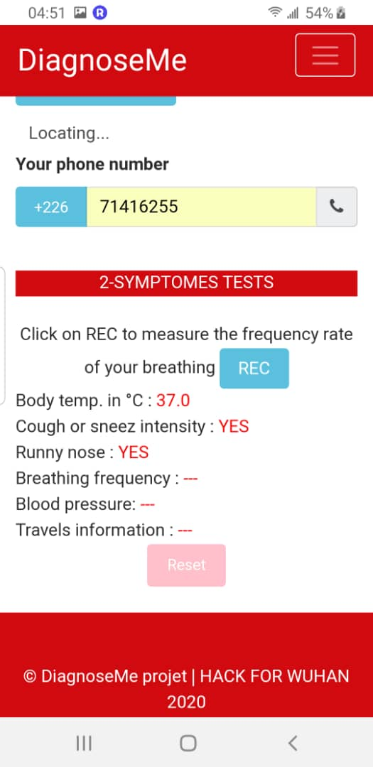
SCREENSHOTS

Slide 16
SCREENSHOTS

