Slide 1
rsHRF toolbox
^{SPM-plugin v2.0}
2019.01.06
Notes:
Connectivity analysis is included in v2.0.
1

Slide 2
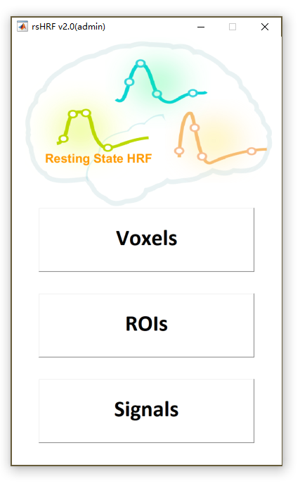
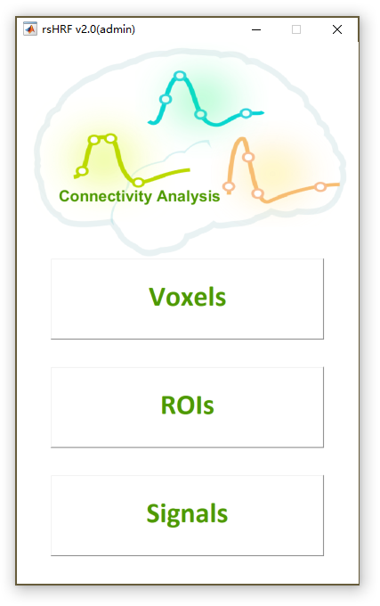
HRF & Connectivity
Resting-state HRF deconvolution
Voxel-wise
ROI-wise, with as input: whole_brain.nii
ROI-signal, with as input: signal.mat/.txt
Connectivity analysis (Seed to Voxels, ROI to ROI)
FC: Correlation
Pearson, Spearman correlation
EC: Granger Causality (GC)
Pairwise GC, Conditional GC,
Partially conditioned GC
Wu, G., Liao, W., Stramaglia, S., & Marinazzo, D. (2013). Recovering directed networks in neuroimaging datasets using partially conditioned Granger causality. BMC Neuroscience, 14(1), 260.

Slide 3

Install
Download:
https://github.com/compneuro-da/rsHRF
Install:
Run code in Command Window (within rsHRF folder)
>> rsHRF_install_SPM
--> SPM should be installed
--> Codes will be copied to ./SPM/toolbox/rsHRF
= spm('Dir')
Or add it into ./SPM/toolbox/

Slide 4
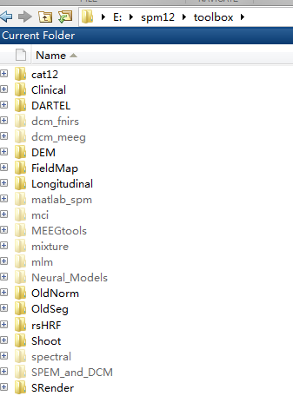
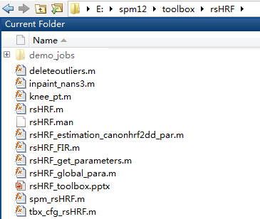
Add it into ./SPM/toolbox/
rsHRF
Notes:
改图片
4

Slide 5
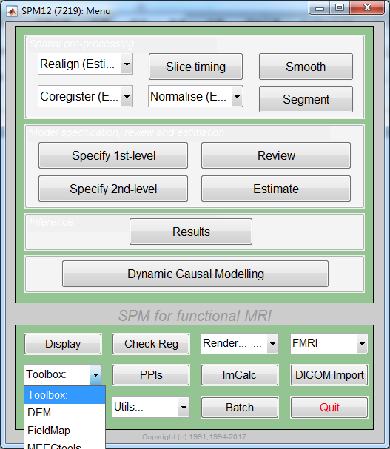
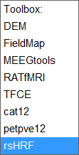
From SPM:
Start Resting State HRF
Command Window:
>> spm fmri
From toolbox
Click rsHRF
Or >> rsHRF
1
2
3

Slide 6
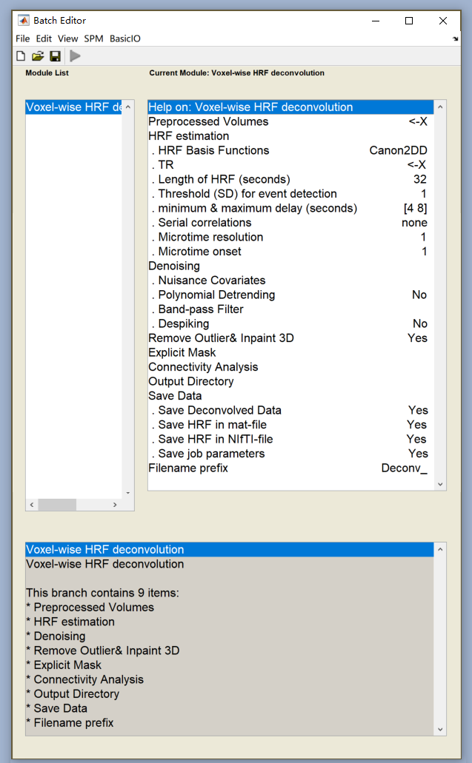
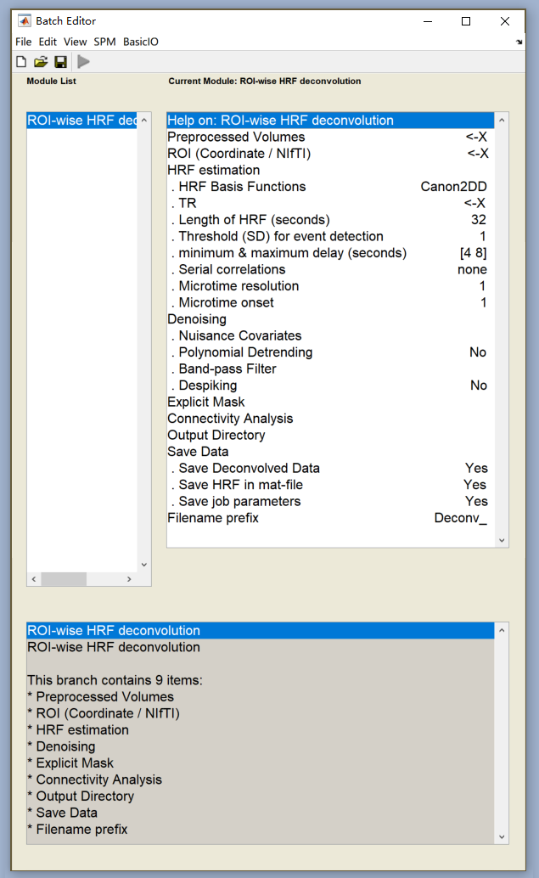
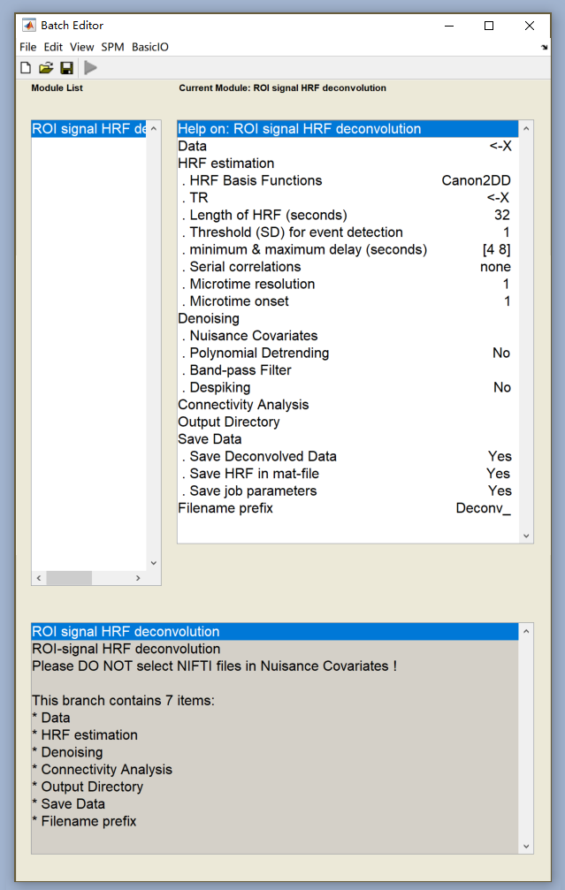
1
Voxels
2
ROIs
3
Signals

Slide 7
From SPM:
Start Connectivity Analysis
Command Window:
>> rsHRF conn
Or >> rsHRF(‘conn’)
1
2
3

Slide 8
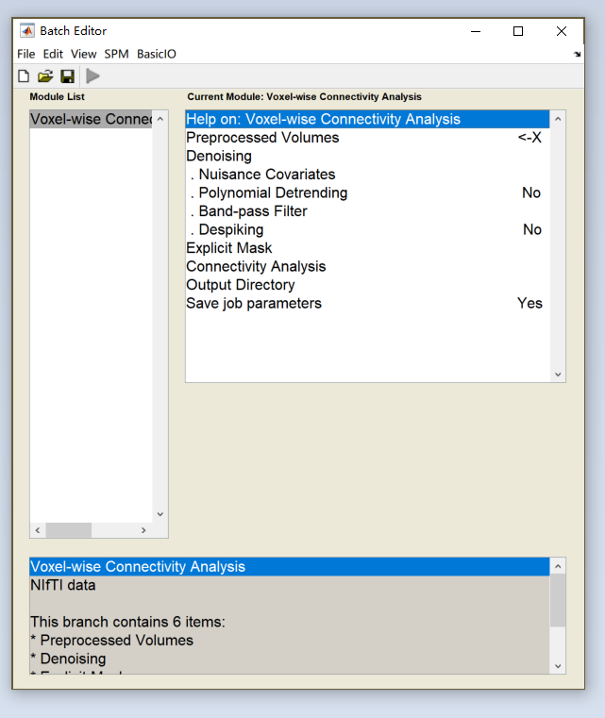
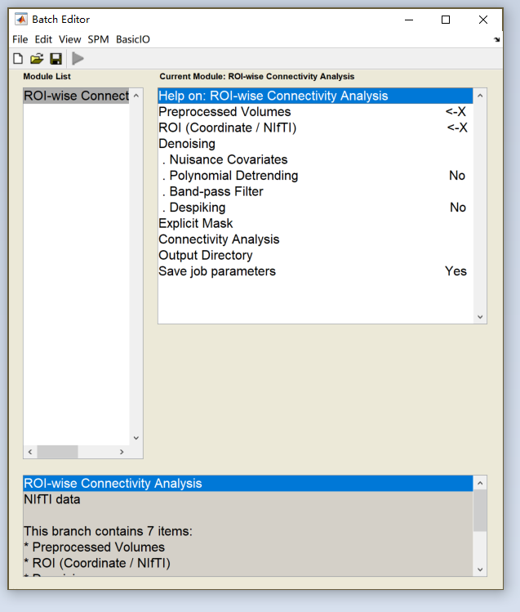
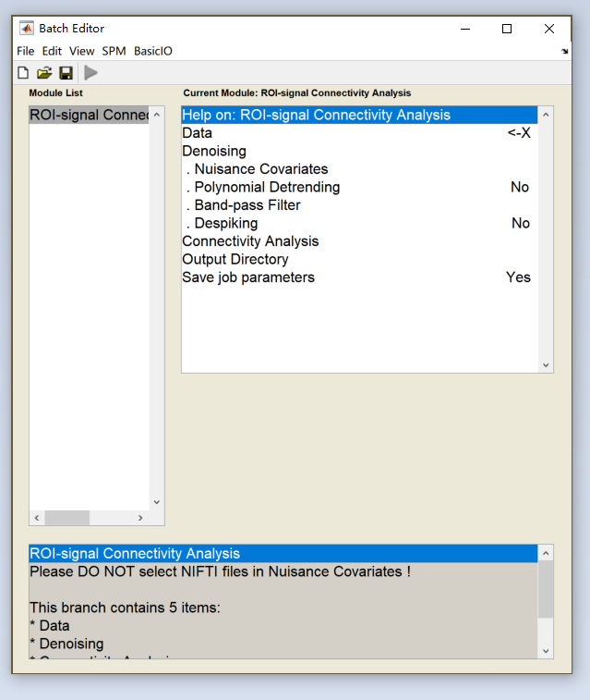
1
Voxels
2
ROIs
3
Signals

Slide 9
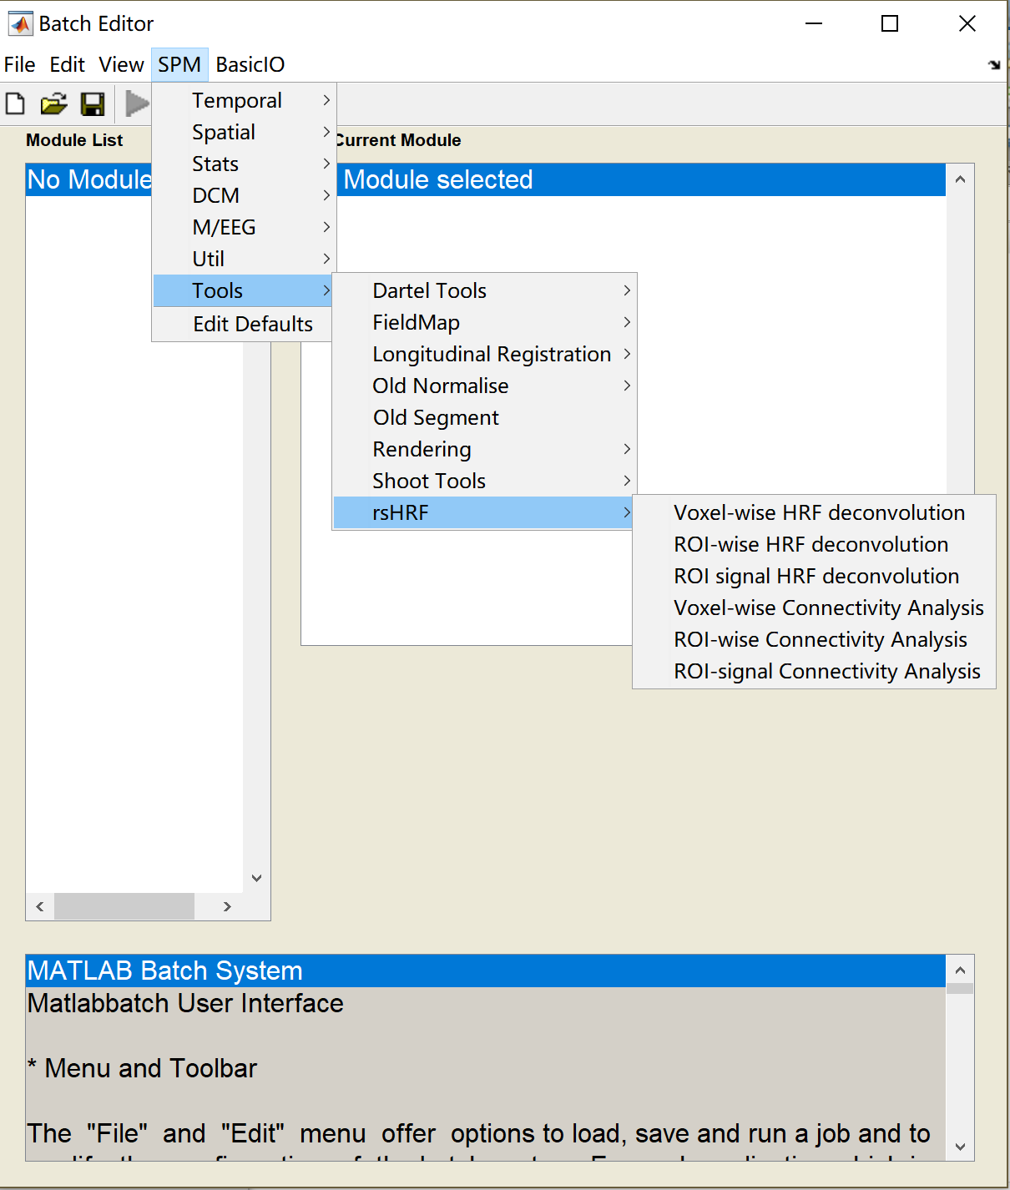
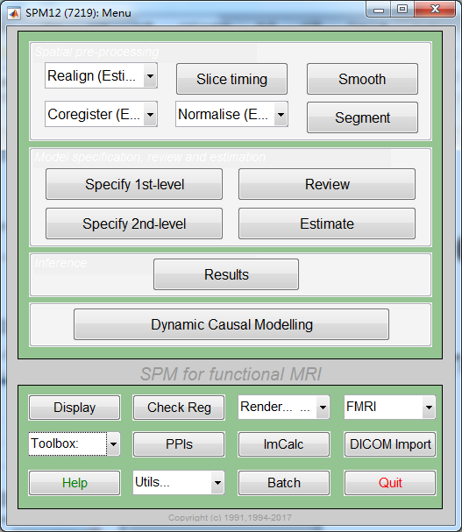
From Batch:
Start rsHRF/
rsHRF conn
Notes:
改
9

Slide 10
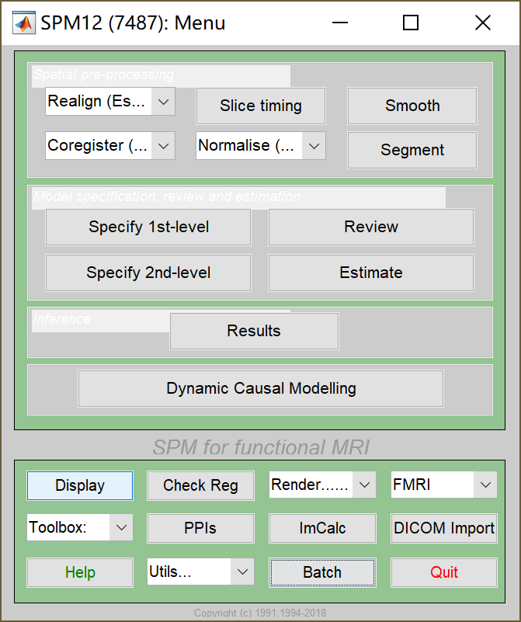
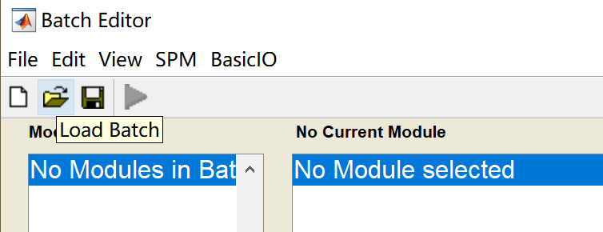
Demo jobs
Load from Batch editor

Slide 11
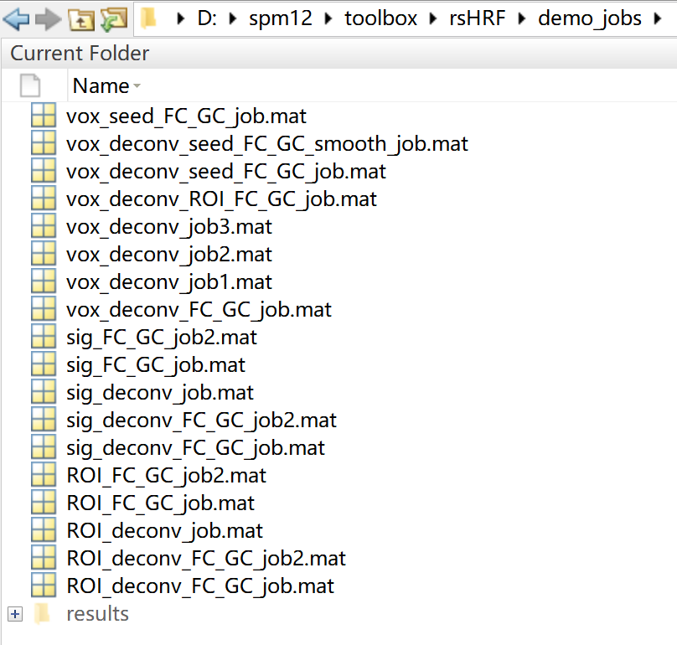
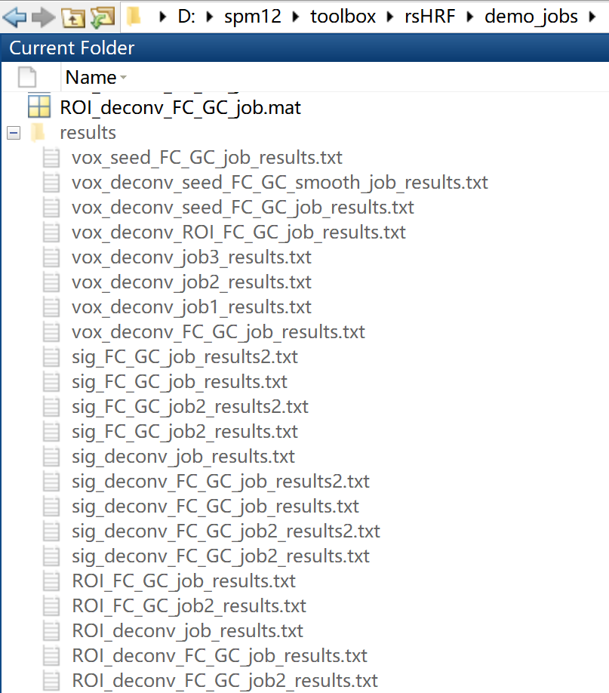
Demo jobs job (.mat) and result (.txt) files
job files
Resting-state HRF deconvolution: *deconv*
Connectivity analysis: *FC_GC*
result files
Notes:
Three cases: 1) Voxel-wise, 2) Signal-wise, 3) ROI-wise

Slide 12
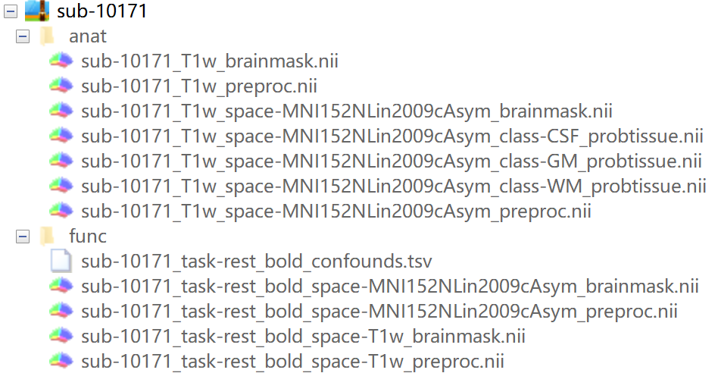
Demo jobs demo data (1 subject)
> UCLA Consortium for Neuropsychiatric Phenomics LA5c Study
Download from https://openneuro.org/datasets/ds000030
Preprocessed by FMRIPREP
RAW_FILE_NAME.nii

Slide 13
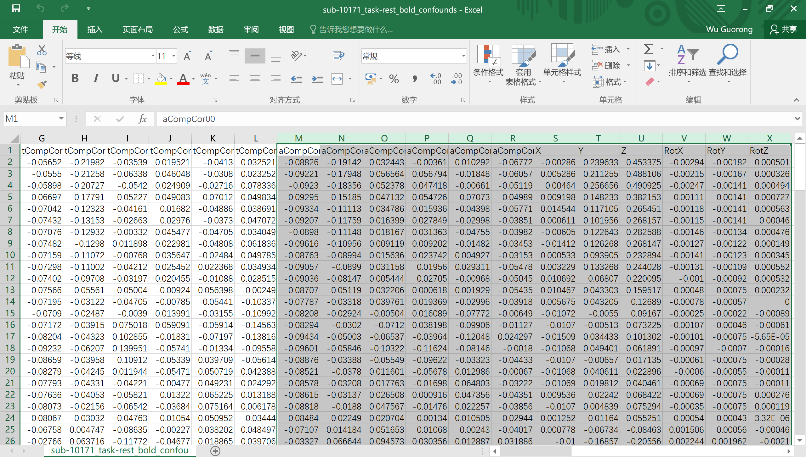
Demo jobs demo data (1 subject)
Nuisance variables: sub-10171_task-rest_bold_confounds.tsv
cd D:\sub-10171\func
dat = importdata('sub-10171_task-rest_bold_confounds.tsv');
varname = dat.textdata(1,end-11:end)
nuisance = dat.data(:,end-11:end);
save('nuisance.txt','nuisance','-ascii')
rp = dat.data(:,end-5:end);
save('rp.txt','rp','-ascii')
aCompCor = dat.data(:,end-11:end-5);
save('aCmopcor.txt','aCompCor','-ascii')

Slide 14
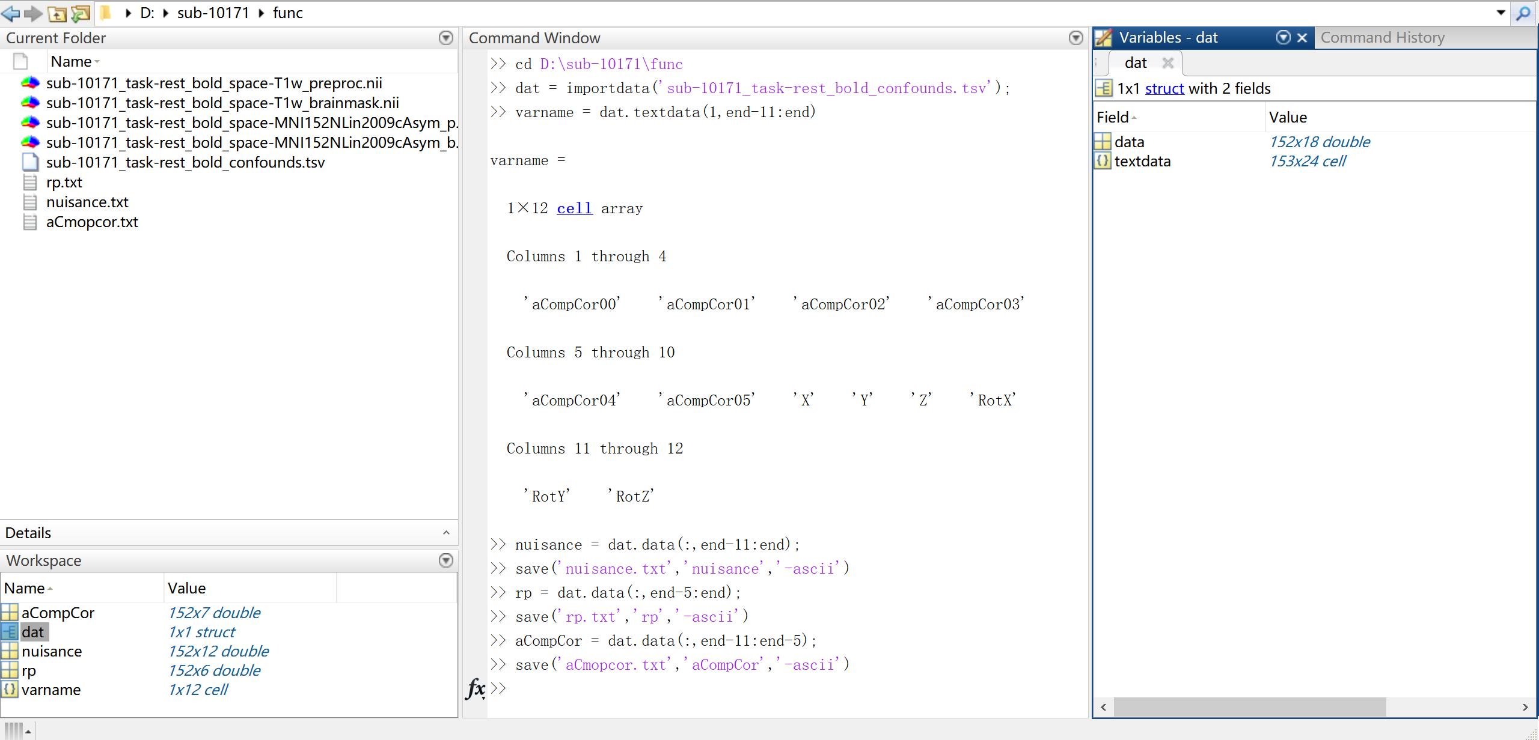
save nuisance variables

Slide 15
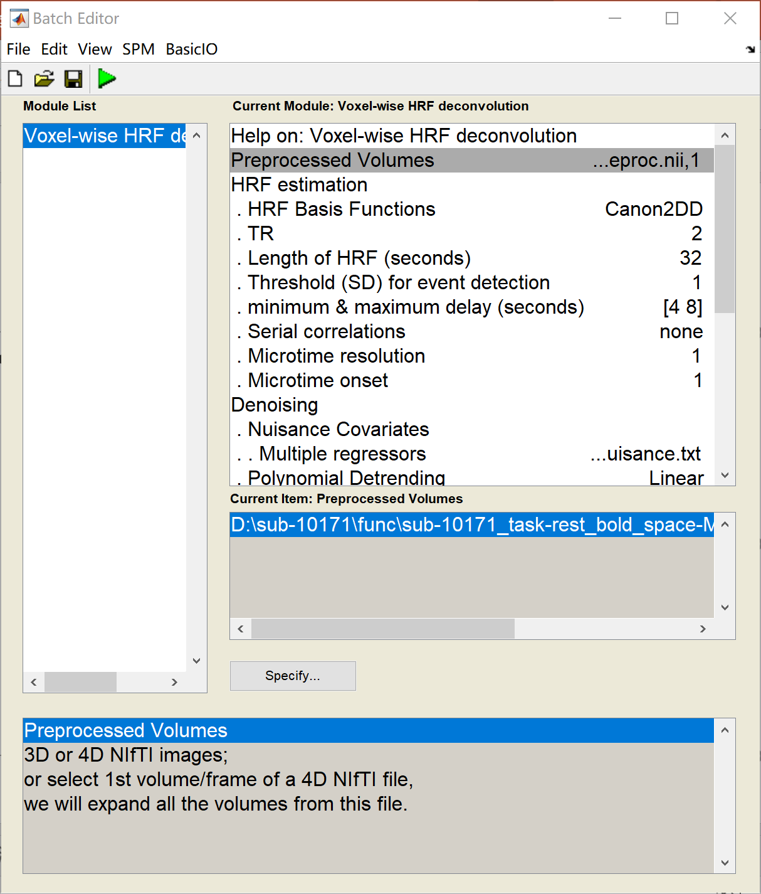
Demo jobs Voxel-wise rsHRF deconvolution
Load batch
/toolbox/rsHRF/demo_jobs/ vox_deconv_job1.mat
Change files/parameters
e.g.:
Preprocessed volumes
Multiple regressors
Explicit Mask
Output directory
Notes:
Demo jobs are only illustrated for the ‘voxel-wise’ case.
vox_deconv_job1.mat: no image covariates
Remark: if you select the first volume/frame of a 4D NifTI file, all volumes from that file will be expanded.

Slide 16
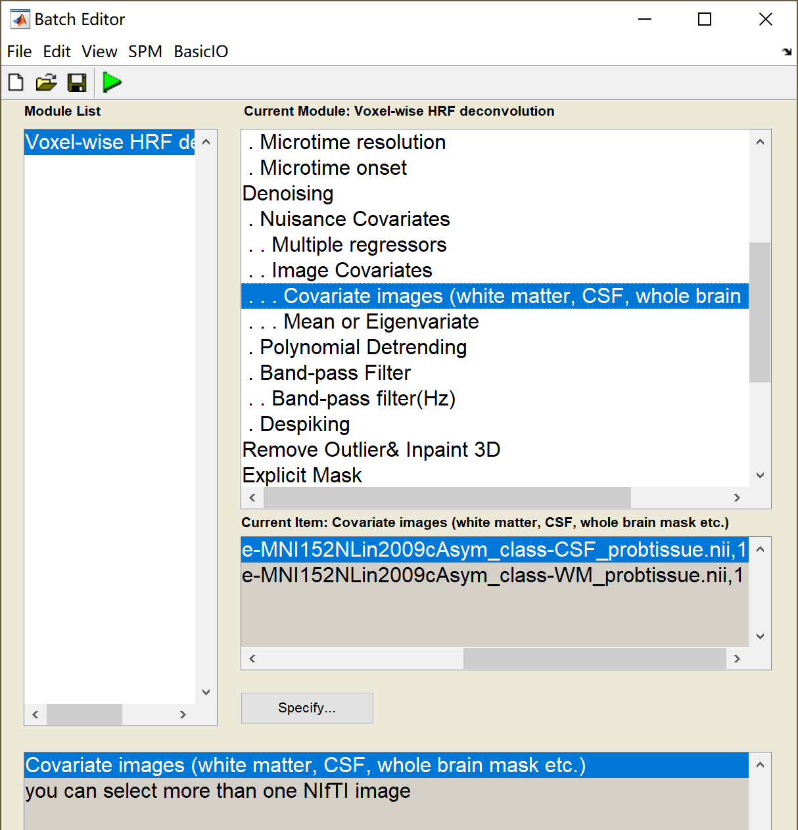
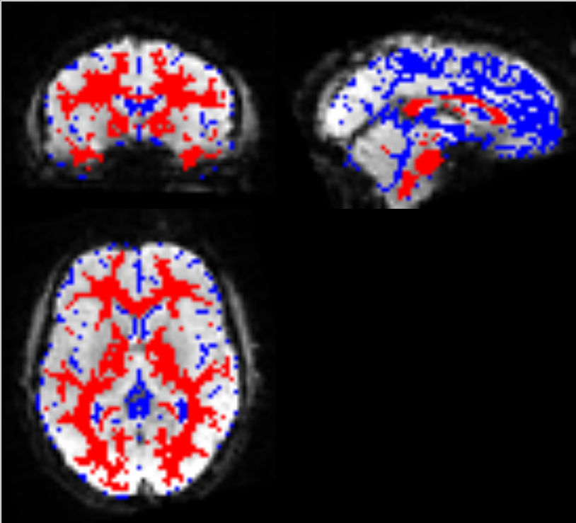
Demo jobs Voxel-wise rsHRF deconvolution
Image covariates
The covariate images and BOLD-fMRI data should be coregistered.
We only select voxels with value > 0.9 in covariate images for nuisance regression.
vox_deconv_job2.mat
Notes:
- vox_deconv_job2.mat: image covariates (WM, CSF)
- vox_deconv_job3.mat: image covariates (WM, CSF, brainmask)

Slide 17
Resting-state HRF deconvolution:
Demo results Voxel-wise rsHRF deconvolution
/rsHRF/demo_jobs/vox_deconv_job1.mat
/rsHRF/demo_jobs/vox_deconv_job1_results.txt
Deconv_RAW_FILE_NAME.nii % HRF deconvolved data
Deconv_RAW_FILE_NAME_FWHM.nii % HRF parameter FWHM/width
Deconv_RAW_FILE_NAME_Height.nii % HRF parameter response height
Deconv_RAW_FILE_NAME_Time2peak.nii % HRF parameter time to peak
Deconv_RAW_FILE_NAME_event_number.nii % estimated BOLD event number
%% remove outlier and Inpainted (Olrm)
Deconv_RAW_FILE_NAME_Olrm.nii % HRF deconvolved data
Deconv_RAW_FILE_NAME_Olrm_FWHM.nii % HRF parameter width
Deconv_RAW_FILE_NAME_Olrm_Height.nii % HRF parameter response height
Deconv_RAW_FILE_NAME_Olrm_Time2peak.nii % HRF parameter time to peak
Deconv_RAW_FILE_NAME_Olrm_event_number.nii % estimated BOLD event number
Deconv_RAW_FILE_NAME_hrf.mat % HRF parameters
Deconv_RAW_FILE_NAME_job.mat % analysis/model parameters
Deconv_RAW_FILE_NAME_outlier_NAN.nii % detected outlier (value=1)
RAW_FILE_NAME = sub-10171_task-rest_bold_space-MNI152NLin2009cAsym_preproc
Notes:
Demo results (Resting-state HRF deconvolution) are illustrated for all three cases (voxel-wise, ROI-wise, ROI-signal).
1. Voxel-wise: vox_deconv_job1.mat

Slide 18
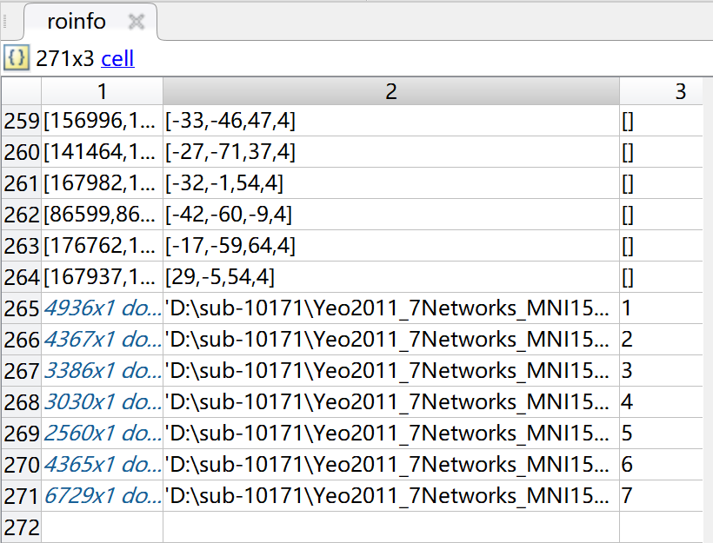
Input = whole_brain.nii
Demo results ROI-wise rsHRF deconvolution
/rsHRF/demo_jobs/ROI_deconv_job.mat
/rsHRF/demo_jobs/ROI_deconv_job_results.txt
Output:
Deconv_RAW_FILE_NAME.mat
data, data_deconv, roinfo
Deconv_RAW_FILE_NAME_hrf.mat
Deconv_RAW_FILE_NAME_job.mat
– data: denoised data (used for HRF deconvolution)
– data_deconv: HRF deconvolved data
– roinfo (3 columns):
1st column: voxels id in 3D volume
2nd column: ROI coordinate/File name
3rd column: label value (label in atlas image)
Notes:
2. ROI-wise: ROI_deconv_job.mat (input = whole_brain.nii)
Remark: roinfo is present in Deconv_RAW_FILE_NAME_job.mat (cf. flag = ‘vox’; line 67-79 in rsHRF.m)

Slide 19
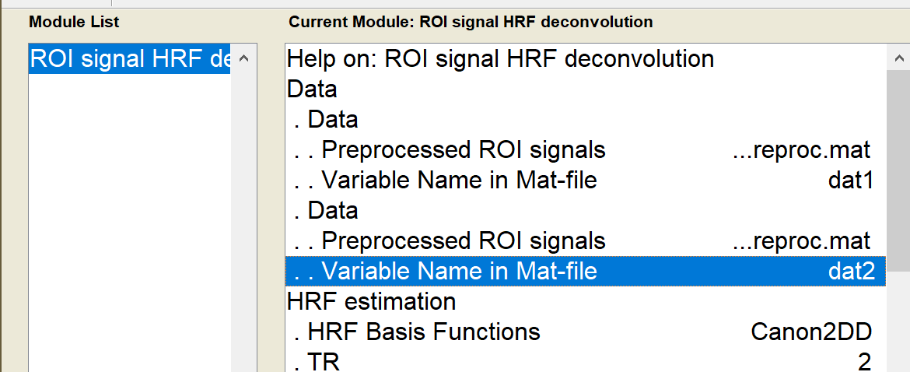
Input = signal.mat/.txt
Demo results ROI-signal rsHRF deconvolution
/rsHRF/demo_jobs/sig_deconv_job2.mat
/rsHRF/demo_jobs/sig_deconv_job2_results.txt
In wgr_rsHRF_global_para.m
para.combine_ROI = 1;
Output 1:
Deconv_combROI_RAW_FILE_NAME.mat
Deconv_combROI_RAW_FILE_NAME_hrf.mat
Deconv_combROI_RAW_FILE_NAME_job.mat
dat1
dat2
Notes:
3. Signal-wise: (default: para.combine_ROI = 1)
sig_deconv_job.mat (input = ONE signal.mat // data (152x271))
sig_deconv_job2.mat (input = TWO signal.mat // dat1 (152x264) + dat2 (152x7)) ← the example that is demonstrated on the slide above
Remark: roinfo is not present in Deconv_RAW_FILE_NAME_job.mat (cf. flag = ‘sig’)

Slide 20
Input = signal.mat/.txt
Demo results ROI-signal rsHRF deconvolution
/rsHRF/demo_jobs/sig_deconv_job2.mat
/rsHRF/demo_jobs/sig_deconv_job2_results2.txt
In wgr_rsHRF_global_para.m
para.combine_ROI = 0;
Output 2:
Deconv_RAW_FILE_NAME_dat1.mat
data, data_deconv, roinfo
Deconv_RAW_FILE_NAME_dat1_hrf.mat
Deconv_RAW_FILE_NAME_dat1_job.mat
Deconv_RAW_FILE_NAME_dat2.mat
Deconv_RAW_FILE_NAME_dat2_hrf.mat
Deconv_RAW_FILE_NAME_dat2_job.mat
Notes:
para.combine_ROI is adaptable in the code (rsHRF.m (line 6) > edit wgr_rsHRF_global_para)

Slide 21
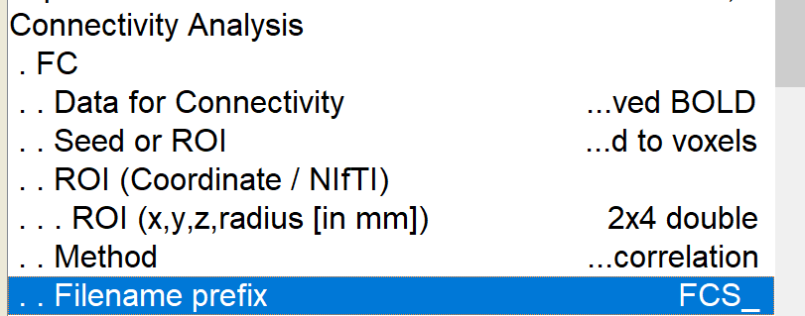
Connectivity analysis:
Demo results Seed to voxels (FC)
/rsHRF/demo_jobs/vox_deconv_seed_FC_GC_smooth_job.mat
/rsHRF/demo_jobs/vox_deconv_seed_FC_GC_smooth_job_results.txt
Spearman correlation:
Deconvolution on smoothed & denoised (outlier removed: Olrm) data, (FC) Spearman correlation between seed (ROI 2) and all other voxels
FCS_2_sRAW_FILE_NAME_deconv_Z_Spearman.nii % Fisher Z Transformation (Spearman r to z)
FCS_2_sRAW_FILE_NAME_deconv_corr_Spearman.nii % Spearman correlation r value (without Olrm)
Notes:
Demo results (Connectivity analysis) are illustrated for both Seed to voxels and ROI to ROI.
Seed to voxels:
vox_deconv_seed_FC_GC_smooth_job.mat (include smoothing) ← the example that is demonstrated on the slide above
vox_deconv_seed_FC_GC_job.mat
Remark: Seed to voxels (whole_brain.nii); cf. open …results.txt
FC: If the user selects deconvolution with outlier removal, then the connectivity analysis will include those data:
with and without deconvolution
with and without Olrm

Slide 22
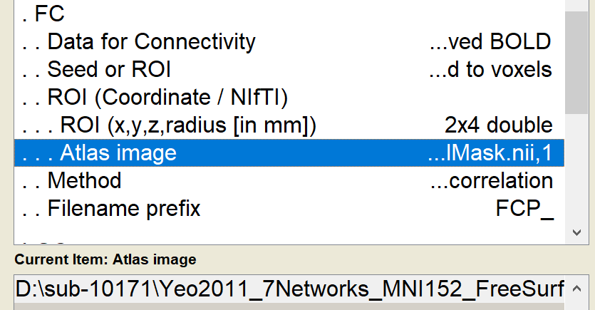
Connectivity analysis:
Demo results Seed to voxels (FC)
/rsHRF/demo_jobs/vox_deconv_seed_FC_GC_smooth_job.mat
/rsHRF/demo_jobs/vox_deconv_seed_FC_GC_smooth_job_results.txt
Pearson correlation:
Deconvolution on smoothed & denoised (outlier removed: Olrm) data, (FC) Pearson correlation between seed (ROI 3) and all other voxels
FCP_3_sRAW_FILE_NAME_Z_Pearson.nii % Fisher Z Transformation (Pearson r to z)
FCP_3_sRAW_FILE_NAME_corr_Pearson.nii % Pearson correlation r value
+
ROI 3: 1st label of Yeo2011_7Net*.nii →
Notes:
The atlas (ROI 3) consists of 7 networks/(sub)ROIs.
22

Slide 23
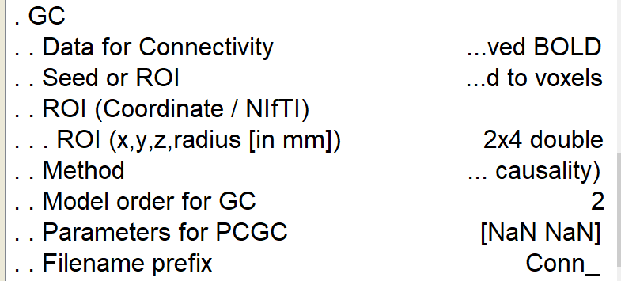
Connectivity analysis:
Demo results Seed to voxels (EC)
/rsHRF/demo_jobs/vox_deconv_seed_FC_GC_smooth_job.mat
/rsHRF/demo_jobs/vox_deconv_seed_FC_GC_smooth_job_results.txt
Granger Causality:
Deconvolution on smoothed & denoised (outlier removed: Olrm) data, Pairwise GC between seed (ROI 2) and all other voxels, model order = 2
Conn_2_sRAW_FILE_NAME_deconv_Olrm_inflow_N_pwGC_order2.nii
Conn_2_sRAW_FILE_NAME_deconv_Olrm_inflow_pval_pwGC_order2.nii
Conn_2_sRAW_FILE_NAME_deconv_Olrm_inflow_pwGC_order2.nii
= Inflow: GC from other voxels to ROI 2
+ Outflow: GC from ROI 2 to other voxels
Notes:
The same results are available for ROI 1.
Remark 1: Seed to voxels (whole_brain.nii); cf. open …results.txt
EC: If the user selects deconvolution with outlier removal, then the connectivity analysis will include those data:
with deconvolution
with and without Olrm
23

Slide 24
Connectivity analysis:
Demo results Seed to voxels (EC)
/rsHRF/demo_jobs/vox_deconv_seed_FC_GC_smooth_job.mat
/rsHRF/demo_jobs/vox_deconv_seed_FC_GC_smooth_job_results.txt
Granger Causality:
Deconvolution on smoothed & denoised (outlier removed: Olrm) data, Pairwise GC between seed (ROI 2) and all other voxels, model order = 2
Conn_2_sRAW_FILE_NAME_deconv_Olrm_inflow_N_pwGC_order2.nii N: GC value c is transformed into N, which is considered to be approximately normal (where n = N-m). If c = 0, m = model order. (Geweke 1982)
Conn_2_sRAW_FILE_NAME_deconv_Olrm_inflow_pval_pwGC_order2.nii _pval_: p-value of GC (F-test)
Conn_2_sRAW_FILE_NAME_deconv_Olrm_inflow_pwGC_order2.nii _pwGC_: pairwise GC
Notes:
24

Slide 25
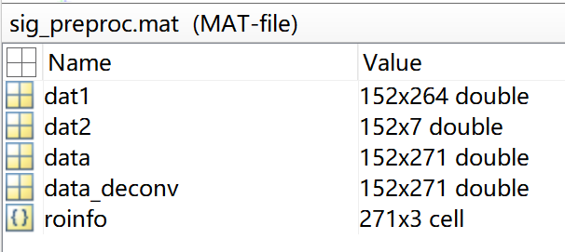
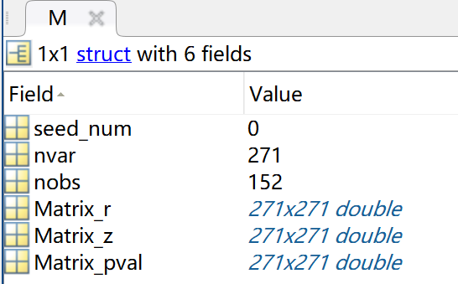
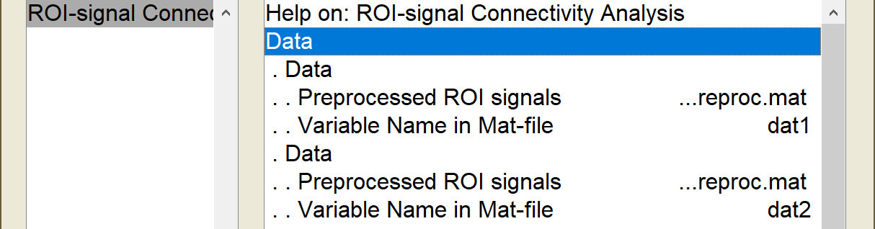
Connectivity analysis:
Demo results ROI to ROI (FC + EC)
/ rsHRF/demo_jobs/sig_FC_GC_job2.mat
/ rsHRF/demo_jobs/sig_FC_GC_job2_results.txt
In wgr_rsHRF_global_para.m
para.combine_ROI = 1;
Signal-wise:
Conn_combROI_RAW_FILE_NAME_Corr_Pearson.mat
Conn_combROI_RAW_FILE_NAME_pwGC.mat
CombROI_RAW_FILE_NAME_conn_job.mat
264+7 = 271
combROI = [dat1 dat2]
Notes:
Remark 1: ROI-to-ROI; NOT whole_brain.nii, so no outlier removal (when deconvolution is selected); cf. open …results.txt.
Remark 2: seed_num is for seed-based analysis, for ROI-to-ROI analysis: seed_num=0.

Slide 26
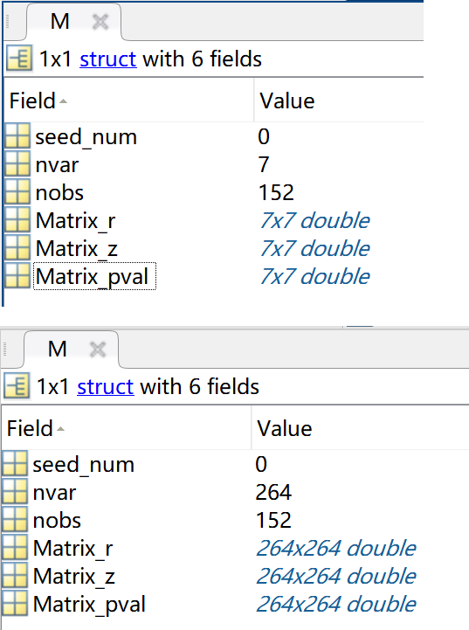
Connectivity analysis:
Demo results ROI to ROI (FC + EC)
/ rsHRF/demo_jobs/sig_FC_GC_job2.mat
/ rsHRF/demo_jobs/sig_FC_GC_job2_results2.txt
In wgr_rsHRF_global_para.m
para.combine_ROI = 0;
Signal-wise:
Conn_RAW_FILE_NAME_dat1_Corr_Pearson.mat
M.Matrix_r: r value, M.Matrix_z: r to z (fisher z)
M.Matrix_pval: p-value (t-test)
Conn_RAW_FILE_NAME_dat1_pwGC.mat
A = M.GC_matrix (GC value) A(x,y) = GC from x to y
M.pval_Matrix: p-value (F-test)
M.GC_Matrix_N: GC value c is transformed into (approximately Normal)
Conn_RAW_FILE_NAME_dat2_Corr_Pearson.mat
Conn_RAW_FILE_NAME_dat2_pwGC.mat

Slide 27
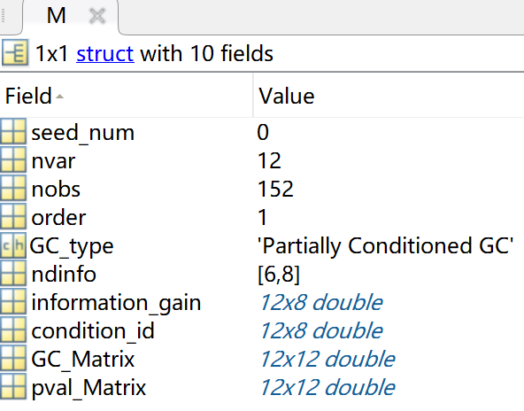
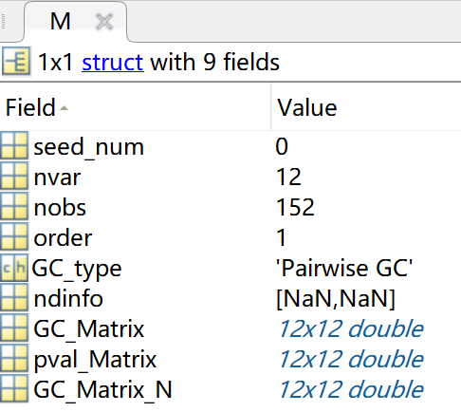
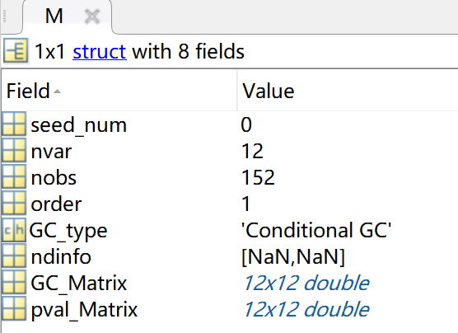
Connectivity analysis:
Demo results ROI to ROI (FC + EC)
/rsHRF/demo_jobs/ROI_deconv_FC_GC_job.mat
/rsHRF/demo_jobs/ROI_deconv_FC_GC_job_results.txt
ROI-wise:
Conn_RAW_FILE_NAME_Corr_Pearson.mat
Conn_RAW_FILE_NAME_PCGC.mat
Conn_RAW_FILE_NAME_deconv_CGC.mat
Conn_RAW_FILE_NAME_deconv_Corr_Spearman.mat
Conn_RAW_FILE_NAME_deconv_PCGC.mat
Conn_RAW_FILE_NAME_deconv_pwGC.mat
Notes:
nvar = number of voxels
nobs = number of time points
27

Slide 28
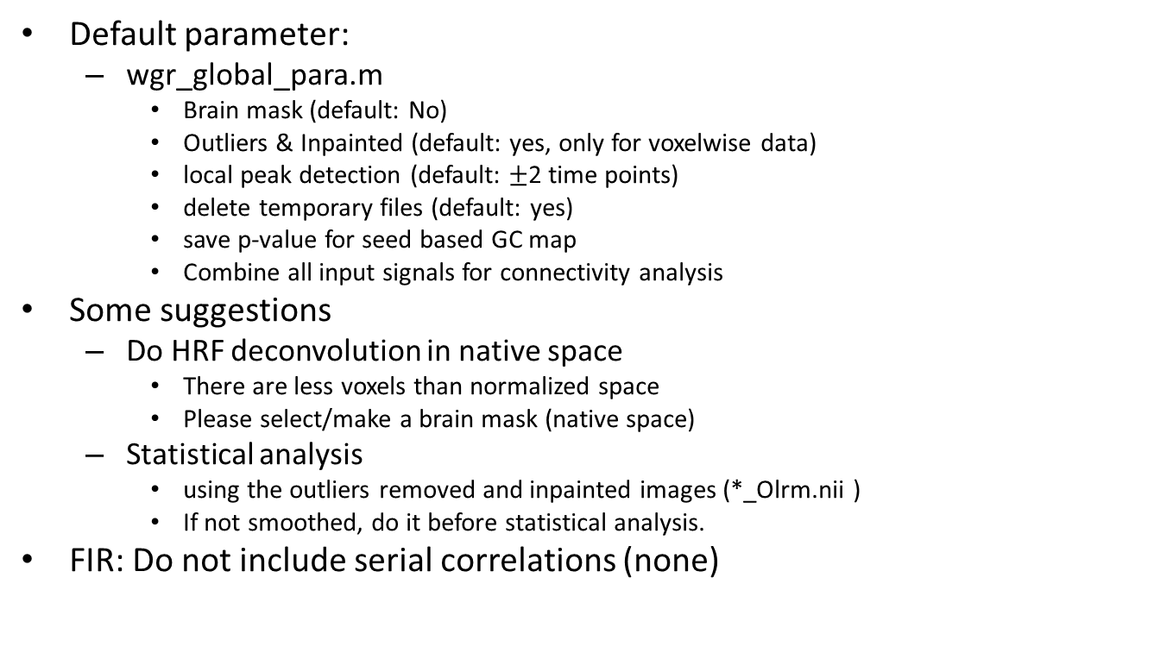
Final Note

