Slide 1
rsHRF toolbox ^{SPM-plugin v2.0}
2019.01.06
Notes:
Connectivity analysis included in v2.0

Slide 2
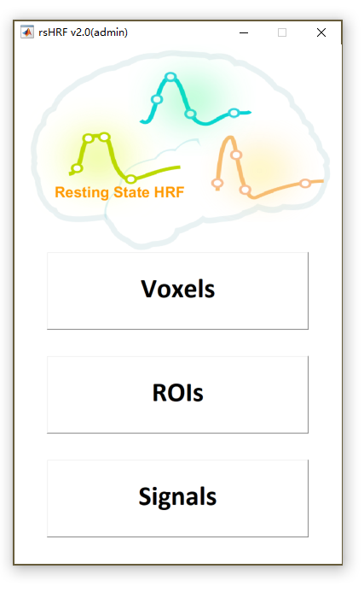
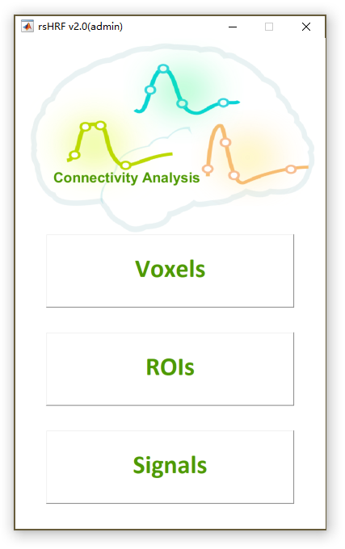
HRF & Connectivity
Resting state HRF deconvolution
Voxelwise
ROIwise
Signals
Connectivity analysis (Seed to Voxels, ROI to ROI)
Correlation
Pearson, Spearman correlation
Granger causality
Pairwise Granger causality(GC), Conditional GC, Partially conditioned GC

Slide 3
Install
Run code in Command Window
>> rsHRF_install_SPM
SPM should be installed
Codes will be copied to ./SPM/toolbox/rsHRF
Or Add it into ./SPM/toolbox/

Slide 4
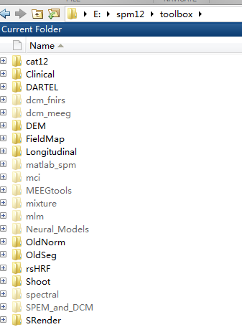
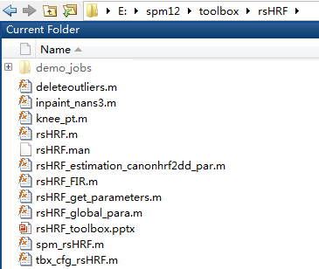
Add it into ./SPM/toolbox/
rsHRF
Notes:
改图片

Slide 5
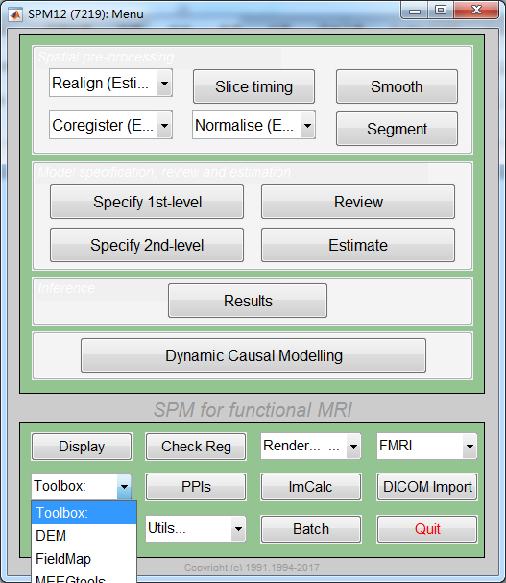
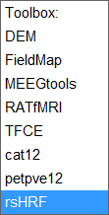
From SPM
Command window: >> spm fmri
From toolbox
Click rsHRF
Or >> rsHRF

Slide 6
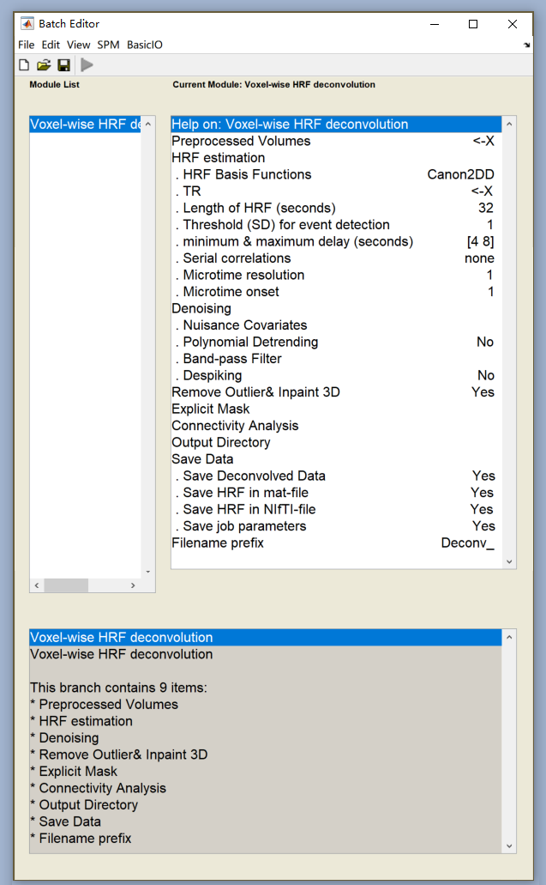
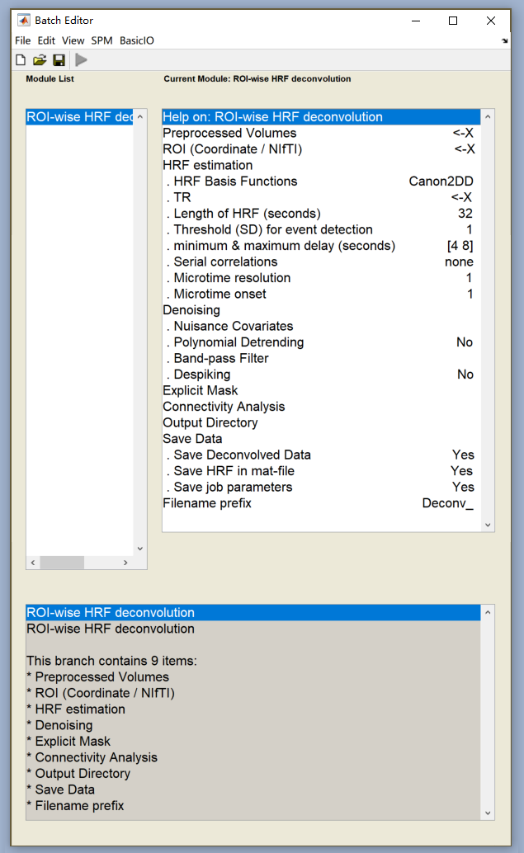
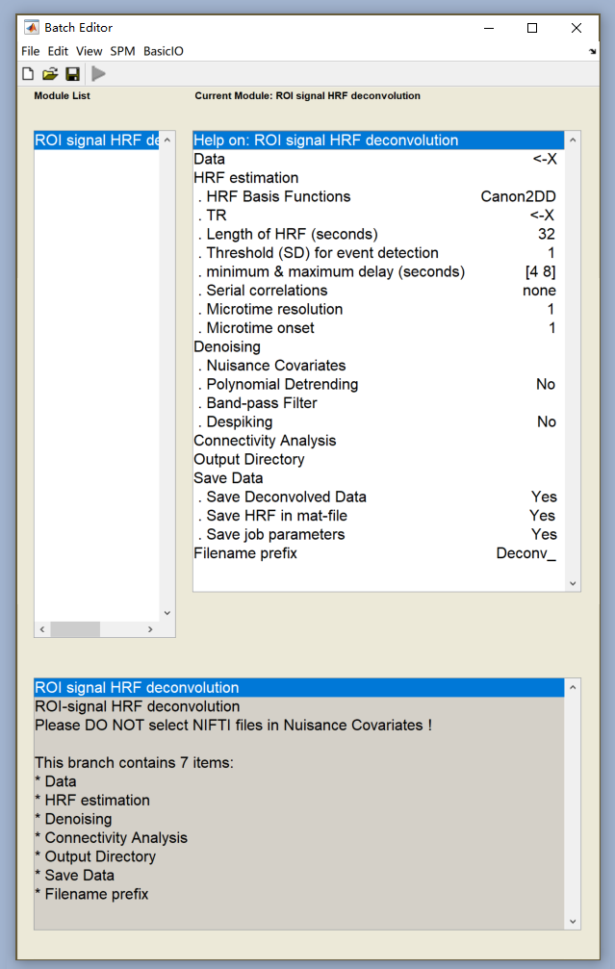
rsHRF deconvolution
Voxels / ROIs /Signals

Slide 7
Connectivity Analysis
Command window:
>> rsHRF conn
Or
>> rsHRF(‘conn’)

Slide 8
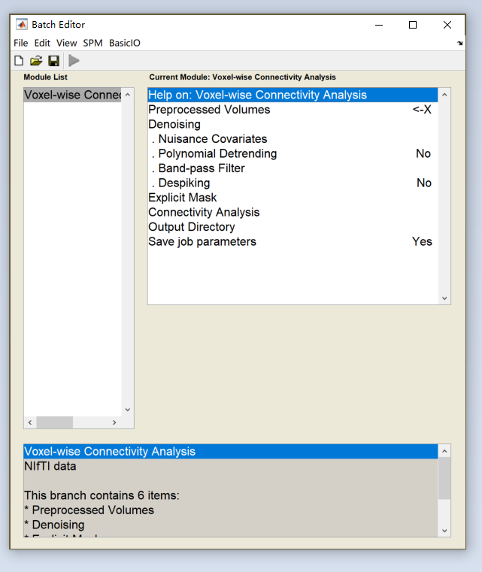
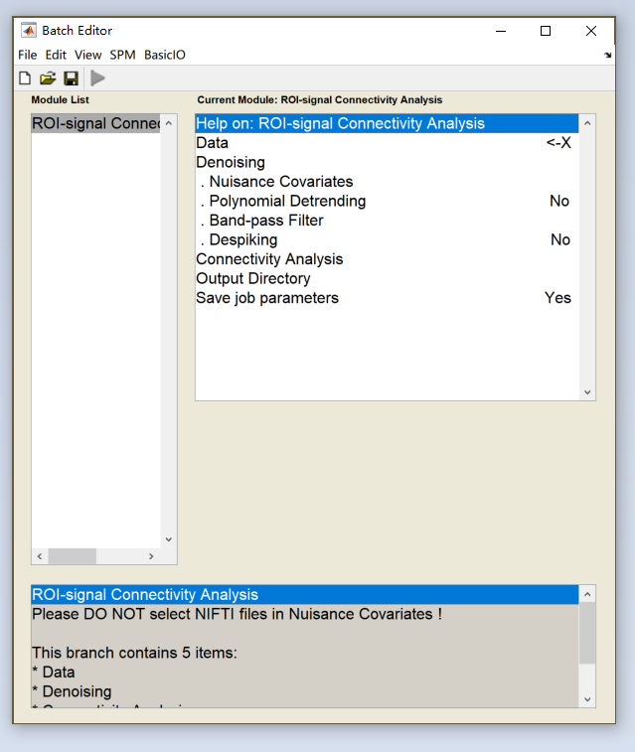
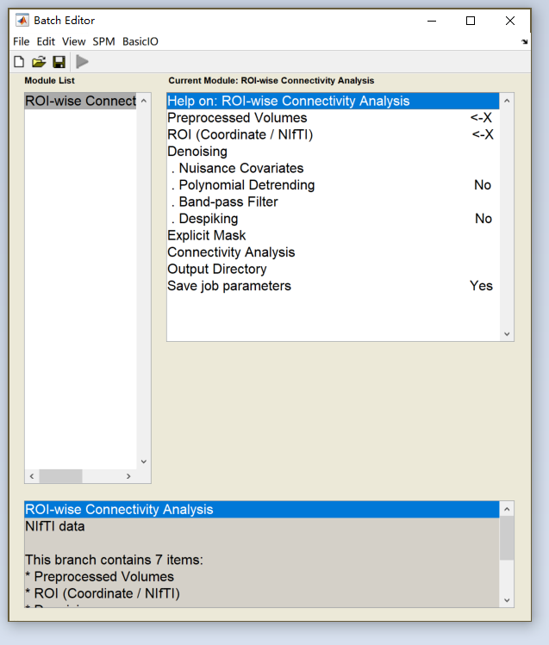
Connectivity analysis
Voxels / ROIs /Signals

Slide 9
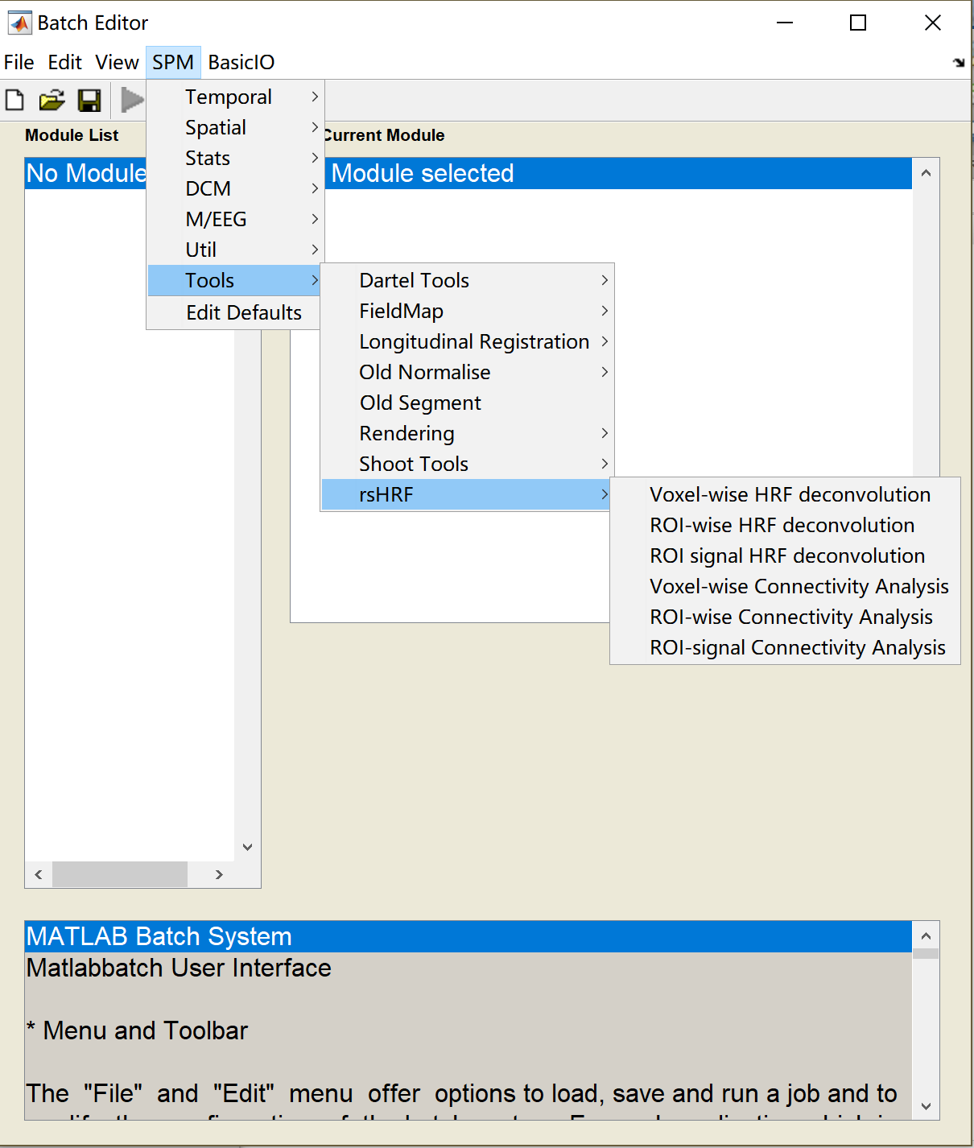
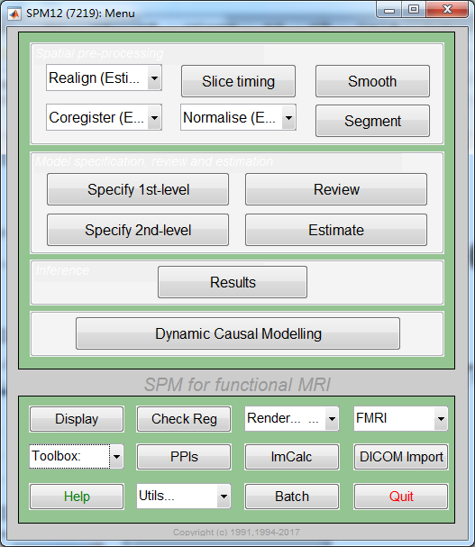
Batch
From batch
Notes:
改

Slide 10
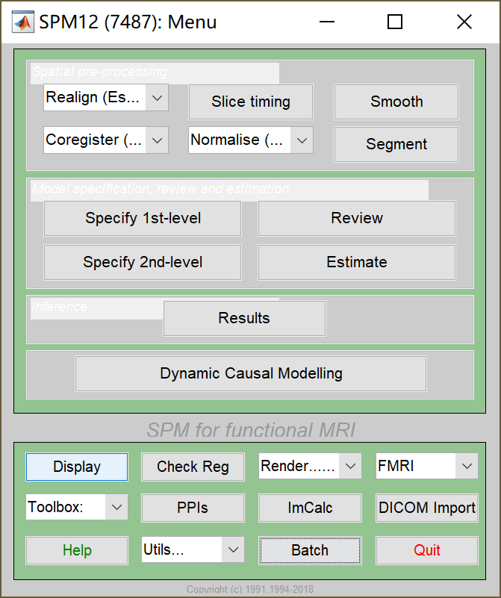
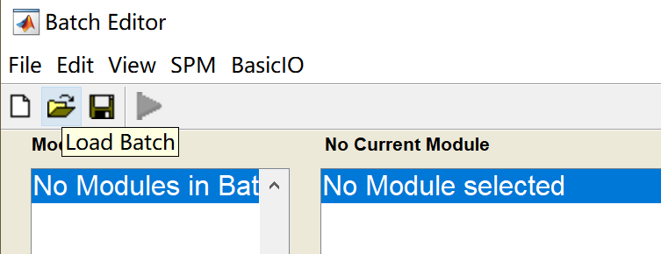
Demo jobs
Load from batch editor

Slide 11
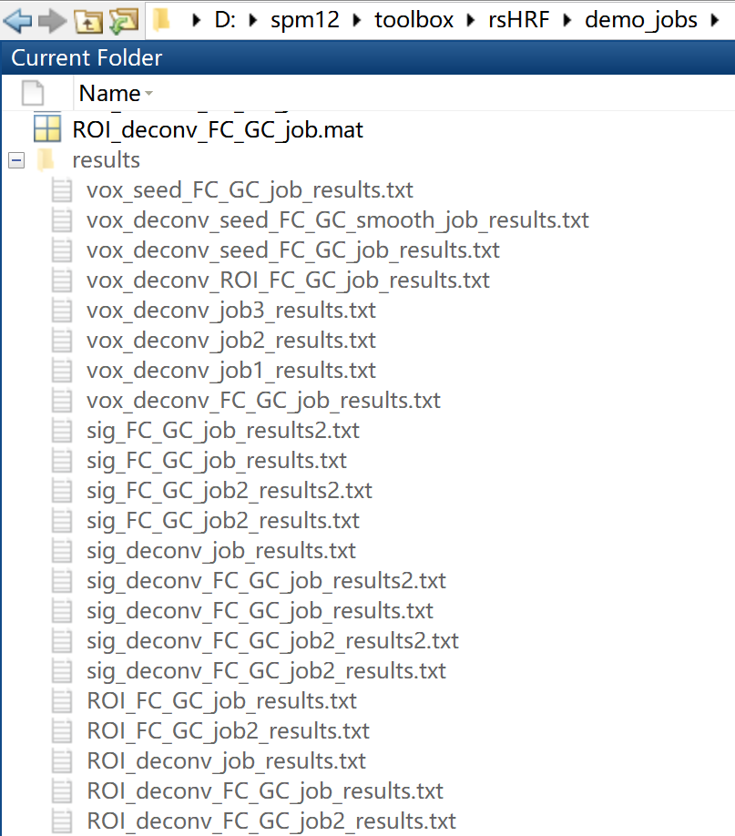
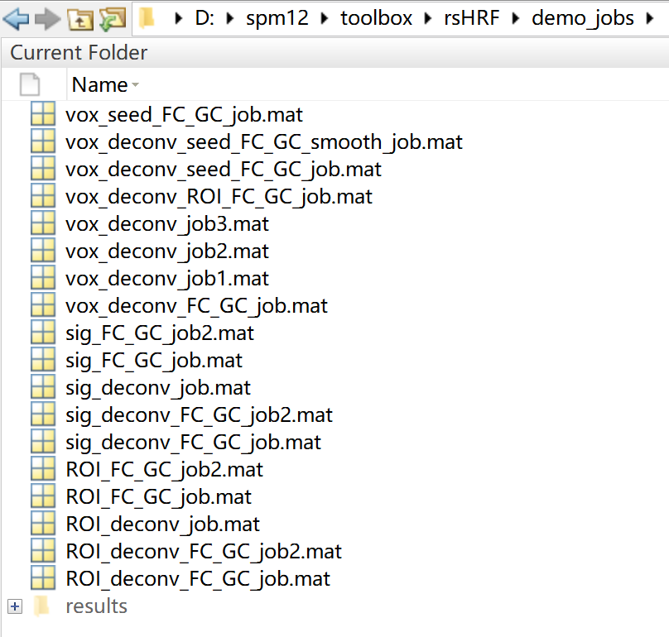
Demo jobs and result files
Jobs ^{(Voxels / ROIs /Signals )}
*deconv*: deconvolution
FC_GC: Connectivity
result files

Slide 12
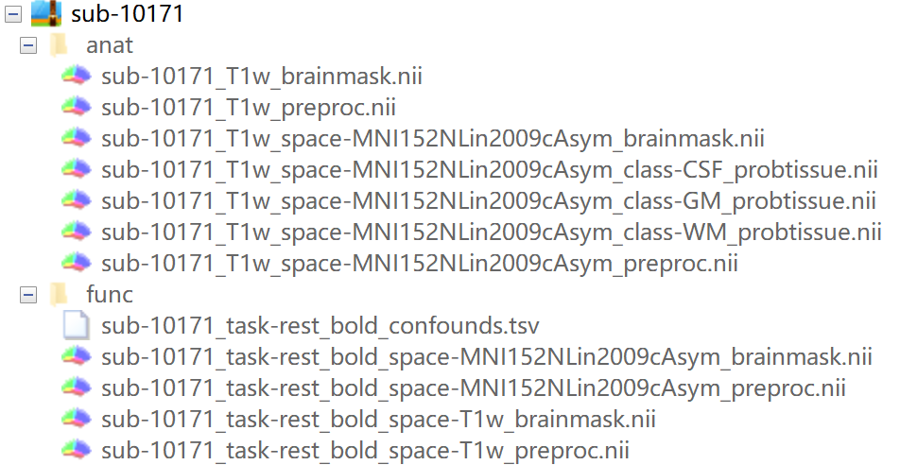
Demo data (1 subject)
UCLA Consortium for Neuropsychiatric Phenomics LA5c Study
Download from https://openneuro.org/datasets/ds000030
Preprocessed by FMRIPREP
RAW_FILE_NAME.nii

Slide 13
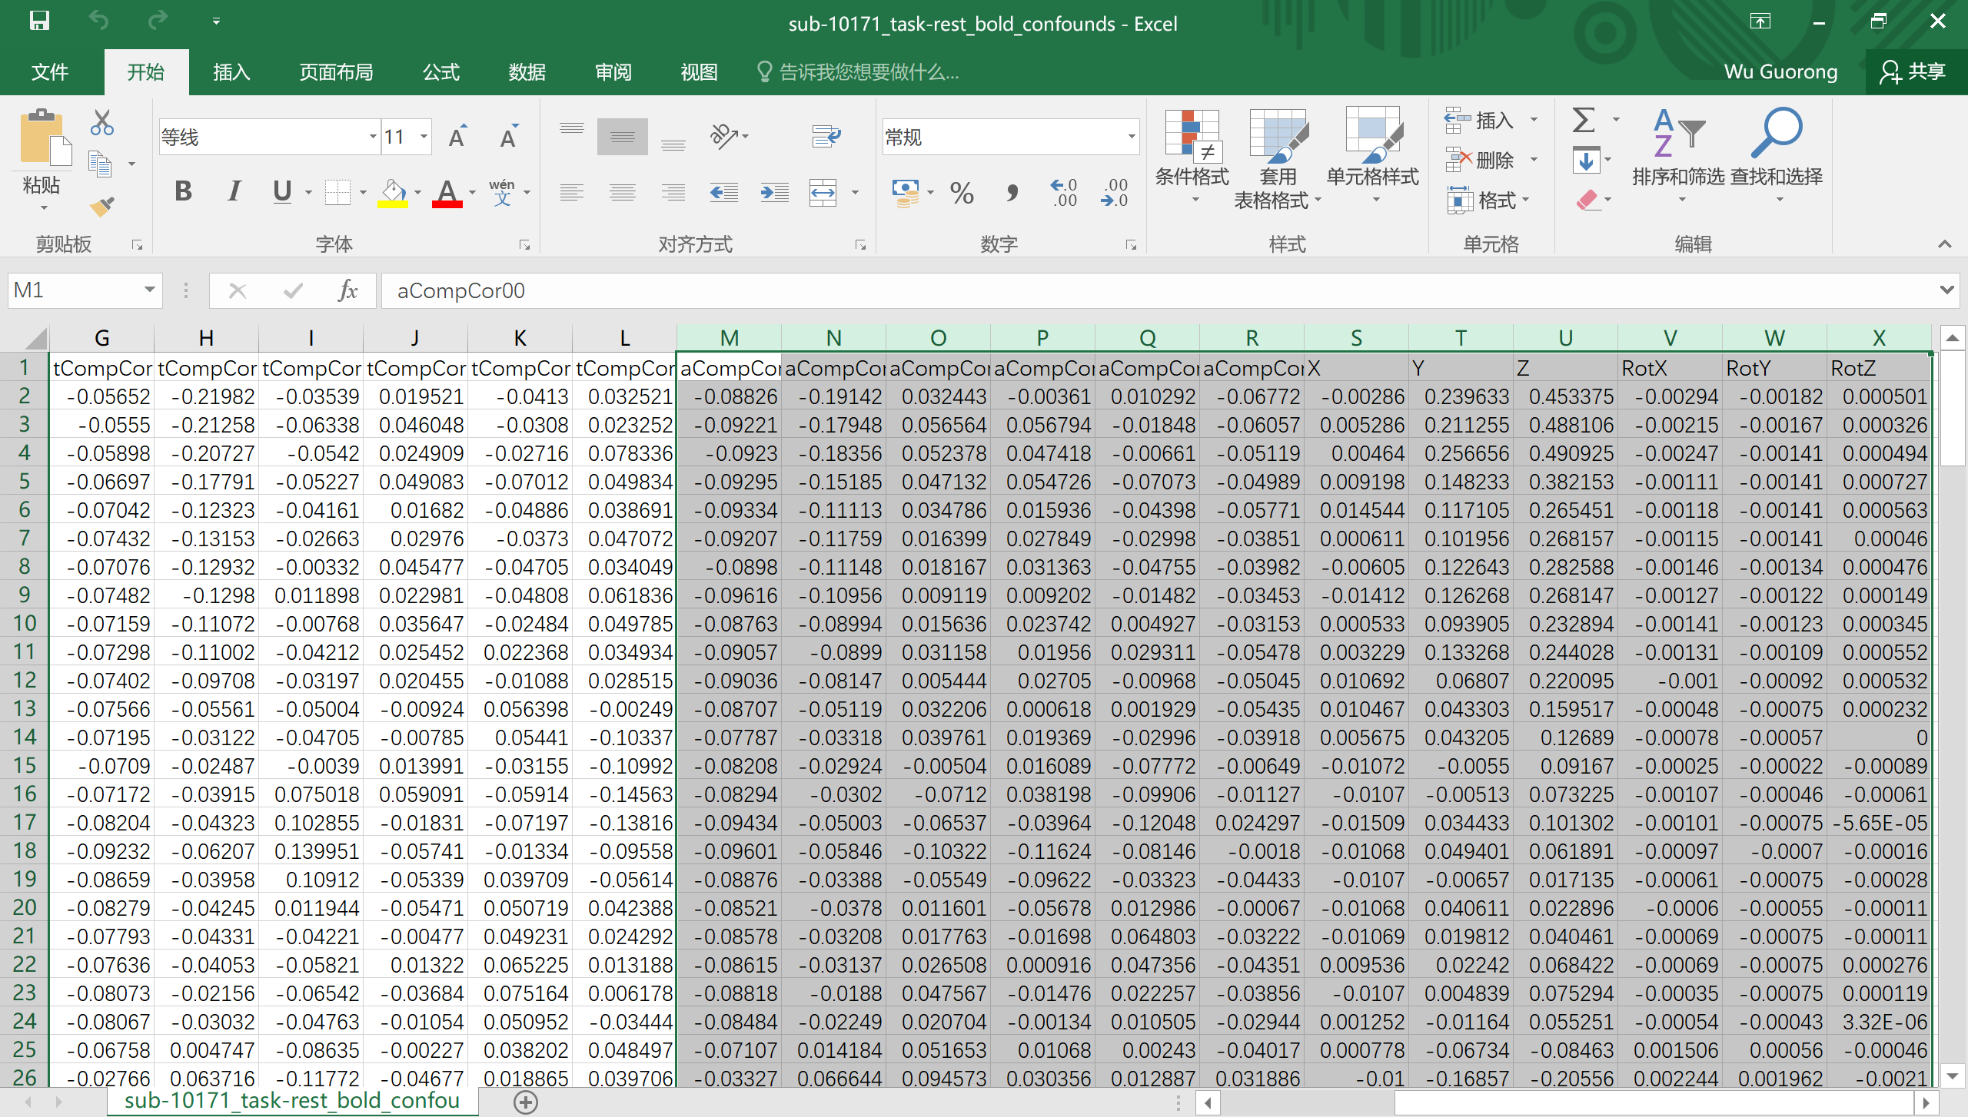
Nuisance variables
sub-10171_task-rest_bold_confounds.tsv
cd D:\sub-10171\func
dat = importdata('sub-10171_task-rest_bold_confounds.tsv');
varname = dat.textdata(1,end-11:end)
nuisance = dat.data(:,end-11:end);
save('nuisance.txt','nuisance','-ascii')
rp = dat.data(:,end-5:end);
save('rp.txt','rp','-ascii')
aCompCor = dat.data(:,end-11:end-5);
save('aCmopcor.txt','aCompCor','-ascii')

Slide 14
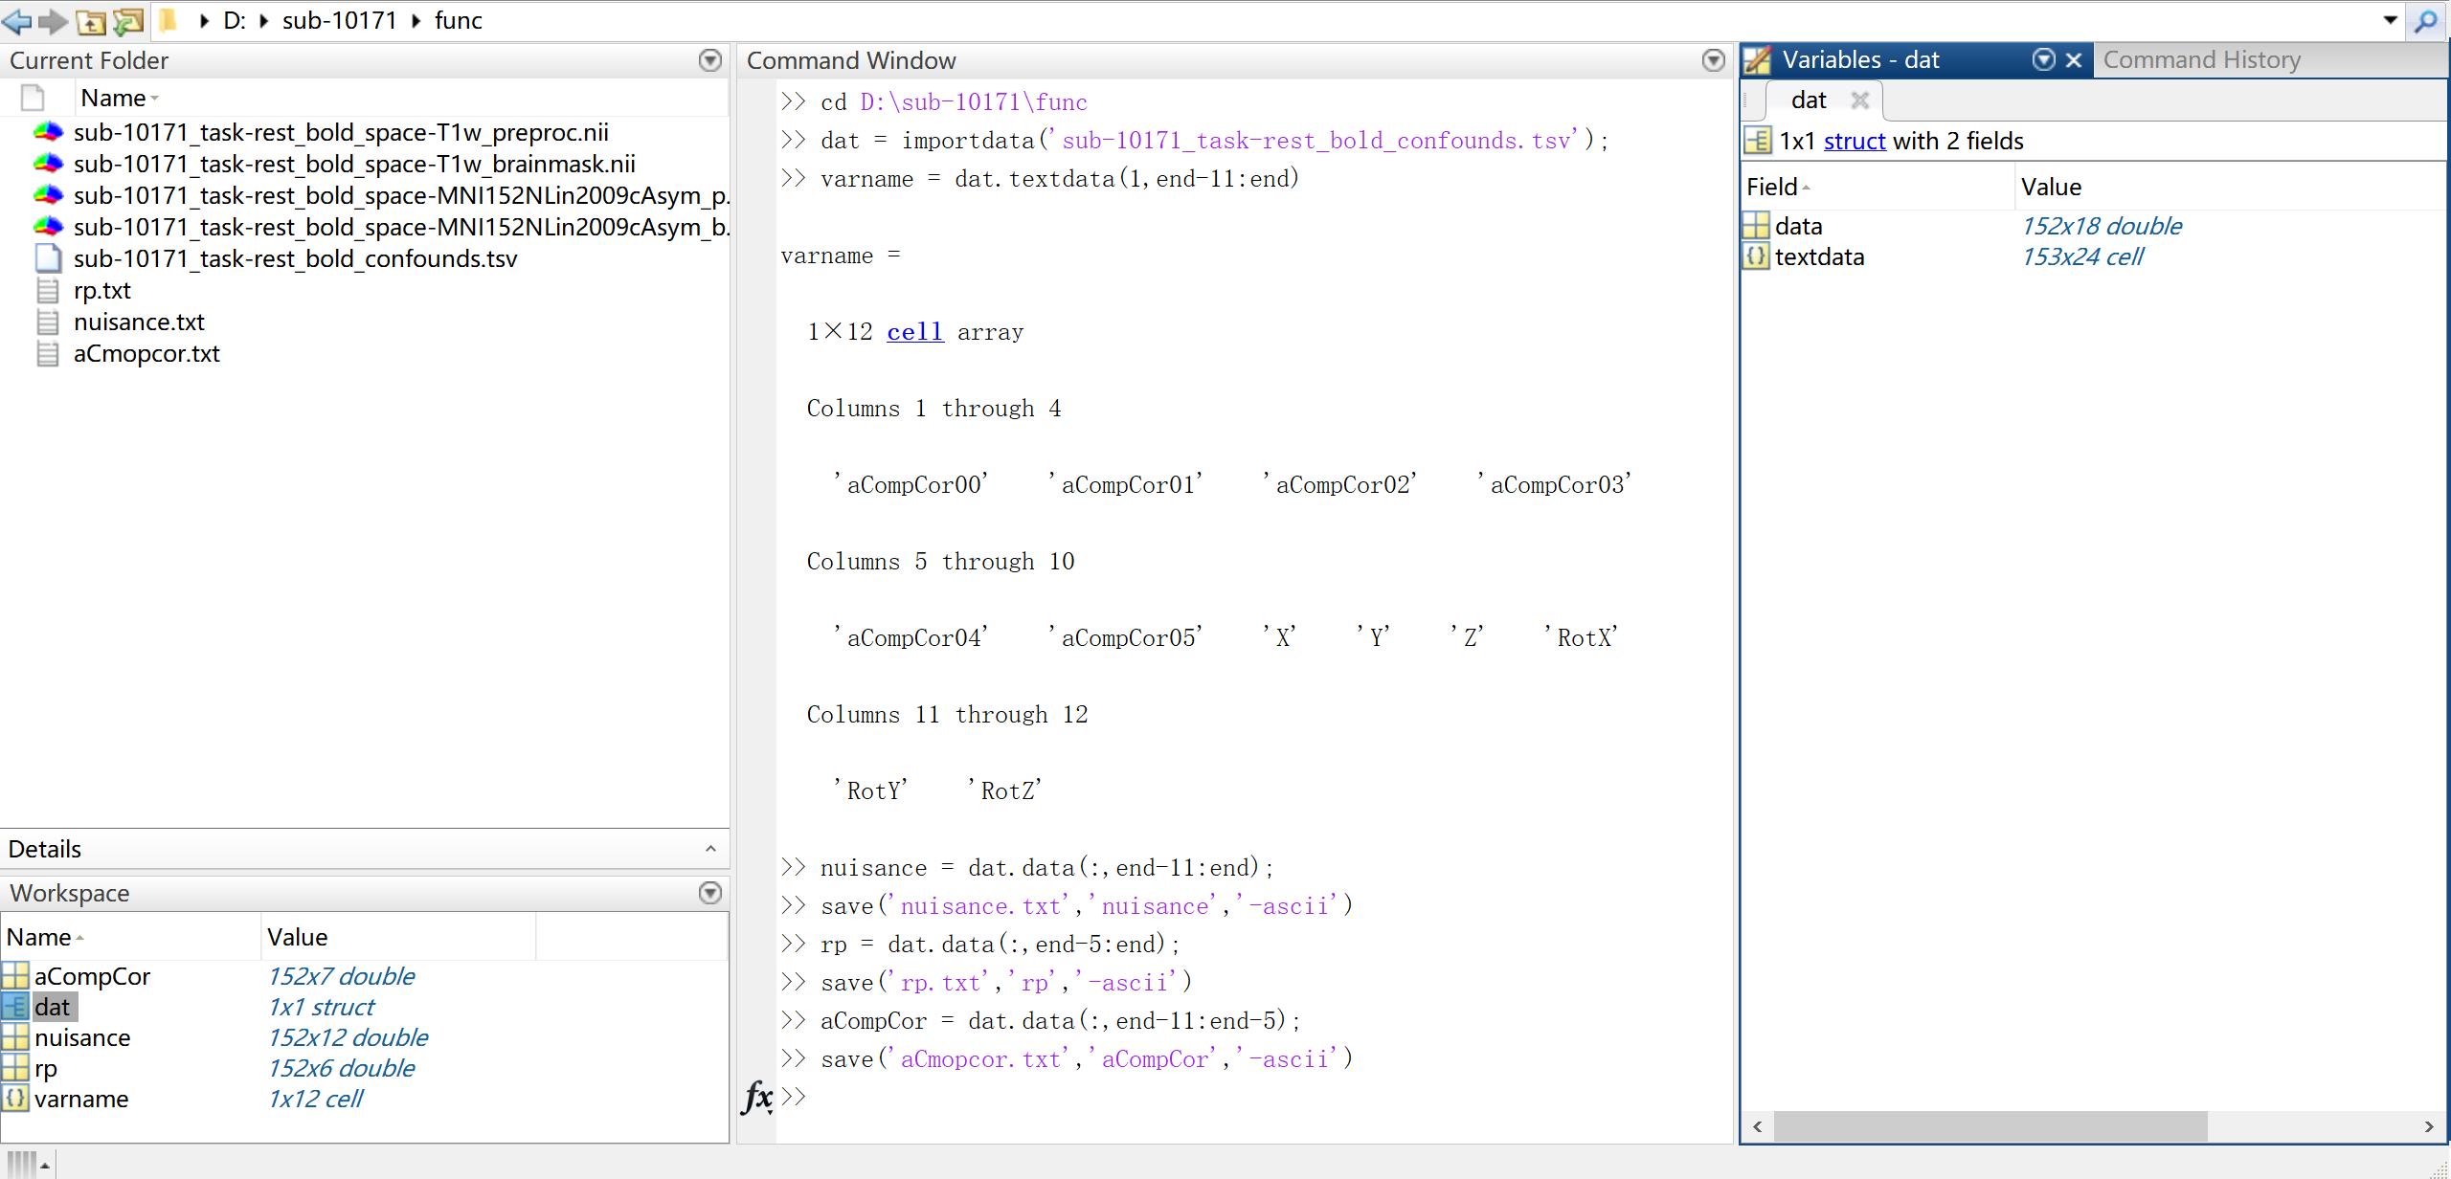
save nuisance variables

Slide 15
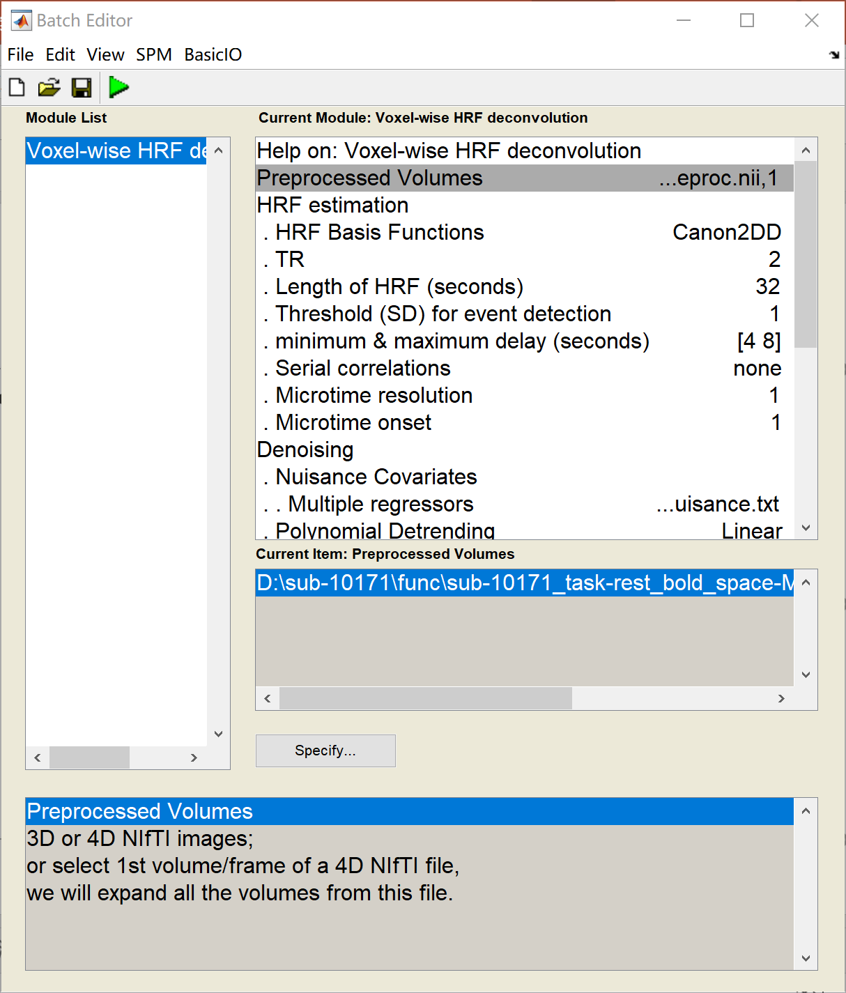
Voxelwise Deconvolution
Load batch
/toolbox/rsHRF/demo_jobs/vox_deconv_job1.mat
Change files/parameters
e.g.:
Preprocessed volumes
Multiple regressors
Explicit Mask
Output directory

Slide 16
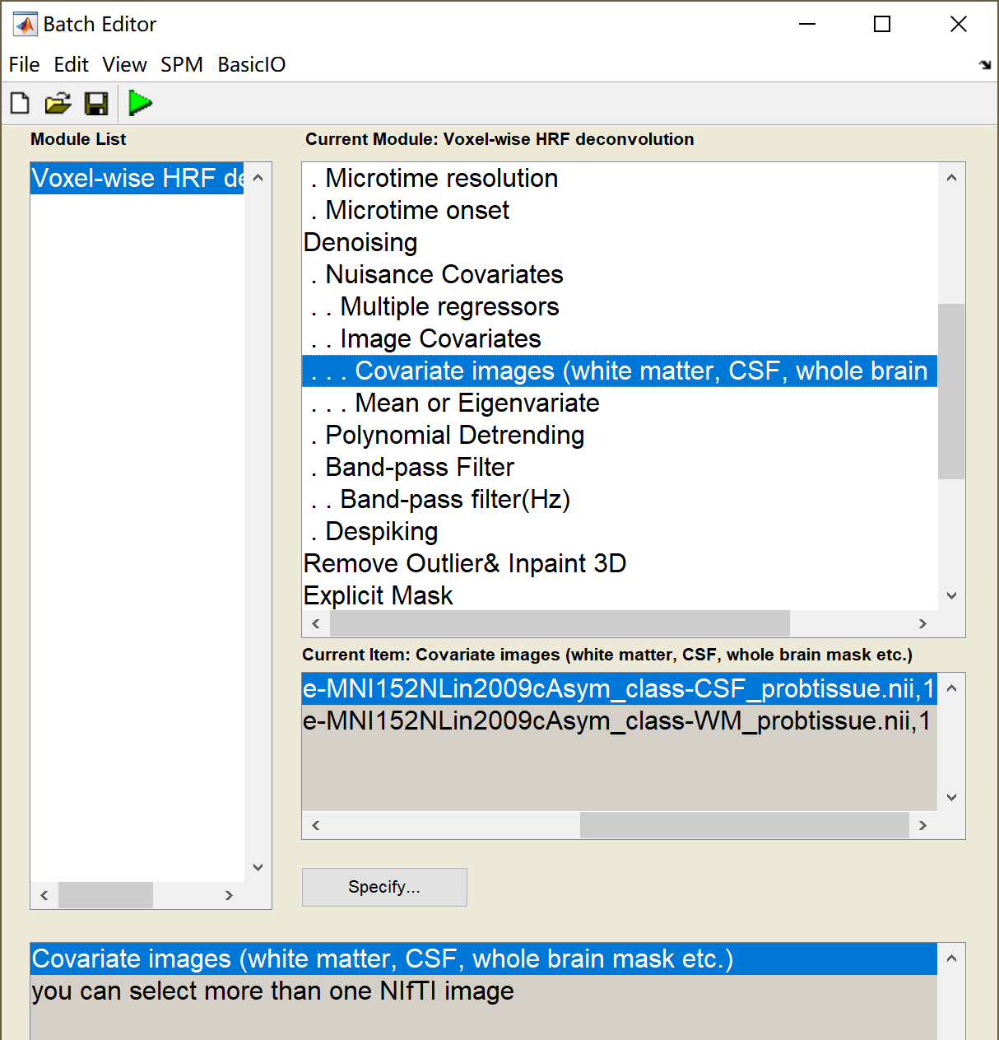
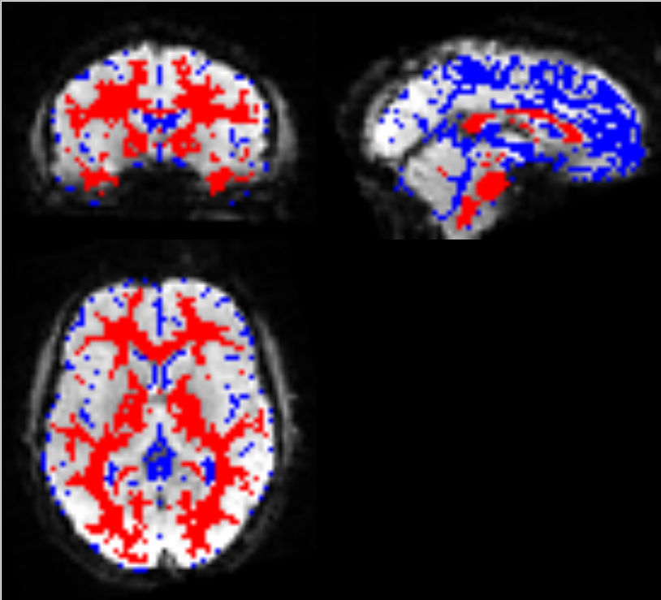
Image covariates
The covariate images and BOLD-fMRI data should be coregistered)
We only select voxels with value >0.9 in covariate images for nuisance regression.
vox_deconv_job2.mat

Slide 17
Voxelwise Deconvolution results
/rsHRF/demo_jobs/vox_deconv_job1.mat
Deconv_RAW_FILE_NAME.nii % HRF deconvolved data
Deconv_RAW_FILE_NAME_FWHM.nii % HRF parameter FWHM/width
Deconv_RAW_FILE_NAME_Height.nii % HRF parameter response height
Deconv_RAW_FILE_NAME_Time2peak.nii % HRF parameter time to peak
Deconv_RAW_FILE_NAME_event_number.nii % estimated BOLD event number
%% remove outlier and Inpainted (Olrm)
Deconv_RAW_FILE_NAME_Olrm.nii % HRF deconvolved data
Deconv_RAW_FILE_NAME_Olrm_FWHM.nii % HRF parameter width
Deconv_RAW_FILE_NAME_Olrm_Height.nii % HRF parameter response height
Deconv_RAW_FILE_NAME_Olrm_Time2peak.nii% HRF parameter time to peak
Deconv_RAW_FILE_NAME_Olrm_event_number.nii
Deconv_RAW_FILE_NAME_hrf.mat % HRF and HRF parameters
Deconv_RAW_FILE_NAME_job.mat % analysis/model parameters
Deconv_RAW_FILE_NAME_outlier_NAN.nii % detected outlier (value=1)
RAW_FILE_NAME = sub-10171_task-rest_bold_space-MNI152NLin2009cAsym_preproc
/rsHRF/demo_jobs/vox_deconv_job1_results.txt

Slide 18
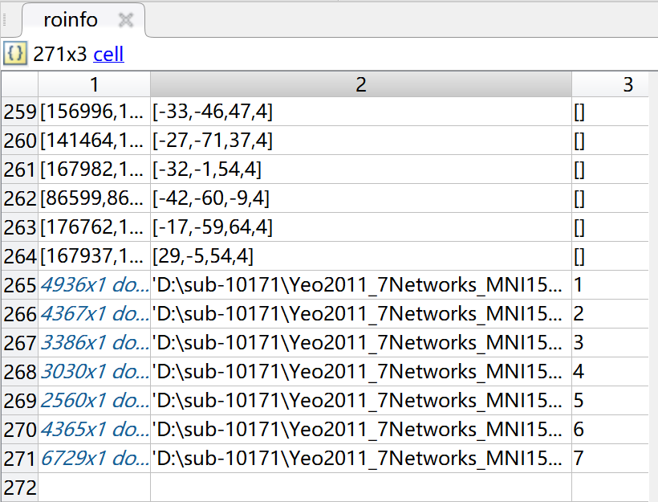
ROIwise Deconvolution results
/rsHRF/demo_jobs/ROI_deconv_job1.mat
Output:
Deconv_RAW_FILE_NAME.mat
data, data_deconv, roinfo
Deconv_RAW_FILE_NAME_hrf.mat
Deconv_RAW_FILE_NAME_job.mat
data: Denoised data (used for HRF deconvolution)
data_deconv: HRF deconvolved data
roinfo (3 column)
1st column: voxels id in 3D volume
2nd column: ROI coordinate/File name
3rd column: label value (label in atlas image)
/rsHRF/demo_jobs/ROI_deconv_job_results.txt

Slide 19
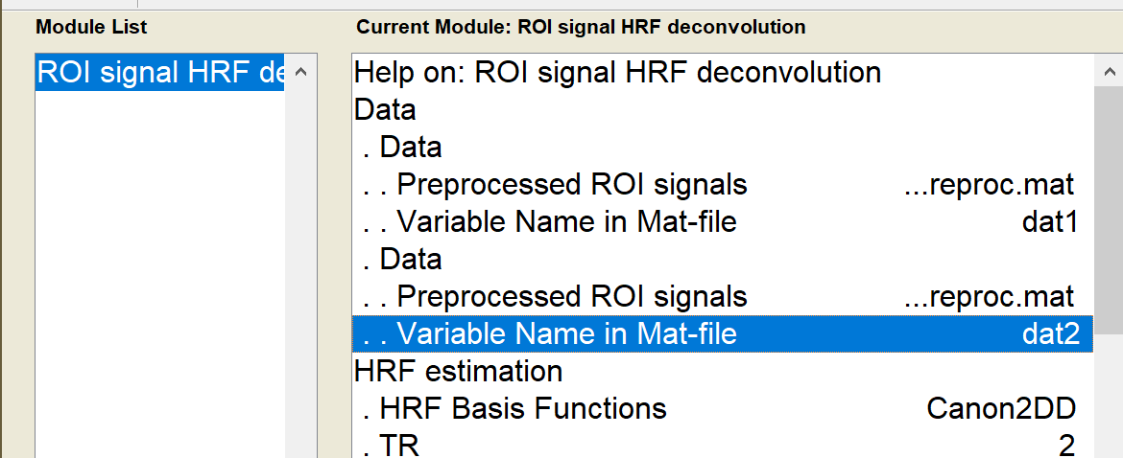
Signals Deconvolution results
/rsHRF/demo_jobs/sig_deconv_job2.mat
Output:
Deconv_combROI_RAW_FILE_NAME.mat
Deconv_combROI_RAW_FILE_NAME.mat
Deconv_combROI_RAW_FILE_NAME.mat
In wgr_rsHRF_global_para.m
para.combine_ROI = 1;
dat1
dat2
/rsHRF/demo_jobs/sig_deconv_job2_results.txt

Slide 20
Signals Deconvolution results
/rsHRF/demo_jobs/sig_deconv_job2.mat
Output
Deconv_RAW_FILE_NAME_dat1.mat
data, data_deconv, roinfo
Deconv_RAW_FILE_NAME_dat1_hrf.mat
Deconv_RAW_FILE_NAME_dat1_job.mat
Deconv_RAW_FILE_NAME_dat2.mat
Deconv_RAW_FILE_NAME_dat2_hrf.mat
Deconv_RAW_FILE_NAME_dat2_job.mat
In wgr_rsHRF_global_para.m
para.combine_ROI = 0;
/rsHRF/demo_jobs/sig_deconv_job2_results2.txt

Slide 21
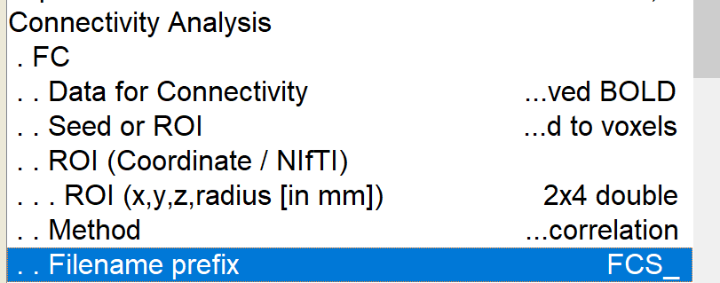
Connectivity output
/rsHRF/demo_jobs/vox_deconv_seed_FC_GC_smooth_job.mat
Seed to voxels maps:
Deconvolution on smoothed & denoised (outlier removed: Olrm) data, (FC) Spearman correlation between seed (ROI 2) and all other voxels
FCS_2_sRAW_FILE_NAME_deconv_Olrm_Z_Spearman.nii % Fisher Z Transformation (Spearman r to z)
FCS_2_sRAW_FILE_NAME_deconv_corr_Spearman.nii % Spearman correlation r value (without OLrm)
/rsHRF/demo_jobs/vox_deconv_seed_FC_GC_smooth_job_results.txt

Slide 22
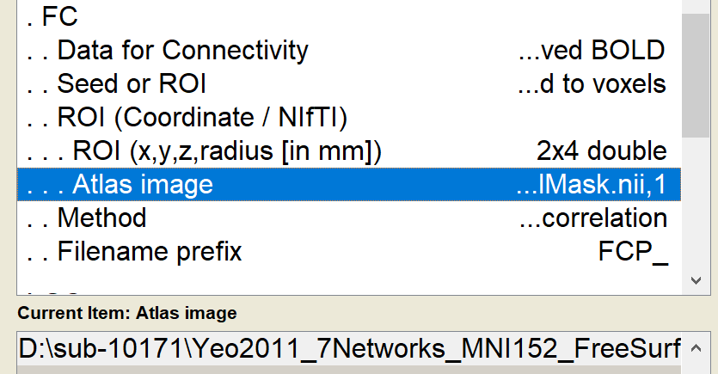
Connectivity output
/rsHRF/demo_jobs/vox_deconv_seed_FC_GC_smooth_job.mat
Seed to voxels maps:
smoothed & denoised data, (FC) Pearson correlation between seed (ROI 3) and all other voxels
FCP_3_sRAW_FILE_NAME_Z_Pearson.nii
% Fisher Z Transformation (Pearson r to z)
FCP_3_sRAW_FILE_NAME_corr_Pearson.nii
% Pearson correlation r value
ROI 3: 1st label of Yeo2011_7Net*.nii →
/rsHRF/demo_jobs/vox_deconv_seed_FC_GC_smooth_job_results.txt

Slide 23
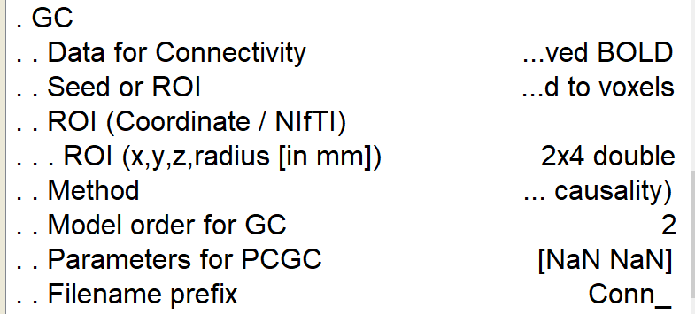
Connectivity output
/rsHRF/demo_jobs/vox_deconv_seed_FC_GC_smooth_job.mat
Seed to voxels maps:
Deconvolution on smoothed & denoised and outlier removed(Olrm) data, Pairwise GC between seed (ROI 1) and all other voxels, model order = 2
Conn_1_sRAW_FILE_NAME_deconv_Olrm_inflow_N_pwGC_order2.nii
Conn_1_sRAW_FILE_NAME_deconv_Olrm_inflow_pval_pwGC_order2.nii
Conn_1_sRAW_FILE_NAME_deconv_Olrm_inflow_pwGC_order2.nii
Inflow: GC from other voxels to ROI 1
Outflow: GC from ROI 1 to other voxels
/rsHRF/demo_jobs/vox_deconv_seed_FC_GC_smooth_job_results.txt

Slide 24
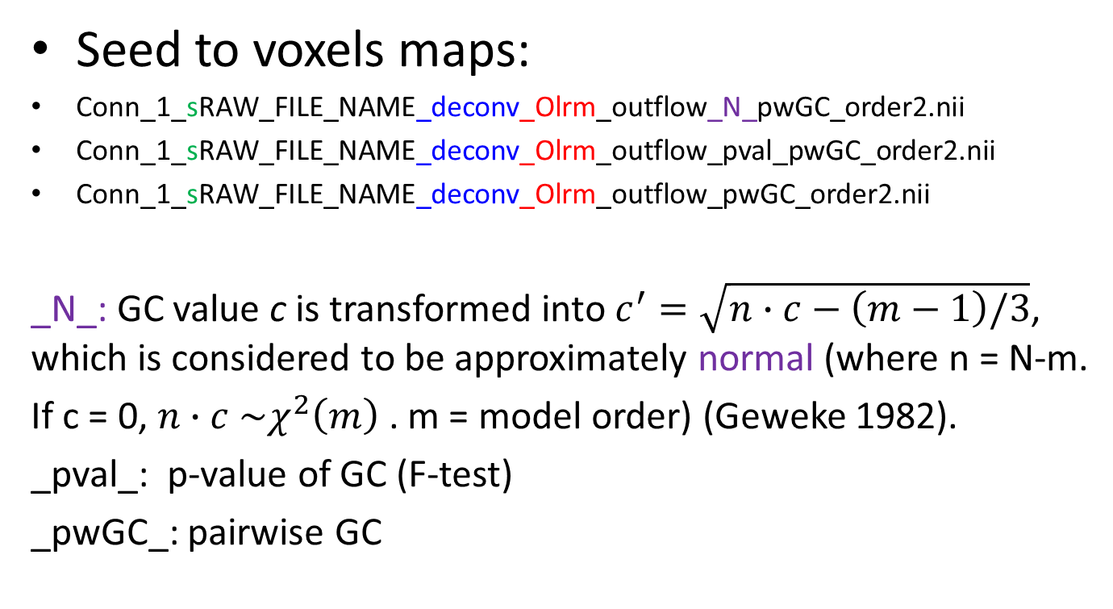
Connectivity output
/rsHRF/demo_jobs/vox_deconv_seed_FC_GC_smooth_job.mat
Seed to voxels maps:
Conn_1_sRAW_FILE_NAME_deconv_Olrm_outflow_N_pwGC_order2.nii
Conn_1_sRAW_FILE_NAME_deconv_Olrm_outflow_pval_pwGC_order2.nii
Conn_1_sRAW_FILE_NAME_deconv_Olrm_outflow_pwGC_order2.nii
_N_: GC value c is transformed into $c^{′}=\sqrt{n∙c−\left(m−1\right)/3}$, which is considered to be approximately normal (where n = N-m.
If c = 0, $n∙c \sim χ^{2}\left(m\right)$. m = model order) (Geweke 1982).
_pval_: p-value of GC (F-test)
_pwGC_: pairwise GC
/rsHRF/demo_jobs/vox_deconv_seed_FC_GC_smooth_job_results.txt

Slide 25
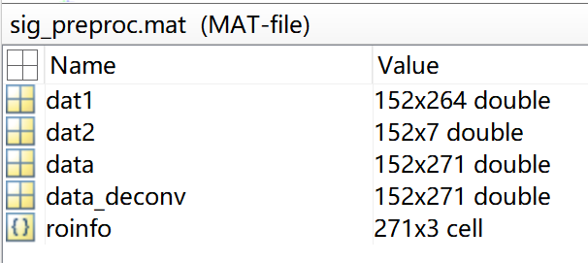
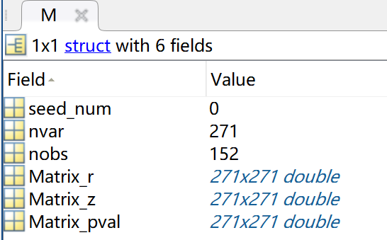
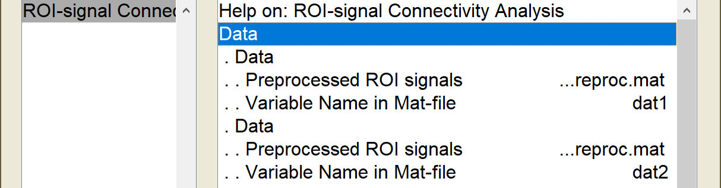
Connectivity output
/rsHRF/demo_jobs/sig_FC_GC_job2.mat
ROI to ROI:
Conn_combROI_RAW_FILE_NAME_Corr_Pearson.mat
Conn_combROI_RAW_FILE_NAME_pwGC.mat
combROI_RAW_FILE_NAME_conn_job.mat
In wgr_rsHRF_global_para.m
para.combine_ROI = 1;
combROI =[dat1 dat2]
271=264+7
/rsHRF/demo_jobs/sig_FC_GC_job2_results.txt

Slide 26
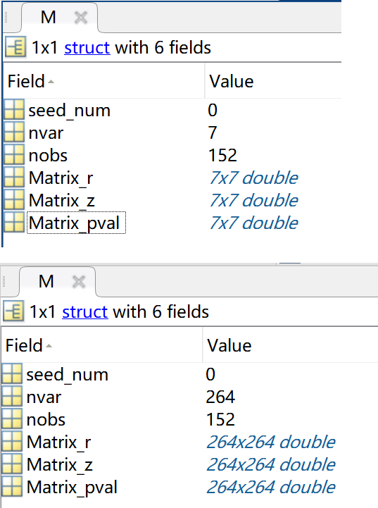

Connectivity output
/rsHRF/demo_jobs/sig_FC_GC_job2.mat
ROI to ROI:
Conn_RAW_FILE_NAME_dat1_Corr_Pearson.mat
M.Matrix_r— r value, M.Matrix_z: r to z (fisher z)
M.Matrix_pval— p-value (t-test)
Conn_RAW_FILE_NAME_dat1_pwGC.mat
A = M.GC_matrix – GC value , A(x,y): GC from x to y
M.pval_Matrix— p-value (F-test),
M.GC_Matrix_N— GC value c is transformed into $c^{′}$ (approximately Normal)
Conn_RAW_FILE_NAME_dat2_Corr_Pearson.mat
Conn_RAW_FILE_NAME_dat2_pwGC.mat
In wgr_rsHRF_global_para.m
para.combine_ROI = 0;
/rsHRF/demo_jobs/sig_FC_GC_job2_results2.txt

Slide 27
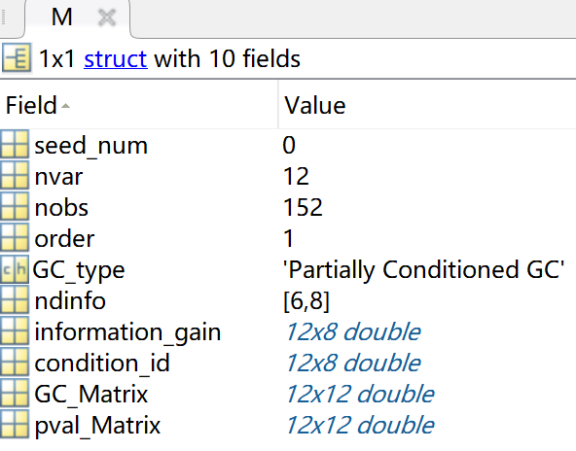
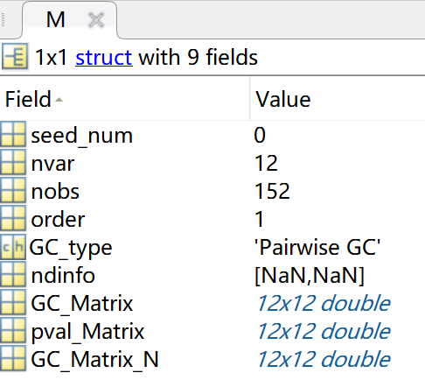
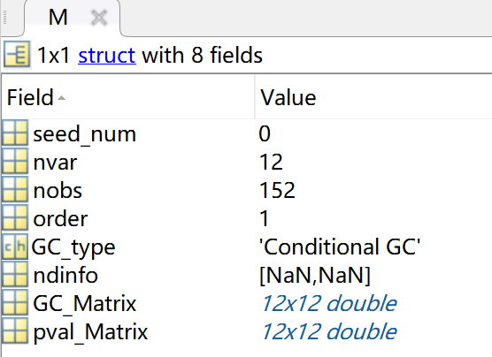
Connectivity output
/rsHRF/demo_jobs/ROI_deconv_FC_GC_job.mat
ROI to ROI:
Conn_RAW_FILE_NAME_Corr_Pearson.mat
Conn_RAW_FILE_NAME_PCGC.mat
Conn_RAW_FILE_NAME_deconv_CGC.mat
Conn_RAW_FILE_NAME_deconv_Corr_Spearman.mat
Conn_RAW_FILE_NAME_deconv_PCGC.mat
Conn_RAW_FILE_NAME_deconv_pwGC.mat
/rsHRF/demo_jobs/ROI_deconv_FC_GC_job_results.txt

Slide 28
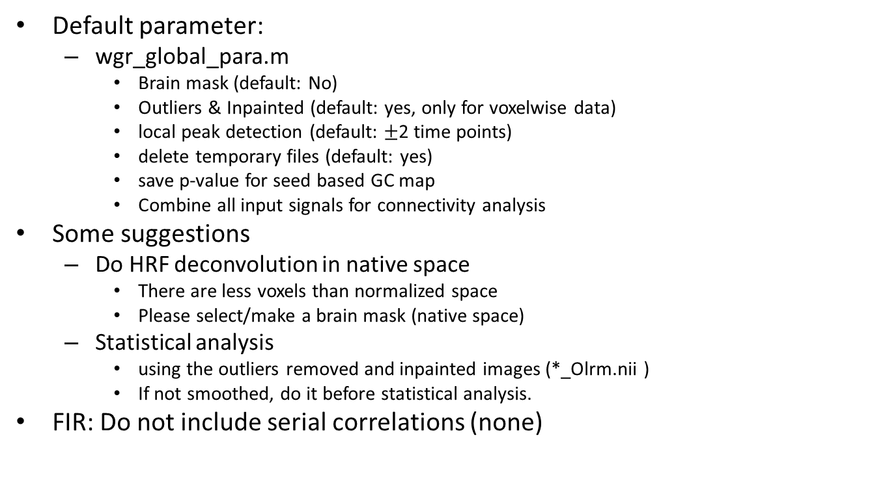
Note
Default parameter:
wgr_global_para.m
Brain mask (default: No)
Outliers & Inpainted (default: yes, only for voxelwise data)
local peak detection (default: $±$2 time points)
delete temporary files (default: yes)
save p-value for seed based GC map
Combine all input signals for connectivity analysis
Some suggestions
Do HRF deconvolution in native space
There are less voxels than normalized space
Please select/make a brain mask (native space)
Statistical analysis
using the outliers removed and inpainted images (*_Olrm.nii )
If not smoothed, do it before statistical analysis.
FIR: Do not include serial correlations (none)

