Slide 1
The Spreading of Influenza
with Worldwide Masks Required
Team 05
Instructor: Mr. John Weible
Team Member:
Enshi Wang (enw12) 664221142
Cheng-Chen Yang (ccy3) 657920840
Vivian Liao (yhliao4) 661311697
学而不思则罔 思而不学则殆

Slide 2
Contents
Research Methods
Hypothesis
02
04
03
05
01
Research Background
Data Source
Conclusion

Slide 3

01 | Research Background
During the covid-19 pandemic, wearing a mask is recommended or required in many countries. Since influenza has a very similar way of spreading, we want to know how the masks could influence the spreading of influenza. Intuitively, people tend to take off the masks if the increase of new cases of covid-19 could slow down, but this might affect the spreading of influenza. The datasets were obtained from WHO and Google Trend which could help us find the relationship between the covid-19 and influenza.

Slide 4
Hypothesis
1
During the pandemic, the global influenza cases may decrease, because people wear face masks everywhere.
02
In countries where the COVID-19 is abating, the confirmed cases of influenza may be increased, since people start not to wear face masks.
2
3
The peak of the spread of influenza may delay due to the pandemic since people wear masks.

Slide 5
03 | Data Source
- The google trend of mask in the US:
https://trends.google.com/trends/explore?date=2019-01-01%202020-10-27&geo=US&q=mask
- The google trend of mask(口罩) in China:
https://trends.google.com/trends/explore?date=2019-01-01%202020-10-27&geo=CN&q=%E5%8F%A3%E7%BD%A9
- The google trend of mask in UK:
https://trends.google.com/trends/explore?date=2019-01-01%202020-10-27&geo=GB&q=mask
- The influenza data of US,UK and China between 2015-2020:
https://apps.who.int/flumart/Default?ReportNo=12
- The daily number of new reported cases of COVID-19 by country worldwide:
https://www.ecdc.europa.eu/en/publications-data/download-todays-data-geographic-distribution-covid-19-cases-worldwide

Slide 6
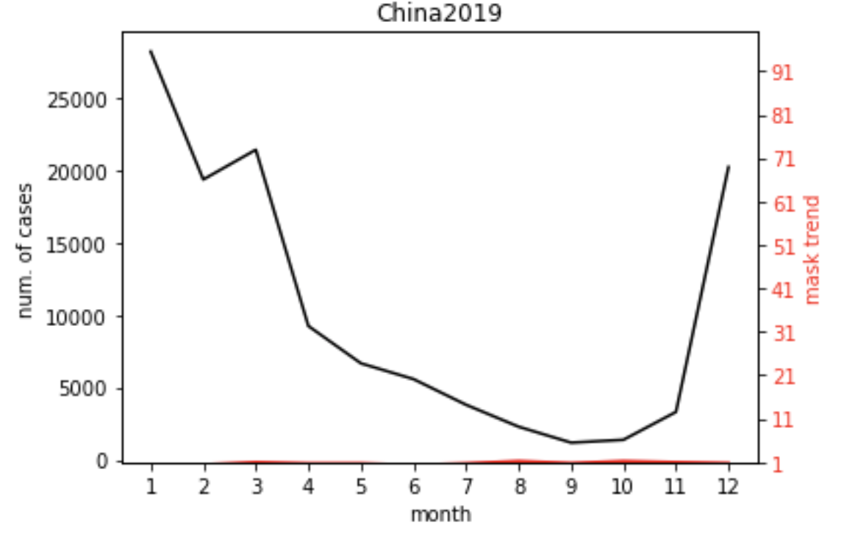
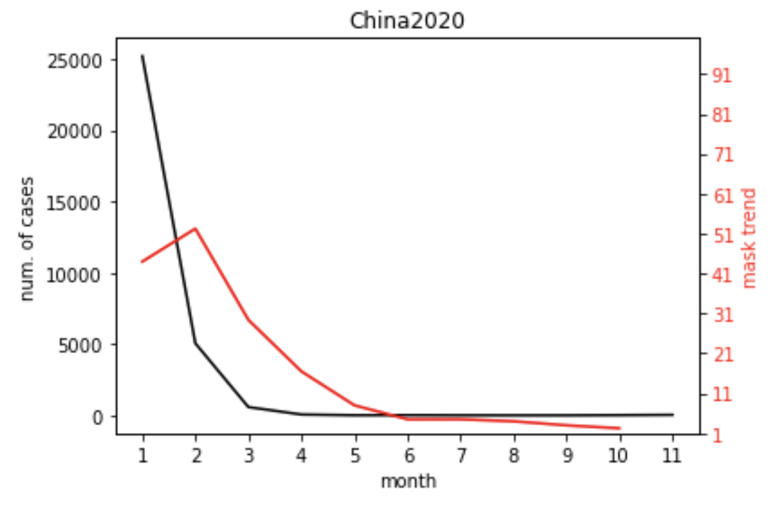
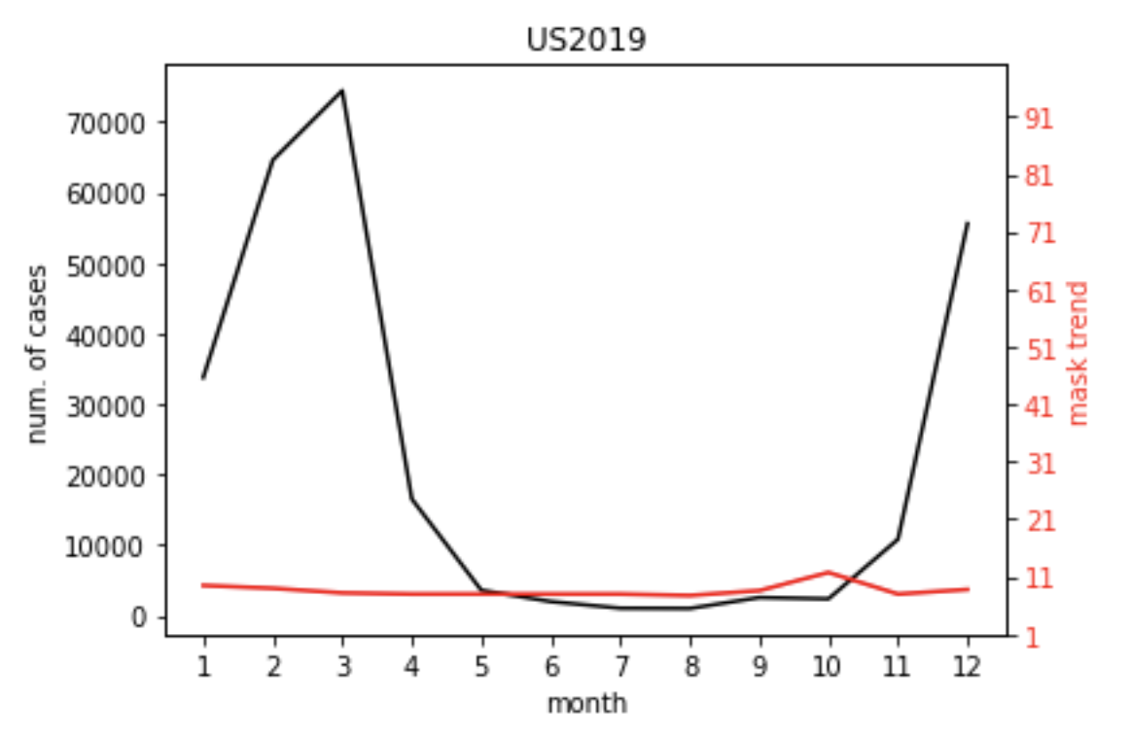
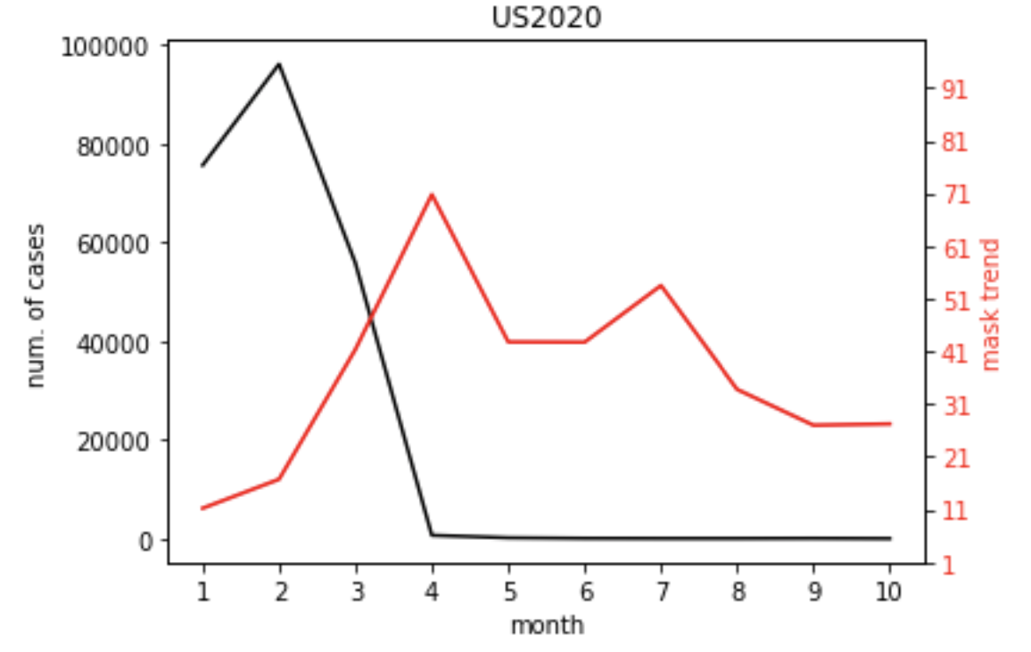
Hypothesis 1 During the pandemic, the global influenza cases may decrease,
because people wear face masks everywhere.
04| Research Method
From “China2019” plot, the flu cases in February is about 19,000, but it decreased to less than 5,000 in February 2020.
From “US2019” plot, the flu cases in March is about 75,000, but it decreased to less than 55,000 in March 2020.

Slide 7
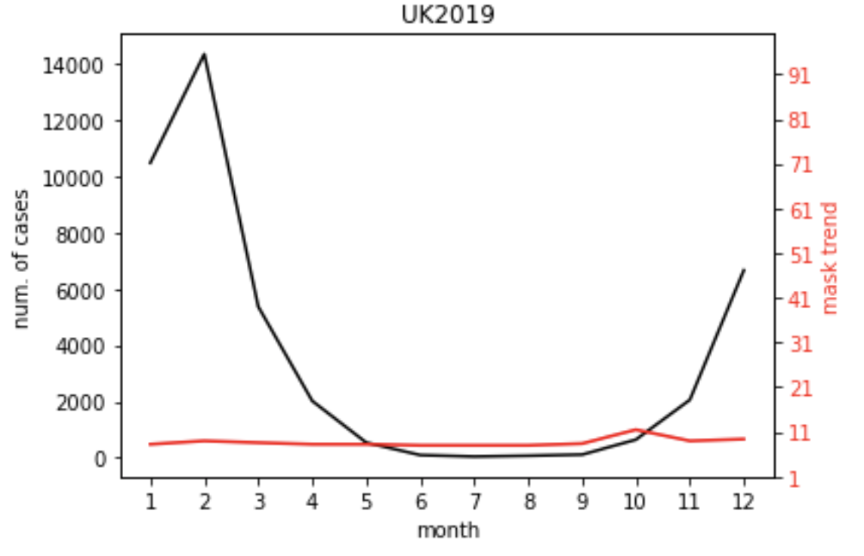
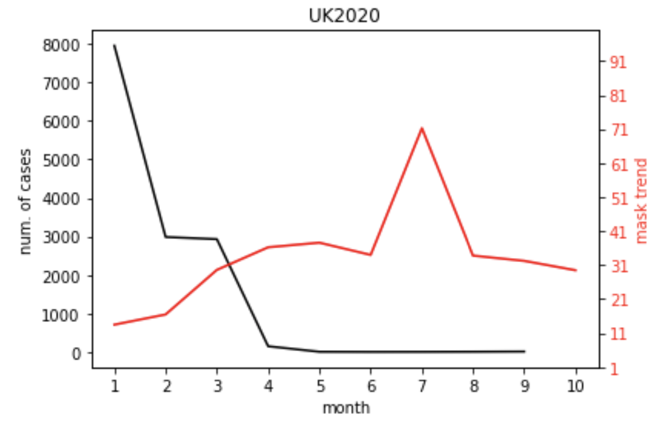
Hypothesis 1 During the pandemic, the global influenza cases may decrease,
because people wear face masks everywhere.
04| Research Method
From “UK2019” plot, the flu cases in February is about 14,000, but it decreased to about 3,000 in February 2020.

Slide 8
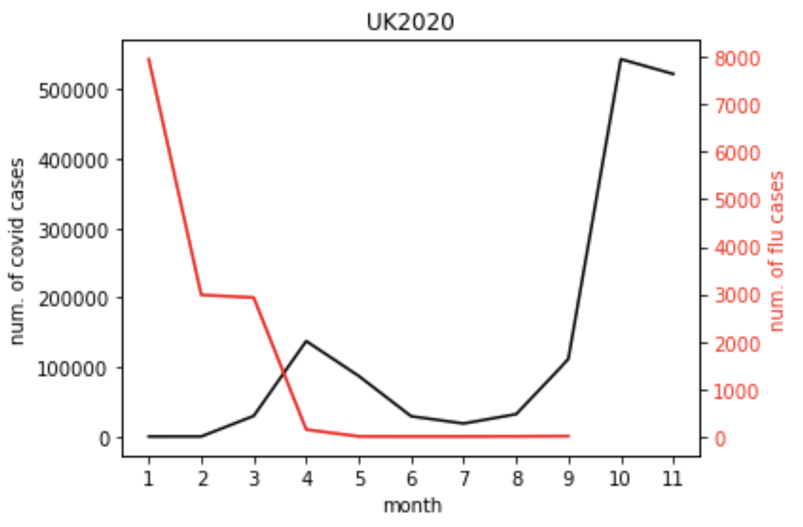
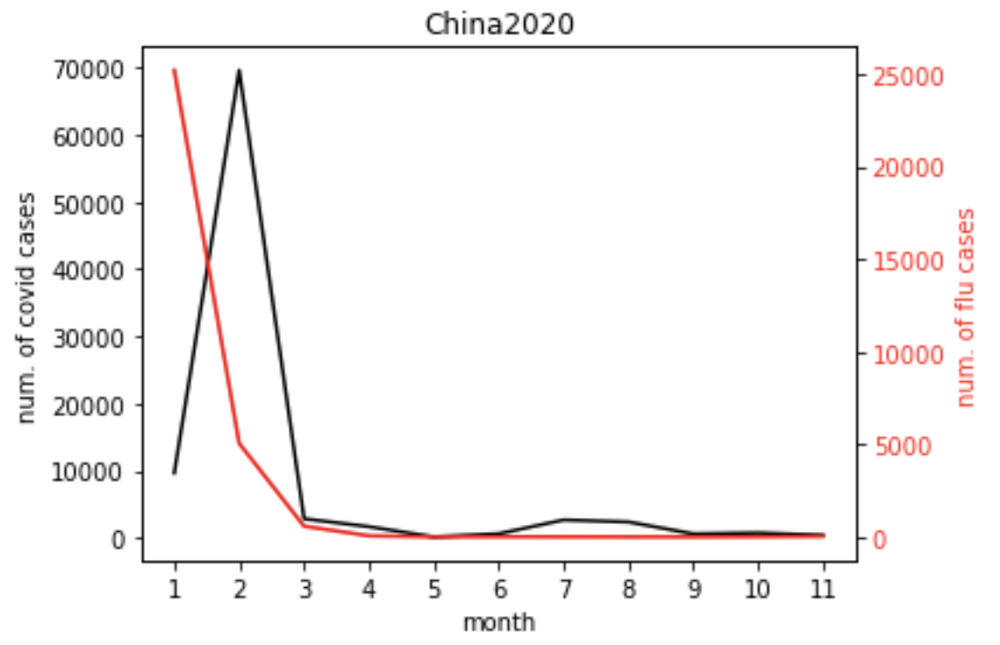
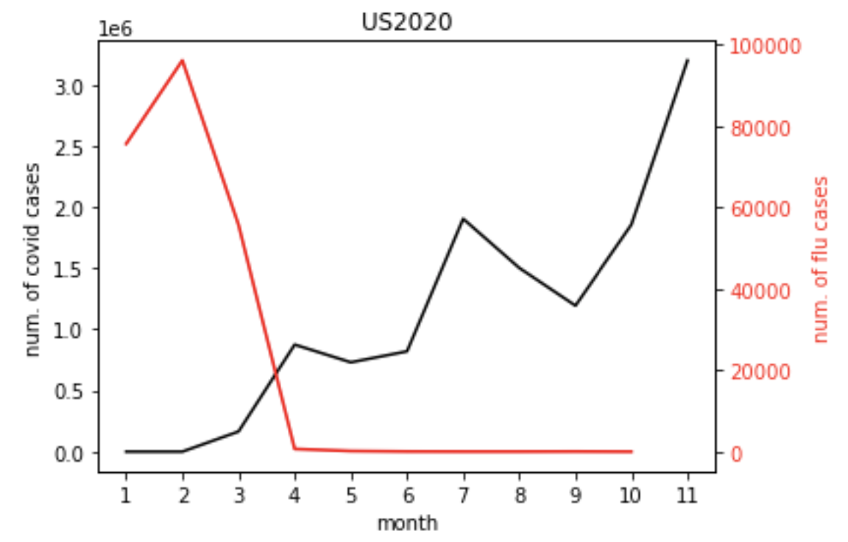
Hypothesis 2 In the countries where the COVID is abating, the flu cases should increase,
because people start not to wear masks.
04| Research Method
There is no increase of flu cases in China even in November. (masks are still required
since the global pandemic have not ended yet)

Slide 9
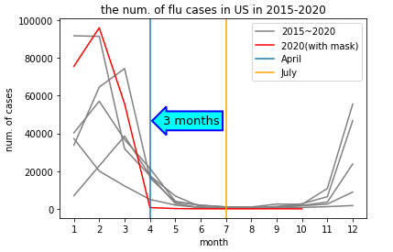
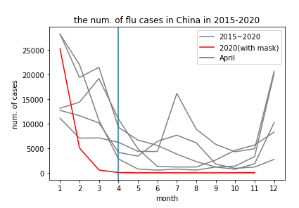
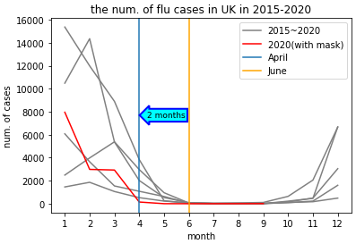
Hypothesis 3 The peak of the spread of influenza may delay due to the pandemic since people wear masks.
04| Research Method
Use the month of mitigation instead
of peak month since influenza surges
in winter (lack of data in 2020).
Historical influenza data from 2015-2020
The influenza was mitigated in April 2020.
3 months earlier than normal in US
2 months earlier than normal in UK
The earlist month of mitigaiton in China.

Slide 10
Conclusion
The results support the hypothesis 1 and have a positive evidence for hypothesis 3. The global flu cases decrease during to the pandemic, and the peak would delay with masks.
05
However, the outcome does not have strong evidences to support our hypothesis 2. From the plot of China, we learn that people are still aware of the pandemic, even though the COVID is abating in their country.

Slide 11
THANKS

