Slide 1
CDA 3103
Recitation 10 – Control Signals

Slide 2
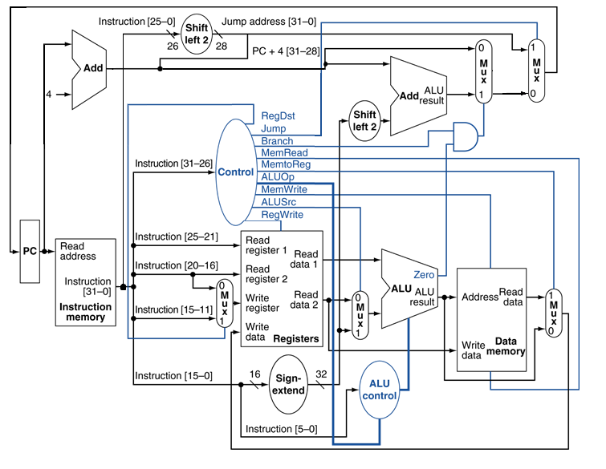
MIPS Single Cycle Datapath

Slide 3
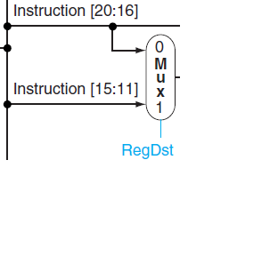
Control Signals – Register Destination
RegDst
Deasserted: the register destination number for the write register comes the rt field (bits 20:16)
Asserted: the register destination number for the write register comes the rd field (bits 15:11)

Slide 4
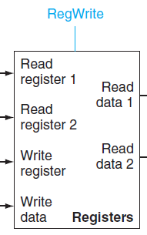
Control Signals – Register Write
RegWrite
Asserted: the register destination on the write register input is written with the value on the write data input

Slide 5
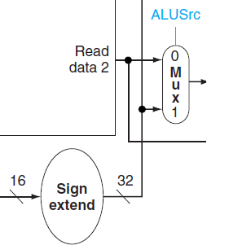
Control Signals – ALU Source
ALUSrc
Deasserted: The second ALU operand comes from the second register file output
Asserted: The second ALU operand is the sign-extended lower 16 bits of the instruction

Slide 6
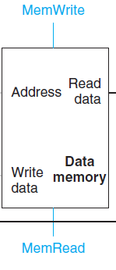
Control Signals – Memory Read
MemRead
Asserted: Data memory contents designated by the address input are put on the read data output.

Slide 7
Control Signals – Memory Write
MemWrite
Asserted: Data memory contents designated by the address input are replaced by the value on the write data input.

Slide 8
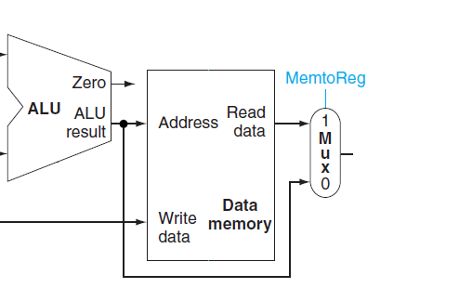
Control Signals – Memory to Register
MemtoReg
Deasserted: The value fed to the register write data input comes from the ALU
Asserted: The value fed to the register write data input comes from the data memory.

Slide 9
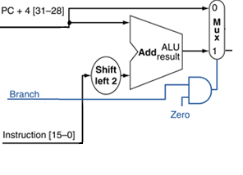
Control Signals – Branch
Branch on Equal
Deasserted: PC = PC + 4
Asserted: Check Zero output of the ALU
When Zero is asserted use the branch target address. PC = PC + 4 + 4*Instruction[15-0]

Slide 10
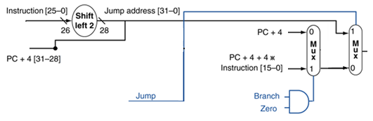
Control Signals – Jump
Jump
Deasserted: PC is either PC + 4 or the branch target
Asserted: PC = PC + 4[31-28] : Instruction[25-0] * 4

Slide 11
Setting Control Signals
Consider the single cycle datapath. What would be the values of the control signals for the following instructions: add, addi, lw, beq, j?

