Slide 1
Predicting the Vote of a Supreme Court Justice Using NLP
Anndi Russell
Capstone Fall 2020

Slide 2
Research Question and Significance
Given the text spoken by a Supreme Court justice during an oral argument, can a model predict the direction of the justice’s vote?
Why does it matter?
Supreme Court decisions are often released months after the oral argument
An accurate prediction would allow for people and organizations whom the ruling would impact to prepare for a most likely outcome

Slide 3
Supreme Court Background
Most cases heard by the Supreme Court were first heard and ruled on by a lower court
There are exceptions; my program doesn’t handle those
Petitioner vs. Respondent
Timed portions of the oral argument (petitioner, respondent, rebuttal)
Voting outcome: Majority vs. Dissent
Vote is either for the petitioner or for the respondent
This is what my program attempts to predict

Slide 4
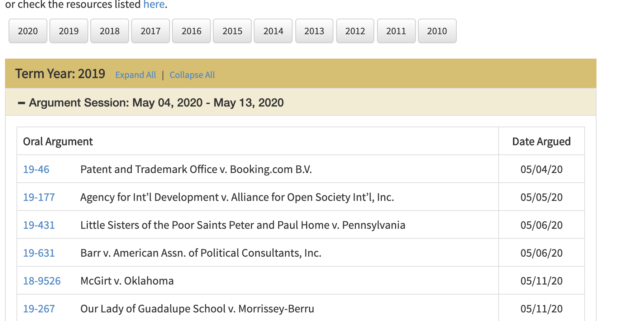
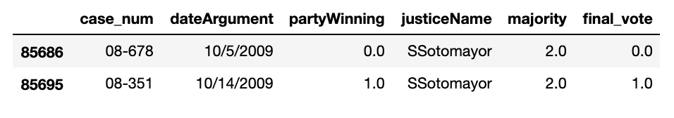
Description of Dataset
Source 1: PDFs of oral argument transcripts
Starting in 2004
Source 2: Washington University Law database
partyWinning
0: respondent , 1: petitioner
majority
1: minority , 2: majority
Outcome: final_vote
1: petitioner , 0: respondent

Slide 5
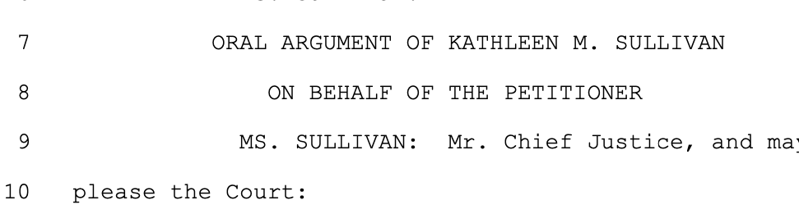
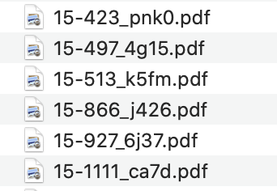
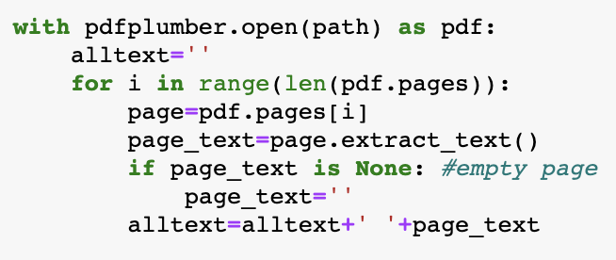
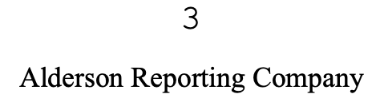
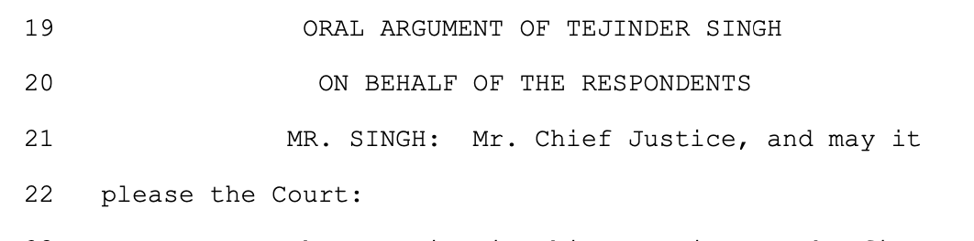
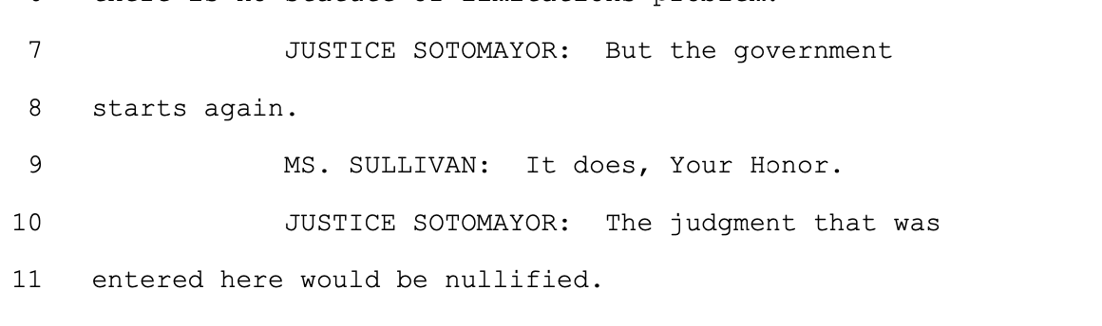
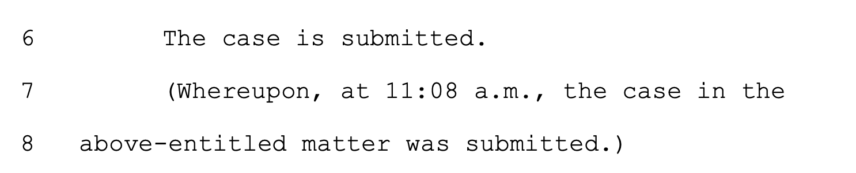
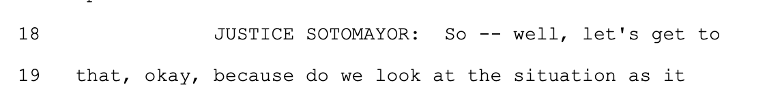
Program Description: PDF text extraction
Remove headers,
numbers, extra white space
Get case number and compare with justice
Extract all text
Mark beginning of sections (3) and get lawyer name
Within each section (3): Separate justice
text from others (with list of all other speakers)
Mark end of case

Slide 6
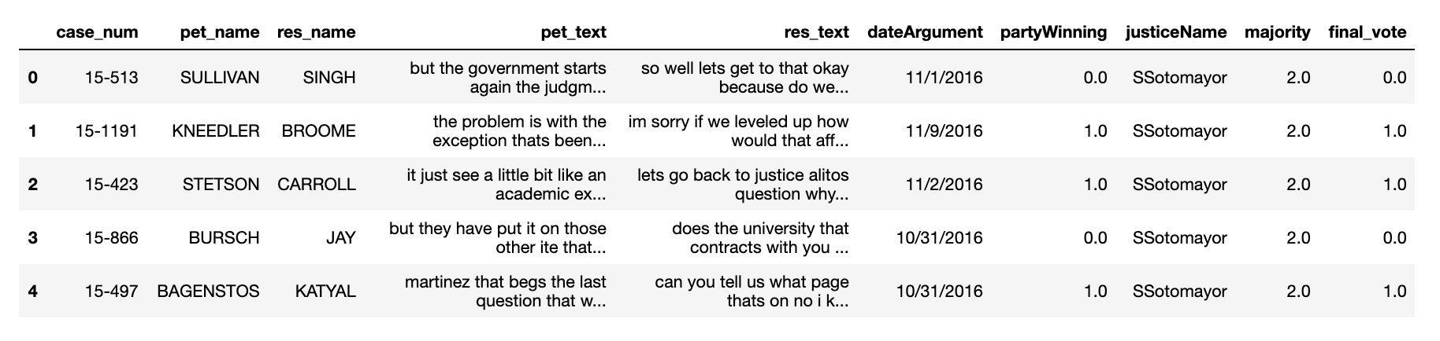
Data Merging to Prepare for Modeling
Merge data from text DataFrames and Washington University Law data (one per justice)
Drop rows without final_vote (very small number of these overall)
8 DataFrames at this point

Slide 7
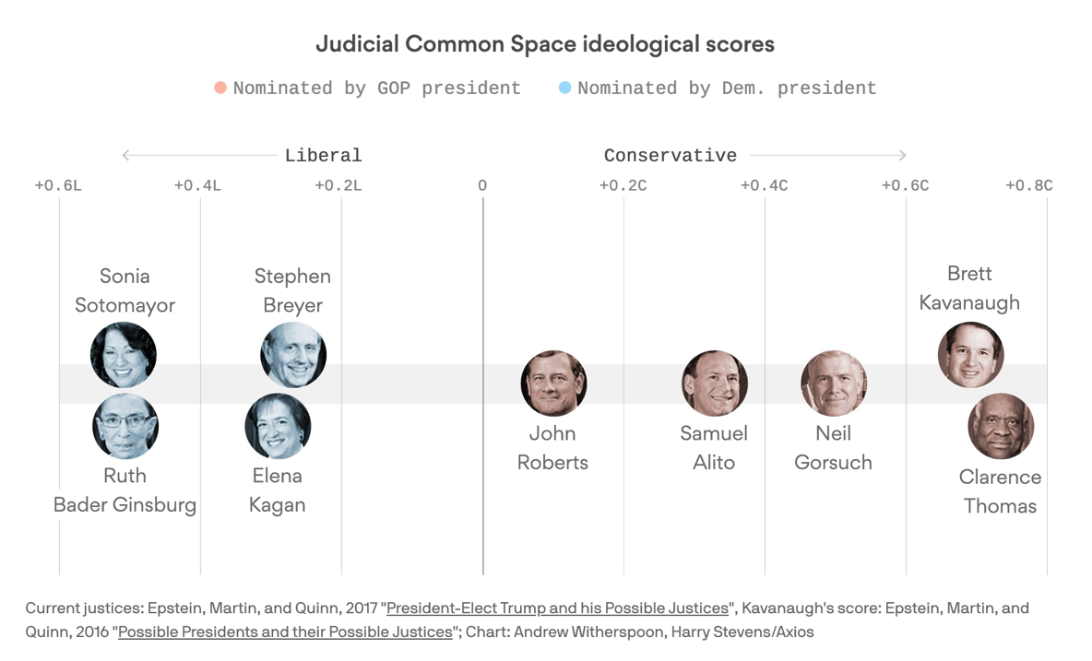
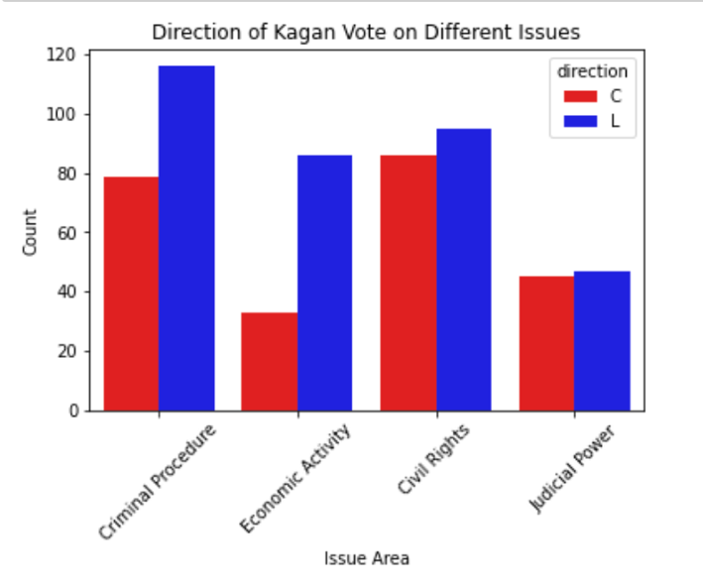
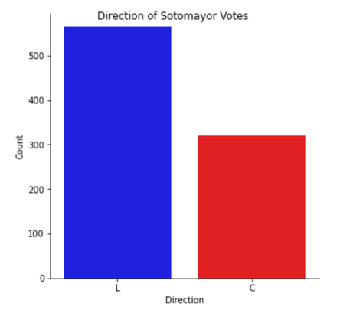
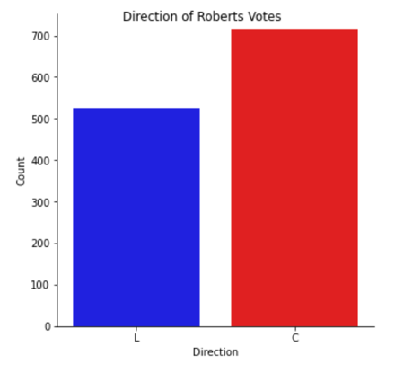
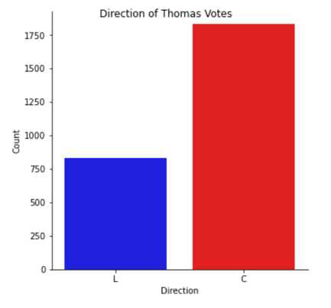
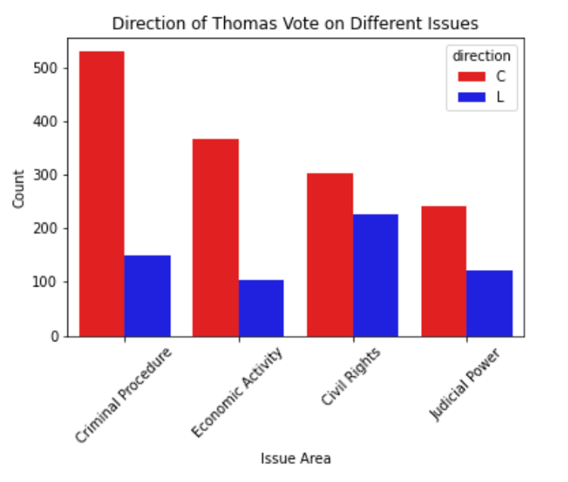
Data Visualization
Liberal or Conservative assignments were made by the Washington University team
Interesting to me the frequency with which justices vote “across the aisle”; differs with different issue areas

Slide 8
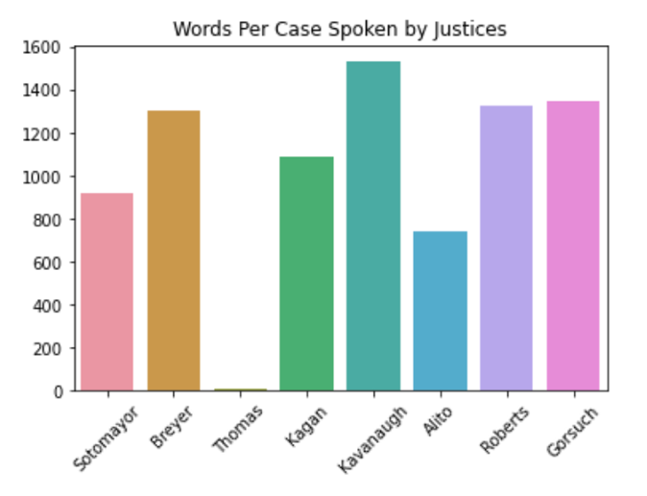
Data Visualization
Words per case by each justice
Kavanaugh speaks the most
Thomas barely speaks
Important context for his model

Slide 9
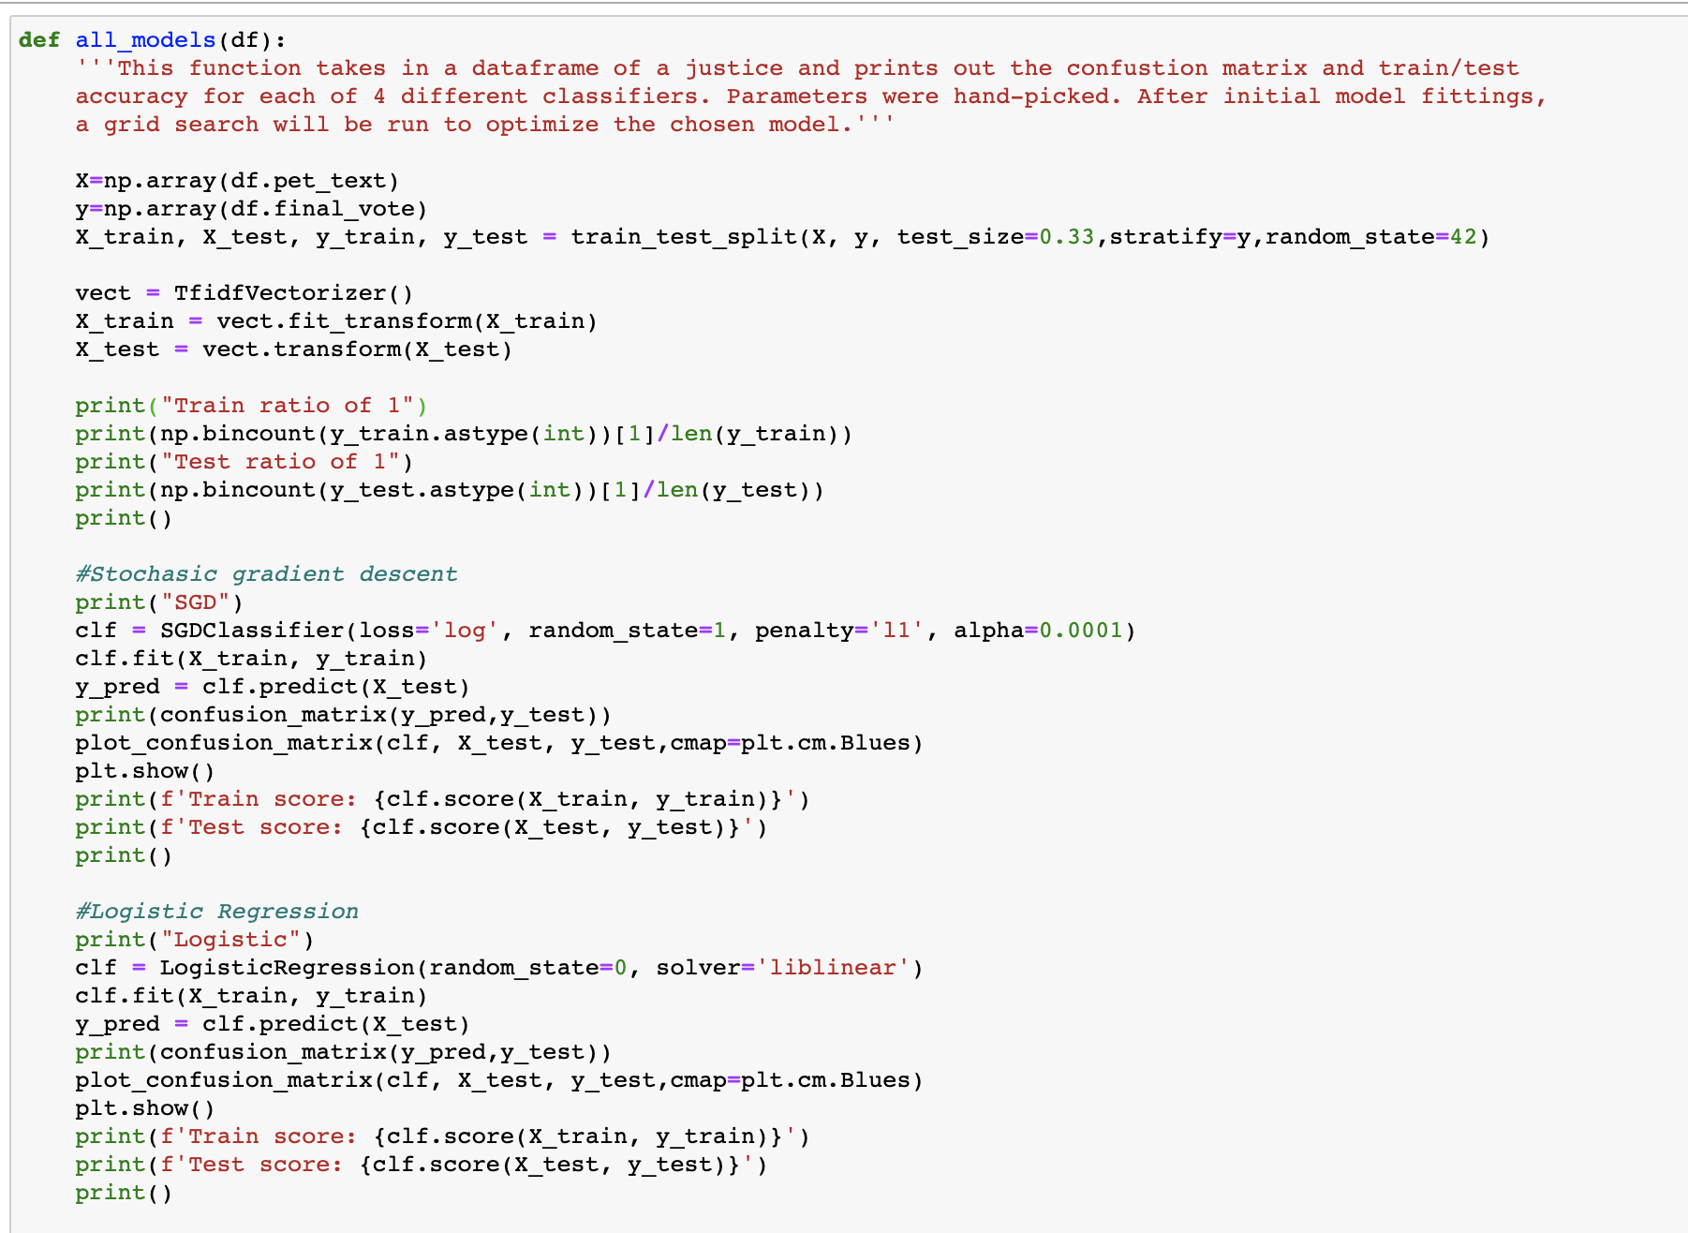
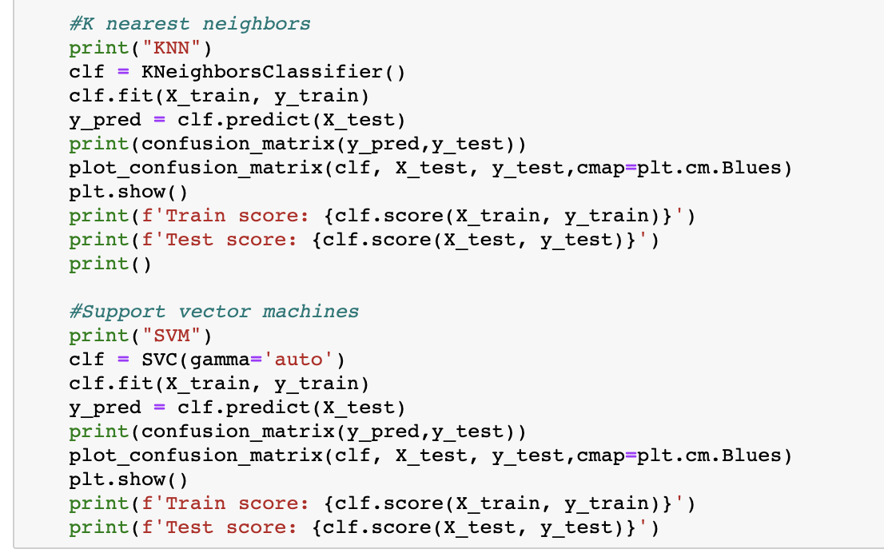
Building the Models with Four Different Algorithms
Defined a function that would print off accuracies and confusion matrices for:
-Stochastic Gradient Descent (log loss function)
-Logistic Regression
-KNN
-Support Vector Machines

Slide 10
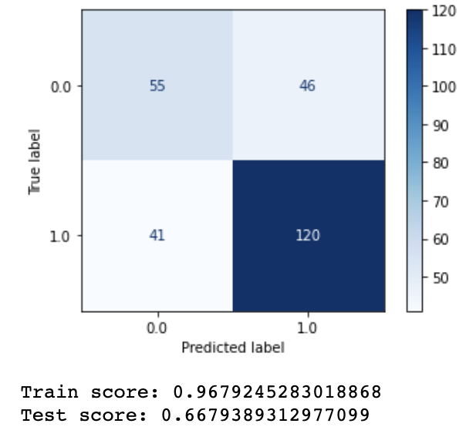
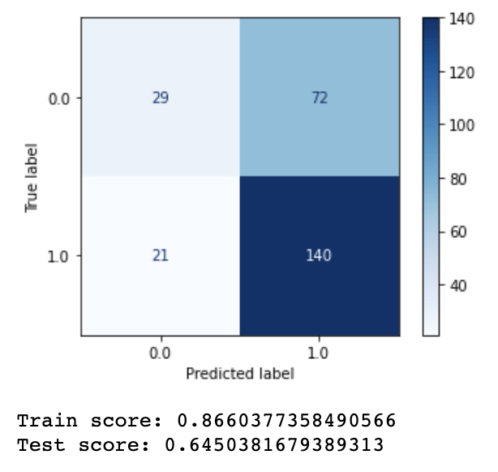
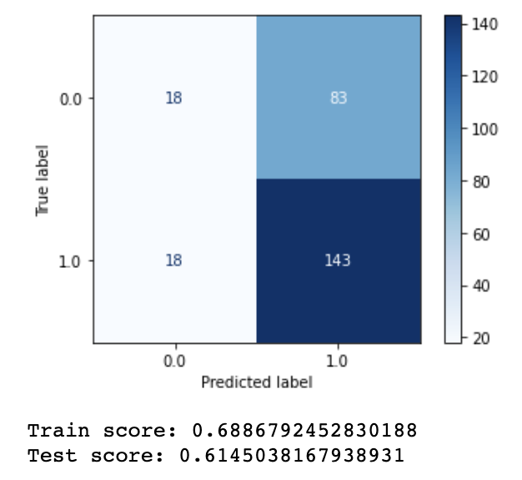
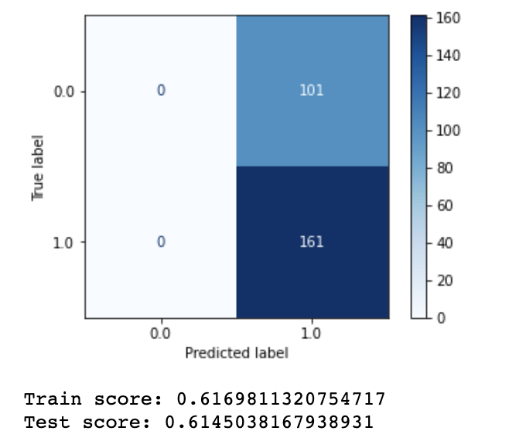
Results of Four Algorithms (Justice Breyer)
SGD
Logistic Regression
KNN
SVM
SGD had the highest test accuracy
SGD had the highest training accuracy by far; tells me that it is learning something
SVM only predicted positives so the accuracy matched the proportion of 1s in the data
Move forward with SGD: Grid Search CV

Slide 11
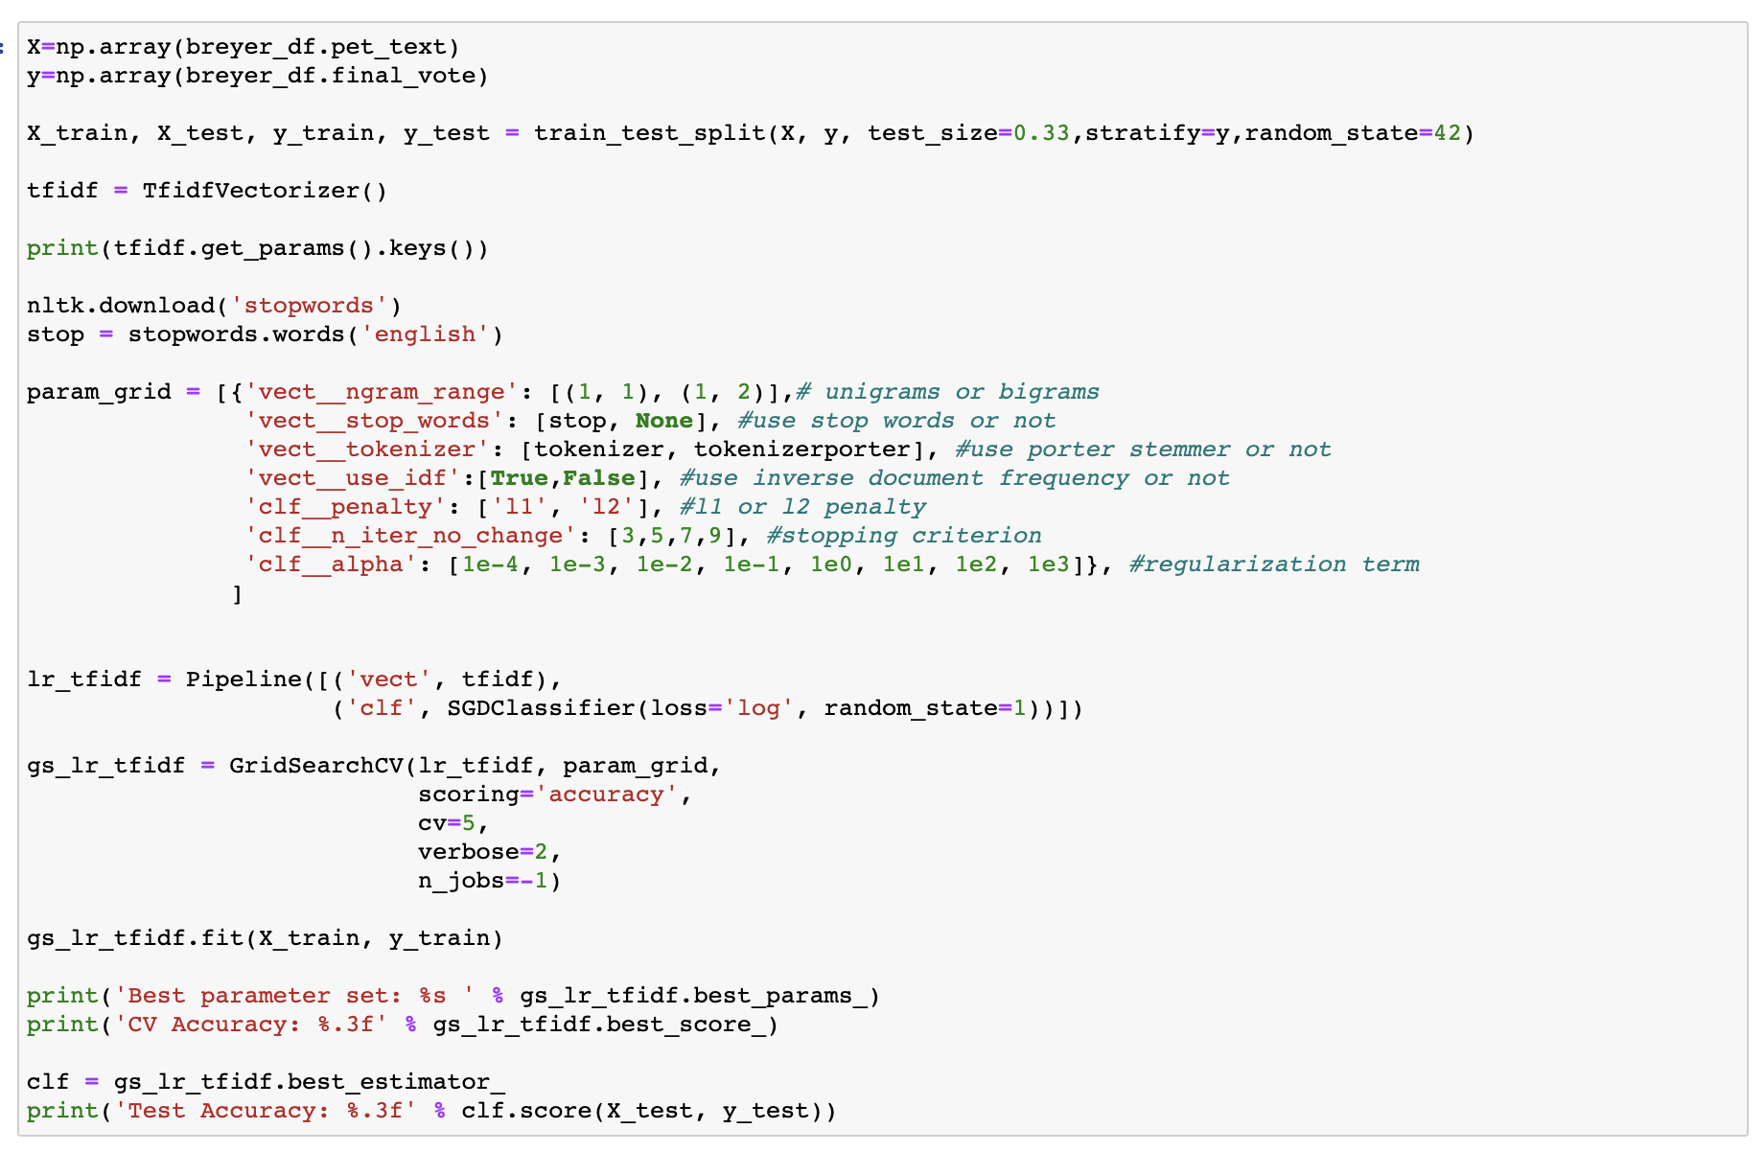
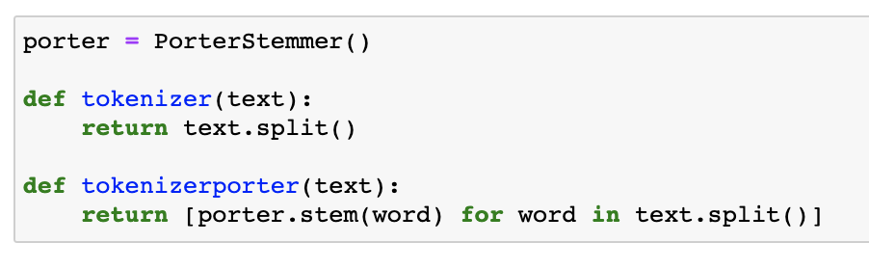
Grid Search CV: Tune SGD and Tfidf Hyperparameters
Tokenizer options
Output:

Slide 12
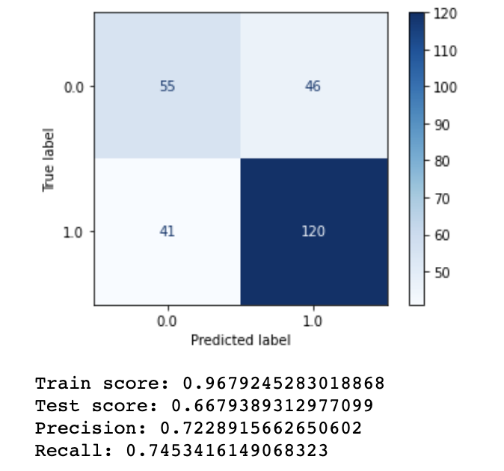
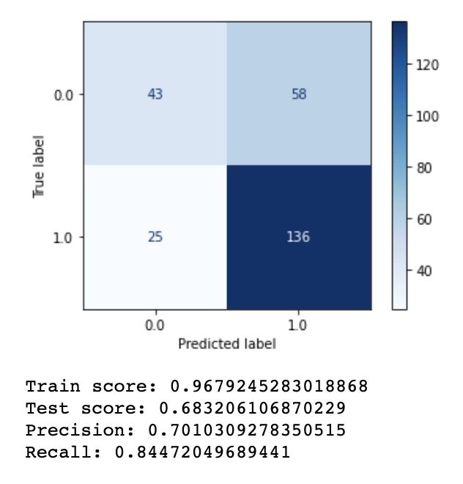
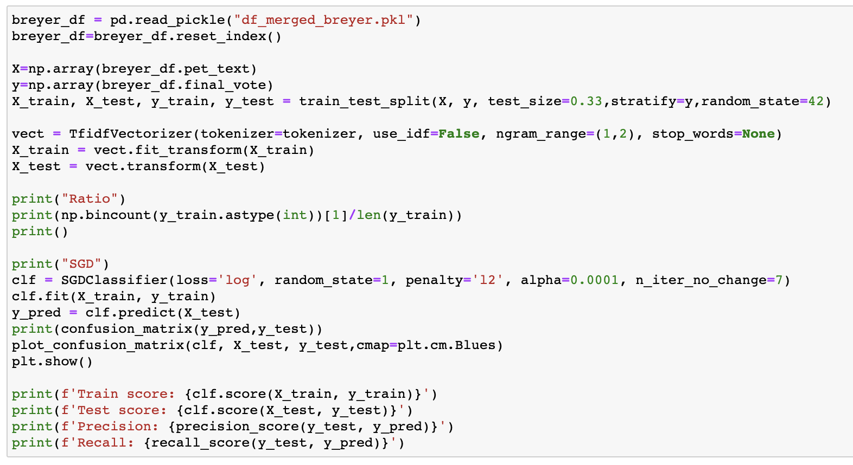
Final Results With Tuned Models
Justice | Test acc.
Thomas | 0.585
Breyer | 0.683
Sotomayor | 0.562
Kagan | 0.633
Alito | 0.680
Gorsuch | 0.627
Roberts | 0.691
Kavanaugh | 0.613
Breyer
Before tuning
After tuning
Final model code:

Slide 13
Conclusion
Models did not perform well overall and should not be considered good predictors of the voting outcome
Future research:
Look at length of speaking time as a factor
Try other vectorizer options
Explore voting and speaking patterns over time
Citations
Supreme Court: https://www.supremecourt.gov/oral_arguments/argument_transcript/2020
Washington University Law Database: http://scdb.wustl.edu/index.php
Axios figure: https://www.axios.com/supreme-court-justices-ideology-52ed3cad-fcff-4467-a336-8bec2e6e36d4.html

