Slide 1
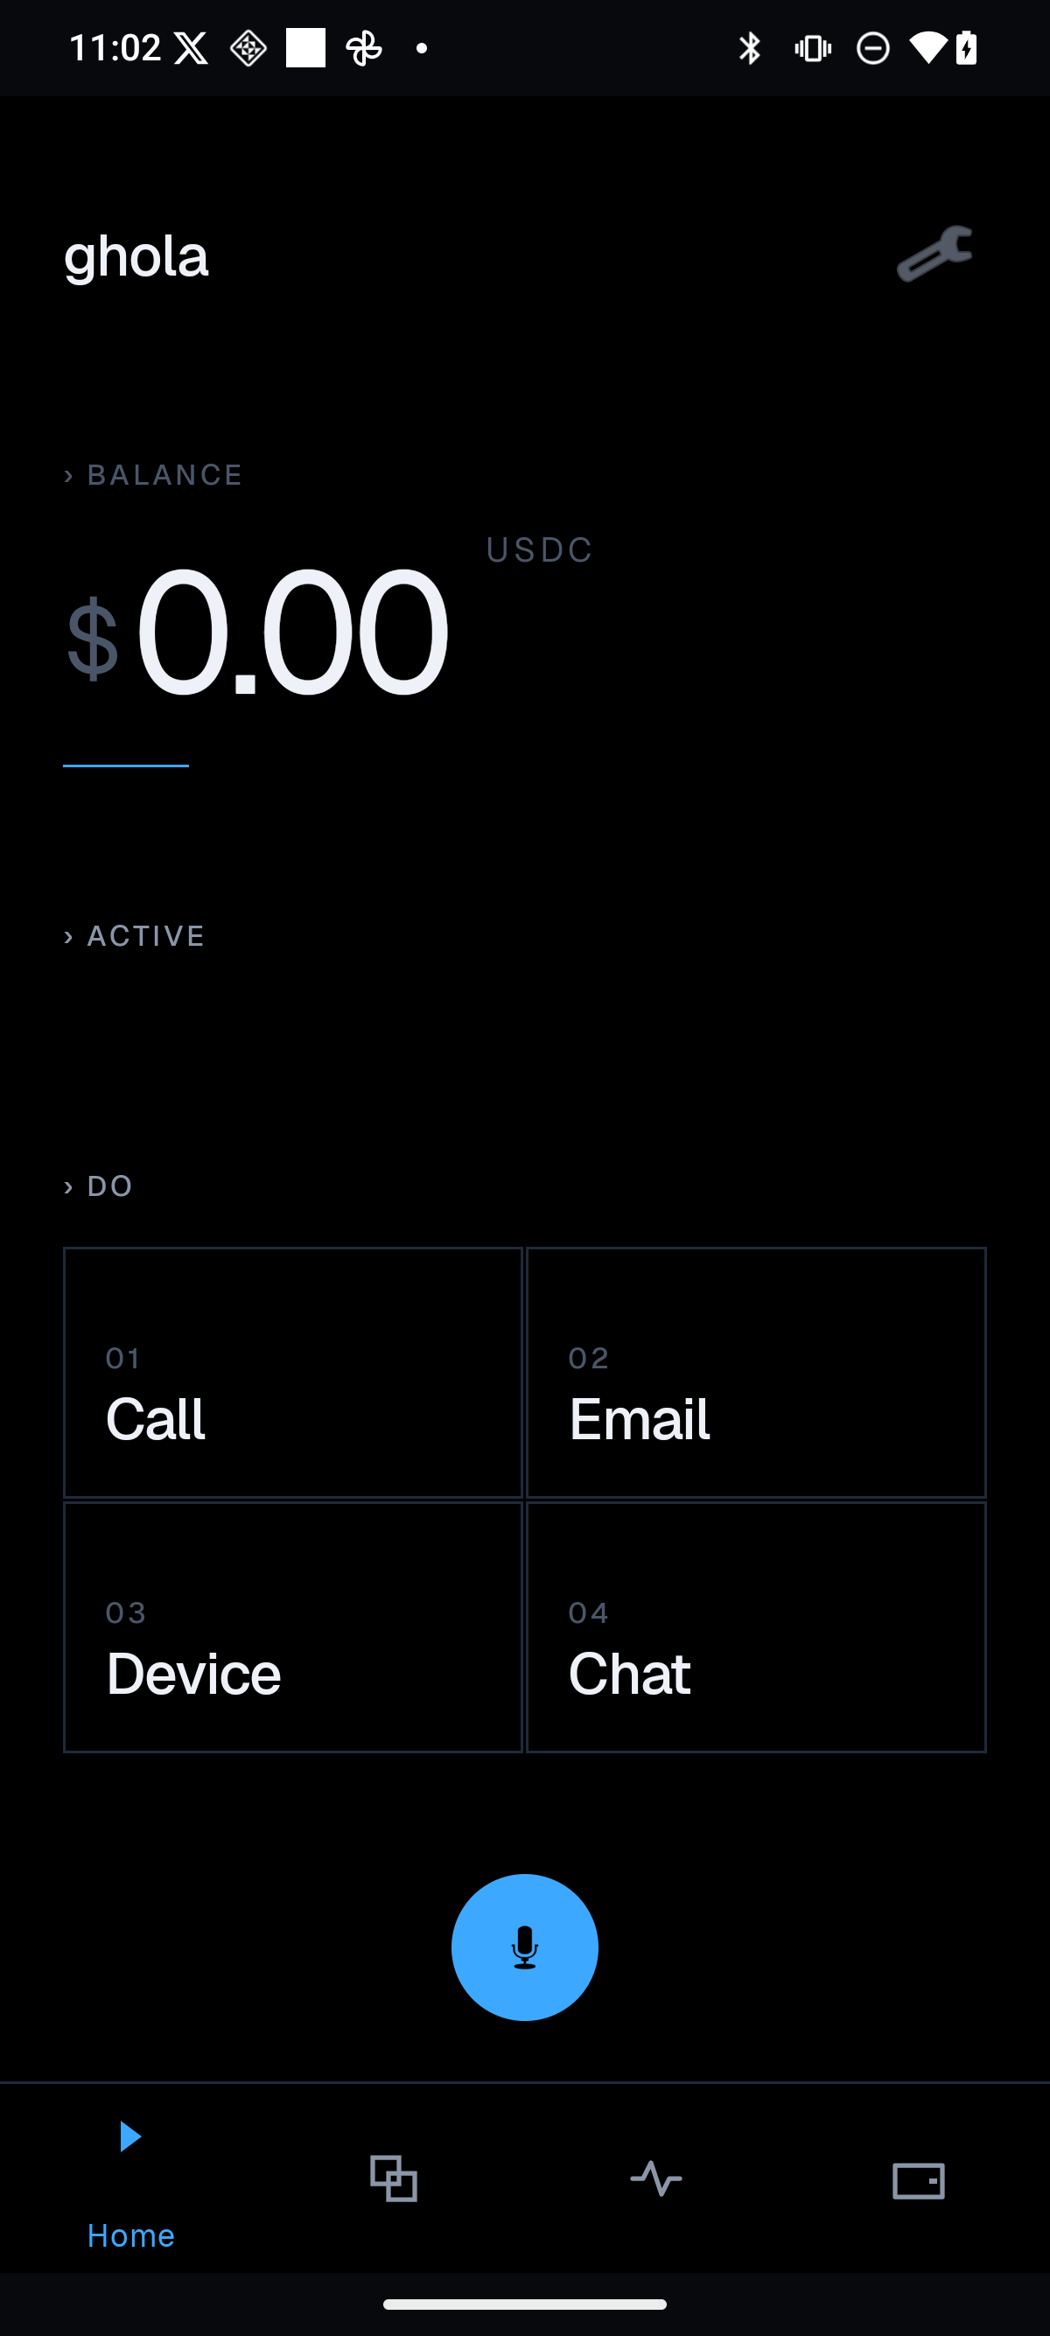
INVESTOR DECK
Ghola
Ghola
Private execution layer
for user-owned agents.
local intelligence · encrypted memory · delegated authority · stablecoin settlement

Slide 2
THE MOMENT
Ghola
Agents are becoming
economic actors.
The question moves from “what can they say?” to “what can they safely do?”
know
do
spend

Slide 3
PROBLEM
Ghola
There is no trusted
execution layer.
identity
siloed account
Identity, memory, permissions, and money are still stitched together app by app.
memory
owned by provider
money
human-first rails

Slide 4
SOLUTION
Ghola
Ghola binds intelligence
to authority.
A user-owned control plane for agents that act across apps, devices, and paid services.
local AI
private state
scoped actions
stablecoin receipts

Slide 5
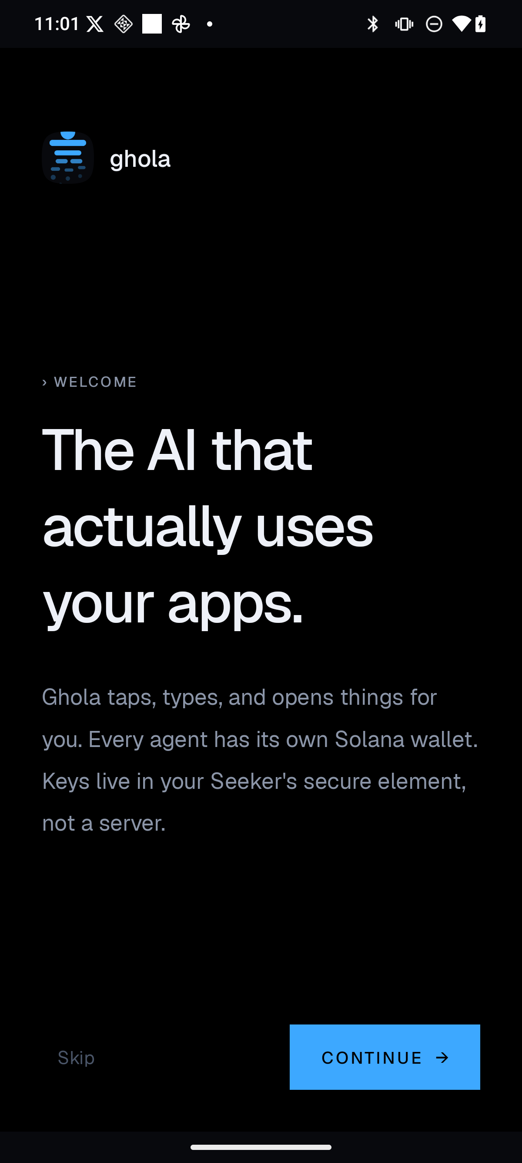
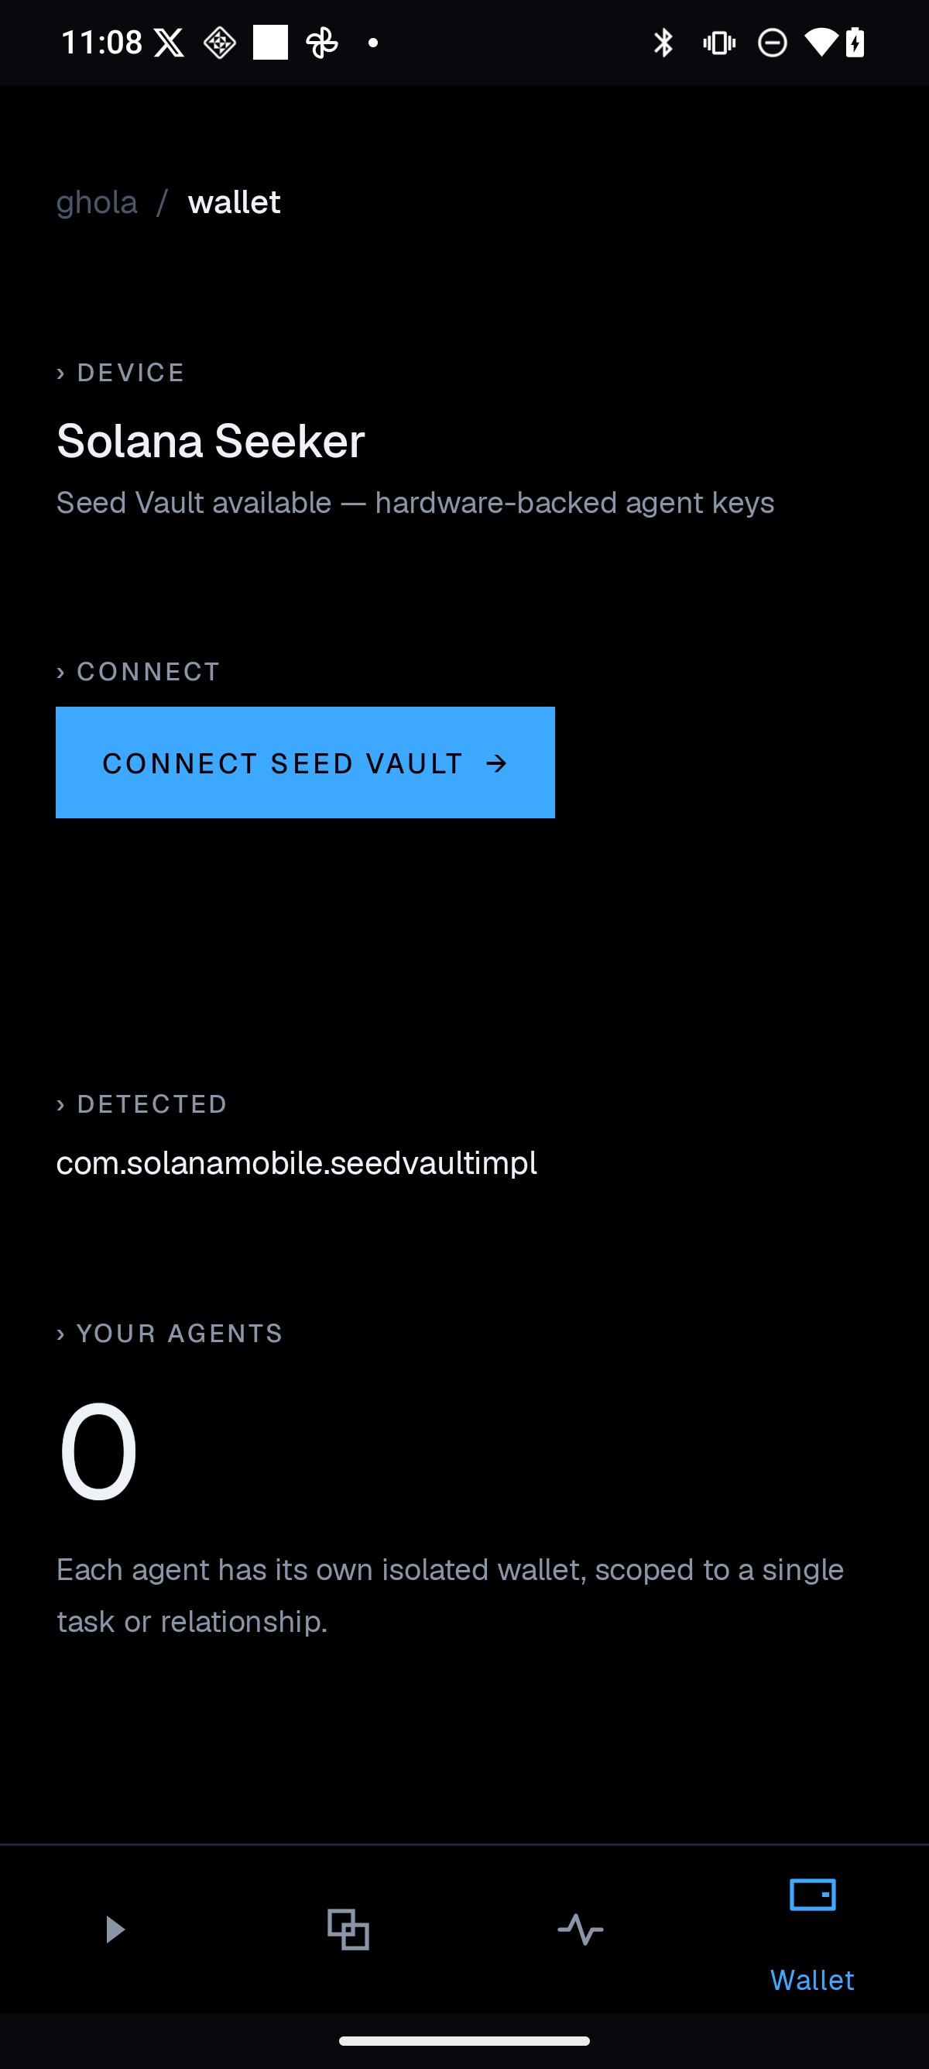
PRODUCT PROOF
Ghola
A real product surface,
not a concept deck.
Native assistant, wallet, and creation flows already exist across the stack.
assistant
actions
wallet

Slide 6
CRYPTO-NATIVE
Ghola
Cards authenticate humans.
Wallets can authorize agents.
wallet
agent
service
stablecoin receipt

Slide 7
WEDGE
Ghola
Start with private
personal work.
Calls, email, calendar, tasks, and approvals are where trust becomes product value.
assistant
approval
commerce
marketplace

Slide 8
ARCHITECTURE
Ghola
One control plane.
Many surfaces.
client
local AI
state
execute
settle
receipt
iOS · Android · web · SAID · Thumper · Gateway · Orni · SDK/MCP

Slide 9
BUSINESS MODEL
Ghola
Revenue follows
agent transactions.
subscription
private assistant
gateway
paid agent calls
marketplace
models, tools, services

Slide 10
COMPETITIVE FRAME
Ghola
Ghola sits in
the hard quadrant.
local privacy
Ghola
Local privacy plus programmable settlement.
local LLM apps
payment rails
Chat apps
wallet infra
programmable settlement

Slide 11
MOAT
Ghola
The moat is the
authority graph.
Every approved action compounds user-owned context, trust, and settlement history.
memory
permissions
authority
graph
spend
receipts

Slide 12
PROOF DEMO
Ghola
The demo should be
a private purchase.
A local agent books a service, asks approval, pays stablecoins, and saves the receipt.
ask
approve
pay
receipt

Slide 13
ASK
Ghola
Raise to harden,
ship, and prove.
harden
wallet, privacy, local AI
The next milestone is a production-grade private agent commerce loop.
ship
native UX + SDK/MCP
prove
book/pay/receipt demo

Slide 14
INVESTOR FIT
Ghola
Agent infrastructure
with an app wedge.
Identity, stablecoins, privacy, Solana, and systems that can become protocols.
Ali: decentralized AI + Solana markets
Eddy: infrastructure + security + token design

Slide 15

CLOSE
Ghola
If agents can know,
do, and spend...
users need to own
the layer that governs them.
Ghola is that private execution layer.

