Slide 1
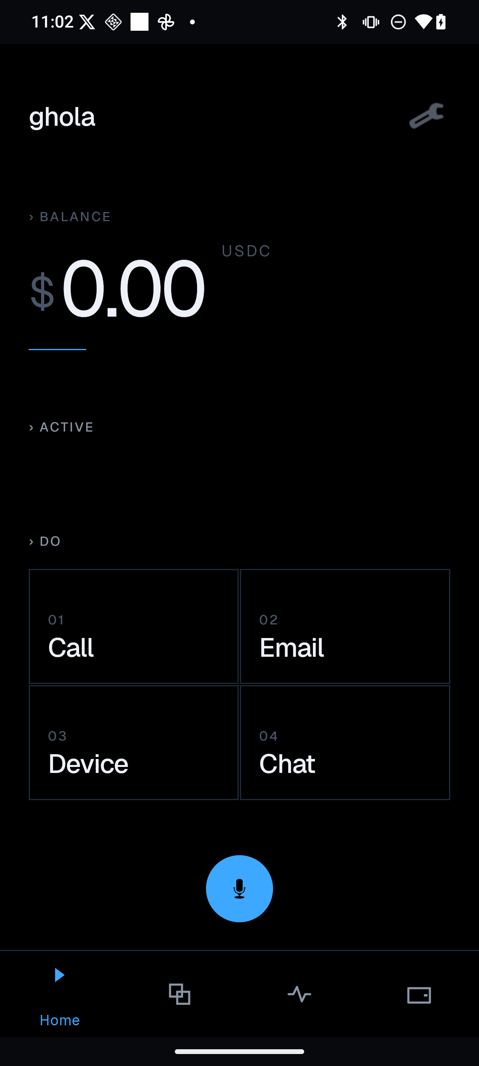
GHOLA
INVESTOR DECK · SEED
01 / 15
PRIVATE EXECUTION LAYER
Agents that act
Owned by you.
Ghola is the user-owned control plane for AI agents — local intelligence, encrypted memory, delegated authority, and stablecoin settlement, in one private execution layer.
LOCAL
ENCRYPTED
DELEGATED
STABLECOIN
shipping product
intelligence
memory
authority
settlement
Private execution layer for user-owned agents
ghola.app · seed pitch · 2026

Slide 2
GHOLA
01 · THE MOMENT
02 / 15
THE MOMENT
Agents are becoming
economic actors.
KNOW
perceive context
DO
take actions
The question moves from “what can they say?” to “what can they safely do?” — and the answer requires a layer that does not yet exist.
SPEND
move money
Private execution layer for user-owned agents
ghola.app · seed pitch · 2026

Slide 3
GHOLA
02 · PROBLEM
03 / 15
PROBLEM
There is no trusted
execution layer.
Identity, memory, permissions, and money are still stitched together app by app.
IDENTITY
MEMORY
MONEY
siloed
provider
human-first
account
owned
rails
Private execution layer for user-owned agents
ghola.app · seed pitch · 2026

Slide 4
GHOLA
03 · SOLUTION
04 / 15
SOLUTION
Ghola binds intelligence
to authority.
A user-owned control plane for agents that act across apps, devices, and paid services.
01
02
03
04
LOCAL AI
PRIVATE STATE
SCOPED ACTIONS
STABLECOIN
inference at the edge
encrypted memory
delegated authority
programmable receipts
Private execution layer for user-owned agents
ghola.app · seed pitch · 2026

Slide 5
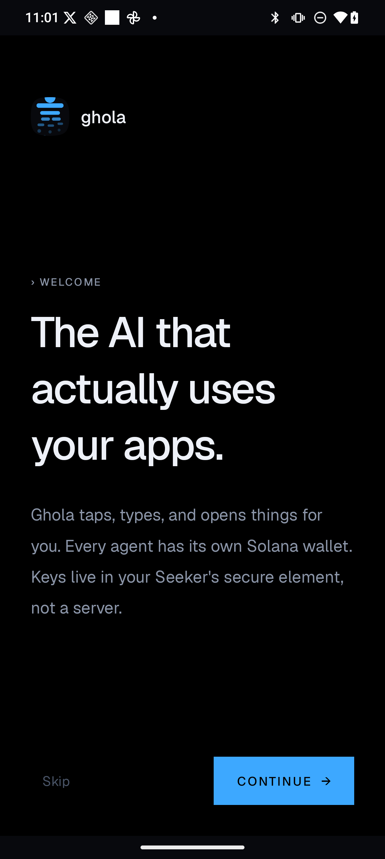
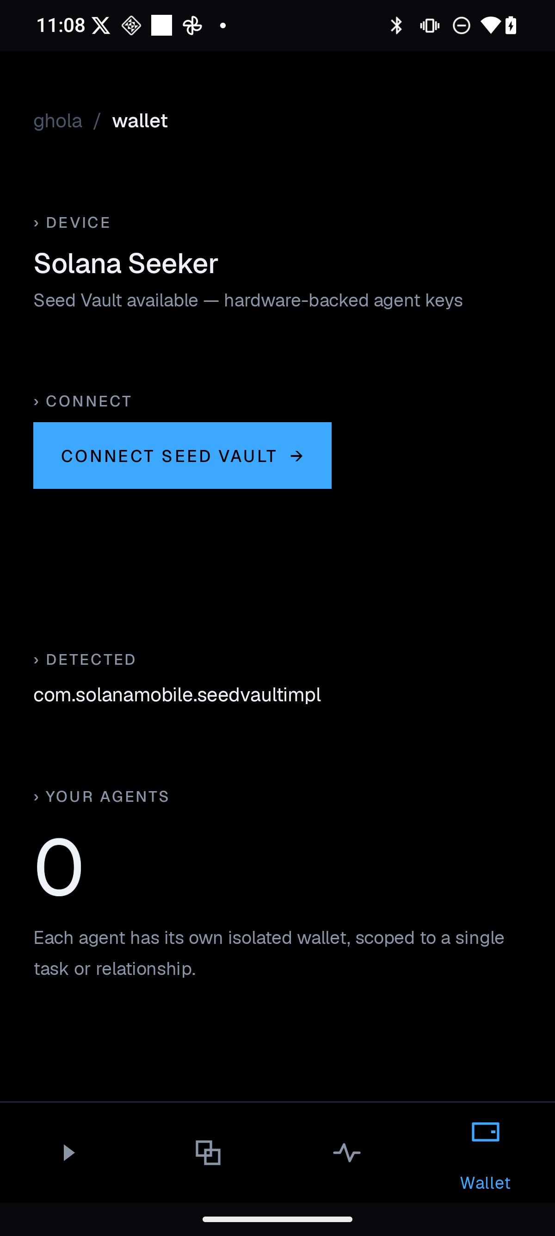
GHOLA
04 · PRODUCT PROOF
05 / 15
PRODUCT PROOF
A real product surface,
not a concept deck.
Native assistant, wallet, and creation flows already exist across the stack — iOS, Android, and web, with a unified gateway behind them.
ASSISTANT
shipped
ACTIONS
shipped
WALLET
shipped
MARKETPLACE
in progress
assistant
actions
wallet
Private execution layer for user-owned agents
ghola.app · seed pitch · 2026

Slide 6
GHOLA
05 · CRYPTO-NATIVE
06 / 15
CRYPTO-NATIVE
Cards authenticate humans
Wallets can authorize agents.
Solana stablecoin settlement turns every agent action into a portable, programmable receipt.
WALLET
AGENT
SERVICE
RECEIPT
›
›
›
user-owned authority
scoped permission
off-chain execution
stablecoin on-chain
Private execution layer for user-owned agents
ghola.app · seed pitch · 2026

Slide 7
GHOLA
06 · WEDGE
07 / 15
WEDGE
Start with private
personal work.
Calls, email, calendar, tasks, and approvals are where trust becomes product value — the daily surface where users feel agent leverage first.
MARKETPLACE
COMMERCE
APPROVAL
ASSISTANT
daily personal work
scoped consent
agent transactions
ecosystem flywheel
Private execution layer for user-owned agents
ghola.app · seed pitch · 2026

Slide 8
GHOLA
07 · ARCHITECTURE
08 / 15
ARCHITECTURE
One control plane
Many surfaces.
SURFACES
CLIENT
iOS · Android · Web
iOS
Android
LOCAL AI
on-device inference
Web
STATE
encrypted memory
SAID
Thumper
EXECUTE
scoped actions
Gateway
Orni
SETTLE
stablecoin rails (Solana)
SDK / MCP
RECEIPT
verifiable history
Private execution layer for user-owned agents
ghola.app · seed pitch · 2026

Slide 9
GHOLA
08 · BUSINESS MODEL
09 / 15
BUSINESS MODEL
Revenue follows
agent transactions.
Three concentric revenue streams that compound as the authority graph grows.
01
02
03
SUBSCRIPTION
GATEWAY
MARKETPLACE
private assistant
paid agent calls
models, tools, services
Per-user subscription for the local-first agent and encrypted state.
Take rate on agent-initiated API calls and paid service execution.
Revenue share on third-party models, tools, and services consumed by user agents.
Private execution layer for user-owned agents
ghola.app · seed pitch · 2026

Slide 10
GHOLA
09 · COMPETITIVE FRAME
10 / 15
COMPETITIVE FRAME
Ghola sits in
the hard quadrant.
↑ LOCAL PRIVACY
Ghola
Local LLM apps
Local privacy plus programmable settlement. Most players sit on one axis. Few combine both.
Payment rails
Chat apps
Wallet infra
PROGRAMMABLE SETTLEMENT →
Private execution layer for user-owned agents
ghola.app · seed pitch · 2026

Slide 11
GHOLA
10 · MOAT
11 / 15
MOAT
The moat is the
authority graph.
Every approved action compounds user-owned context, trust, and settlement history — a private graph no incumbent can rebuild.
PERMISSIONS
AUTHORITY
scoped grants
MEMORY
GRAPH
encrypted state
RECEIPTS
settlement history
Private execution layer for user-owned agents
ghola.app · seed pitch · 2026

Slide 12
GHOLA
11 · PROOF DEMO
12 / 15
PROOF DEMO
The demo should be
a private purchase.
A local agent books a service, asks approval, pays in stablecoins, and saves the receipt — end-to-end, on-device first.
1
2
3
4
ASK
APPROVE
PAY
RECEIPT
agent perceives intent
user grants scope
stablecoin settlement
stored in user graph
Private execution layer for user-owned agents
ghola.app · seed pitch · 2026

Slide 13
GHOLA
12 · ASK
13 / 15
THE ASK
Raise to harden,
ship, and prove.
The next milestone is a production-grade private agent commerce loop.
Q3
Q4
Q1
HARDEN
SHIP
PROVE
wallet · privacy · local AI
native UX + SDK / MCP
book / pay / receipt demo
Lock down the core: secure enclave wallet, on-device memory, audited permission model.
Native iOS and Android with first-class developer surface for third-party agents.
End-to-end private commerce loop, publicly demoed and used by design partners.
Private execution layer for user-owned agents
ghola.app · seed pitch · 2026

Slide 14
GHOLA
13 · INVESTOR FIT
14 / 15
INVESTOR FIT
Agent infrastructure
with an app wedge.
Identity, stablecoins, privacy, Solana, and systems that can become protocols — Ghola lives at the intersection.
ALI
EDDY
decentralized AI + Solana markets
infrastructure + security + token design
Bringing user-owned intelligence and on-chain commerce into a single private execution layer.
A control plane that earns its protocol-grade properties through real product distribution.
Private execution layer for user-owned agents
ghola.app · seed pitch · 2026

Slide 15

GHOLA
CLOSE
15 / 15
THE TAKEAWAY
If agents can know,
do, and spend —
users must own the layer
that governs them.
Ghola is that private execution layer.
Private execution layer for user-owned agents
ghola.app · seed pitch · 2026

