Slide 1
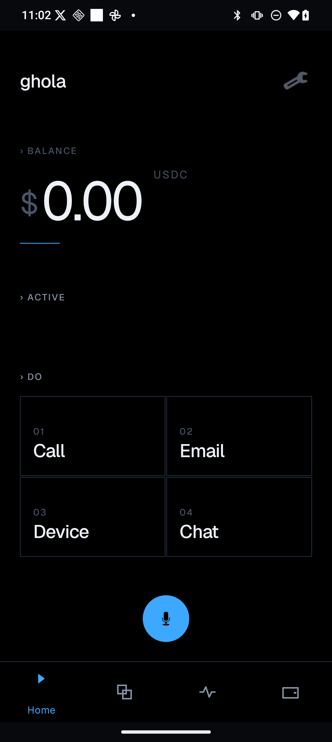
VOL. 01 · SEED · MAY 2026
PRIVATE EXECUTION LAYER
ghola
AN EXECUTION LAYER · FOR USER-OWNED AGENTS · STABLECOIN-SETTLED
Agents that act
Owned by you.
A user-owned control plane that binds local intelligence, encrypted memory, scoped authority, and on-chain settlement — so agents can finally do, not just talk.
FIG. 01
Ghola on iOS
01
02
03
04
LOCAL
PRIVATE
SCOPED
SETTLED

Slide 2
GHOLA
§ 01 · THE MOMENT
02/15
THE MOMENT
Until now, AI has only said things.
KNOW
01
they perceive context
DO
02
they take actions
SPEND
03
they move money
Now we need a layer that can hold all three — and answer to the user, not the provider.

Slide 3
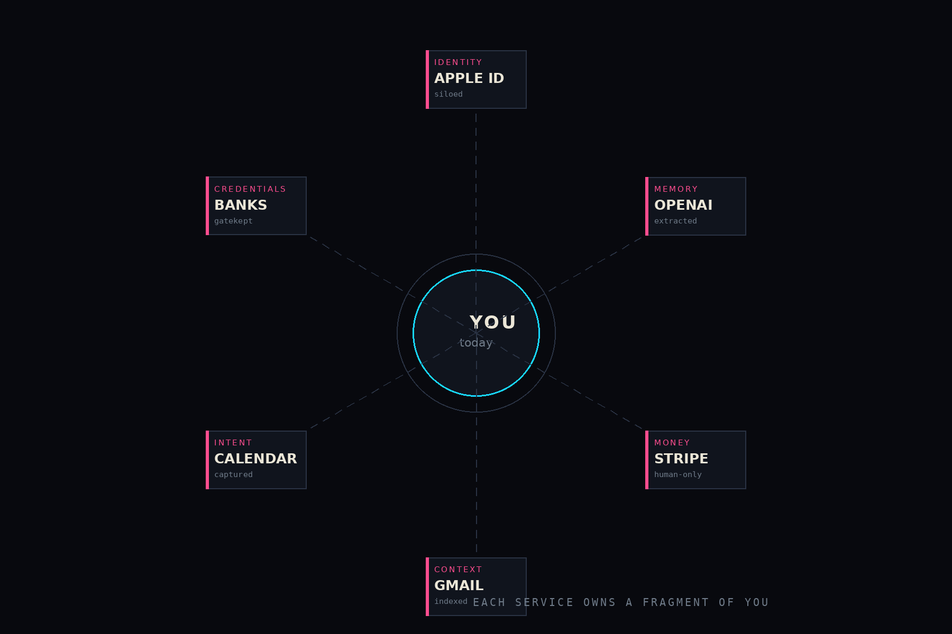
GHOLA
§ 02 · PROBLEM
03/15
PROBLEM
There is no
trusted
execution layer.
Identity, memory, permissions, and money live in different silos — each owned by someone else, none stitched together for you.
“You” are reassembled by every app — temporarily, on their terms.

Slide 4
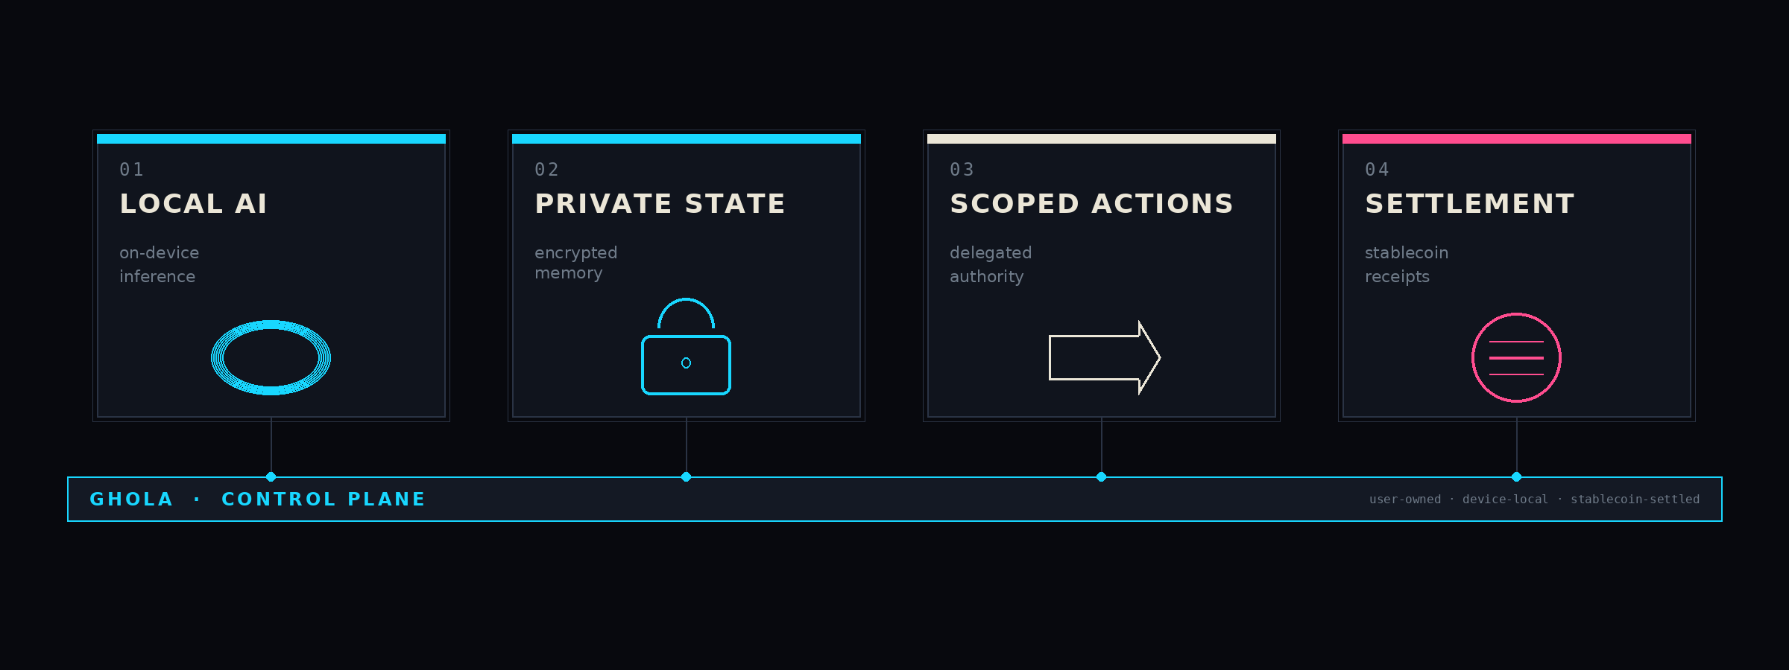
GHOLA
§ 03 · SOLUTION
04/15
SOLUTION
Ghola binds intelligence to authority.
Four components, one user-owned bus. Each binds to the next — and the user keeps the keys.
FIG. 02 · GHOLA CONTROL PLANE — END TO END

Slide 5
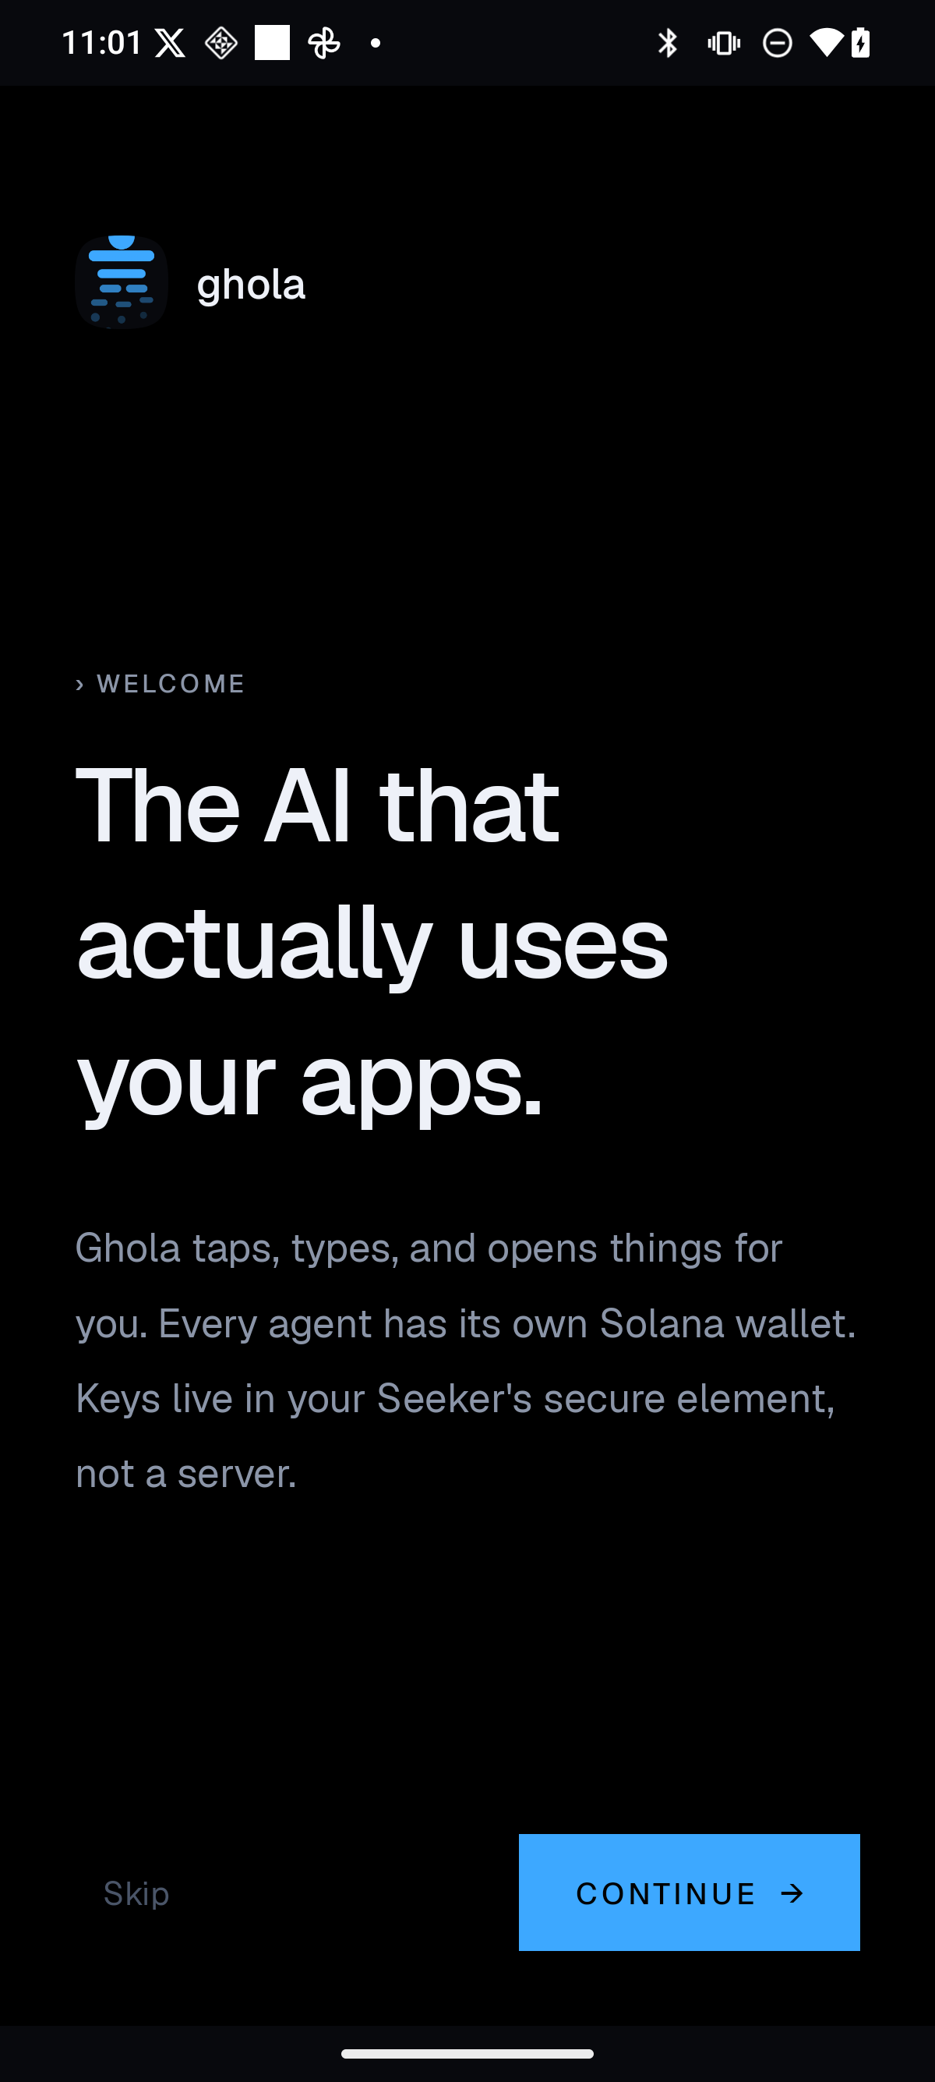
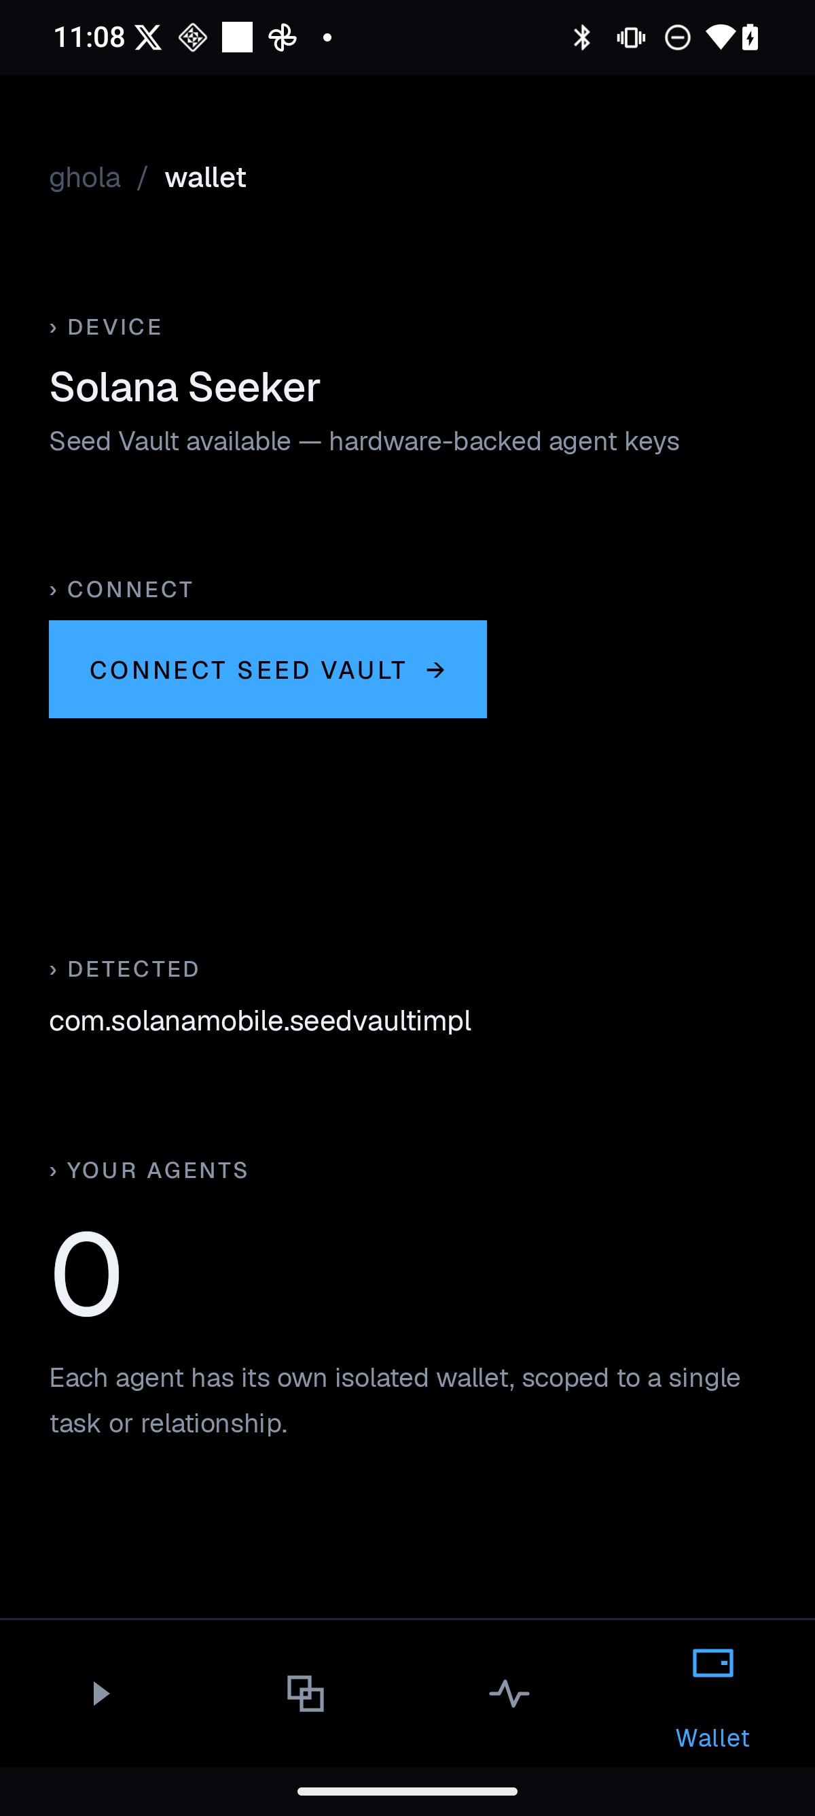
GHOLA
§ 04 · PROOF · PRODUCT
05/15
PROOF
A shipping product,
not a slide ware deck.
Native apps already exist across the stack. Assistant, scoped actions, and a Solana wallet are in users' hands today — all under one local-first runtime.
ASSISTANT
shipped
ACTIONS
shipped
WALLET
shipped
GATEWAY
private β
FIG. 03
FIG. 04
FIG. 05
ASSISTANT
ACTIONS
WALLET
MARKETPLACE
in design
iOS · shipped
iOS · shipped
Solana Seeker · shipped

Slide 6
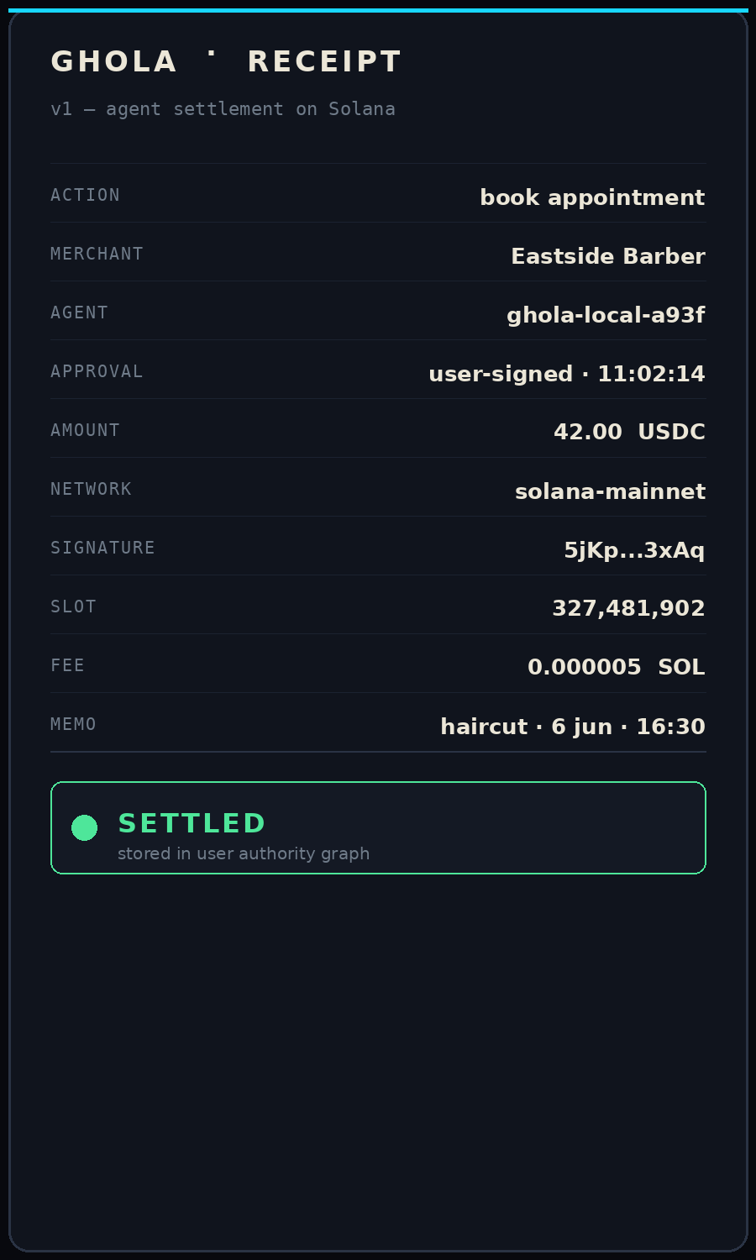
GHOLA
§ 05 · CRYPTO-NATIVE
06/15
CRYPTO-NATIVE
Cards authenticate
humans
Wallets authorize agents.
Every agent action becomes a receipt — signed by the user, settled in stablecoins on Solana, and stored back into the user's own authority graph.
$0.000005
400ms
USDC
user
fee / tx
finality
stablecoin
signs always
FIG. 06 · RECEIPT

Slide 7
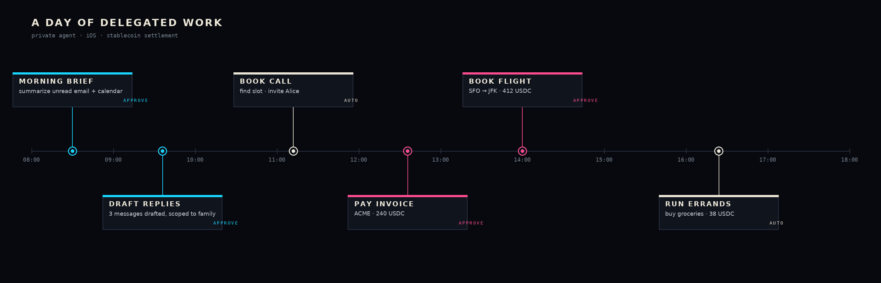
GHOLA
§ 06 · WEDGE
07/15
WEDGE
Start with private personal work.
Calls, calendars, inboxes, and bookings — the daily surface where users feel agent leverage first.

Slide 8
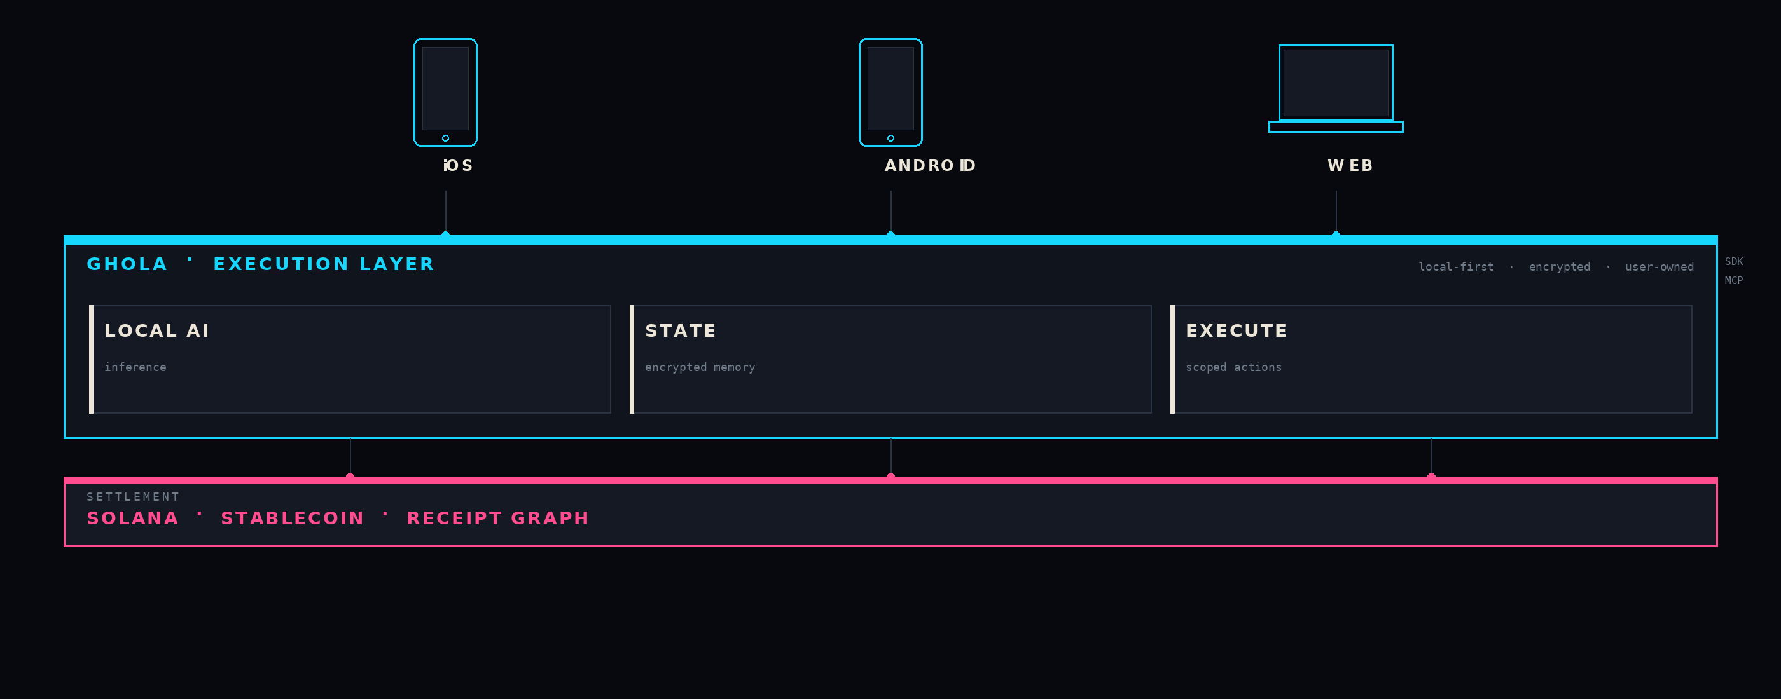
GHOLA
§ 07 · ARCHITECTURE
08/15
ARCHITECTURE
One control plane. Many surfaces.
iOS, Android, web at the top. Local AI, state, and execute in the middle. Stablecoin settlement at the bottom. All user-owned.

Slide 9
GHOLA
§ 08 · BUSINESS MODEL
09/15
BUSINESS MODEL
Revenue compounds with the authority graph.
Three concentric streams. Each one strengthens as more agent actions settle on Ghola.
01
02
03
SUBSCRIPTION
GATEWAY
MARKETPLACE
$20
2%
15%
/ user / mo
of agent spend
rev share
Private assistant + encrypted state — the personal layer.
Take rate on agent-initiated paid actions. Volume scales with trust.
Models, tools, services consumed by user agents through the gateway.
Each layer compounds the next — more actions → more graph → more spend.

Slide 10
GHOLA
§ 09 · COMPETITIVE FRAME
10/15
COMPETITIVE FRAME
Ghola owns
the hard quadrant.
↑ LOCAL PRIVACY
Ghola
Apple Intelligence
Phantom · MetaMask
Stripe · Wise
Most players sit on one axis: privacy or settlement. Ghola is the only system that does both — local on the device, programmable on Solana.
ChatGPT · Claude
PROGRAMMABLE SETTLEMENT →

Slide 11
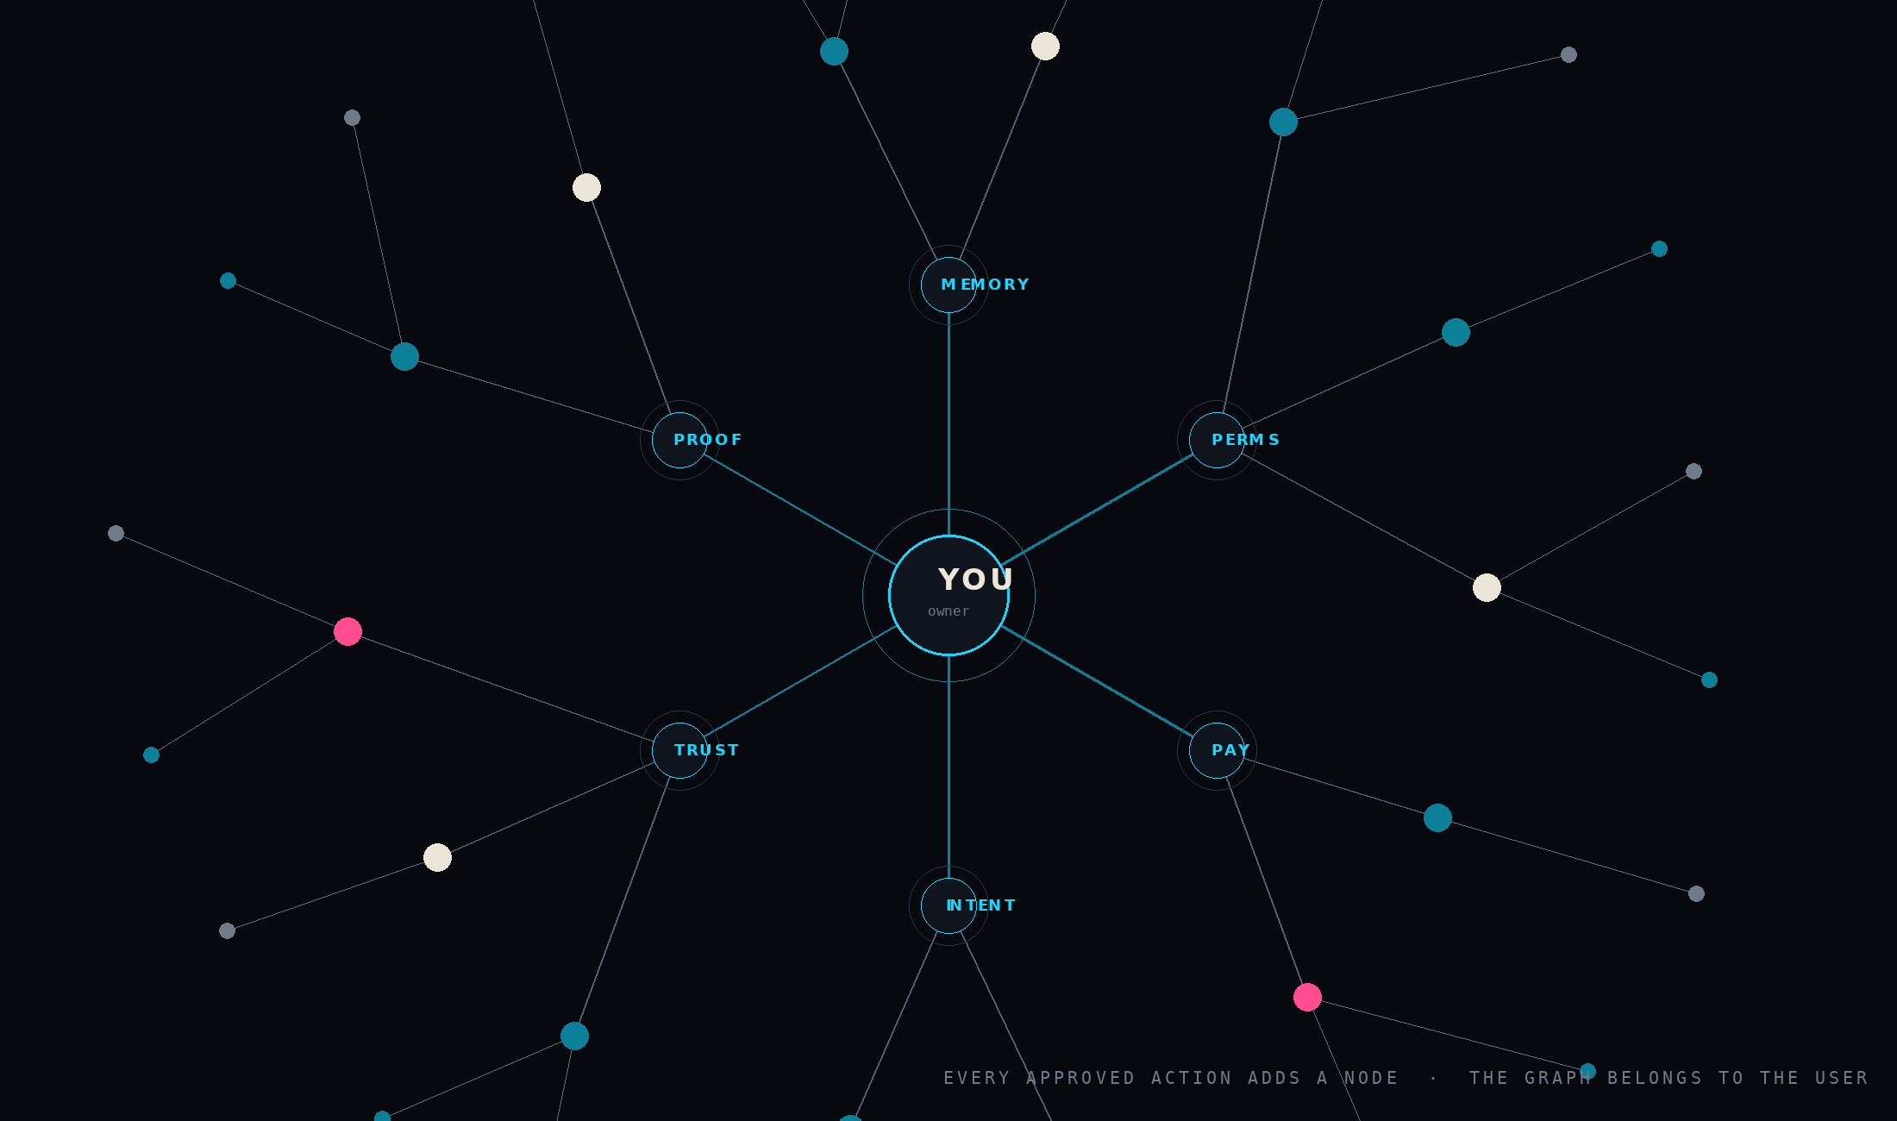
GHOLA
§ 10 · MOAT
11/15
MOAT
The moat is the
authority graph.
Every approved action becomes a node. Every receipt becomes an edge. The graph belongs to the user — and no incumbent can reconstruct it from the outside.
OWNED
PORTABLE
VERIFIABLE
by the user
across devices
on Solana

Slide 12
GHOLA
§ 11 · PROOF · DEMO
12/15
PROOF · DEMO
The demo is a private purchase.
A local agent books, asks consent, pays in stablecoins, stores the receipt. End to end, on device.
01
02
03
04
ASK
APPROVE
PAY
RECEIPT
agent perceives intent
user signs scope
stablecoin settlement
stored to authority graph
“book me a haircut for thursday”
“okay · 1 booking · ≤ 50 USDC”
42.00 USDC · solana-mainnet
node added · signature 5jKp…3xAq

Slide 13
GHOLA
§ 12 · ASK
13/15
THE ASK
Raise to harden, ship, prove.
Production-grade private agent commerce loop within 9 months.
Q3 2026
Q4 2026
Q1 2027
HARDEN
SHIP
PROVE
wallet · privacy · local AI
native UX + SDK / MCP
book · pay · receipt
Secure enclave wallet, on-device memory, audited permissions.
Native iOS + Android — first-class developer surface.
End-to-end private commerce loop with design partners.
RAISE · SEED
USE OF FUNDS
$3M · 18-month runway
team (60%) · infra (25%) · GTM (15%)

Slide 14
GHOLA
§ 13 · INVESTOR FIT
14/15
INVESTOR FIT
Agent infrastructure with an app wedge.
Where Ghola intersects with the theses we admire.
DECENTRALIZED AI
STABLECOINS
PRIVACY
user-owned intelligence
programmable money
local-first by default
SOLANA
PROTOCOLS
CONSUMER WEDGE
settlement at consumer speed
systems that earn the title
real users, daily use
“Identity, stablecoins, privacy, Solana — Ghola lives at the intersection.”

Slide 15

BACK COVER · 15 / 15
GHOLA · PRIVATE EXECUTION LAYER
If agents can know,
do, and spend —
users must own the
layer that governs them.
Ghola is that layer. We're building it now.
CONTACT
SOURCE
BUILDING
team@ghola.app
ghola.app / pitch
iOS · Android · Solana

