Slide 1

SMARTWATCH SCHEDULER SIMULATION
PRESENTED BY ANDIA GHOLAMI
AND MAEDEH NASOODI

Slide 2



Simulate smartwatch for task scheduling
Objective
Face recognition access
Embedded Systems Project
Real-time voice
notifications

Slide 3

System Overview
1.Face detection to grant access
2.Task table: Add, Edit, Delete
3.Voice alerts at task time with repeat every 10 seconds
4.Stop button to silence notification

Slide 4


User interface
•• Tkinter GUI
•• Task list display
•• Add/Edit/Delete buttons
•• Pop-up windows for input & alerts

Slide 5

Task Storage
Voice Notifications
Stored in tasks.json
JSON read/write via task_data.py
pyttsx3 for text-to-speech
Notifier checks time every minute
Announces task + shows pop-up
Repeats every 10s until stopped

Slide 6
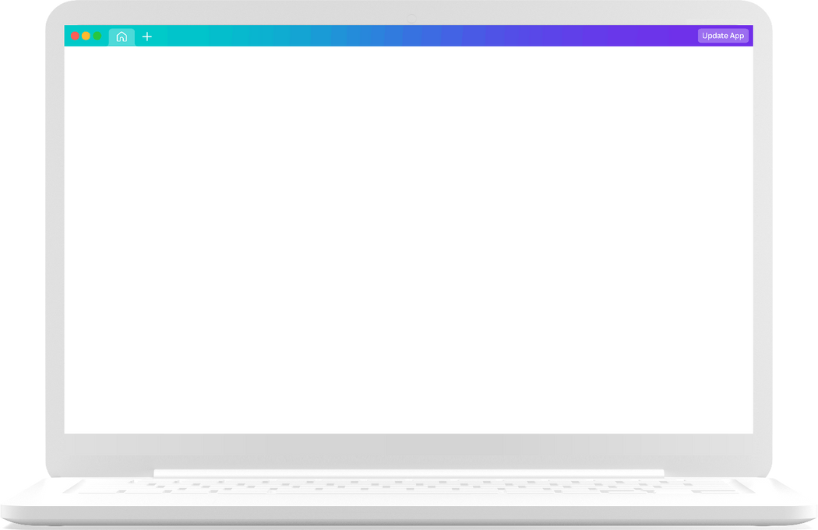

Conclusion
This project simulates a smartwatch with task scheduling, face detection access, and voice alerts. It showcases key embedded systems concepts like real-time response, multitasking, and user interaction through a modular Python design.

Slide 7
Thank you very much!

