Slide 1
Anne Joan Benita V
Final Project

Slide 2
PROJECT TITLE
AI-Driven YouTube Video Summarization: Transformative Insights from Generative Models​

Slide 3


AGENDA
Problem Statement
Project Overview
Who are the End Users
Your Solution and Its Value Proposition
The Wow in your Solution
Modelling
Result
3/21/2024 Annual Review

Slide 4

PROBLEM STATEMENT
In the vast ocean of online video content, users often encounter challenges in efficiently consuming and extracting valuable information from lengthy YouTube videos. Many viewers struggle to find the time to watch entire videos or navigate through them to locate specific segments of interest. This issue is compounded by the sheer volume of content available on the platform, making it increasingly difficult for users to identify relevant videos and extract meaningful insights.
3/21/2024 Annual Review

Slide 5

PROJECT OVERVIEW
This project title encompasses the idea of using generative AI to automatically summarize long YouTube videos, which is a common challenge in today's fast-paced world. The project will involve using AI-generative solutions, such as the Whisper model for transcription and the BART model for summarization, to extract the main highlights from YouTube videos. The project will also emphasize the importance of verifying copyright and licensing permissions before proceeding with the download. Additionally, the project will explore the potential of generative AI in various domains, including natural language processing tasks like classification and named-entity recognition, as well as its ability to perform in low-labeled data domains through prompting or prompt engineering. The project aims to demonstrate the power of generative AI in creating realistic images, code, and dialogue, and its potential impact on enterprise applications.

Slide 6
WHO ARE THE END USERS?
1. Content Creators: YouTube content creators can benefit from this project by quickly generating summaries of their own videos. This can help them understand viewer engagement, improve content quality, and optimize video creation strategies.
2. Viewers and Subscribers: End users who watch YouTube videos can use the generated summaries to get a quick overview of the video content before deciding to watch the full video. This can save time and help them find relevant content more efficiently.
3. Researchers and Academics: Researchers in the fields of artificial intelligence, natural language processing, and machine learning can use the project as a case study for generative AI applications in real-world scenarios. Academics can also leverage the project for educational purposes and to explore the potential of AI in content analysis.
4. **Media Companies and Marketers**: Media companies and marketers can utilize the project to analyze trends in video content, understand audience preferences, and optimize their video marketing strategies. The generated summaries can provide valuable insights for content curation and audience targeting.

Slide 7

YOUR SOLUTION AND ITS VALUE PROPOSITION
To address this problem, we propose the development of an AI-driven YouTube video summarization system using generative models. This system aims to automatically generate concise summaries of YouTube videos, providing users with a condensed overview of the video's key points, topics, and insights. By leveraging advanced natural language processing (NLP) techniques and generative AI models, such as GPT (Generative Pre-trained Transformer) variants, our solution will enable users to quickly grasp the essence of a video without having to watch it in its entirety.
The value propositions of this project are:
Developing an AI-based pipeline for extracting relevant information from YouTube videos.
Training and fine-tuning generative AI models to generate accurate and coherent summaries of video content.
Implementing a user-friendly interface for users to interact with the summarization system and access summarized video content.

Slide 8

THE WOW IN YOUR SOLUTION
The solution includes personalized summarization, where the generated summaries are tailored to the preferences and interests of individual end users.
This can be implemented by User Profiling, Analzying the interests, collecting feedback from the end-users about the relevancy of the summarization and then continuously improve the model to suit the preferences.
3/21/2024 Annual Review
8

Slide 9
MODELLING
Process Video
Speech Recognition
Video Analysis
Natural Language Processing
Summarization
USER
Output in the form of Key Points
Web Interface / Mobile App
AI MODEL
Youtube Data API
Video URL
Get Video Details
3/21/2024 Annual Review
9

Slide 10
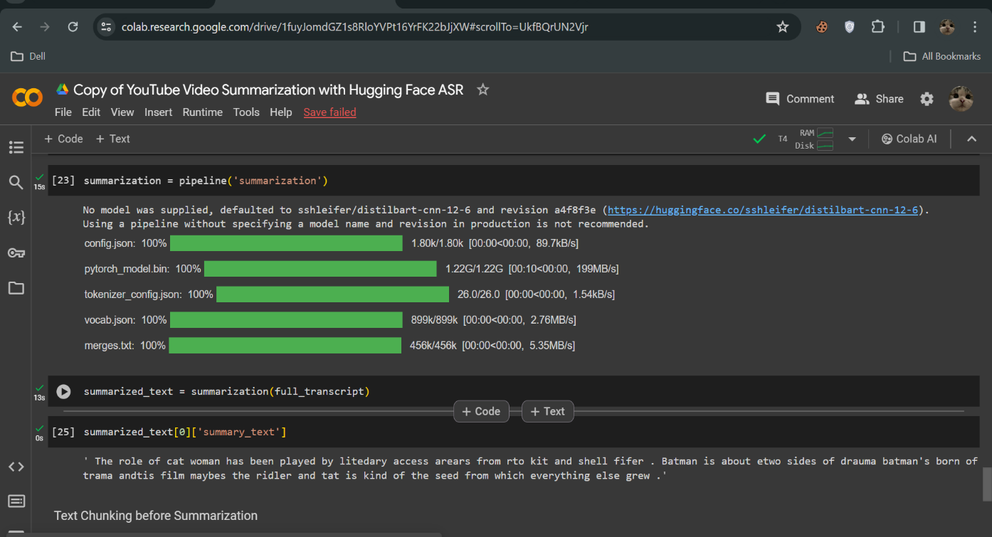
RESULTS
Overall, this project aims to address the challenge of information overload on YouTube and revolutionize the way users interact with and consume video content through the power of AI-driven summarization.
https://github.com/anne2512/IBM-PROJECT-GENAI-ANNEJOANBENITA
3/21/2024 Annual Review
10

